Slide 1
Steering Committee Meeting
Presented to
Montgomery County Department of Transportation
Presented by
Dan Goldfarb, P.E.
Transportation Planning Manager Tyson Corner Office
Vanasse Hangen Brustlin, Inc. & FITP
April 30, 2013

Slide 2
Study Team Activities
Montgomery County RTS Work Scope Programs
Service planning and integration study;
Transit signal priority
Coordination Meetings
Working Group Meeting
Veirs Mill MTA/SHA Study Team Coordination Meeting

Slide 3
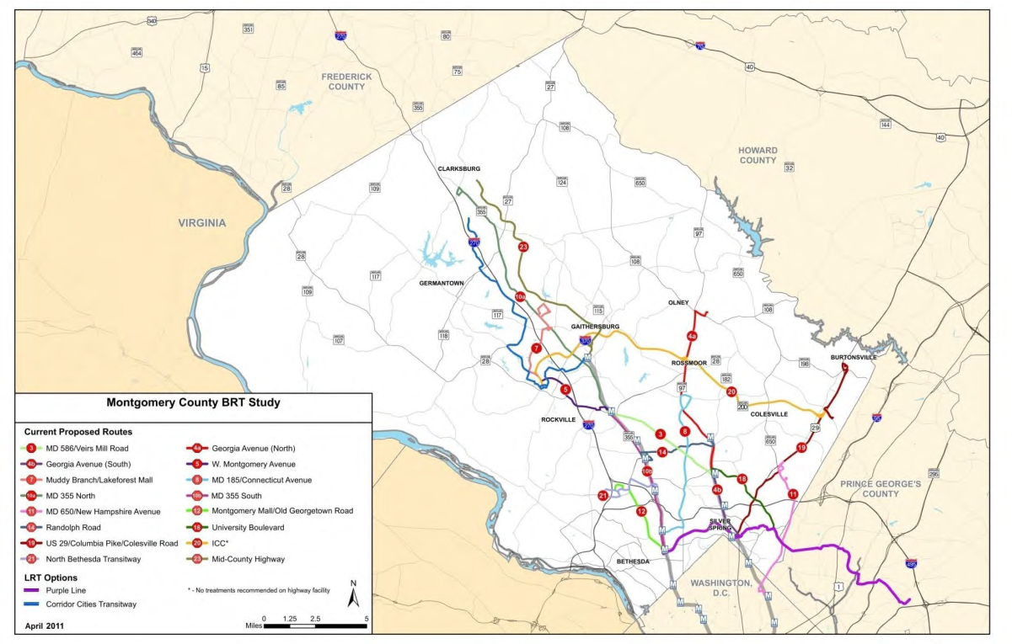
Service Planning Focus Corridors
MD 355 South - Rockville Pike
MD 586/Veirs Mill Road
Randolph Road
US 29 - Columbia Pike
CCT South
ICC
MD 97 North - Georgia Avenue(Glenmont to Olney)

Slide 4
Scope of Work Service Planning and System Integration
Review Existing Studies and Plans - Near Completion
Compile Existing Transit Network - Near Completion
Develop Criteria for RTS - Underway
Route Planning
Identify Physical Design
Capital Needs

Slide 5
Service Planning Overview Decision Matrix Concept

Slide 6
Decision Matrix/Service Planning Framework
Tool for Framing the Service Options
System wide
Corridor Applied
Consensus Built
Fleet
Infrastructure
Plan Framework
Service
Station

Slide 7
Minimum Decision Matrix/Service Planning Framework
Limited Stops
10 Minute Headways
Unique Identity
6:00 a.m. to 10:00 p.m. Span of Service
Fleet
Infrastructure
Plan Framework
Service
Station

Slide 8
Develop Criteria for RTS
Infrastructure
Demand
Service Standards
Ridership Criteria
Roadway Criteria
Identity Criteria
Corridor Specific
Service
Service
Demand
Infrastructure

Slide 9
Decision Framework
Ridership
By Segment
Origin/Destination
Activity Centers
Networks
Existing
Planned (CLRP)
Service Characteristics
Frequency
Service Span/Hours of Operation
Station Spacing
Type of Service
Point – to – Point
Feeder
Interlining
Skip-Stop
Demand
Service
Infrastructure

Slide 10
Decision Framework
Guideway
Stations
Rolling Stock
Demand
Service
Infrastructure

