Slide 1
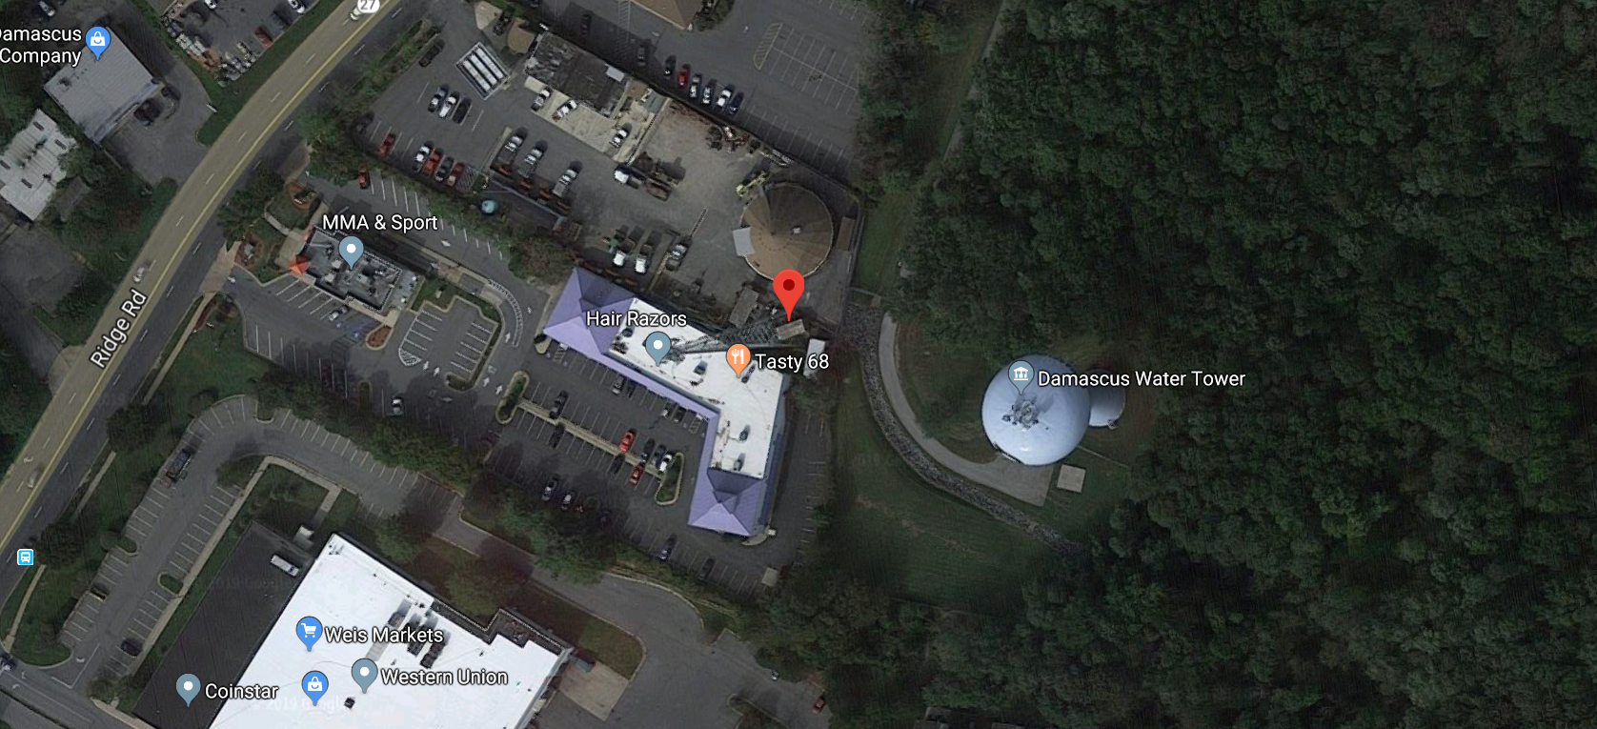
Damascus Tower

Slide 2
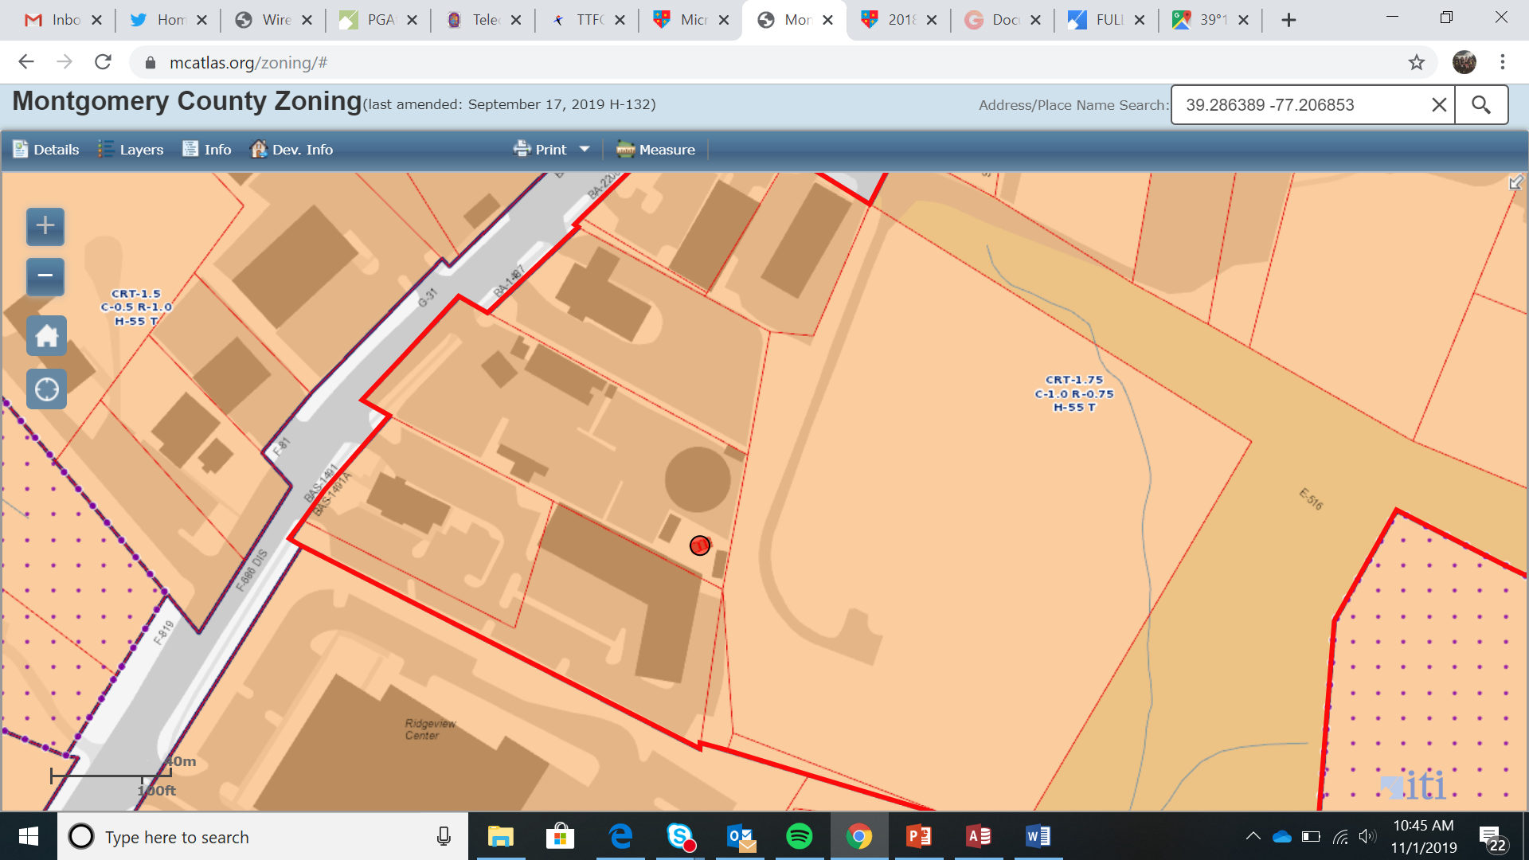
Damascus Tower

Slide 3
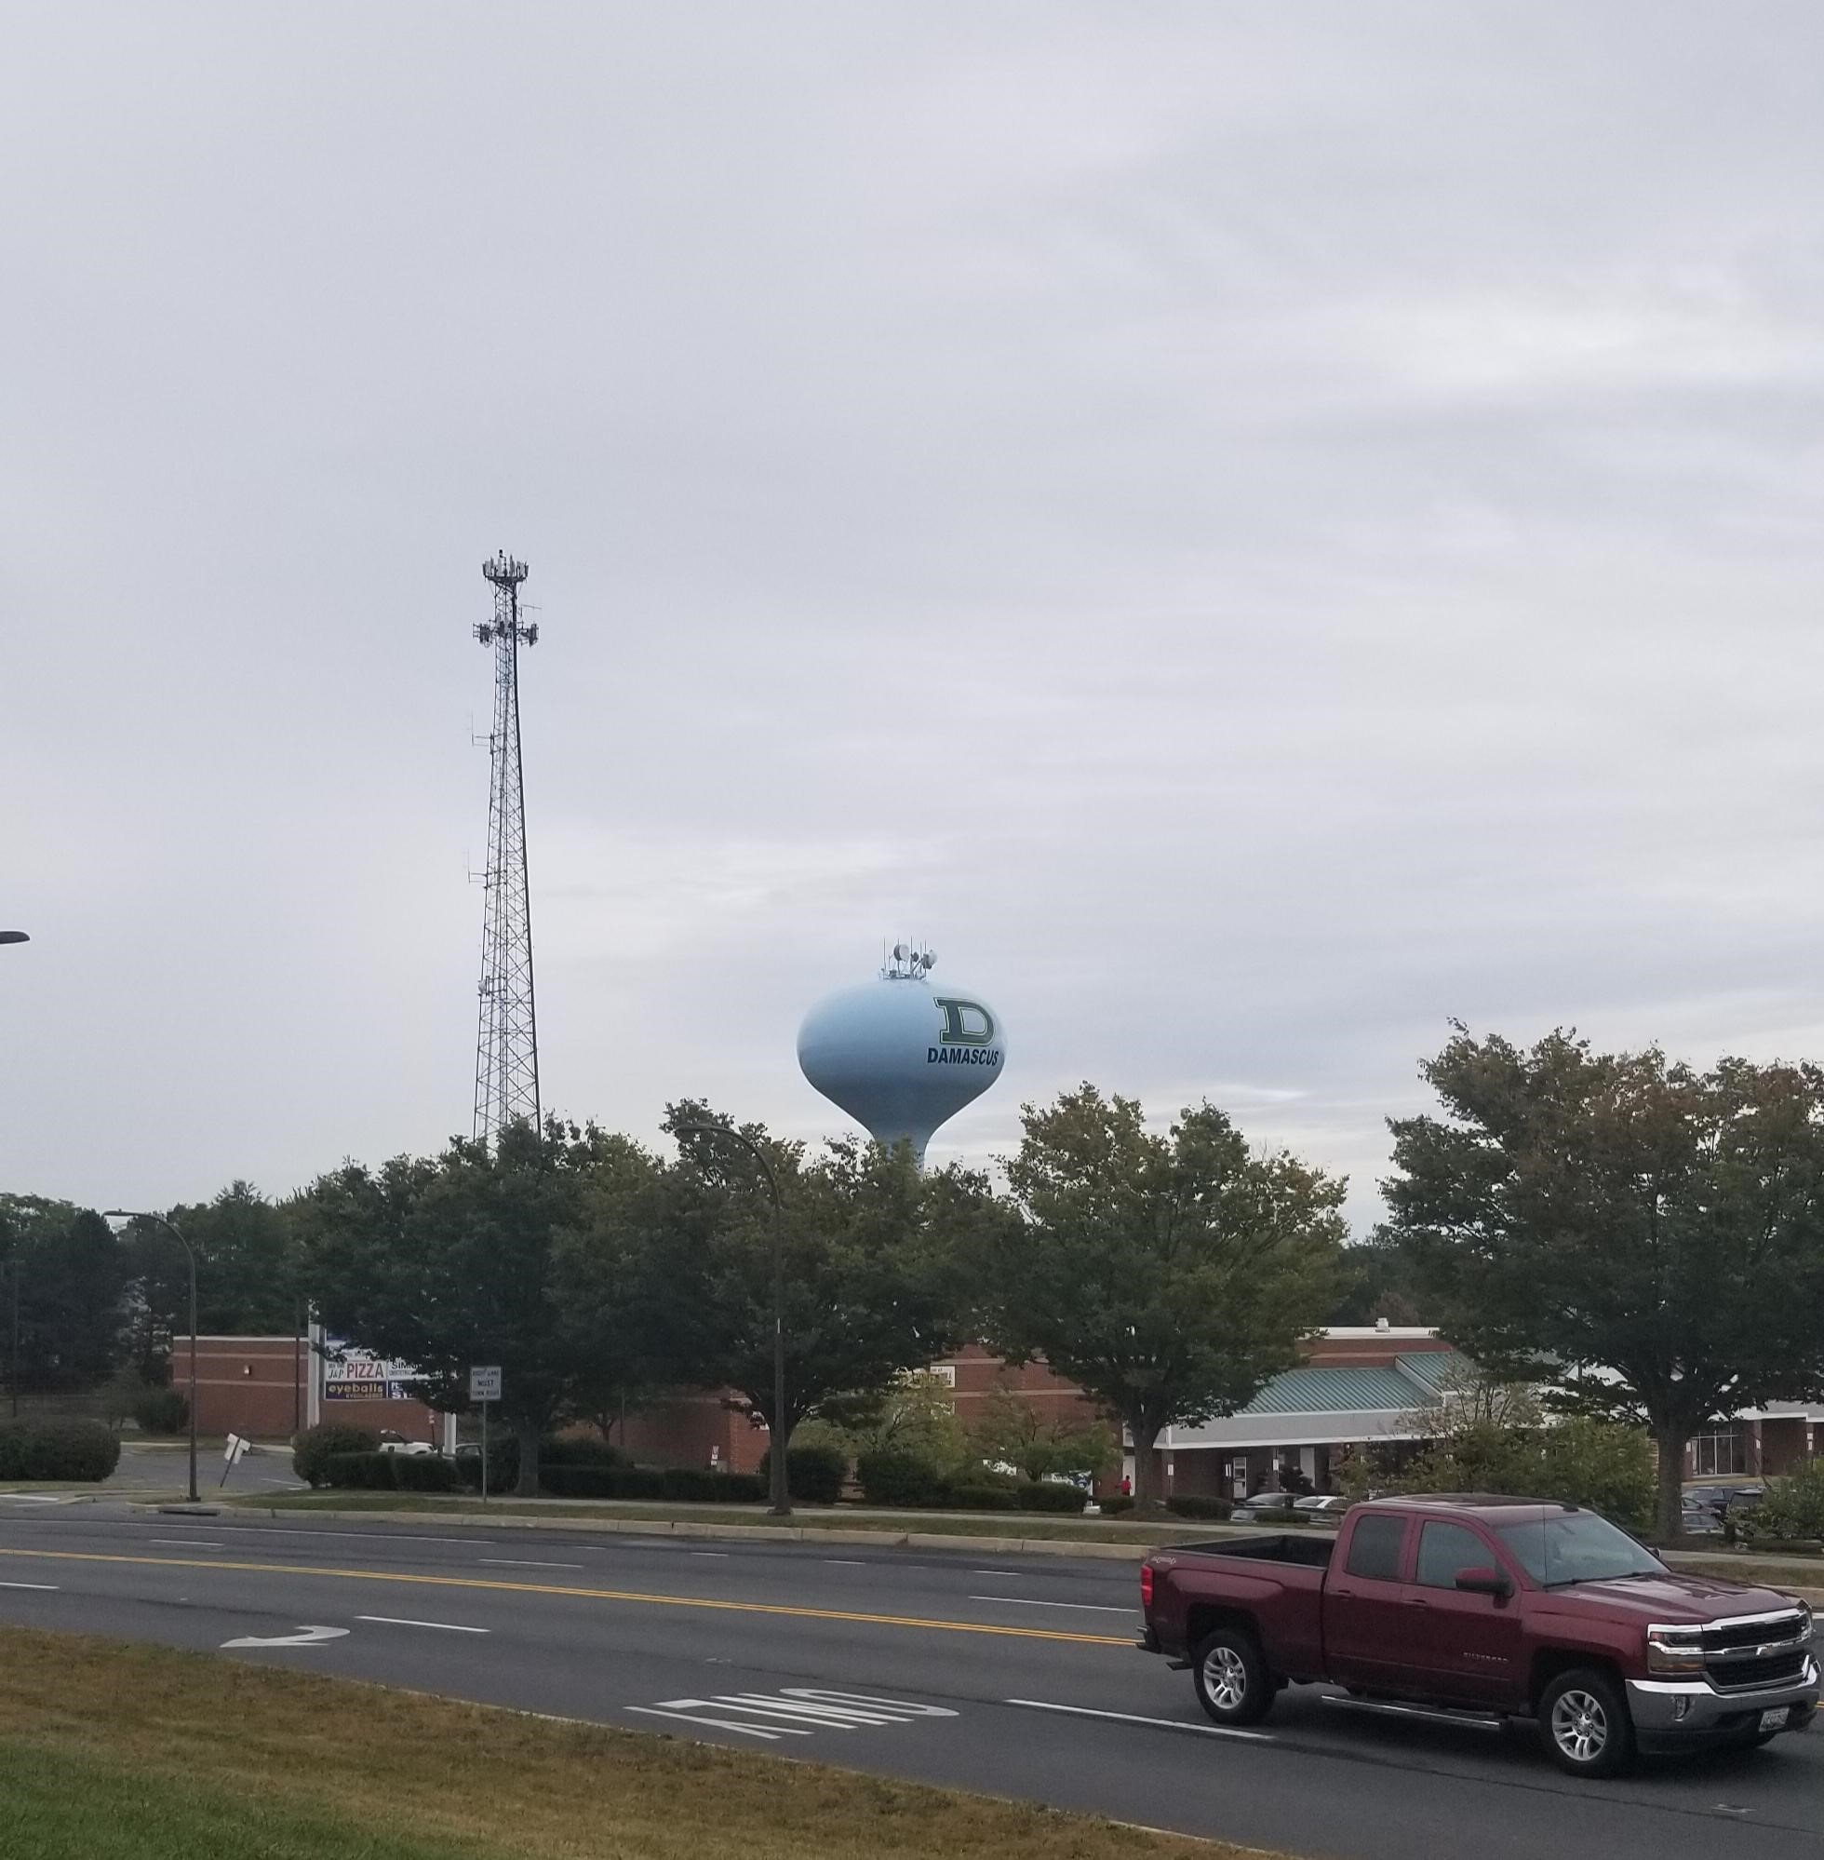
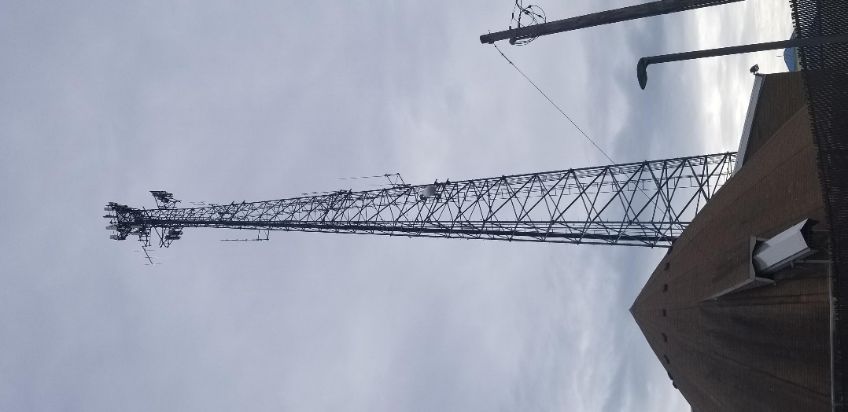
Damascus Tower

Slide 4
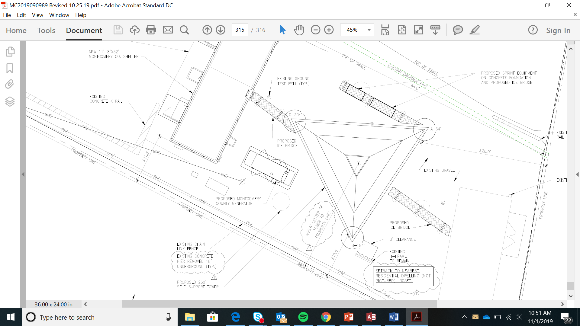
Damascus Tower

Slide 5
Damascus Tower

Slide 6
Damascus Tower

Slide 7
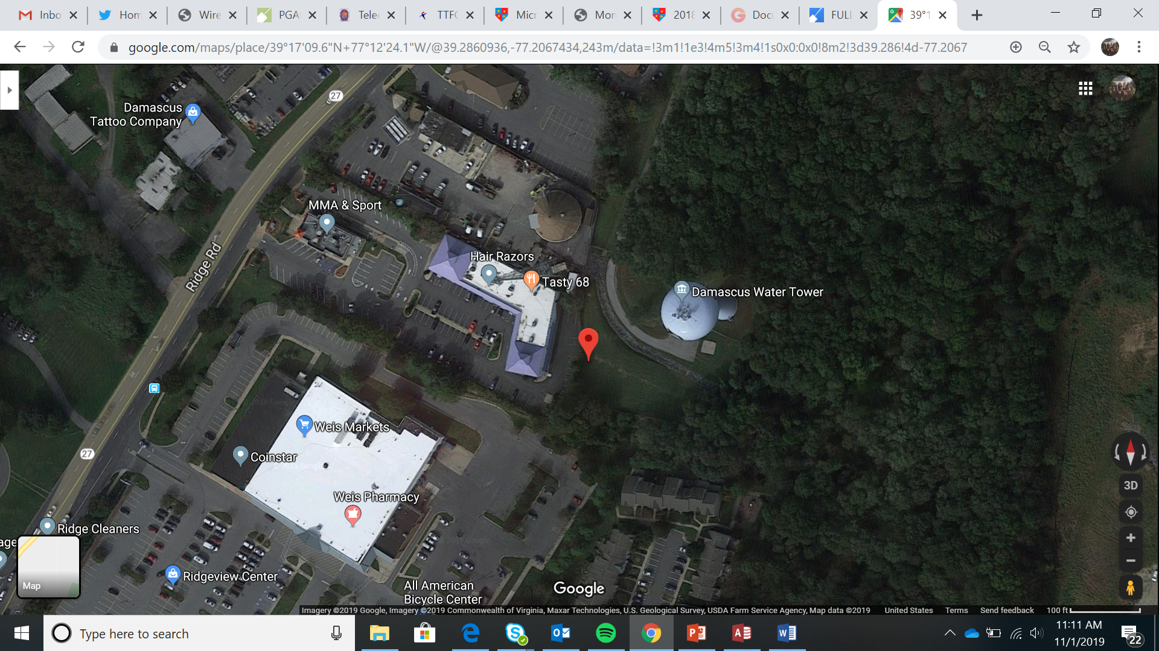
Damascus COW

Slide 8
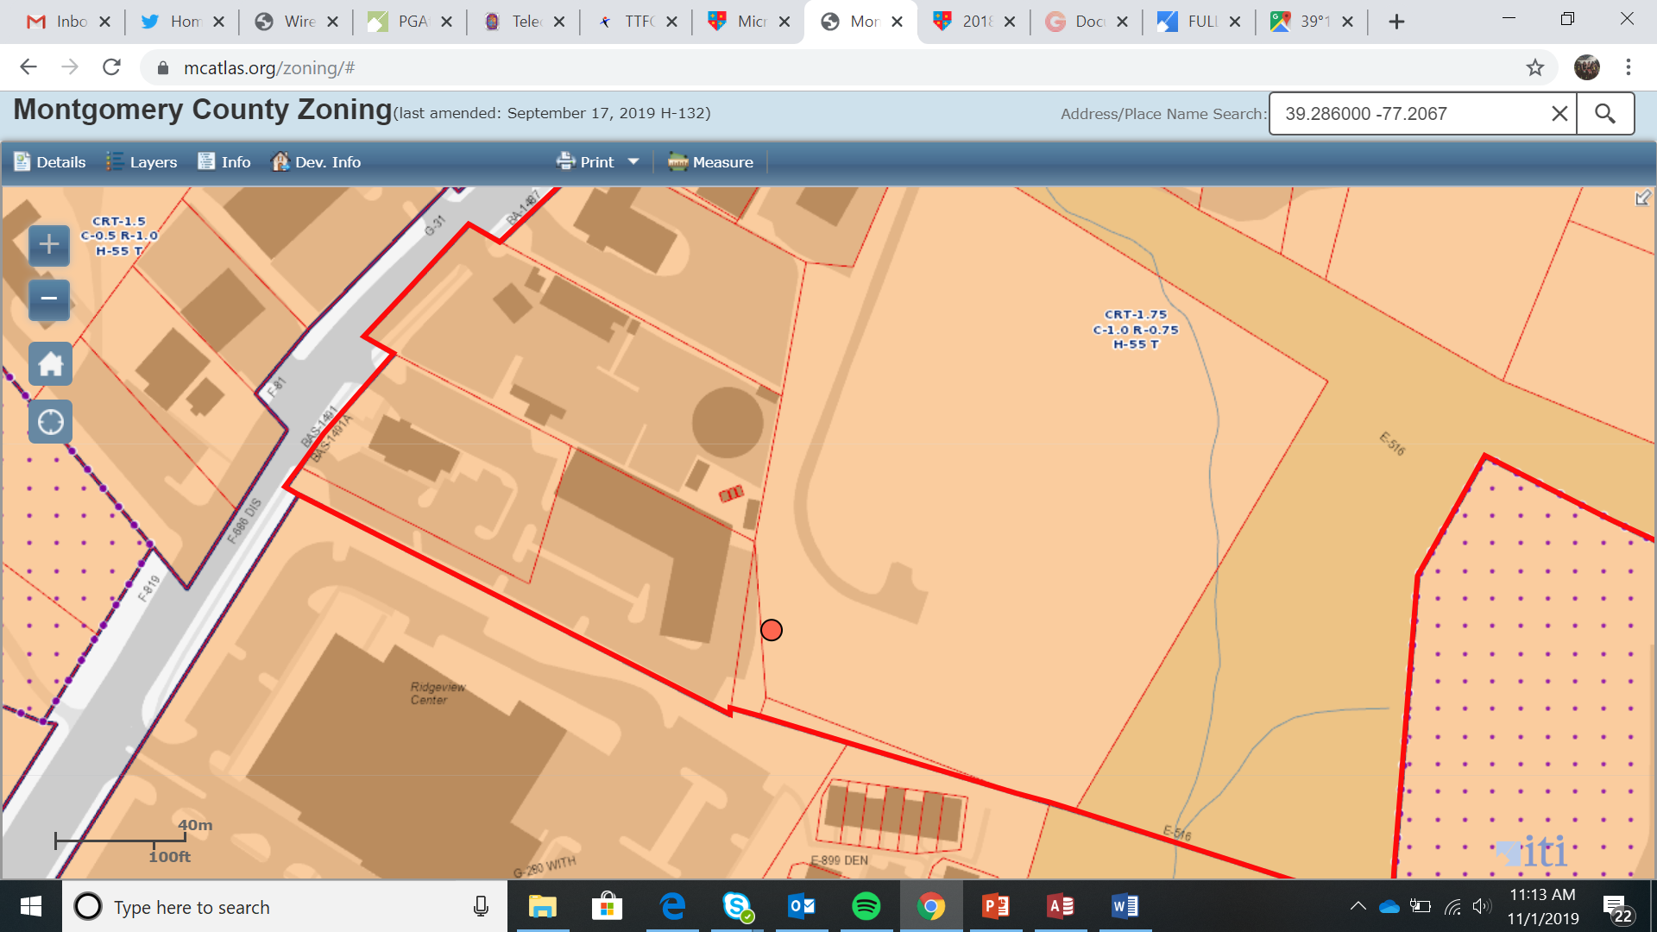
Damascus COW

Slide 9
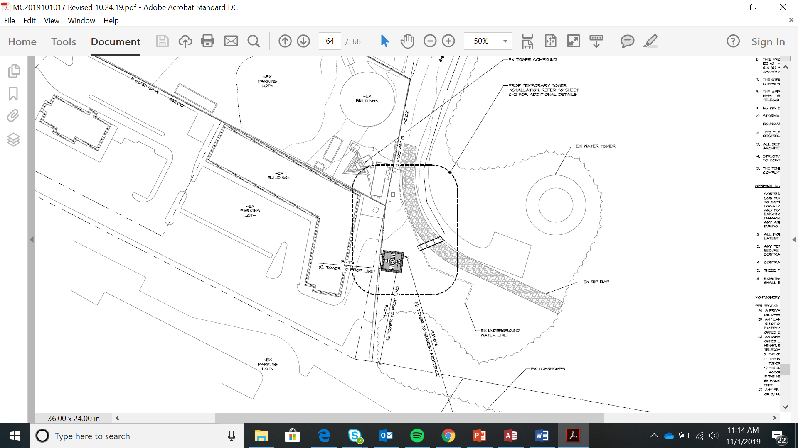
Damascus COW

Slide 10
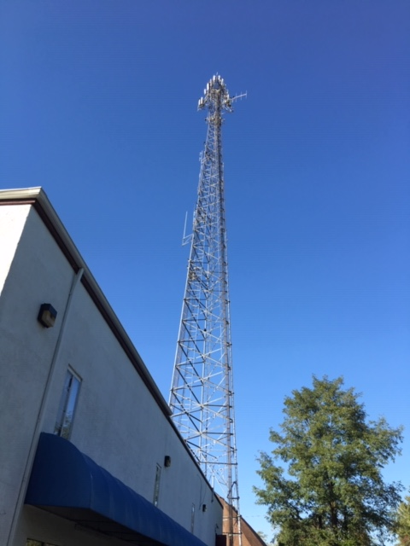
Damascus COW

Slide 11
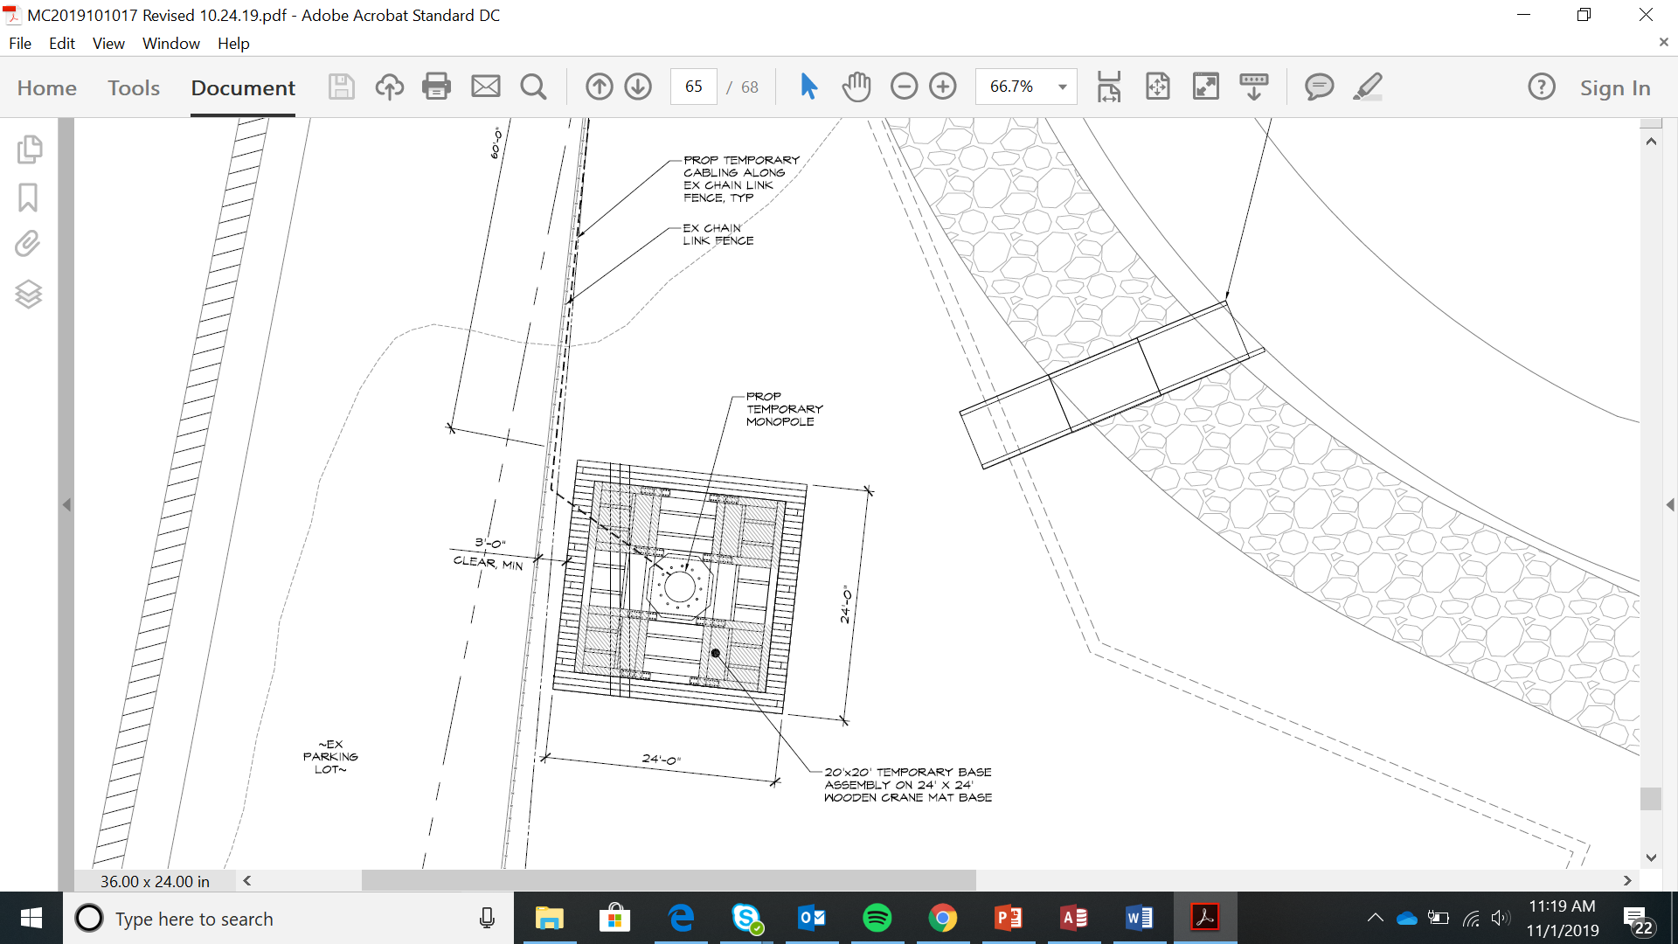
Damascus COW

Slide 12
Damascus COW

Slide 13
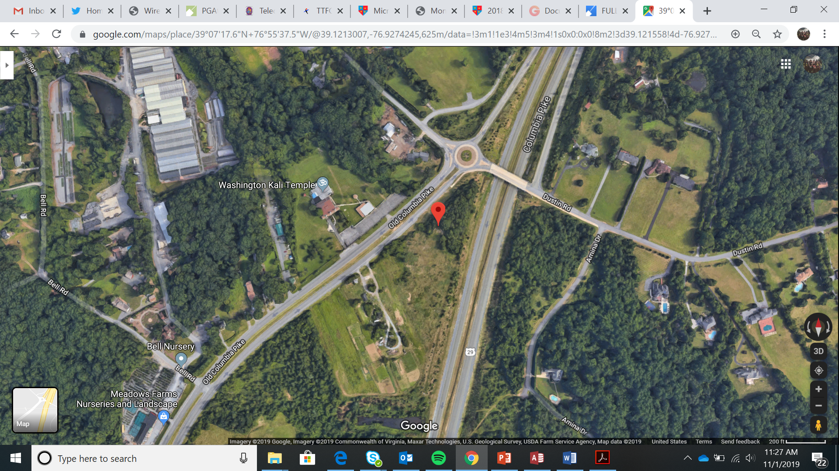
Burtonsville Tower

Slide 14
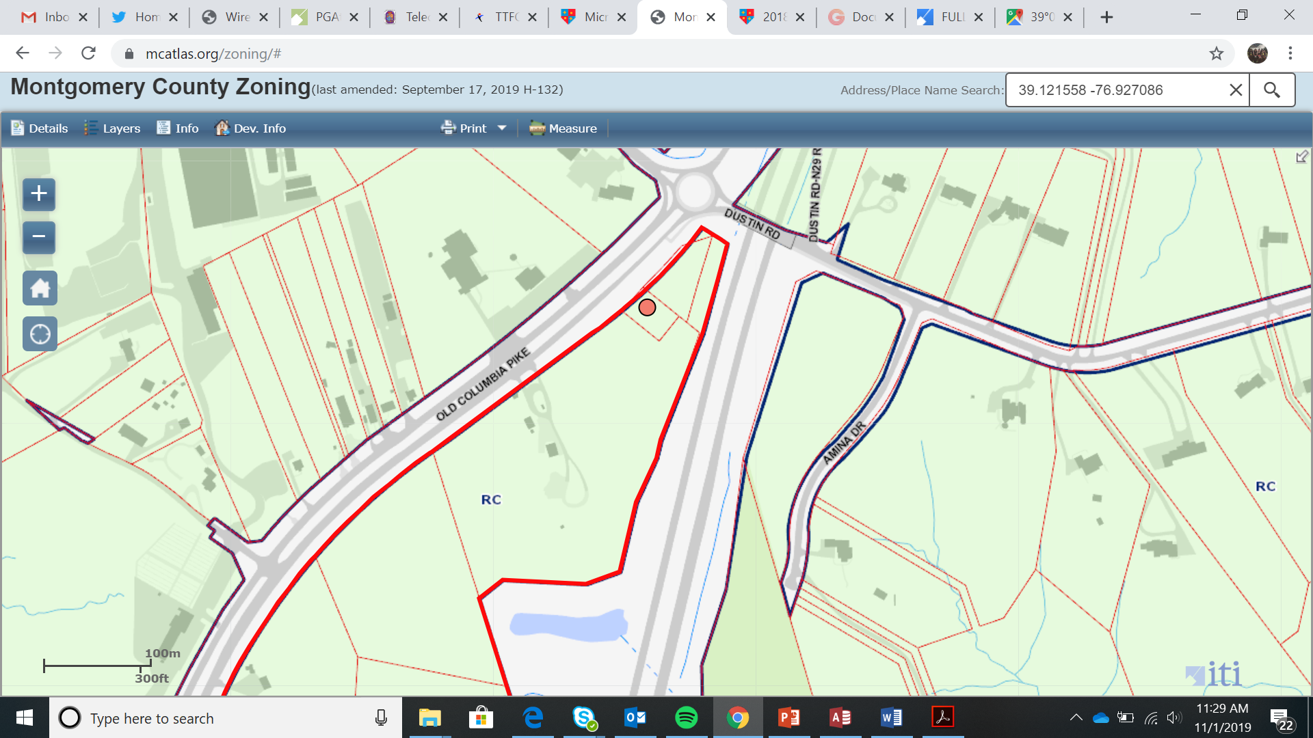
Burtonsville Tower

Slide 15
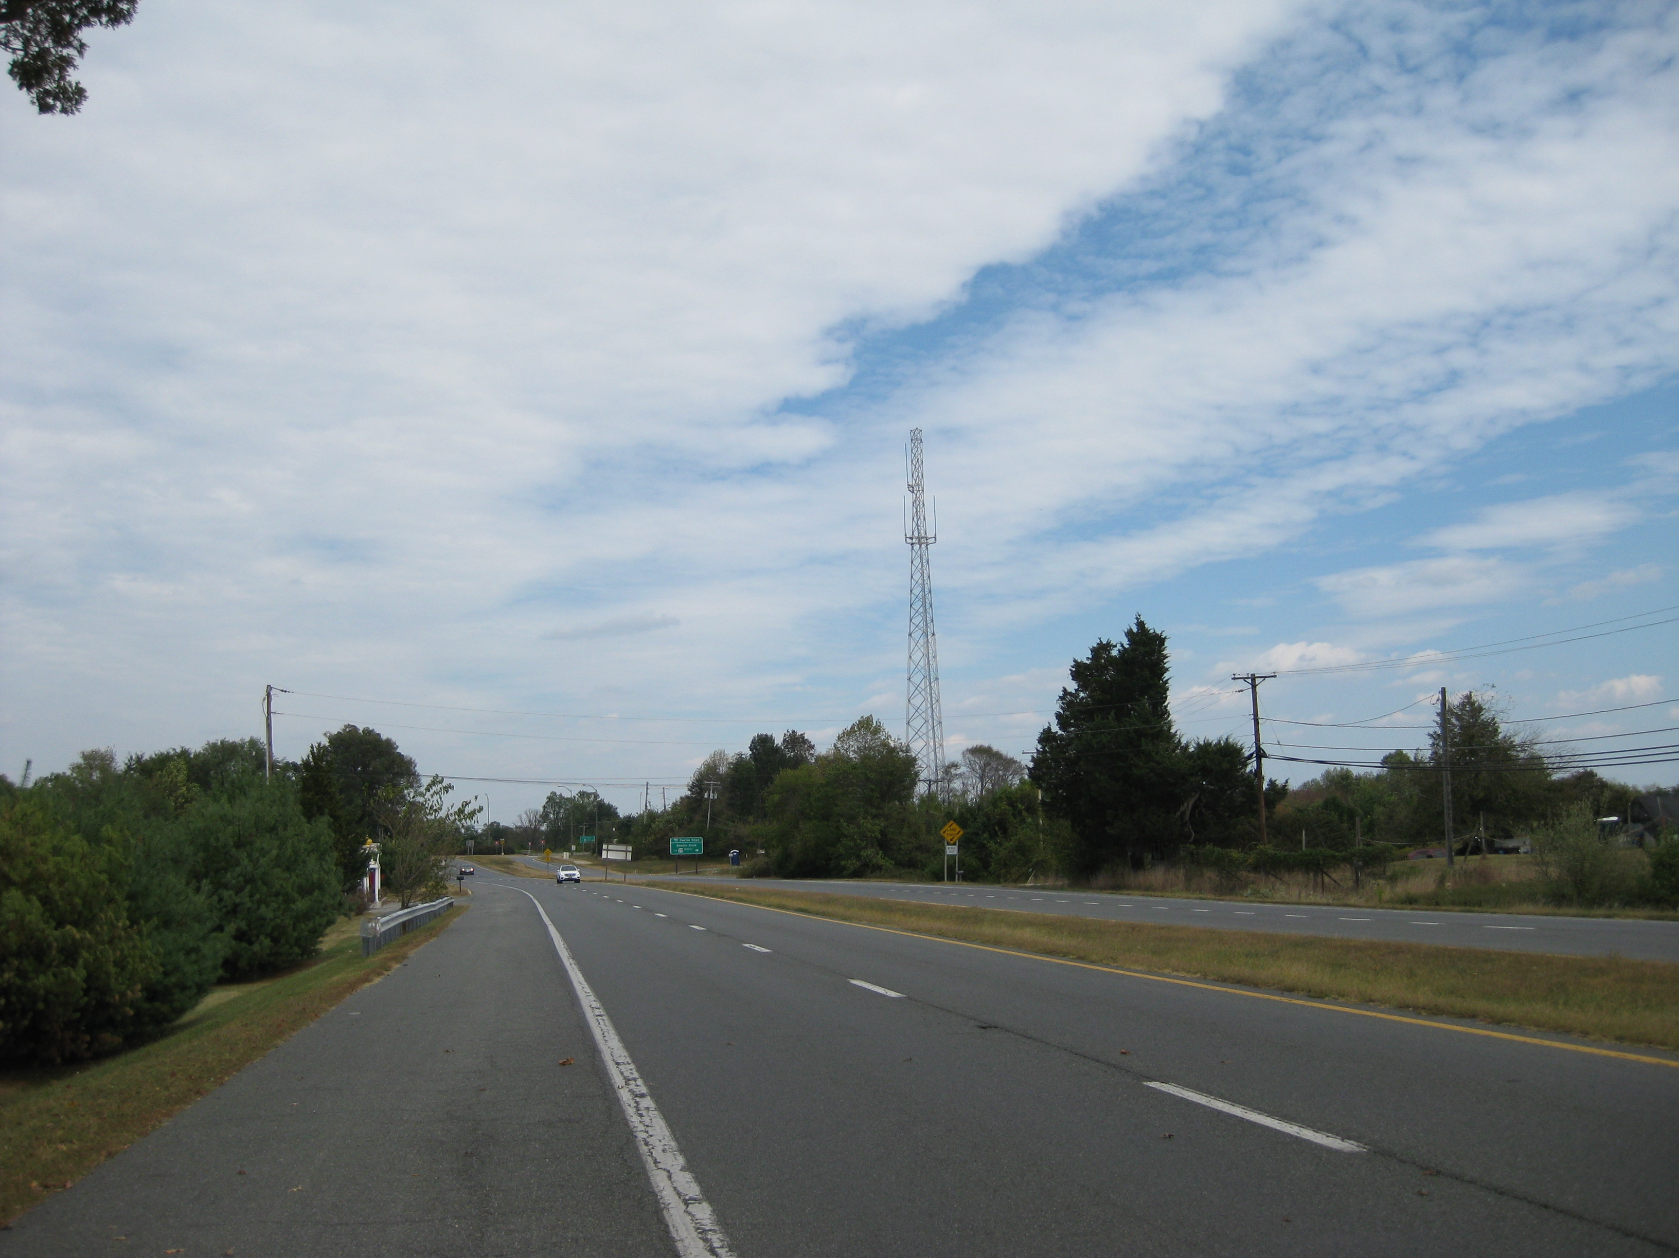
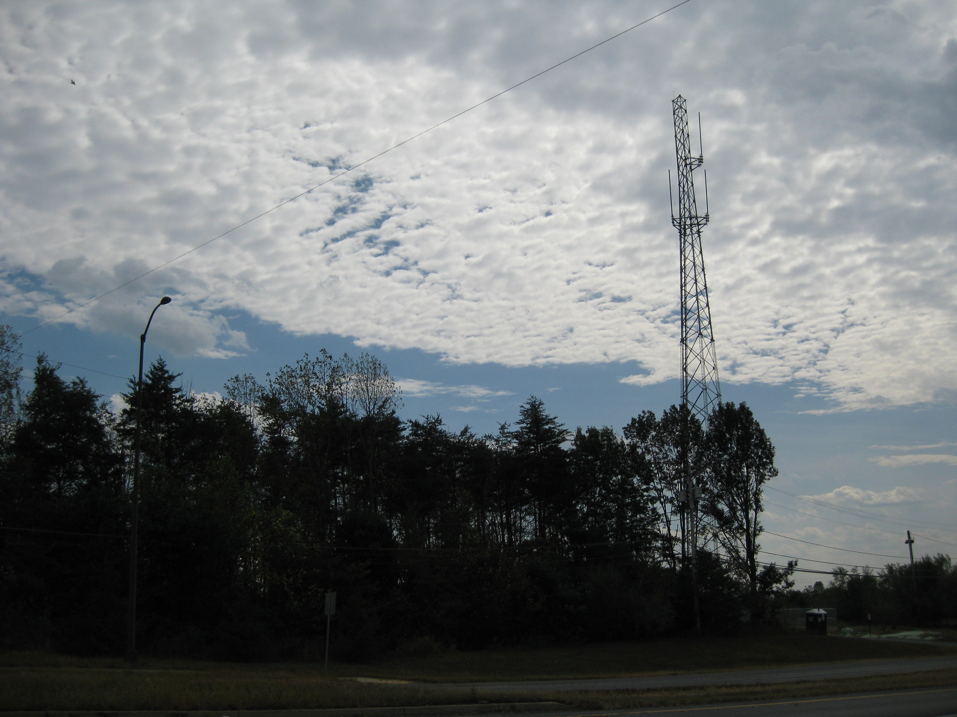
Burtonsville Tower

Slide 16
Burtonsville Tower

Slide 17
Burtonsville Tower

Slide 18
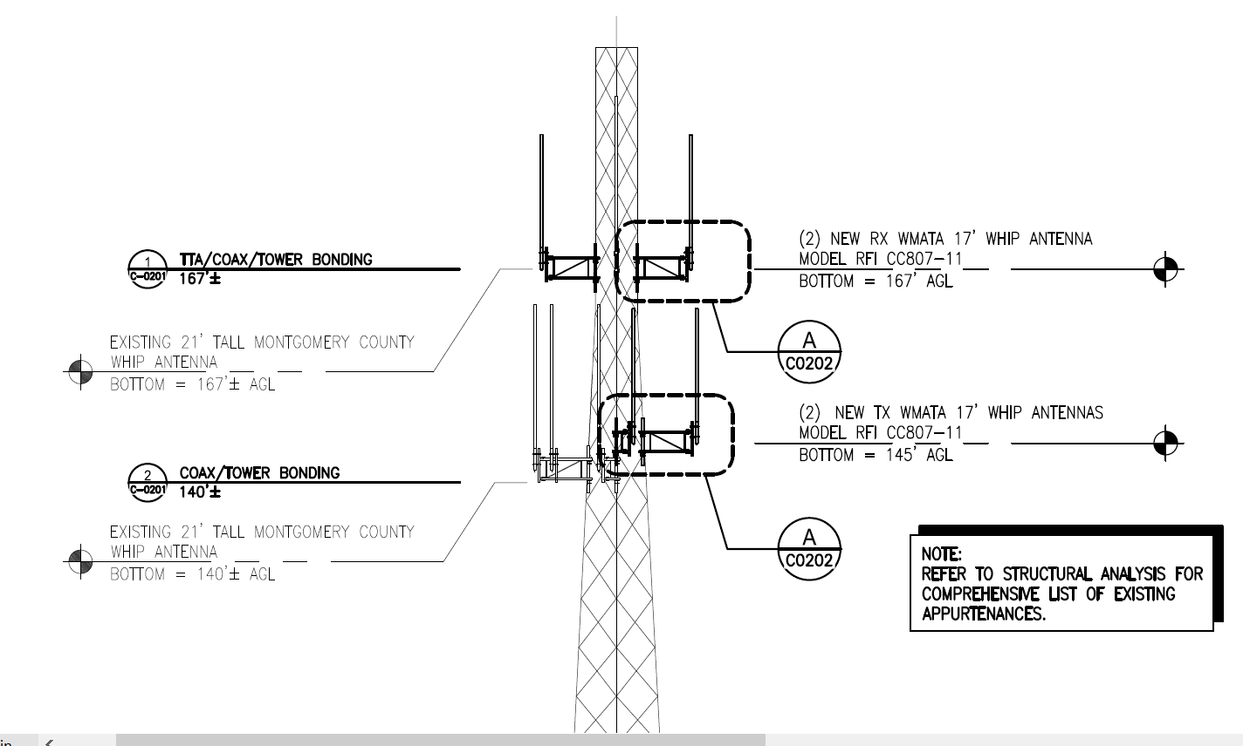
Burtonsville Tower

