Slide 1
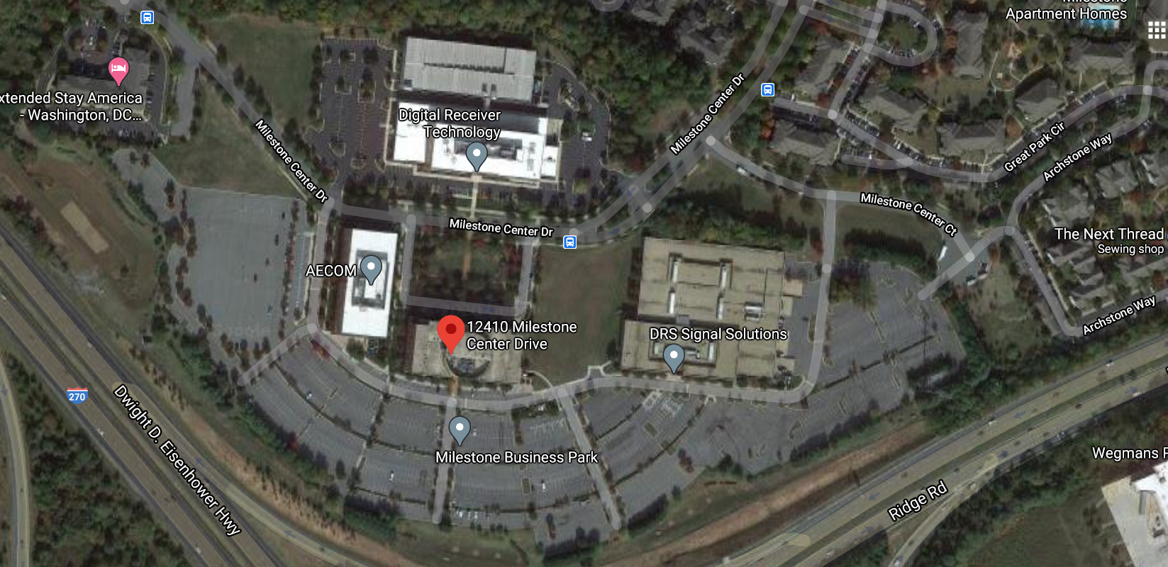
Milestone Center Ct Building
Notes:
Smartlink Group has applied on behalf of AT&T Wireless (New Cingular Wireless PCS) to attach 16 antennas and 16 remote radio heads (RRH) at 106' on an existing 83'5" building. Equipment cabinets and a natural gas generator will be placed on a proposed 15'x19'6" steel platform.

Slide 2
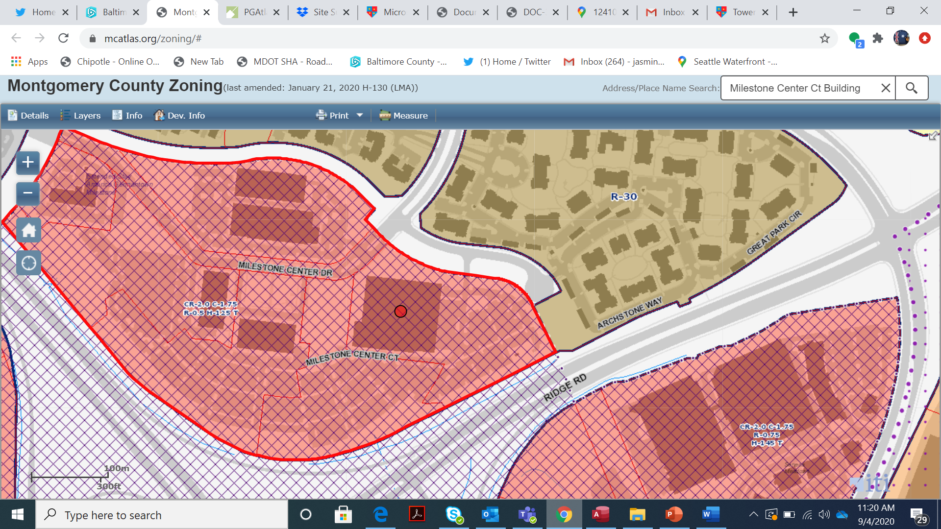
Milestone Center Ct Building
Notes:
The site is zoned CR-2.0 and located at the intersection of I270 and Maryland Route 27.

Slide 3
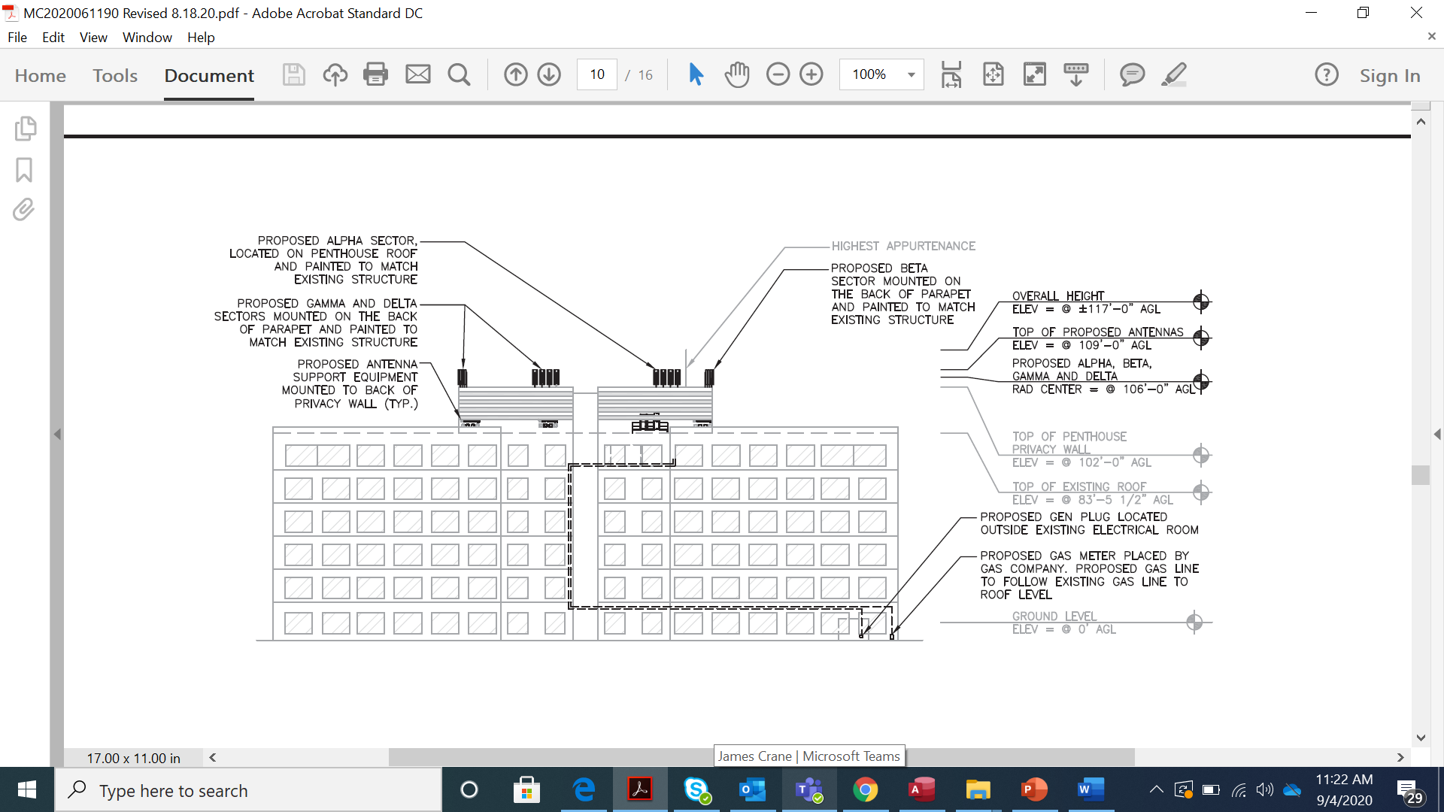
Notes:
This application represents the first carrier colocation for this building. The antennas will be placed in four sectors on the penthouse area.

Slide 4
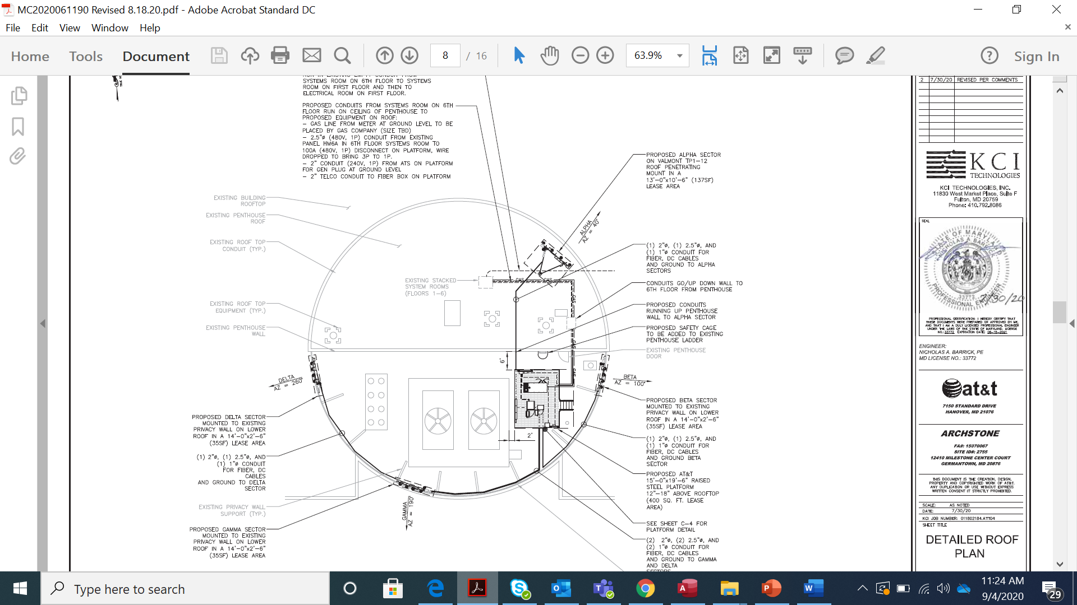
Milestone Center Ct Building

Slide 5
Milestone Center Ct Building
Notes:
The roof work will also include support equipment: and natural gas backup generator installed on a 15'x19'6" steel platform.

Slide 6
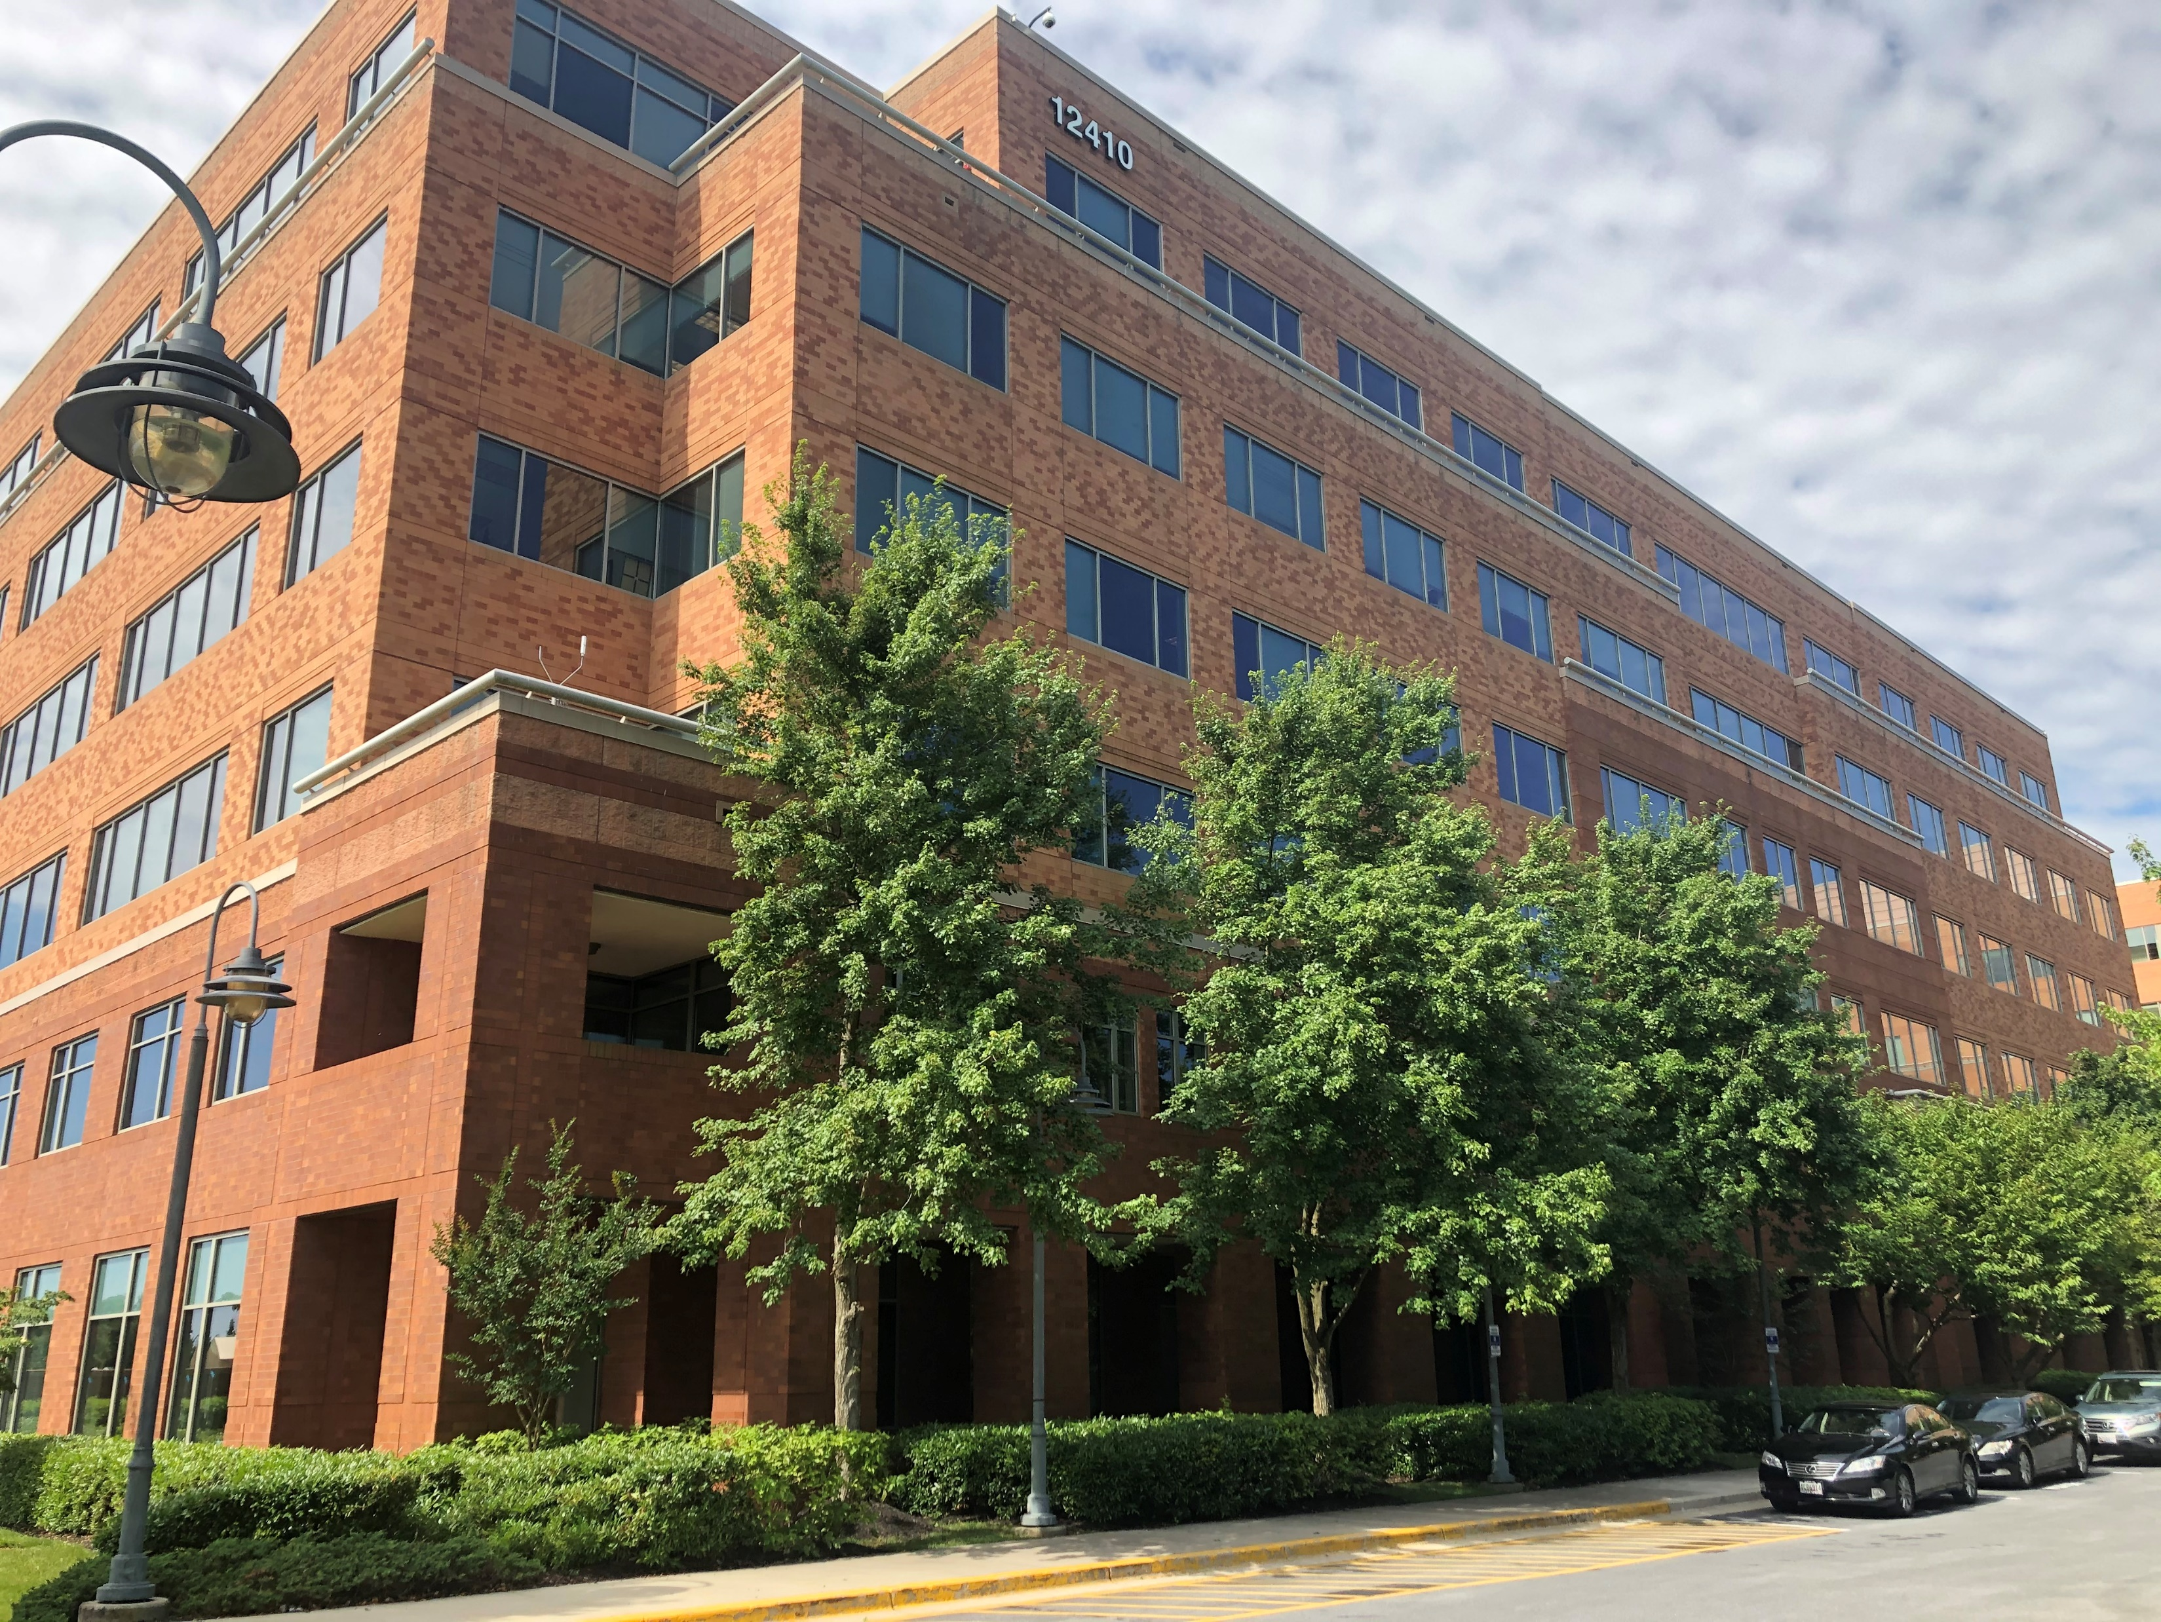
Milestone Center Ct Building
Notes:
All equipment will be painted to match the building.

Slide 7
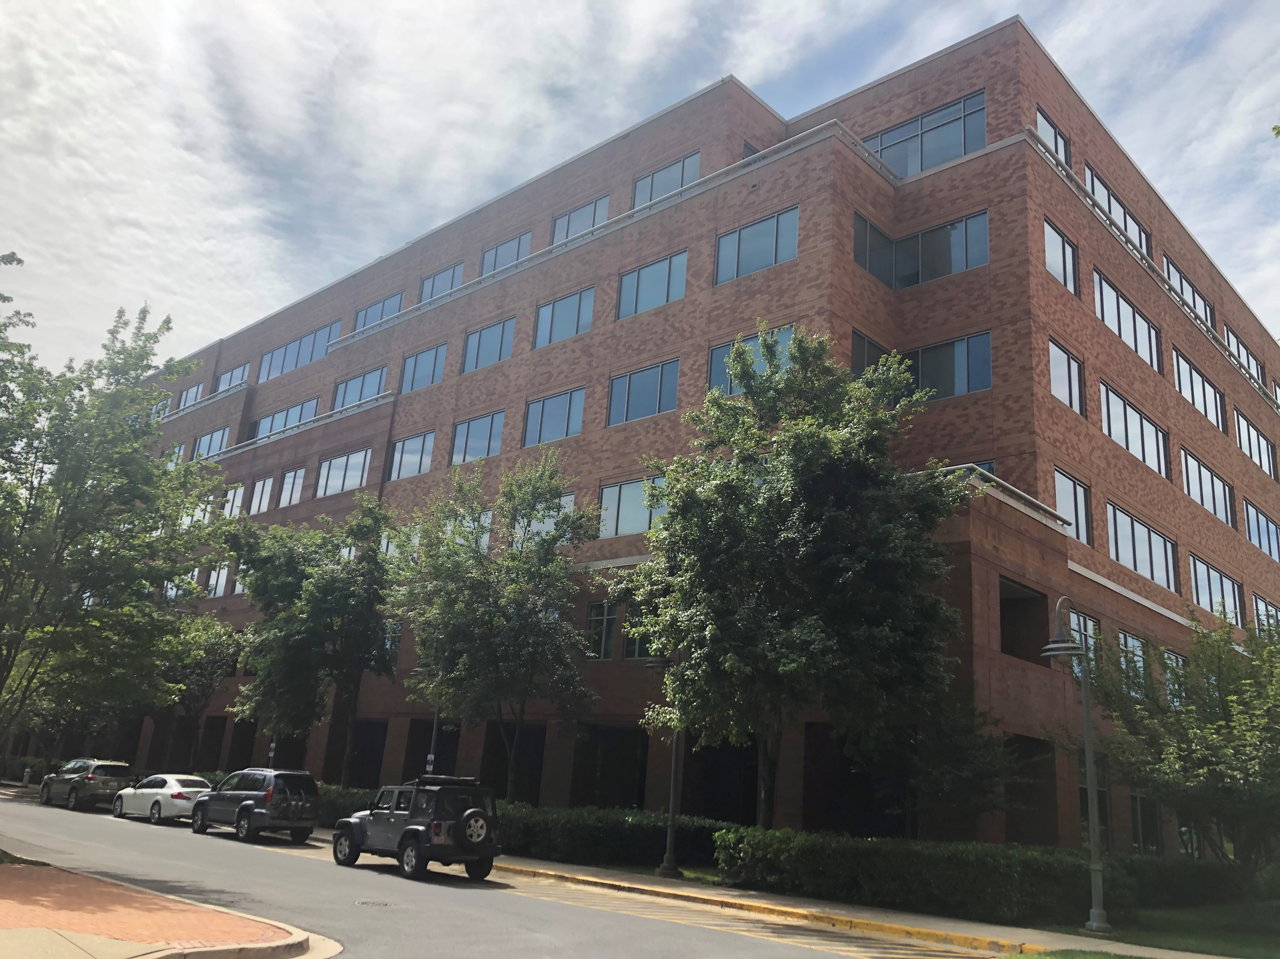
Milestone Center Ct Building

Slide 8
Pinnacle Towers
Notes:
This application is submitted by Crown Castle of behalf of Fox Television, specifically the local affiliate WTTG. The image on the left shows the location of the tower as does the one on the right.

Slide 9
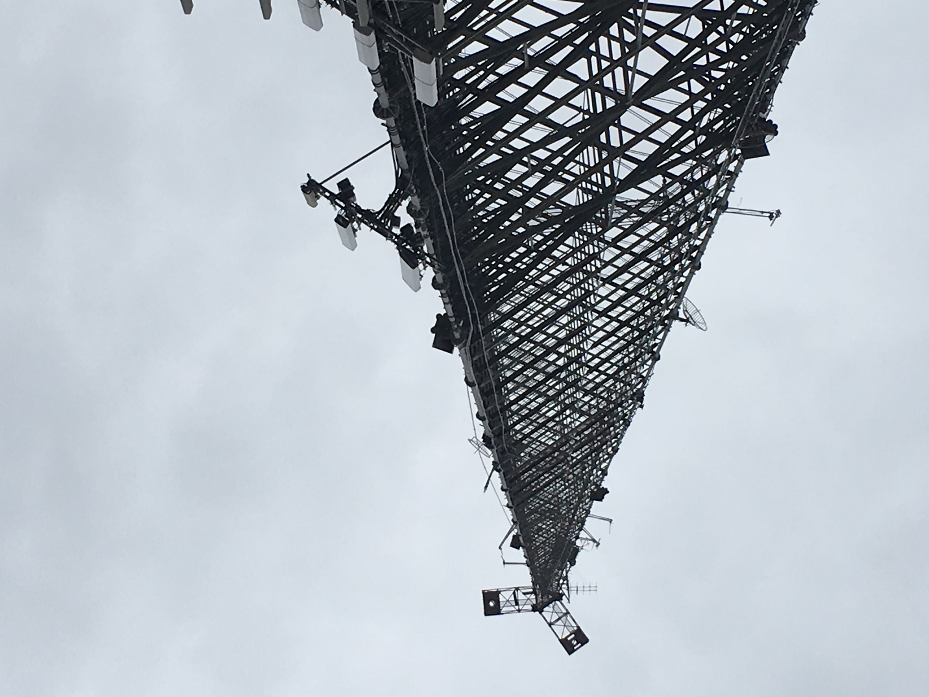
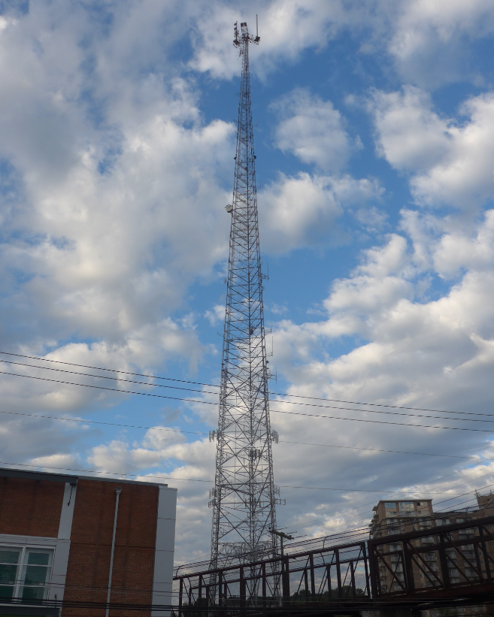
Pinnacle Towers
Notes:
For this application Fox is proposing to install six antennas, two microwave dishes and one video camera at various RAD Centers on the tower.

Slide 10
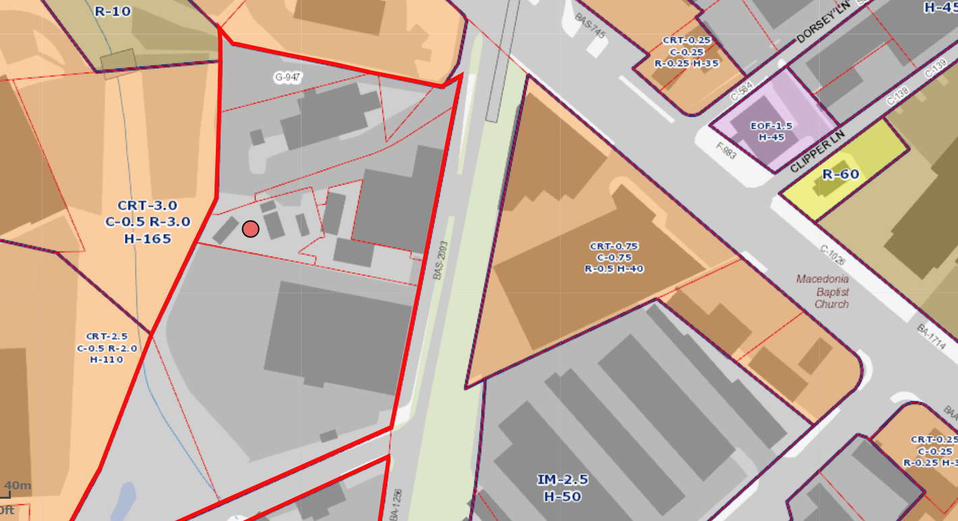
Pinnacle Towers
Notes:
The site is zoned IM 2.5 and overlooks the Capital Crescent Trail.

Slide 11
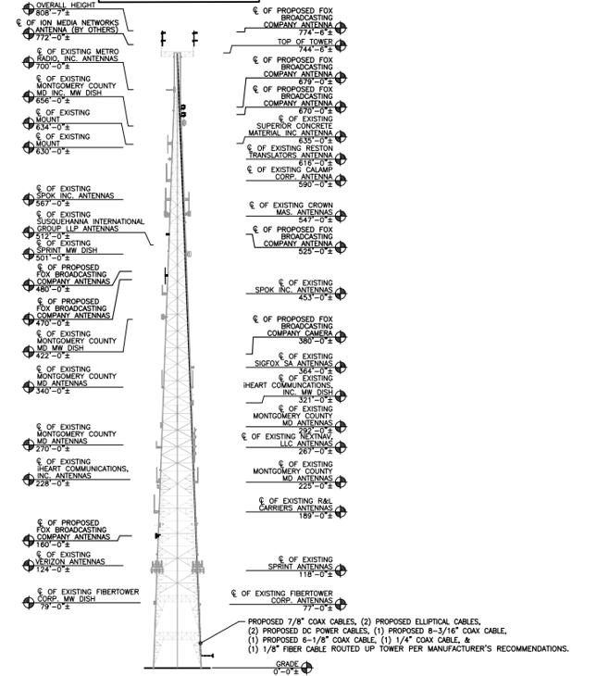
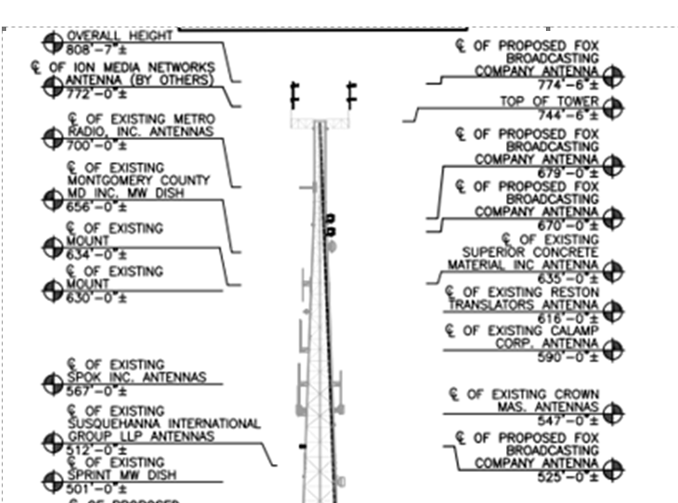
Pinnacle Towers
Notes:
Fox is proposing its largest antenna to be attached at 770’. Including a lighting conductor that antenna will be 59’ 6” and the top of the antenna’s elevation above ground level will be 799’8”T. This will be below the tower’s calculated AGL of 809’ as calculated by both the FCC and FAA.

Slide 12
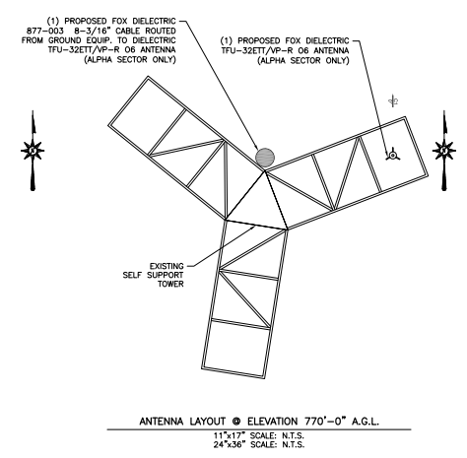
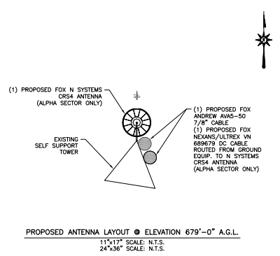
Pinnacle Towers

Slide 13
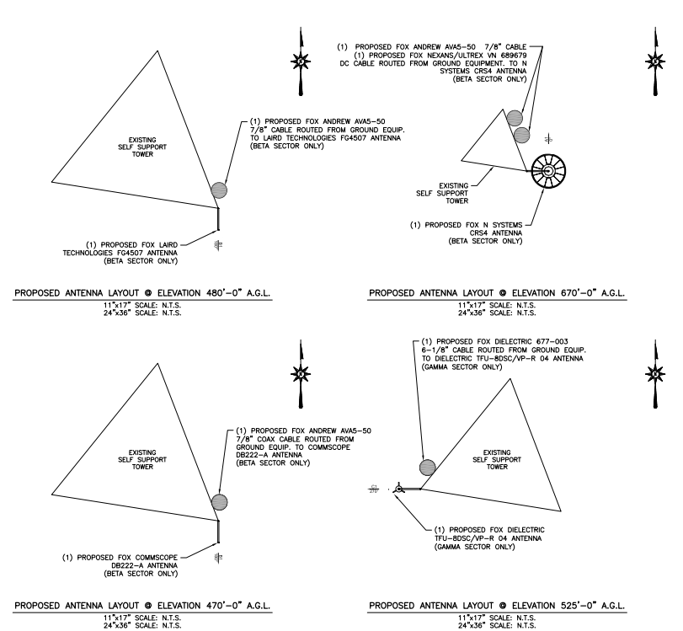
Pinnacle Towers
Notes:
An 18’ antenna will be placed at 525’. The remaining antennas range in size from 56:” to 127”.

Slide 14
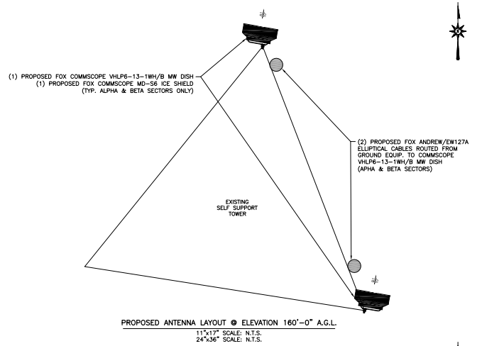
Pinnacle Towers
Notes:
The dish antenna are 75”’wide.

Slide 15
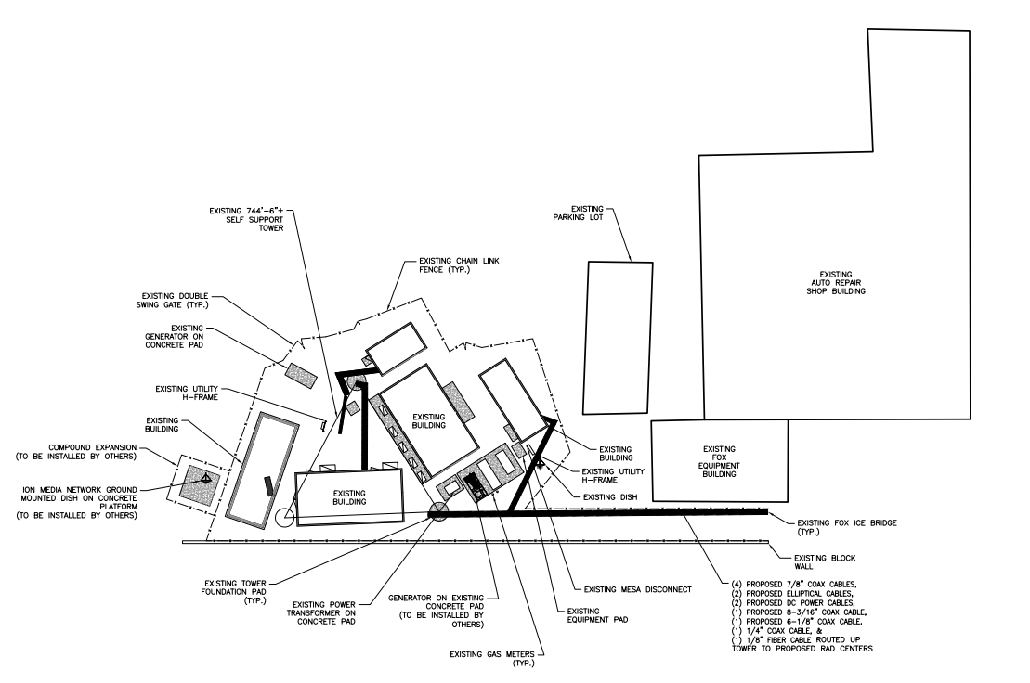
Pinnacle Towers
Notes:
No groundwork is proposed with this application. Any subsequent ground work would also be submitted to the TFCG.

