Slide 1
Crown Castle/T-Mobile @
PEPCO 813443-2791
(2021051450)

Slide 2
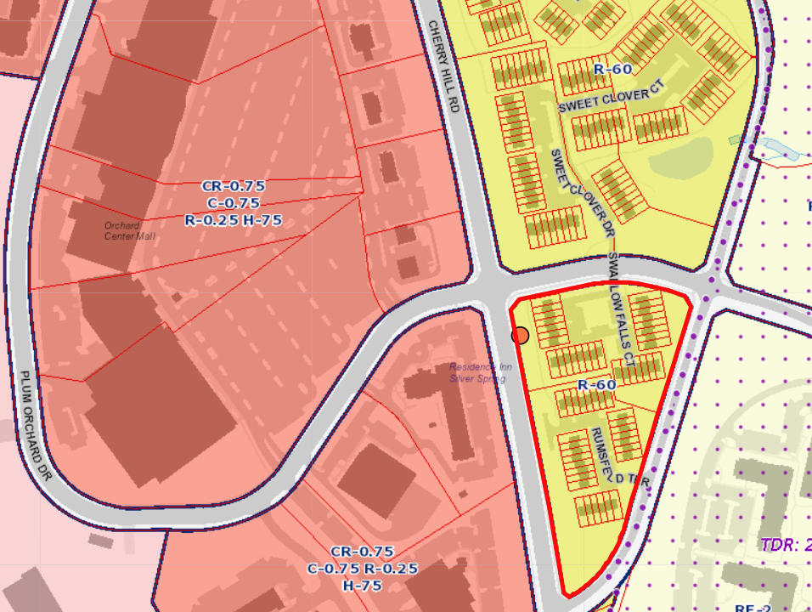
1450 - PEPCO 813443-2791

Slide 3
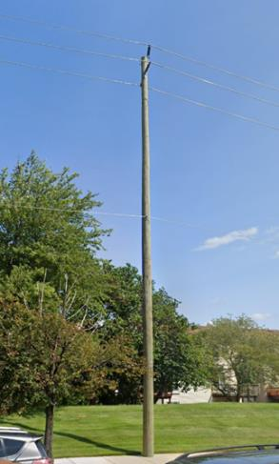
1450 - PEPCO 813443-2791

Slide 4
Crown Castle/T-Mobile @
PEPCO 791424-6090
(2021061484)

Slide 5
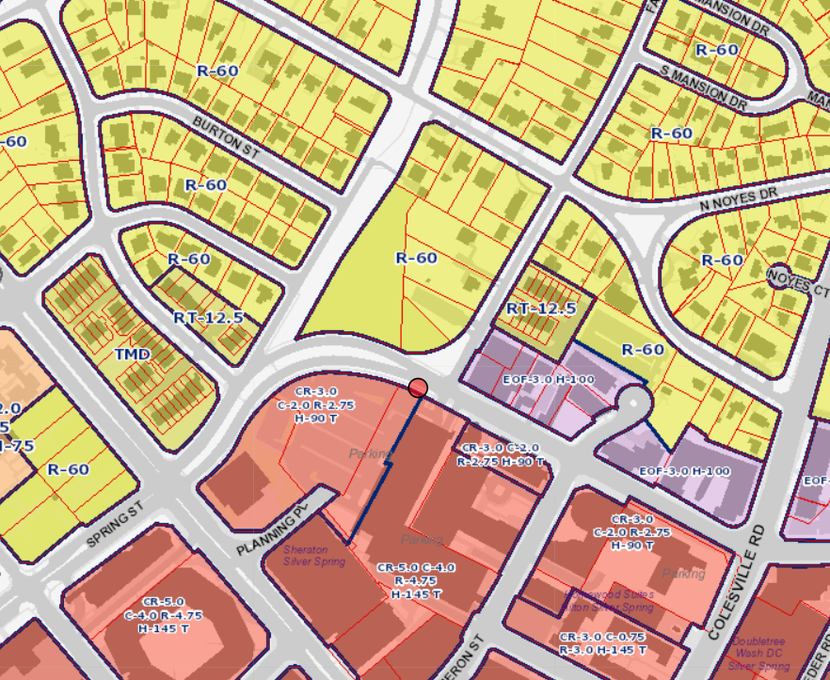
1484 - PEPCO 791424-6090

Slide 6
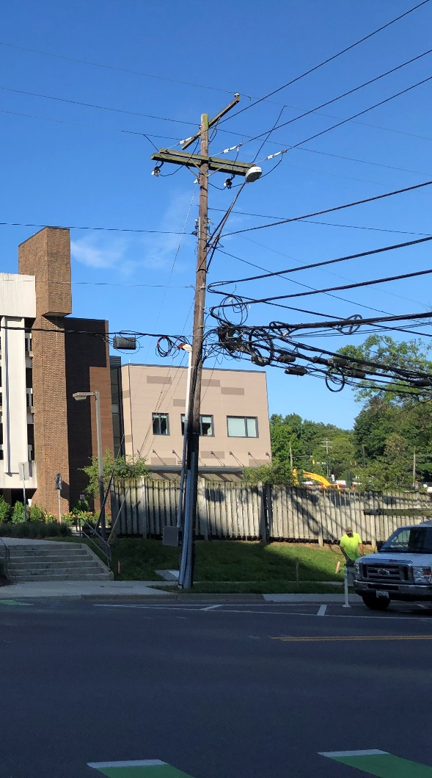
1484 - PEPCO 791424-6090

Slide 7
Crown Castle/T-Mobile @
PEPCO 812446-3789
(2021061490)

Slide 8
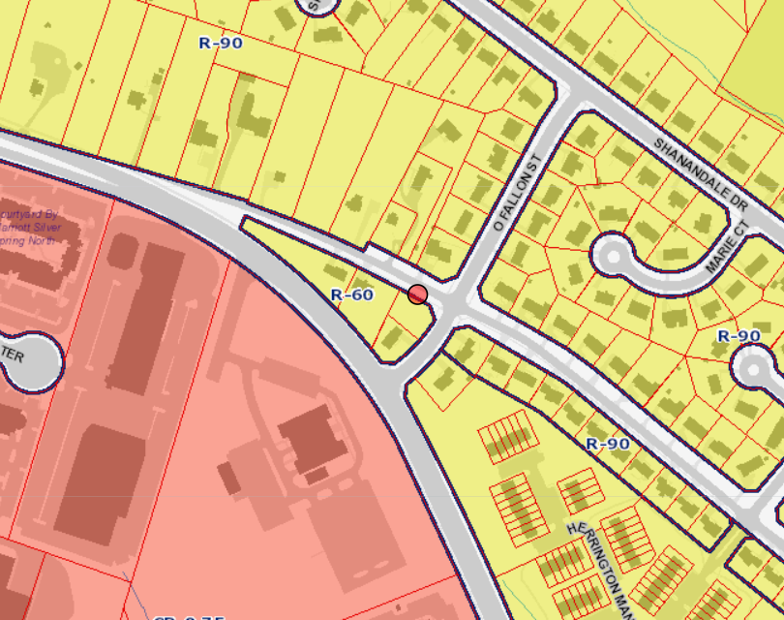
1490 - PEPCO 812446-3789

Slide 9
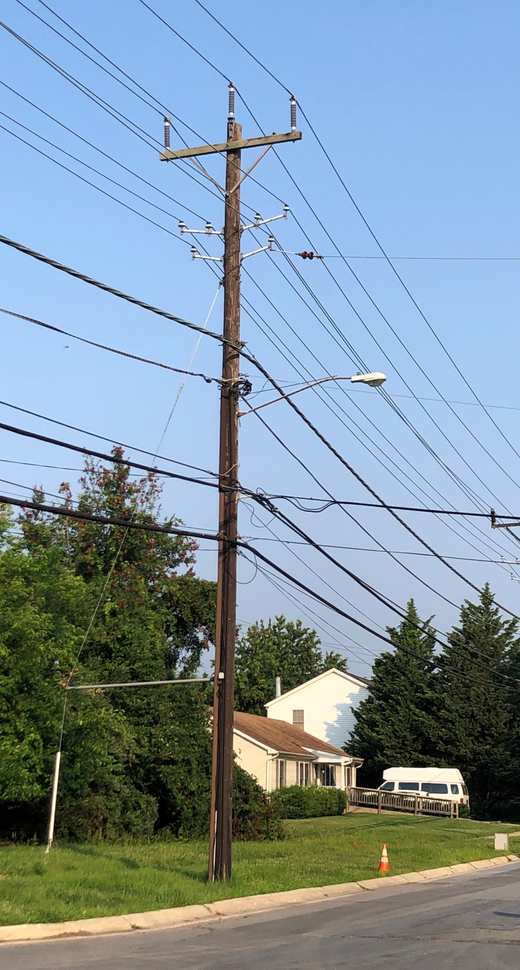
1490 - PEPCO 812446-3789

Slide 10
Crown Castle/T-Mobile @
PEPCO 799416-510810
(2021101594)
Not Recommended

Slide 11
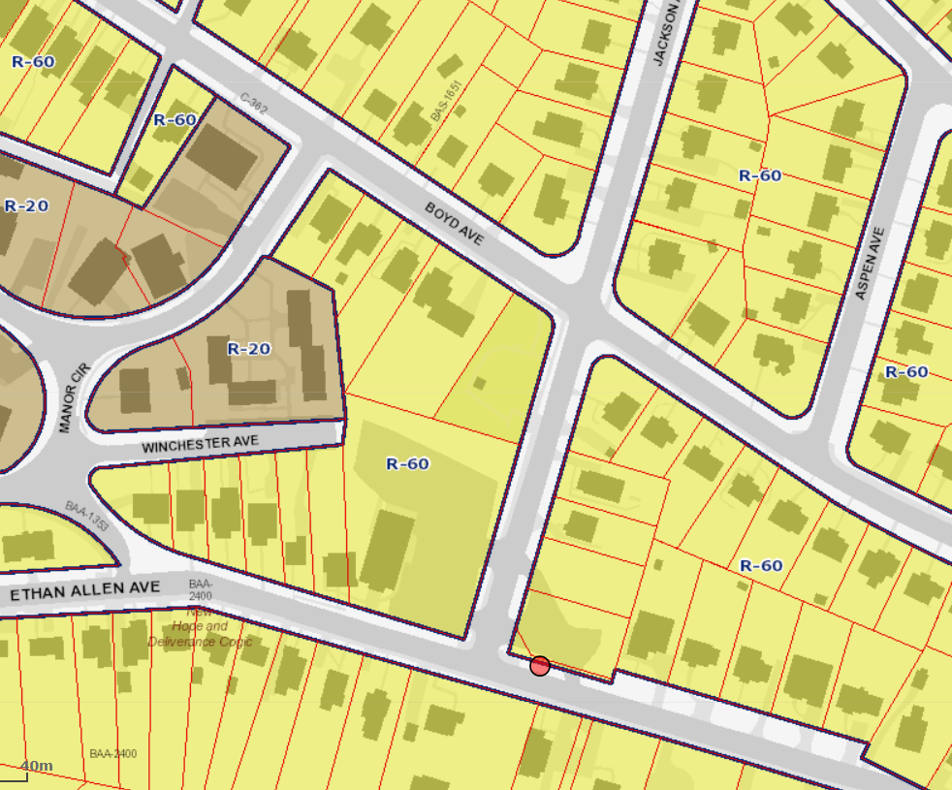
1594 - PEPCO 799416-510810

Slide 12
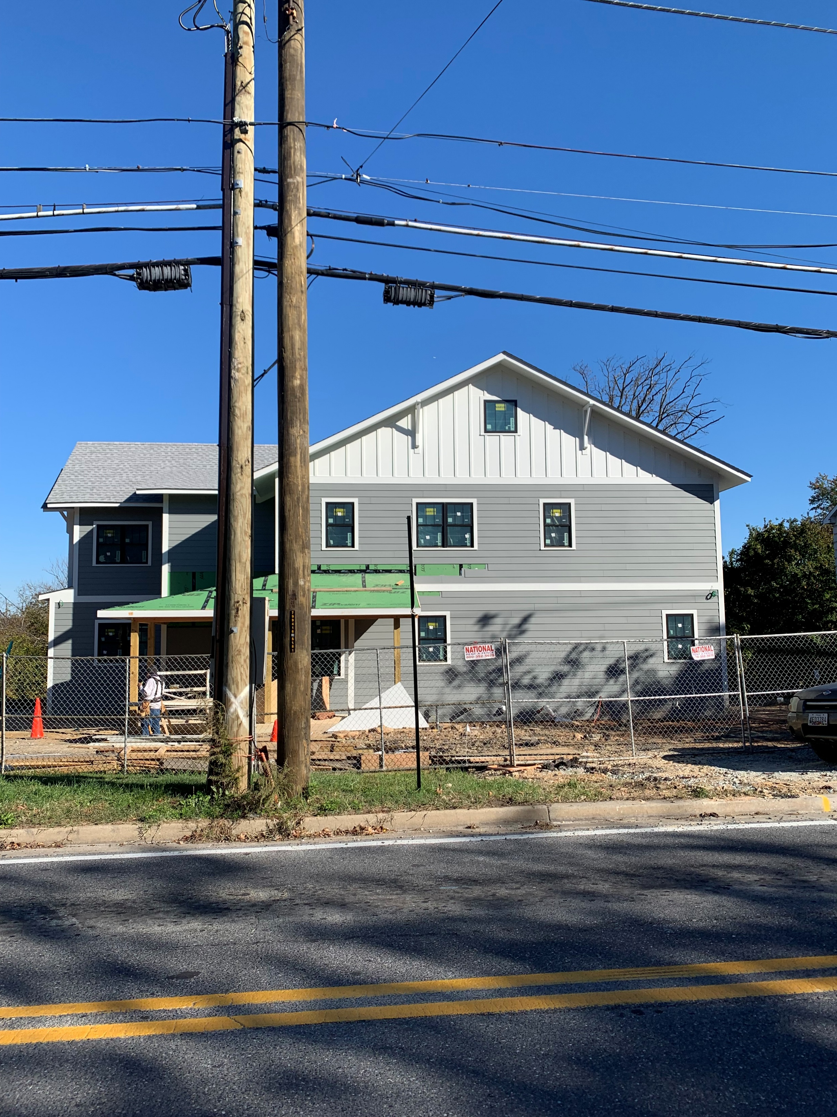
1594 - PEPCO 799416-510810

Slide 13
1594 - PEPCO 799416-510810
From page C-1 of plans

Slide 14
Crown Castle/T-Mobile @
PEPCO 795421-0031
(2022021683)

Slide 15
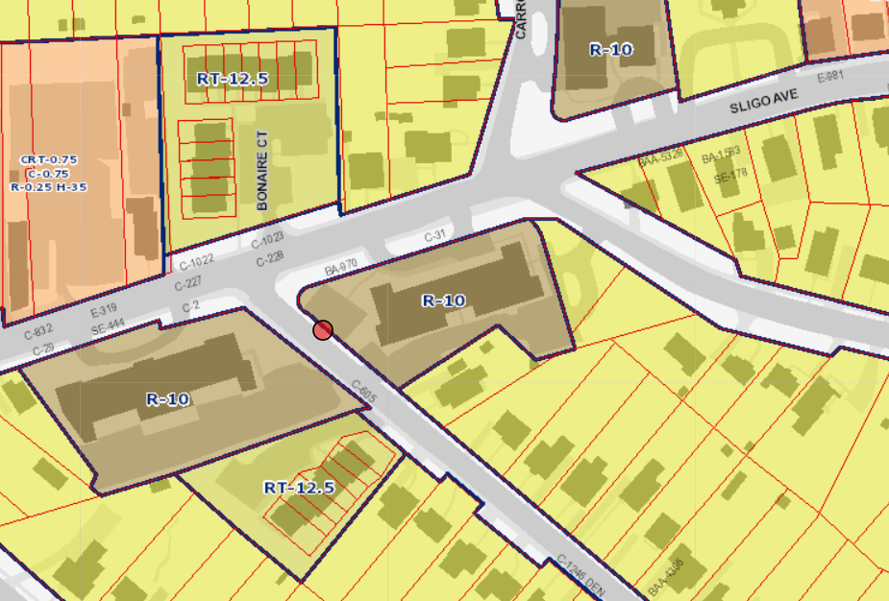
1683 - PEPCO 795421-0031

Slide 16
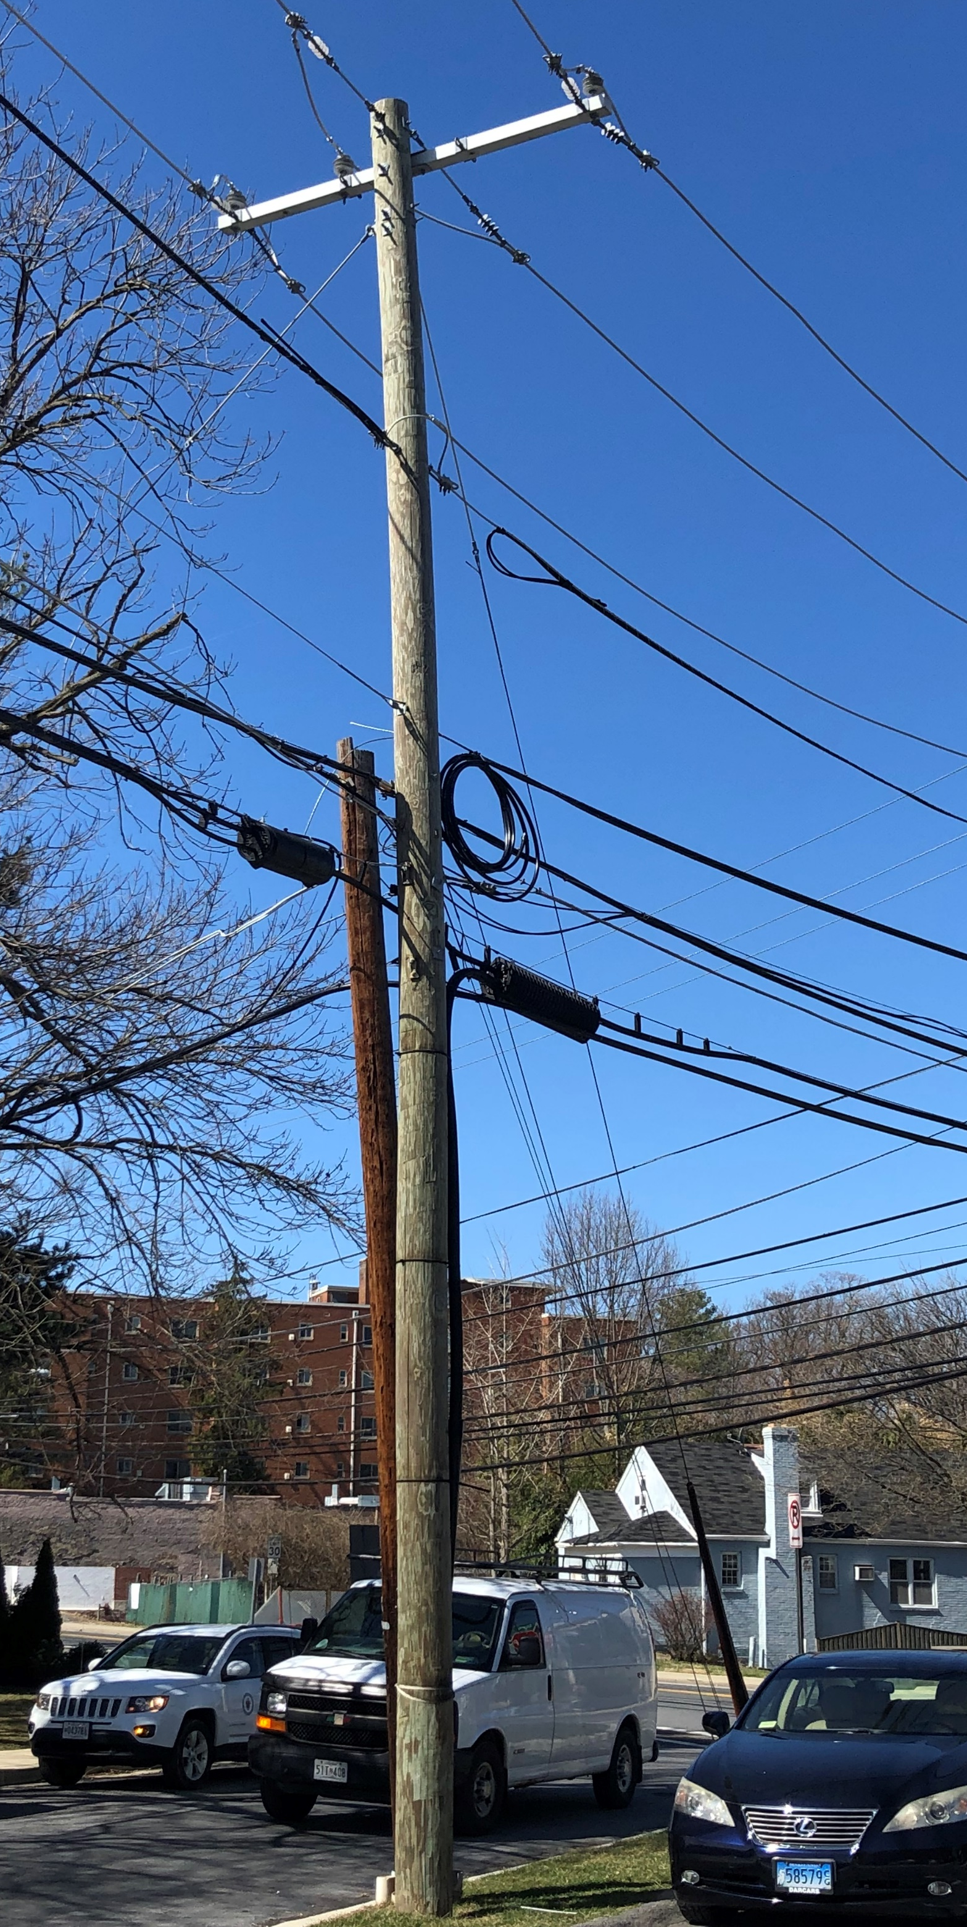
1683 - PEPCO 795421-0031

Slide 17
AT&T @ Verizon 8
(2021111614)
Notes:
Sitelink has filed on behalf of New Cingular Wireless/AT&T for installation of a small cell antenna on a PEPCO replaced wooden utility pole located in the Montgomery county right of way. (1) antenna will be installed at the top of the pole with (2) RRH's installed in a cabinet located mid pole.

Slide 18
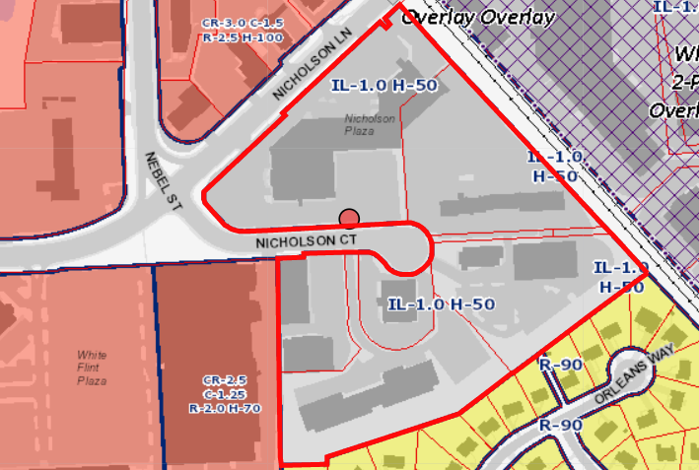
1614 – Verizon 8
Notes:
The site is zoned RE-2C. The pole is located approximately 104 feet from a single-family home.

Slide 19
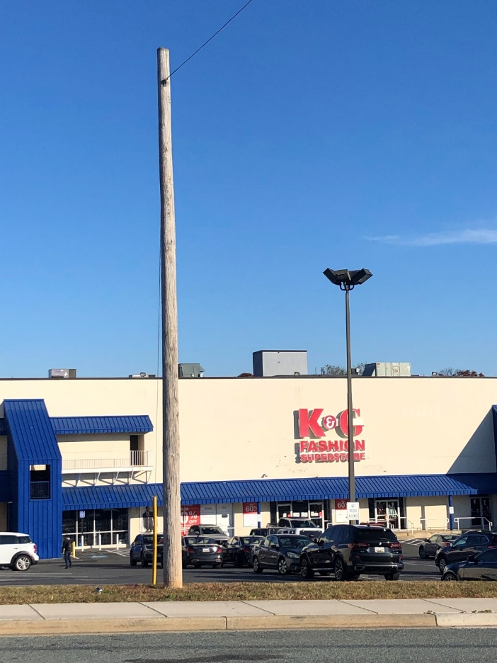
1614 – Verizon 8
Notes:
The existing pole is 43’ tall and replaced a 28’8” pole. A 2’10" tall antenna/shroud will be attached atop the pole. Two remote radio heads will be placed in a 4’ equipment cabinet mounted at 12’.

Slide 20
AT&T @ PEPCO 747422-8828
(2021111624)
Notes:
Sitelink has filed on behalf of New Cingular Wireless/AT&T for installation of a small cell antenna on a PEPCO replaced wooden utility pole located in the Montgomery county right of way. (1) antenna will be installed at the top of the pole with (2) RRH's installed in a cabinet located mid pole.

Slide 21
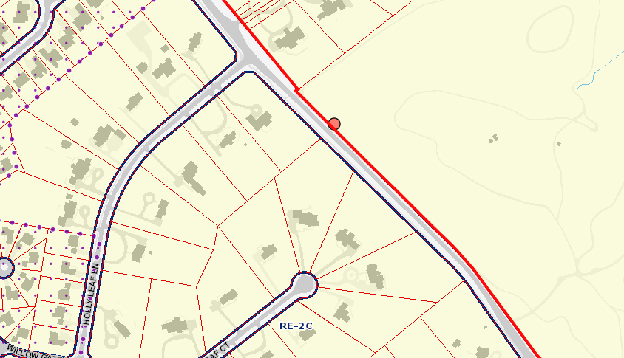
1624 - PEPCO 747422-880280
Notes:
The site is zoned RE-2C. The site is 287 feet from the closest dwelling. It is adjacent to the golf course for the Congressional Country Club. The other side of Persimmon Tree Road borders a walking trail and private residences. A heavily wooded area buffers the walking trail and the homes.

Slide 22
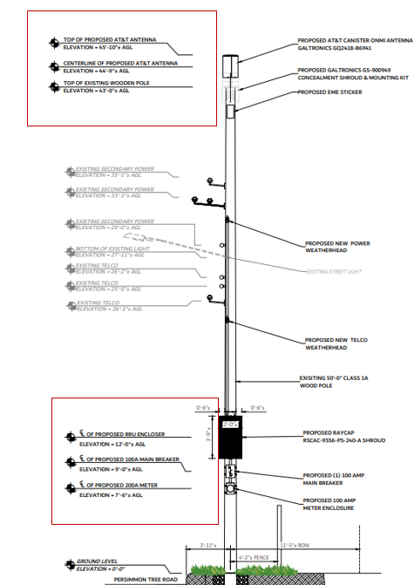
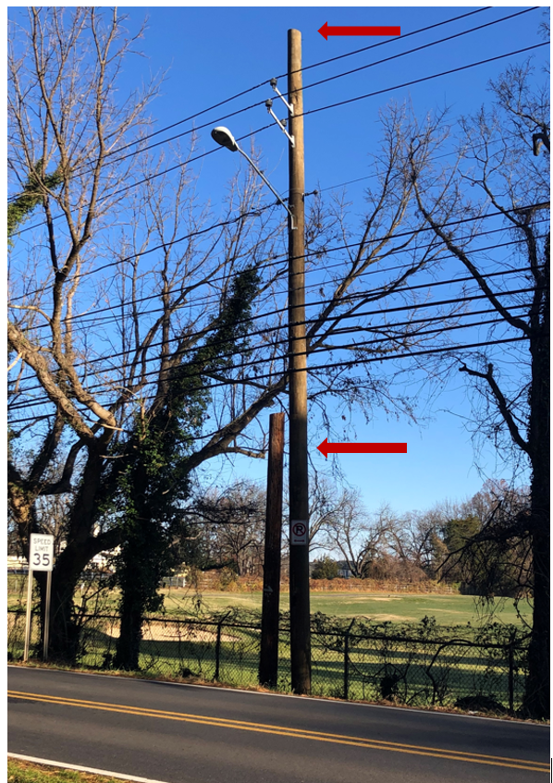
1624 - PEPCO 747422-8828
Notes:
The existing pole is 43’ tall and replaced a 35’7” pole. A 2’10" tall antenna/shroud will be attached atop the pole. Two remote radio heads will be placed in a 4’ equipment cabinet mounted at 12’.

Slide 23
AT&T @ PEPCO 772442-060130
(2021111625)
Notes:
Sitelink has filed on behalf of New Cingular Wireless/AT&T for installation of a small cell antenna on a PEPCO replaced wooden utility pole located in the Montgomery county right of way. (1) antenna will be installed at the top of the pole with (2) RRH's installed in a cabinet located mid pole.

Slide 24
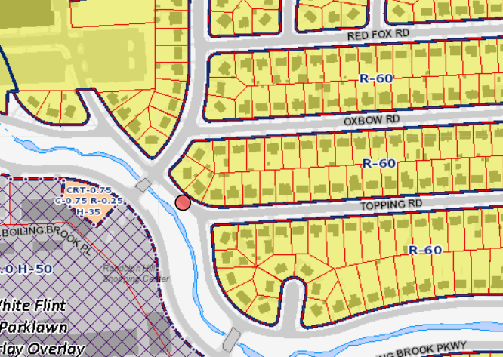
1625 - PEPCO 772442-060130
Notes:
The site is zoned R-60. The pole is located approximately 75 feet from a single-family home.

Slide 25
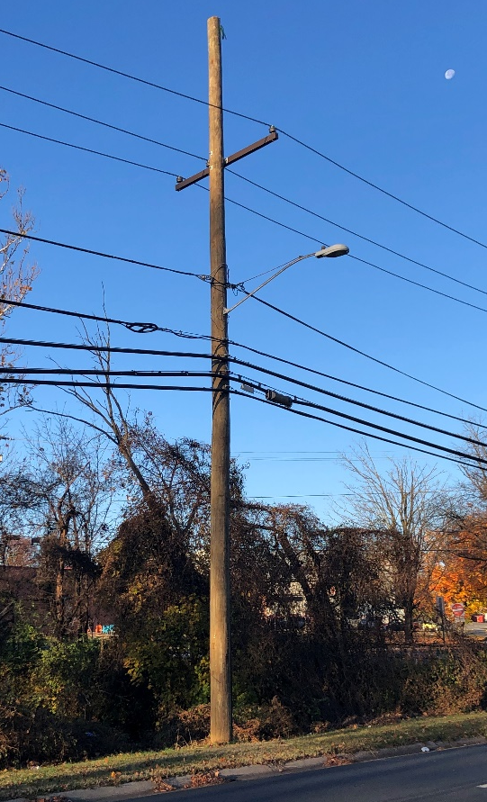
1625 - PEPCO 772442-060130
Notes:
The existing pole is 46’ tall and replaced a 35’ pole. A 2’1" tall antenna/shroud will be attached atop the pole. Two remote radio heads will be placed in a 4’ equipment cabinet mounted at 12’.

Slide 26
AT&T @ PEPCO 744424-8643
(2021111628)
Notes:
Sitelink has filed on behalf of New Cingular Wireless/AT&T for installation of a small cell antenna on a PEPCO replaced wooden utility pole located in the Montgomery county right of way. (1) antenna will be installed at the top of the pole with (2) RRH's installed in a cabinet located mid pole.

Slide 27
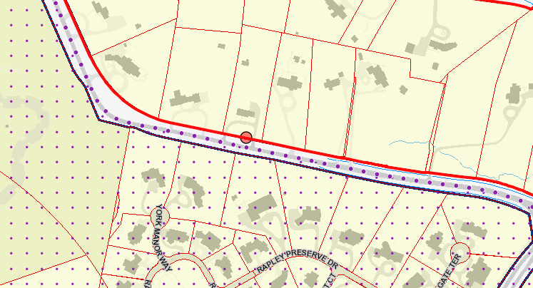
1628 - PEPCO 744424-8643
Notes:
The site is zoned RE-2C. The pole is located approximately 104 feet from a single-family home.

Slide 28
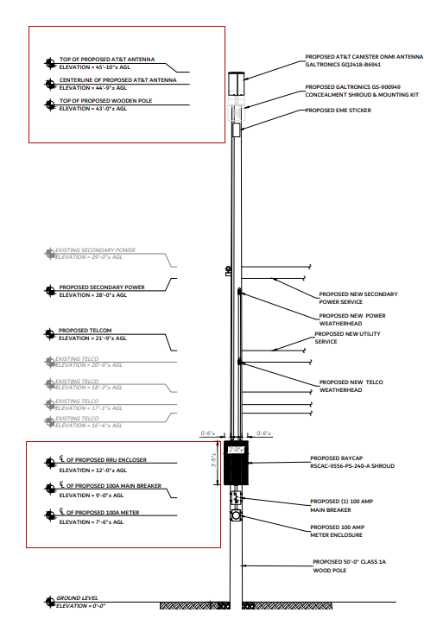
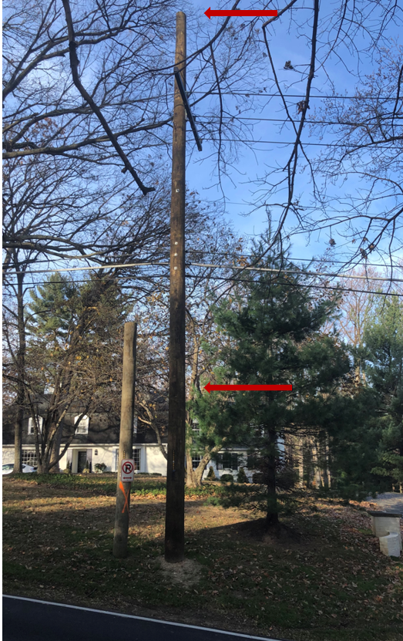
1628 - PEPCO 744424-8643
Notes:
The existing pole is 43’ tall and replaced a 28’8” pole. A 2’10" tall antenna/shroud will be attached atop the pole. Two remote radio heads will be placed in a 4’ equipment cabinet mounted at 12’.

Slide 29
Telecom Capital Group/Verizon
New Monopole and Colocation
Claggettsville Monopole site
Application 2021081541 and 2021081545

Slide 30
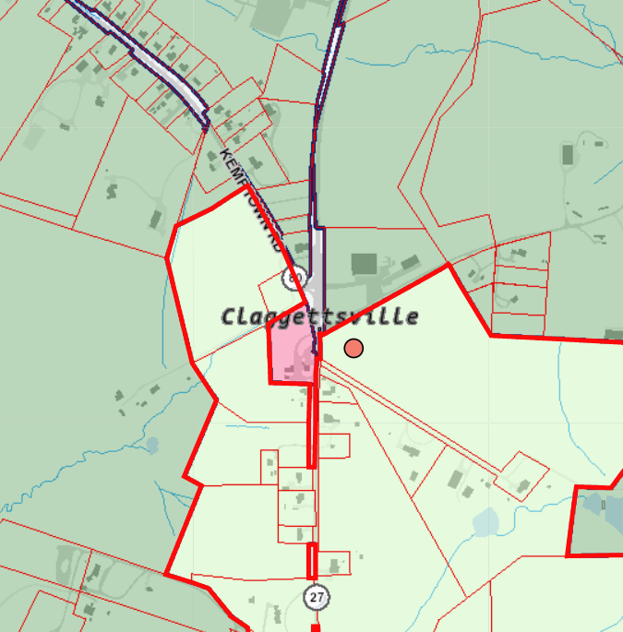
Clarksburg Premium Outlets

Slide 31
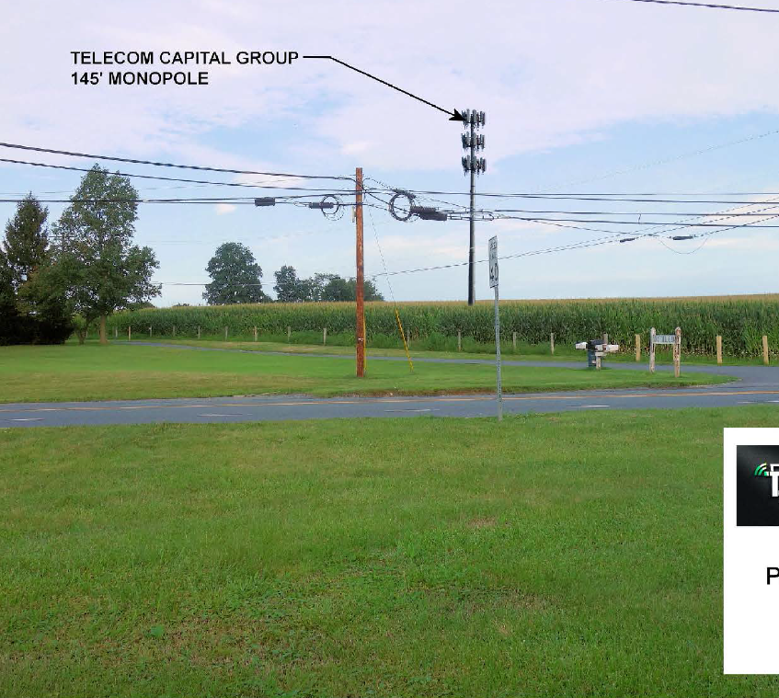
Claggettsville Monopole

Slide 35
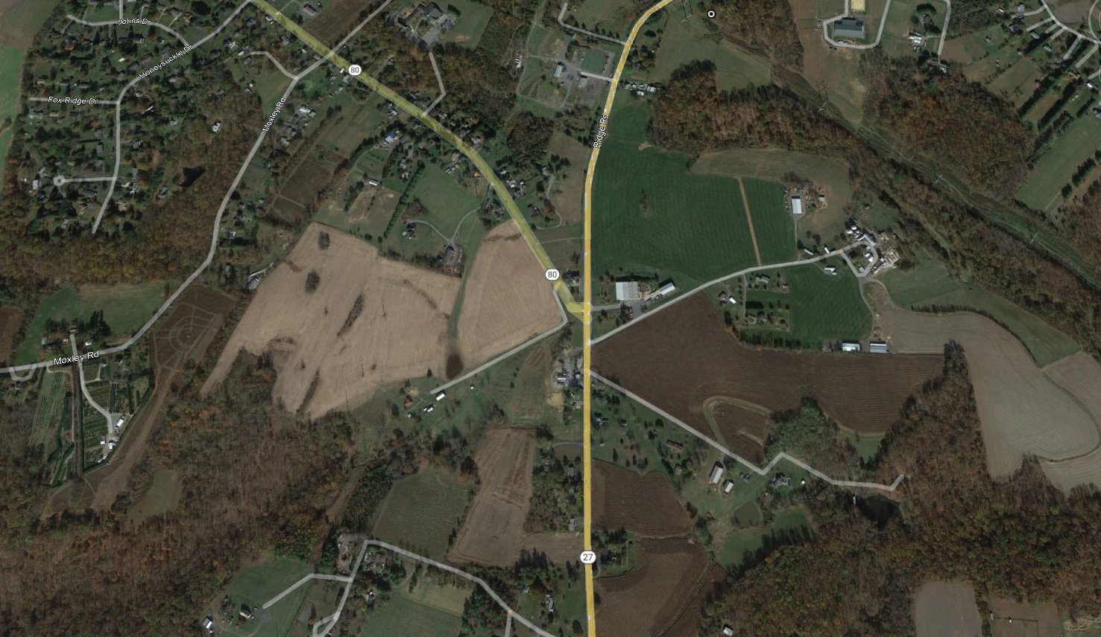
Nearby Residences

Slide 36
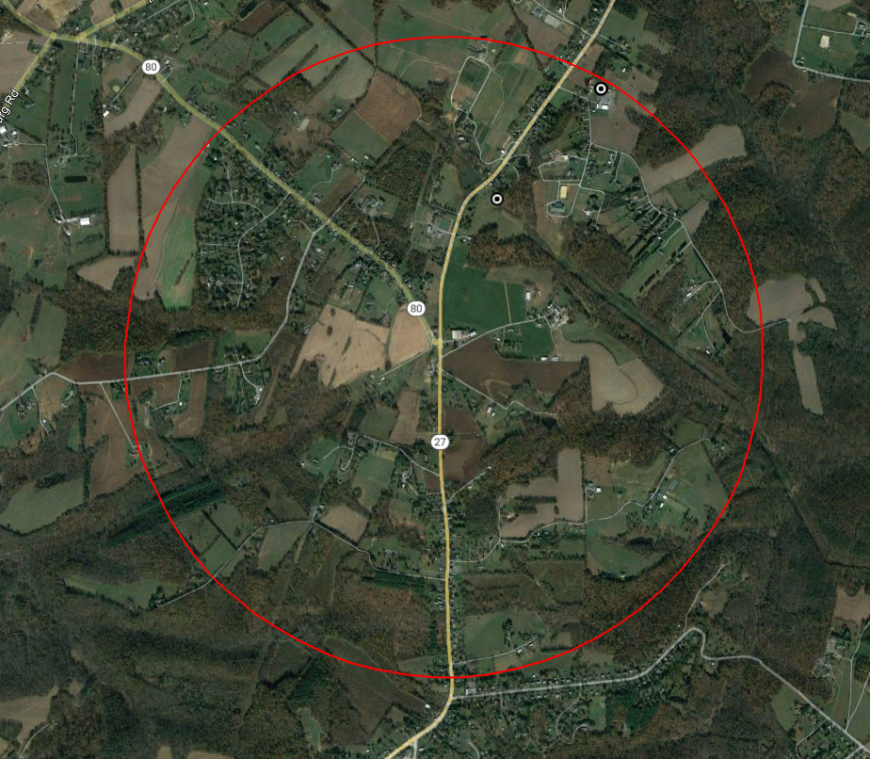
Alternate sites (Verizon/CTC)

Slide 39
Telecom Capital Group/Verizon
Old Hundred Monopole site
New Monopole and Colocation
Application 2021081528 and 2021081533

Slide 40
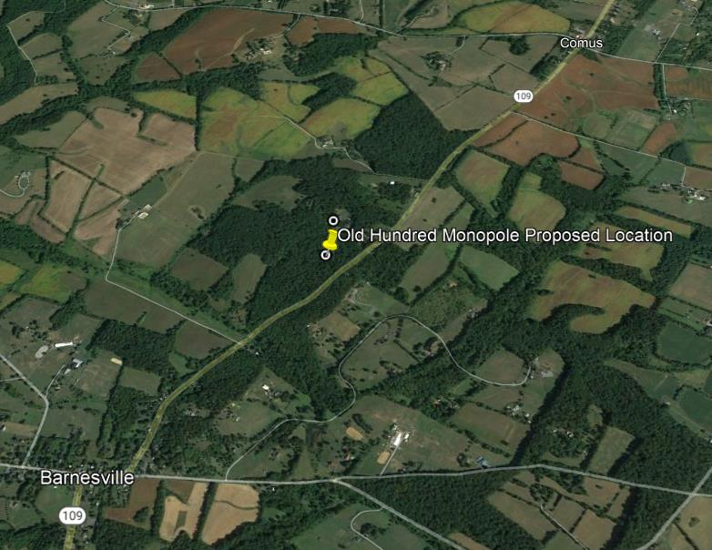
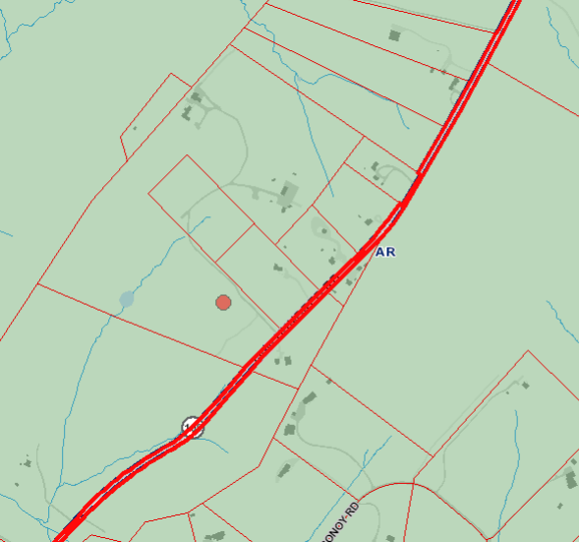
Clarksburg Premium Outlets

Slide 41
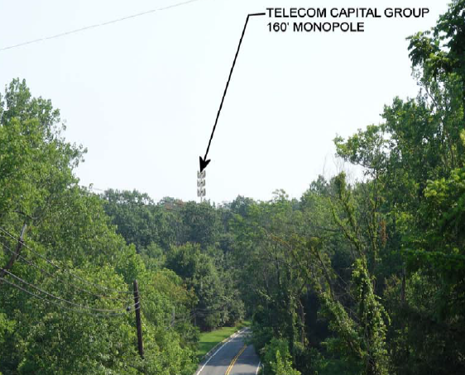
Old Hundred Monopole

Slide 45
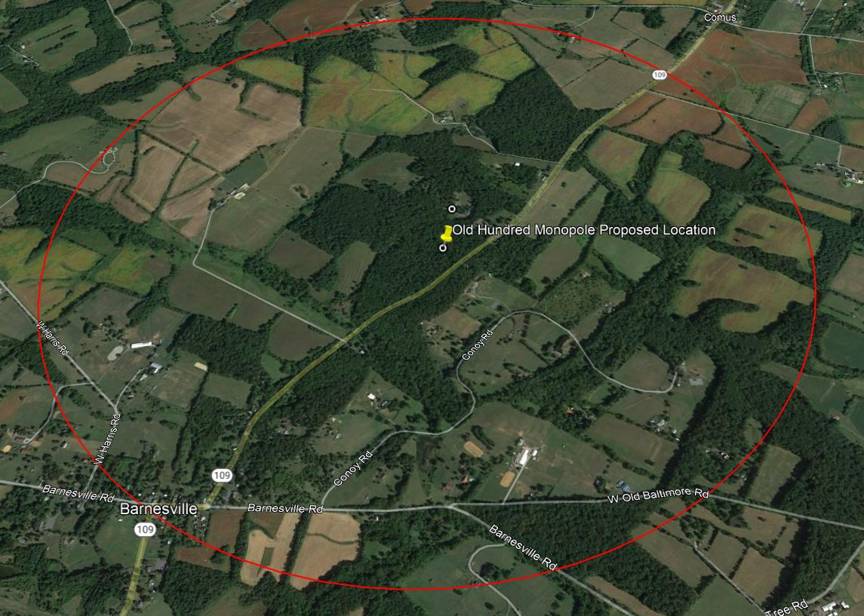
Alternate sites (Verizon/CTC)
2009/2010 application

