Slide 1
November 2022 TFCG SLIDE DECK

Slide 2
T-Mobile @ Pepco 106-S
(2022081925)

Slide 3
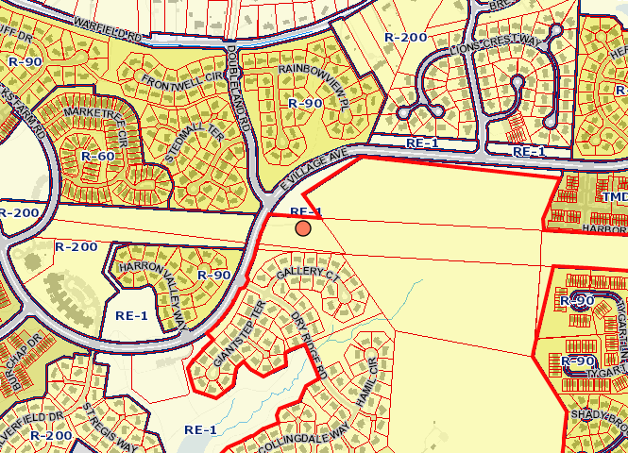
1925 - PEPCO 106-S
Notes:
PEPCO transmission tower in the greater Gaithersburg area, between Montgomery Village and Laytonsville. Transmission tower is located to the east of E. Village Avenue near the intersection with Doubleland Rd. The area is zoned R-200.

Slide 4
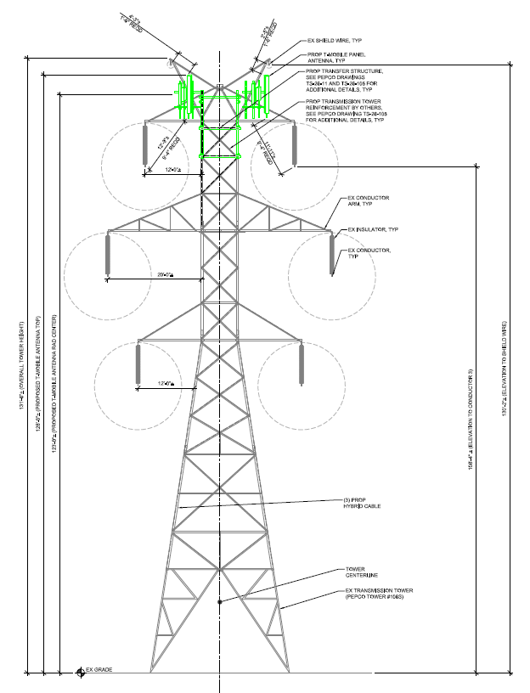
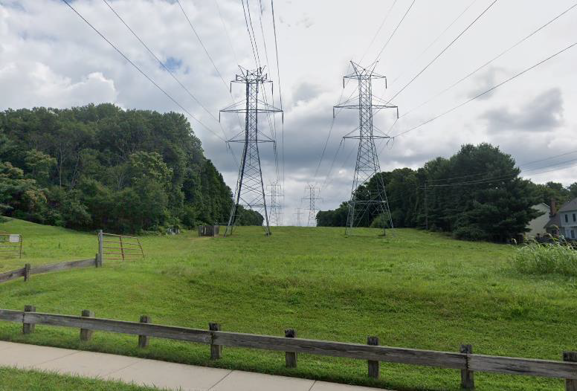
1925 - PEPCO 106-S
Notes:
Antennas will be installed at a RAD center of 123.8’ on the existing 131.5’ PEPCO transmission tower. There are no antennas on 106-S. An application from Clearwire was reviewed and recommended by the TFCG in April 2010 but the antennas were not attached.

Slide 5
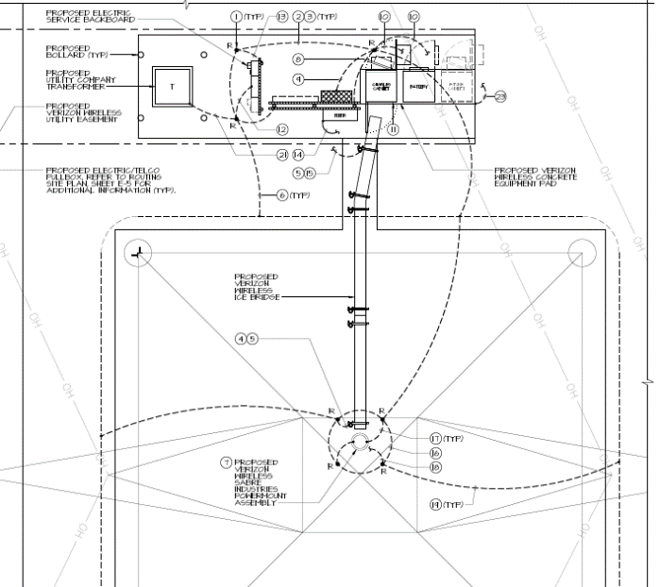
1925 - PEPCO 106-S
Notes:
Two new equipment cabinets will be added to the existing concrete equipment pad next to the neighboring transmission tower, connected by underground cabling to the new installation. We recommend this application.

Slide 6
AT&T Wireless @ Pepco 37-S
(2022091942)

Slide 7
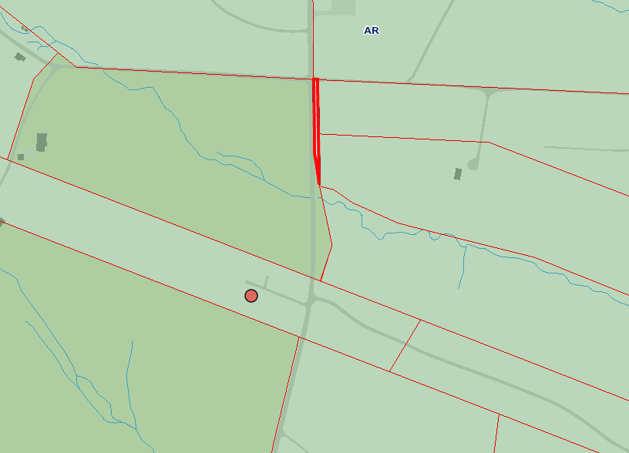
1942 - PEPCO 37-S
Notes:
AT&T Wireless to colocate on Pepco Transmission tower 37-S, West of MD-117 Bucklodge Rd. The site is zoned AR.

Slide 8
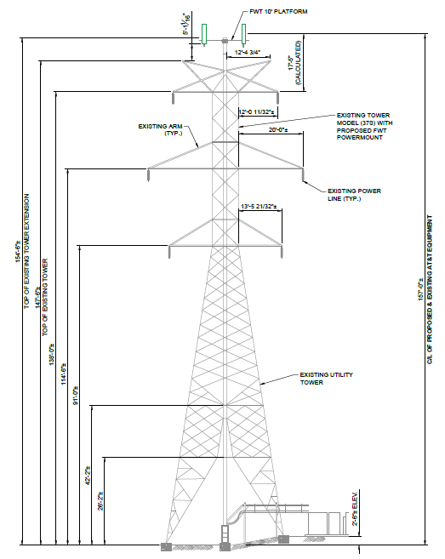
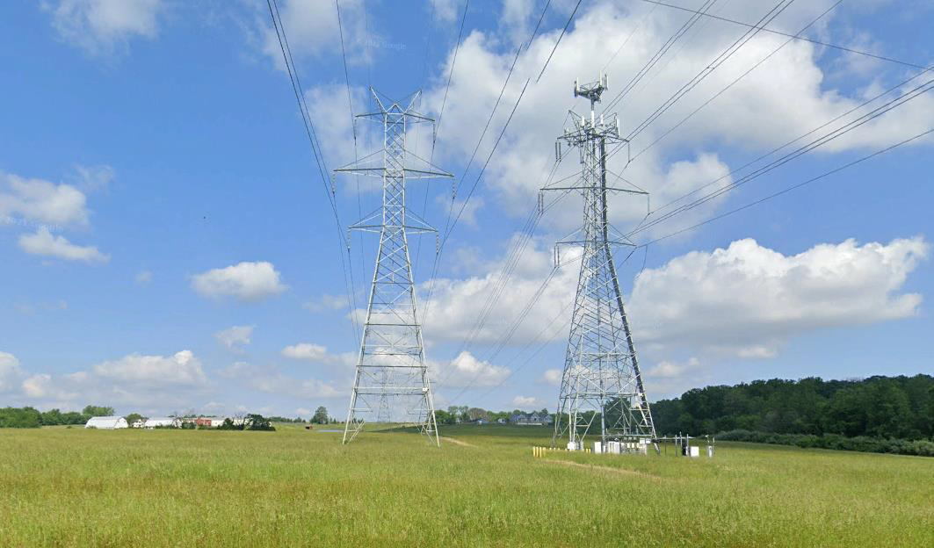
1942 - PEPCO 37-S
Notes:
The antennas will be mounted on an existing 154.5’ PEPCO transmission tower at a RAD center of 157’. A new concrete equipment pad will installed at grade next to the tower. There are no other antennas or carriers on the transmission tower. The TFCG reviewed and recommended a similar application from Verizon to colocate on 37-S in November 2013, but the antennas weren’t installed. We recommend this application.

