Slide 1
Verizon @
PEPCO 795419-4179
(2022051806)

Slide 2
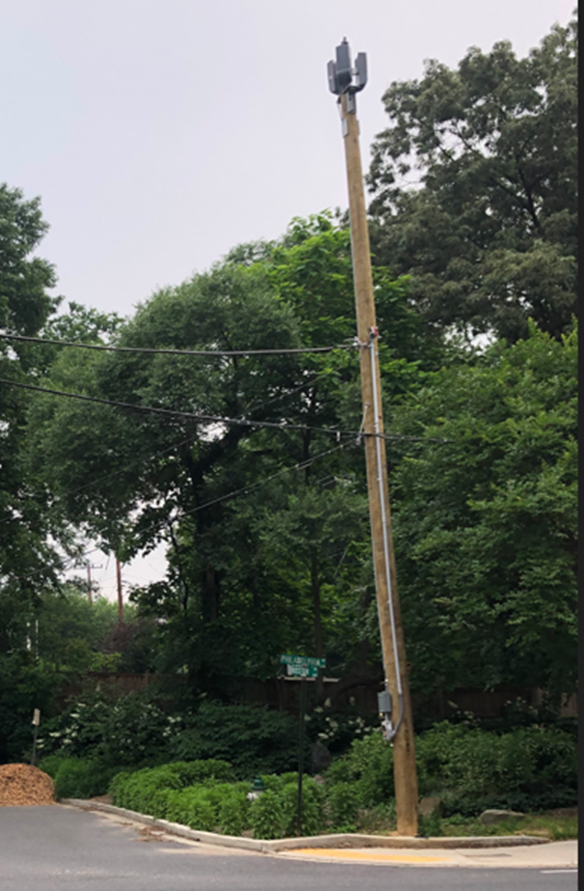
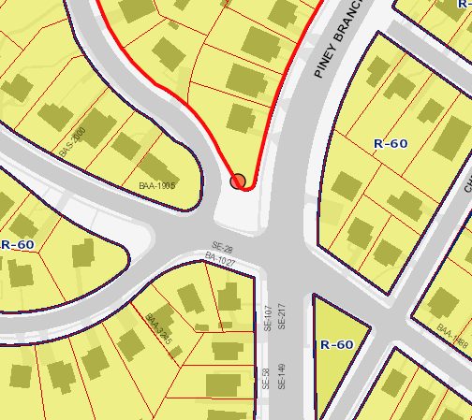
1806 - PEPCO 795419-4179
Notes:
The site is located at the intersection of Philadelphia Ave (East West Highway) and Boston Avenue. The ROW is under the Maryland State Highway Administration, which was confirmed by DPS during the application review process.

Slide 3
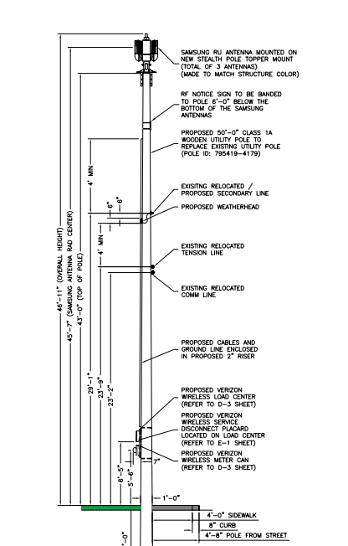
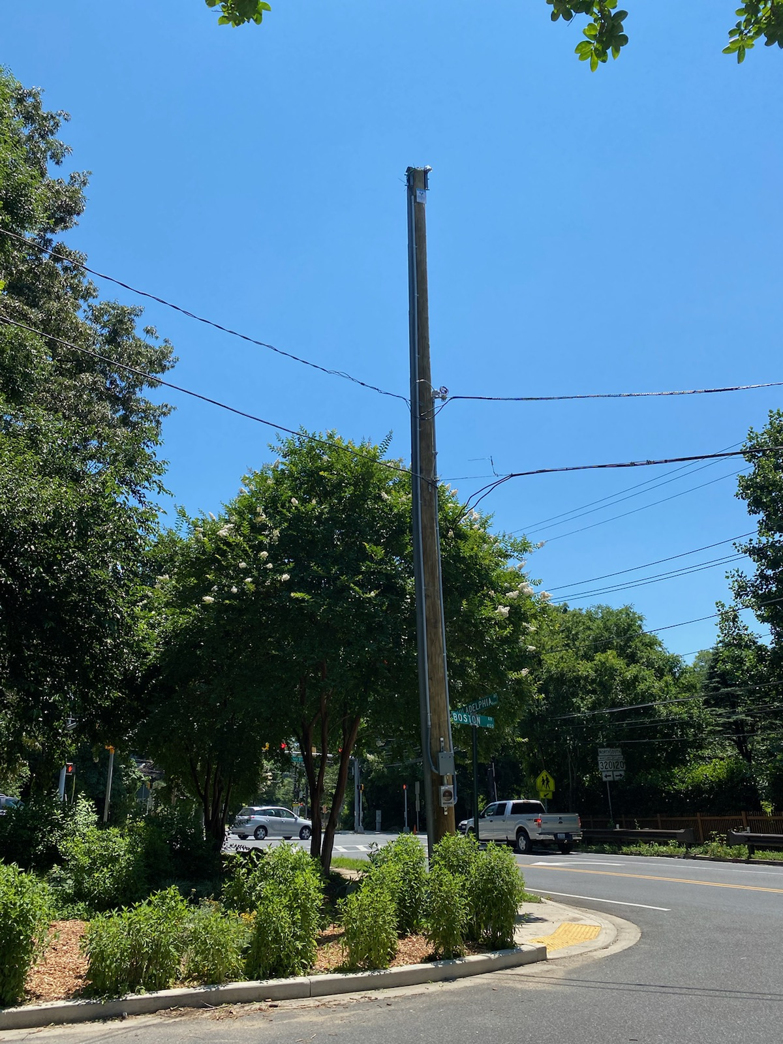
1806 – PEPCO 795419-4179
Notes:
The Verizon attachments were installed at the end of March, 2022. However, the proposal was not reviewed by the TFCG. In order to comply with the permitting process, Verizon was directed to file its proposal with the TFCG.

