Slide 1
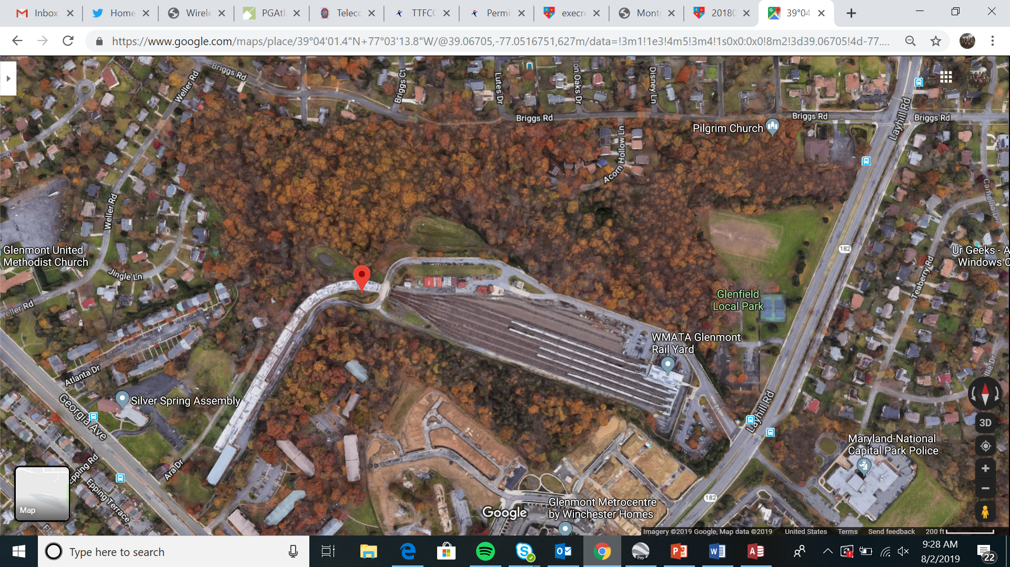
Glenmont Tower

Slide 2
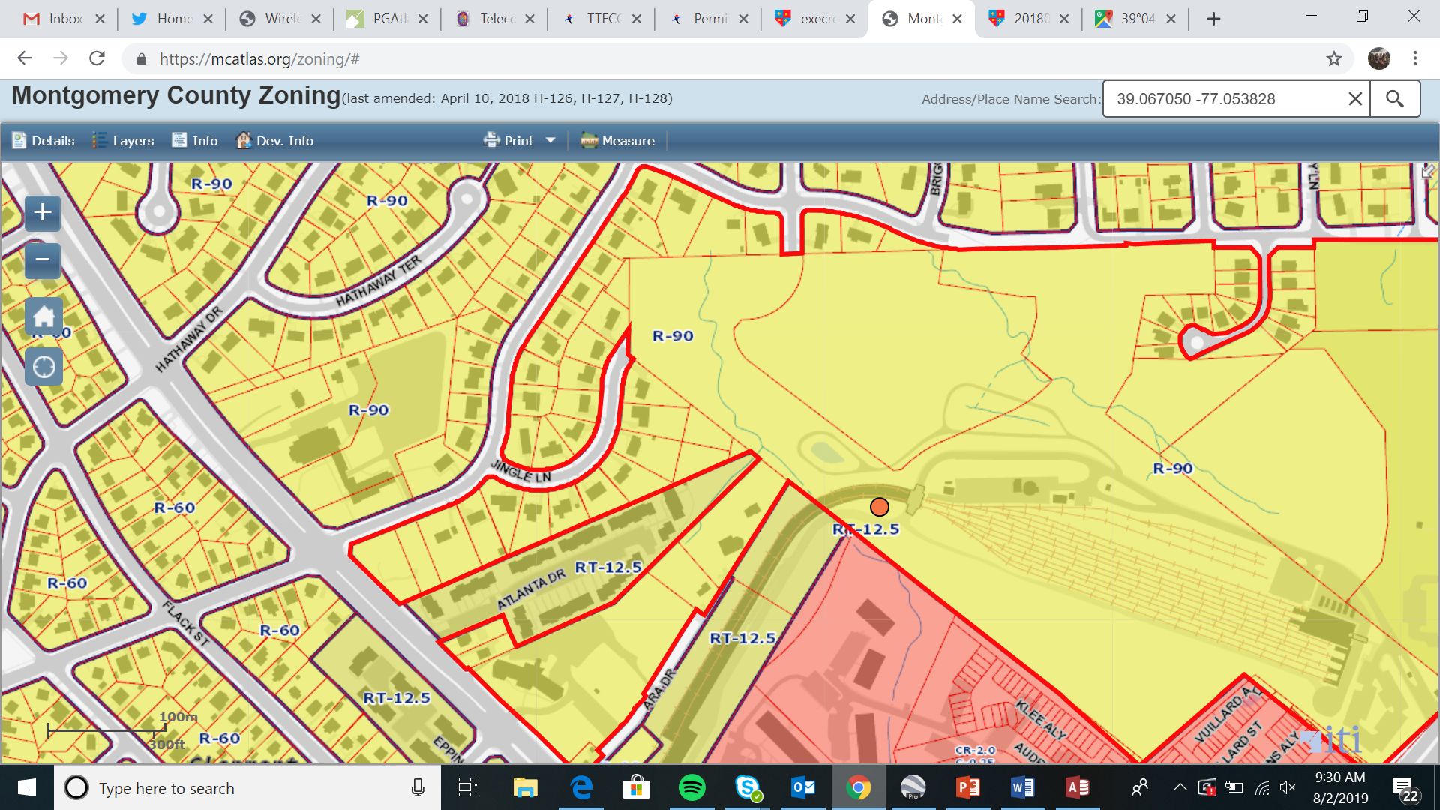
Glenmont Tower

Slide 3
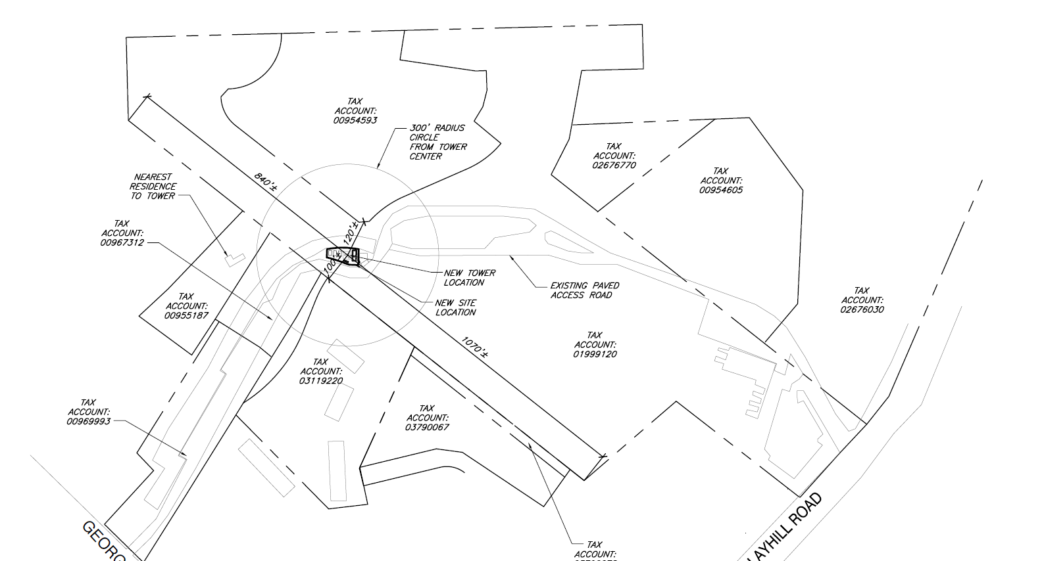
Glenmont Tower

Slide 4
Glenmont Towers

Slide 5
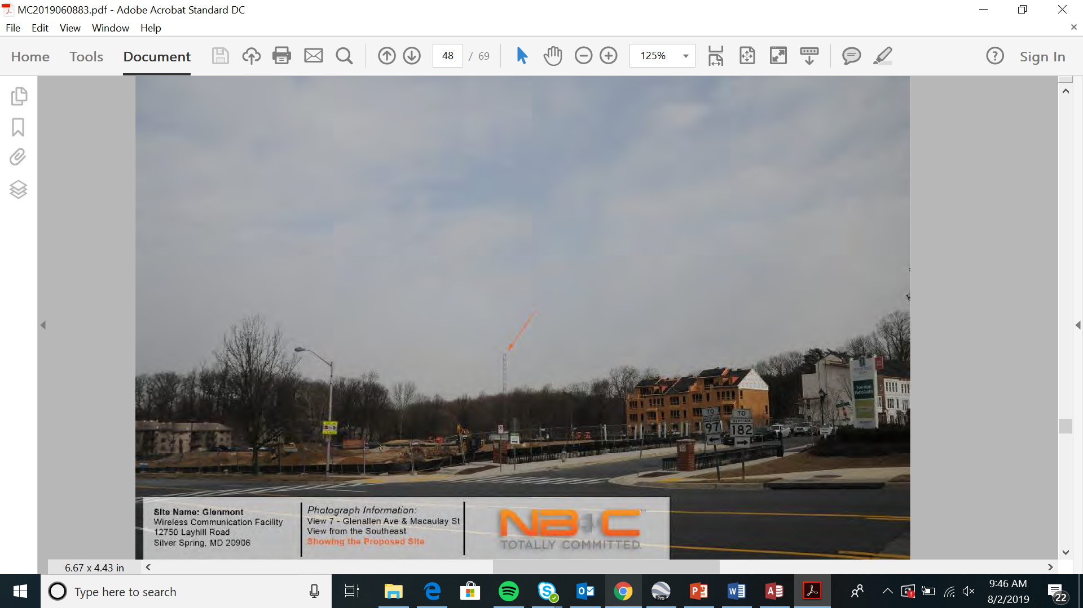
Glenmont Tower

Slide 6
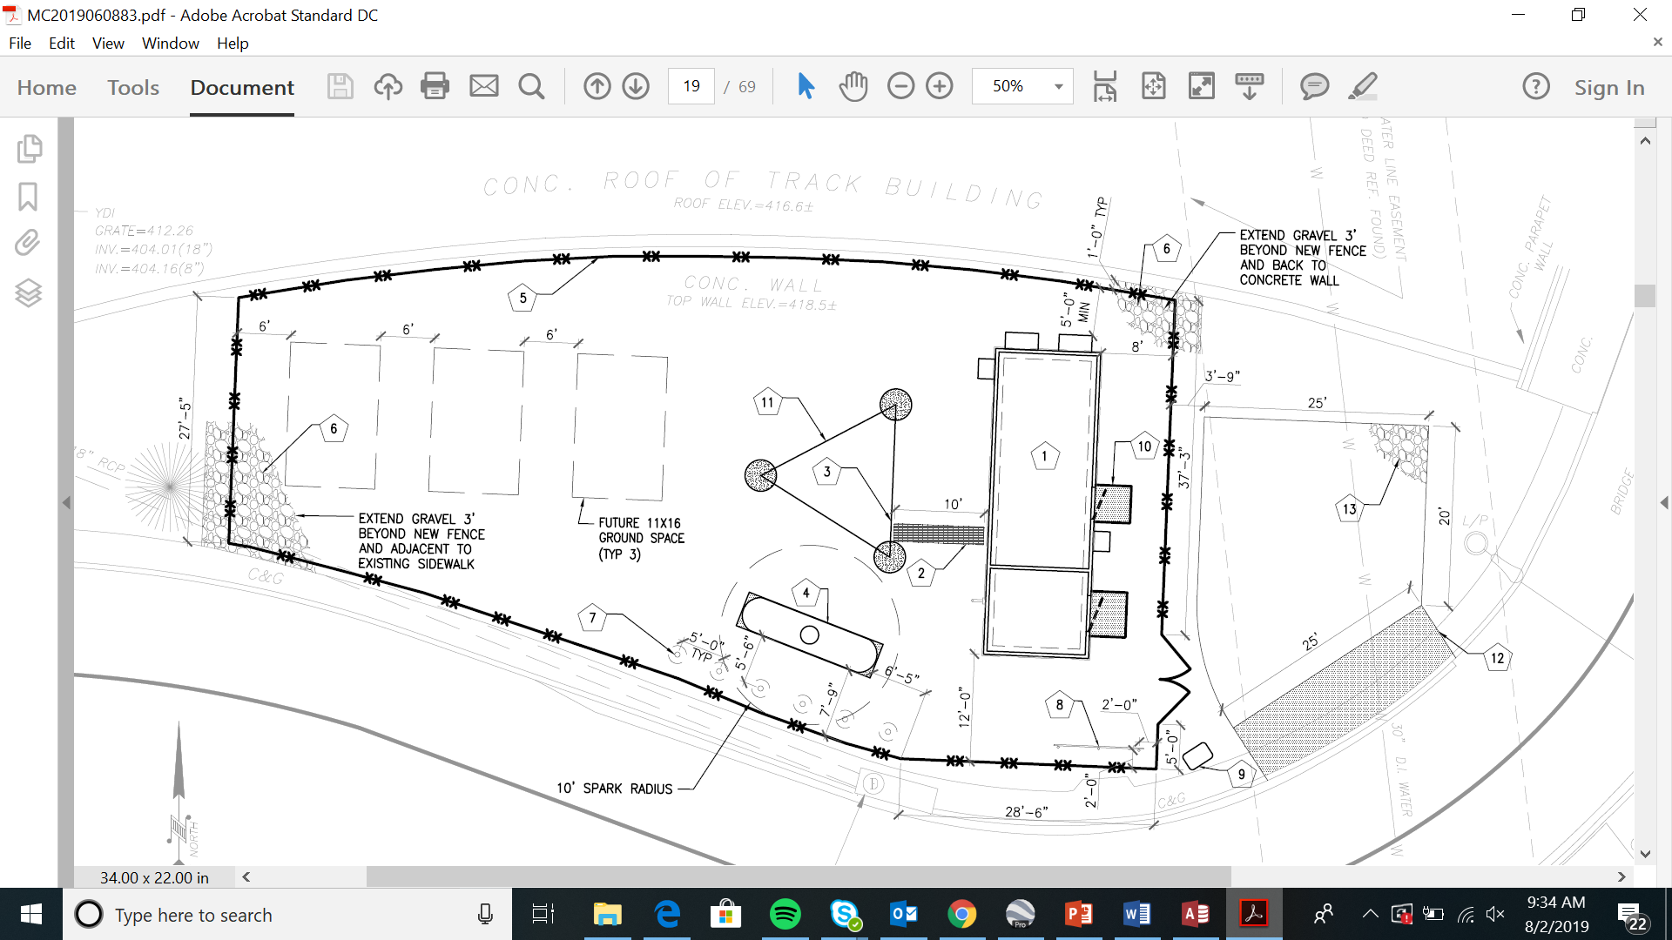
Glenmont Tower
Notes:
.

Slide 7
Glenmont Tower

Slide 8
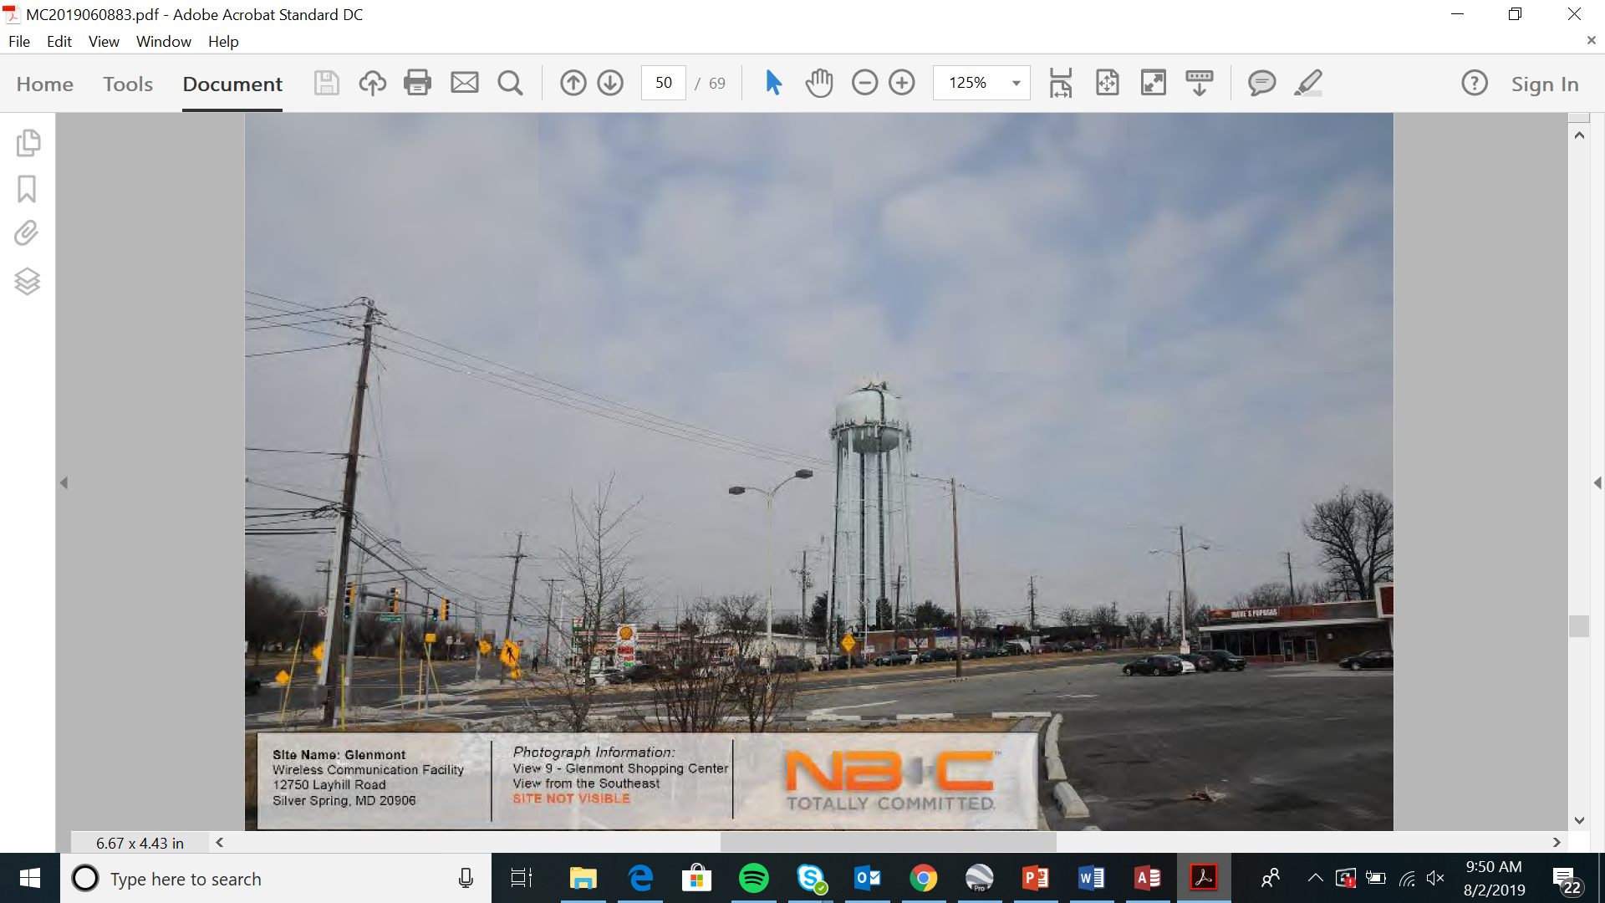
Glenmont Tower

