Slide 1
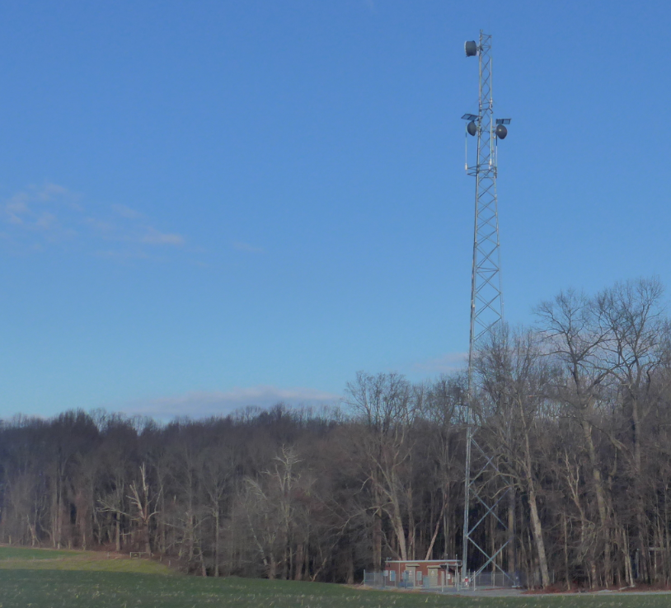
WMATA@ Brookeville Tower
Notes:
4301 Brookeville Road, Brookeville

Slide 2
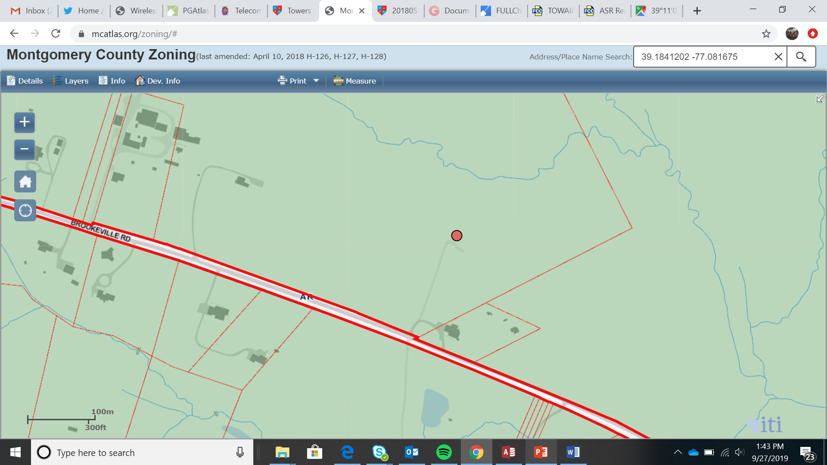
Brookeville Tower
Notes:
The 230’ self supporting lattice tower is owned by Montgomery County. The only other occupant is the Montgomery County Radio Communications Services (MCRCS). WMATA will use the tower for its public safety communications.
The tower is located on private property, zoned AR.
The tower was recommended by the TFCG in October 2019.

Slide 3
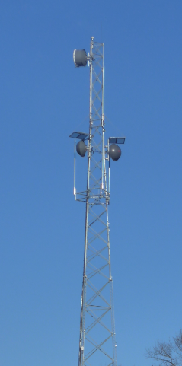
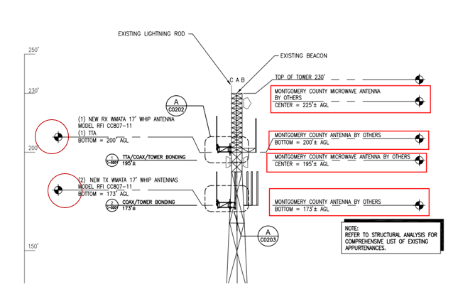
Brookeville Tower
Notes:
This partial drawing of the Tower Elevation shows the proposed WMATA attachments of (2) Omni Whip antennas at centerlines of 181.58’ and (1) Omni Whip Antenna at a centerline of 208.58’ on the left side of the drawing (circled).
The existing Montgomery County attachments are on the right.

Slide 4
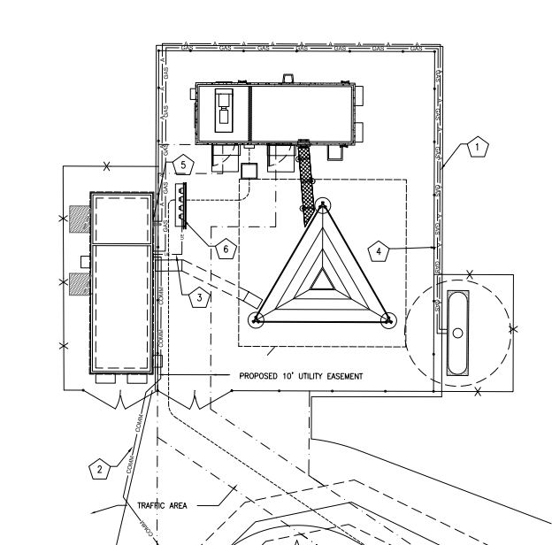
Brookeville Tower
Notes:
WMATA proposes to install a 11'-8" x 34' prefabricated shelter within a small compound expansion to the west side of the
existing compound indicated by left arrow. . A 1,000-gallon propane tank will be installed on the east side of the compound indicated by right arrow.. New fencing is proposed to enclose the compound expansions.

Slide 5
Brookeville Tower – Fence Expansion
Two Expansions on West and East Side.
Notes:
The above excerpt from the submitted plans shows the fence expansion will be consistent with the current compound at 8’ high and will also include barbed wire.

