Slide 1
MRSA
What is It?

Slide 2
MRSA
Methicillin-resistant staphaureus (MRSA)
Caused more than 94,000 life-threatening infections and nearly 19,000 deaths in 2005
Most associated with healthcare settings
Most frequent among people with weakened immune systems

Slide 3
MRSA (Methicillin-Resistant Staph Aureus)
Staph” infections have been around since the beginning of history.
“Because so many antibiotics have been used in recent years, the bacteria are now starting to become resistant, and this created MRSA
MRSA infections have been a problem in hospitals for several years
Has surfaced in community
Such infections are generally mild
Pimples or boils
Red, Painful, swollen, drain pus
Typically single not multiple
Occurs in otherwise healthy people
Staph is common on most people
Can commonly live on the skin or in their nose

Slide 4
MRSA pimples in a person with a suppressed immune system

Slide 7
MRSA

Slide 9
MRSA
Clusters among athletes, military recruits, children, prisoners
May live on surfaces contaminated with body fluids containing MRSA
Treated with antibiotic and/or having your doctor drain the infection

Slide 10
Primary Means of Transmission
Skin-to-skin contact
Crowded conditions
Poor hygiene
Sharing of Personal Items

Slide 11
Reduce the Risks of Disease Transmission through…. PREVENTION

Slide 12
The Prevention Program Includes…
Education on Infection Control
Encouraging good hygiene practices
Eat a healthy diet
Proper cleaning & disinfection of athletic equipment
Proper handling of blood and OPIM

Slide 13
By altering one component of the triangle, one or more of the other components may be changed
Environmental Surfaces & Equipment, Personnel who come to work with infections
Herpes, Ringworm HOST:
Staph Infections Recruits, EMTs, MRSA Firefighters, Officers

Slide 14
Boost the Host

Slide 15
Host (Personnel)
Healthy Habits
Diet rich in green, yellow, and orange vegetables can bolster natural immunity.
Doctor or nutritionist may recommend vitamins or mineral supplements to compensate for specific dietary deficiencies.
Drinking 8 to 10 glasses of water a day can help flush disease causing organisms from the body.

Slide 16
Causal Agent
A causal agent is biological, physical or chemical entity capable of causing disease.
Bacteria – Ex: Staph Infections (MRSA)
*Antibiotics
Virus – Ex: Herpes
*Antiviral Medication
Fungus – Ex: Ringworm
*Antifungal Medication

Slide 17
Alter the Environment
Hygiene Practices
Keep cuts & scrapes clean and covered
Do not touch other people’s cuts & bandages w/o gloves
Do not share personal items
Towels, soap, razors, tweezers, sports equipment, ball caps, linen etc.
Shower after P.T. or strenuous activities
Hand Hygiene
Wash your hands
Soap and water is best
Waterless hand sanitizer if soap & water is not available
Antimicrobial soap is not recommended
Cleaning

Slide 18
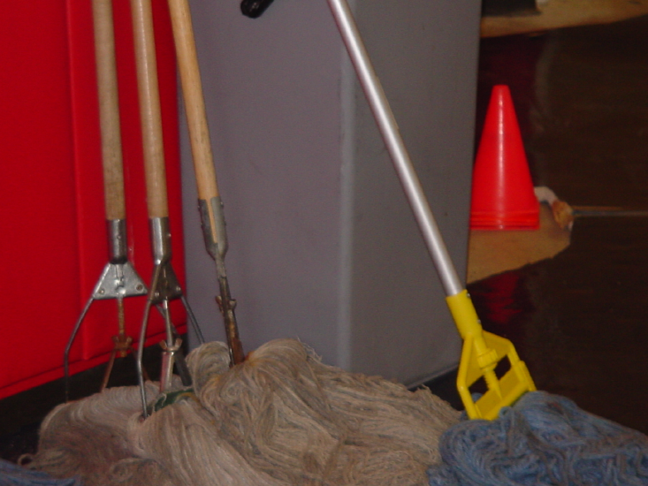
The Environment may harbor Diseases

Slide 19
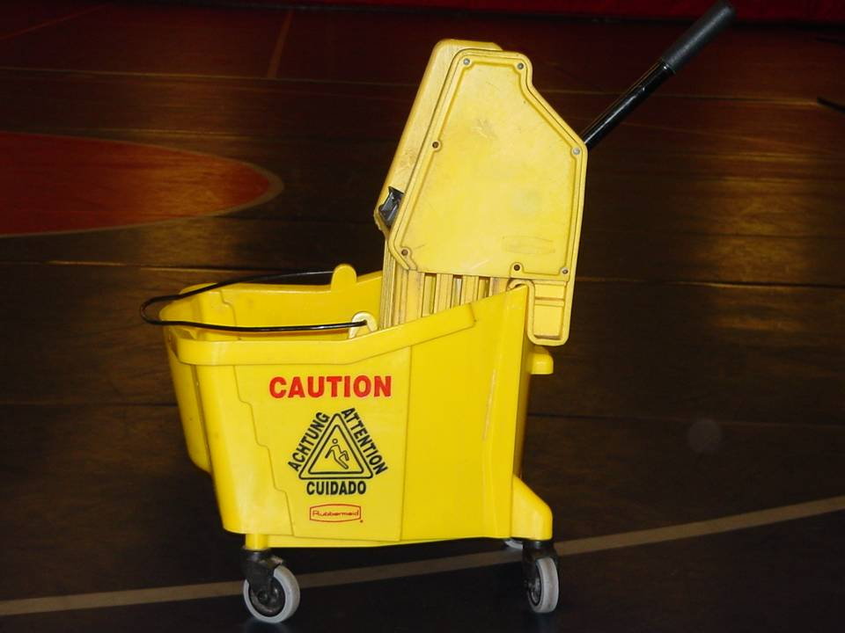

Slide 20
Follow Instructions for Chemical Use
All Chemical Germicides and Bleach Solutions (1:100)
MIX Appropriately
USE Appropriately
READ and FOLLOW LABELS

Slide 21
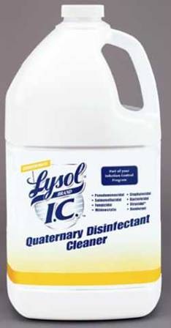
LYSOL® Brand ICTM Quaternary Disinfectant Cleaner (Concentrate)
Effective cleaner and disinfectant that kills odor-causing bacteria.
Highly concentrated, cost-effective formula dilutes at 1:256.
Virucidal, Fungicidal and Bactericidal*.
Effective against HIV-1, VRE, MRSA and other gram-positive as well as gram-negative microorganisms.
Neutral pH in use.
EPA Registration No. 47371-129-675
* In the presence of 5% organic matter

Slide 22
Prevention
Wash your hands
Healthy eating habits
Keep cuts & scrapes clean and covered
Do not touch other people’s cuts & bandages w/o gloves
Do not share personal items
Towels, soap, razors, tweezers, sports equipment, ball caps, linen etc.
Shower after P.T. or strenuous activities
Clean surfaces with a disinfectant that will kill Staph such as Cidex II, DisCide Ultra or a 1:100 bleach solution (mixed every 24 hrs)
Don’t forget to decon mop heads and buckets

Slide 23
What to Do if You Have a Boil
If you get a boil have it evaluated by your PCP
The only way to tell is for a doctor or nurse to collect some of the drainage (pus) and send it to the lab for “culture”. The lab grows the bacteria on a culture plate so that they can be identified. This process usually takes 2 to 4 days. The lab can also test to see which antibiotics will work best to treat the infection.
If you are diagnosed with MRSA contact the designated infection control officer
Work Restrictions may be implemented for an active abscess.

