Slide 1
Administration of Intramuscular (IM) Epinephrine for the EMT
New 7/1/2015 MCFRS

Slide 2
Objectives
The providers will summarize the need for this change from an epinephrine auto injector
The provider will define the proper dosage of epinephrine for the adult and pediatric patient for the following medical situations.
Asthma
Allergic Reaction
Anaphylaxis
Drawing up the medication
The student will be able to carry out the administering of the medication

Slide 3
Objectives (con’t)
The student will be able to summarize the protocols for the following medical situations that will require the administration of IM epinephrine:
Asthma
Allergic Reaction
Anaphylaxis

Slide 4
Epinephrine/Adrenalin
Reference: Maryland Medical Protocol 2015
Pharmacology
The administration of epinephrine causes increases in:
Systemic vascular resistance
Systemic arterial pressure
Heart rate
Increase contractility
Increases myocardial oxygen requirement
Cardiac automaticity
AV conduction
Causes bronchial dilation by smooth muscle relaxation

Slide 5
Epinephrine/Adrenalin (con’t)
Reference: Maryland Medical Protocol 2015
Indications
Moderate to severe allergic reaction with respiratory distress or mild allergic reaction with history of life-threatening allergic reaction
Pediatric patients with severe asthma
Contraindications
None in the presence of anaphylaxis
Used with caution for pregnant patients

Slide 6
Epinephrine/Adrenalin (con’t)
Reference: Maryland Medical Protocol 2015
Adverse Effects
Tachycardia/Palpitations
Angina
Headache
Nausea/vomiting
Dizziness
Hypertension
Nervousness/anxiety
Tremors
Dosage
Adult (Over age 3) 0.3 mg IM
Pediatric (under age 3) 0.15 mg IM

Slide 7
Maryland Medical Protocols

Slide 8
Protocol Review – Allergic Reaction
Types/levels of Reaction
Mild: Local swelling & itching at the site
Moderate: Hives & mild wheezing
Severe: Diffuse wheezing, pharyngeal swelling, dyspnea, hypoperfusion, abnormal skin color, stridor, and/or loss of peripheral pulses

Slide 9
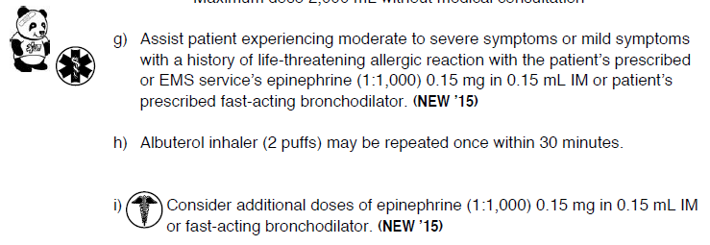
Protocol Review – Allergic Reaction

Slide 10
Protocol Review – Asthma/COPD
Presentation:
Patient may exhibit any of the following: wheezing and/or crackles, abnormal respiratory rate, rapid heart rate, stridor, grunting, cyanosis, mottled skin, altered mental status, nasal flaring, retractions, accessory muscle use, dyspnea, diminished or absent breath sounds, and/or tripod positioning.
3. Treatment
CONSIDER MEDICAL CONSULTATION FOR PATIENTS GREATER THAN 45 YEARS OF AGE OR PATIENTS WITH A CARDIAC ISTORY.

Slide 11
Protocol Review – Asthma/COPD
Protocol Review – Asthma/COPD
Assist the patient experiencing moderate to severe or mild symptoms with a history of life-threatening allergic reaction with the patient’s prescribed or EMS epinephrine auto-injector or patient’s prescribed fast-acting bronchodilator
Use of the EMS services Epinephrine auto-injector/IM injection requires medical consultation
Albuterol inhaler (2 puffs) may be repeated once within 30 minutes
Consider additional doses of patients prescribed fast acting bronchodilator or Epinephrine auto-injector/IM injection

Slide 12
Protocol Review – Asthma/COPD
Protocol Review – Asthma/COPD
(n) Assist the patient experiencing moderate to severe or mild symptoms with a history of life-threatening allergic reaction with the patient’s prescribed or EMS epinephrine auto-injector/IM injection or patient’s prescribed fast-acting bronchodilator
MEDICAL CONSULTATION IS REQUIRED IF TH EPATIENT HAS
CONGENITAL HEART OR CHRONIC LUNG DISEASE
(o) Fast-acting bronchodilators (2 puffs) may be repeated once within 30 minutes
(p) Consider additional doses of patients fast-acting bronchodilator or epinephrine auto-injector/IM injection

Slide 13
Protocol Review – Asthma/COPD
Protocol Review – Overdose/Poisoning: Injection

Slide 14
Dosage of Epinephrine
The same dosage as currently administered from an auto injector
Adult Dosage:
0.3 mg
any patient 3 years of age or older
Pediatric Dosage
0.15 mg
less than 3 years of age

Slide 15
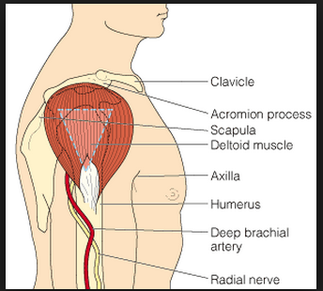
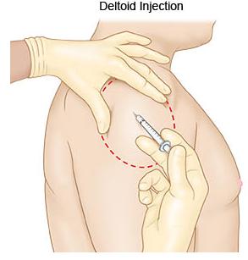
Where do I give the Intramuscular Injection
Deltoid Muscle (Upper arm muscle):
Completely expose the upper arm. You will give the injection in the center of an upside down triangle. Feel for the bone that goes across the top of the upper arm (acromion process). The bottom of it will form the base of the triangle. The point of the triangle is directly below the middle of the base at about the level of the armpit. The correct area to give an injection is in the center of the triangle, 1 to 2 inches below the acromion process. This site should not be used if the person is very thin or the muscle is very small.

Slide 16
Where do I give the Intramuscular Injection
Alternate location:
Lateral middle aspect of the thigh (same as auto injector)

Slide 17
Parts of a Syringe
Cover
There are 3 parts to a syringe:
SafetyGlide: Safety shield to cover
The contaminated needle.
Needle: The needle goes into the muscle. 25 ga. 1” (2 per kit)
Barrel: The barrel holds the medicine and has markings on it like a ruler. The markings are in milliliters (mL).
Plunger: The plunger is used to get medicine into and out of the syringe.
Needle
SafetyGlide
Barrell
Plunger

Slide 18
How do I draw up the Epinephrine
Identify the medical need for the IM Injection
Select the Epi 1:1.000 ampule
Verify the expiration date is still valid
Check and verify the medication order at least 4 times before administering:
1. When removing from drug kit
2. When preparing the medication for administration
3. Just before administering the medication to the patient
4. Immediately following the injection

Slide 19
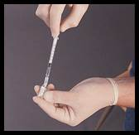
Ampule
Tap down any medication from the top of the ampule (figure 1)
With a gauze pad, snap off the ampule top at the scored neck (figure 2 & 3)
Invert ampule and insert 1 cc syringe into ampule
Draw up the desired dose from the ampule
(figure 4)
Cap remove and then dispose of the needle from the syringe
Open the new needle from the packaging and push onto syringe. Do not remove cap over the needle
figure 1
figure 2
figure 3
figure 4

Slide 20
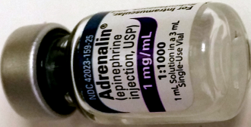
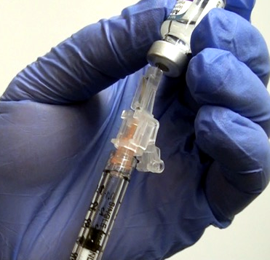
Single-Use Vial
Snap off the top of the single-use vial (figure 2 & 3)
Invert Single-Use Vial and insert 1 cc syringe into vial
Pull back on the plunger and draw up the desired dose from the vial (figure 2)
Pull the syringe out of the vial and secure the SafetyGlide cap, twist needle off of syringe in a counter clockwise twist and then dispose of the needle from the syringe in a sharps container
Open the new needle from the packaging and twist clockwise onto the syringe. Do not remove cap over the needle yet
figure 1
figure 2

Slide 21
How Do I Give An Intramuscular Injection?
Prepare the Site: Open the alcohol wipe: Wipe the area where you plan to give the injection in a circular motion. Let the area dry. Do not touch this area until you give the injection.
Prepare the needle: Hold the syringe with your writing hand and pull the cover off with your other hand. Place the syringe between your thumb and first finger. Let the barrel of the syringe rest on your second finger.
Hold the skin around where you will give the injection: With your free hand, gently press on and pull the skin so that it is slightly tight.
Insert the needle into the muscle: Hold the syringe barrel tightly and use your wrist to inject the needle through the skin and into the muscle at a 90 degree angle.

Slide 22
How to, continued
Check the needle: Let go of the skin with your other hand. Hold the syringe so it stays pointed straight in.
Inject the medicine: Push down on the plunger to inject the medicine. Do not force the medicine by pushing hard. Some medicines hurt. You can inject the medicine slowly to reduce the pain.
Remove the needle: Once the medicine is injected, remove the needle at the same angle as it went in. Slide the SafetyGlide forward to cover the needle. Dispose in sharps container.
Place gauze over the area where you gave the injection.

Slide 23
How to, continued
Place a sterile gauze over site and apply slight pressure.
Bandage site
Document the time, dosage and location of the medication administration
Re-assess the patients response to the medication:
Improvement:
Decreased effort to breath
Decreased swelling in airway
No Change or s/s worsening
Consult for additional dose of IM epinephrine

Slide 24
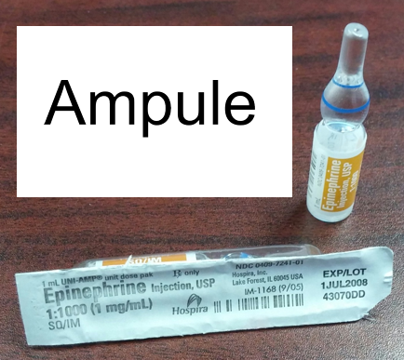
Restocking
When restocking at the hospital do not accept multi-dose vials. The vial must be 1mg Epinephrine in 1ML. If the hospital does not have the 1.omg/1 cc ampule or vial restock from your station.
Restock the following items:
One 1.0 mg/1 cc ampule/vial of epinephrine
One 1cc syringe Luer-Lok tip
Two 25ga. 1” safety needles
Two alcohol preps
Two 2x2 gauze pads

Slide 25
Review
Why was this change made from auto injectors to syringes?
Maryland Medical protocols
What are the landmarks for the primary and secondary injection sites
What do you need to administer IM epinephrine
What do you need to restock, and what don’t you take if offered?

Slide 26
For questions please contact the on-duty EMS officer.

