Slide 1
Community Solutions Program Fellowship Presentation
Community Engagement: By Bonventure Chengeck

Slide 2
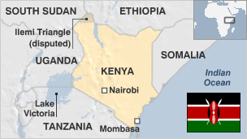
The Region

Slide 3
About Act! *A National NGO registered in 2001, initially as Pact Kenya *Rebranded in 2011 as Act! (Act Change Transform) *Capacity Building and Grant Making Organization
Democracy and Human Rights
Environment
and NRM
Peace Building and Conflict Transformation
Key Platforms

Slide 4
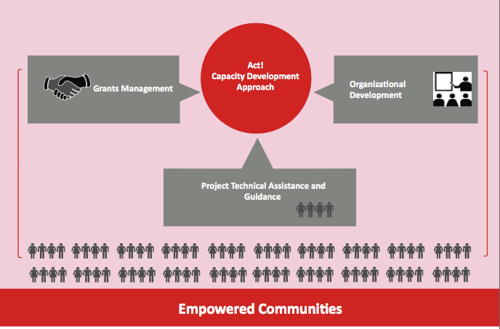
What we do

Slide 5
Our Approach to Grants Management
Both competitive and targeted solicitation
Open and transparent selection process; final approval given by donor prior to issuing award
Each CSO/partner receiving award assigned 3 dedicated officers (technical/thematic area; grants; capacity development)
Regular (every fortnight) monitoring of operating environment and advising partners on context and need to change approach (if needed)
Conflict analysis informs our conflict management programs; context analysis and strategic assessments
Quarterly reporting by partners; fully functional M&E Unit supports reporting
Notes:
Competitive through issuing RFA/Calls for proposals; where there is need for speciliased approach, ACT will engage agency with expertise in the area directly. ACT also pre-qualifies organizations to carry out rapid response

Slide 6
Conflicts in Kenya
Political conflicts
Usually occur around elections time – means to displace populations from an area to prevent them from voting
Associated with devolution (control of counties)
Resource based conflicts
Access to and control over land most common cause of resource conflicts; also closely related to political conflicts
Also take form of communities raiding cattle from each other especially in ASAL area
Notes:
Political conflicts have been witnessed in Kenya since advent of multi-party politics; most recent was the massacres of Pokomos in Tana River County in August - September 2012. Previous incidences were reported in 1992, 1997 and 2007
Land has been used as scapegoat by the political class to incite communities against each other (under the pretext that people who have traditionally not inhabited a particular area have marginalised the traditional inhabitants of an area by acquiring land therein; land was cited as being the cause of conflict witnessed in 2007 and in 2014 (Lamu and Tana River)

Slide 7
Conflicts in Kenya
Resource based conflicts have recently taken dimension of administrative and electoral boundaries dispute
Extractives: Discovery of oil and mineral resources likely to exacerbate resource based conflicts as populations rush to mineral rich areas (and local populations may feel threatened by presence of “foreigners”). Also associated with mushrooming border/boundary disputes/conflicts
Violent Extremism
Notes:
Boundaries determine what resources are available in a particular area; there have been contestations over electoral and administrative boundaries – and these at times lead to other types of conflicts

Slide 8
Office of Community Partnerships
Strengthen relationships between the Montgomery County government and the residents it serves
Special focus on underserved and emerging communities and the neighbors in need
The OCP serves as a bridge builder between the County government and community organizations serving the residents of Montgomery County
Works across the barriers of race, ethnicity, income, and religion that too often diminish communities
Carry out the County Executive's commitment to build a larger policy table with participation by a more diverse range and greater number of residents to become America’s most welcoming community.

Slide 9
Engagements with OCP: Gilchrist Center
Providing information & referral to other services available in the county
Registration and enrollment of students for the various classes
Recruitment of volunteers
Preparation for the classes and assist in actual teaching of the computer classes
Attending weekly planning and staff meetings

Slide 10
African Affairs Advisory Group
Working as a Liaison between the African Communities and the County government
Advising the County on the needs and concerns of African immigrants
Reaching out to the African immigrant community in the County
Linking the African community to the opportunities and agencies in the County
Participated in organizing and coordinating African events and activities
Strengthening Sister City ties and initiatives

Slide 11
Pan-African Festival

Slide 12
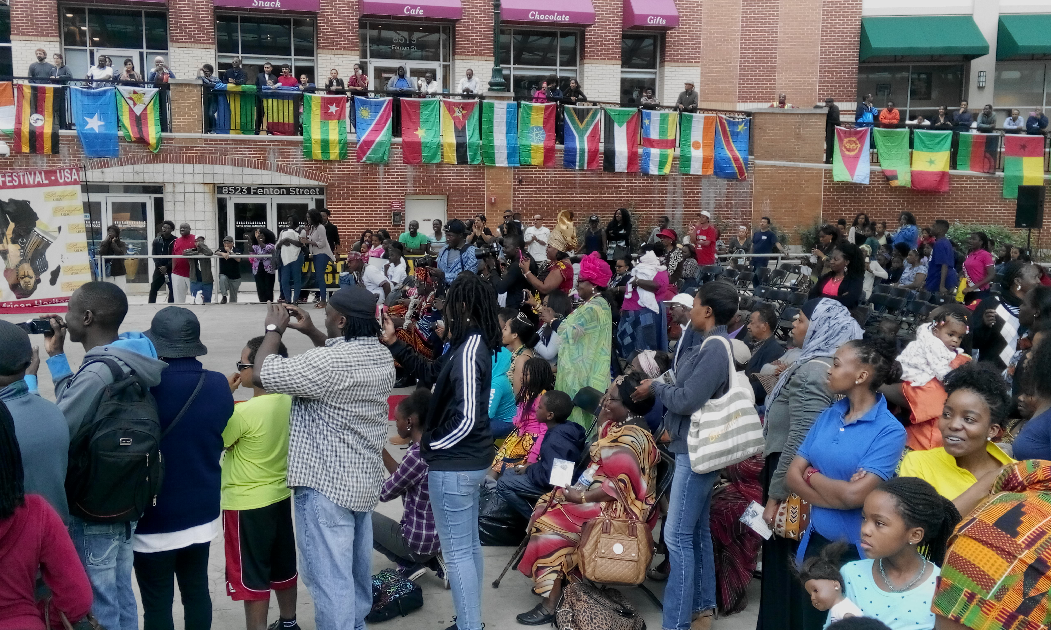
African Month Events

Slide 13
OCP events

Slide 14
Recommendations
Engaging the LGBTQ community constructively
Reaching out to the wider African community groups
Expanding the programs to reach more community members especially the Immigrant integration services through the Gilchrest centers
Use of back up teacher especially for the basic computer
Enhance civic engagement for immigrants
Recruit staff for administrative support (Website, Newsletter, e-communique, managing contact lists, coordination of events etc)

Slide 15
Community Leadership Institute Outcomes
Leadership theories: Studied various reading and learning materials on contemporary leadership theories and models for social change
Leadership practices: Learned decision making processes, conflict skills, group processes and team building processes
Group Practices: Learned how to support and improve others leadership practice, constructive discussions in small groups
Individual reflection & Goal Setting: Assessed our growth as leaders, developed our vision and goals

Slide 16
Follow on Project: Countering Violent Extremism through Cooperation and Evidence (CVECE)
Goal: Reduced violent extremism through improved stakeholder collaboration and evidenced based communication strategies

Slide 17
Radicalization & Recruitment of Vulnerable Youths

Slide 18
Countering Radicalisation and Violent Extremism
Extremism and radicalization in Kenya has been attributed to the following
Real and perceived marginalization of certain sections of the society
Heavy handedness and militarized approach in responding to grievances by marginalized groups
Proximity to areas where there is proliferation of violent extremists groups (Al-Shabaab in Somalia and MRC in Coast)
Misinterpretation of religious texts/concepts by clerics – and this serves to incite/radicalize the youth
Corruption
Notes:
Research conducted by ISS indicates that wholesome condemnation of Somali community as terrorists/sympathizers of terrorists has created resentment towards authorities and pushed the youth to join violent extremist groups

Slide 19
Trust & cooperation
Objective 1: Supporting reforms in the policing/security sector to improve trust and cooperation between communities and security agencies in CVE

Slide 20
Cost of Violent Extremism
Objective 2: Research and provide information on the cost of extremism to the local economies. Policy makers and communities are believed to understand hard data and research in general.

Slide 21
Militarized Security Responses

