Slide 1


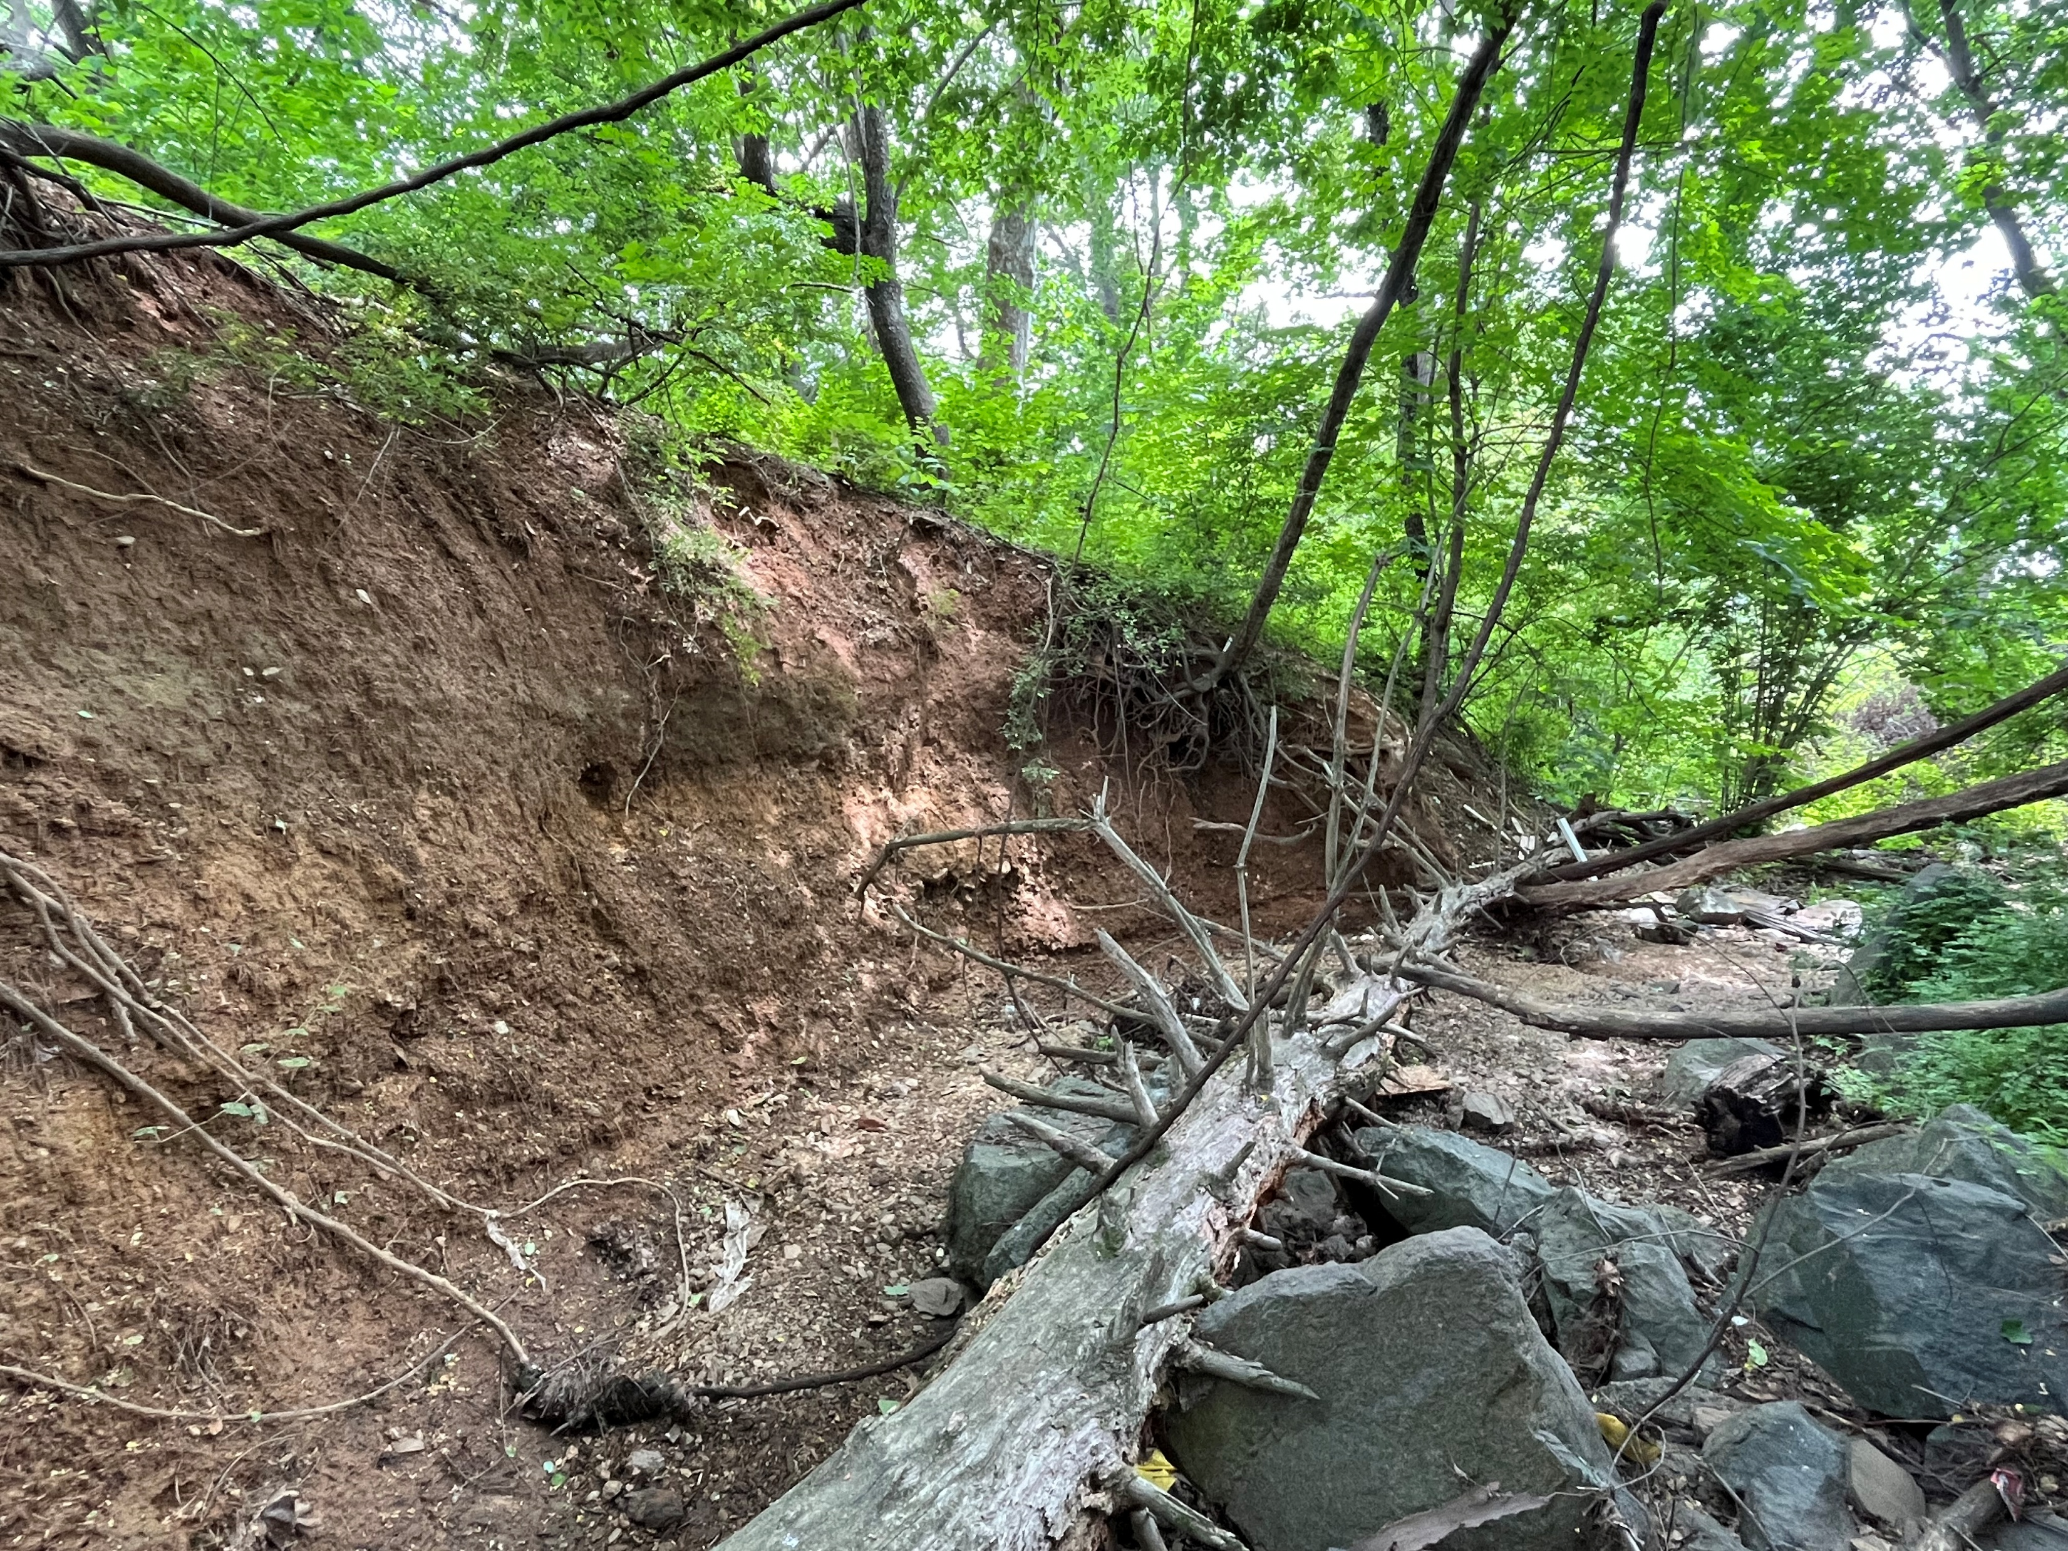
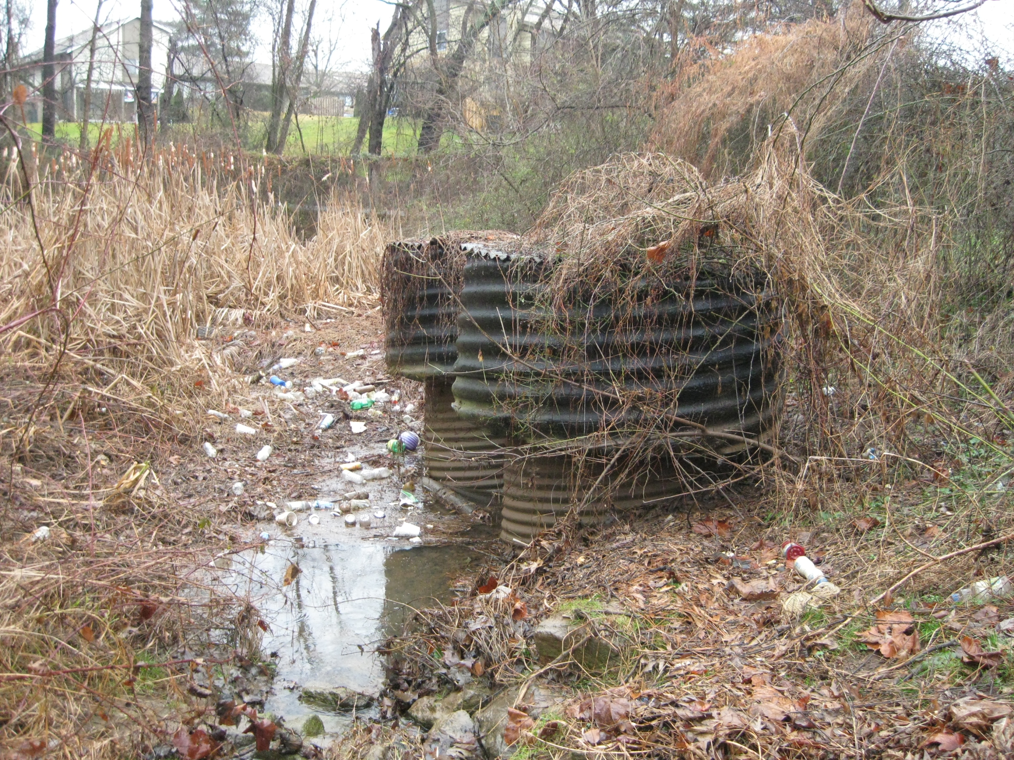

Germantown Park – Stream and Pond Restoration
HOA Community Meeting
January 20, 2026

Slide 2
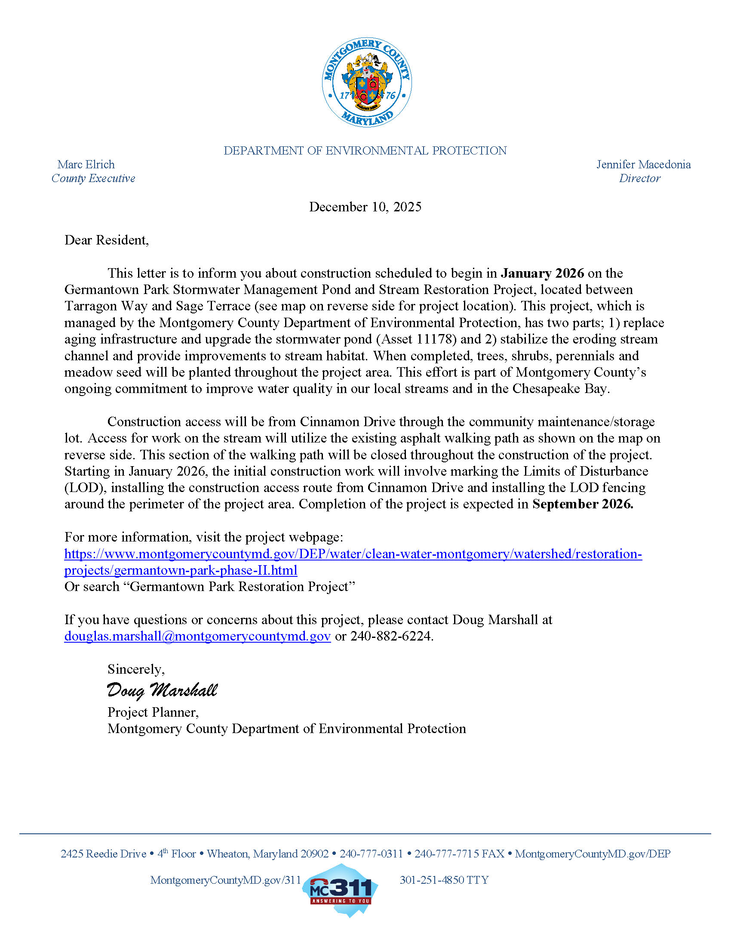
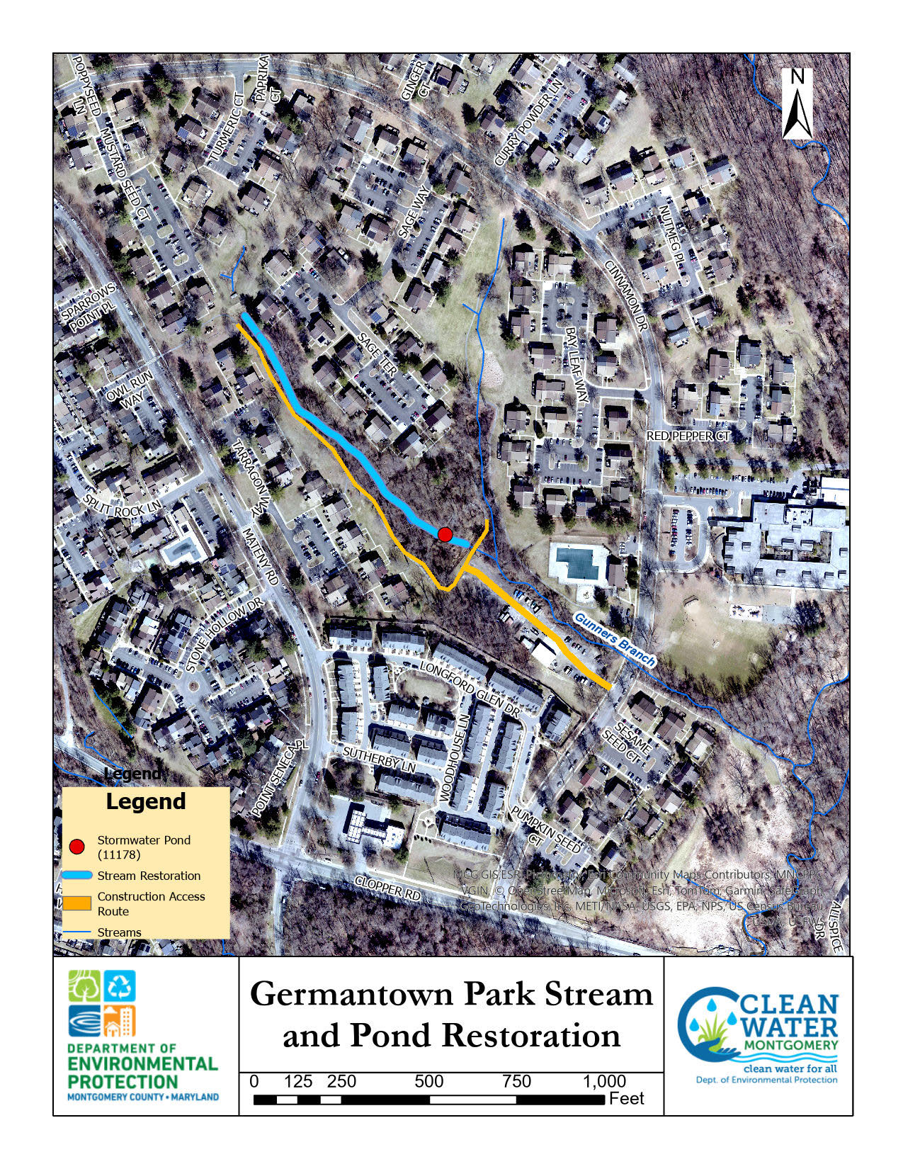
Construction Notification Letter - Went Out in December 2025

Slide 3
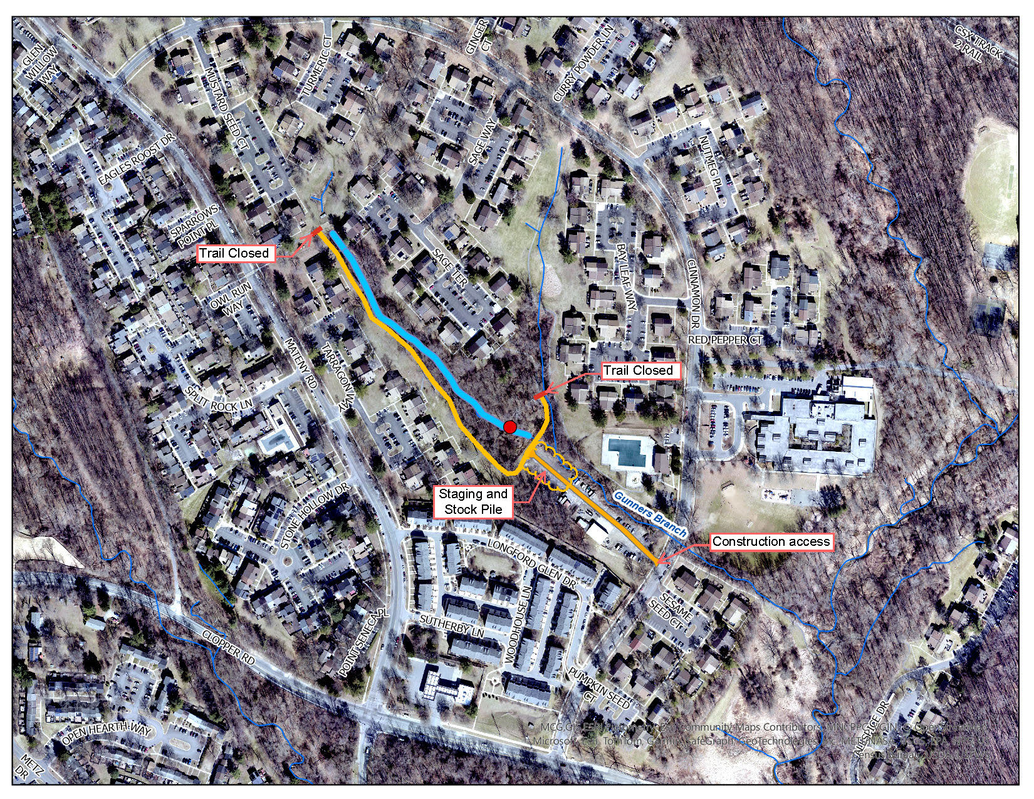
Project
Overview

Slide 4
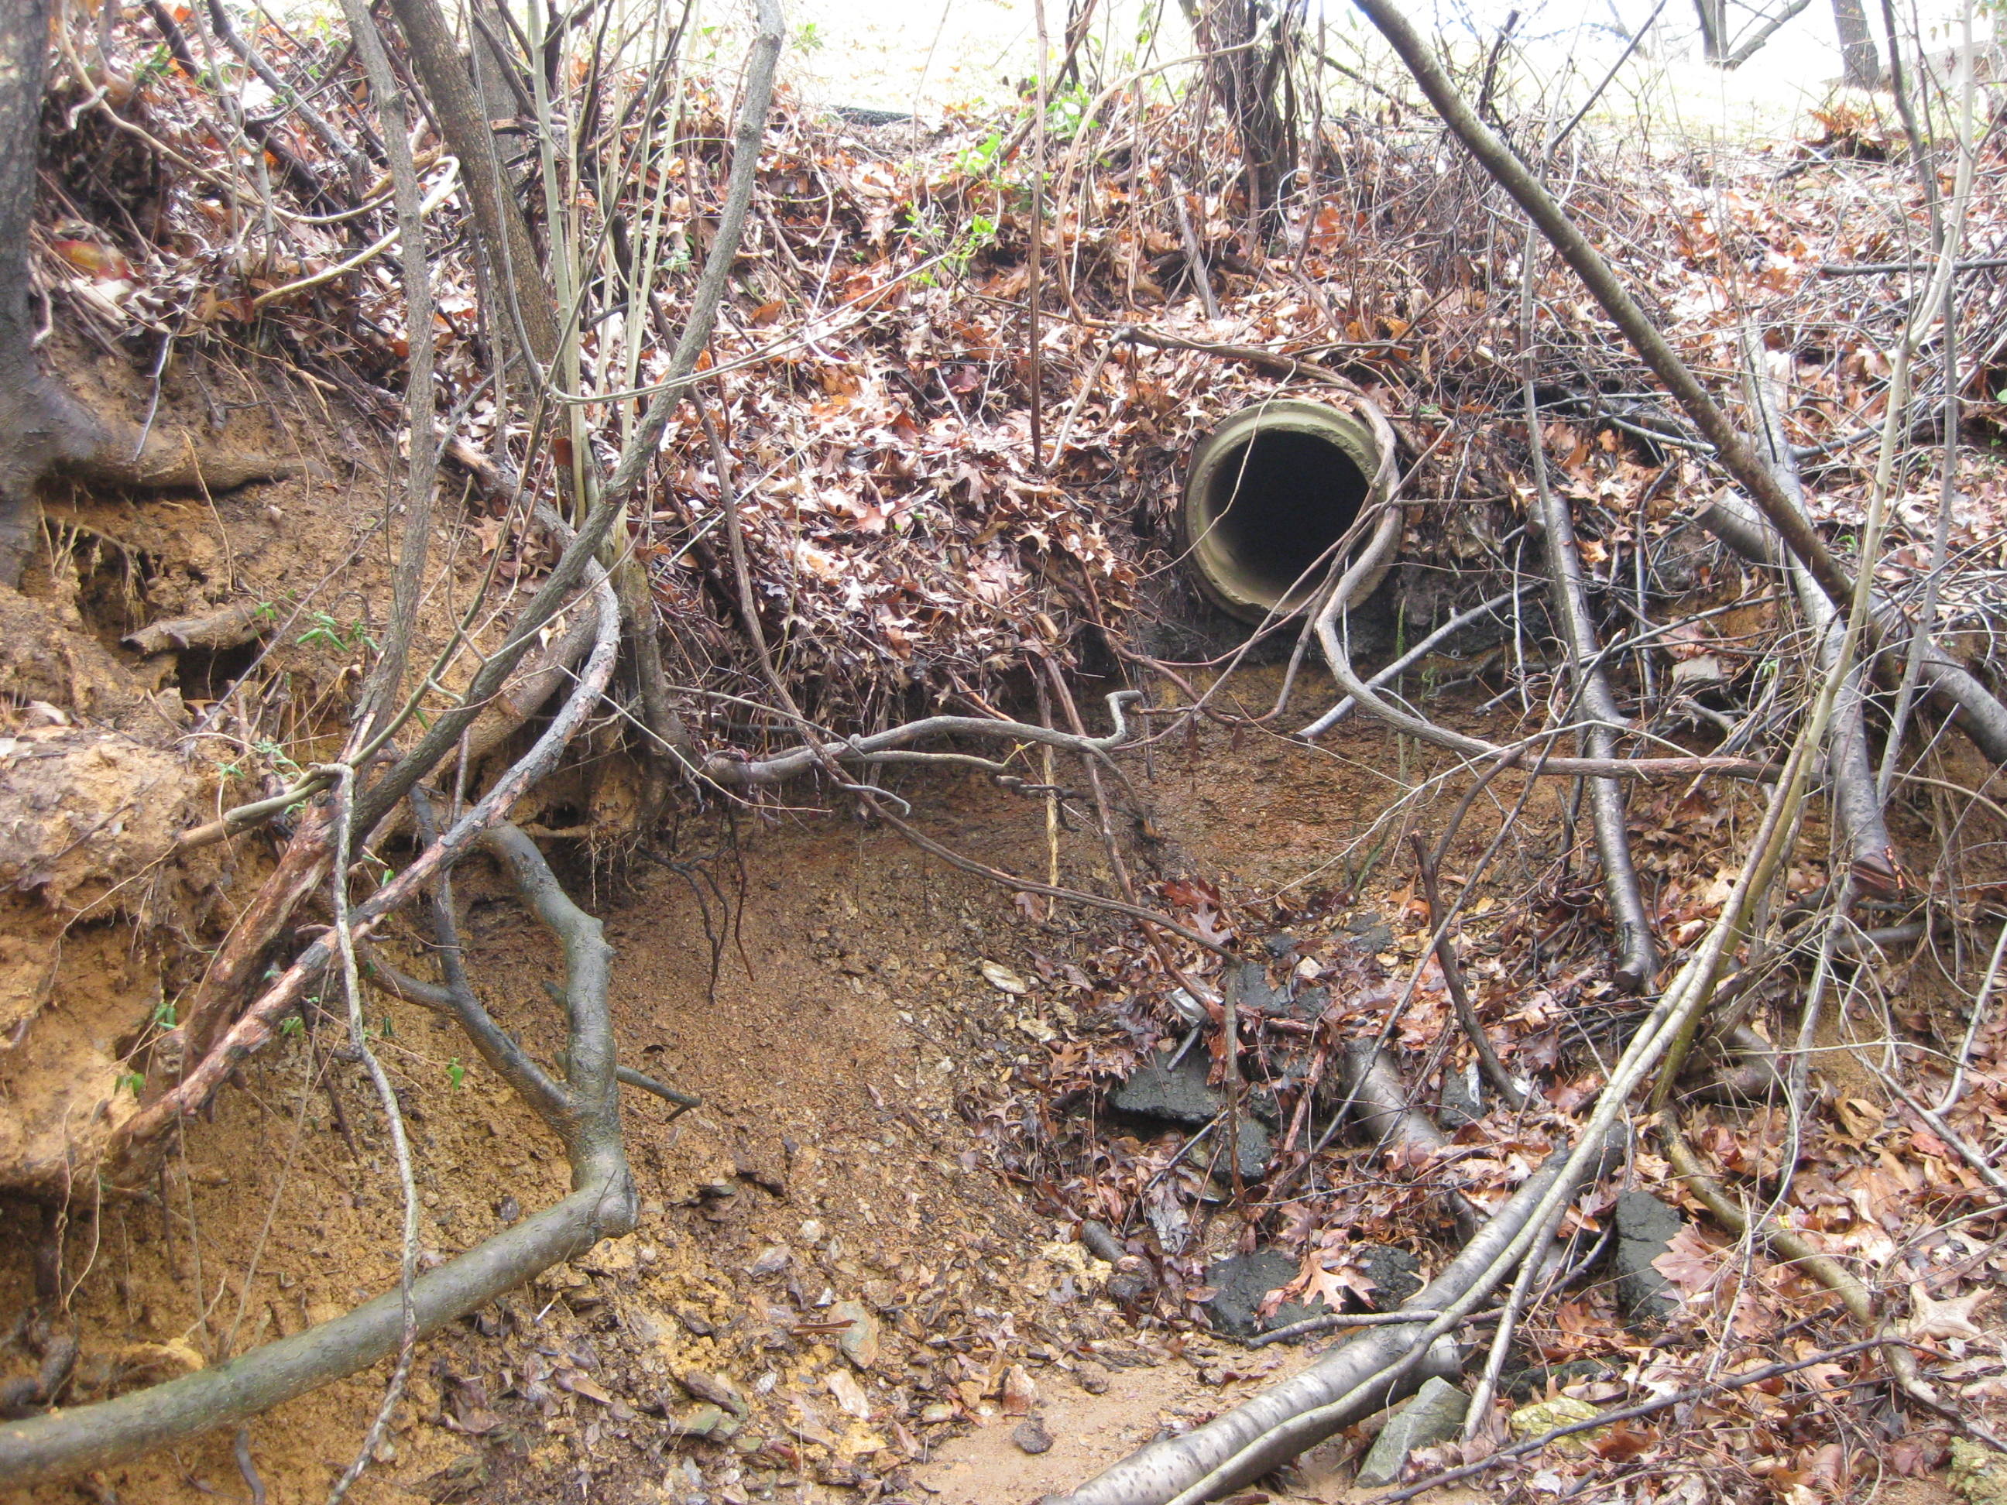
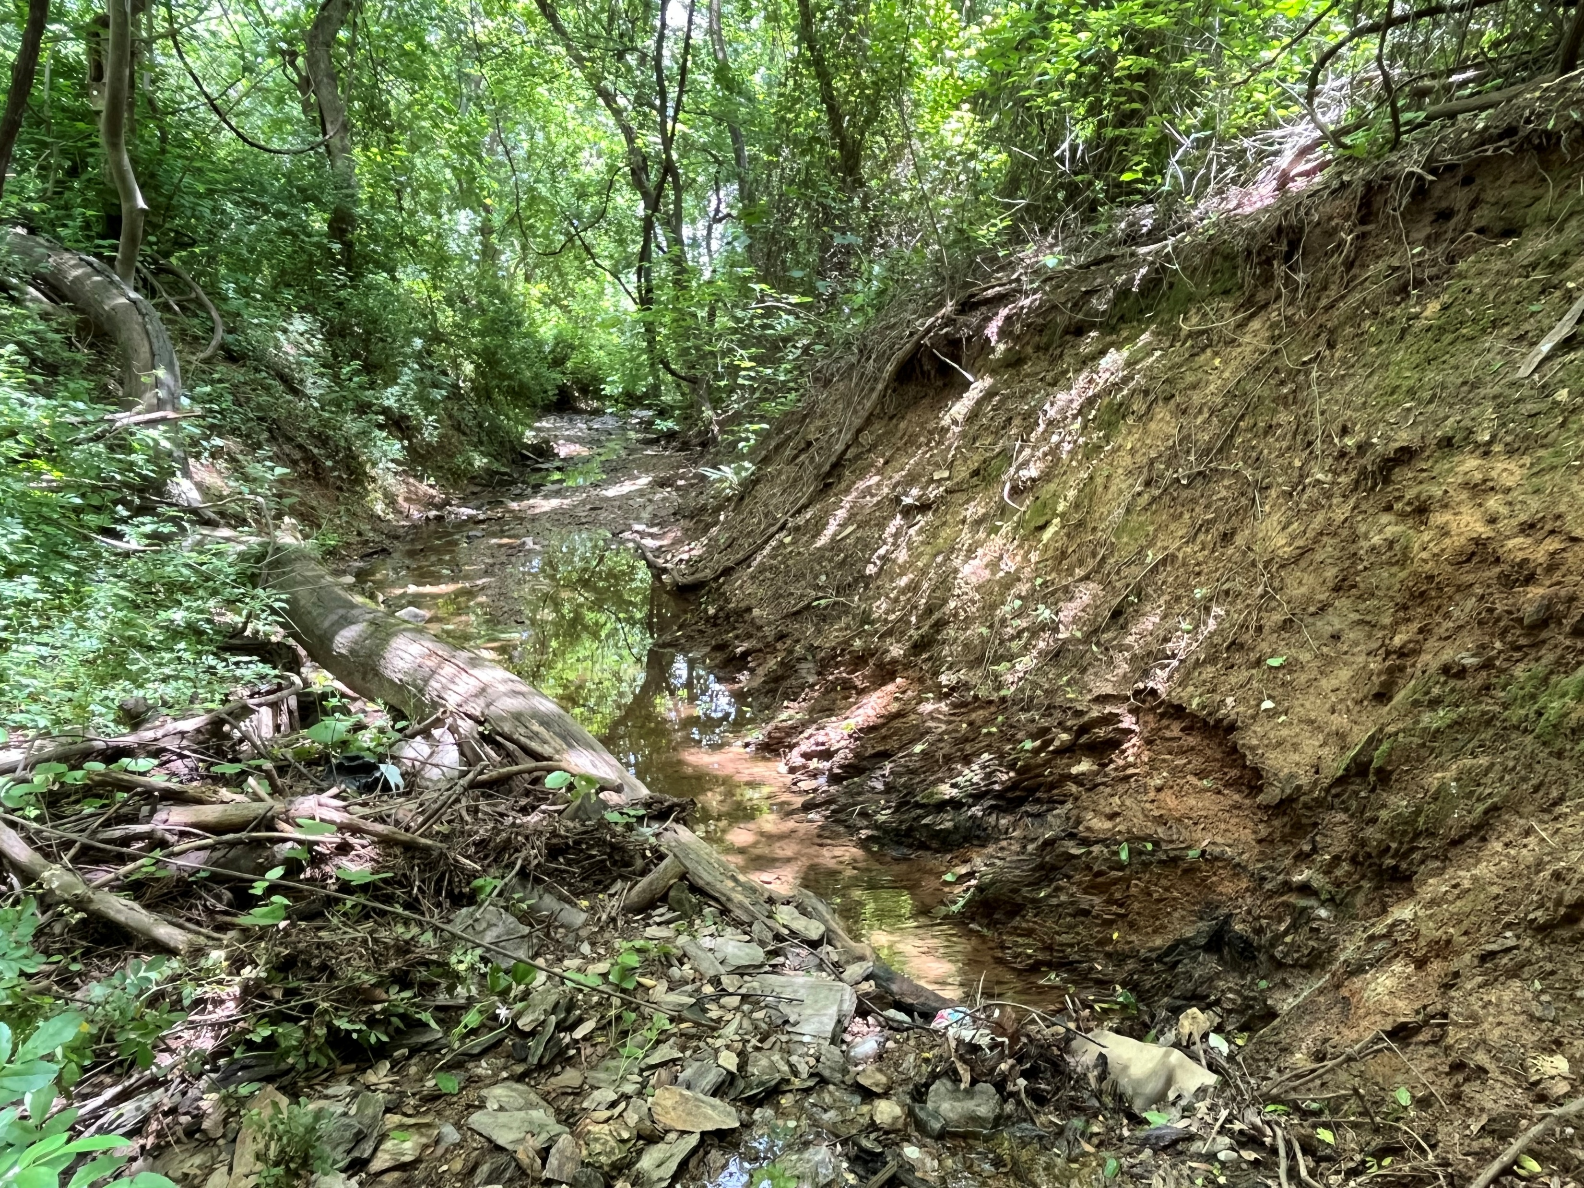
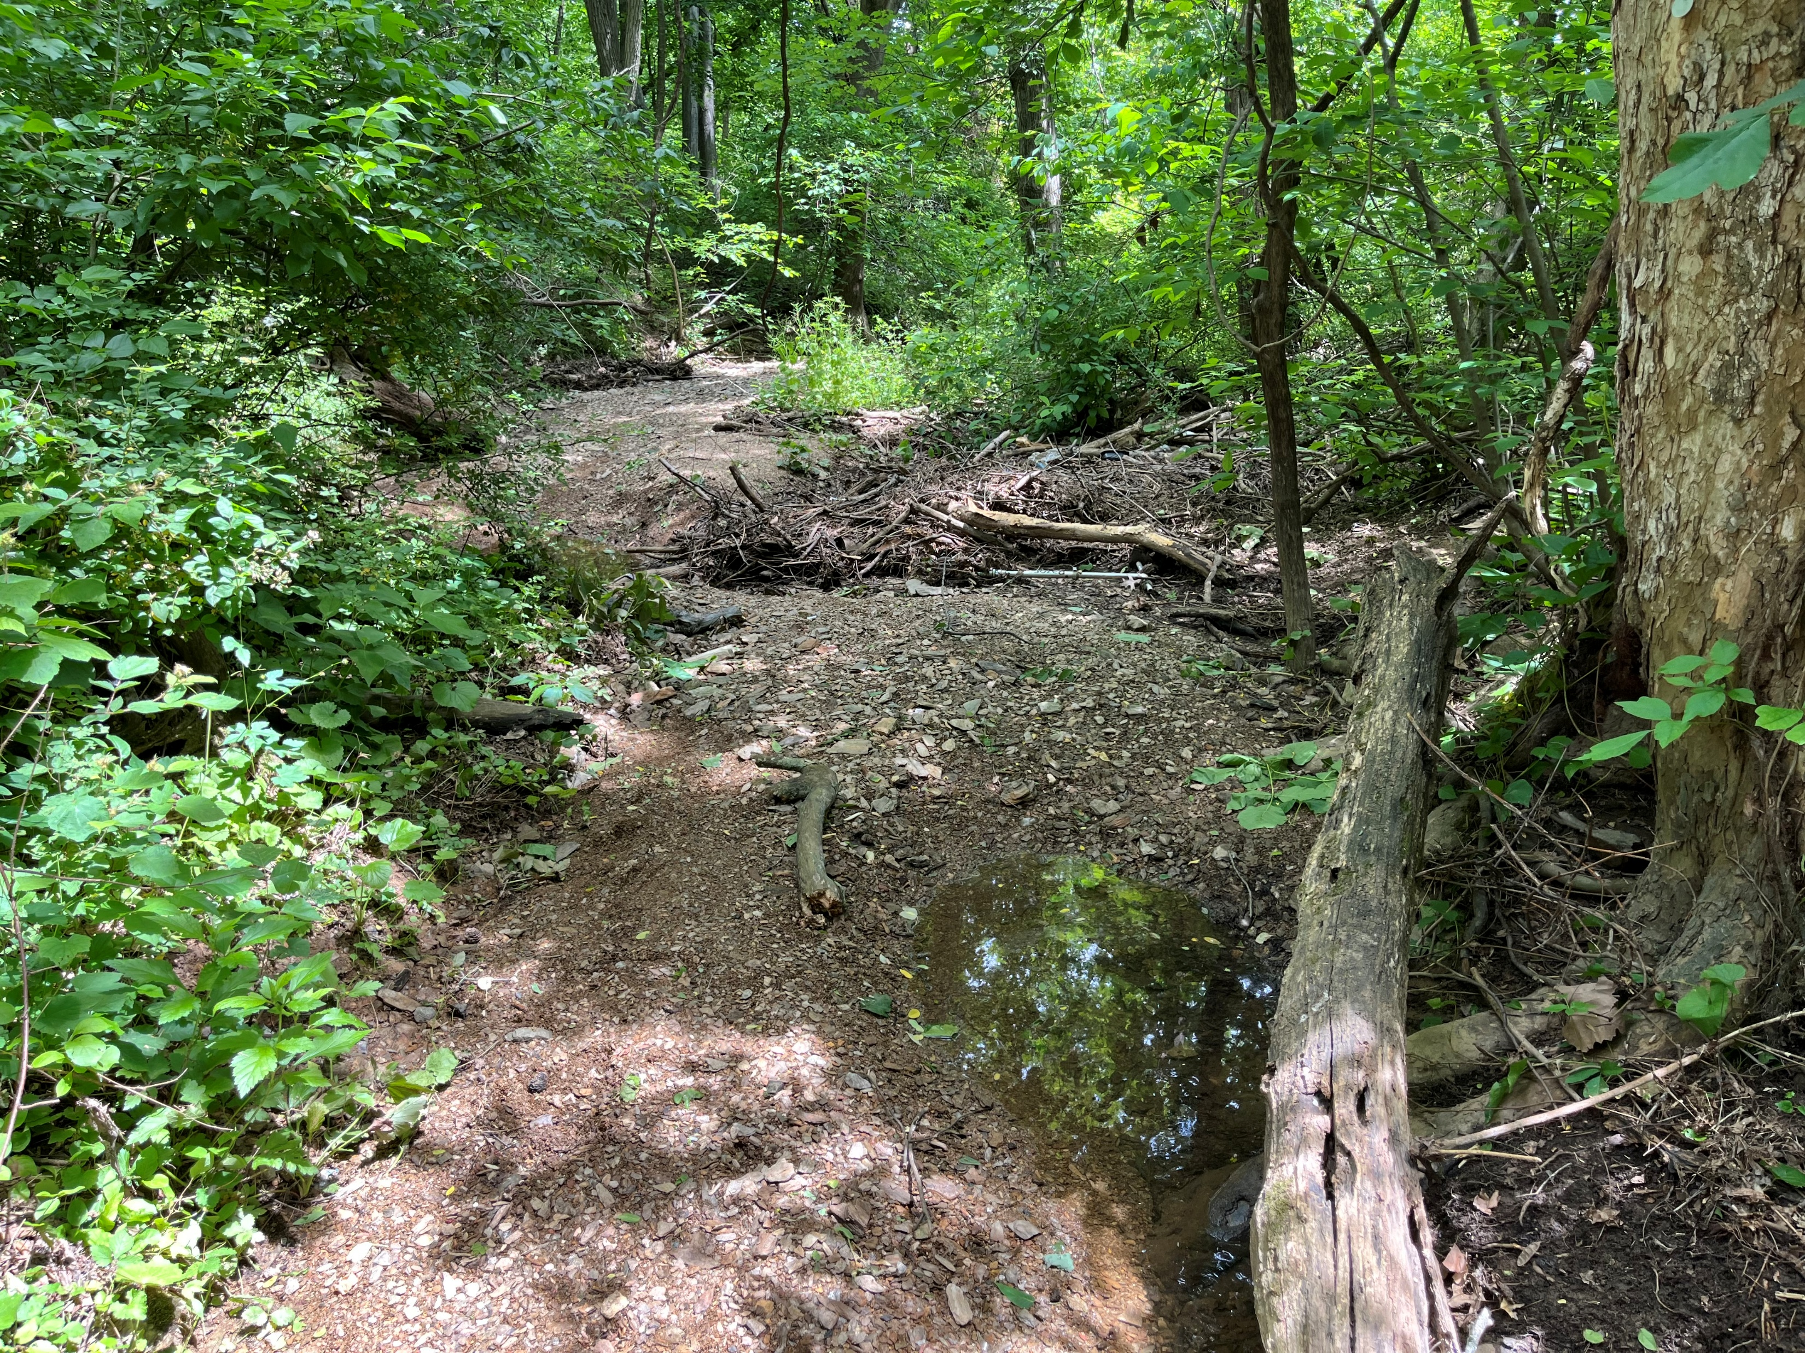
Stream – Current Condition

Slide 5
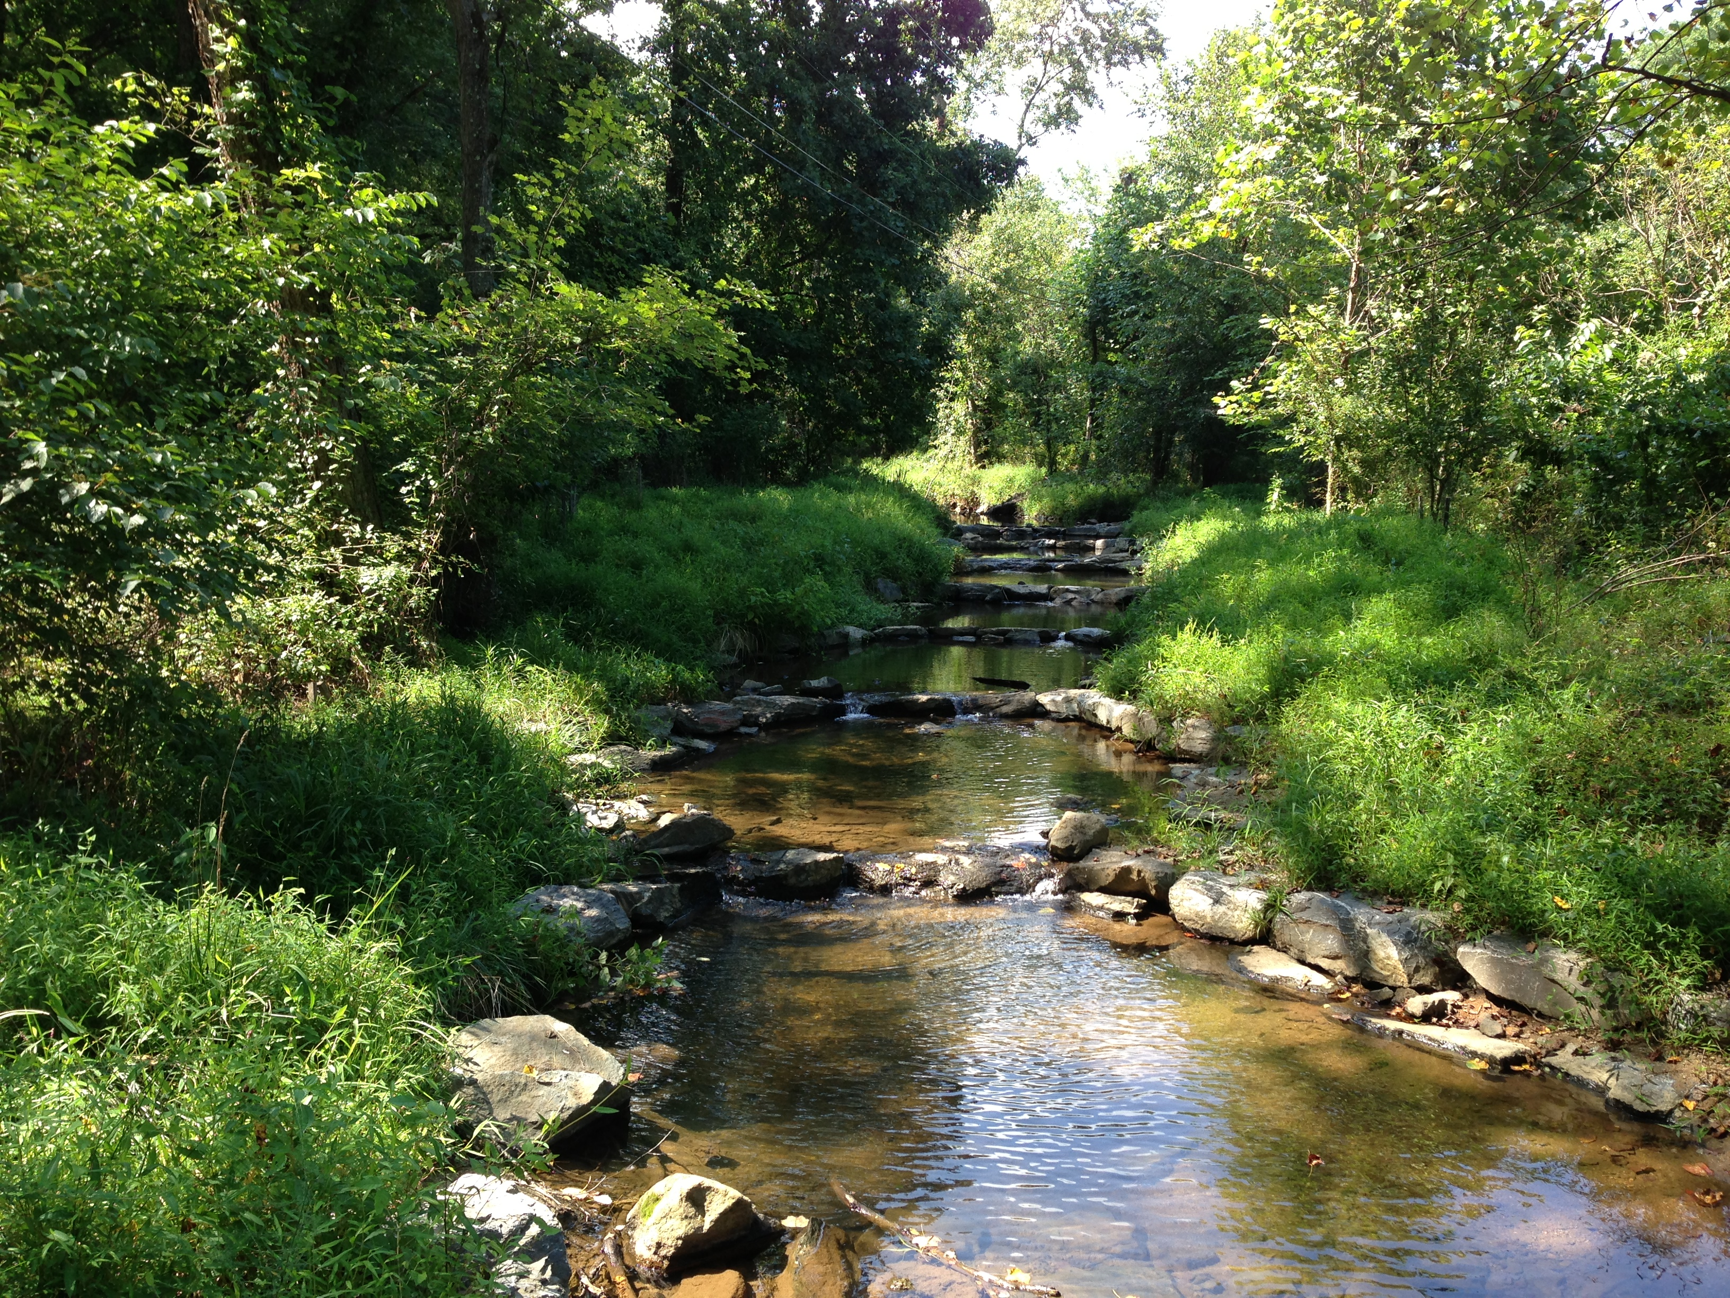
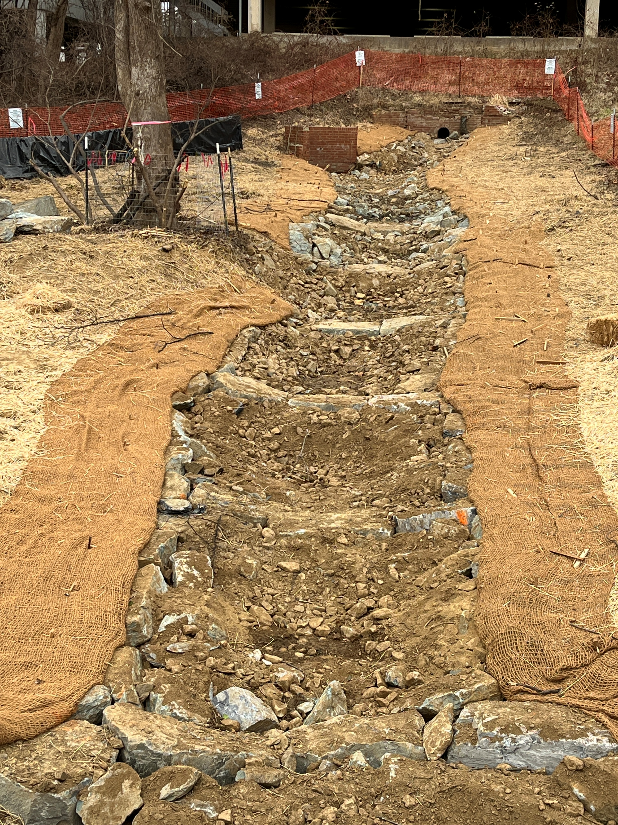
Step Pools – Three Years After Construction
Step Pools in Construction

Slide 6
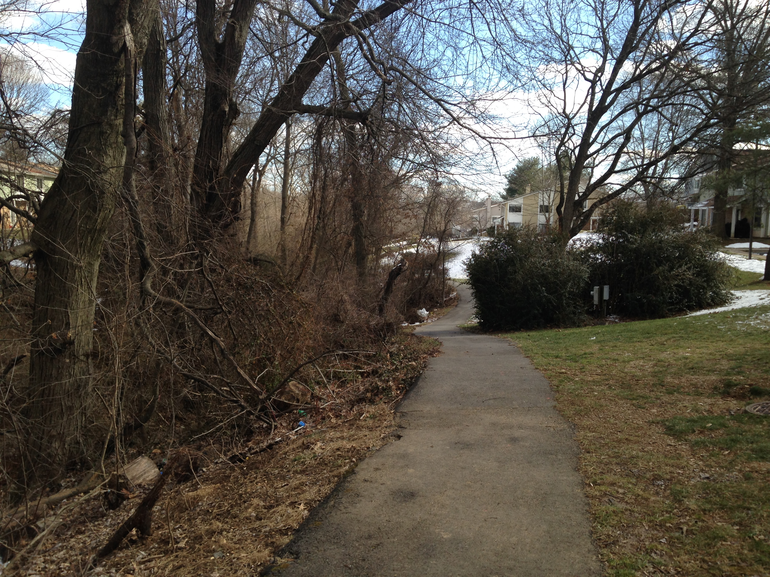

Slide 7
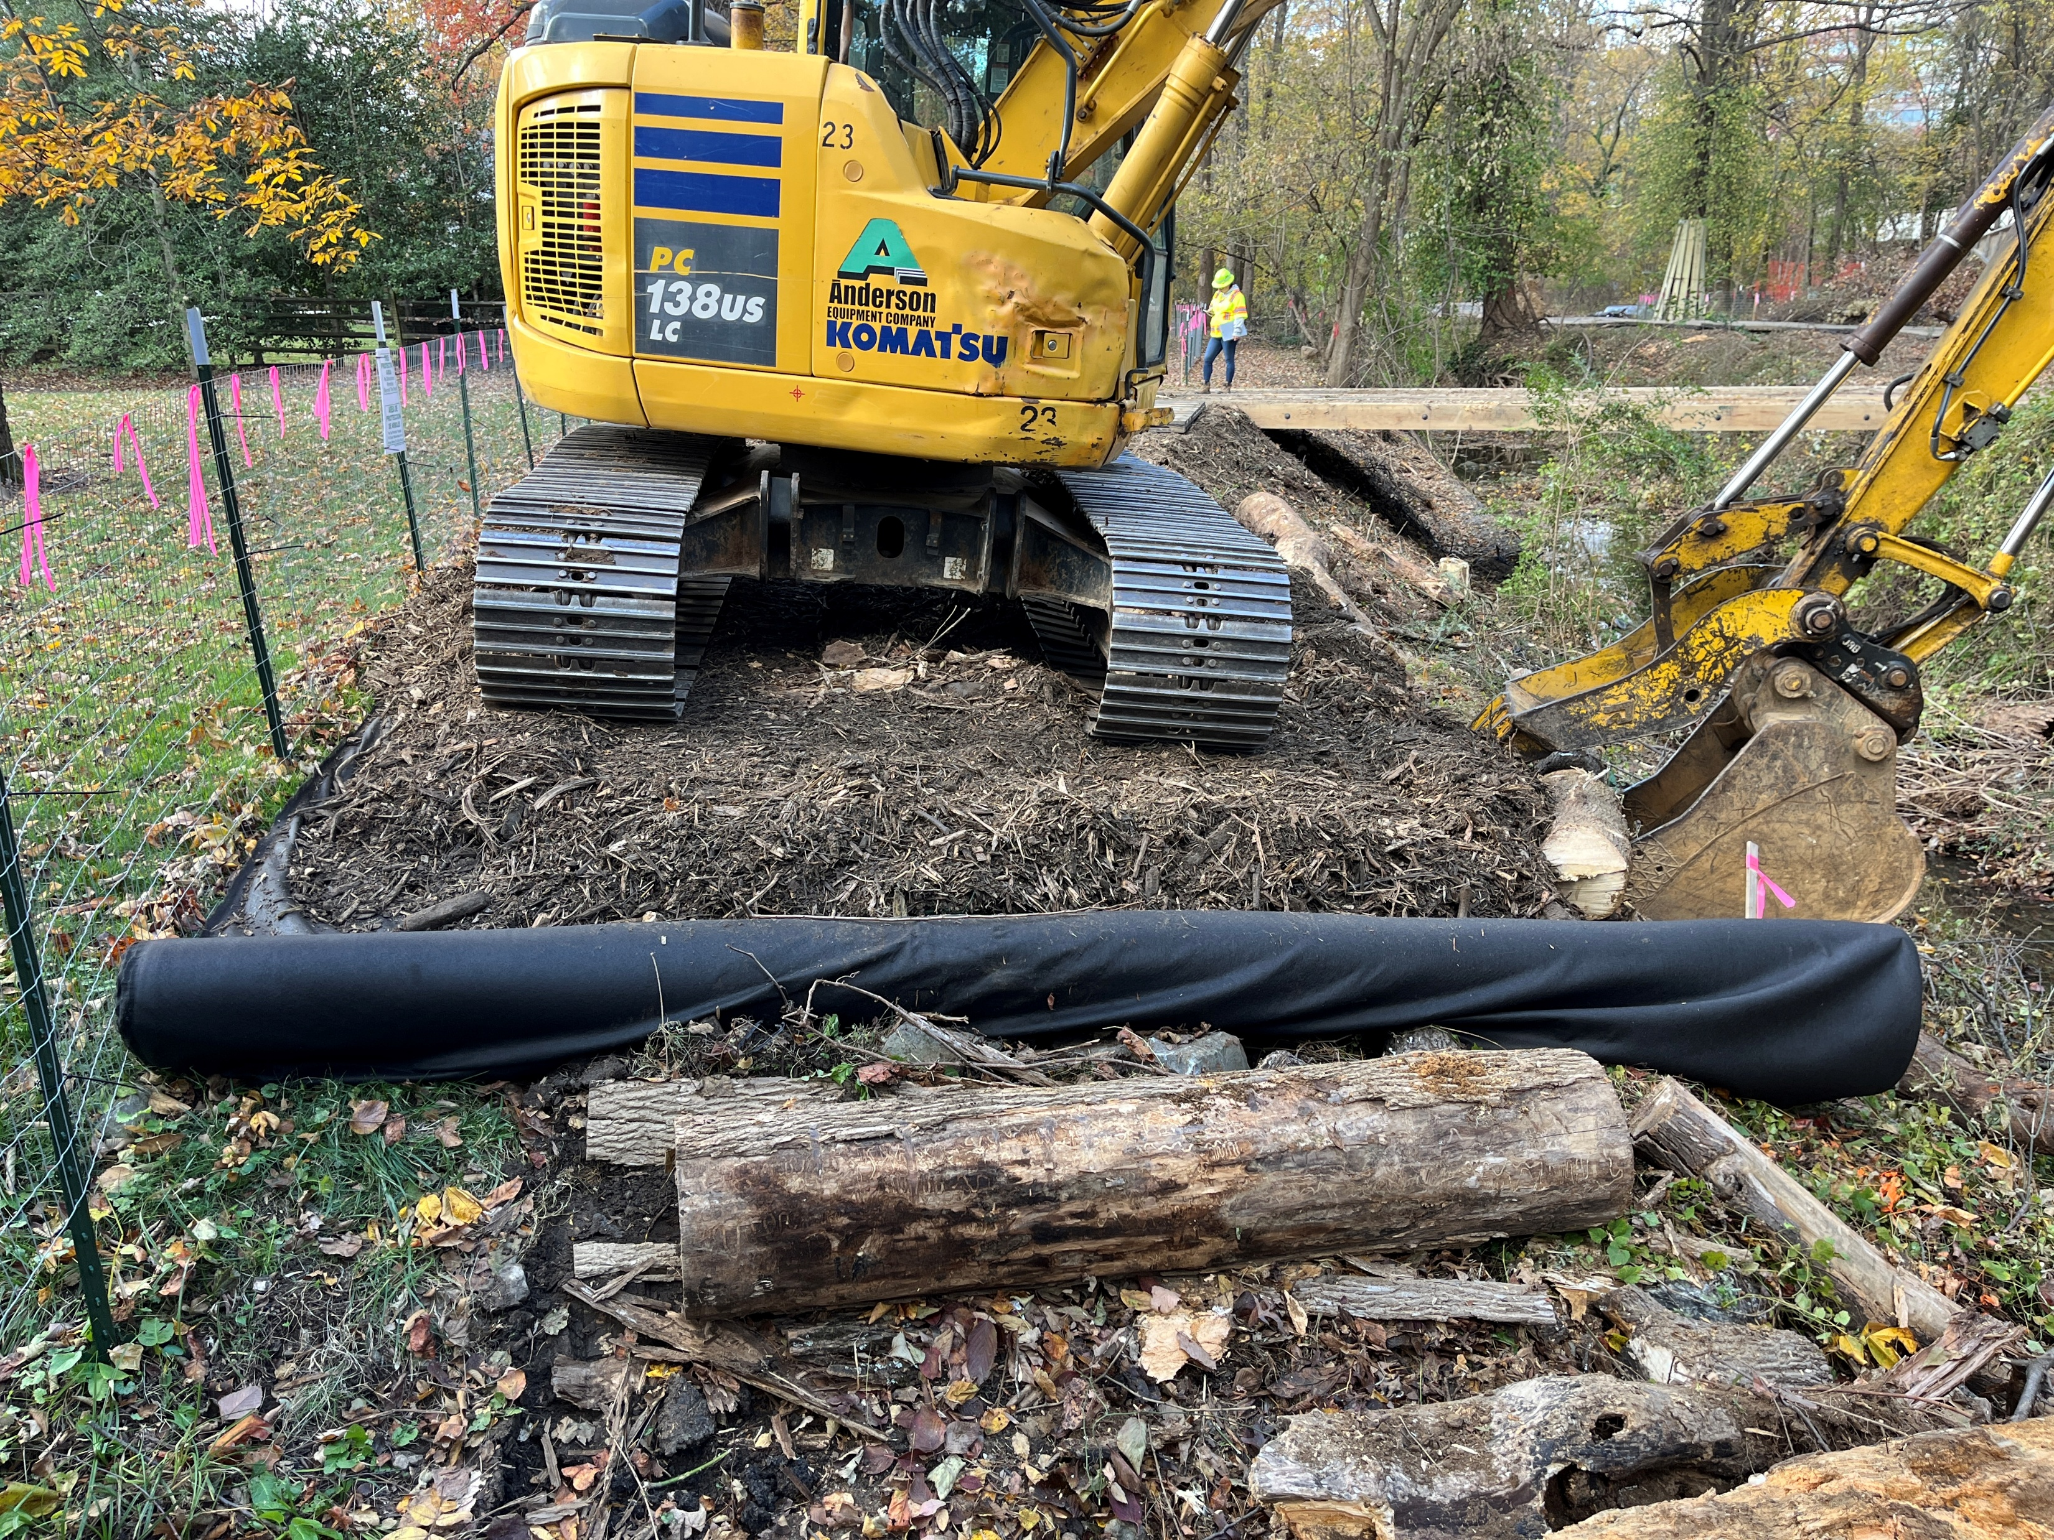
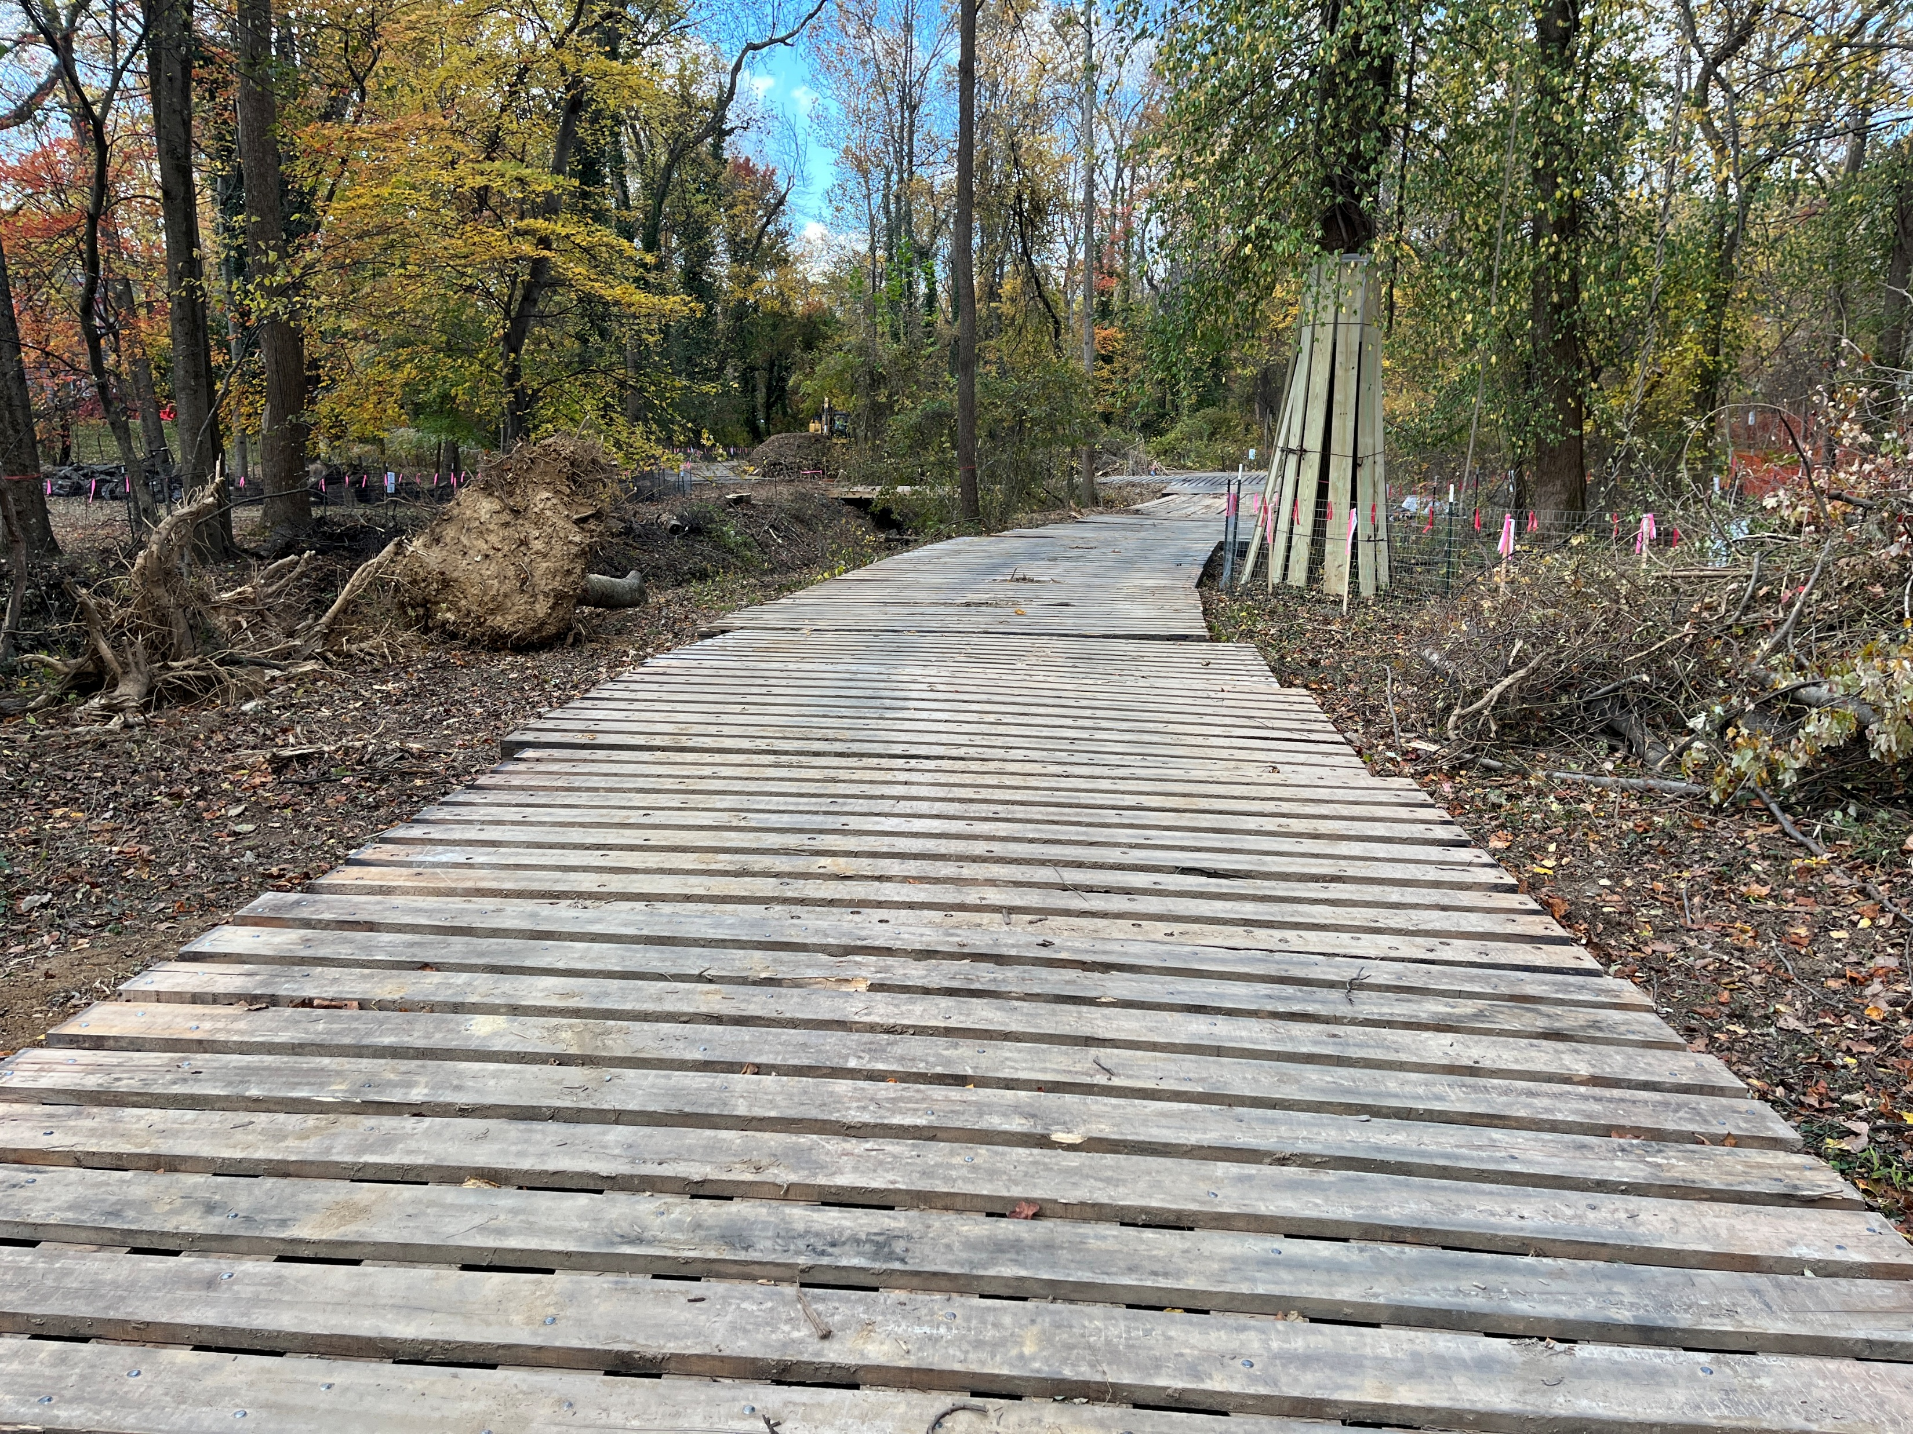
CONSTRUCTION ACCESS
Body text

Slide 8
Stream Planting
UPLAND TREE AND SHRUBS
COMMON NAME BOTANICAL NAME QUANTITY
TREES
Pignut Hickory Carya glabra 14
Tulip Poplar Liriodendron tulipifera 14
White Oak Quercus alba 14
Black Oak Quercus velutina 13
Flowering Dogwood Cornus florida 10
American Holly Ilex opaca 9
Black Cherry Prunus serotina 9
Black Locust Robinia pseudoacacia 9
TOTAL 92
Shrubs
Spicebush Lindera benzoin 55
Red Elderberry Sambucus racemosa 54
Smooth Blackhaw Viburnum prunifolium 54
TOTAL 163
EMERGENT HERBACEOUS PLANTS ALONG STREAM EDGE
COMMON NAME BOTANICAL NAME QUANTITY
Broomsedge Bluestem Andropogon virginicus 146
New England Aster Aster novae-nagliae 145
Fringed Sedge Carex cinita 145
Shallow Sedge Carex lurida 145
Boneset Eupatorium perfoliatum 145
Povery Rush Juncus tenuis 145
TOTAL 871
Riparian Seeding Mix
consisting of 27 grass and herbaceous species

Slide 9
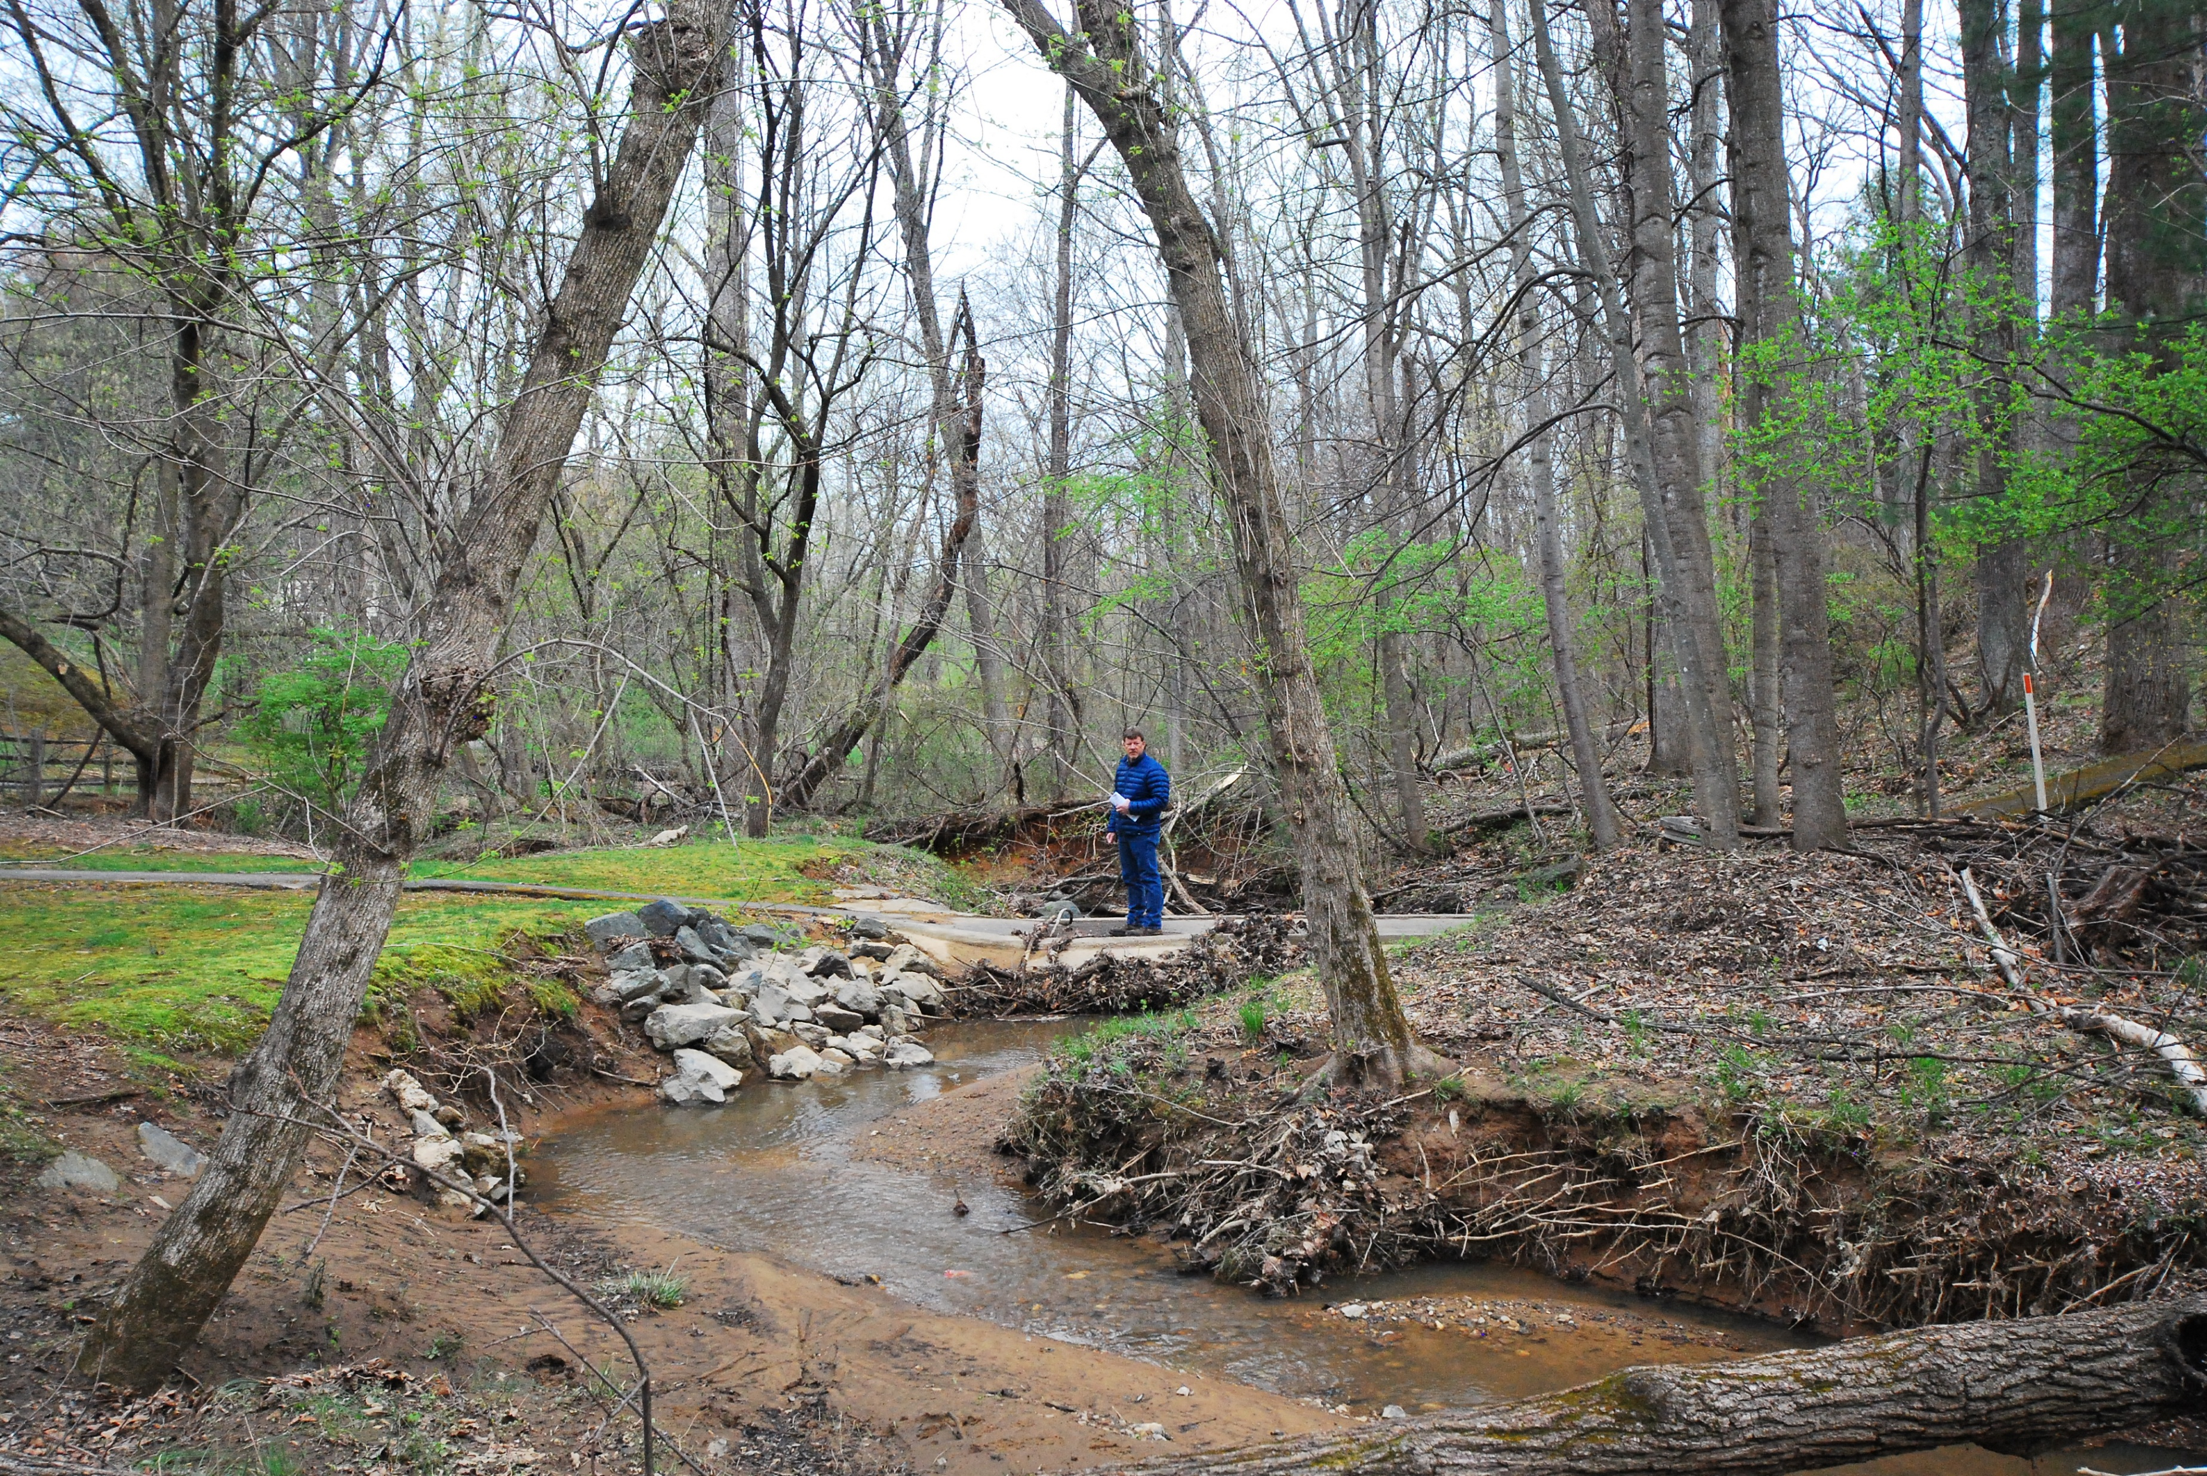
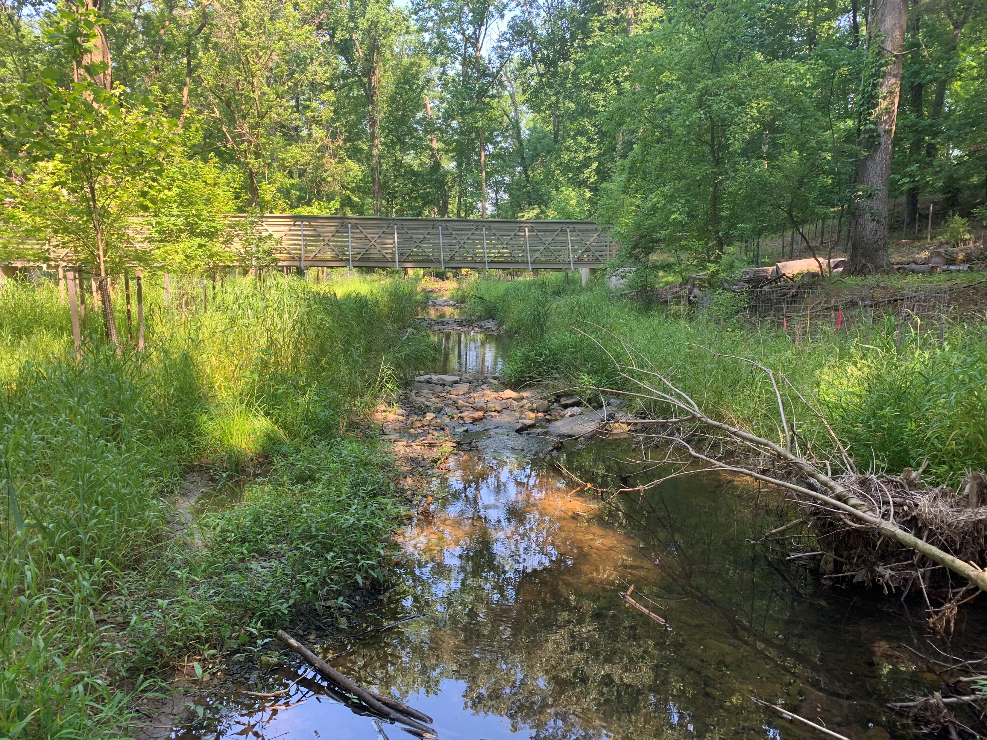
Stream Restoration Examples
April 2017
June 2020

Slide 10
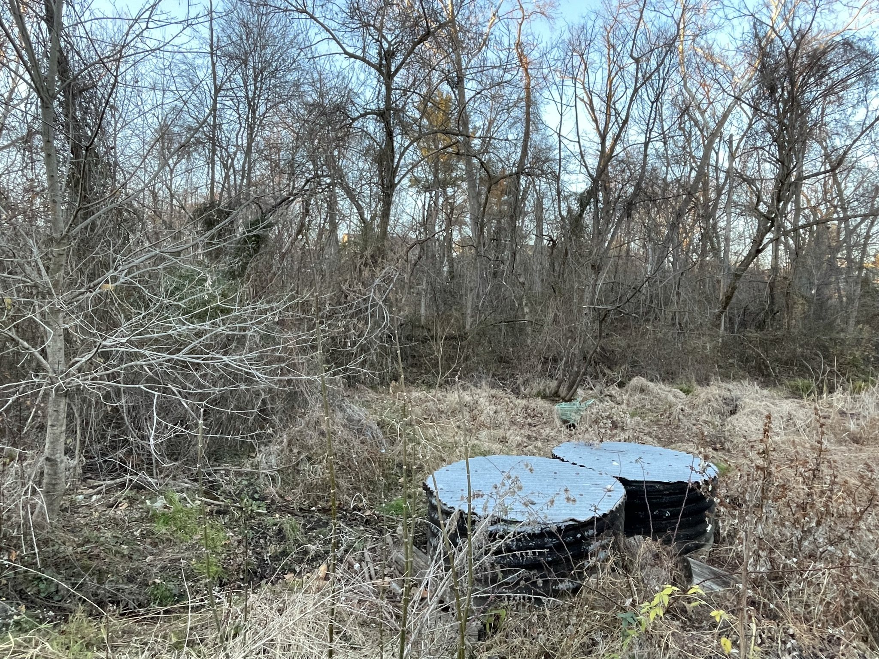
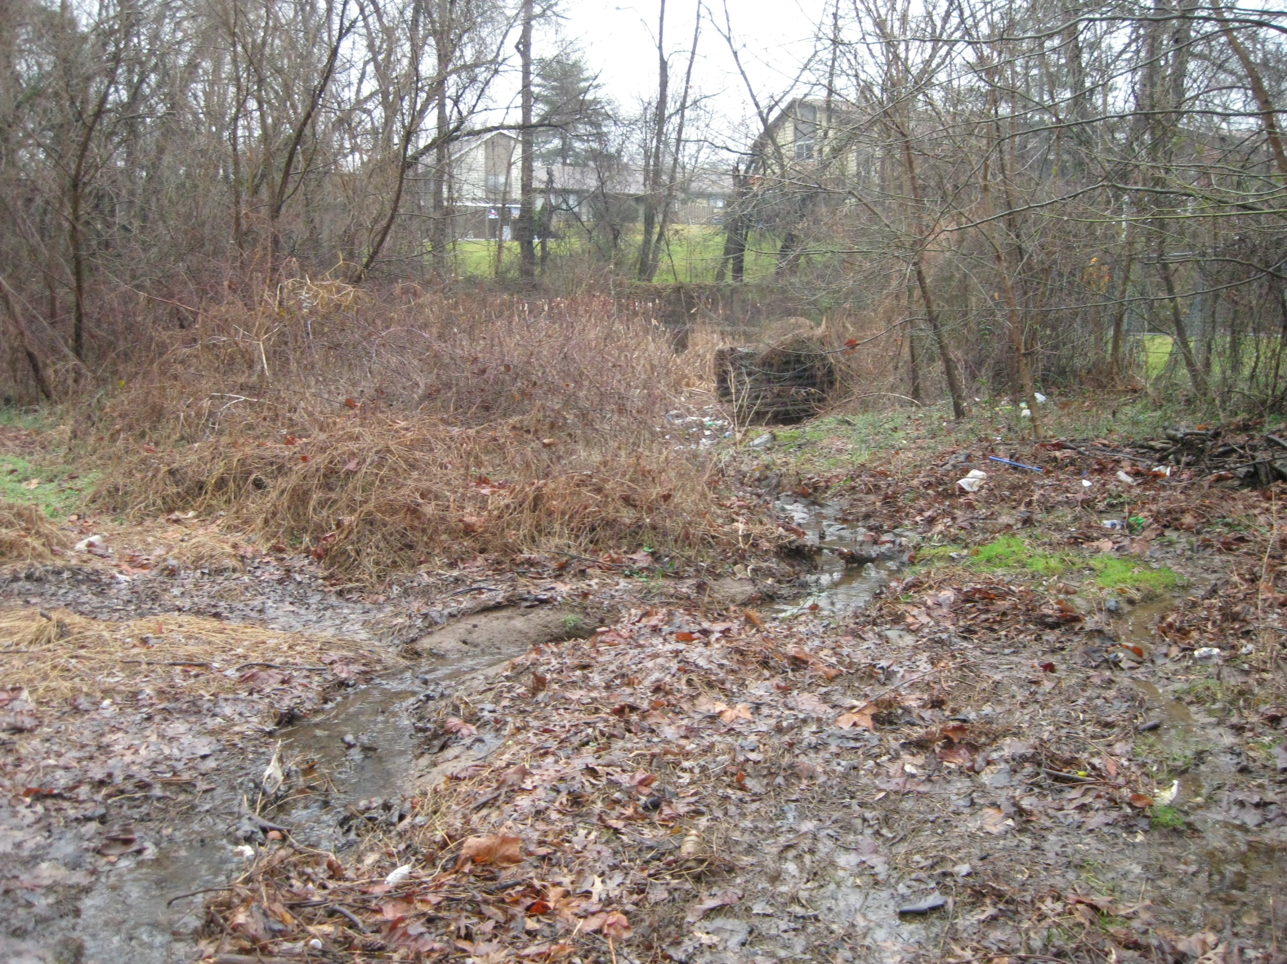
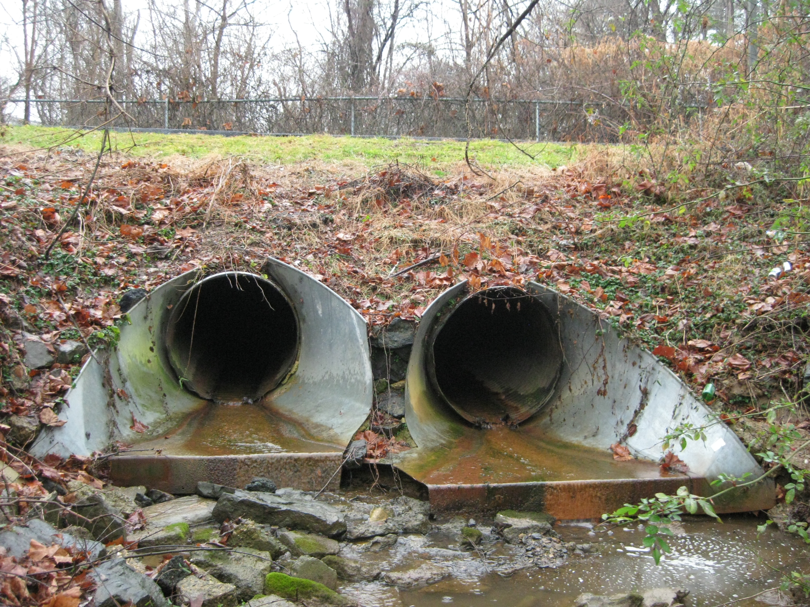
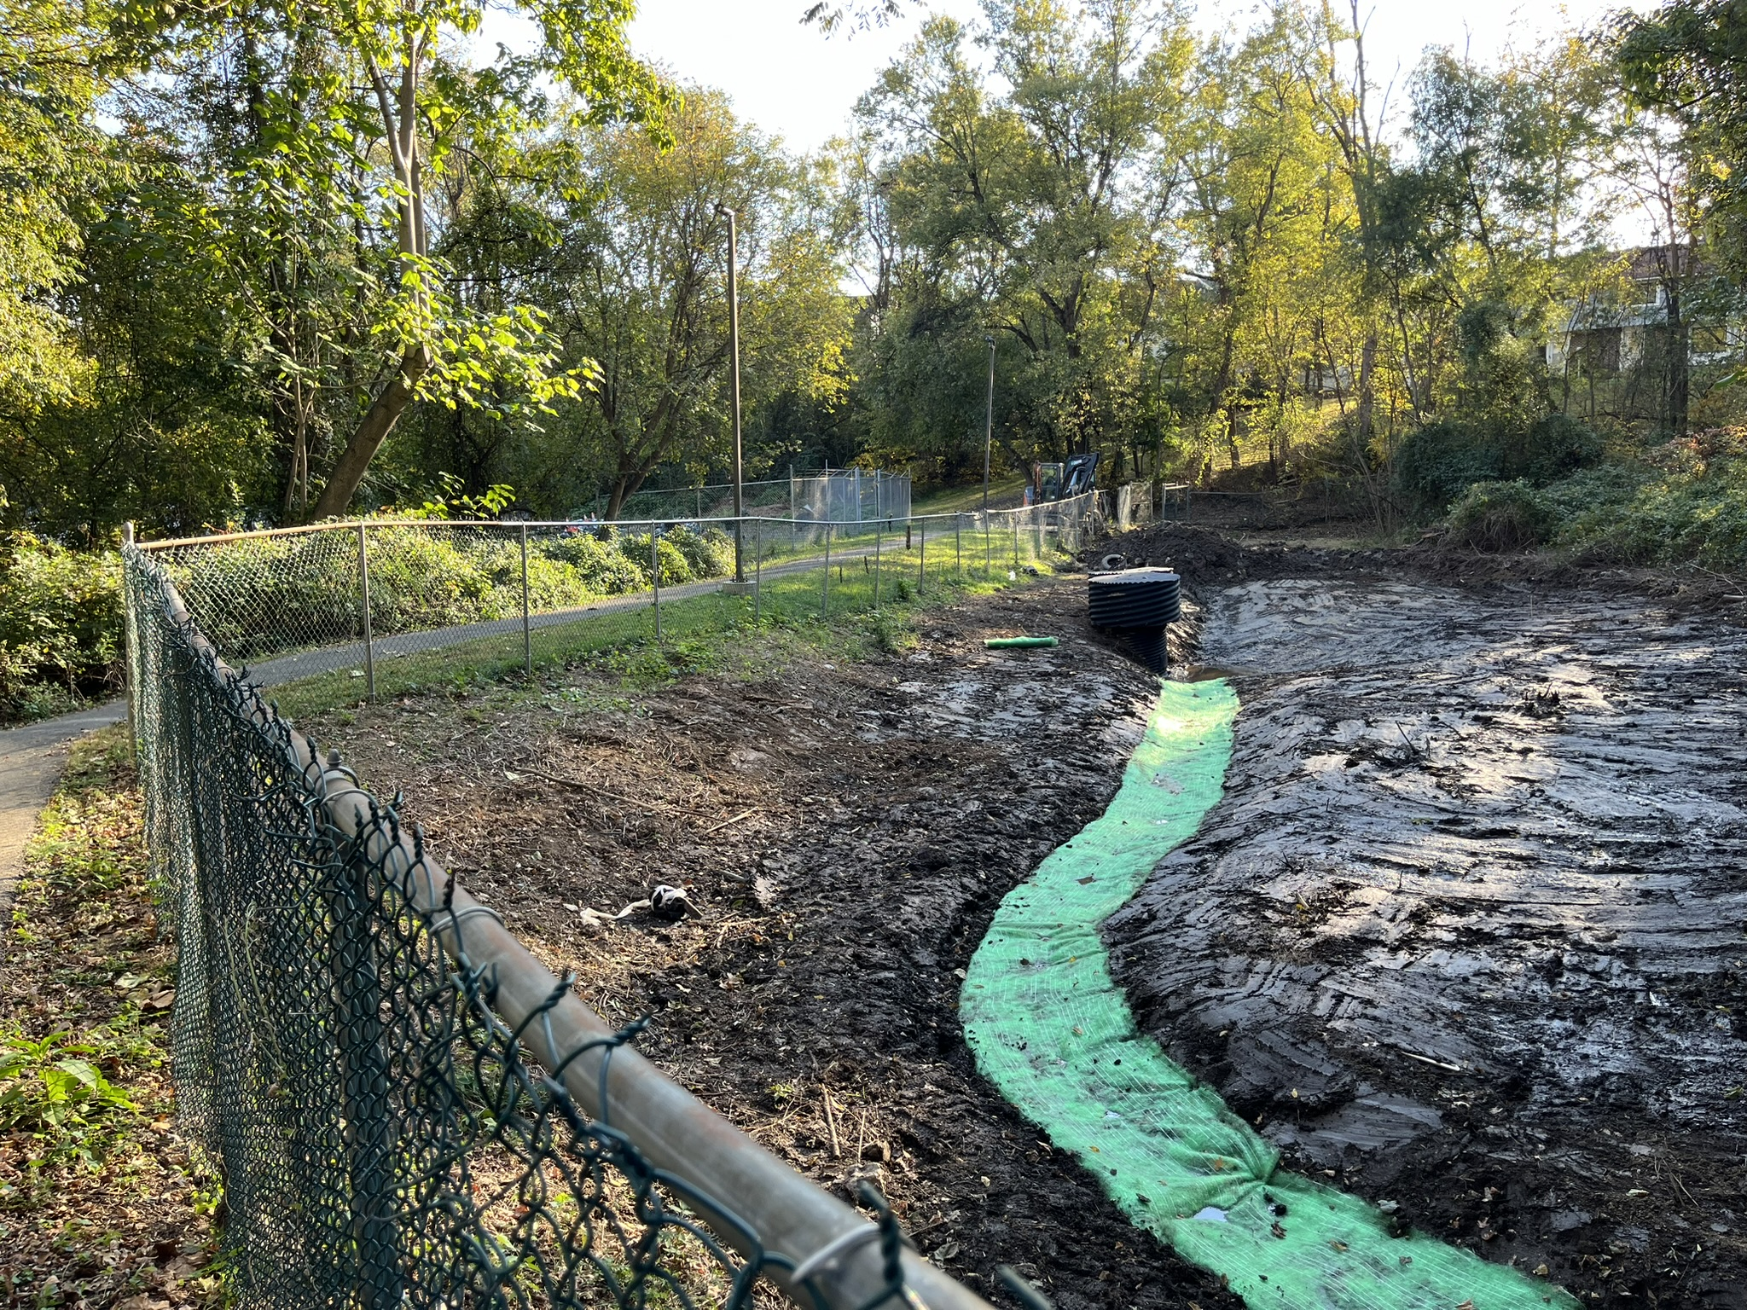
Pond (11178) – Current Condition
Body text

Slide 11
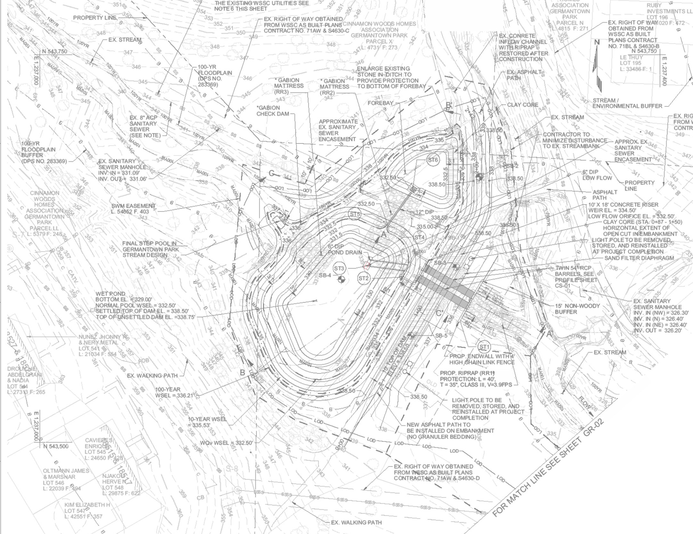
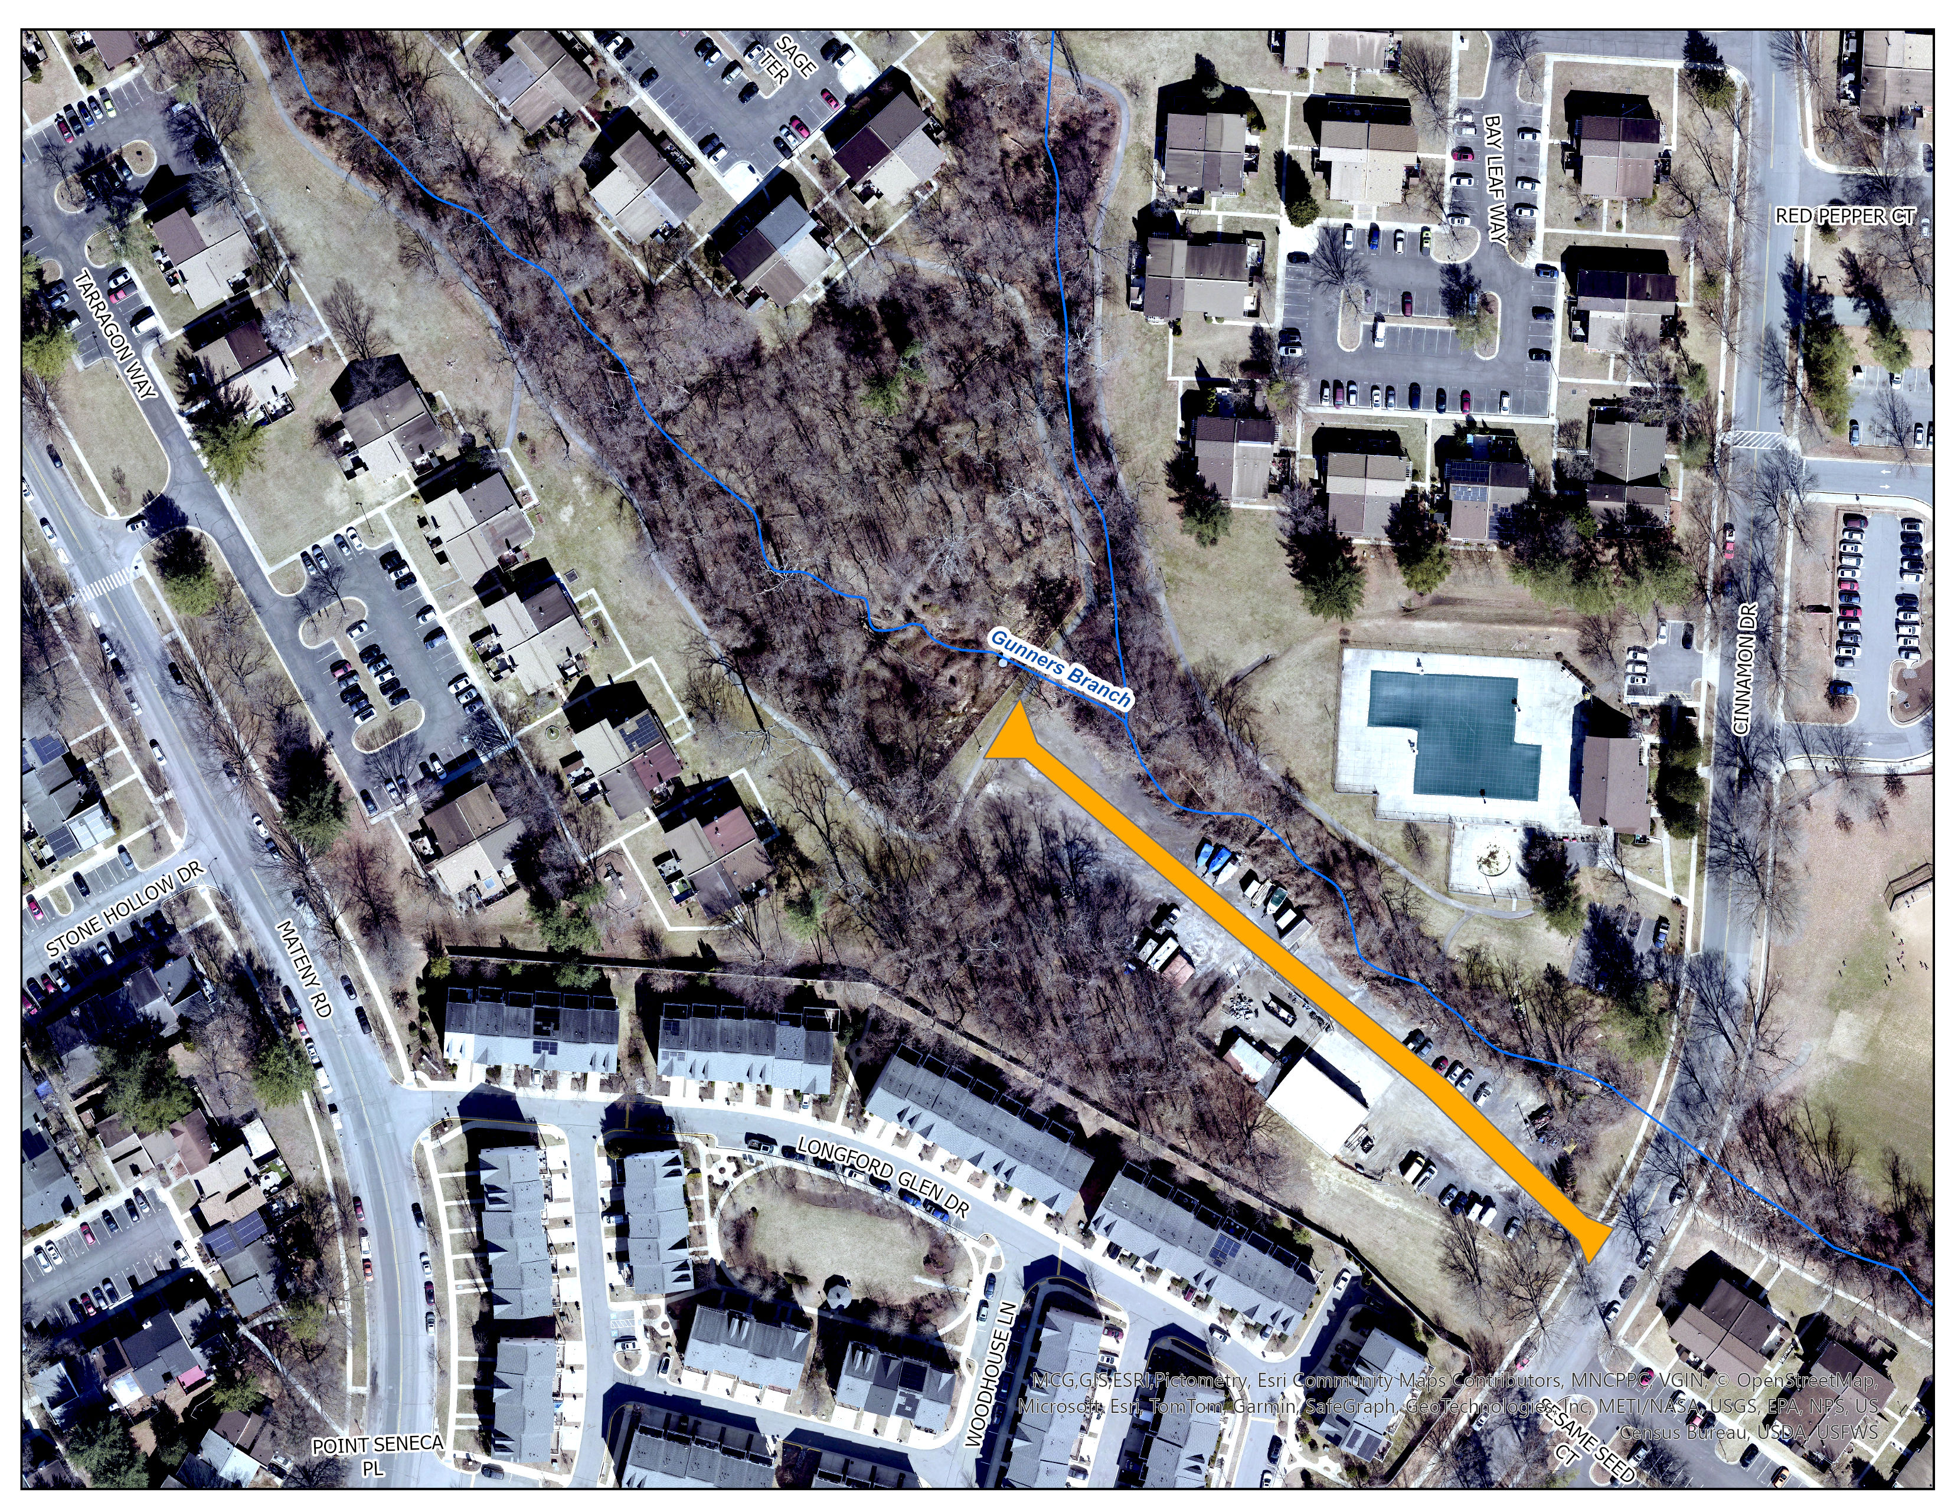
Germantown Park Pond Plan
Pond Retrofit will Include:
Convert dry pond to a wet pond (max depth = 3.5 feet)
Create a new forebay at the northeast end of pond
Replace two 48” metal risers with a new concrete riser
Replace two 36” metal pipes with two new 54” concrete pipes
Dam embankment will be reconstructed with a clay core for added safety factor
Trees, shrubs, aquatic plants and herbaceous plants will be planted around the pond perimeter

Slide 12
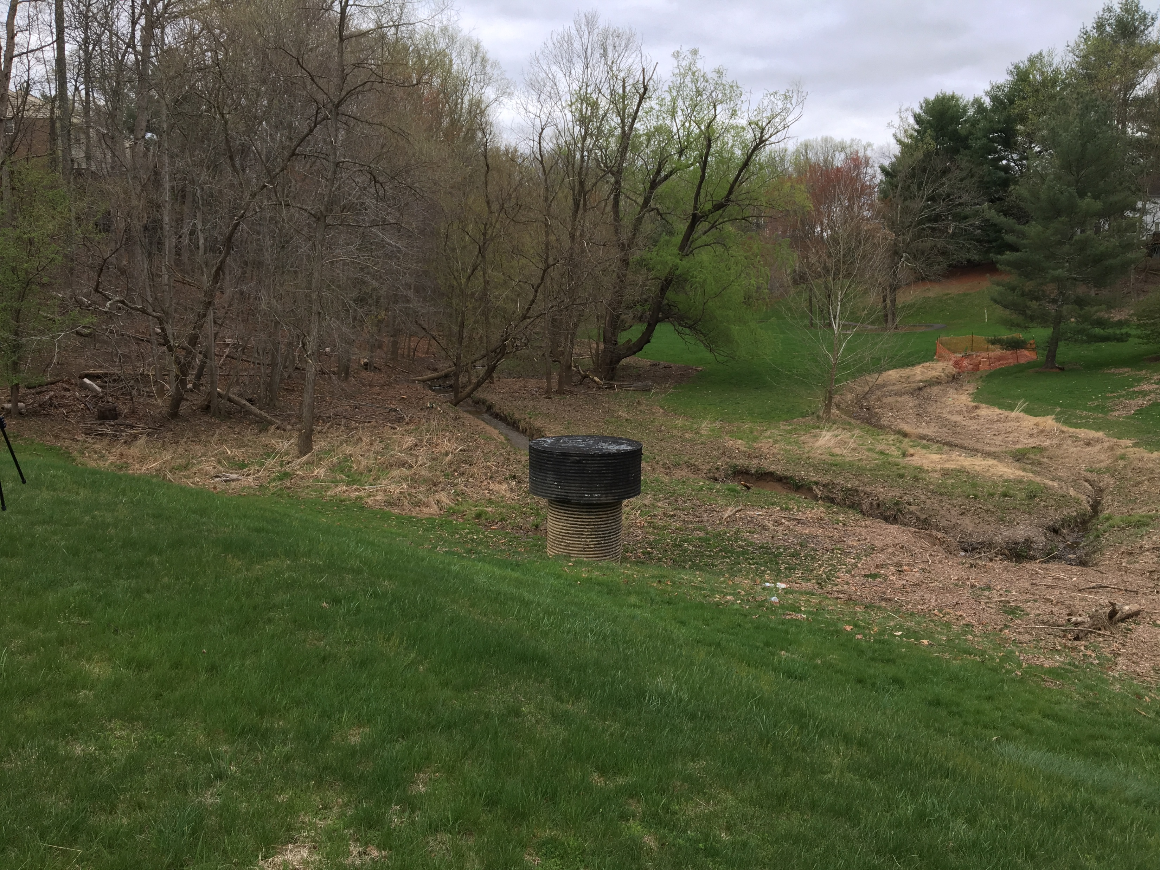
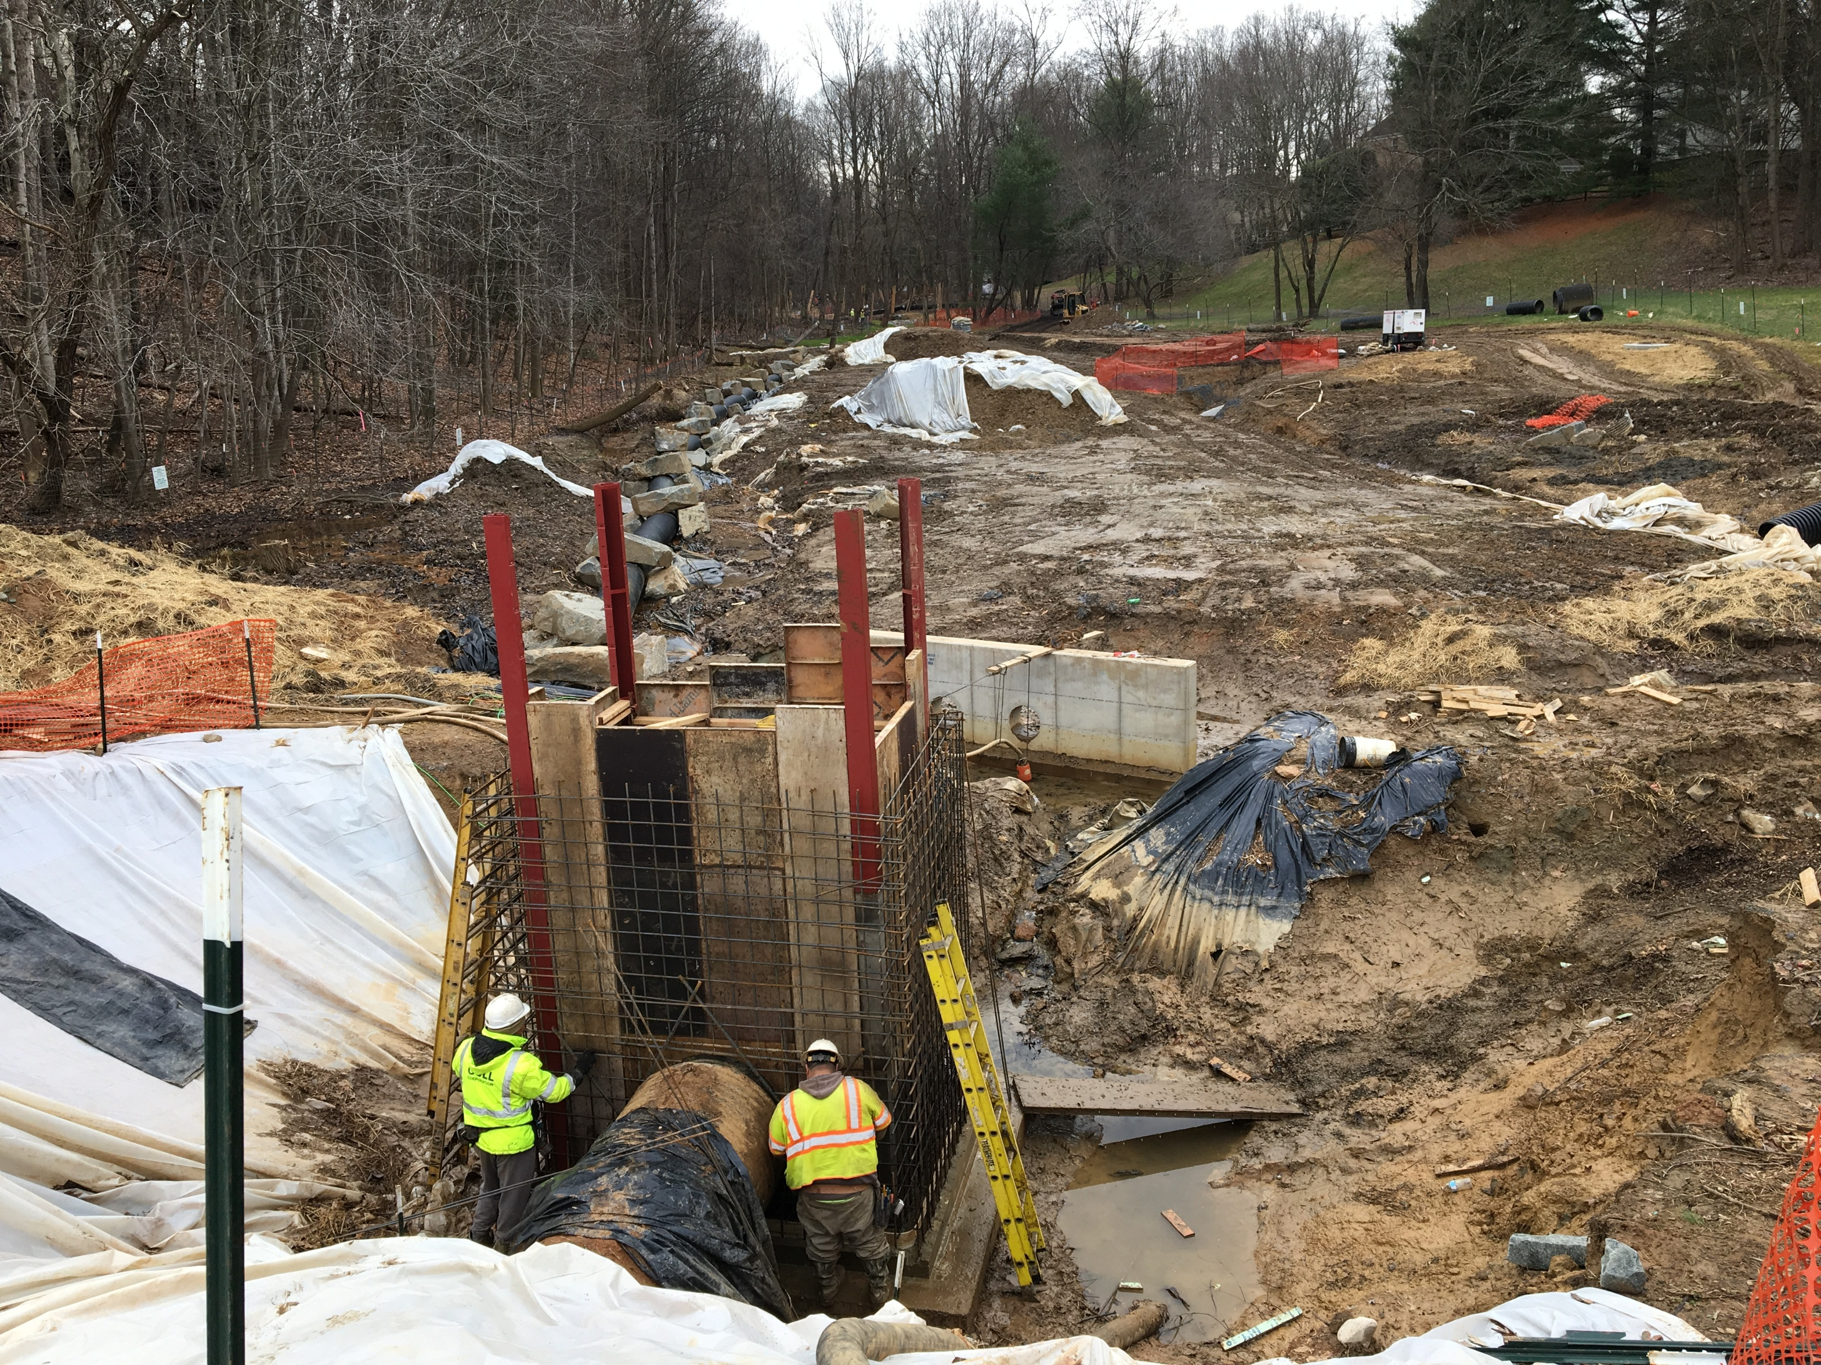
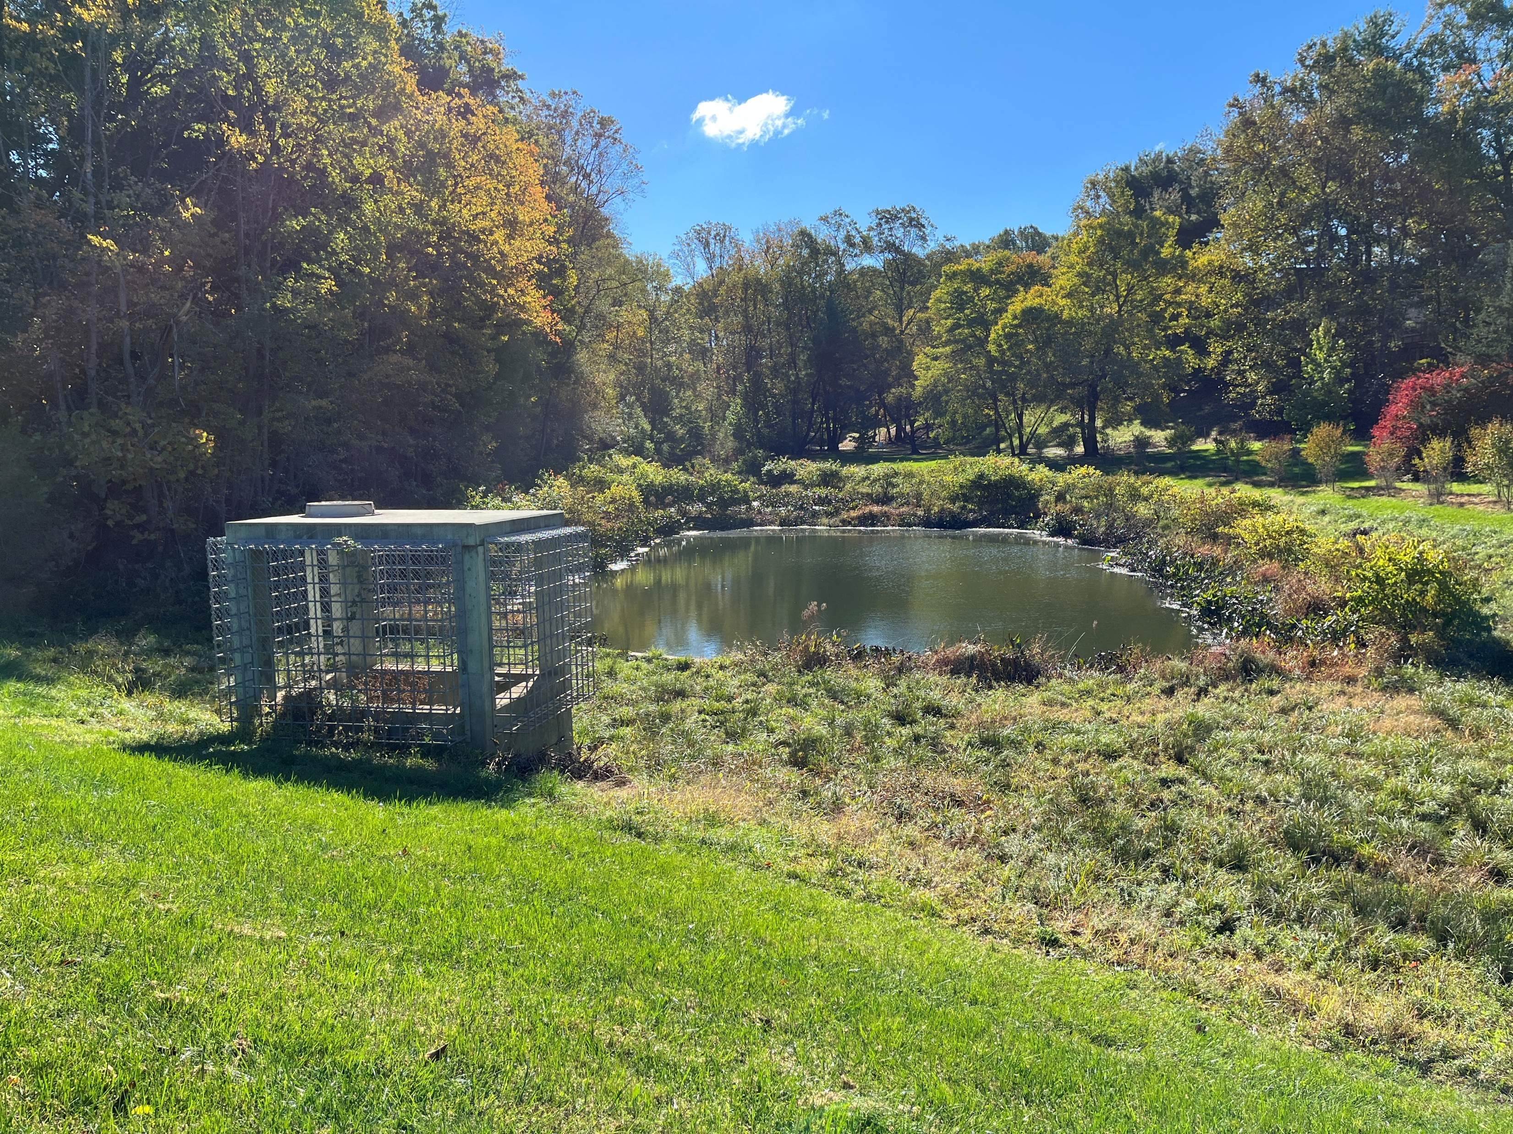
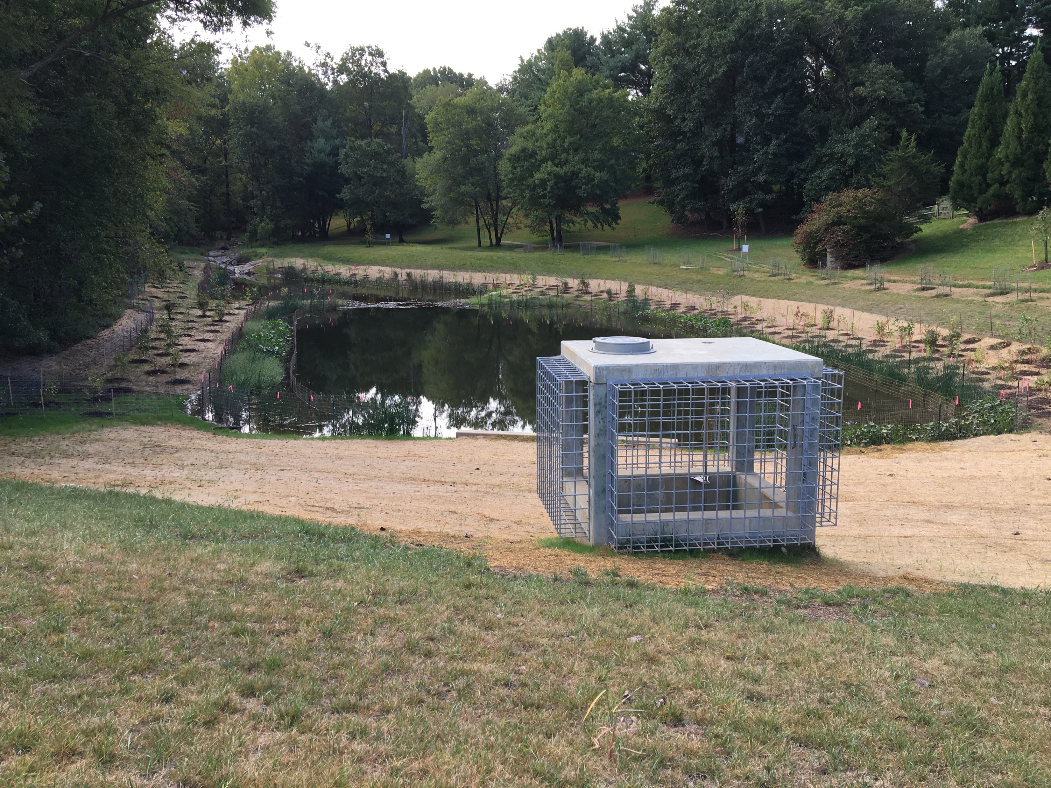
Fallsreach Pond Retrofit
February 2019
April 2018
August 2019
October 2024

Slide 13
Pond Planting
TREES AND SHRUBS
COMMON NAME BOTANICAL NAME QUANTITY
TREES
American Sycamore Plantanus occidentalis 2
Southern Red Oak Quercus falcata 3
TOTAL 5
Shrubs
Ruby Spice Sweetpepper Clethra anifolia 20
Red-Twig Dogwood Cornus sericea ‘Farrow’ 27
Red Sprite Winterberry Ilex verticillata ‘Red Sprite’ 40
Jim Dandy Winterberry Ilex verticillata ‘Jim Dandy’ 5
TOTAL 92
AQUATIC PLANTS AROUND POND PERIMETER
COMMON NAME BOTANICAL NAME QUANTITY
Broadleaf Arrowhead Sagittaria lattifolia 226
Pickerelweed Pontederia cordata 302
Blueflag Iris Iris versicolor 226
Soft-stem Bulrush Schoeoplectus tabernaemontani 202
American Bur-reed Sparganium americanum 202
Arrow Arum Peltandra virginica 269
TOTAL 1,427
Riparian Seeding Mix
consisting of 27 grass and herbaceous species to be planted on side slopes of pond.
Areas adjacent to asphalt path to be sodded.

Slide 14
Germantown Park Pond and Stream Schedule
Start Construction
(Pond and Stream) 1/23/26
Pond Completion 7/13/26
Stream Completion 9/11/26
Plant Warranty Ends
(Pond and Stream) 9/30/27

Slide 15

Questions?
Contact: Doug Marshall
Project Planner, Watershed Restoration Division
Douglas.marshall@MontgomeryCountyMD.gov
240-777-7767
Visit The Project Webpage At:
https://www.montgomerycountymd.gov/DEP/water/clean-water-montgomery/watershed/restoration-projects/germantown-park-phase-II.html
Or Search On-Line For “Germantown Park Pond Restoration”

