Slide 1
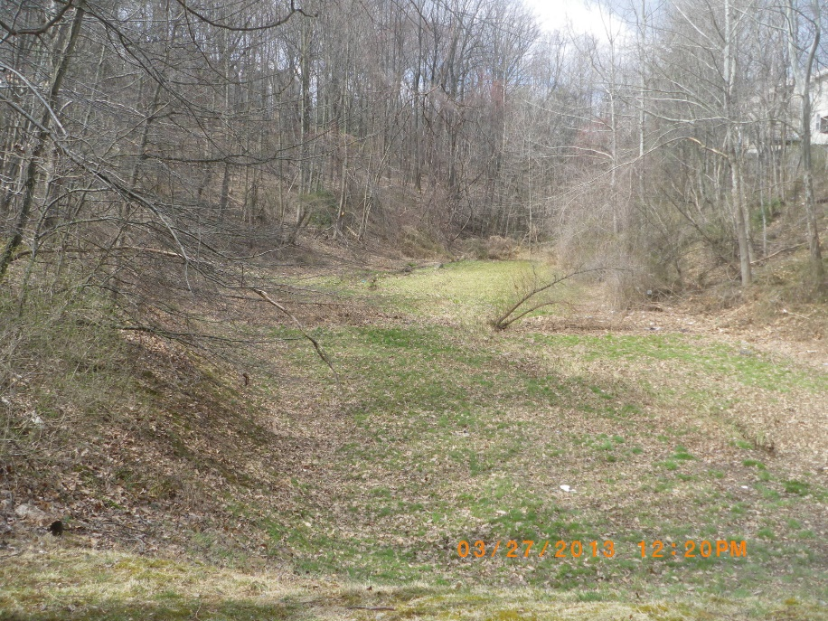
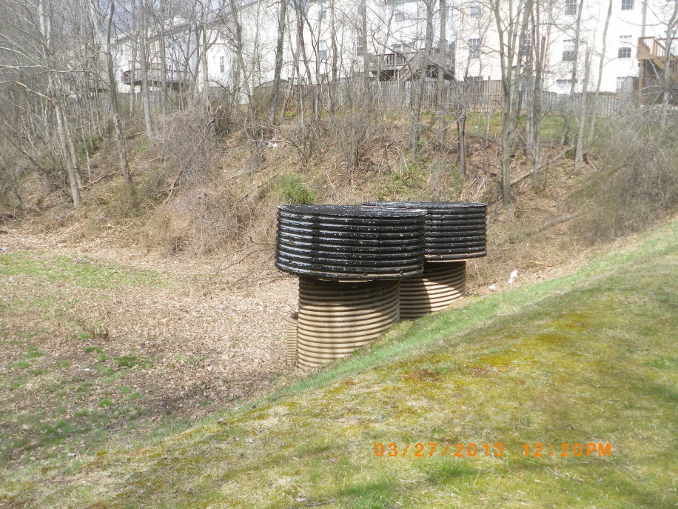
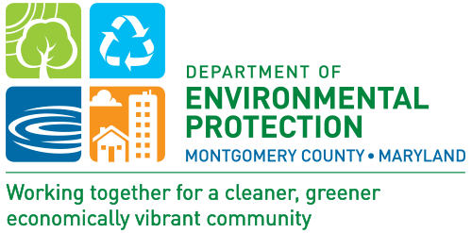
Germantown View
Stormwater Pond Retrofit Projects
Second Public Meeting: March 13, 2018
Notes:
Millions have lived without love. No one has lived without water.
Turkish businessman, 1998
I thought this was hilarious, I got the quote from Jerry’s CD … we do not have to use it.

Slide 2
Introductions
    Tony Kakoullis, P.E.
      Project Manager, Montgomery County DEP/JV
    Robyn Barnhart, P.E.
      Project Designer, CPJ & Associates, Inc.
    Doug Marshall
      Project Planner, Montgomery County DEP
    Radhika Wijetunge
      Staff Planner, Montgomery County DEP/JV

Slide 3
Tonight’s Agenda
Sources of water on earth
Montgomery County background
What is a watershed?
Introduction to stormwater runoff
What the County is doing to protect our waterways
Project goals
Proposed pond retrofit designs
Examples of similar projects
What to expect during construction
Project schedules
Questions/Comments

Slide 4
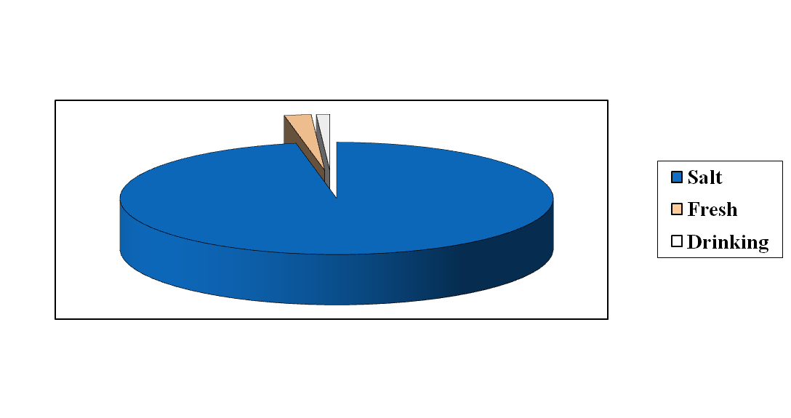
Sources of Water
About 97% is salt water
About 2% is fresh
Only 1% is available for drinking water
  95% from groundwater across the Country
  32% from groundwater, 68% from surface water in Maryland
    Potential for greater impacts from runoff in Maryland
4
Notes:
Drinking water protection and urban nonpoint source pollution. Materials on page 50 and 51 of the Resource Packet.
About 97% is salt water on the earth. 2% is in the ice caps. Only the remaining 1% is available for drinking water. Of this 1%, groundwater accounts for about 95% of the nation's freshwater resources, eventually flow into surface water bodies. It can bubble out of the ground as a spring or it can be pumped from wells.
In Maryland, about 68% of the population is served from surface sources, the remainder from wells, either individual or community systems.
Do you know where your household drinking water comes from?
Rivers, lakes, reservoirs, springs, and groundwater wells.
Aquifers: underground rivers of water formed from water that seeps from the land surface through the soil layers and becomes trapped between rock formations.

Slide 5
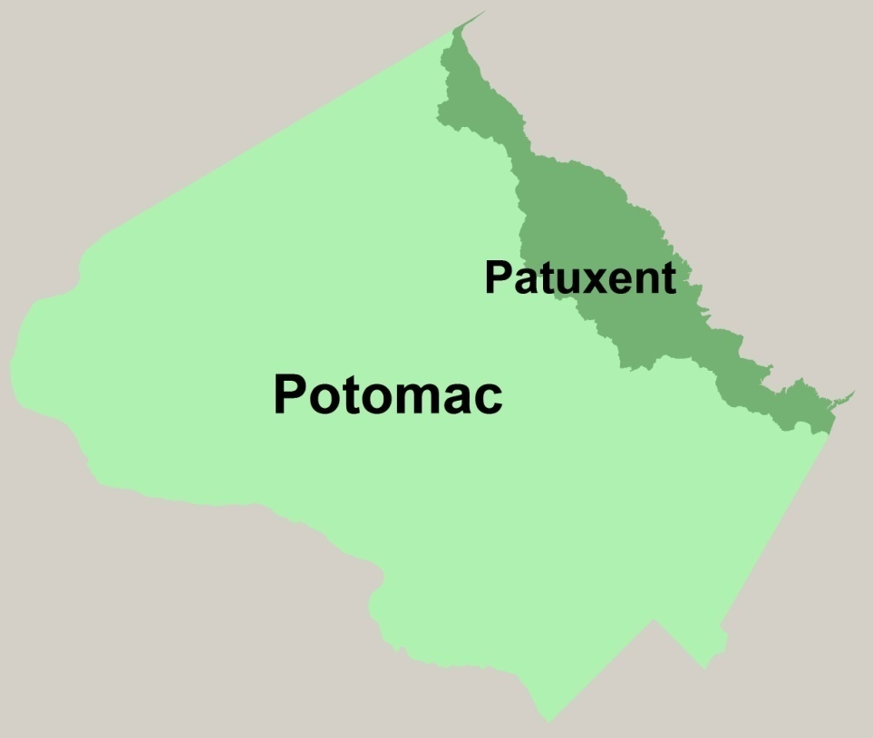
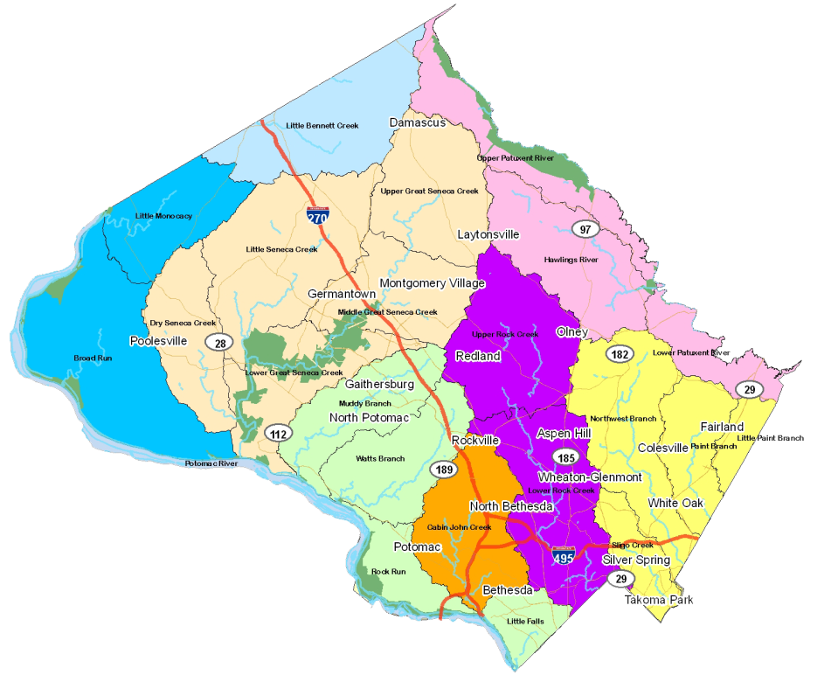
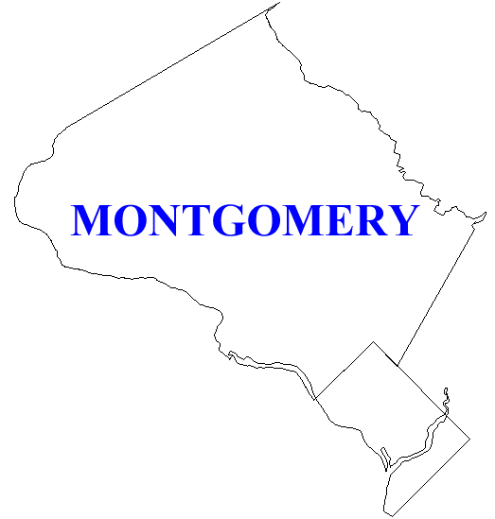
Montgomery County, MD
Over 1,000,000 people
  Second only to Baltimore City within Maryland in average people per
  square mile
500 sq. miles
About 12% impervious surface overall
  About the size of Washington DC
Over 1,500 miles of streams
Two major river basins:
  Potomac
  Patuxent
Eight local watersheds
District of Columbia
Impervious: Not allowing water to soak through the ground.
5
Notes:
Brief history and tidbits about MoCo.
EXPLAIN impervious
Potomac 88% of MC
Patuxent 12% of MC
Of the 184 languages spoken the top 5 non English spoken are: Spanish, Chinese (Mandarin), Korean,
Vietnamese, Amharic (Ethiopia)

Slide 6
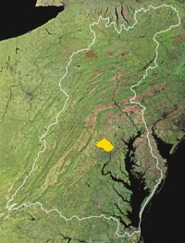
What is a Watershed?
A watershed is an area from which the water above and below ground drains to the same place.
Different scales of watersheds:
  Chesapeake Bay
  Eight local watersheds
  Neighborhood (to a storm drain)
6
Notes:
What watershed is this in?

Slide 7
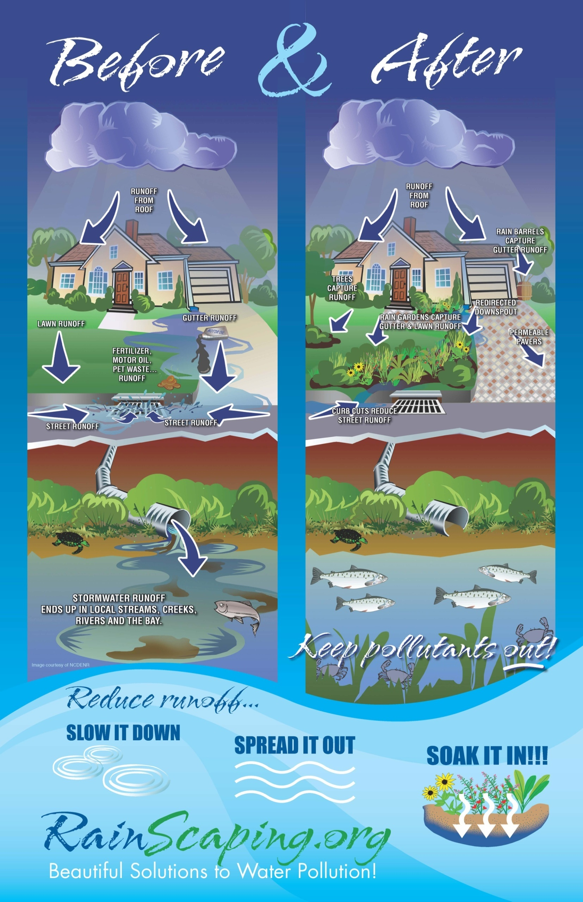

What is Runoff?
Water that does not soak into the ground becomes surface runoff. This runoff flows over hard surfaces like rooftops, driveways and parking lots collecting potential contaminants and flows:
  Directly into streams
  Into storm drain pipes, eventually leading to streams
  Into stormwater management facilities, then streams
Two Major Issues:
Volume/Timing of Runoff
Water Quality
7
Notes:
Brief history and tidbits about MoCo.
EXPLAIN impervious
Stormwater is water that originates from storms… becomes runoff

Slide 8
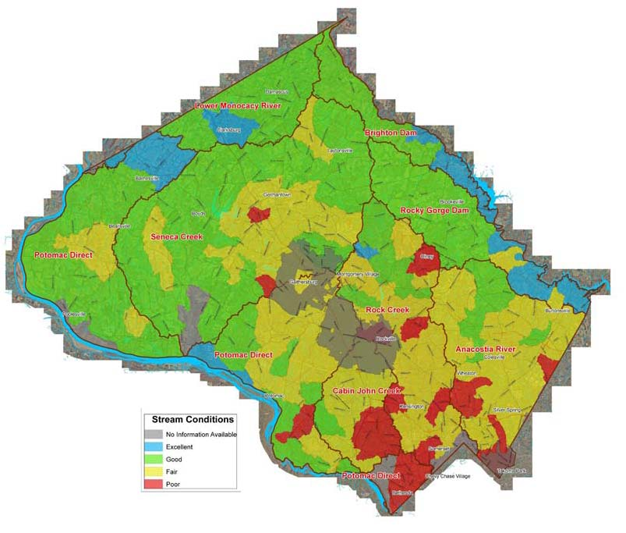
What is the County doing to protect our Streams?
Must meet regulatory requirements
  Federal Clean Water Act permit program
  MS4 = Municipal Separate Storm Sewer System
Applies to all large and medium Maryland jurisdictions
County programs
  Restore our streams and watersheds
    Add runoff management
  Meet water quality protection goals
    Reduce pollutants getting into our streams
  Educate and engage all stakeholders
    Individual actions make a difference
  Focus on watersheds showing greatest impacts
8
Notes:
Federal Clean Water Act
NPDES: National Pollutant Discharge Elimination System
MS4: Municipal Separate Storm Sewer System Permit
MS4 Permit sets priorities for all Watershed
8
11/2/2011

Slide 9
MS4 permit, what is it?
Montgomery County is responsible for:
  What goes into our storm drain pipes
  What comes out of them
  What flows into the streams
Requires additional stormwater management for 20 percent of uncontrolled impervious surfaces (3,778 acres)
9

Slide 10
Two types of designs for Ponds
Channel Protection Volume (CPV)
  Designing a pond to capture 2.6 inches of rain (a 1-year storm event)
  Storing and slowly releasing this rain event for 12 to 24 hours
  Main Objective for this Design: Provide the greatest impact to reduce downstream erosion
Water Quality Volume (WQV)
  Capturing and filtering out the pollutants during a 1-inch rain event, and is based on impervious area
  Main Objective for this Design: Reduce nutrients from entering the stream
Ideal Situation
  Design a facility that does both with the land area being the only limiting factor
10
Notes:
What are we looking at proposing for these two facilities?

Slide 11
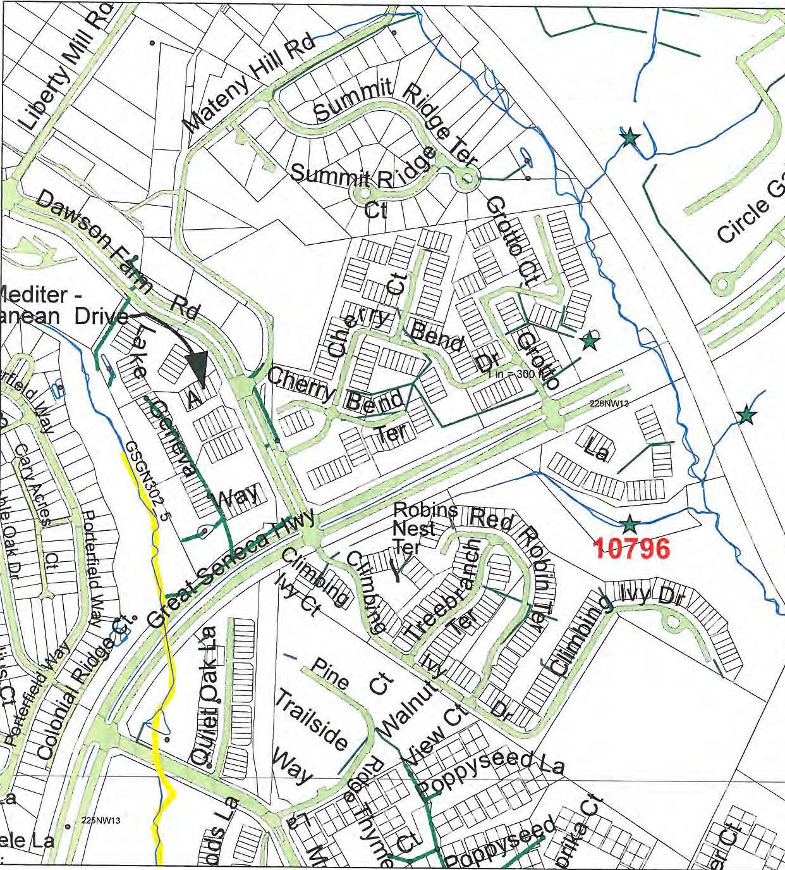
Germantown View Site Vicinity Map
11
Notes:
Talk about how the County is looking at upgrading older stormwater facilities as a cost effective way to meet our MS4 permit. And describe briefly the location of this pond.

Slide 12
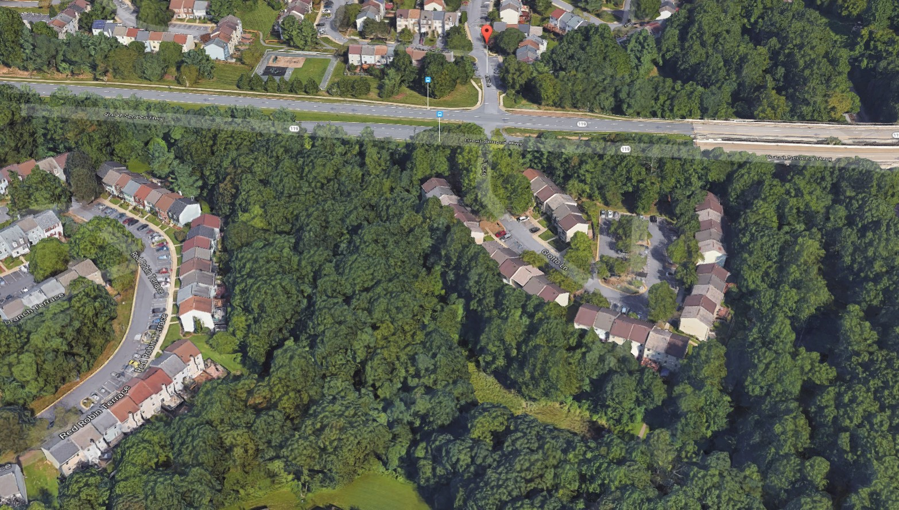
Germantown View
Aerial Image of Site Area
Aerial Image – Looking North
12

Slide 13
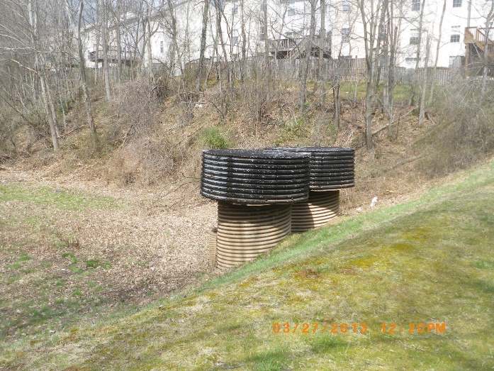
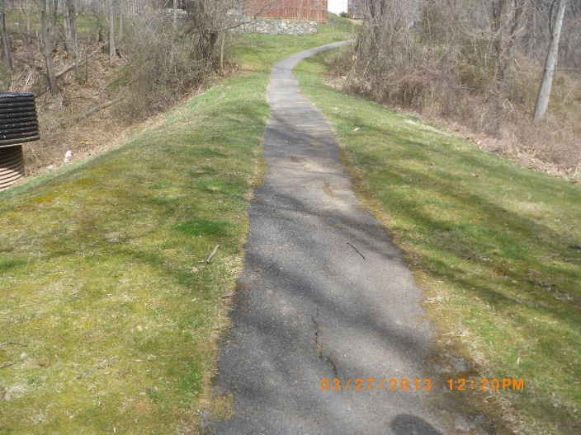
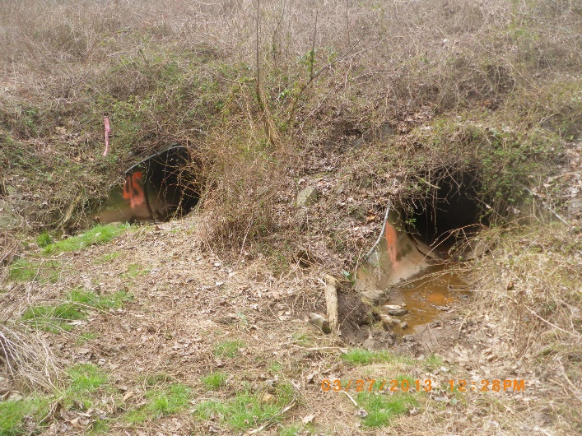
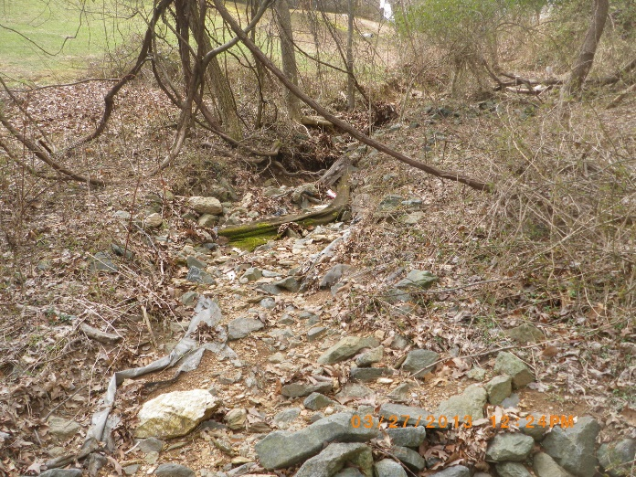
Existing Conditions
Germantown View Pond Design
Existing corrugated metal riser
Existing embankment (dam)
Existing pond outfall pipes
Inflow stream channel
13

Slide 14
Goals of the Germantown View Project
Create a permanent pool to capture nutrients and provide water quality treatment (full Water Quality Volume, WQv)
Reduce runoff “peak-flow” also called Channel Protection Volume (CPv)
Enhance site aesthetics with extensive plantings
  Aquatic plants within and along the perimeter of the permanent pool will help absorb nutrients and provide a balanced aquatic ecosystem.
    Will attract amphibian (frogs, salamanders, etc.) and (smaller) fish species
    The resulting aquatic ecosystem will have a balance of prey (mosquitoes) and predator species
Replace riser structure
Upgrade outfall barrel to current standards Using Slip Lining
14

Slide 15
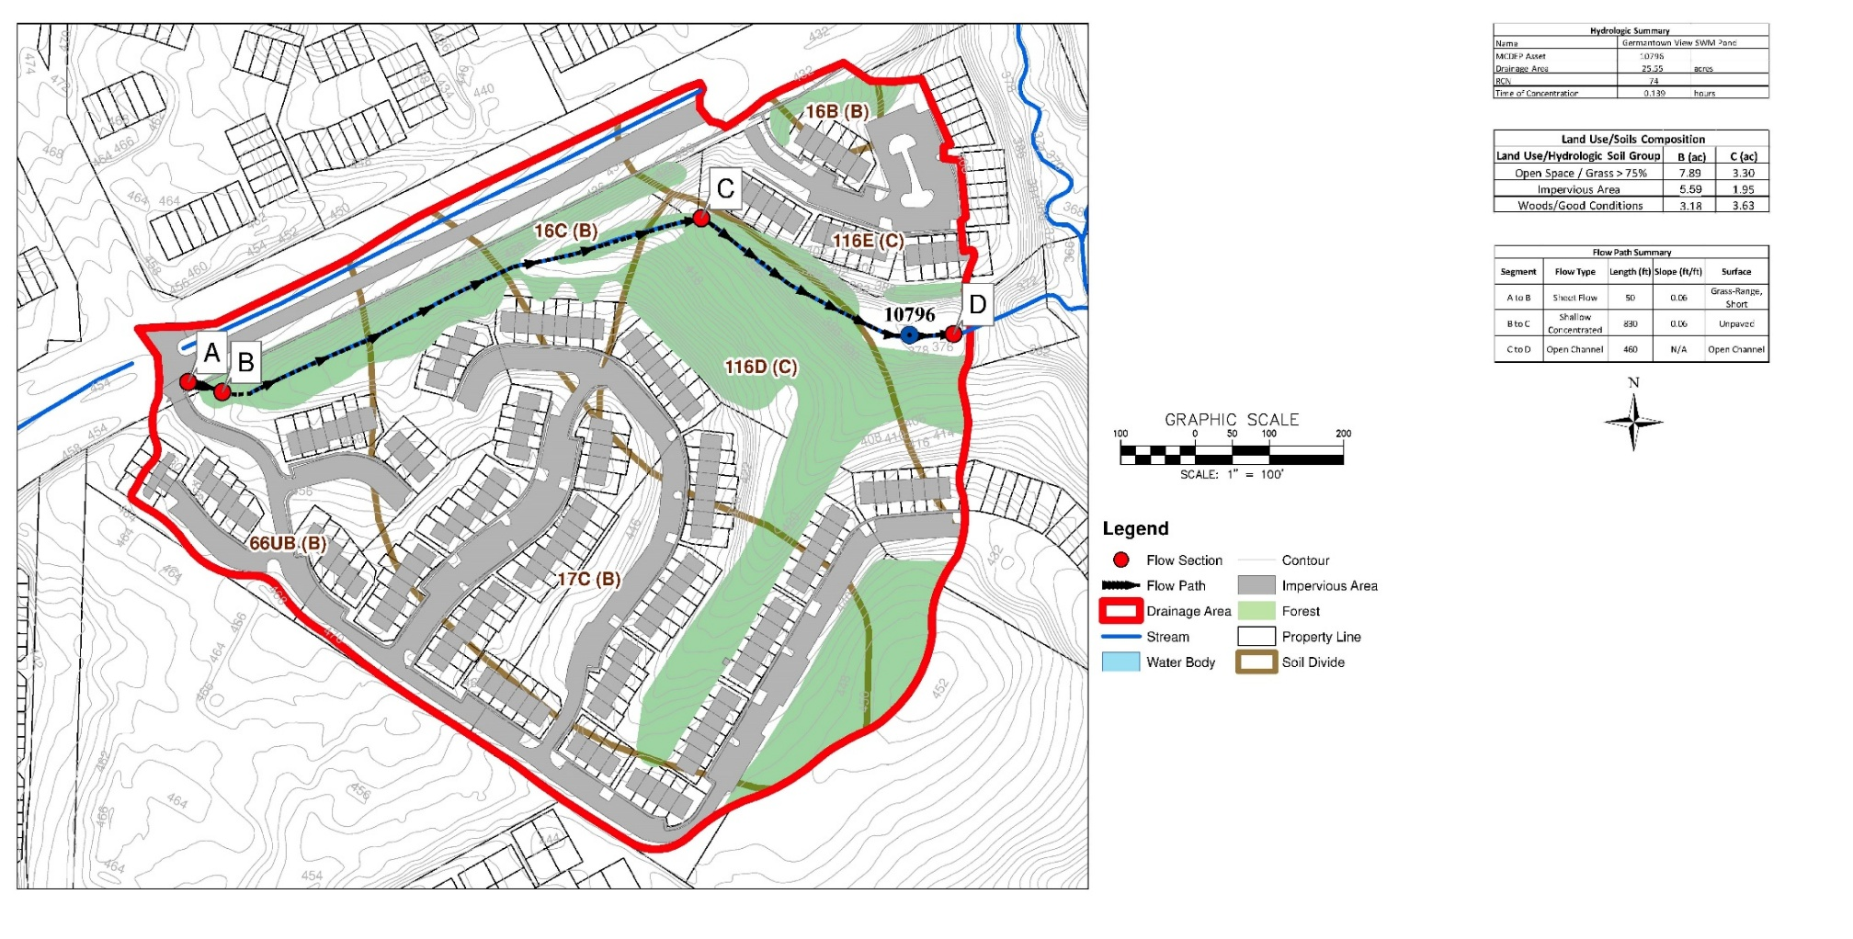
Germantown View – Drainage Area
15

Slide 16
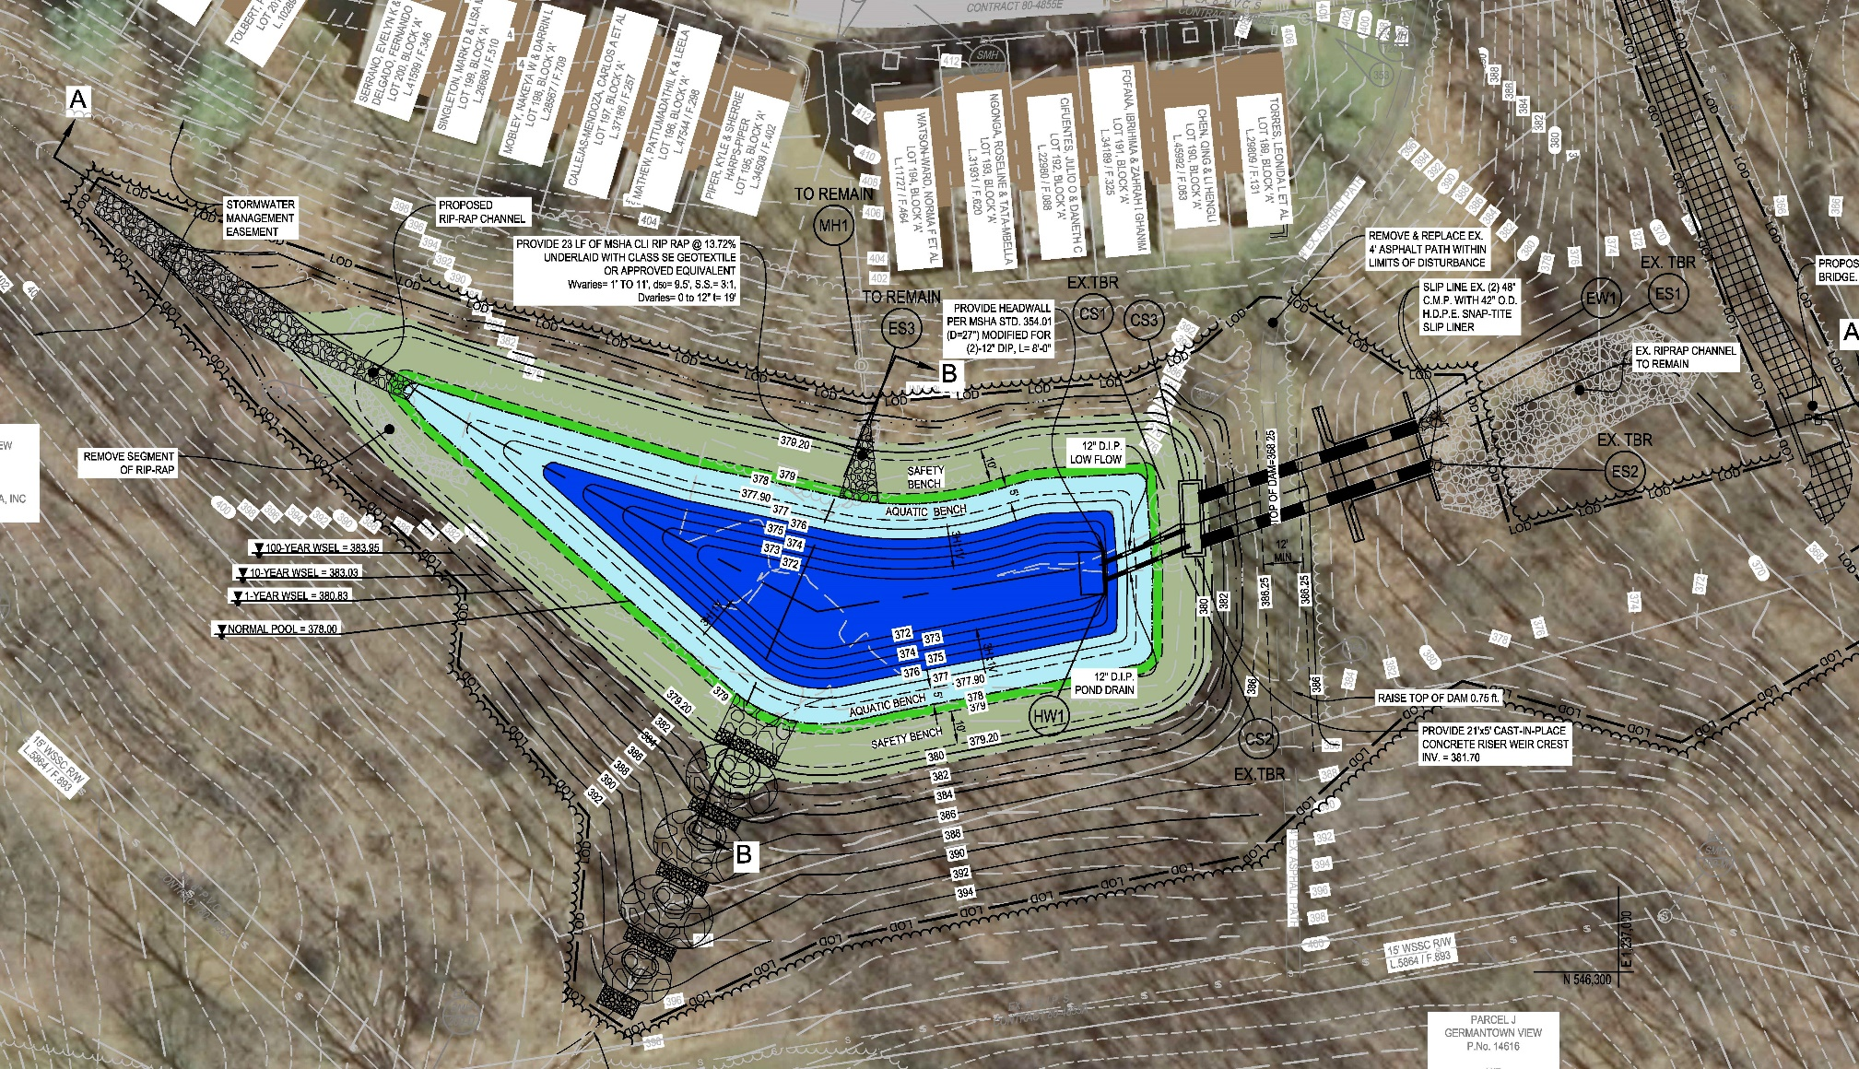
Germantown View Proposed Pond Design
Design Summary
Total DA = 110.45 acres
Individual DA = 23.03 acres
WQ Provided = 0.46 ac-ft (100%)
CPv Provided = 3.26 ac-ft (100%)
Imp Area Treated = 3.65 acres
16

Slide 17
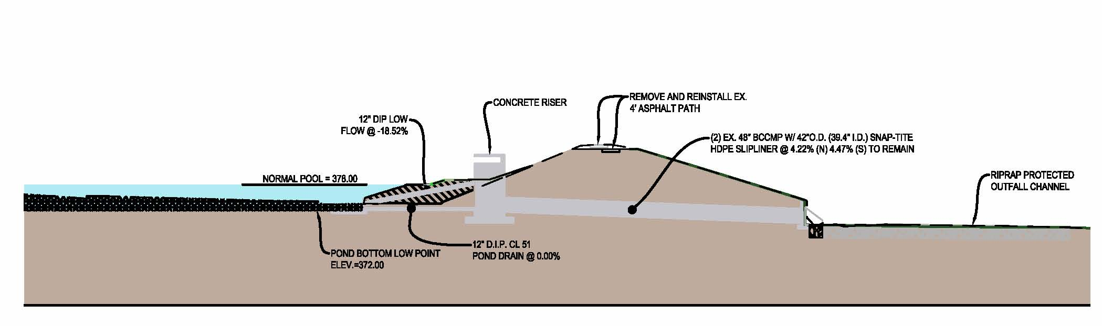
Germantown View Proposed Pond Design
17

Slide 18
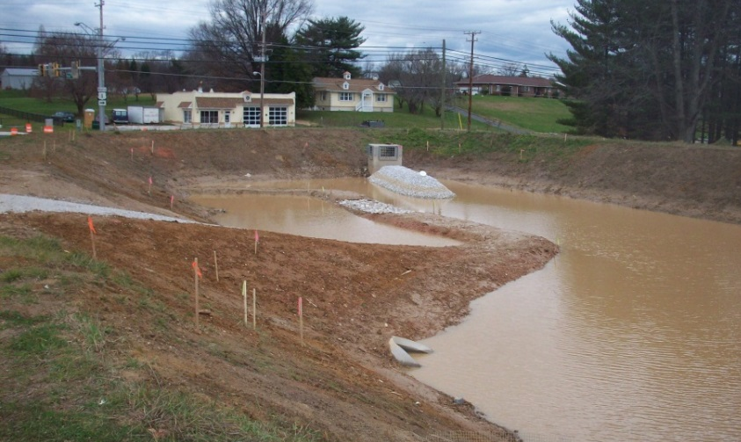
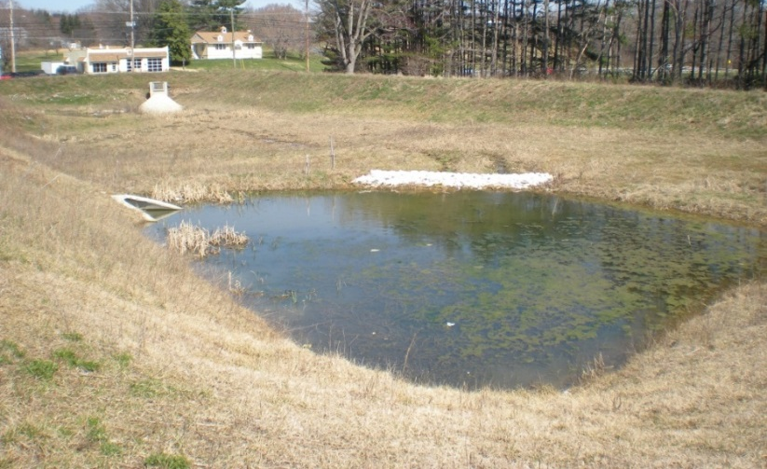
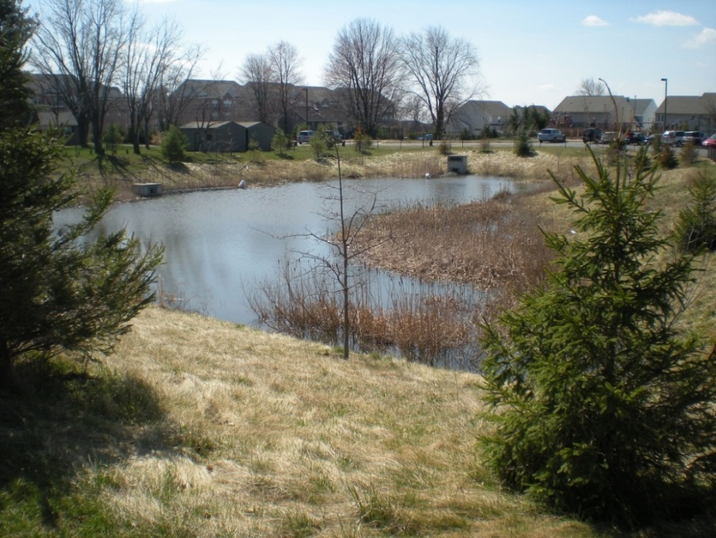
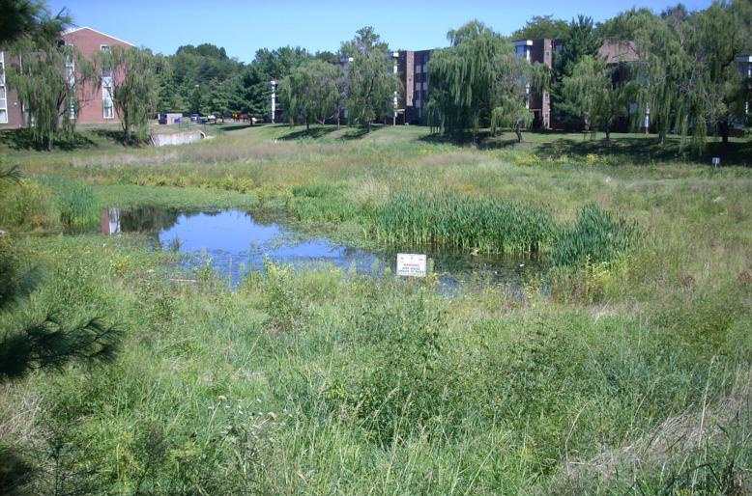
Examples of Wet Pond Retrofits
In Construction
1 Year After Construction
18
5 Years After Construction
5 Years After Construction

Slide 19
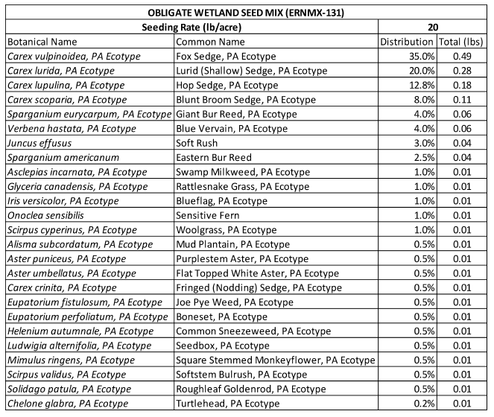
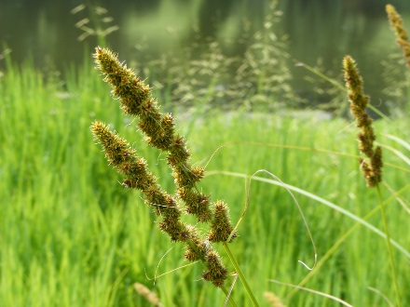
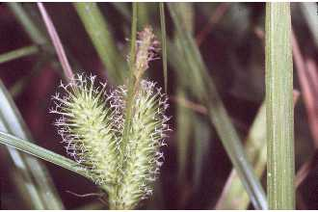
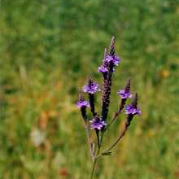
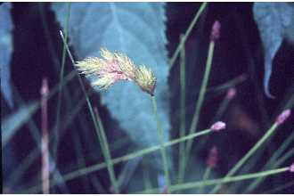
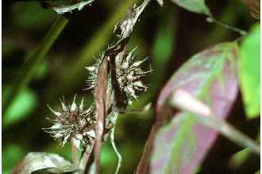
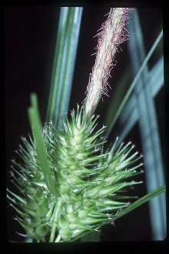
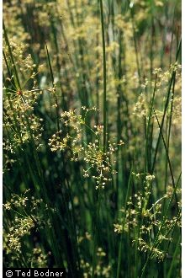
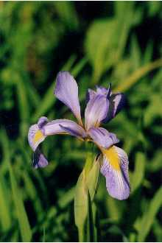
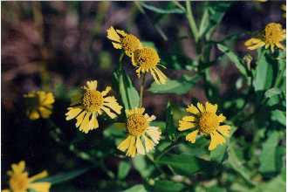
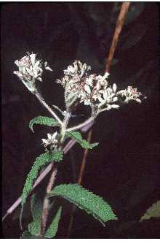
Example Native Vegetation for Aquatic Bench
19

Slide 20
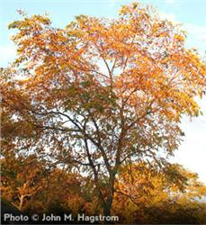
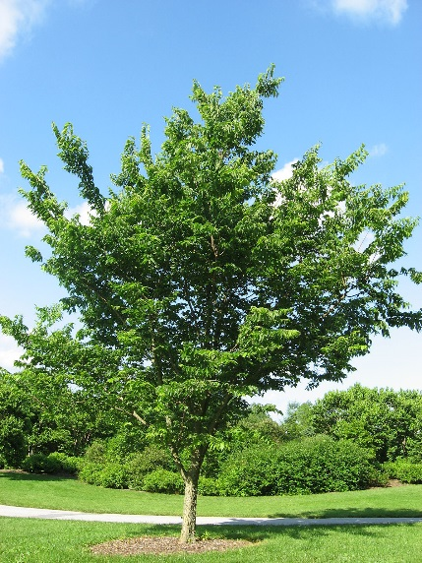
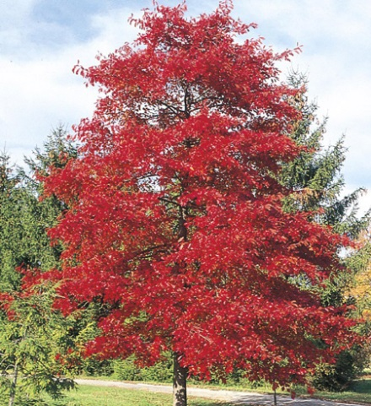
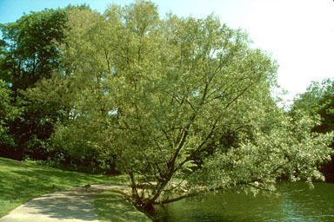
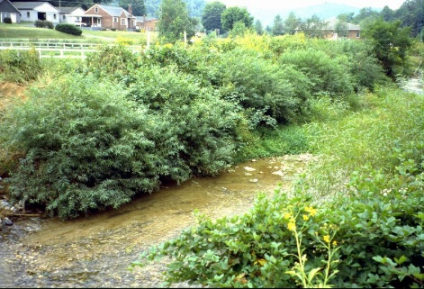
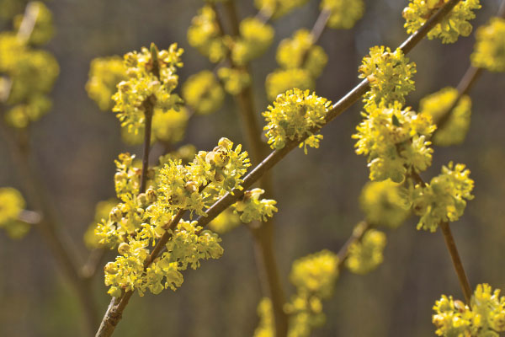
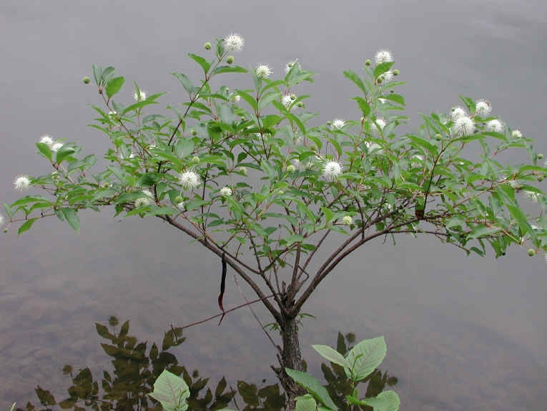
Common Riparian Trees and Plants Examples
Trees
Common Hackberry
Live Stakes
Kentucky Coffee Tree
Black Gum
Black Willow
Shrubs
Buttonbush
Buttonbush
Silky Dogwood
20

Slide 21
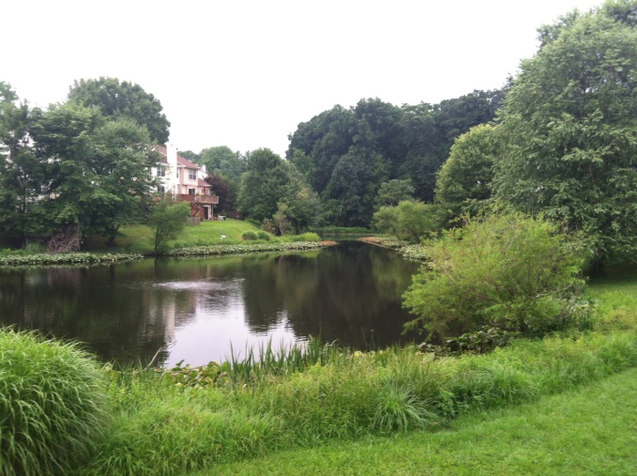
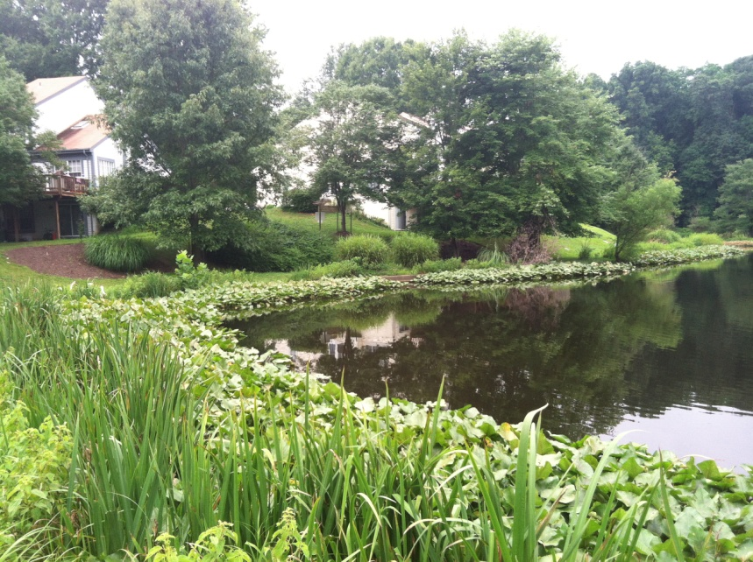
Vegetated Pond Fringe Examples
Aquatic vegetation provides buffer between the water’s edge and adjacent land
Native plant species foster aquatic ecosystem development within pond
21

Slide 22
What to Expect During Construction
Duration
  Approximately 8-10 months (weather dependent)
Construction Hours
  Monday through Friday, 7AM – 4PM
Safety
  Work limits will be fenced with high visibility orange construction safety fence
Traffic
  Access off Great Seneca Highway
Noise
  Contractor is required to comply with Montgomery County Noise Ordinance
Sediment
  Contractor will be required to comply with Montgomery County Sediment Control Permit and not track dirt onto roads
22
Notes:
Can add own photo for your own projects.

Slide 23
Questions/Comments?
Doug Marshall
(240) 777-7767 douglas.marshall@montgomerycountymd.gov
Germantown View Project Page: https://www.montgomerycountymd.gov/water/restoration/germantown-view-seneca-forest.html
23

Slide 24
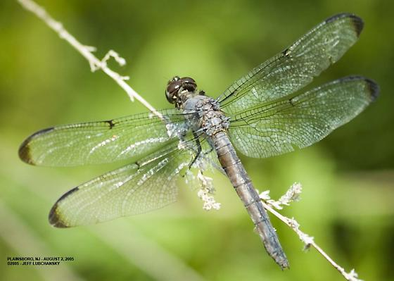
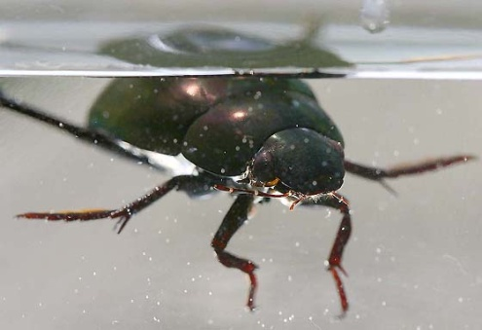
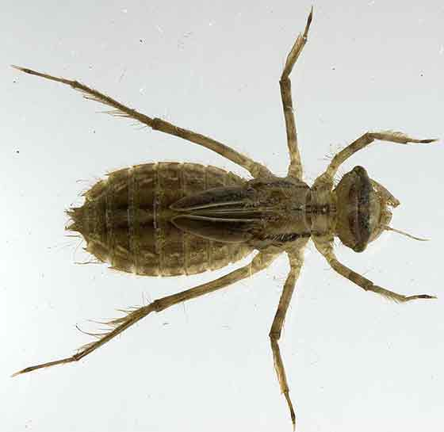
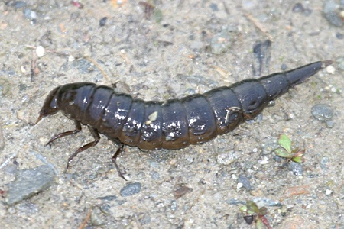
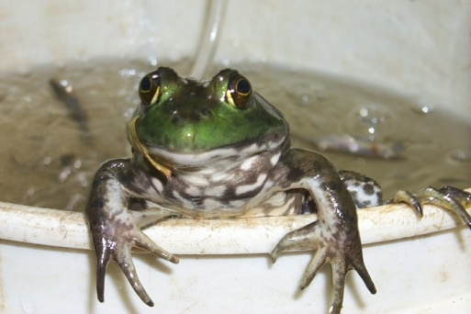
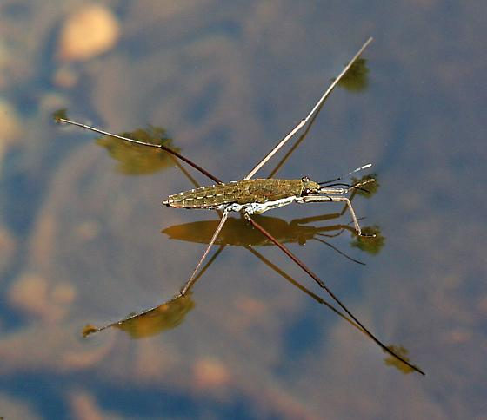
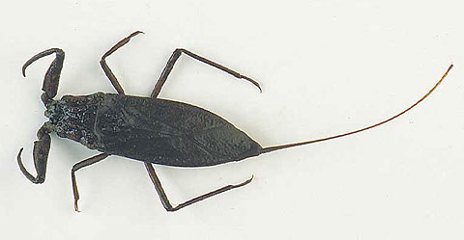
Mosquito Predators
Non-Biting Midge
Diving Beetle
Damselfly Larvae
Backswimmers
Water Scorpion
Dragonfly Nymph
Phantom Midge
Water Strider
Swallows, Adult Dragonflies, Frogs
Dragonfly
Diving beetle
Dragonfly larva
Megaloptera
Water scorpion
Frog
Water strider
24

