Slide 1

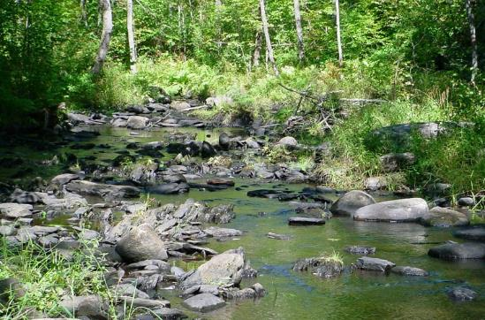

Grosvenor Stream Restoration
Virtual Public Meeting
June 14, 2021
Timberlawn & Penbrooke
Notes:
Team, Zoom patience, chat, Community amenity and protecting water quality in streams and Bay

Slide 2
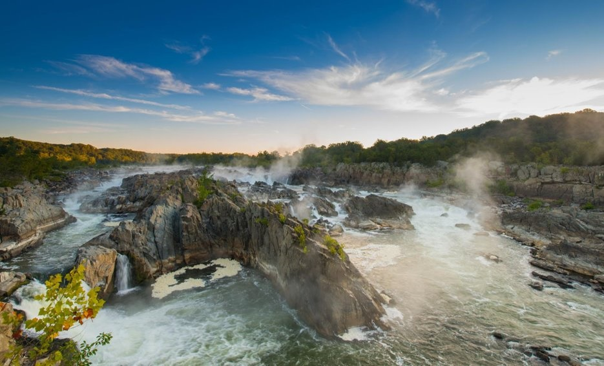
Agenda
Project Background
New Stream Design
What to Expect
Questions
History
Notes:
Pickerelweed (Pontederia cordata)

Slide 3
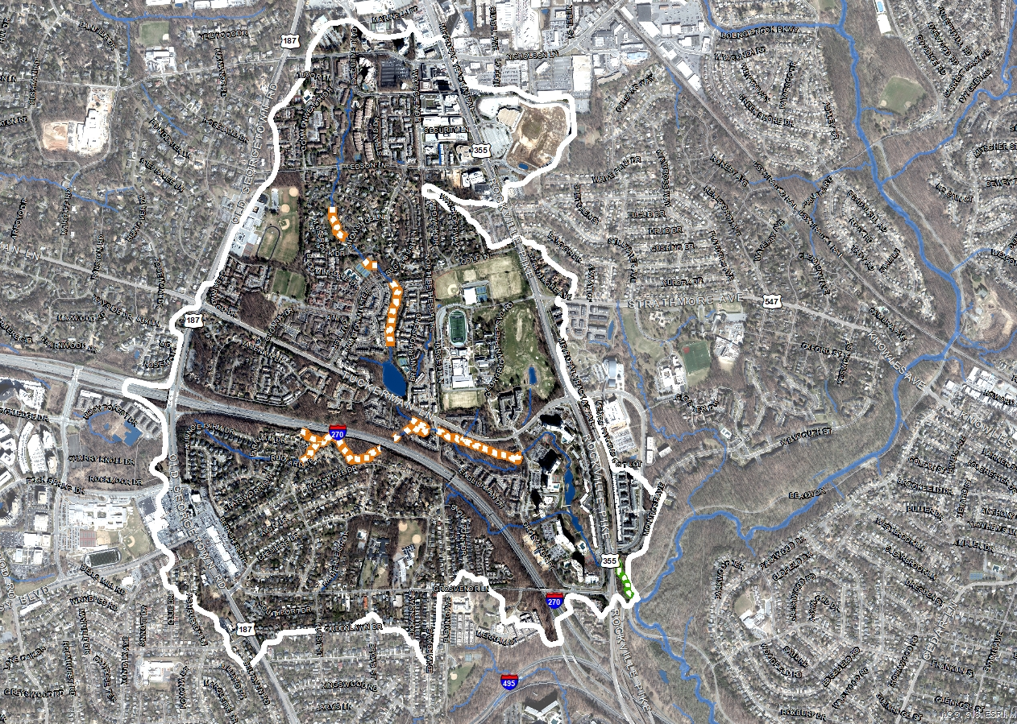
Grosvenor Tributary – Rock Creek
187
355
Tuckerman Ln
Rock Creek
History
270
Drainage Area: 1,116 acres
Impervious Cover: 40.0 %

Slide 4
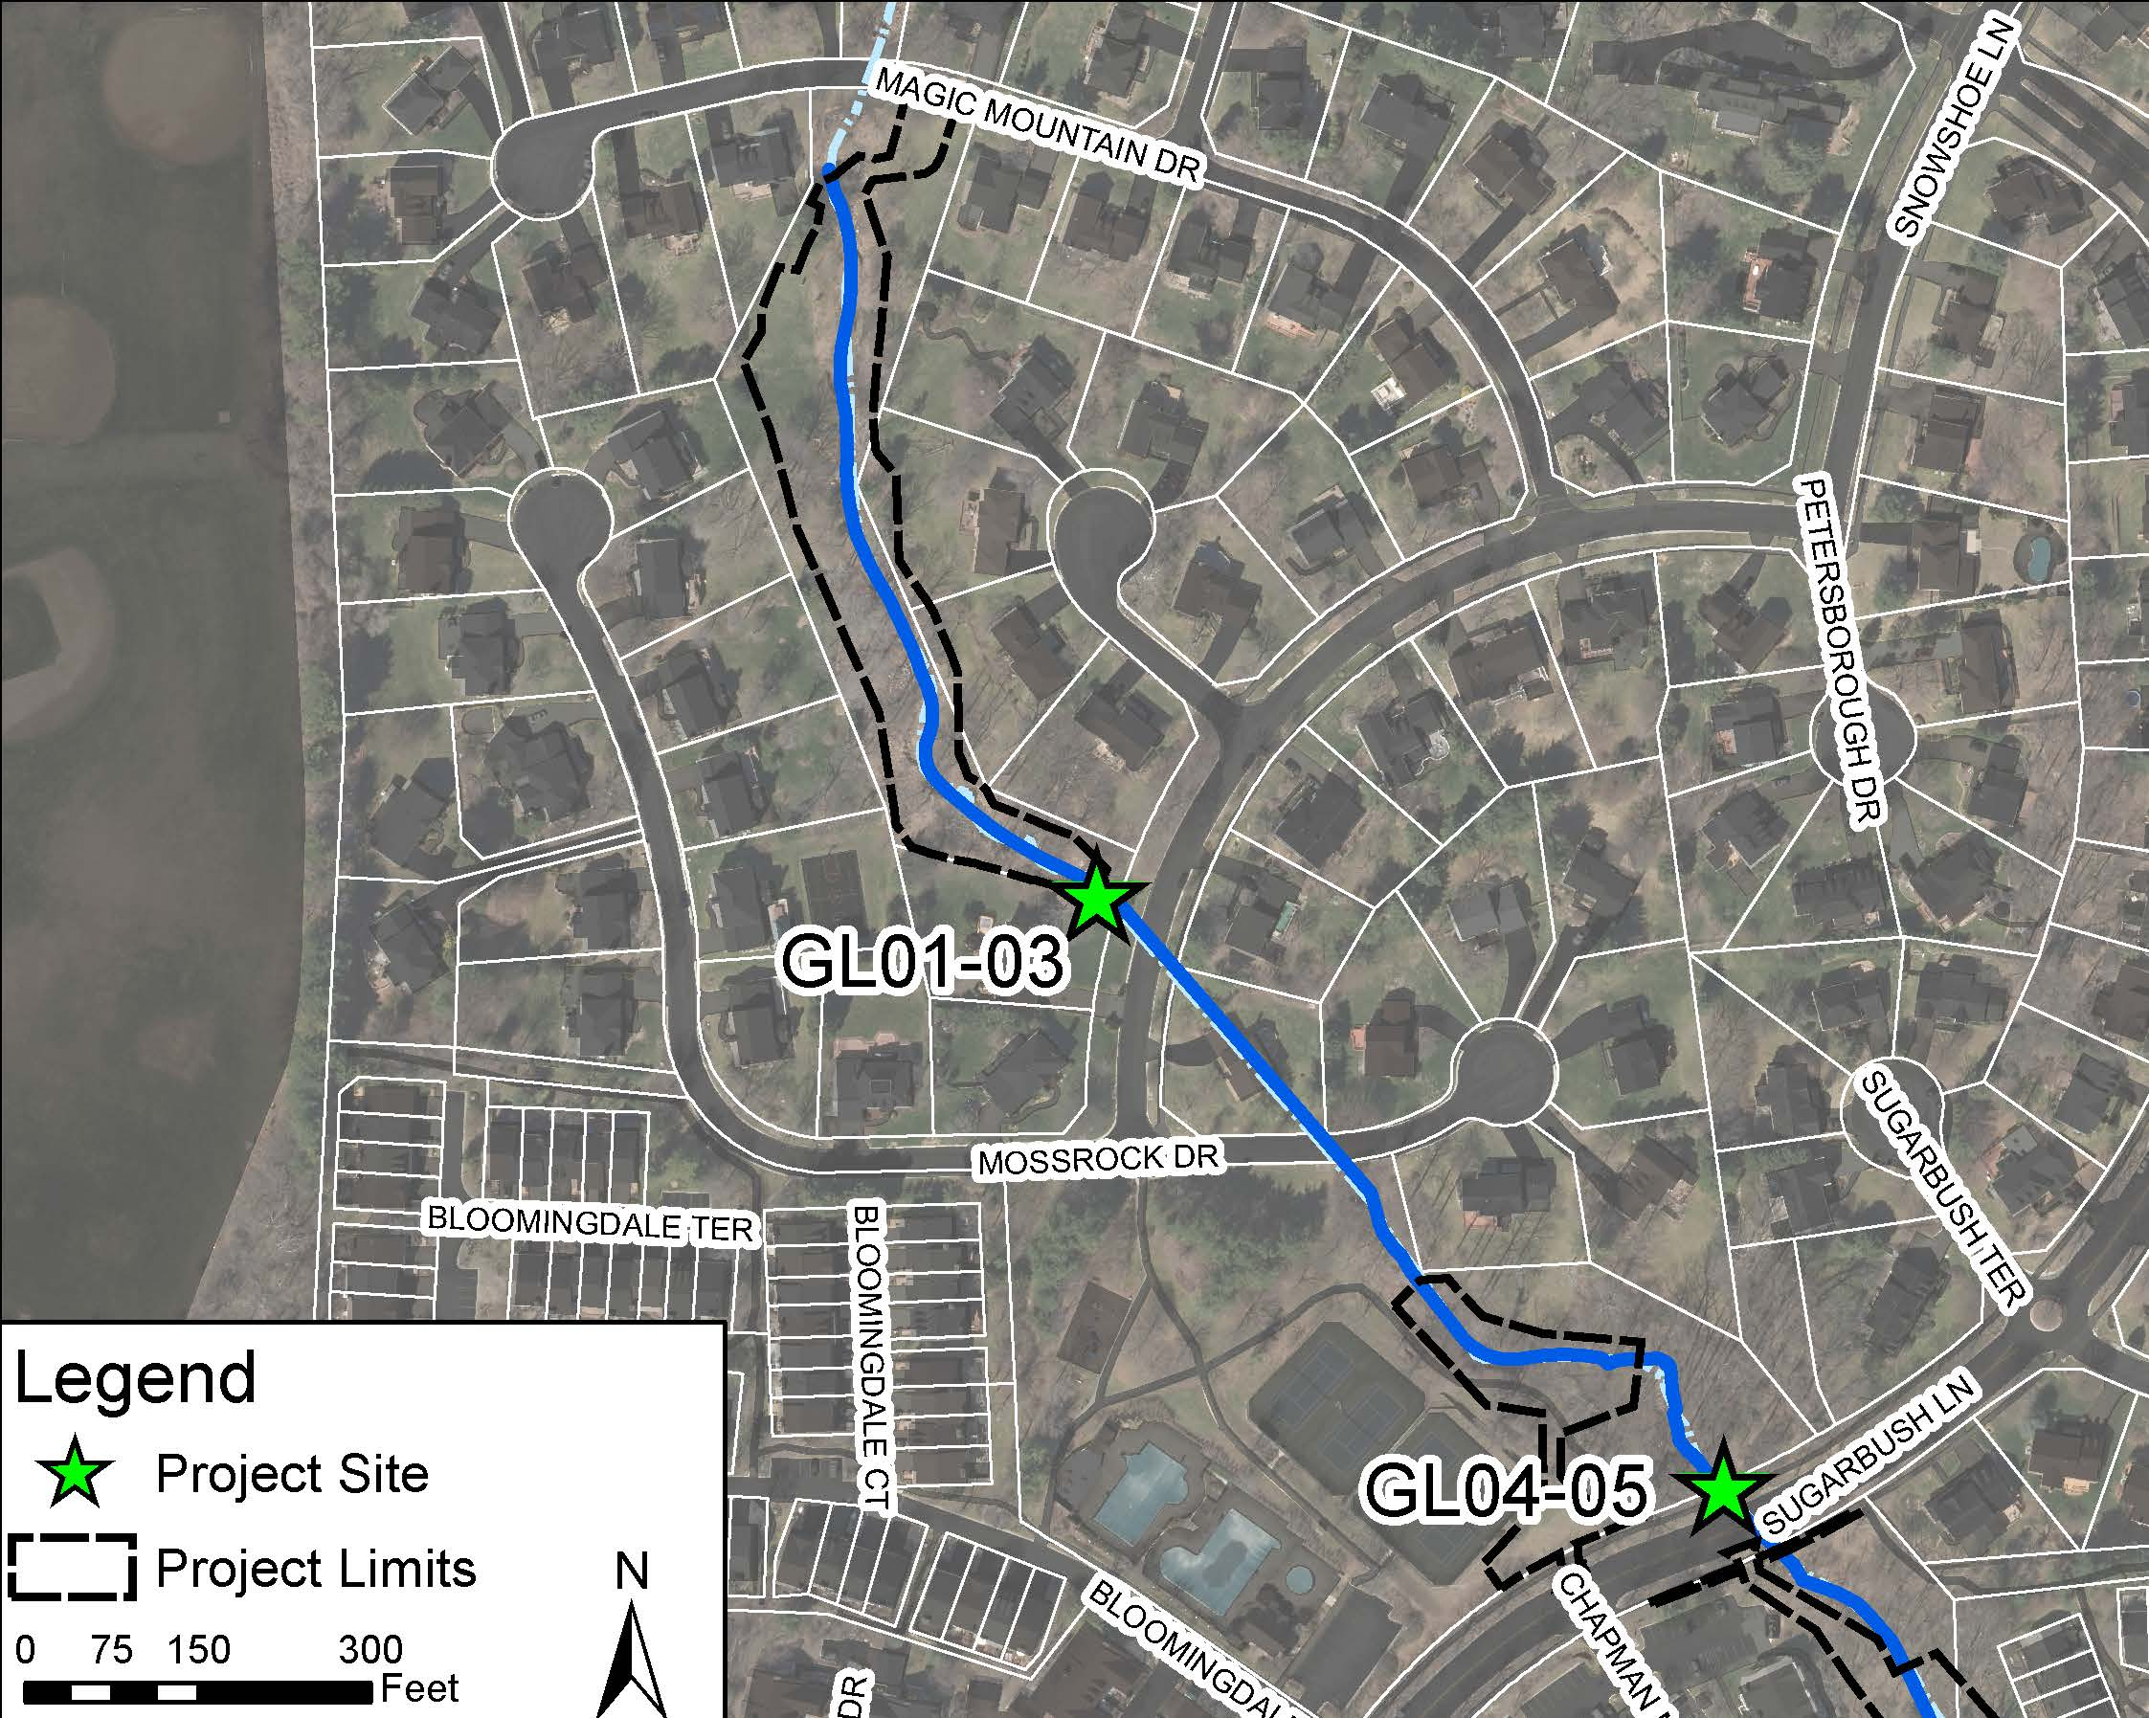
Project Location
Project Limits of Disturbance
Notes:
.

Slide 5
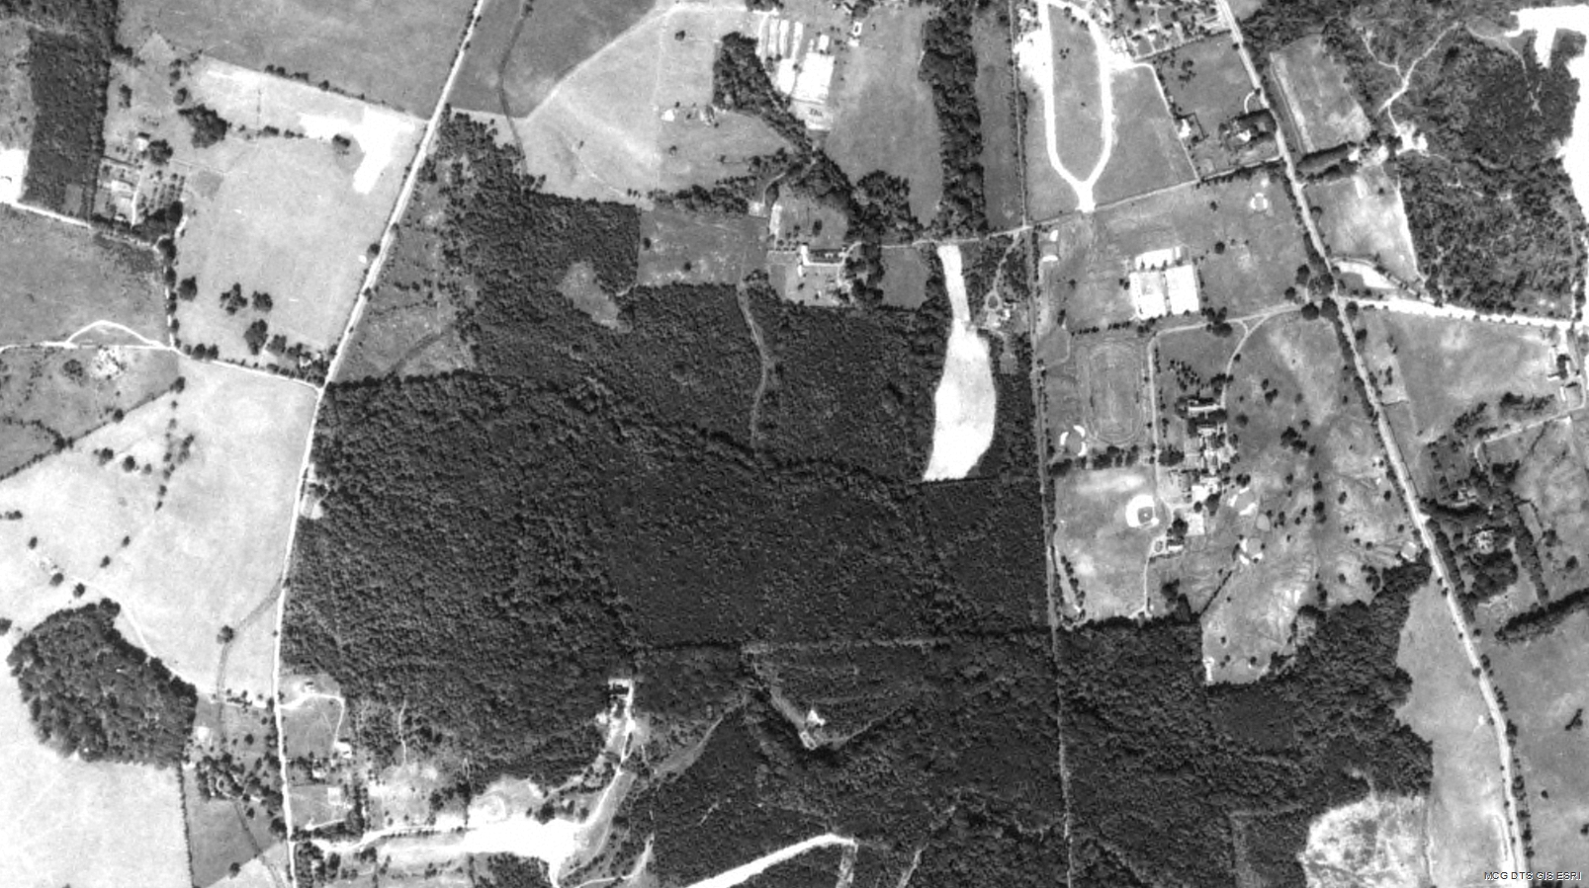
Recognize This?
History
Notes:
Northwest Branch - Bel Pre Creek, which drains to Northwest Branch - Bel Pre Creek, which flows into Anacostia River, and eventually into the Potomac River.

Slide 6
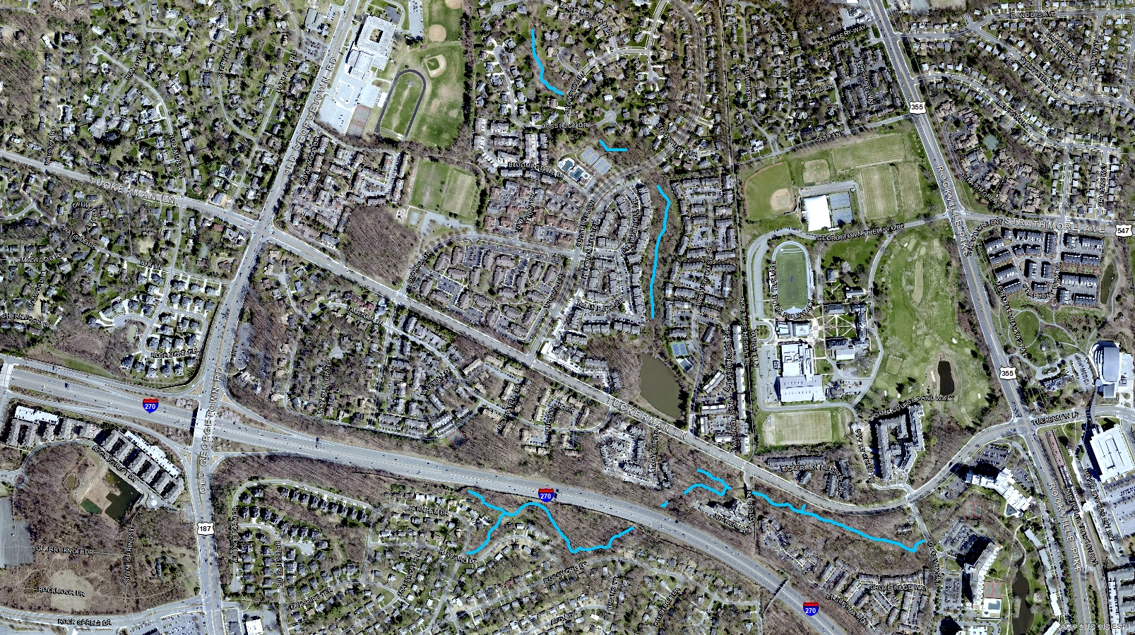
Recognize Now?
History
Notes:
Northwest Branch - Bel Pre Creek, which drains to Northwest Branch - Bel Pre Creek, which flows into Anacostia River, and eventually into the Potomac River.

Slide 7
Watershed Changes – 70 years
History
Notes:
Northwest Branch - Bel Pre Creek, which drains to Northwest Branch - Bel Pre Creek, which flows into Anacostia River, and eventually into the Potomac River.

Slide 8
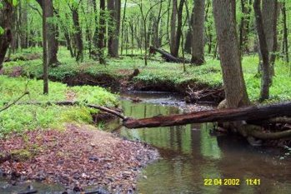
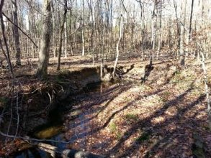
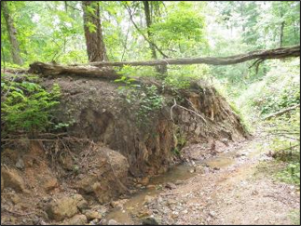
Why is stream restoration being done?
Because increased impervious and uncontrolled/under-controlled stormwater is impacting our streams​
Stream in a Watershed with 8% impervious cover.
Stream in a Watershed with 20% Impervious Cover
Stream in a Watershed with 30% impervious Cover
Notes:
Northwest Branch - Bel Pre Creek, which drains to Northwest Branch - Bel Pre Creek, which flows into Anacostia River, and eventually into the Potomac River.

Slide 9
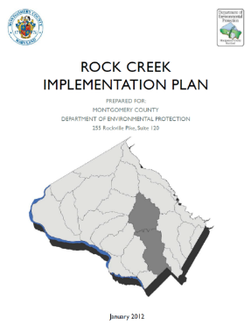
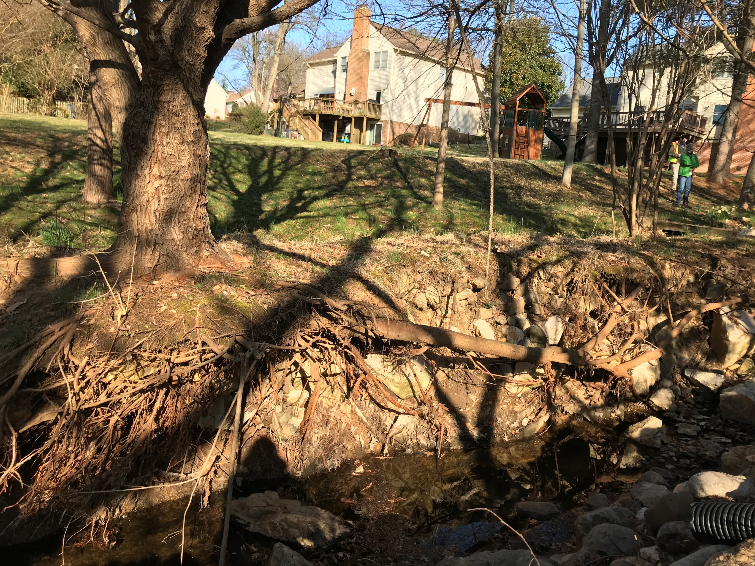
Project Selection
Constructed in the 1960-1980s
Located in a key watershed (Rock Creek) for restoration
Erosion of banks threatening utilities and natural resources
Opportunity for water quality and ecological improvements
Notes:
County required to restore watershed – high untreated IA – water quality

Slide 10
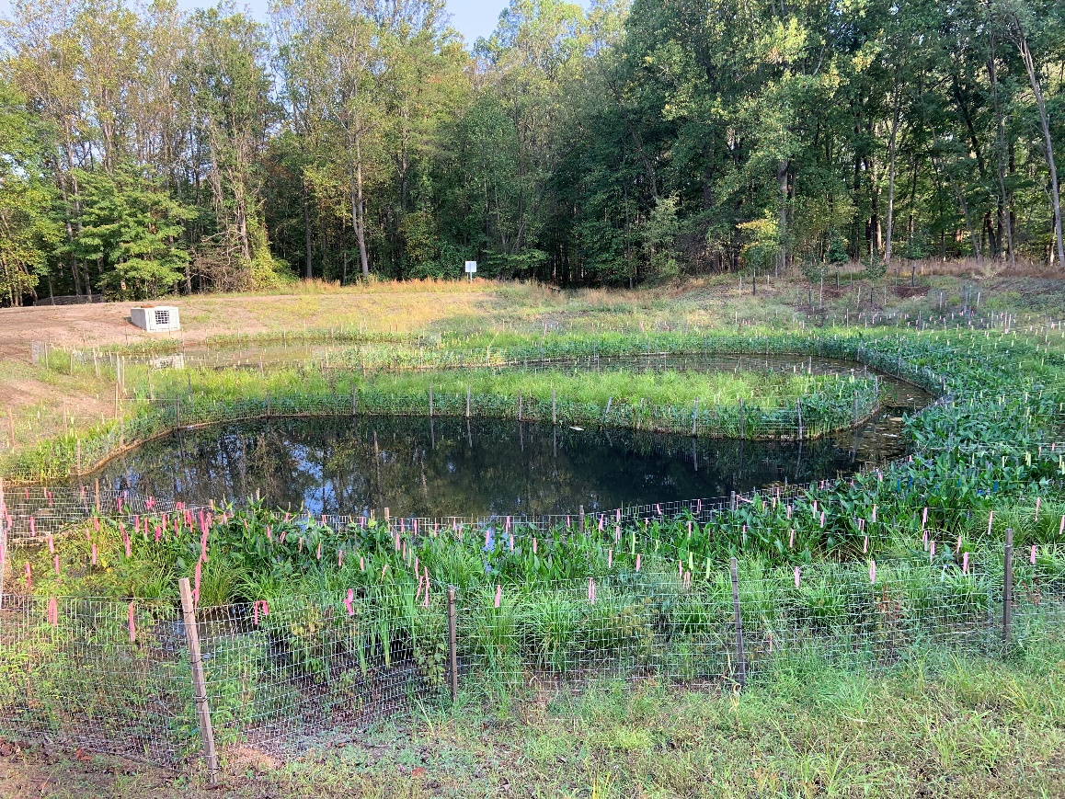
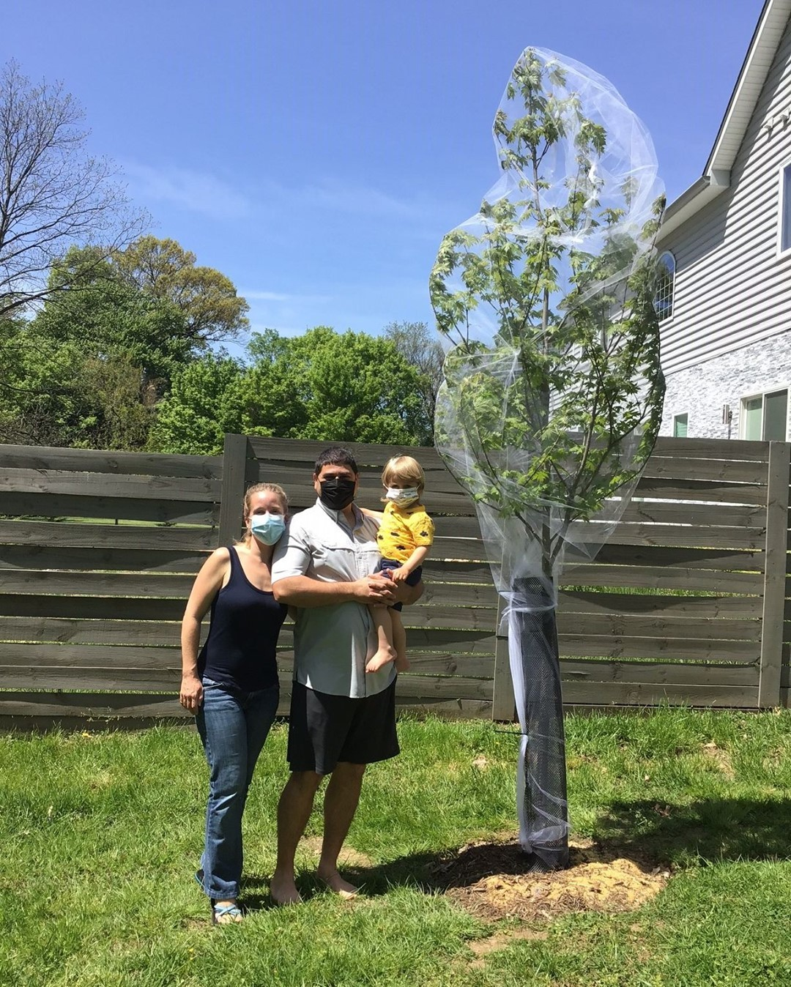
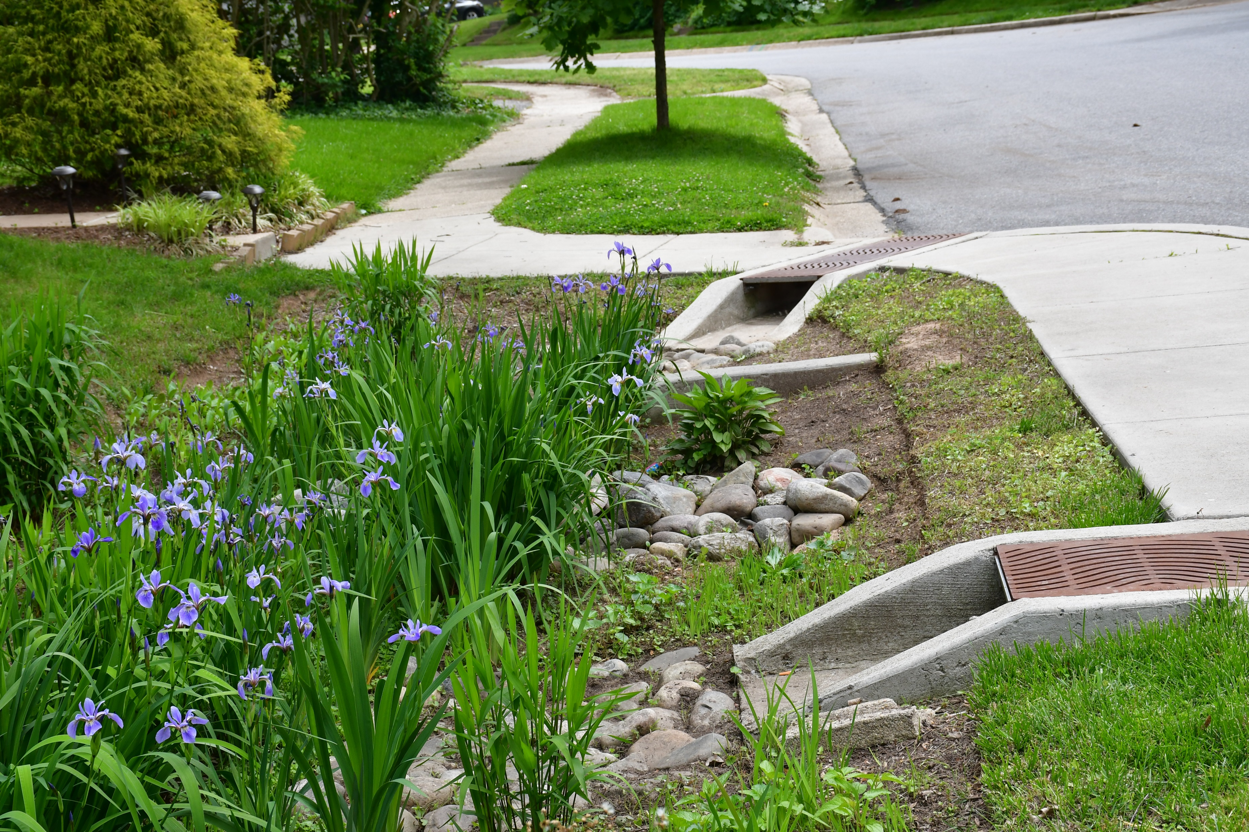
Watershed Restoration
Pond Improvements
Bioretention/Raingarden
Tree Canopy

Slide 11
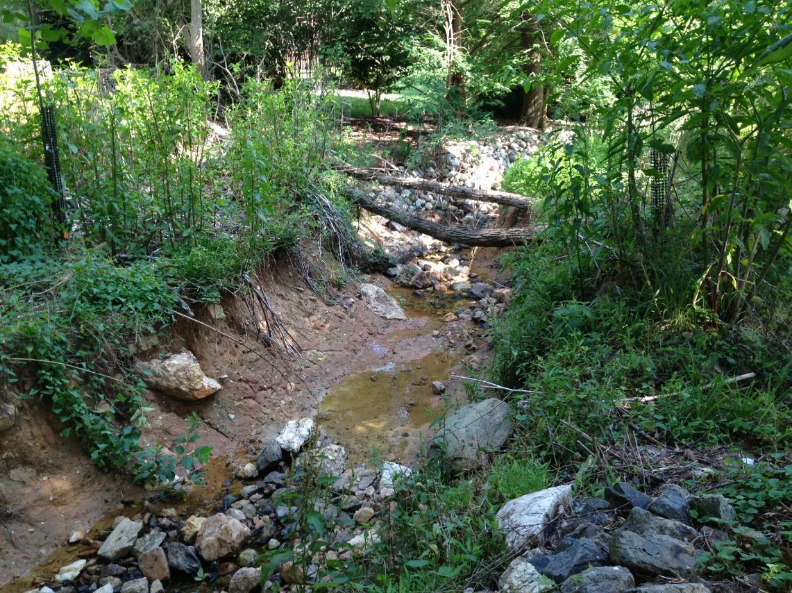
Current Stream Condition (Timberlawn)
Existing Photos

Slide 12
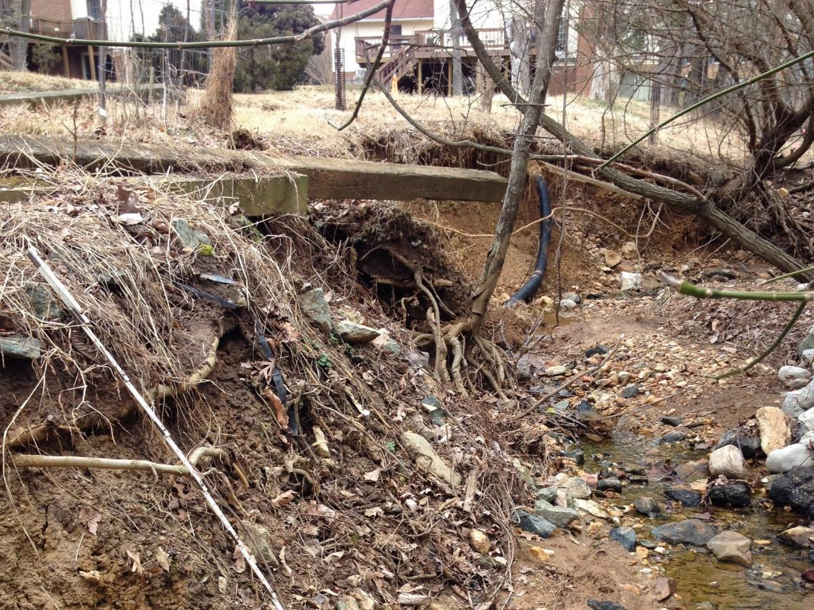
Current Stream Condition (Timberlawn)
Existing Photos

Slide 13
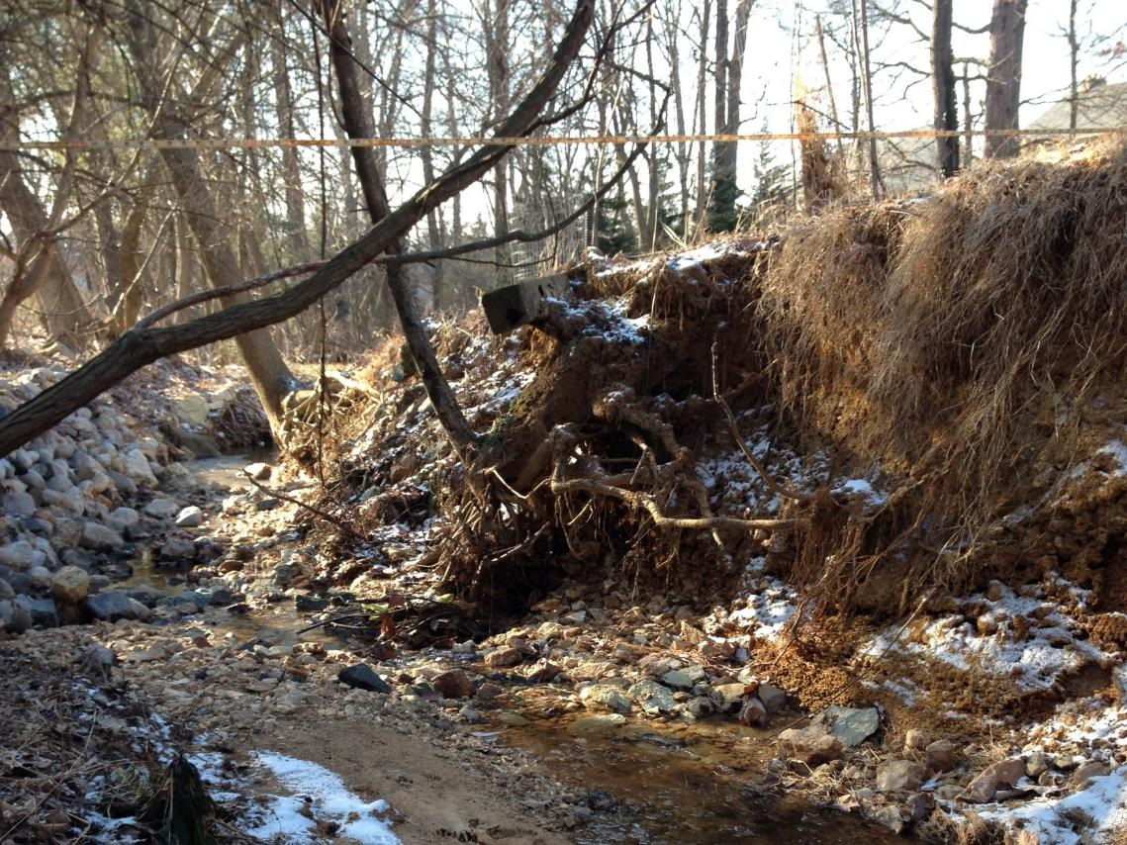
Current Stream Condition (Timberlawn)
Existing Photos

Slide 14
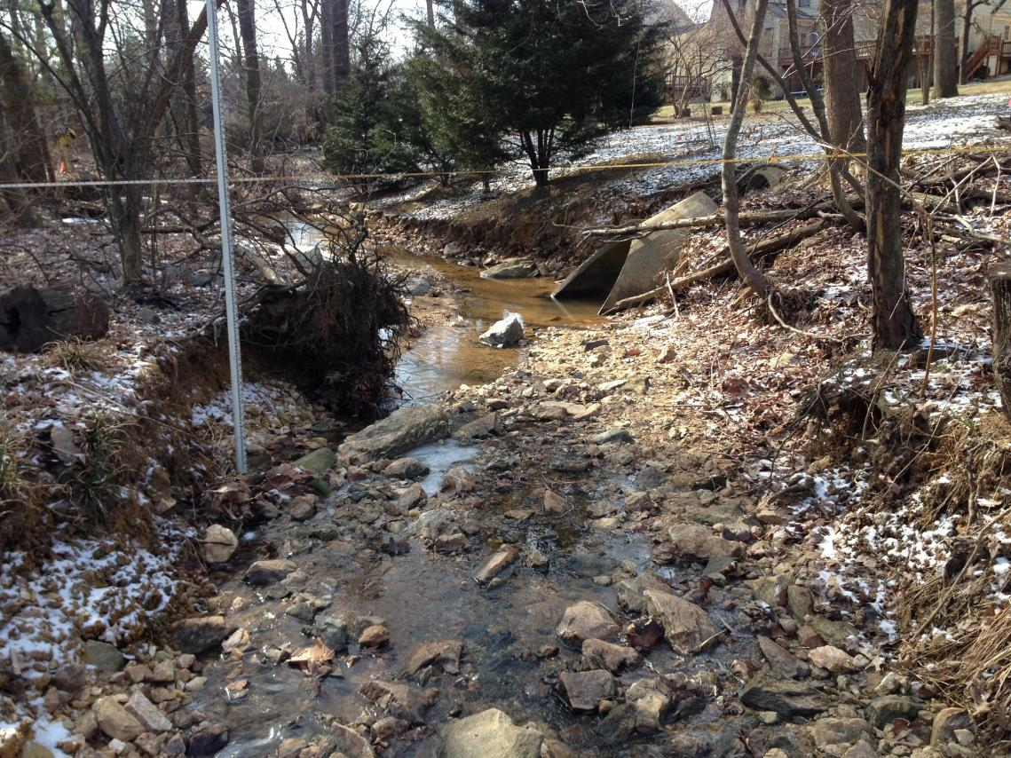
Current Stream Condition (Timberlawn)
Existing Photos

Slide 15
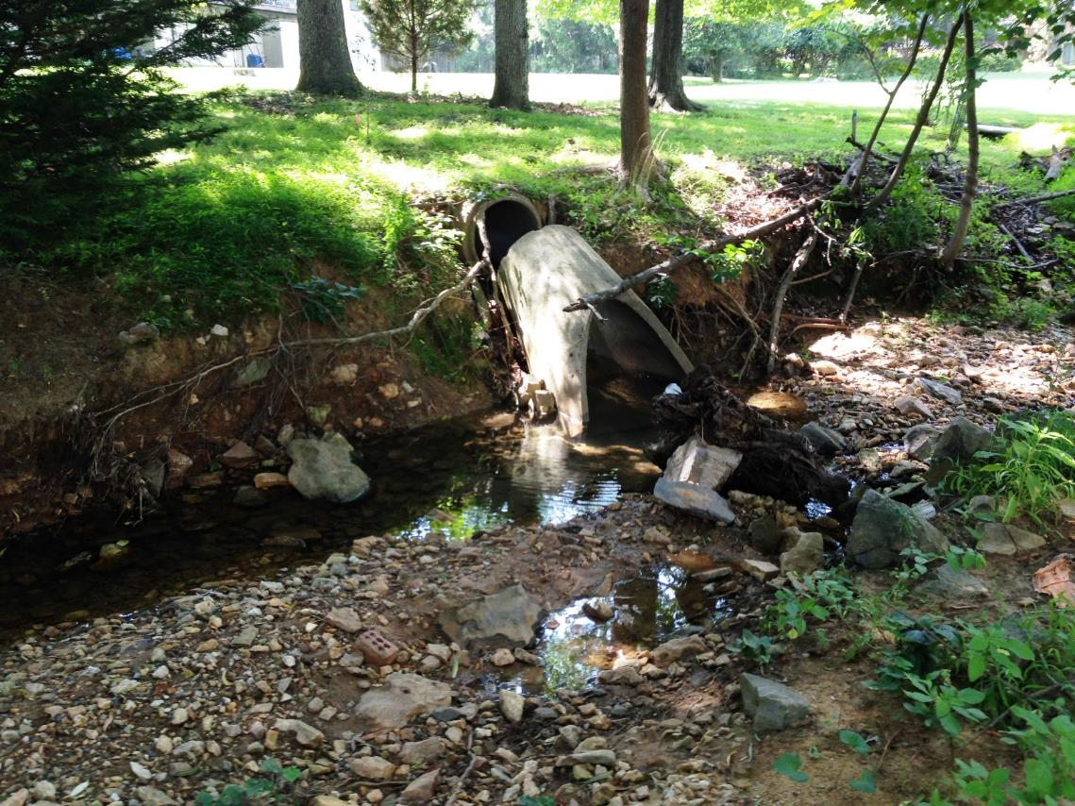
Current Stream Condition (Timberlawn)
Existing Photos

Slide 16
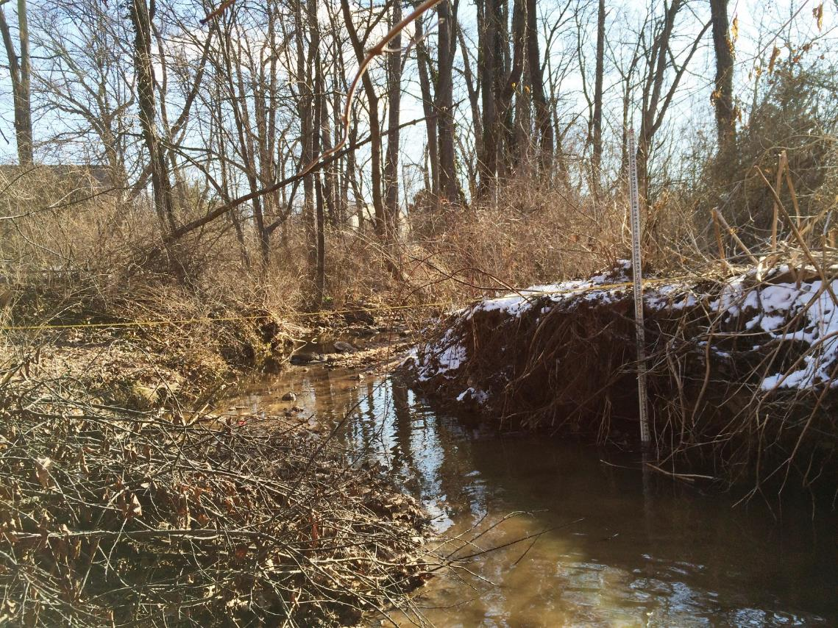
Current Stream Condition (Penbrooke)
Existing Photos

Slide 17
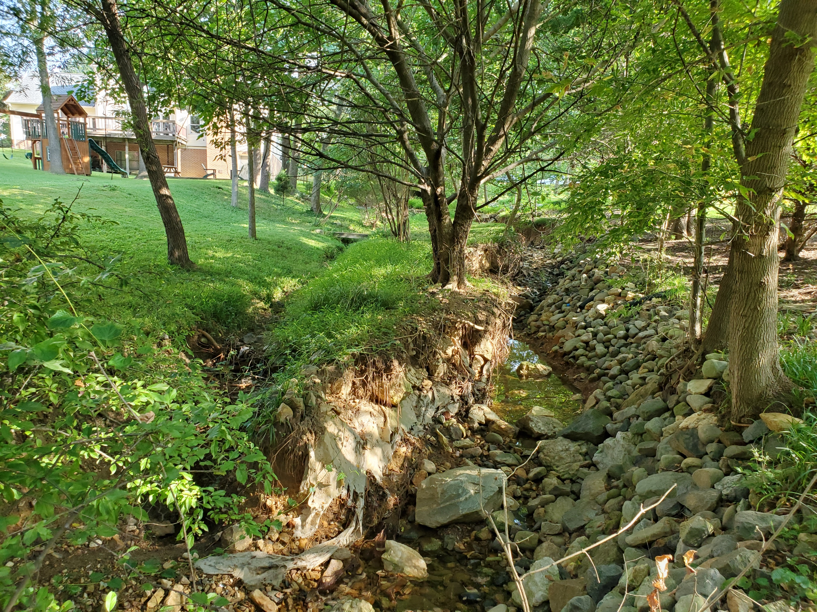
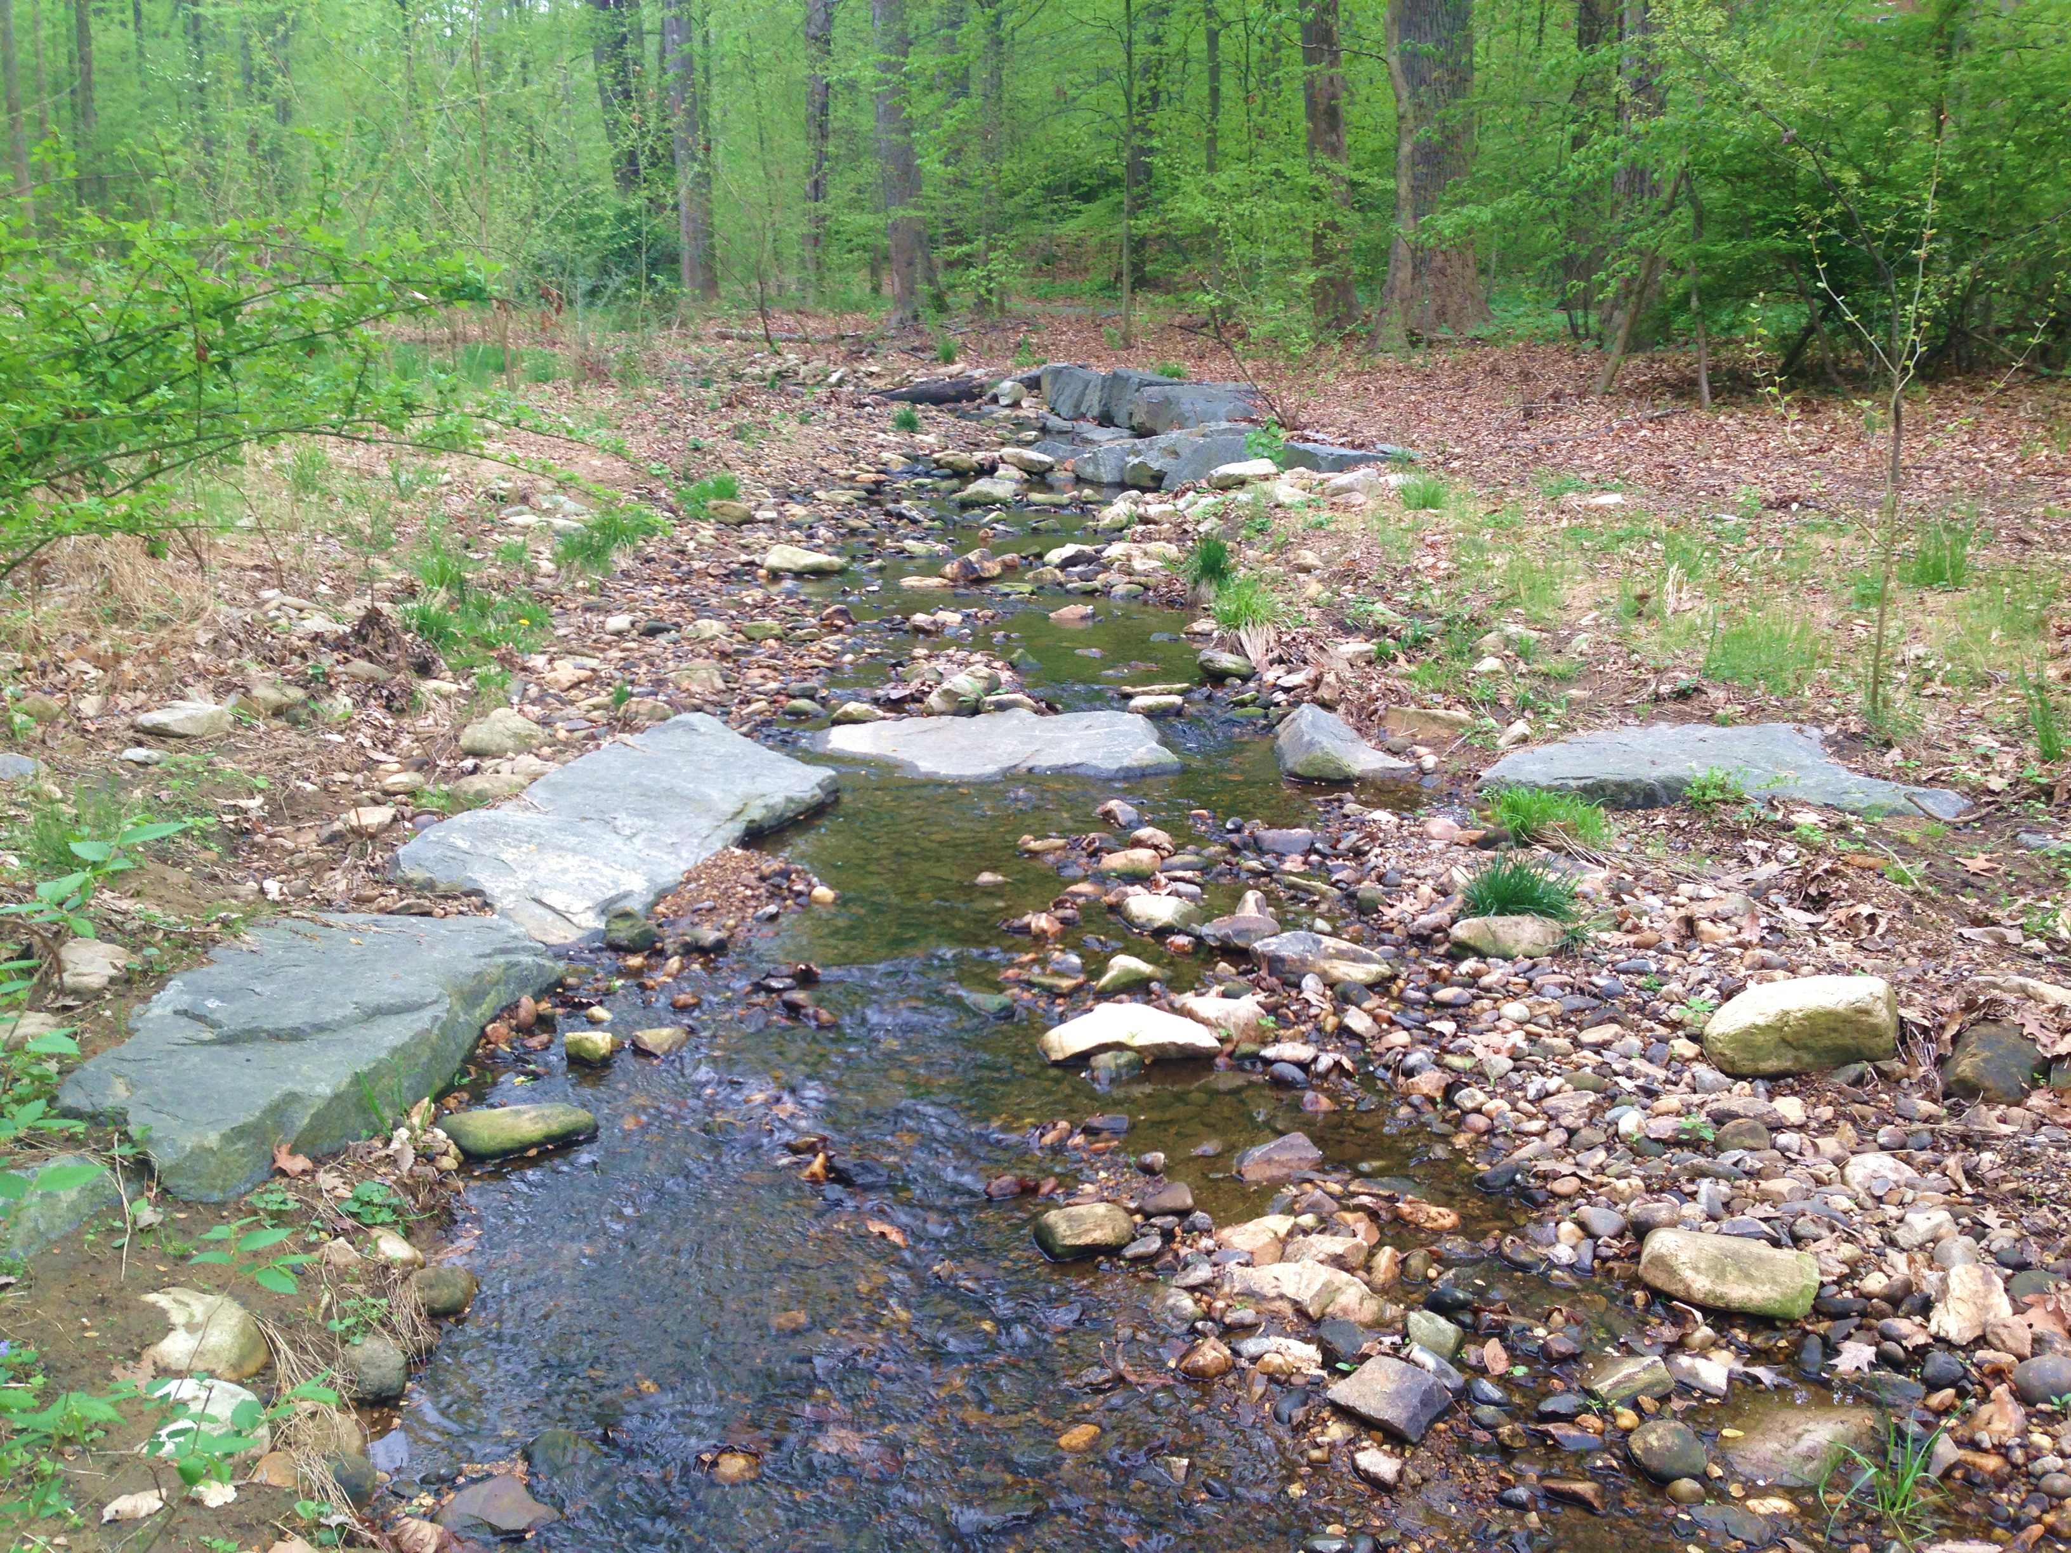
Project Objectives
Improve water quality
Improve riparian buffer between stream and properties
Stabilize stream banks to lessen future erosion
Project Objectives
Notes:
Design improves the pond grading to maximize shallow pool areas for aquatic vegetation. This enhances the facility on several levels. The vegetation improves the aesthetic appearance as well as the aquatic habitats. In addition, it increases the water quality for the downstream creeks and rivers.

Slide 18
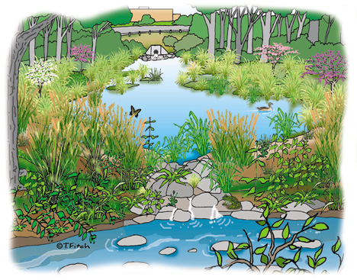
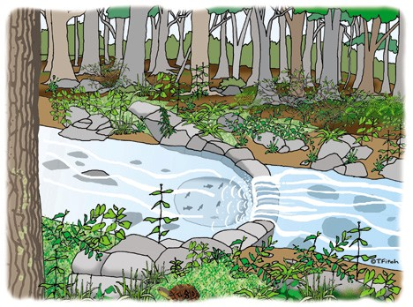
Stream Restoration Approach
In-Stream Structures (Cross Vane, Step Pool, etc.)
Habitat enhancement
Riffle/pool system for aquatic habitat and fish passage
Diverse and native plant communities, forested wetlands
Pollutant Reduction
Erosion prevention & Sediment trapping
Project Objectives
Notes:
Channel bed grade control & reduce bank velocity
Maintain Channel Capacity
Riparian cover – shading and avian habitat
Design improves the pond grading to maximize shallow pool areas for aquatic vegetation. This enhances the facility on several levels. The vegetation improves the aesthetic appearance as well as the aquatic habitats. In addition, it increases the water quality for the downstream creeks and rivers.

Slide 19
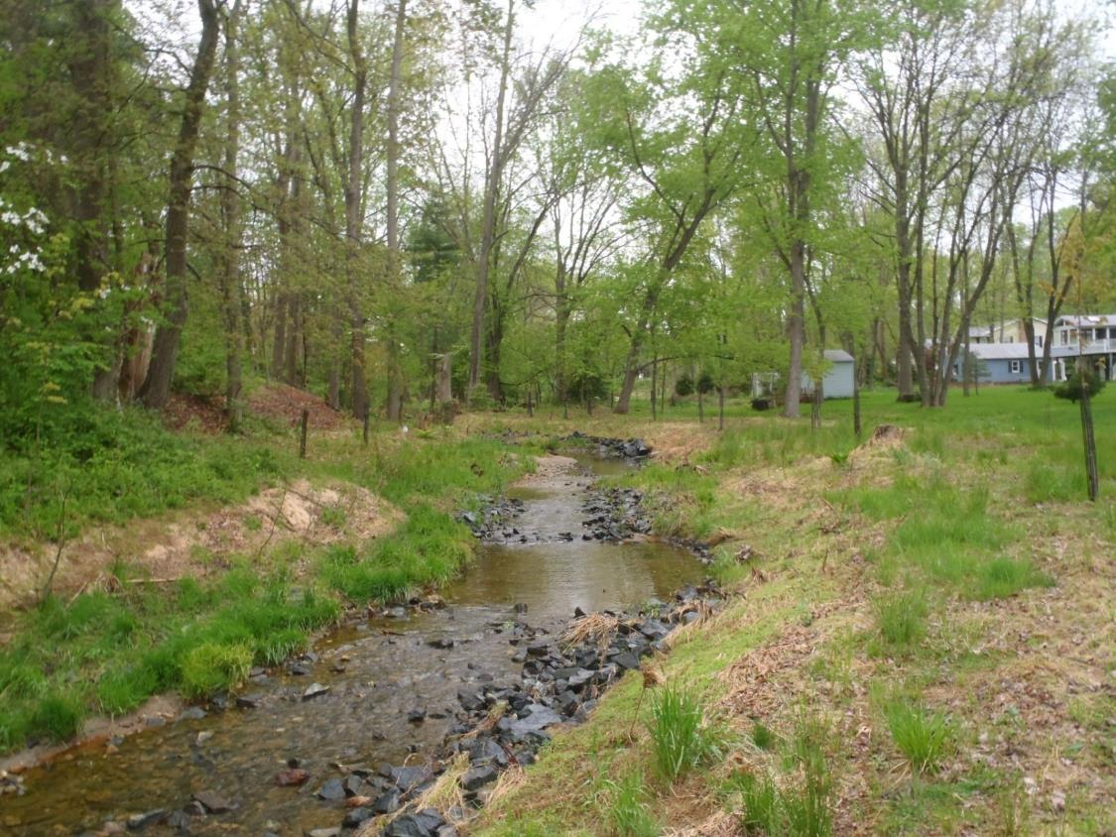
Riffle/ Pool Sequence
Stream Restoration
Notes:
Design improves the pond grading to maximize shallow pool areas for aquatic vegetation. This enhances the facility on several levels. The vegetation improves the aesthetic appearance as well as the aquatic habitats. In addition, it increases the water quality for the downstream creeks and rivers.

Slide 20
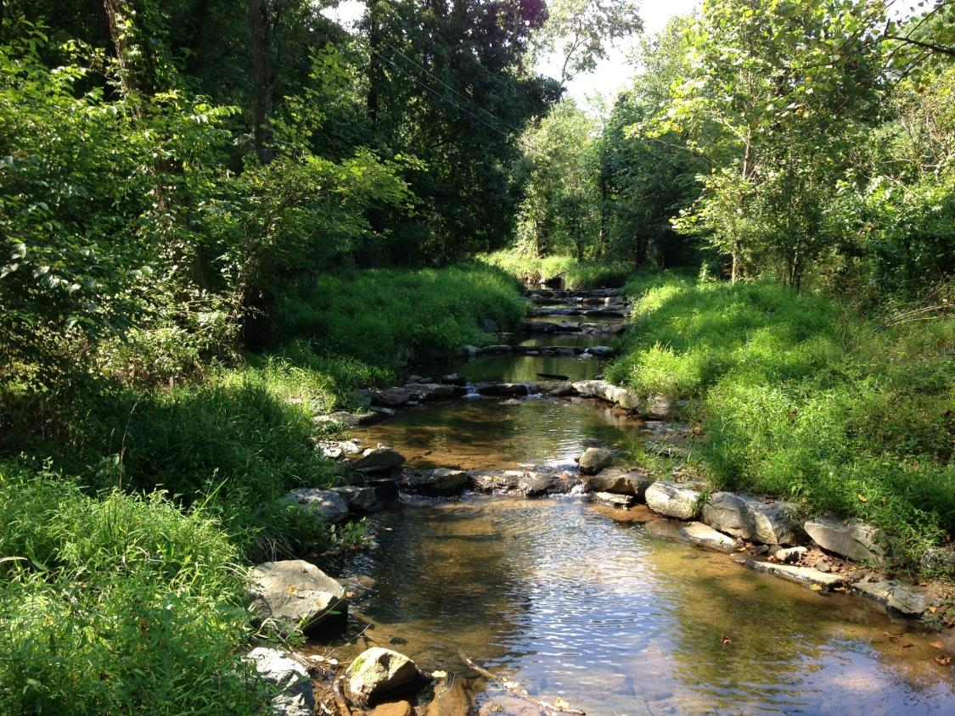
Step Pool System
Stream Restoration
Notes:
Design improves the pond grading to maximize shallow pool areas for aquatic vegetation. This enhances the facility on several levels. The vegetation improves the aesthetic appearance as well as the aquatic habitats. In addition, it increases the water quality for the downstream creeks and rivers.

Slide 21
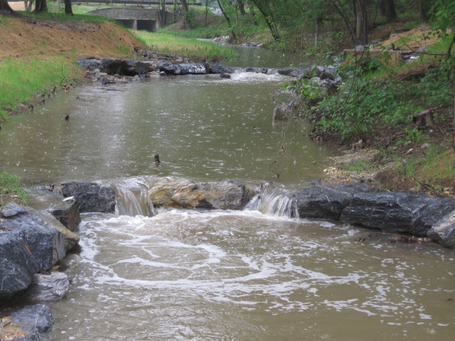
Cross Vane
Stream Restoration
Notes:
Design improves the pond grading to maximize shallow pool areas for aquatic vegetation. This enhances the facility on several levels. The vegetation improves the aesthetic appearance as well as the aquatic habitats. In addition, it increases the water quality for the downstream creeks and rivers.

Slide 22
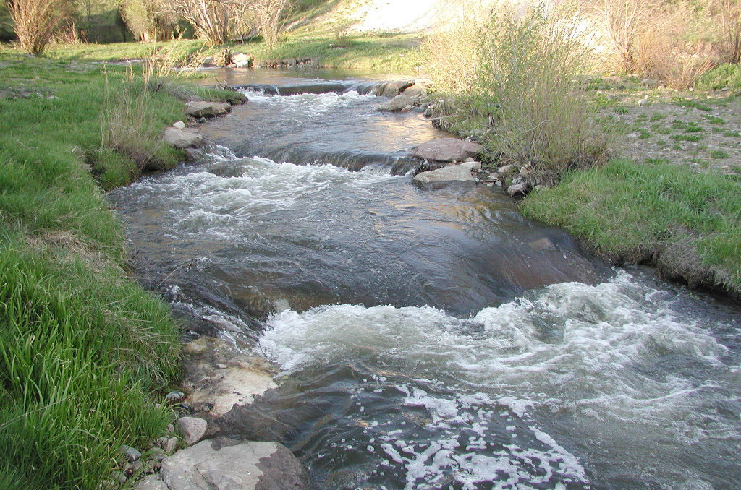
Rock Sill
Stream Restoration
Notes:
Design improves the pond grading to maximize shallow pool areas for aquatic vegetation. This enhances the facility on several levels. The vegetation improves the aesthetic appearance as well as the aquatic habitats. In addition, it increases the water quality for the downstream creeks and rivers.

Slide 23
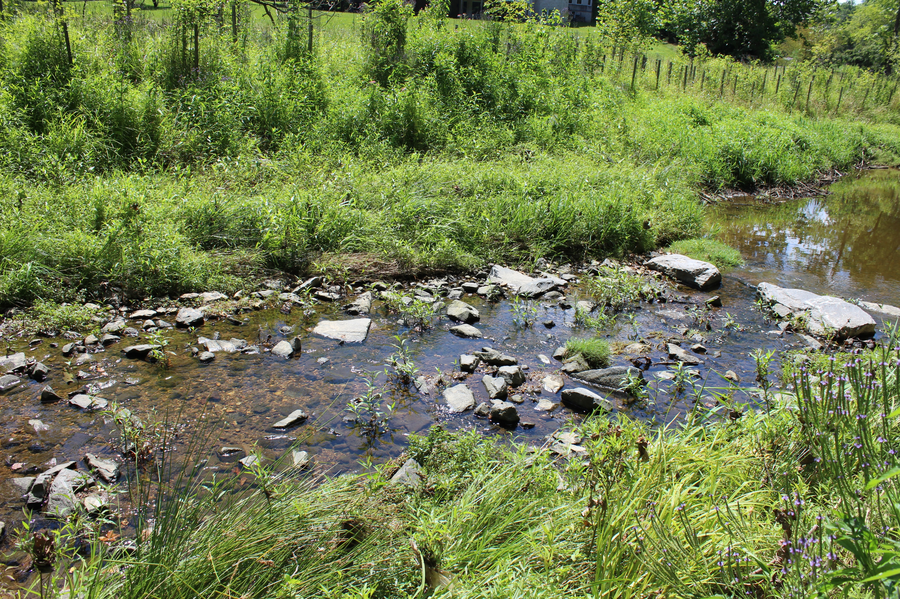
Constructed Riffle
Stream Restoration
Notes:
Design improves the pond grading to maximize shallow pool areas for aquatic vegetation. This enhances the facility on several levels. The vegetation improves the aesthetic appearance as well as the aquatic habitats. In addition, it increases the water quality for the downstream creeks and rivers.

Slide 24
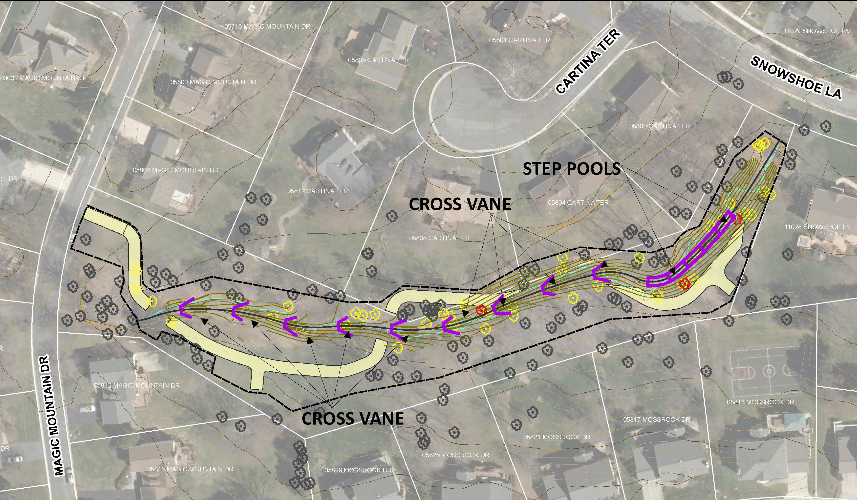
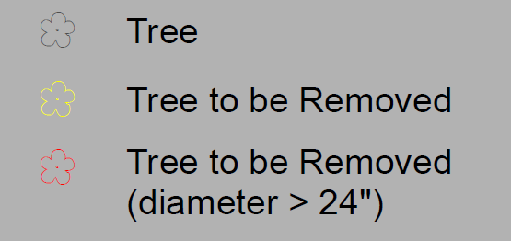
Stream Restoration Design
ACCESS PATH
Design
STREAM RESTORATION TECHNIQUE
0.13 miles of stream restored on this reach
1.13 miles of stream restored on this project
Staging Areas will be located within the project limits
Design Board Website Link: https://www.montgomerycountymd.gov/water/restoration/grosvenor-luxmanor-stream.html
Notes:
Design improves the pond grading to maximize shallow pool areas for aquatic vegetation. This enhances the facility on several levels. The vegetation improves the aesthetic appearance as well as the aquatic habitats. In addition, it increases the water quality for the downstream creeks and rivers.

Slide 25
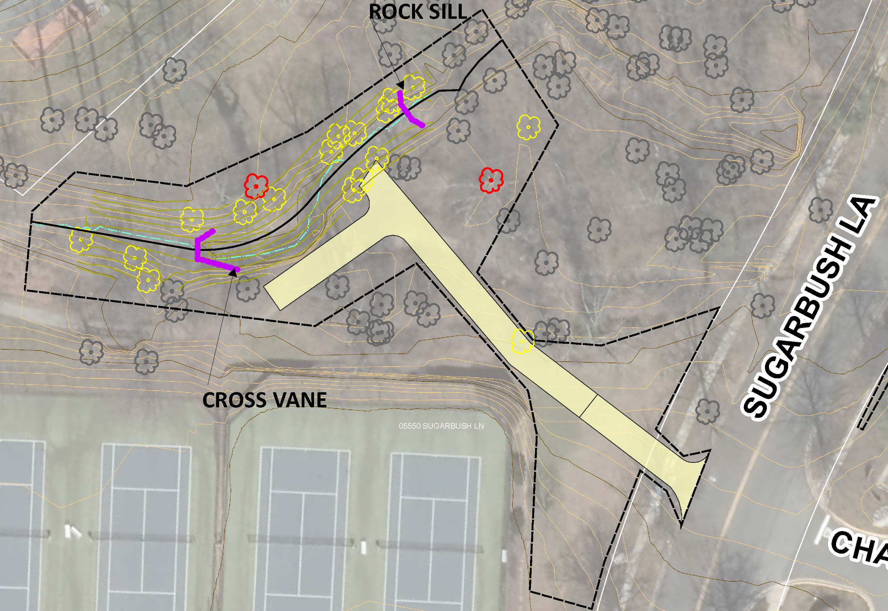
Stream Restoration Design (Penbrooke)
ACCESS PATH
Design
STREAM RESTORATION TECHNIQUE
0.03 miles of stream restored on this reach
1.13 miles of stream restored on this project
Staging Areas will be located within the project limits
Notes:
Design improves the pond grading to maximize shallow pool areas for aquatic vegetation. This enhances the facility on several levels. The vegetation improves the aesthetic appearance as well as the aquatic habitats. In addition, it increases the water quality for the downstream creeks and rivers.

Slide 26
Construction Access (GL01-03)
ACCESS PATH
Design
Notes:
Construction Equipment parked inside black perimeter limit of disturbance

Slide 27
Construction Access (Penbrooke)
Pedestrian sidewalk access will be closed in this construction area but will be safely routed across the road at existing crossings with signage.
Sidewalk Closure
Design
Sidewalk Closure
Notes:
Design improves the pond grading to maximize shallow pool areas for aquatic vegetation. This enhances the facility on several levels. The vegetation improves the aesthetic appearance as well as the aquatic habitats. In addition, it increases the water quality for the downstream creeks and rivers.

Slide 28
Tree Impacts (GL01-03)
Design
Additional Bankside Trees (Yellow) To Be Removed – majority eroded at roots
Notes:
Design improves the pond grading to maximize shallow pool areas for aquatic vegetation. This enhances the facility on several levels. The vegetation improves the aesthetic appearance as well as the aquatic habitats. In addition, it increases the water quality for the downstream creeks and rivers.
42 trees are removed (some ash may be gone already)
More than 47 trees are planted (to be updated with FCP)
959 shrubs are planted (to be updated with FCP)
536 fern plugs are planted

Slide 29
Tree Impacts (Penbrooke)
Design
Additional Bankside Trees (Yellow) To Be Removed – majority eroded at roots
Notes:
Design improves the pond grading to maximize shallow pool areas for aquatic vegetation. This enhances the facility on several levels. The vegetation improves the aesthetic appearance as well as the aquatic habitats. In addition, it increases the water quality for the downstream creeks and rivers.
19 trees are removed
More than 19 trees are planted
174 shrubs are planted
388 fern plugs are planted

Slide 30
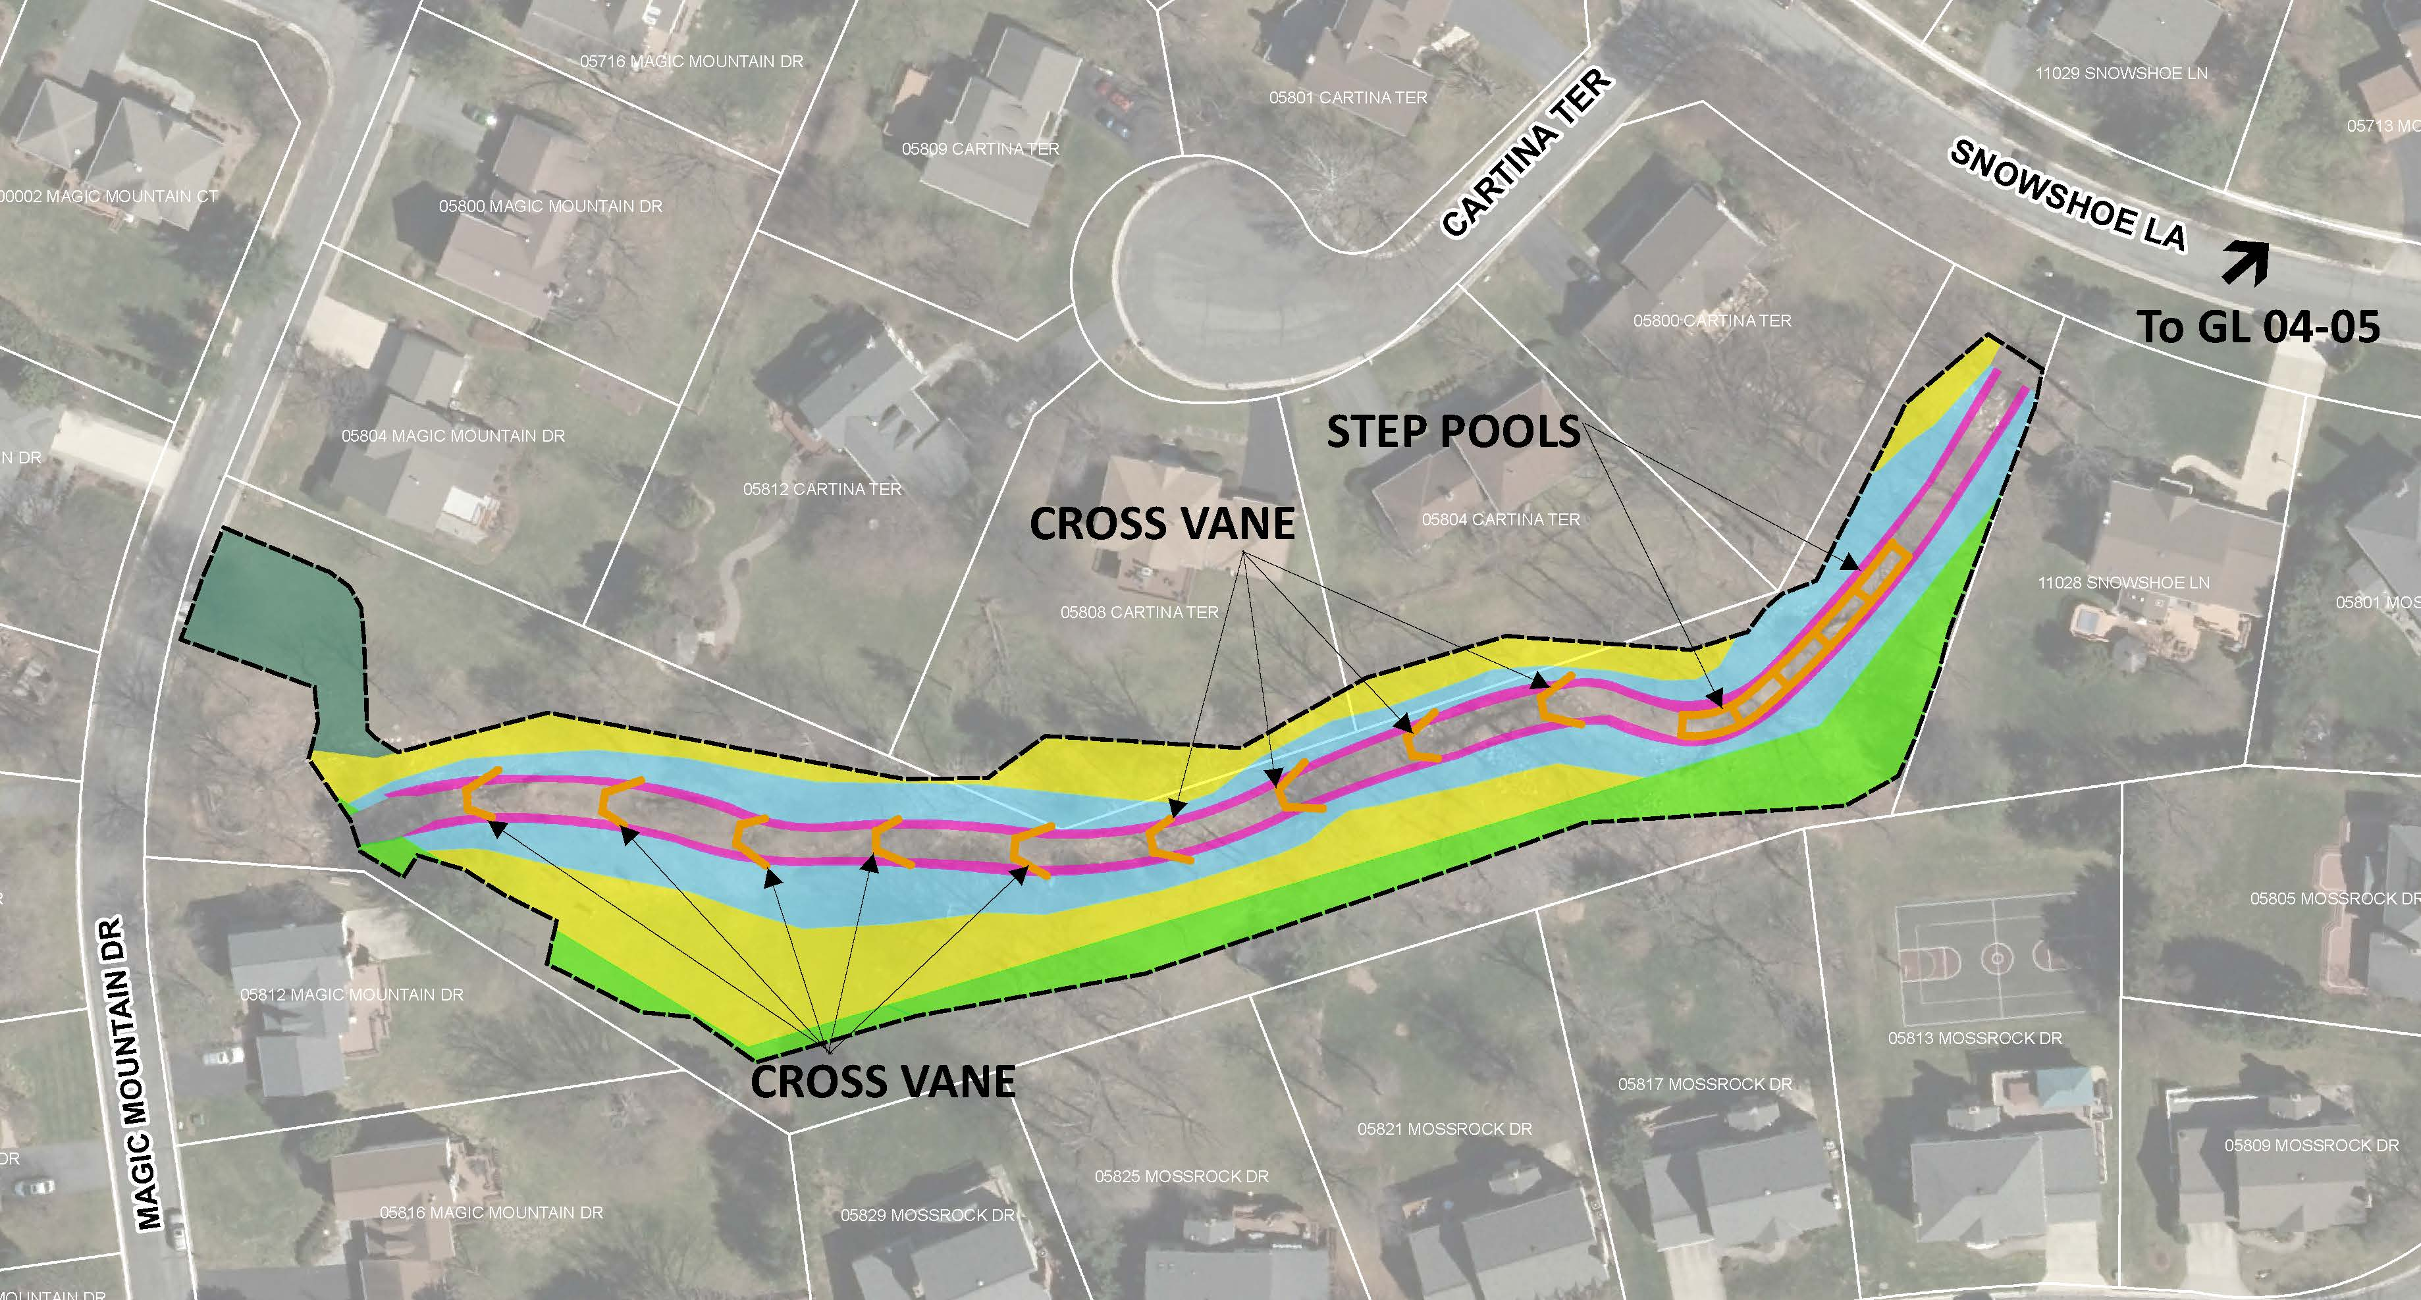
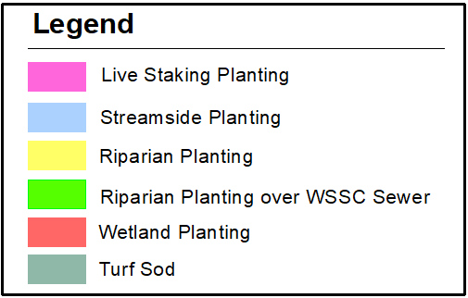
Landscape Planting
Notes:
Design improves the pond grading to maximize shallow pool areas for aquatic vegetation. This enhances the facility on several levels. The vegetation improves the aesthetic appearance as well as the aquatic habitats. In addition, it increases the water quality for the downstream creeks and rivers.

Slide 31
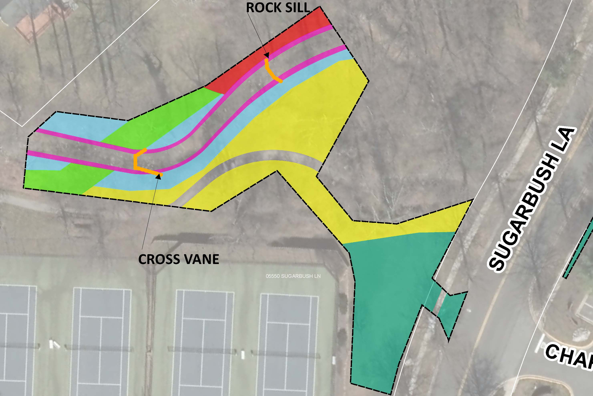
Landscape Planting (Penbrooke)
Notes:
Design improves the pond grading to maximize shallow pool areas for aquatic vegetation. This enhances the facility on several levels. The vegetation improves the aesthetic appearance as well as the aquatic habitats. In addition, it increases the water quality for the downstream creeks and rivers.

Slide 32
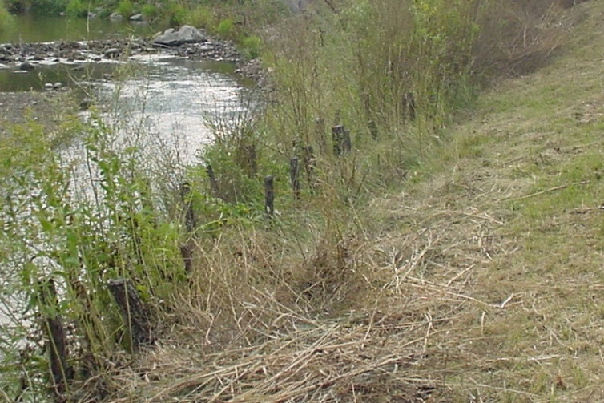
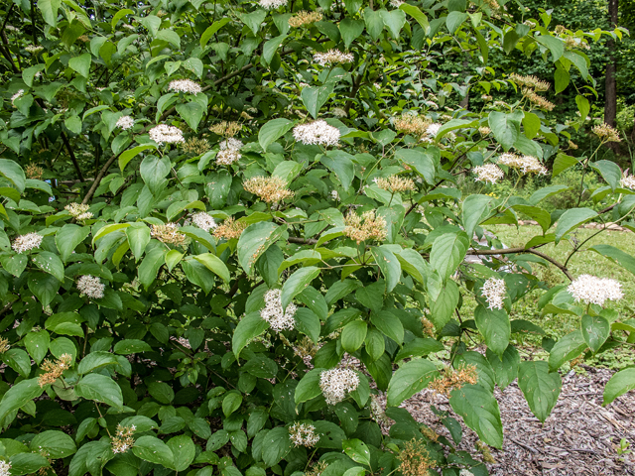
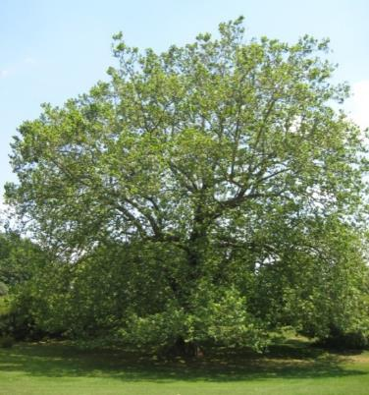
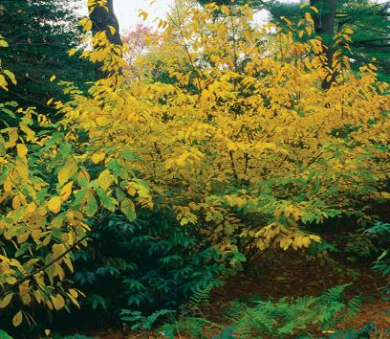
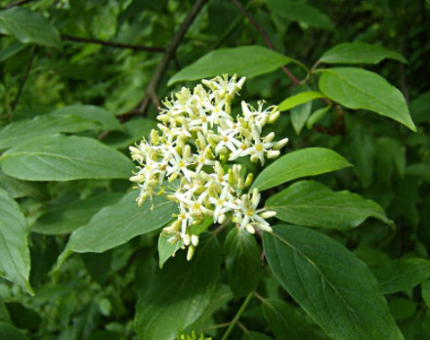
Proposed Plantings
Live Staking
Silky dogwood
Native Landscaping
Sycamore
Spice Bush
Notes:
Design improves the pond grading to maximize shallow pool areas for aquatic vegetation. This enhances the facility on several levels. The vegetation improves the aesthetic appearance as well as the aquatic habitats. In addition, it increases the water quality for the downstream creeks and rivers.

Slide 33
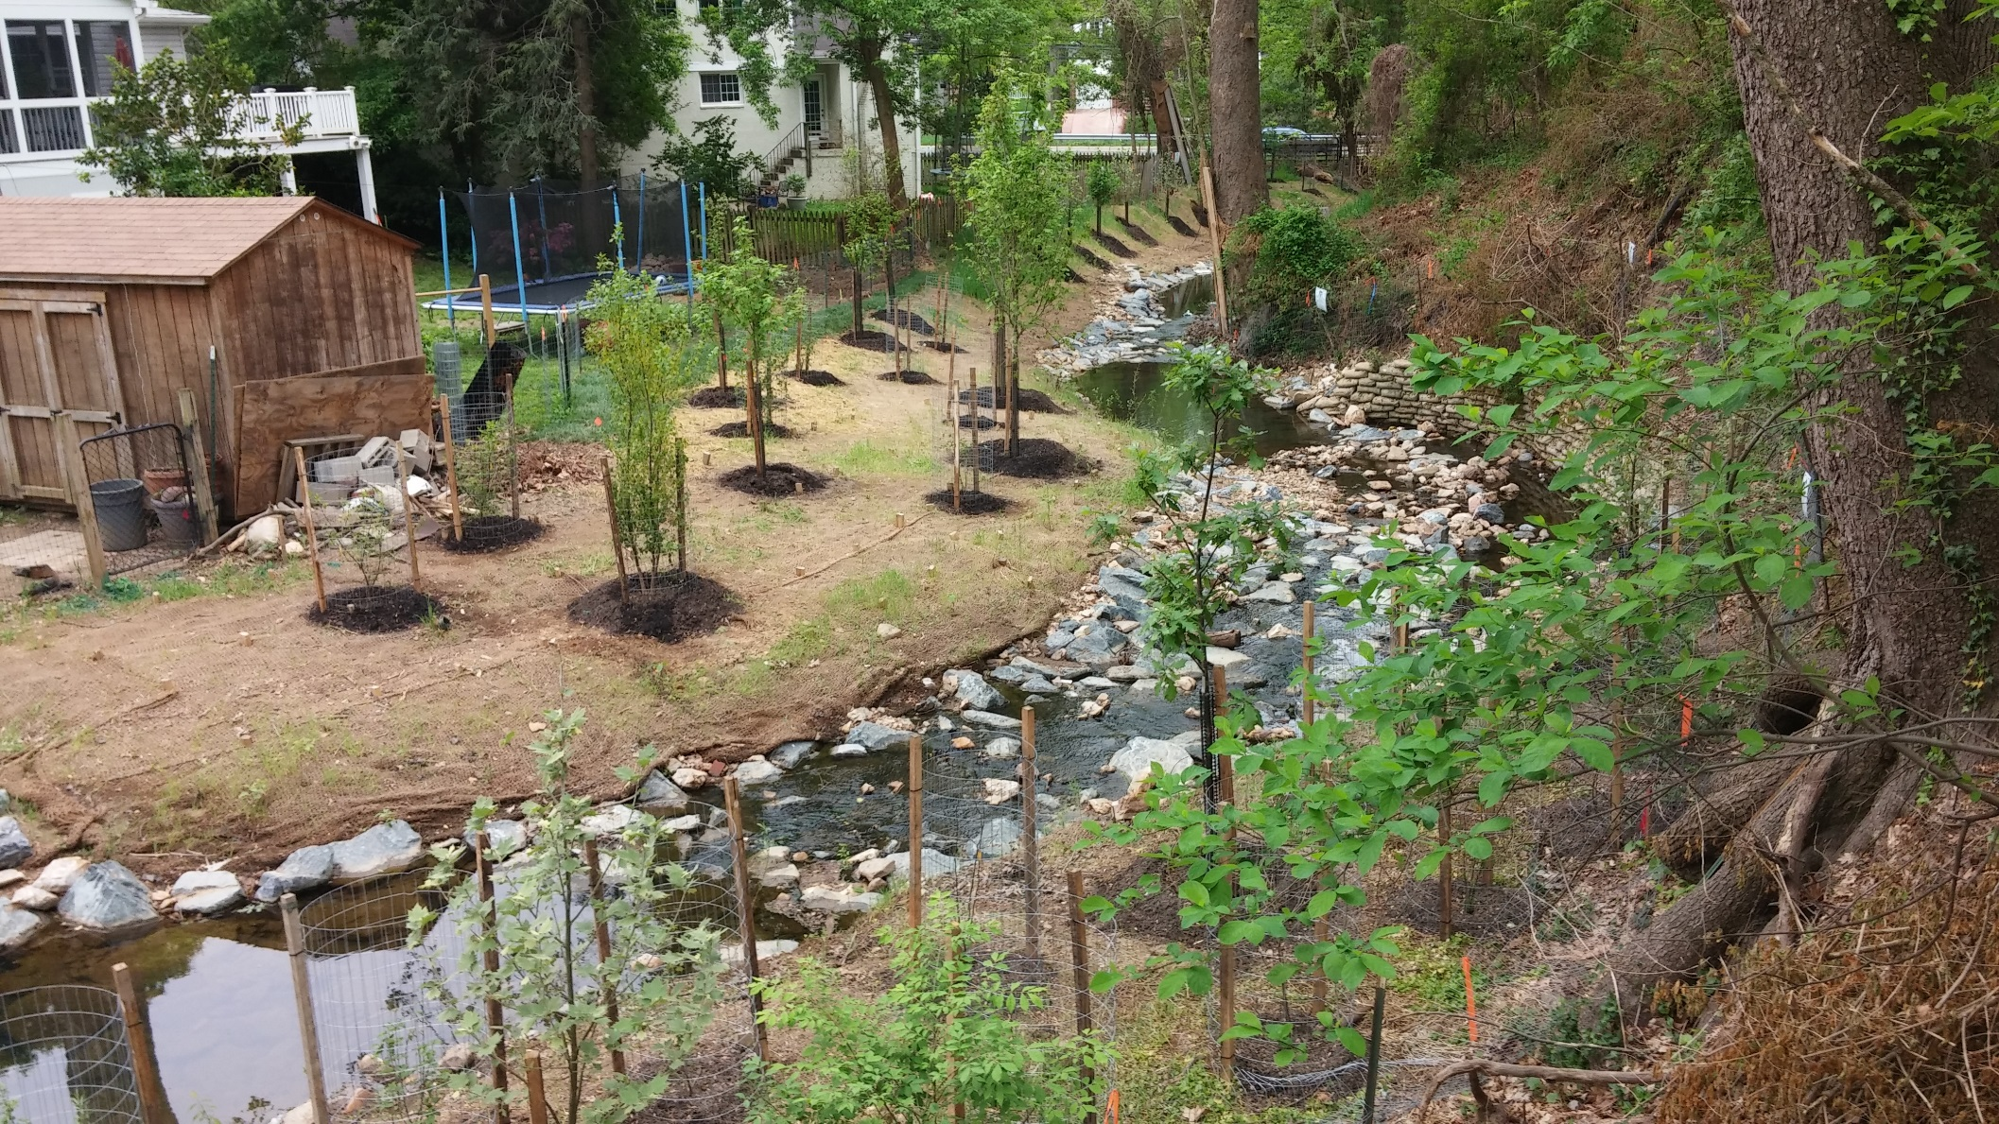
Streamside/ Riparian Planting
Streamside Planting: Steeper slopes right against the stream banks
Riparian Planting: Flatter slopes further away from the stream (larger overstory trees/ shrubs)
Landscaping
Notes:
Design improves the pond grading to maximize shallow pool areas for aquatic vegetation. This enhances the facility on several levels. The vegetation improves the aesthetic appearance as well as the aquatic habitats. In addition, it increases the water quality for the downstream creeks and rivers.

Slide 34
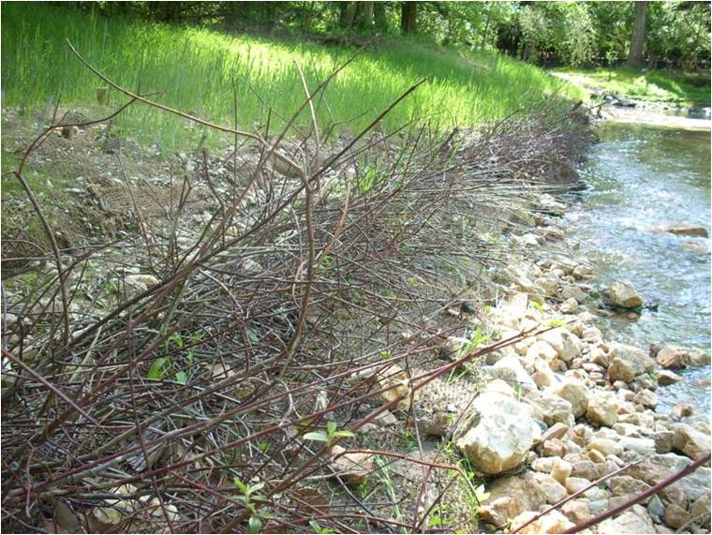
Live Stake Planting
Live Stake Planting: These plants are placed along the toe of the new stream edge and will remain wet from base-flow.
Landscaping
Notes:
Design improves the pond grading to maximize shallow pool areas for aquatic vegetation. This enhances the facility on several levels. The vegetation improves the aesthetic appearance as well as the aquatic habitats. In addition, it increases the water quality for the downstream creeks and rivers.

Slide 35
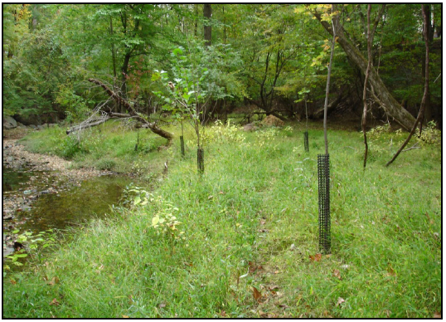
Monitoring
After proposed planting, invasive species will be monitored and managed by Montgomery County for 5 years to support forest establishment.
After Construction
Notes:
Design improves the pond grading to maximize shallow pool areas for aquatic vegetation. This enhances the facility on several levels. The vegetation improves the aesthetic appearance as well as the aquatic habitats. In addition, it increases the water quality for the downstream creeks and rivers.

Slide 36
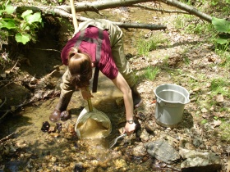
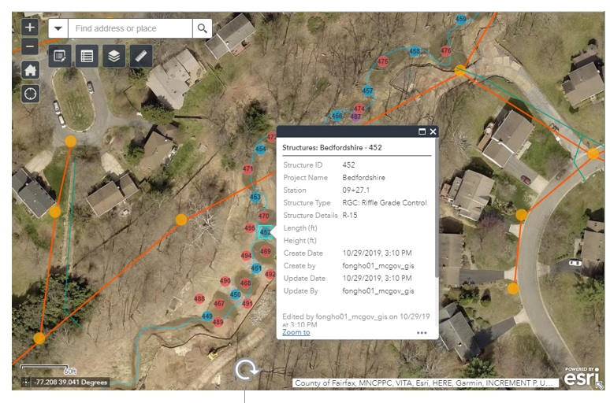
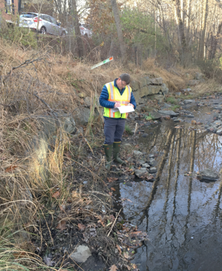
Restoration Monitoring
Biological Monitoring
Stream Cross Sections
Stream Restoration Structures
After Construction
Notes:
Biological – fish etc. ; ACOE – wait and see 1, 3, 5, sometimes 10
Design improves the pond grading to maximize shallow pool areas for aquatic vegetation. This enhances the facility on several levels. The vegetation improves the aesthetic appearance as well as the aquatic habitats. In addition, it increases the water quality for the downstream creeks and rivers.

Slide 37
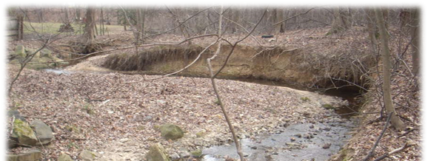
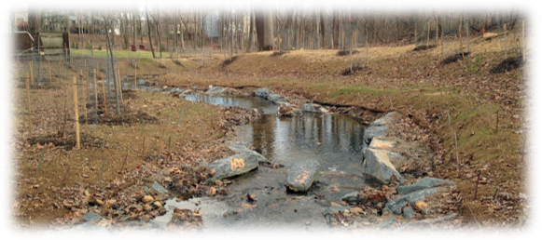
Hollywood Stream Restoration
Stream Before
Stream After

Slide 38
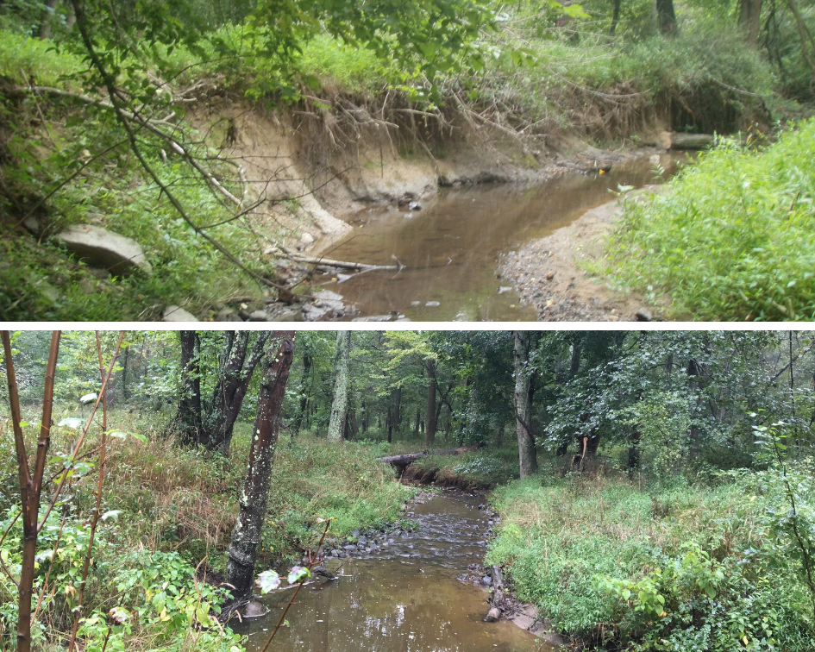
Woodlawn Stream Restoration
Stream Before
Stream After

Slide 39
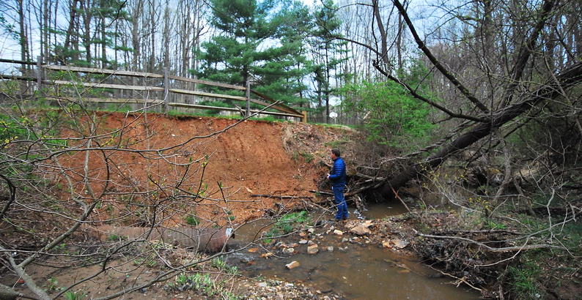



Falls Reach Stream Restoration
Stream Before
Stream After

Slide 40


Grosvenor - Parks Stream Restoration
Stream After
Stream Before

Slide 41

Stream Restoration Easements
Grants County legal access to construct and maintain project
Temporary, Permanent, or Both
No Change to Property Ownership
Permanent Easements are in Land Records
Required Prior to Construction
Private Property Access
Notes:
*Also Forest Consv. Plan Notifications, and Floodplain Changes - Temporary = minor work, staging areas, landscaping
Permanent – structures – main channel – Maintenance
County Attorney Reviews
Floodplain Letters

Slide 42
Retrofit Schedule
Easement Signatures Summer 2021
Design and Permitting Ongoing - Fall 2021
Permits Secured Fall 2021
Construction Bidding Winter – Early 2022
Construction Begins Spring 2022 (6-8 months)
for Part of Project Area
Retrofit Schedule
Notes:
Permits include MDE Dam Safety; MDE Loan Financing - May mobilizing - but not beginning until June 15 (aquatic habitat)
WSSC work – coordinated with PM

Slide 43


What to Expect During Construction
Resident Notification
Project Website
Project Sign
Duration
About 6-8 months
Construction Hours
Monday through Friday, 7AM – 4PM
Safety
Fencing around construction
Follow applicable COVID-19 precautions at time
Traffic
Minor from entering and exiting construction traffic and contractor parking during the day
Sidewalk Detour (Penbrooke at Sugarbush Ln)
During Construction
Notes:
Construction Inspector; Contractor required to comply with Montgomery County Noise Ordinance and sediment control permit

Slide 44

Project Completion
Celebration
Donnybrook – 2015 Celebration
Notes:
Construction Inspector; Contractor required to comply with Montgomery County Noise Ordinance and sediment control permit

Slide 45



Other DEP Programs for Residents
RainScapes – rainscapes.org
Tree Montgomery – treemontgomery.org
Organic Lawn Care
www.montgomerycountymd.gov/lawns
Residential Energy Program
www.montgomerycountymd.gov/green/energy/home
Volunteer
www.montgomerycountymd.gov/water/volunteer
Useful Links
Notes:
Staff available to help

Slide 46


Questions?
Contact: Christy Ciarametaro
Watershed Project Planner
Christy.Ciarametaro@montgomerycountymd.gov
240-777-7720
Project Website:
https://www.montgomerycountymd.gov/water/restoration/grosvenor-luxmanor-stream.html
OR
Google “Grosvenor Stream Restoration”

