Slide 1


Dafig quarterly
Report
Montgomery County Yard Trim Compost Facility
March 10, 2026

Slide 2
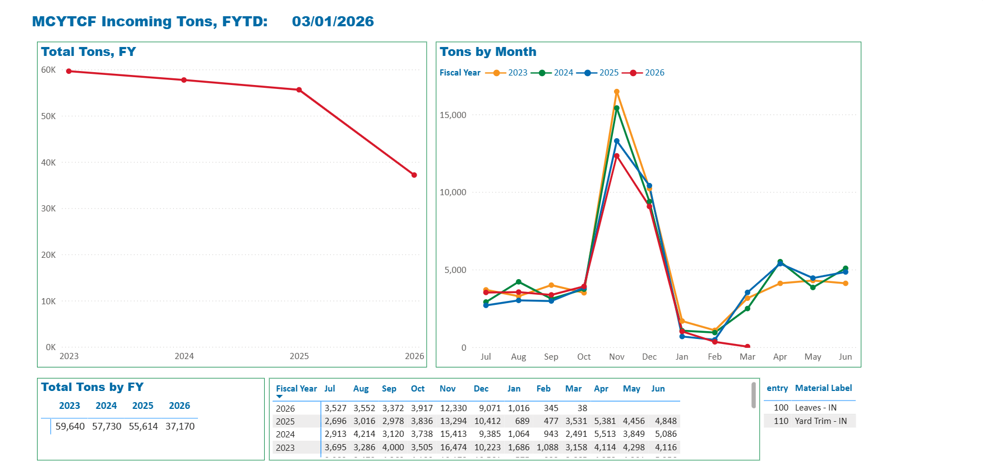
Tons of Yard Trim
Received
By Fiscal Year
FY 2026 as of 3/1/2026

Slide 3
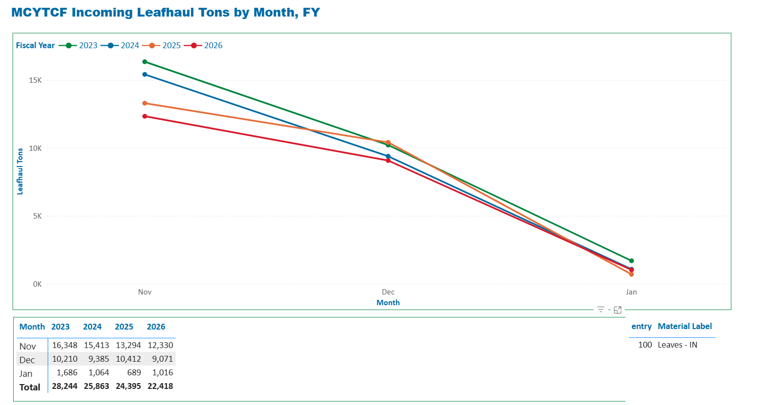
Tons of Yard Trim
Received
By Month During
Leaf Haul
FY 2026 as of 3/1/2026

Slide 4
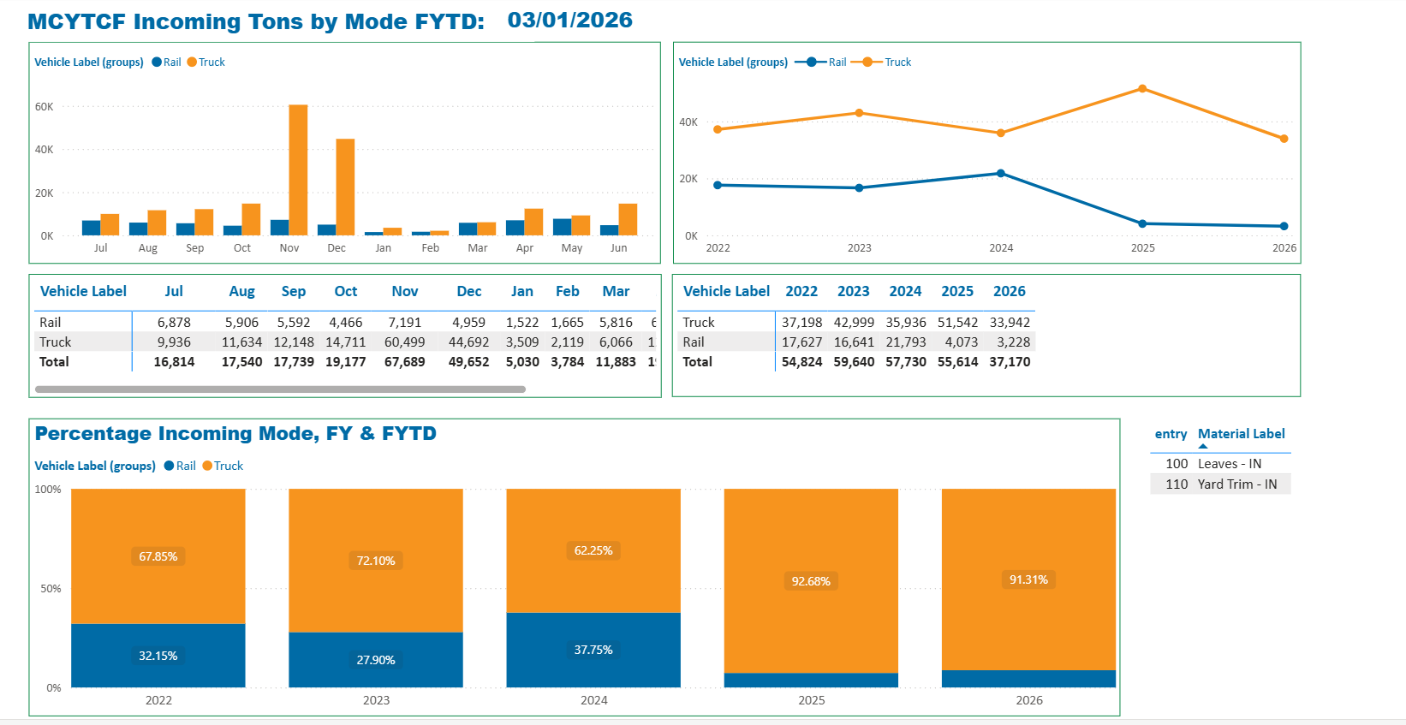
Incoming Tons by Mode

Slide 5
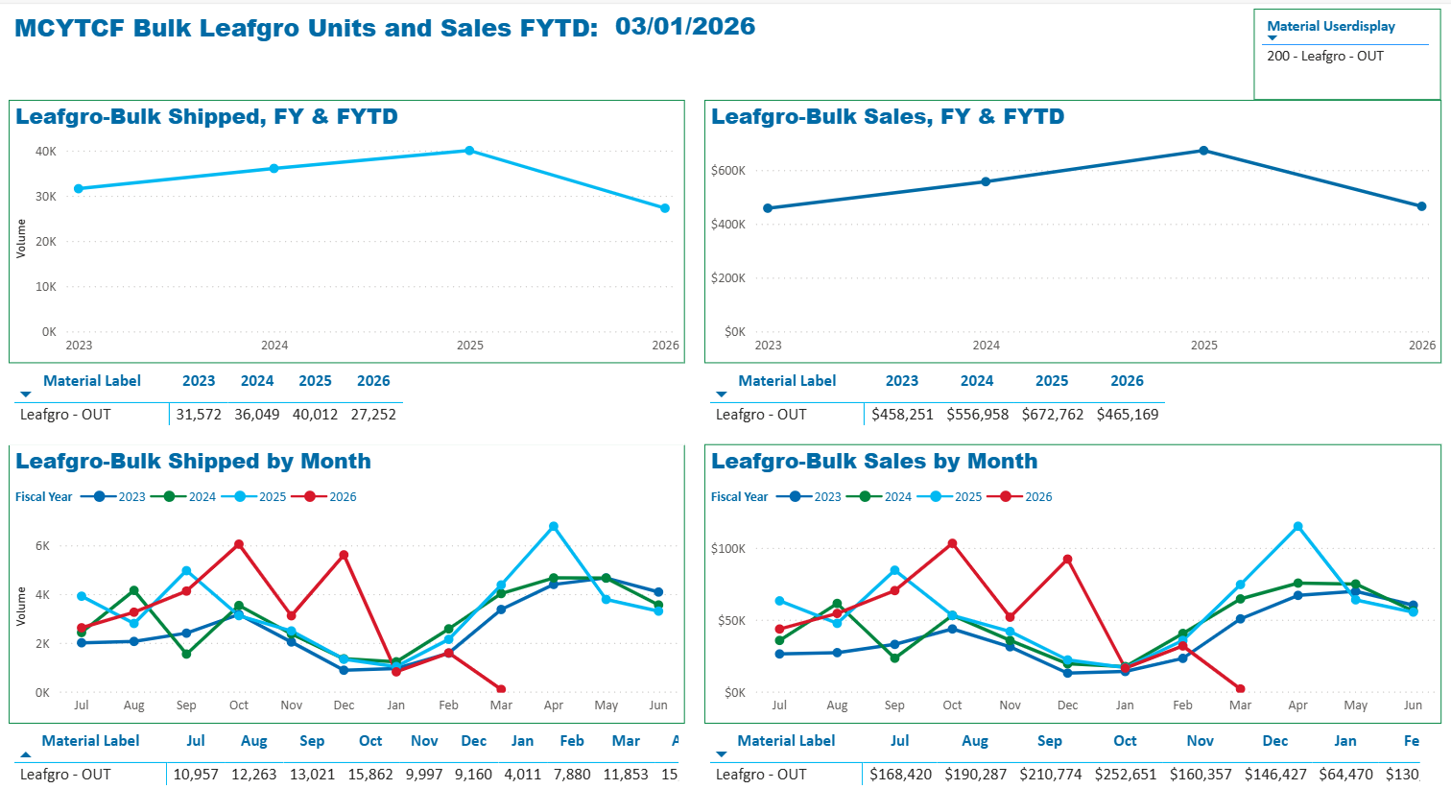
Bulk Leafgro®
Yd³ Shipped & Sales
per Fiscal Year
FY 2026 as of 3/1/2025

Slide 6
Bulk Leafgro®
Yd³ Shipped & Sales
per Month
FY 2026 as of 3/1/2025
Notes:
In FY23 we finished within the average of the last two years. With the market fluctuations due to COVID buyers are being cautious when planning purchases. While we were firm on commitments to sell LeafGro to distributors we are glad that we were able to sell all 650,000 before the end of the fiscal year.

Slide 7
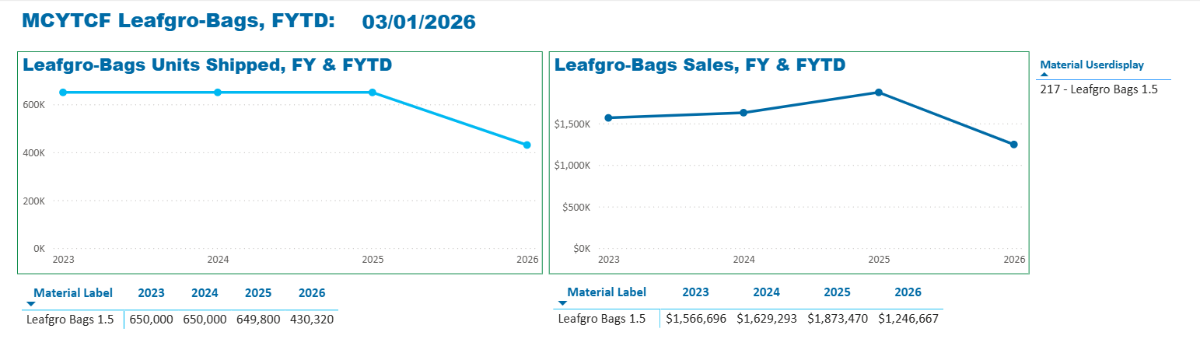
Bagged Leafgro®
Units Shipped & Sales
per Fiscal Year
FY 2026 as of 3/1/2025
Notes:
It’s the beginning of the season and we are diligently working to ramp up on bagging

Slide 8
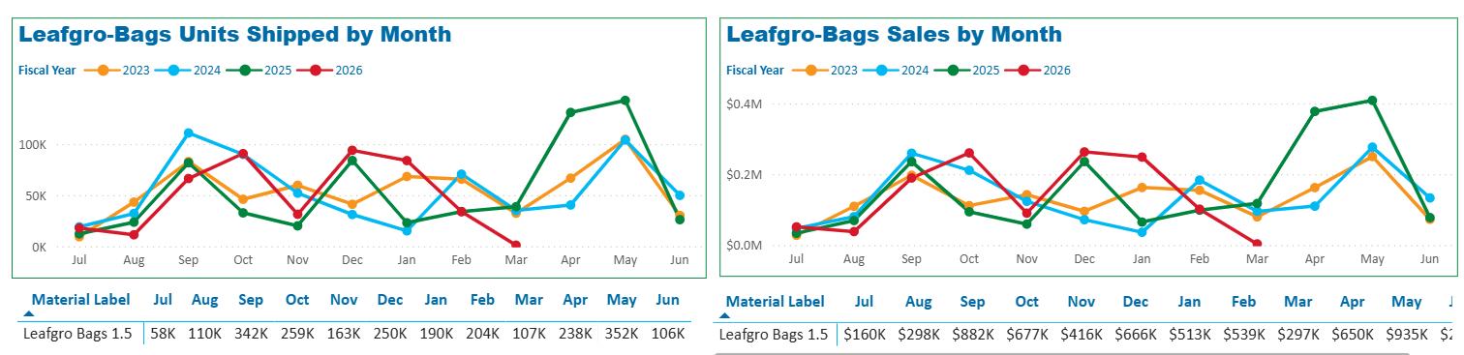
Bagged Leafgro®
Units Shipped & Sales
per Month
FY 2026 as of 3/1/2025
Notes:
Beginning of bagging we are working with our distributors to increase sales; this increase will remain dependent on available/ready to bag product.

Slide 9
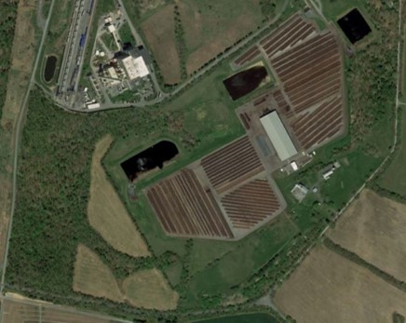
Stormwater Pond management
Ponds sampled monthly per NPDES permit requirements
Biological Oxygen Demand (BOD)
  How much oxygen is needed to breakdown organic matter in water
    Measured in mg/l.
  Discharge Limit: 100 mg/l
Total Suspended Solids (TSS)
  The total amount of suspended solids in the water column
    Measured in mg/l.
  Discharge Limit: 100 mg/l
Power of Hydrogen (pH)
  How acidic/basic water is.
    pH Range: 0 – 14 7 is neutral
  Discharge Limit: 8.5
All ponds were within permit limits during this quarter
Notes:
BOD – Oxygen exists in lakes in small amounts, it is crucial/essential for life; oxygen exists as dissolved oxygen.
how organic matter affects the concentration of dissolved oxygen in a pond is integral to water-quality management
TSS –
pH – determines the solubility (amount that can be dissolved in the water) and biological availability (amount that can be utilized by aquatic life) of nutrients ex: phosphorus, nitrogen, and carbon and heavy metals (lead, copper, cadmium, etc.)

Slide 10
Fluid SPILLS
Overview:
11/17/2025: Hauling contractor – hydraulic line leak < 10 gallons of fluid spilled on the asphalt pad. It was immediately contained and the area was cleaned.
11/19/2025: Hauling contractor - hydraulic line leak < 1 gallons of fluid spilled on asphalt pad. The spill was immediately contained and the area was cleaned.
12/1/2025: MES loader – hydraulic line leak < 5 gallons of fluid spilled on the concrete pad of the pavilion. MES contained and cleaned the spill and fixed the piece of equipment.
12/11/2025: Hauling contractor – hydraulic line leak < 10 gallons of fluid spilled on asphalt pad. The spill was immediately contained and the area was cleaned.
1/13/2026: MES loader – hydraulic line leak < 5 gallons of fluid spilled on the concrete pad of the pavilion. MES contained and cleaned the spill and fixed the piece of equipment.

