Slide 1
Holton-Arms School
Gorove Slade Exhibits
March 3, 2026

Slide 2
Proposed Changes
School enrollment increases from 670 to 870
  Increased busing targets and TDM
  Intersection mitigations at Royal Dominion Drive
Summer Camp enrollment​ increases from 665 to 970
  Staggered arrival and dismissal
Auxiliary Programming
  Third-party use of outdoor facilities on Saturdays from 9-4
  Third-party use from 5:30 – 7:30 PM two nights a week
  Third-party use from 4:00 – 7:00 PM on summer nights
  Will not generate more traffic than School peak hours

Slide 3
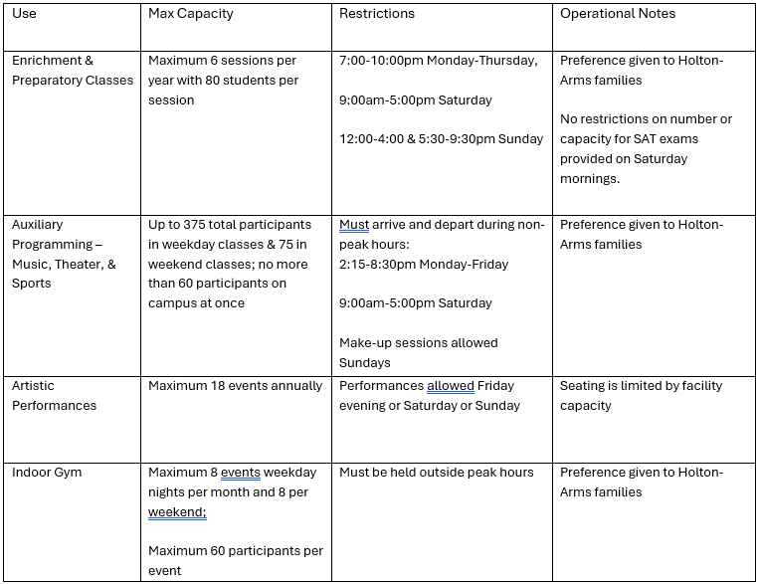

Slide 4
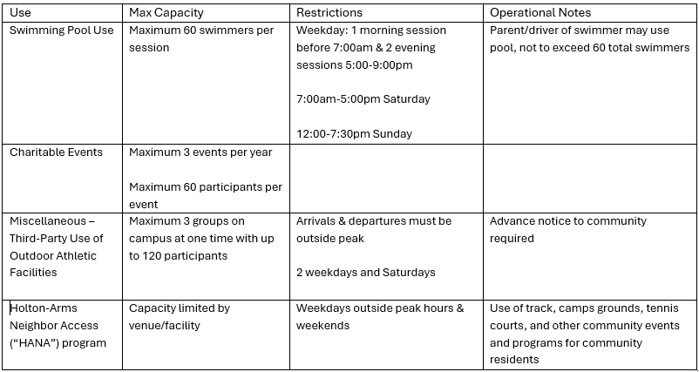

Slide 5
Auxiliary Programming
Peak hours are analyzed because they represent the time-period when the most stress is placed on the transportation network
Analysis is intended to provide mitigation for time periods with the highest traffic-stress, improving roadways even outside of peak hours
As long as trips are arriving/departing outside of peak hour, there is no basis for differentiating trips between Holton-Arms and other organizations

Slide 6
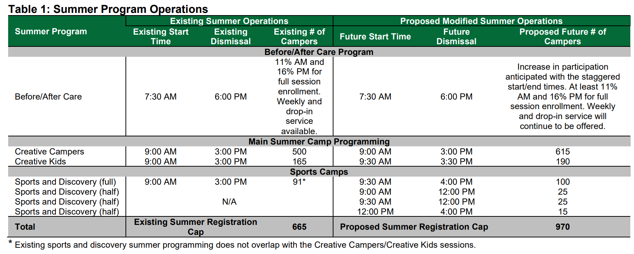
Summer Program Operations
Exhibit 33 (a), Table 1, page 4​

Slide 7
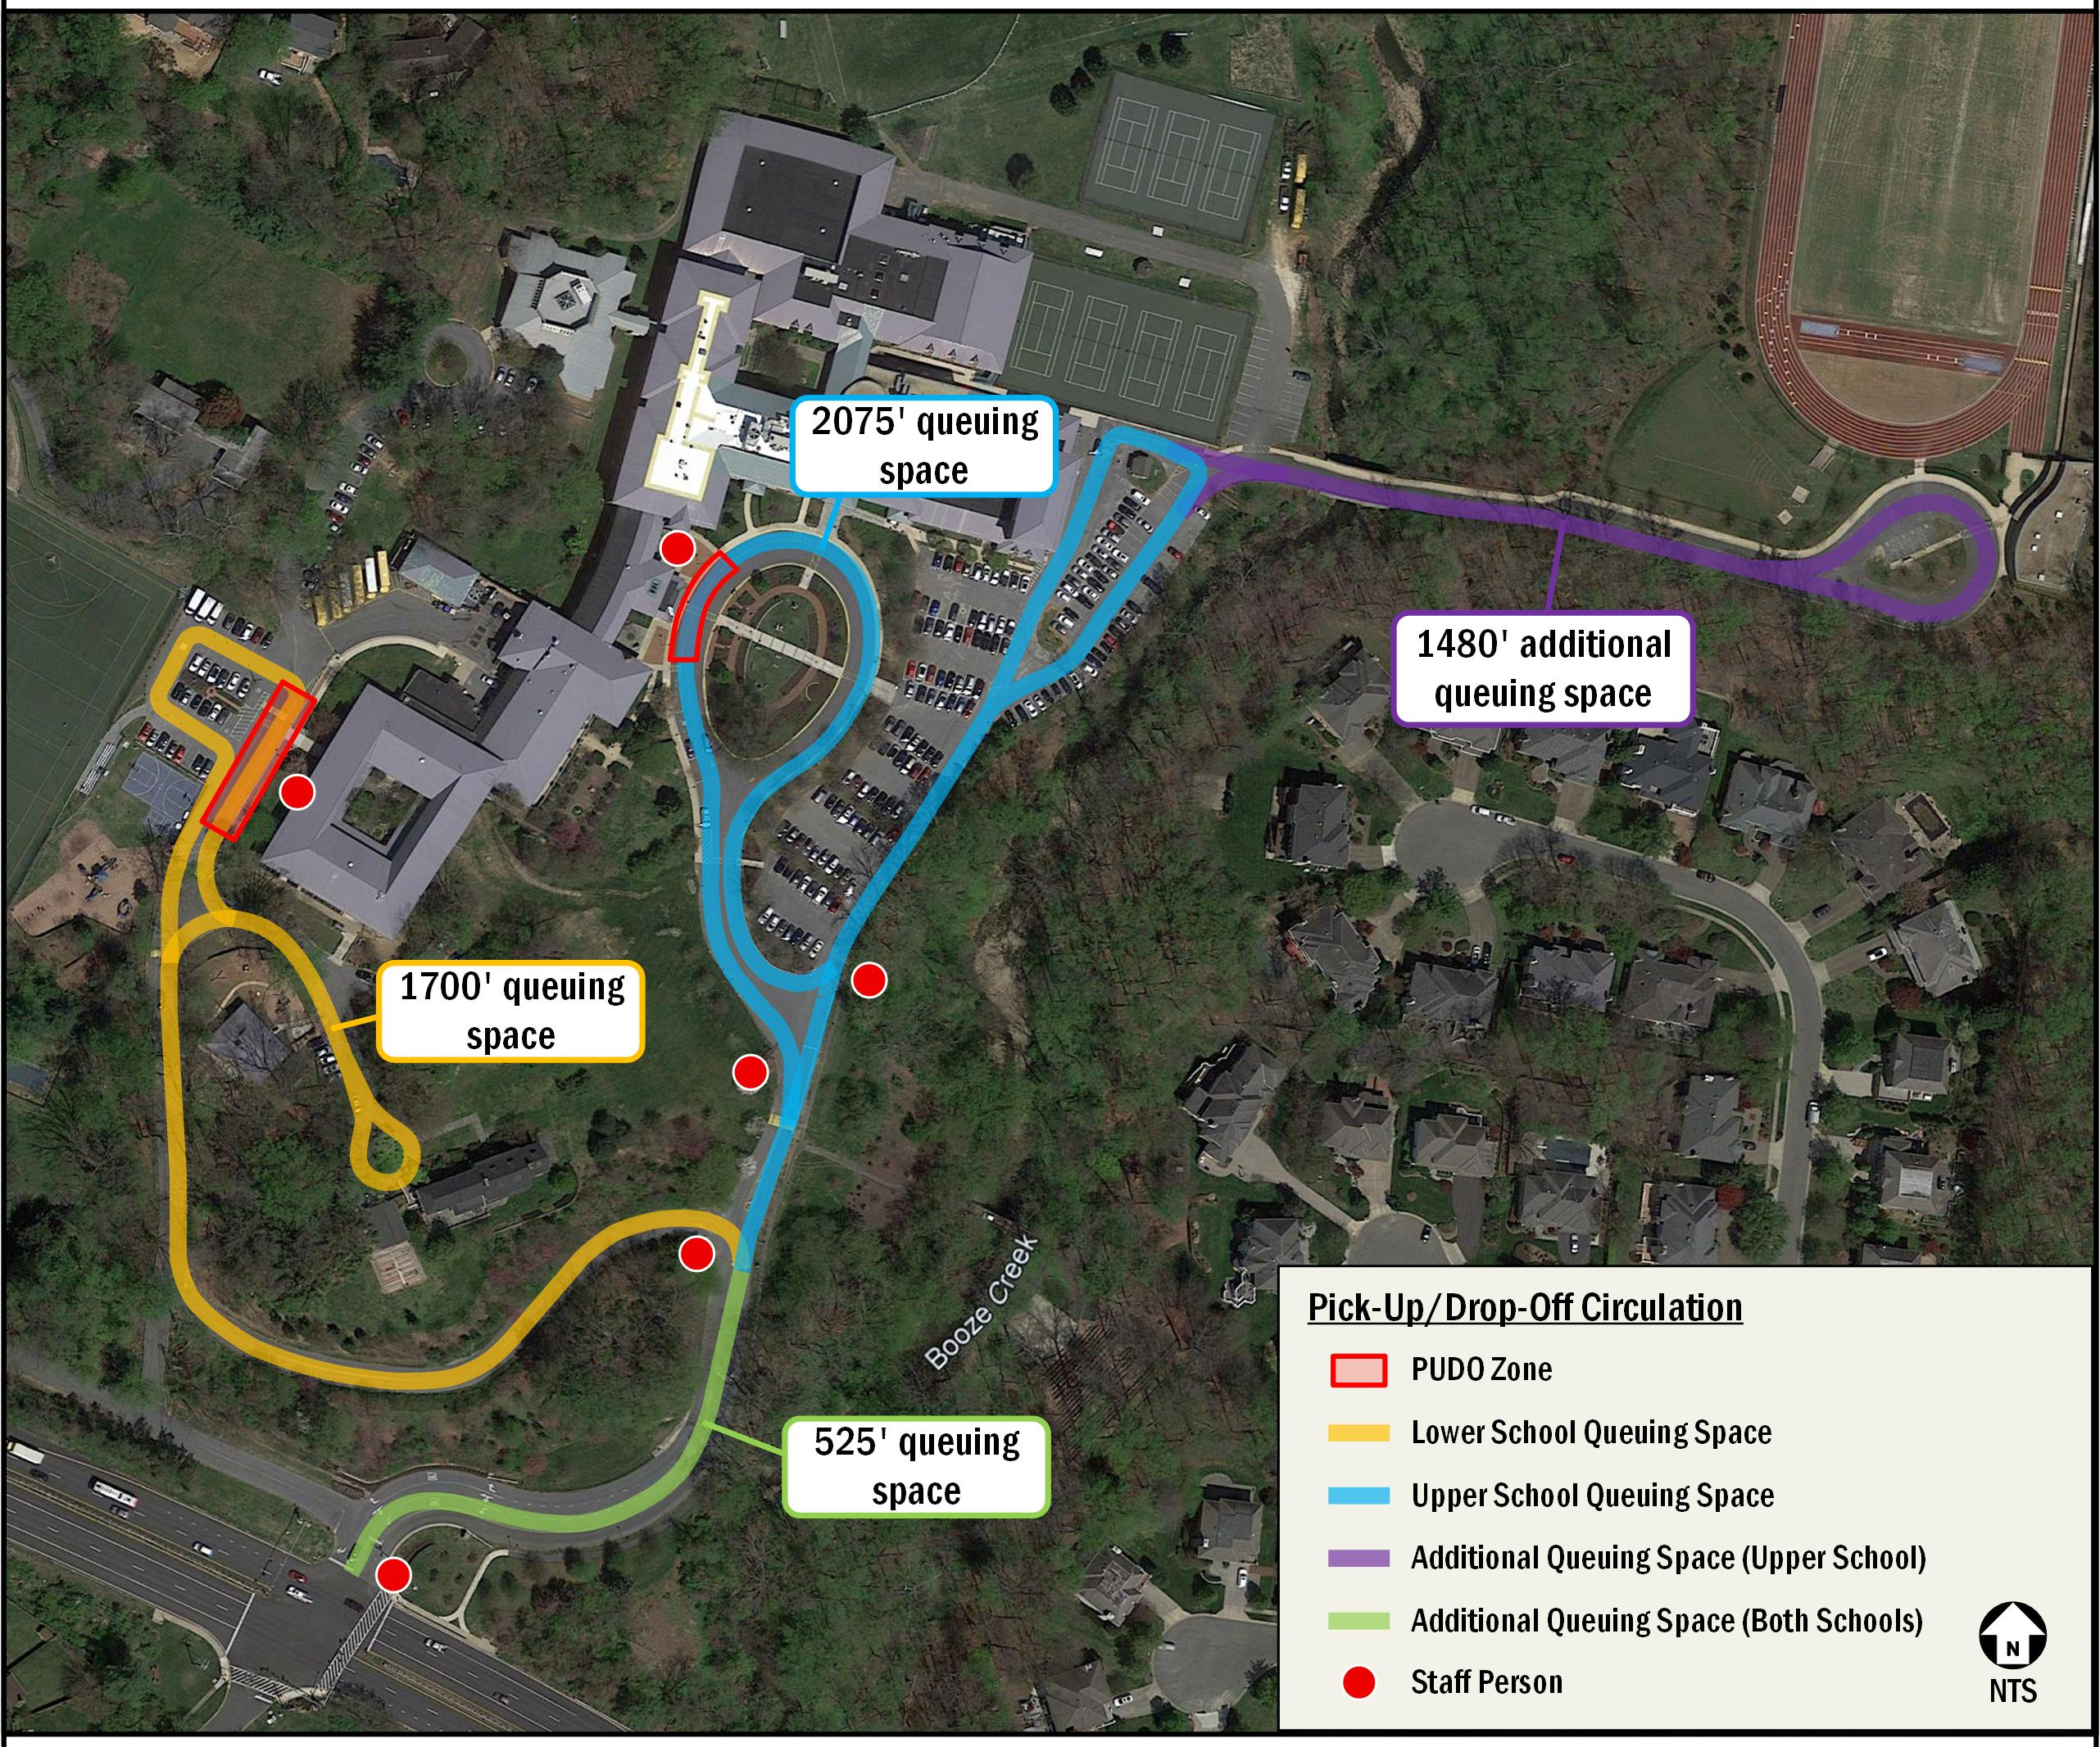
Site Circulation
Exhibit 33, Figure 3, page 13

Slide 8
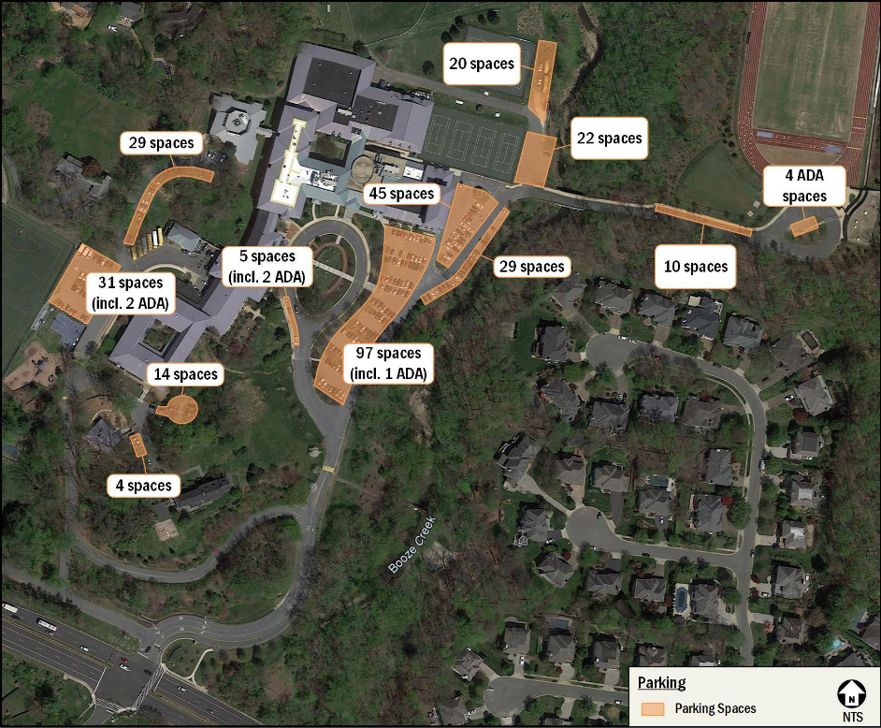
Site Parking

Slide 9
Bus Stop Adjacent to Site

Slide 10
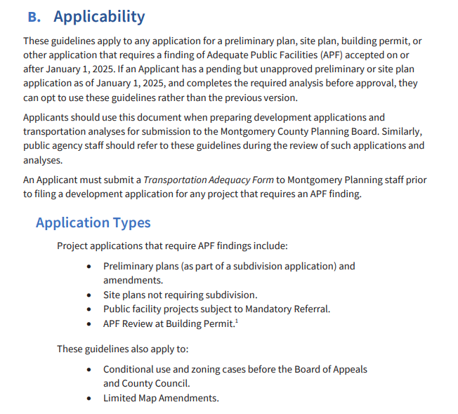
Applicability Guidelines
2025 LATR Guidelines, page 2

Slide 11
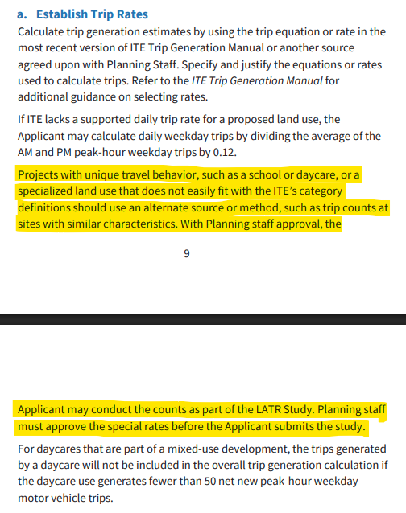
Trip Generation Guidelines
2025 LATR Guidelines, pages 9/10

Slide 12
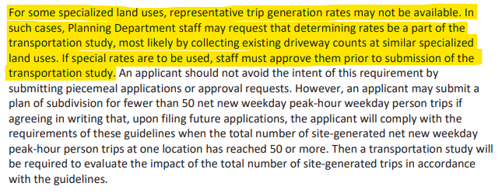
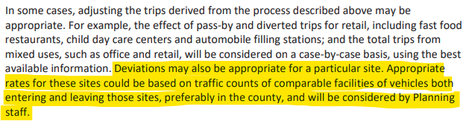
2023 LATR Guidelines, page 28
2023 LATR Guidelines, page 41
Trip Generation Guidelines

Slide 13
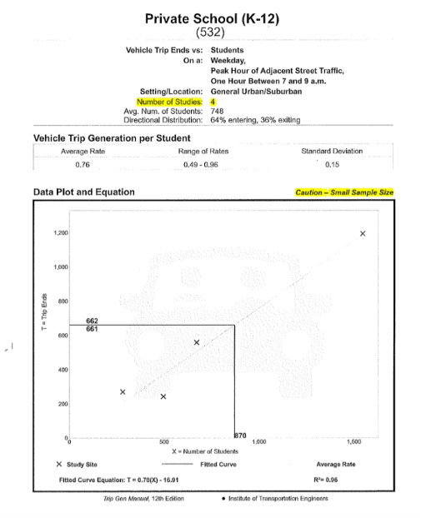
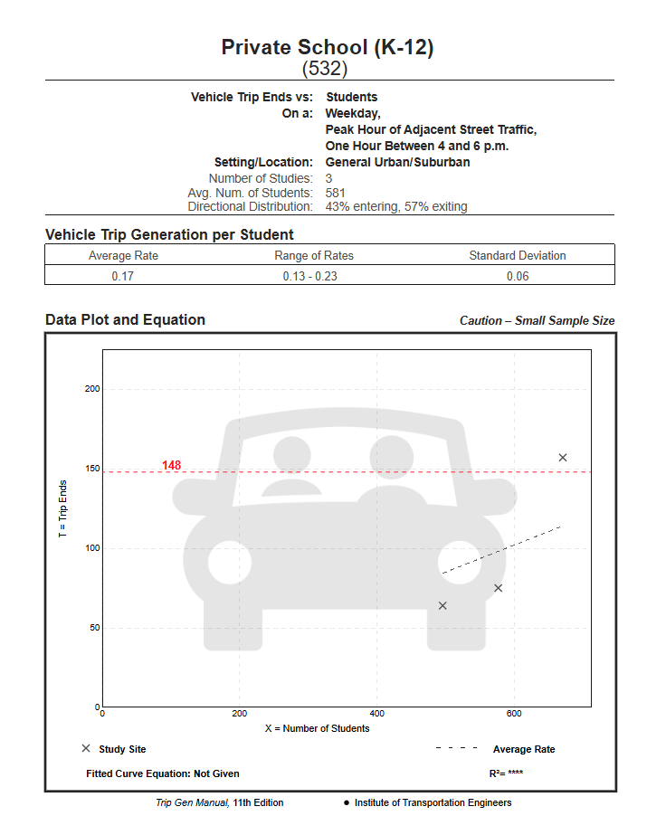
ITE Private School Trip Generation
Exhibit 41.e, page 36
ITE 11th Edition PM Peak Hour Trip Generation

Slide 14
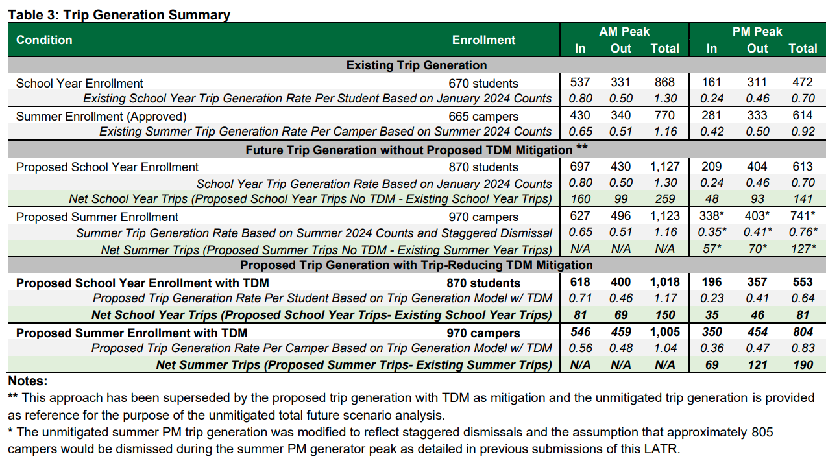
Trip Generation Summary
Exhibit 33, Table 3, page 12

Slide 15
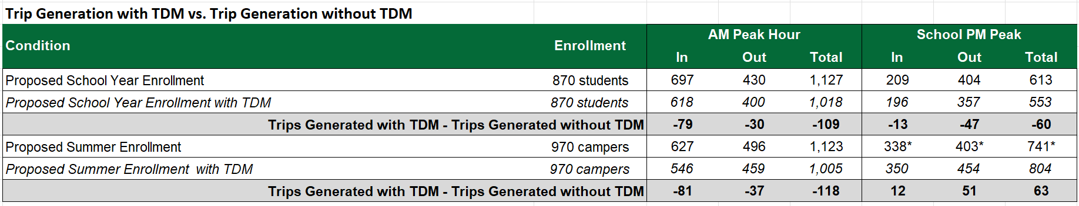
Reduction in Trips from TDM

Slide 16
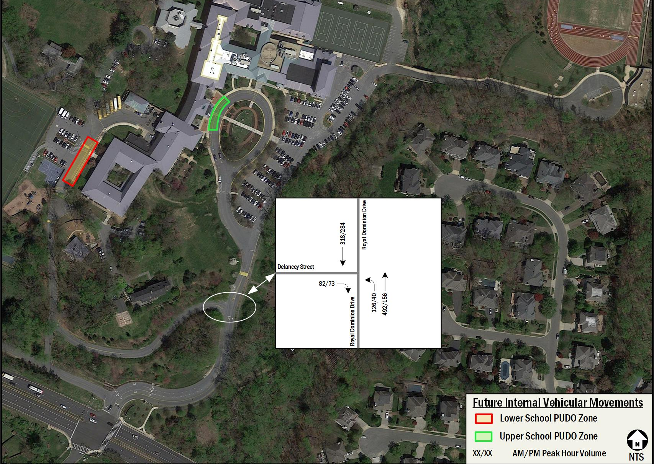
Pick-up/Drop-off Traffic Split

Slide 17
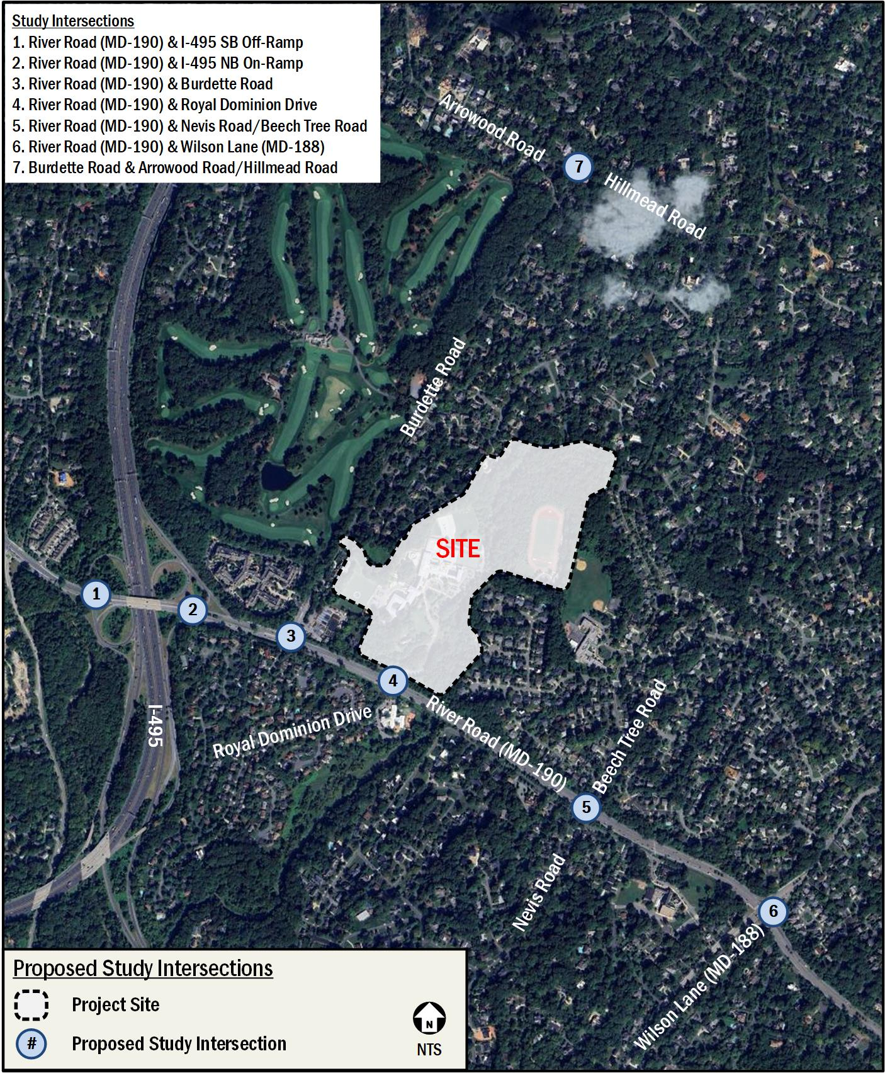
Study Area Intersections
Exhibit 33, Table 3, page 12

Slide 18
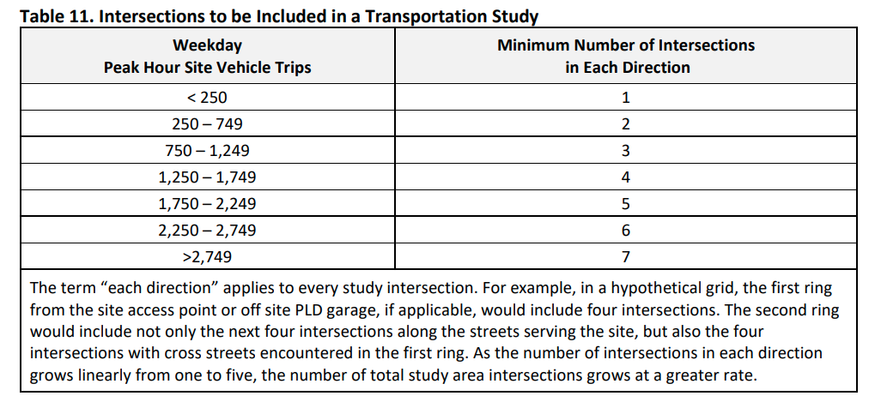
Study Intersection Requirements
2023 LATR Guidelines, Table 11, page 38

Slide 19
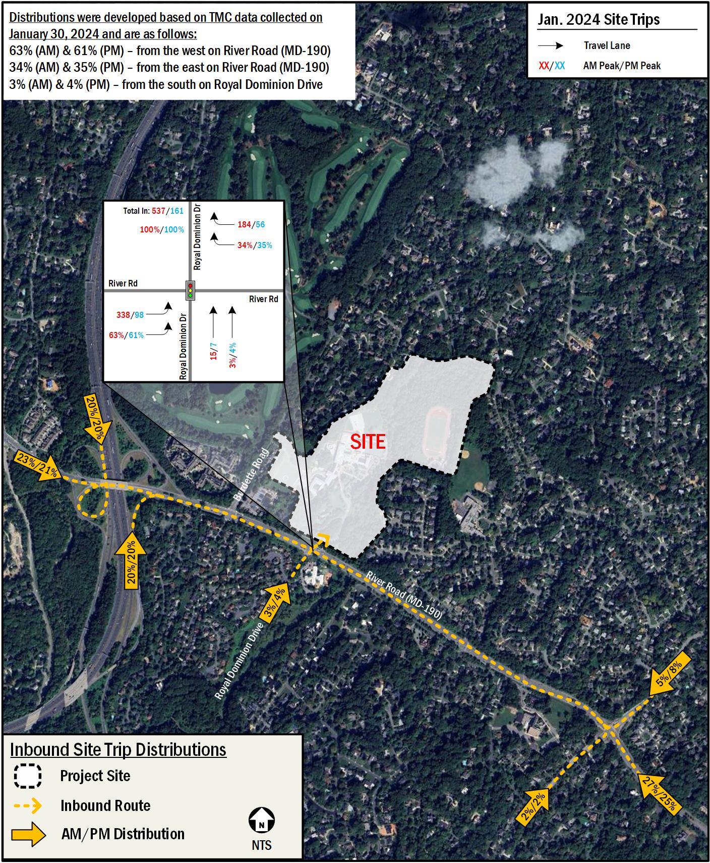
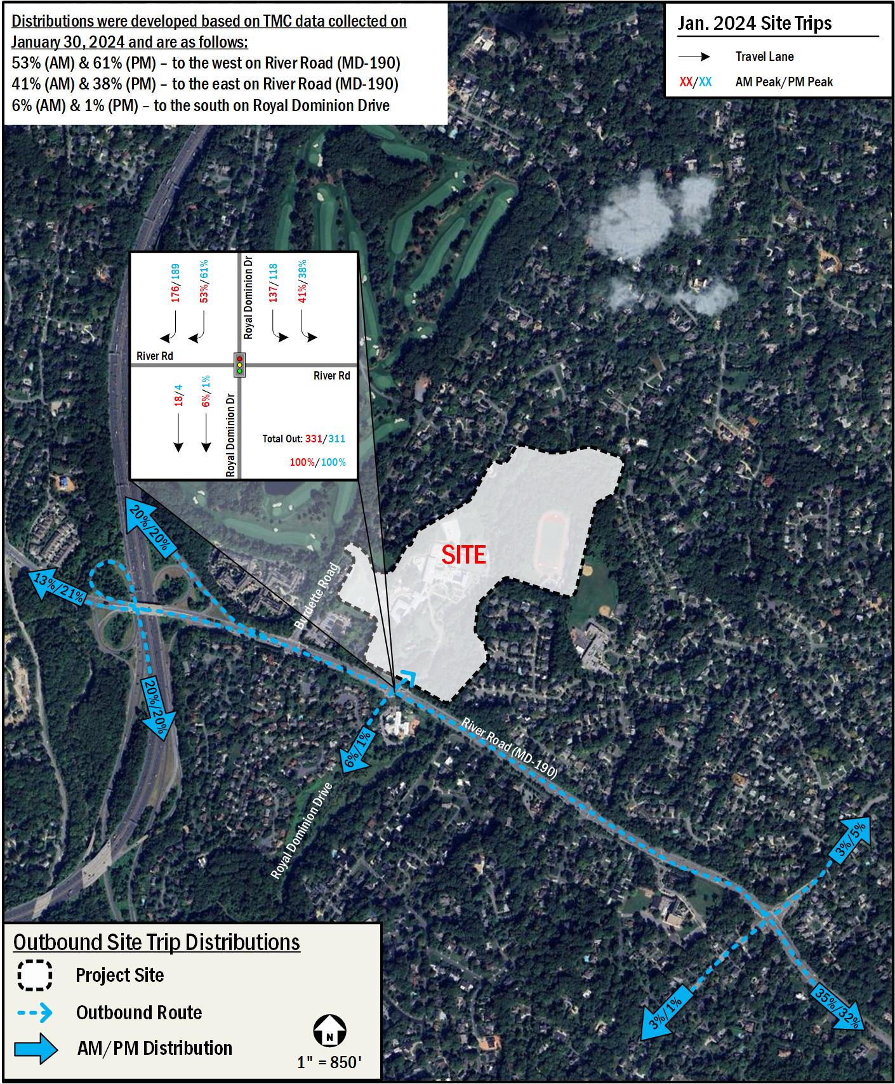
Distributions Used in Analysis
Exhibit 33, Table 3, page 12

Slide 20
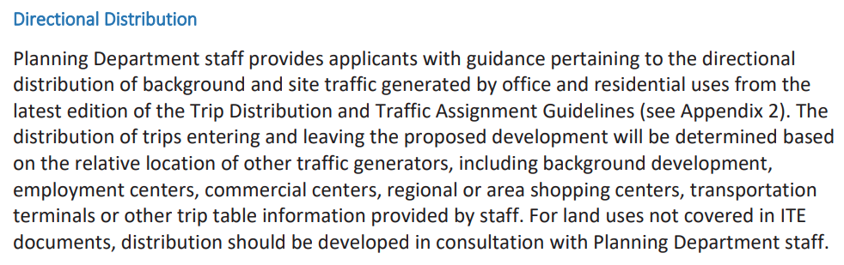
Distributions
2023 LATR Guidelines, page 41

Slide 21
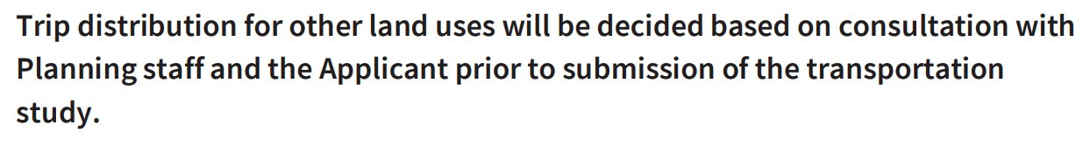
Distributions
2025 LATR Guidelines, page 45

Slide 22
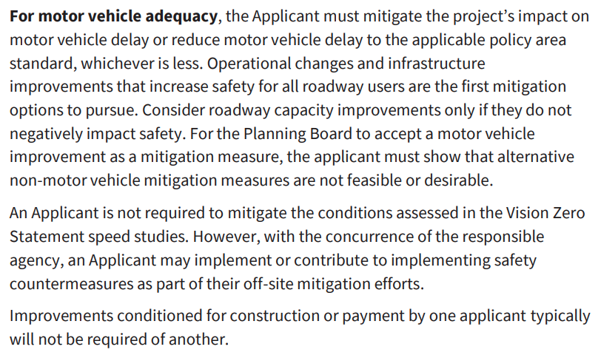

Motor Vehicle Adequacy
2025 LATR Guidelines, page 35

Slide 23
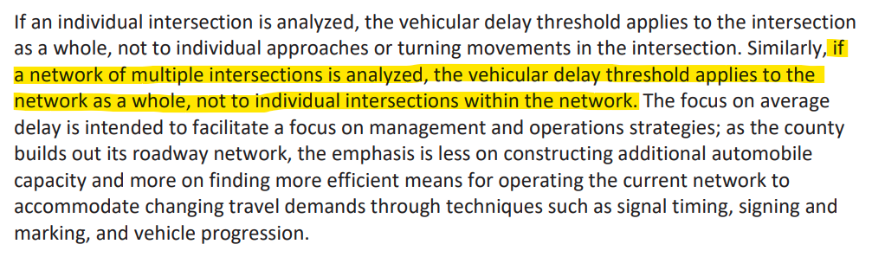
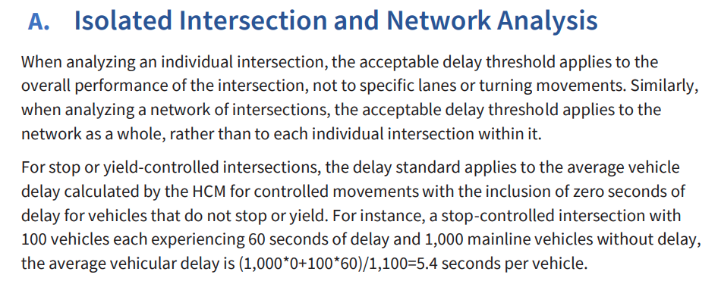
2025 LATR Guidelines, page 62
Corridor-Based Analysis
2023 LATR Guidelines, page 33

Slide 24
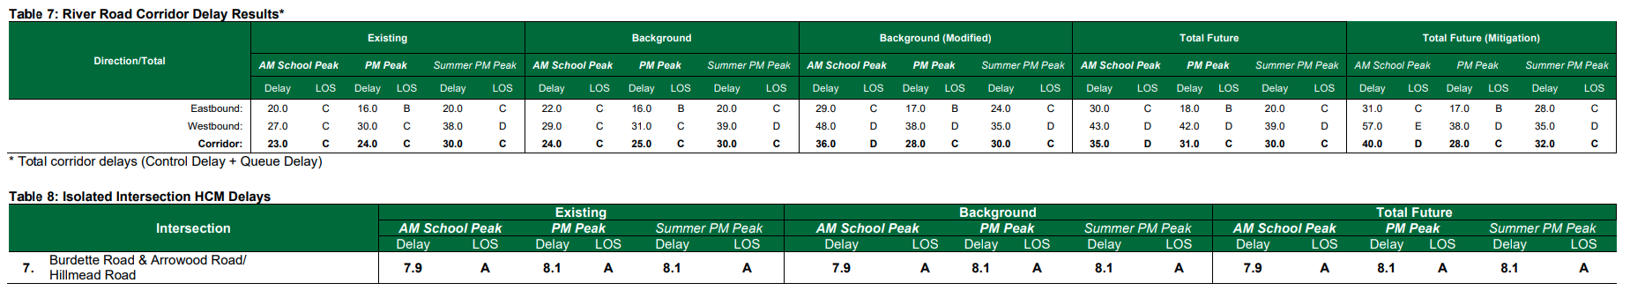
Intersection Delays
Exhibit 33, Tables 7/8, page 24

Slide 25
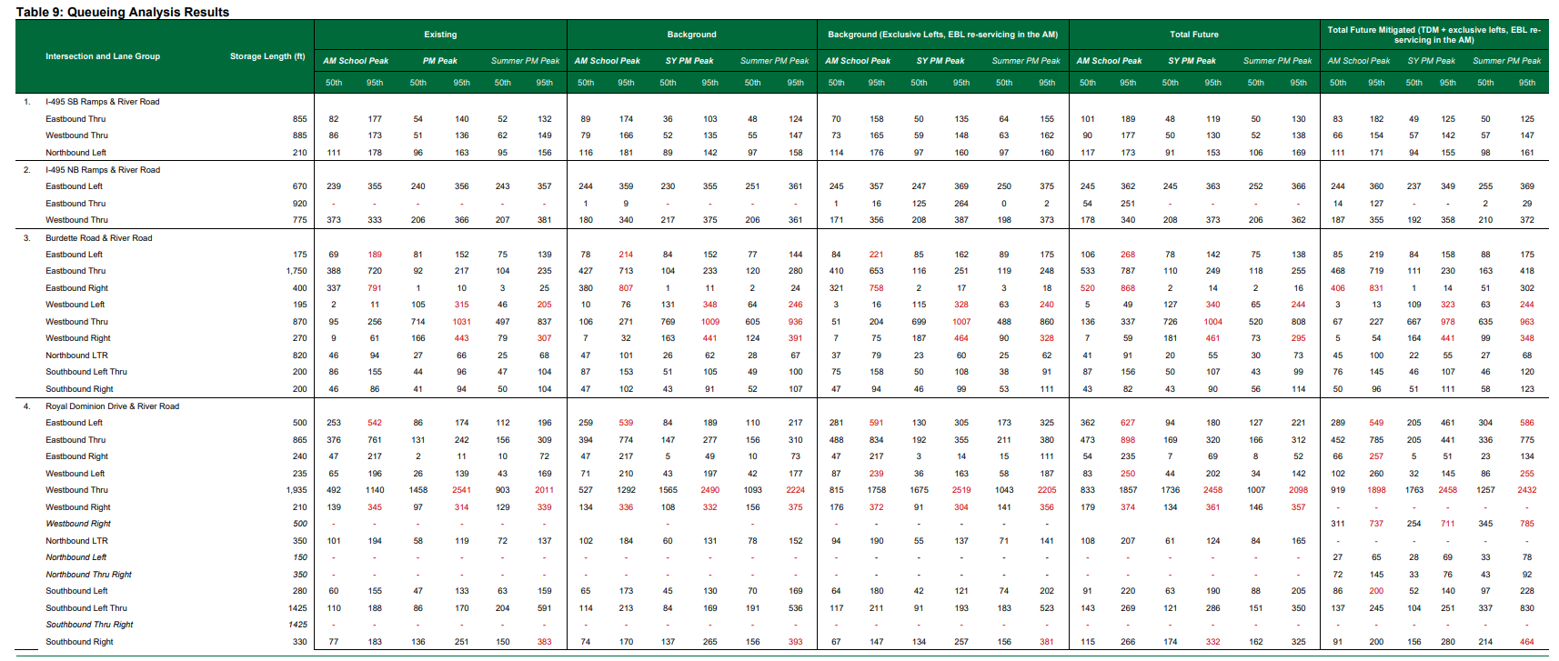
Intersection Queues
Exhibit 33, Table 9, page 24
School Driveway

Slide 26
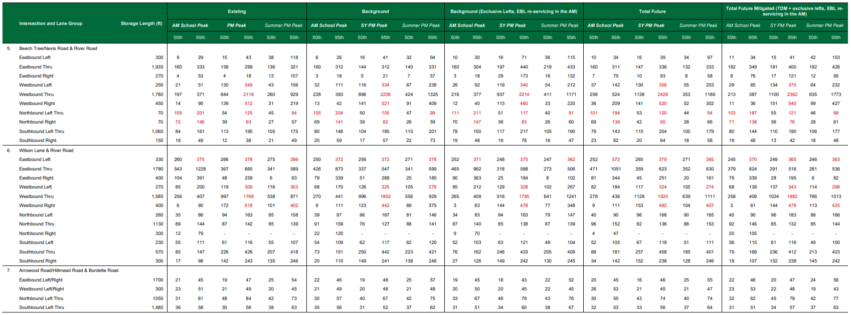
Intersection Queues
Exhibit 33, Table 9, page 25

Slide 27
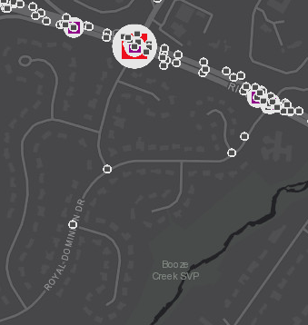
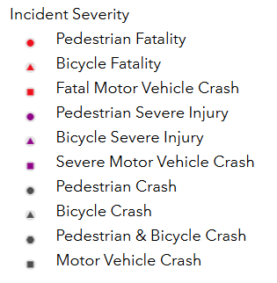
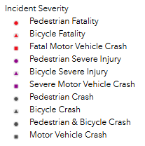
Crashes in Al Marah
Montgomery County Interactive Crash Map, Al Marah Neighborhood
All crashes are motor vehicle only (no pedestrians involved)

Slide 28
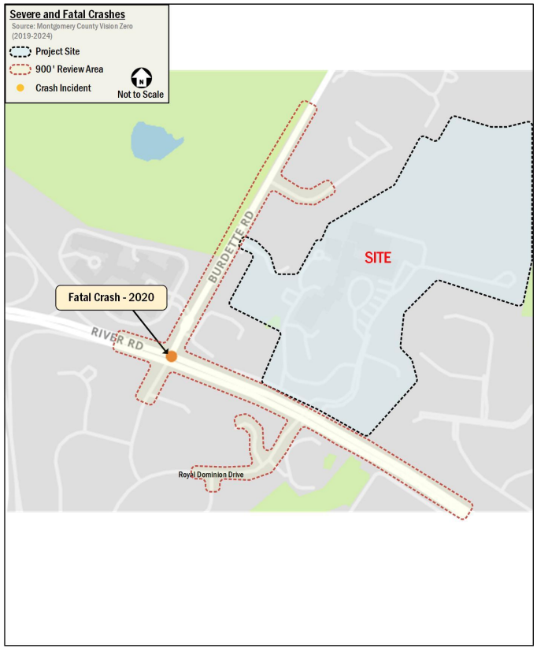
Severe and Fatal Crashes: Exhibit 33, Figure 4, page 16
Fatal vehicle crash

Slide 29
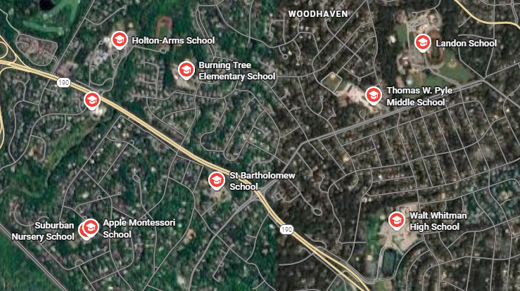
Schools Along the River Road Corridor

Slide 30
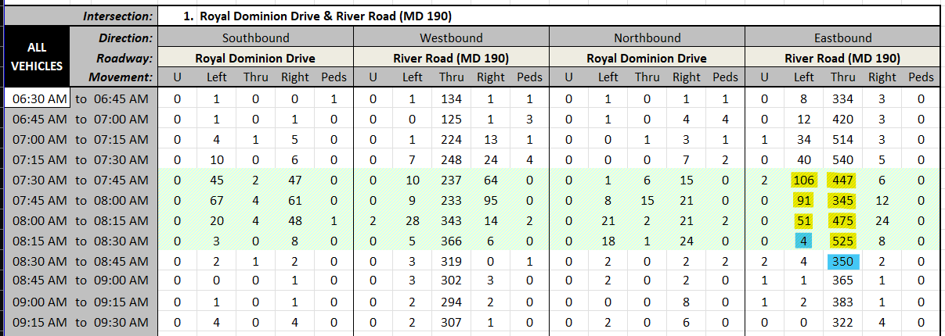
2025 AM Traffic Counts at Royal Dominion Drive

Slide 31
Proposed Mitigations at Royal Dominion Drive

Slide 32
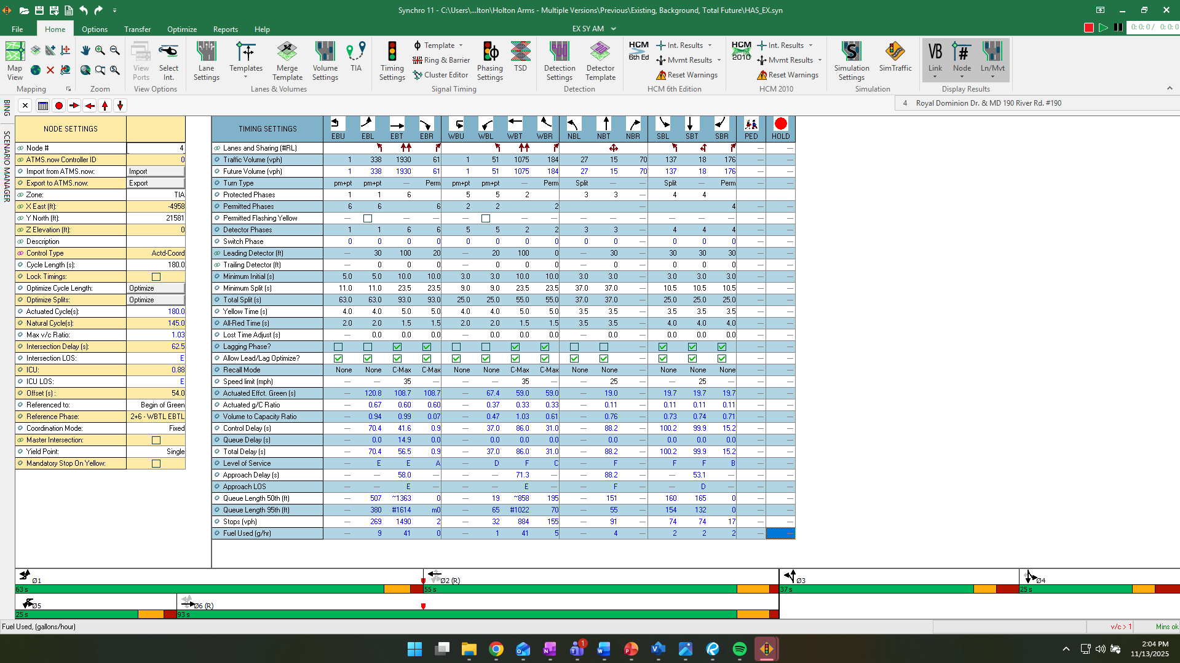
Existing AM Timings at River Road & Royal Dominion Drive

Slide 33
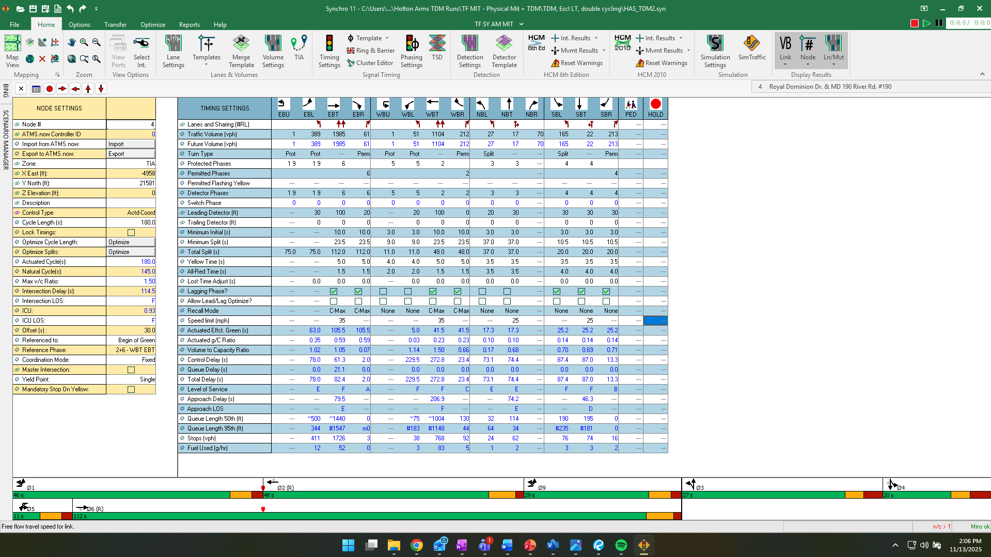
Proposed AM Timings at River Road & Royal Dominion Drive – Double Cycling

Slide 34
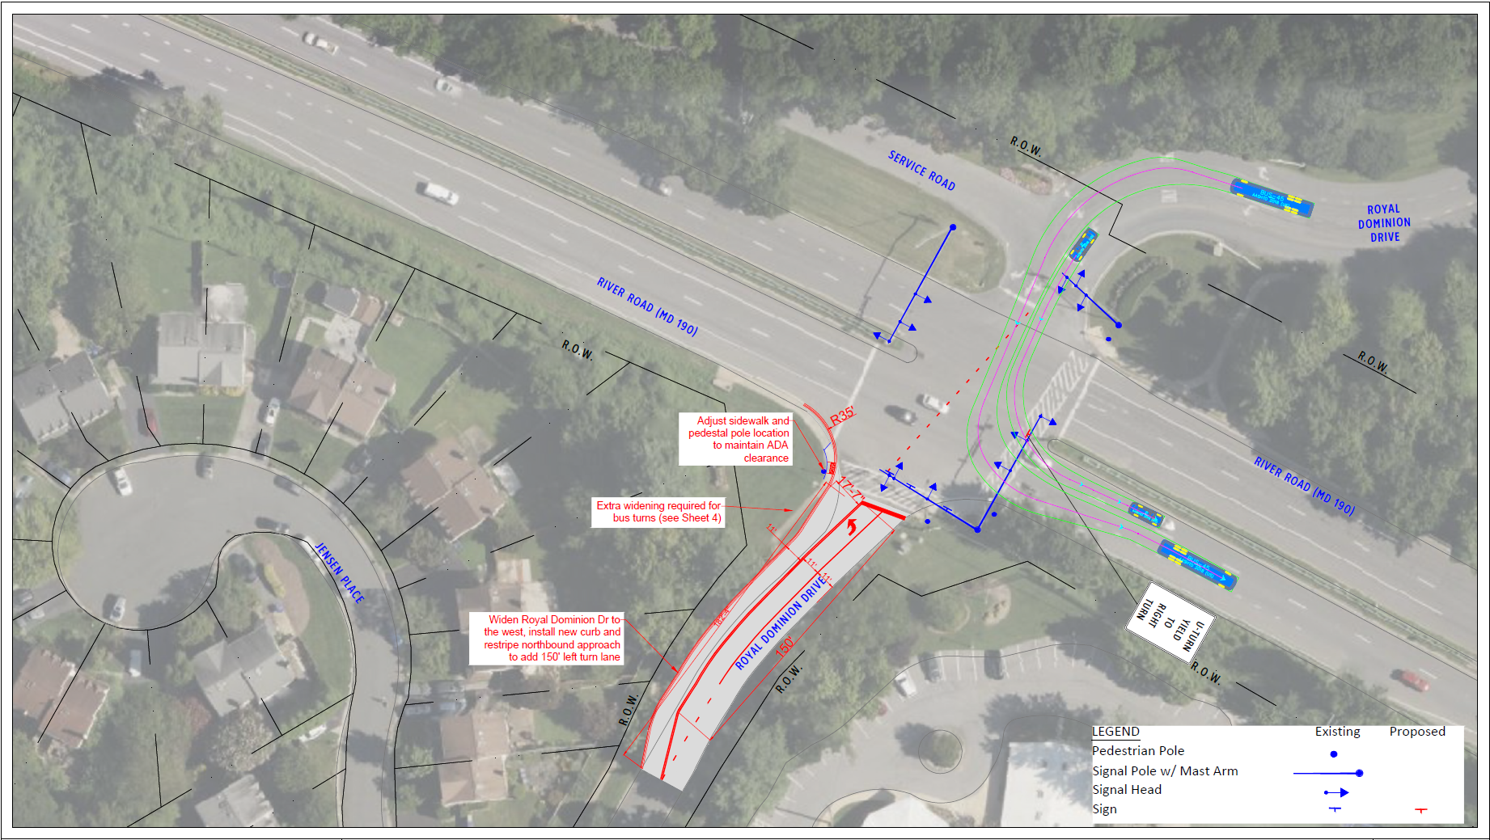
Proposed Mitigations at Royal Dominion Drive: Exhibit 40, Section O, page 335

Slide 35
Left Turns Out of the Al Marah Neighborhood

Slide 36
Cut-Through Analysis: Exhibit 38.c, Figure 1, page 5

Slide 37
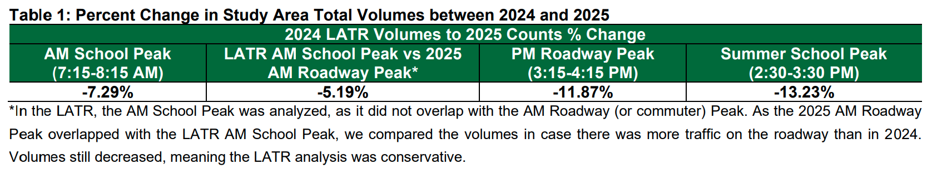
2024-2025 Volume Comparison
Exhibit 38.c, Table 1, page 2

Slide 38
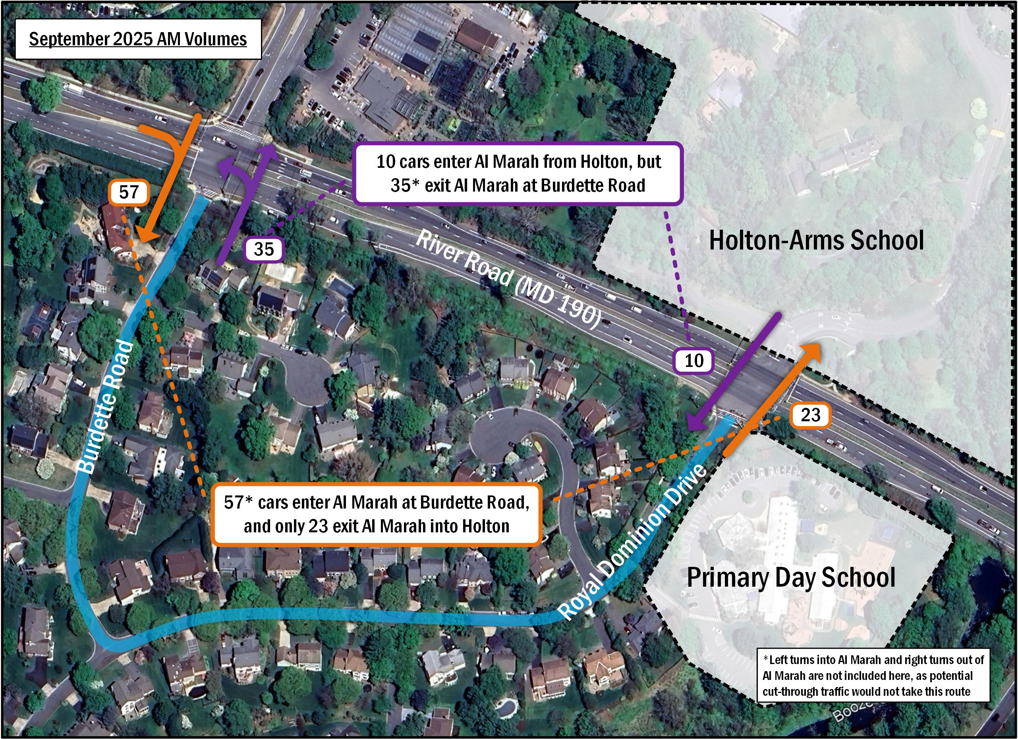
Cut-Through Analysis: Exhibit 38.c, Figure 2, page 6

Slide 39
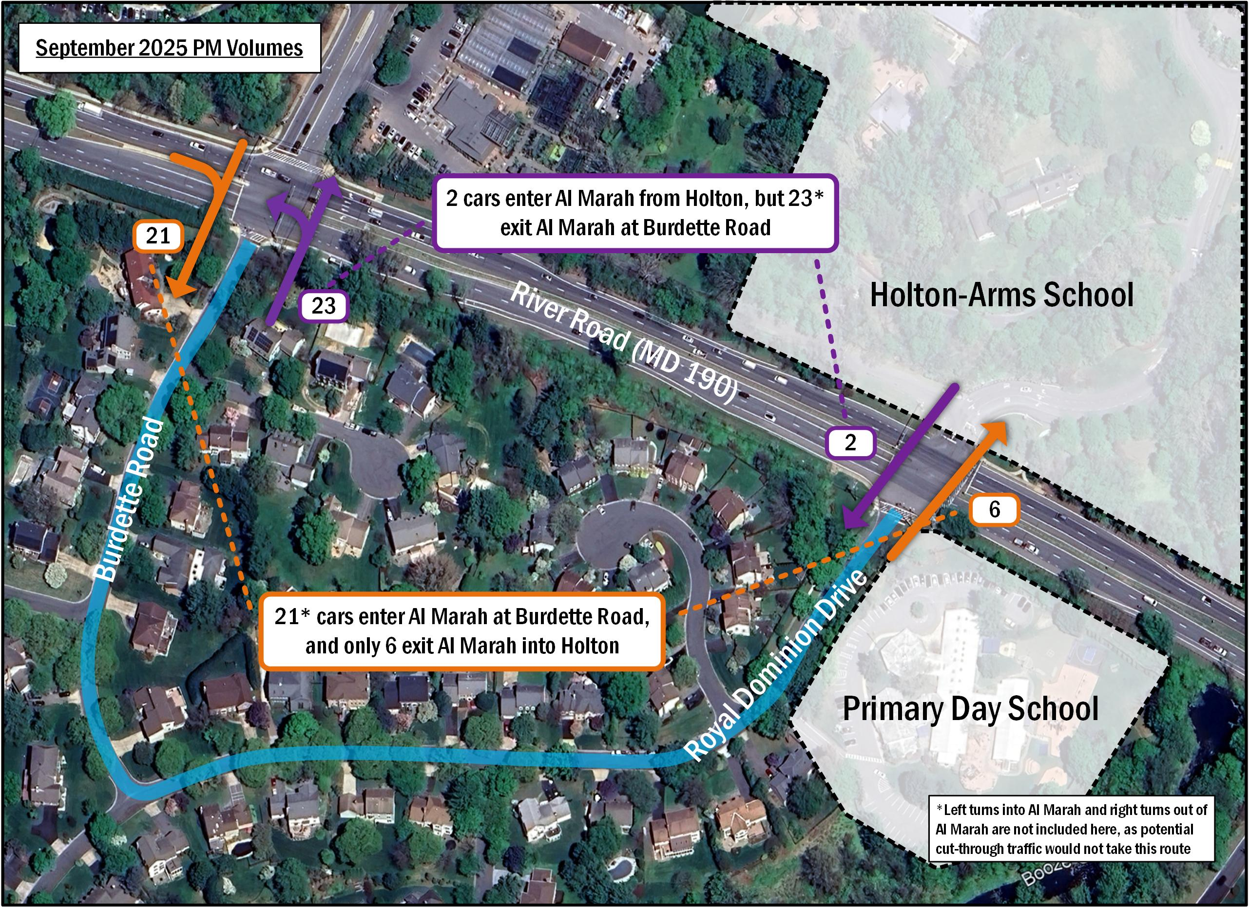
Cut-Through Analysis: Exhibit 38.c, Figure 3, page 7

Slide 40
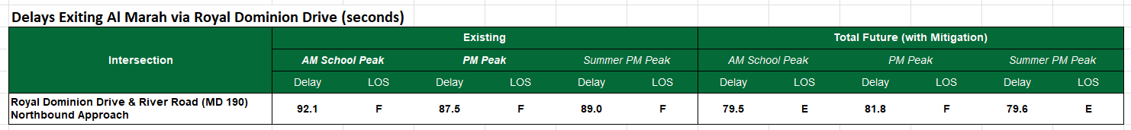
Delays for Vehicles Exiting Al Marah via Royal Dominion Drive

Slide 41
French International School Cut-Through

