Slide 1
Holton-Arms School
Gorove-Slade Exhibits

Slide 2
School Characteristics
School Hours: 8:00 AM – 3:30 PM​
  A significant number of lower school participate in programming dismissed at 4:30 PM​
  Other extracurriculars dismiss after 3:30 PM​
  There is no before-care during the school year
Daycare Hours: 7:30 AM – 5:00 PM​
  Extended day care goes until 6:00 PM​
Current enrollment and staffing​
  672 students (in excess of 655 + 5)​
  225 faculty and staff​
    Not all faculty and staff are on site at the same time​
Busing​
  12 regular bus routes​
  4 late buses serving 8 of the regular routes

Slide 3
Summer Program Characteristics
Summer Camp Hours: 9:00 AM – 3:00 PM​
  Extended care: 7:30 AM – 6:00 PM​
Summer Camp Enrollment​
  665 campers​
Busing​
  7 regular bus routes​

Slide 4
Proposed Changes
School enrollment increases from 670 to 870
  Increased busing targets and TDM
  Intersection mitigations at Royal Dominion Drive
Summer Camp enrollment​ increases from 665 to 970
  Staggered arrival and dismissal
Rental of School facilities
  Rental of outdoor facilities on weekends from 9-4
  Rental from 5:30 – 7:30 PM two nights a week
  Rental from 4:00 – 7:00 PM on summer nights
  Will not generate more traffic than School peak hours

Slide 5
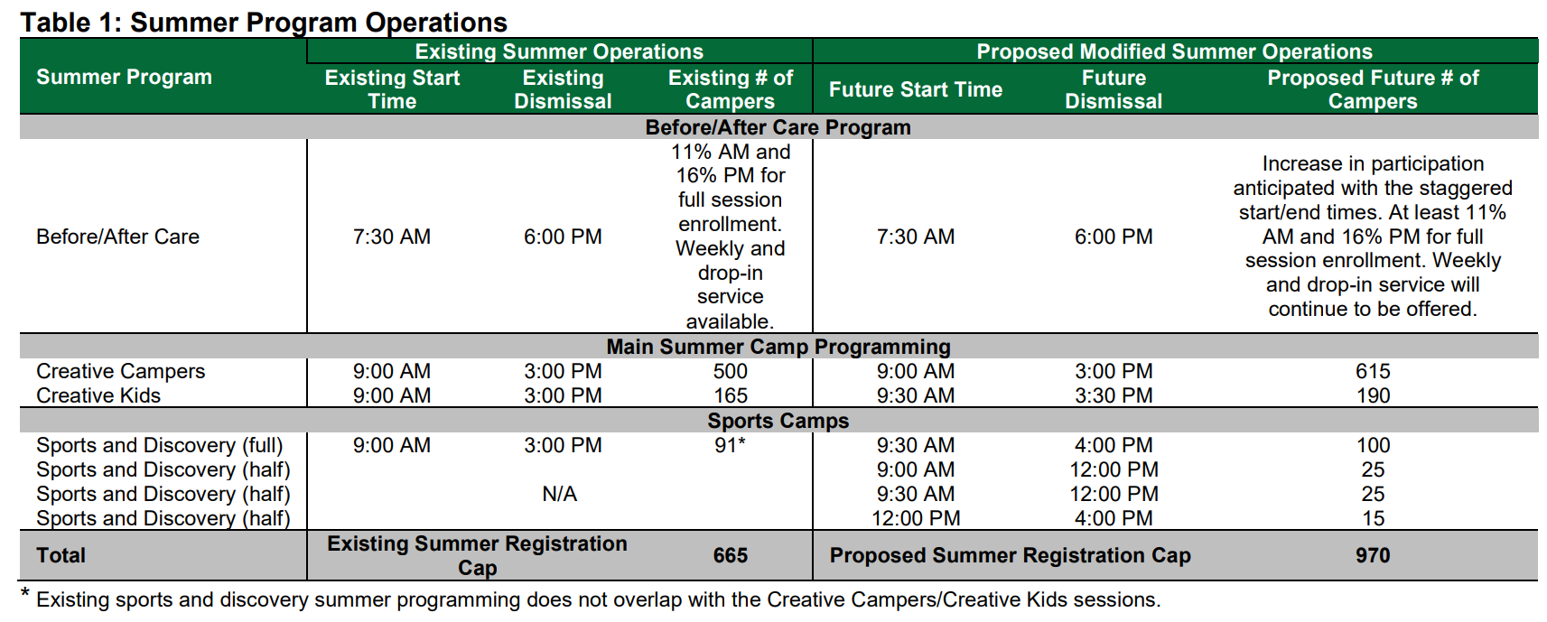
Summer Program Operations
Exhibit 33 (a), Table 1, page 4​

Slide 6
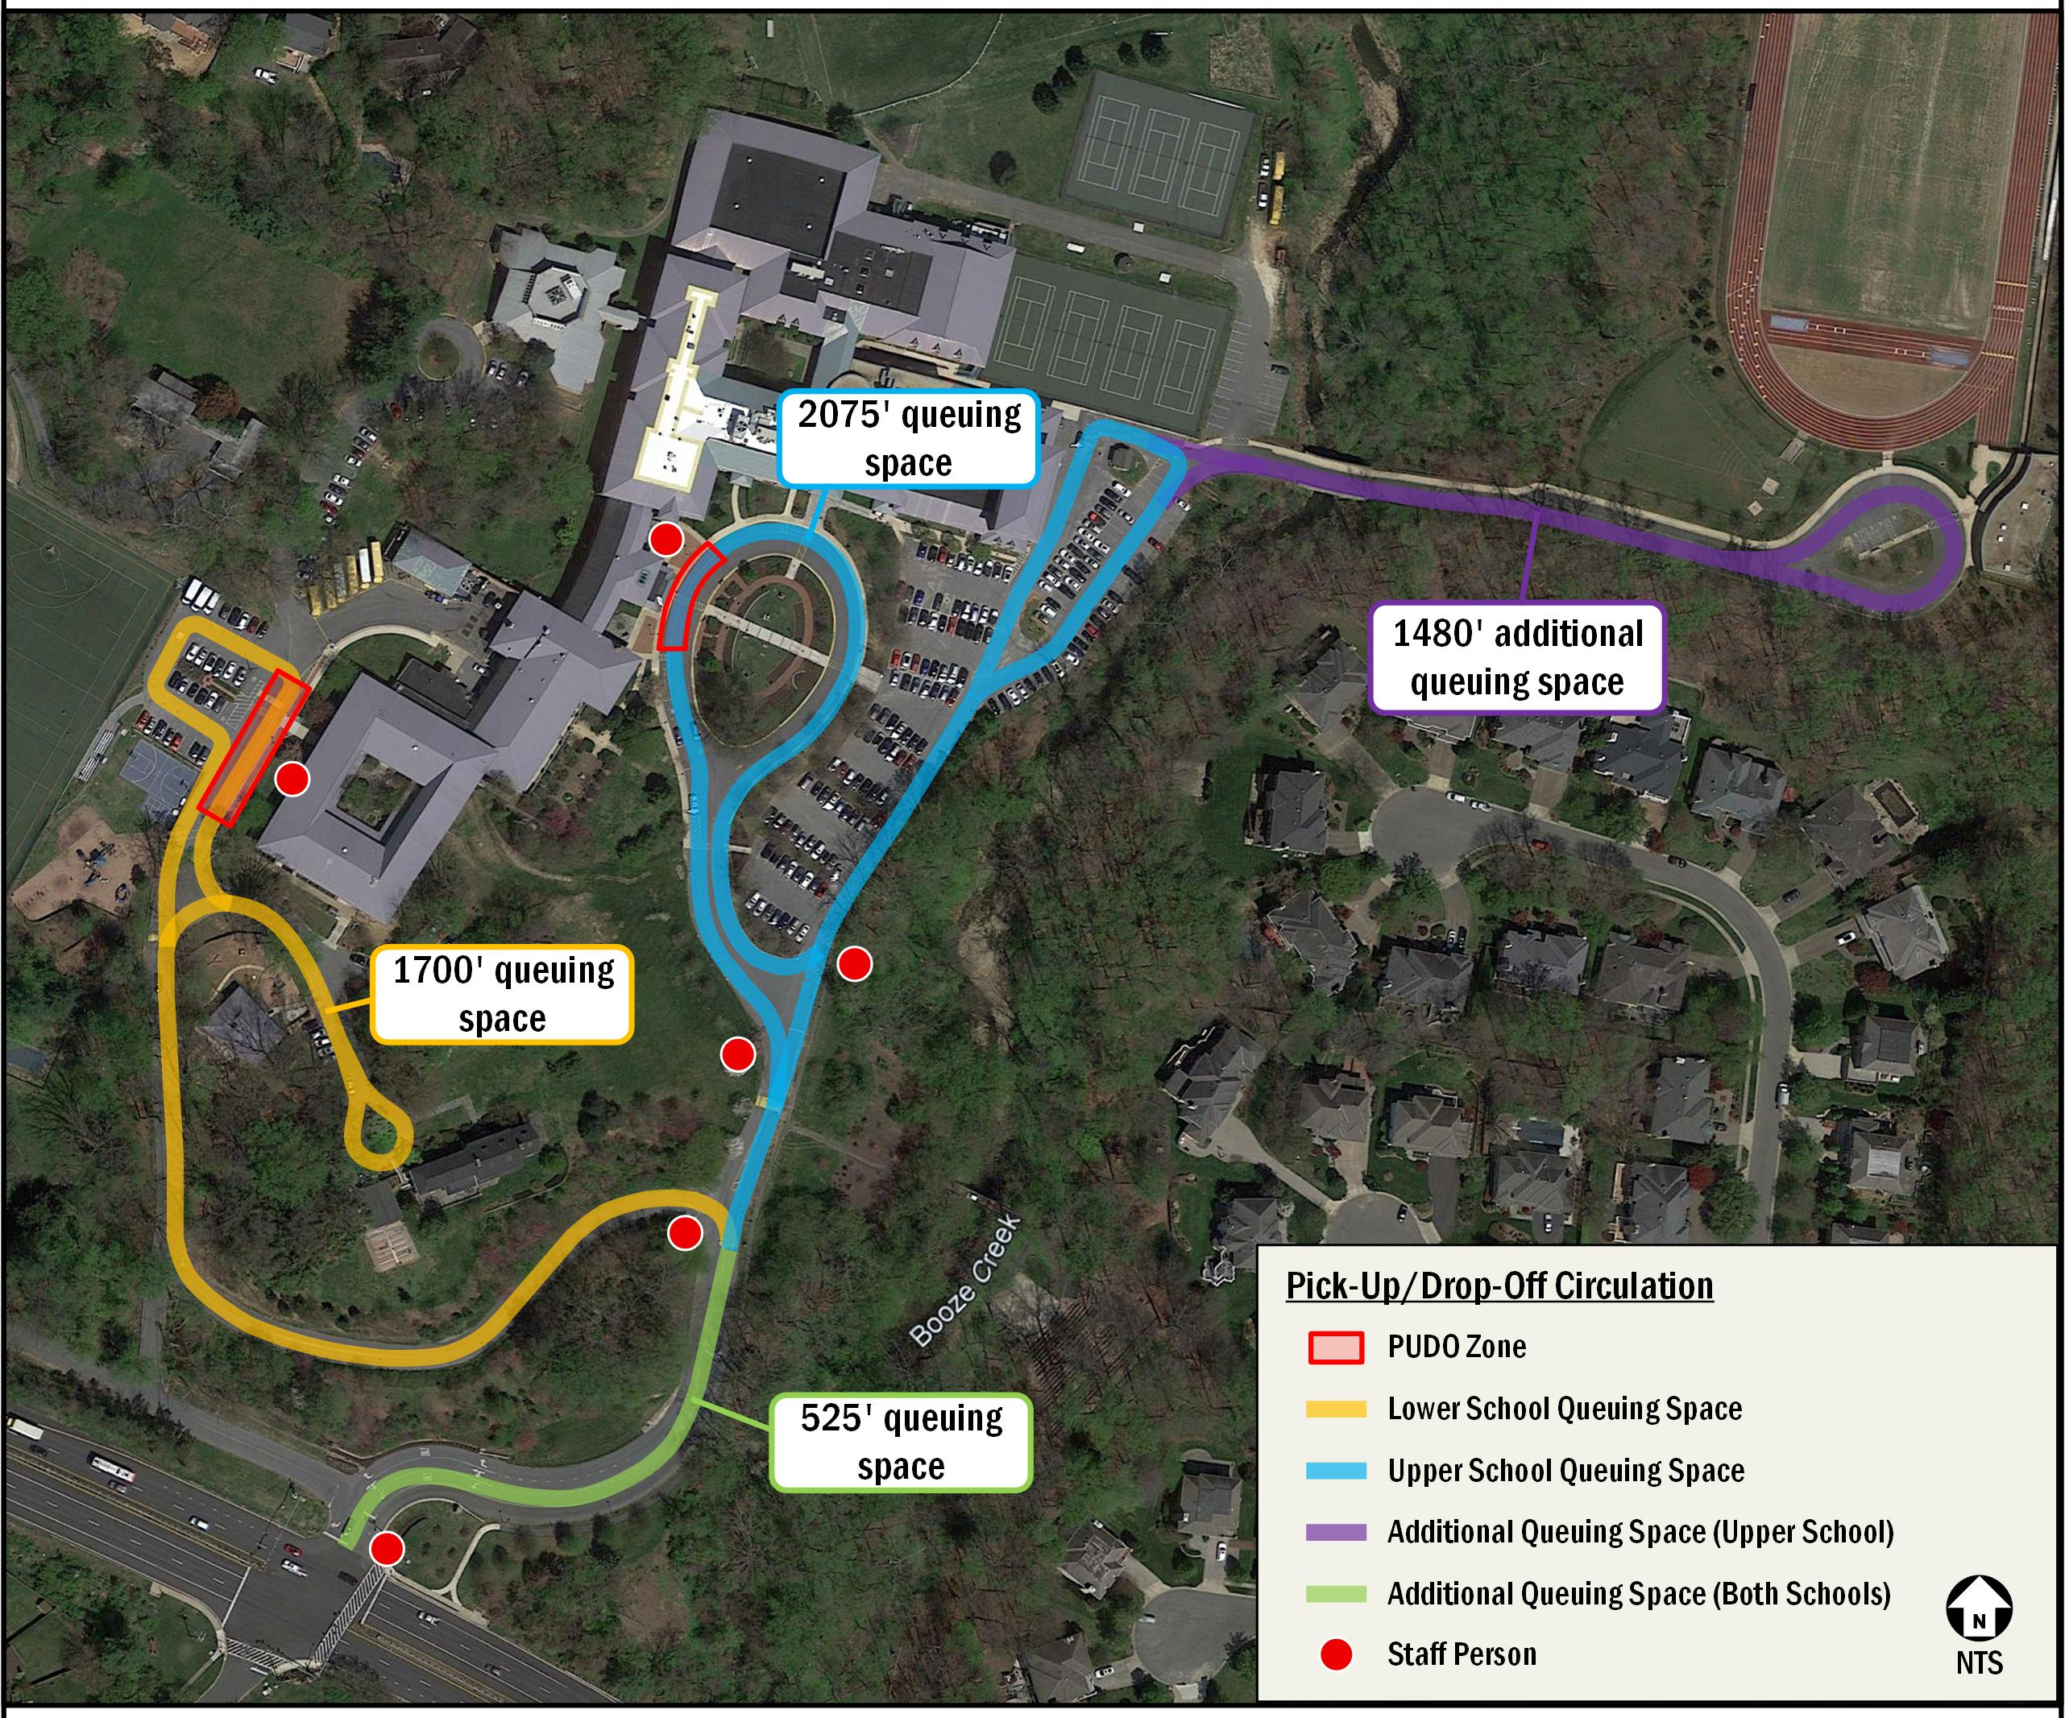
Site Circulation
Exhibit 33, Figure 3, page 13

Slide 7
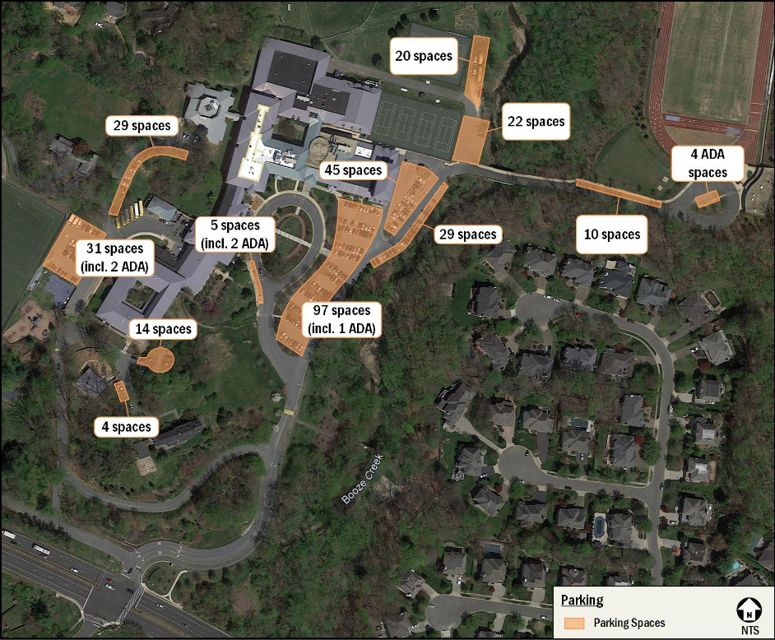
Site Parking

Slide 8
Bus Stop Adjacent to Site

Slide 9
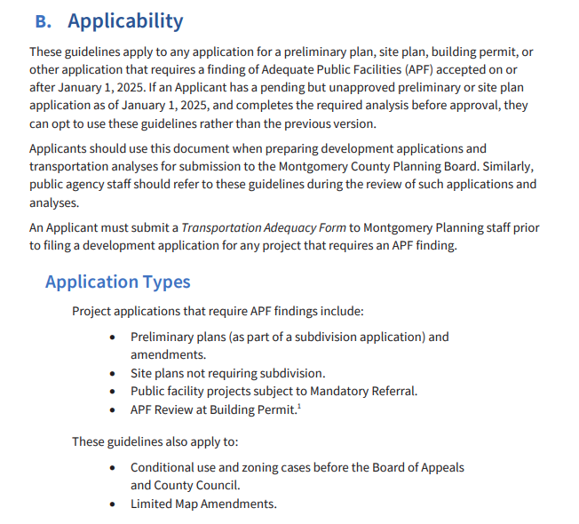
Applicability Guidelines
2025 LATR Guidelines, page 2

Slide 10
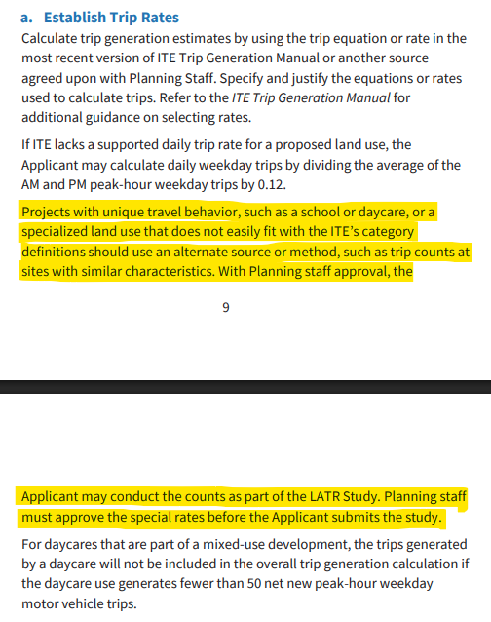
Trip Generation Guidelines
2025 LATR Guidelines, pages 9/10

Slide 11
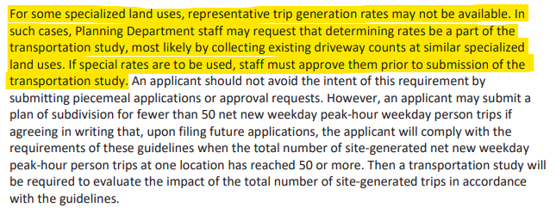
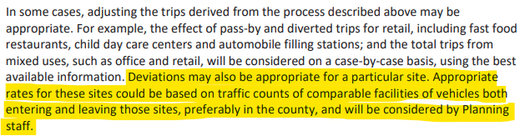
2023 LATR Guidelines, page 28
2023 LATR Guidelines, page 41
Trip Generation Guidelines

Slide 12
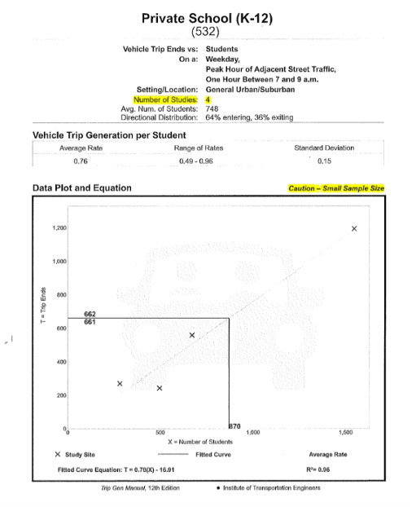
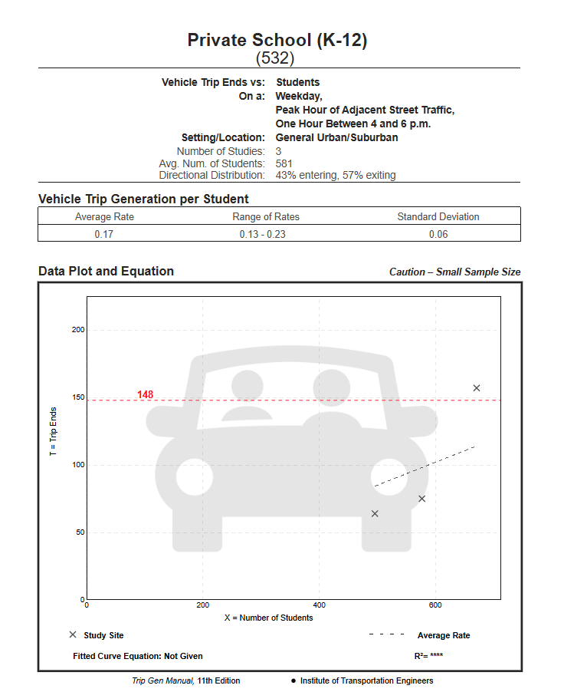
ITE Private School Trip Generation
Exhibit 41.e, page 36
ITE 11th Edition PM Peak Hour Trip Generation

Slide 13
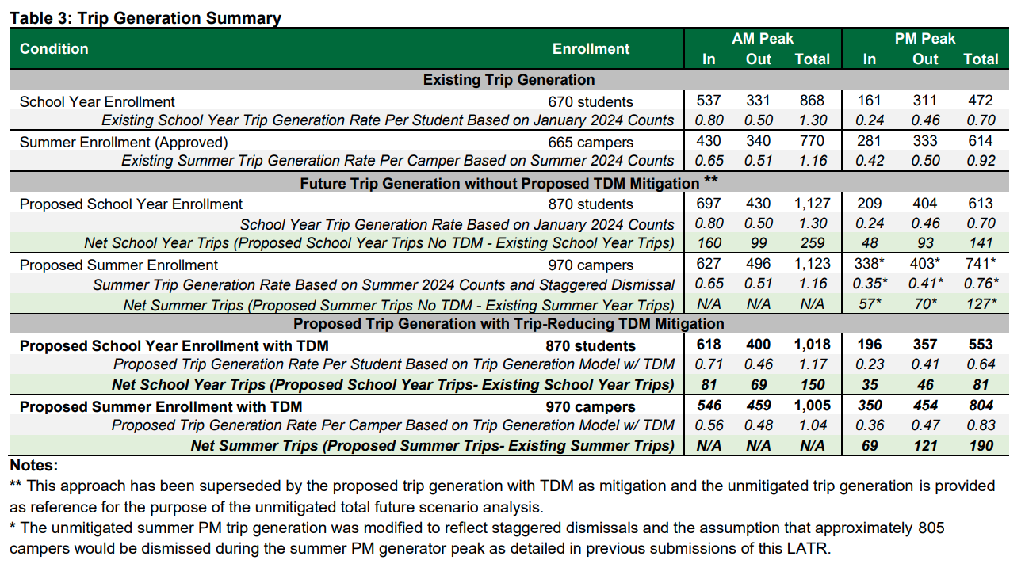
Trip Generation Summary
Exhibit 33, Table 3, page 12

Slide 14
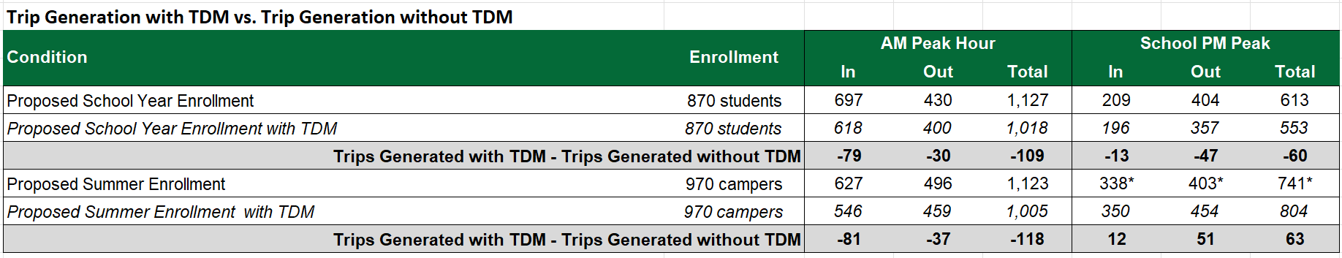
Reduction in Trips from TDM

Slide 15
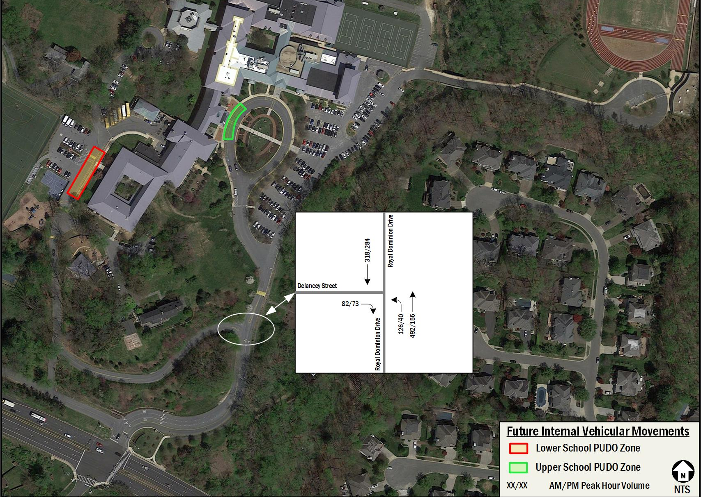
Pick-up/Drop-off Traffic Split

Slide 16
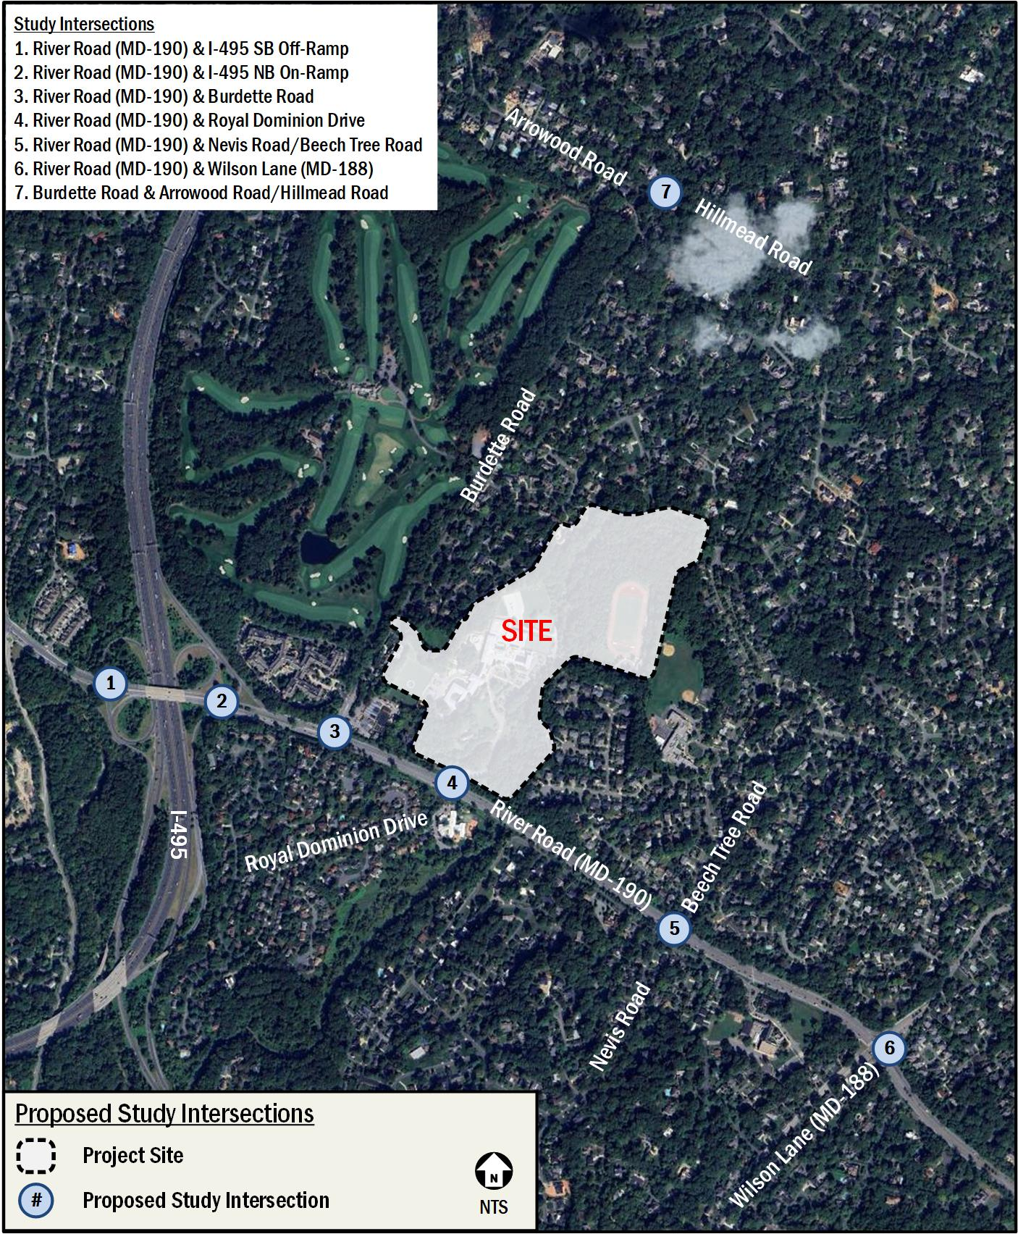
Study Area Intersections
Exhibit 33, Table 3, page 12

Slide 17
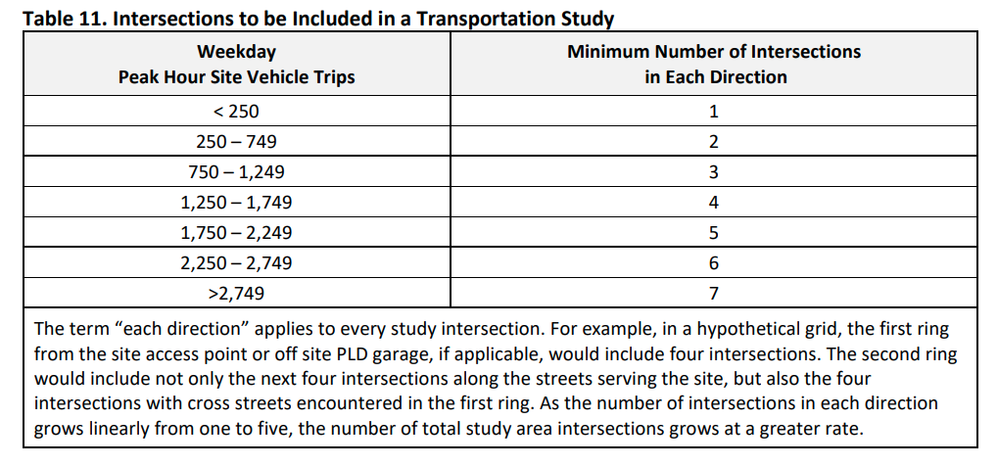
Study Intersection Requirements
2023 LATR Guidelines, Table 11, page 38

Slide 18
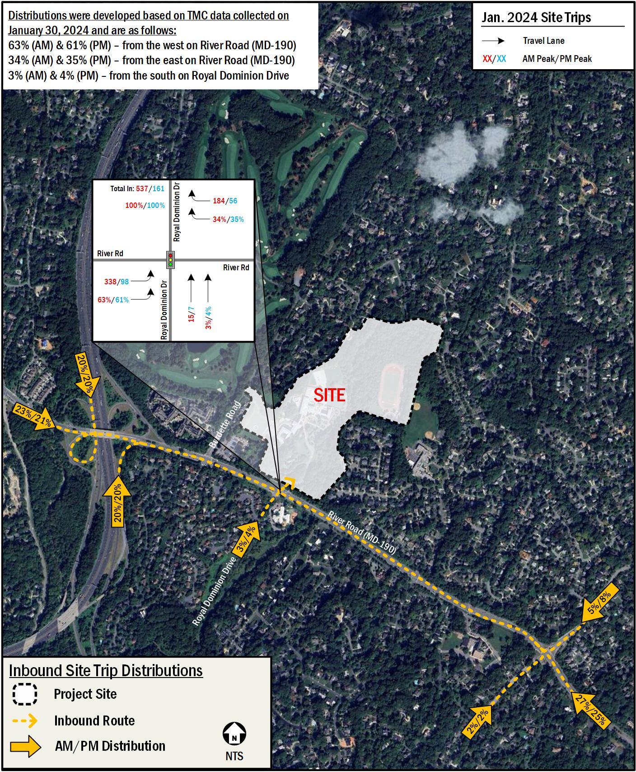
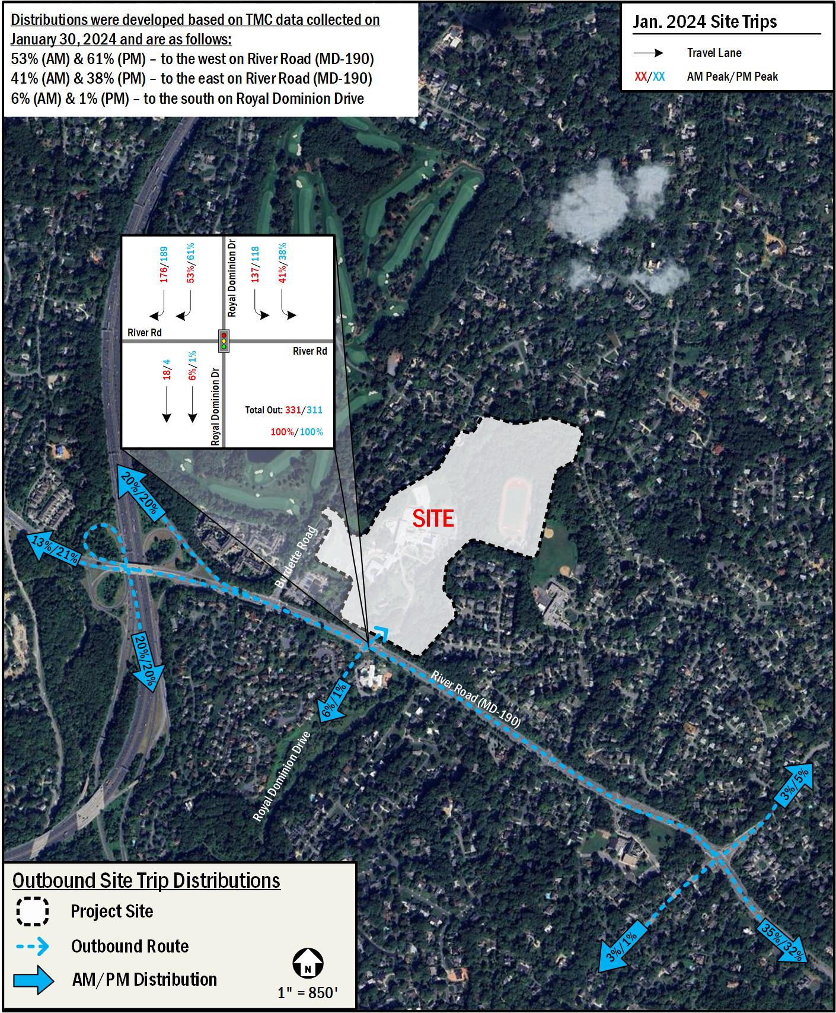
Distributions Used in Analysis
Exhibit 33, Table 3, page 12

Slide 19
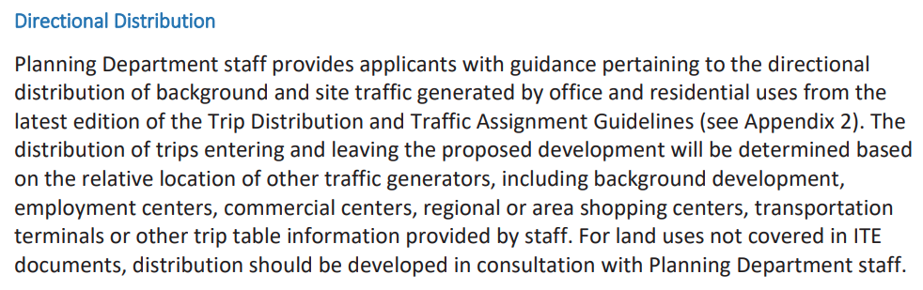
Distributions
2023 LATR Guidelines, page 41

Slide 20
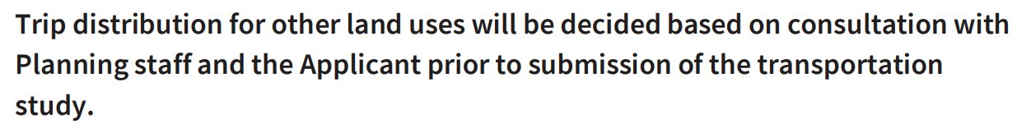
Distributions
2025 LATR Guidelines, page 45

Slide 21
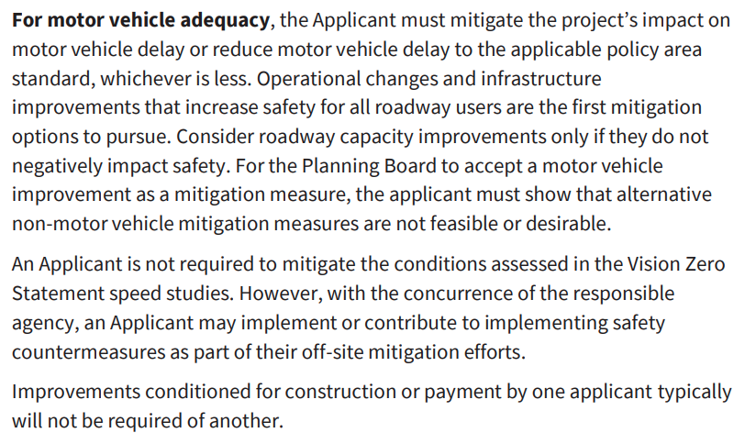

Motor Vehicle Adequacy
2025 LATR Guidelines, page 35

Slide 22
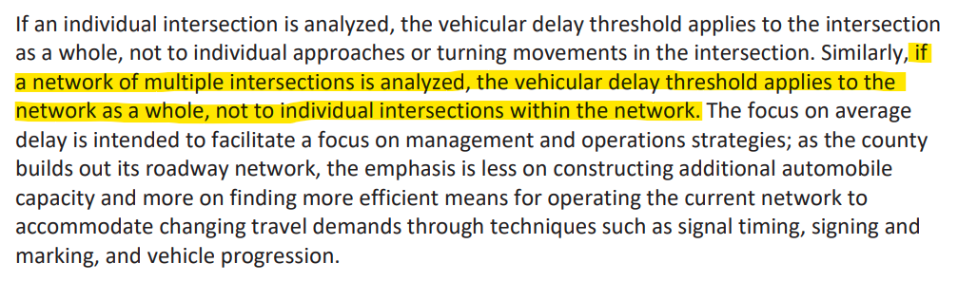
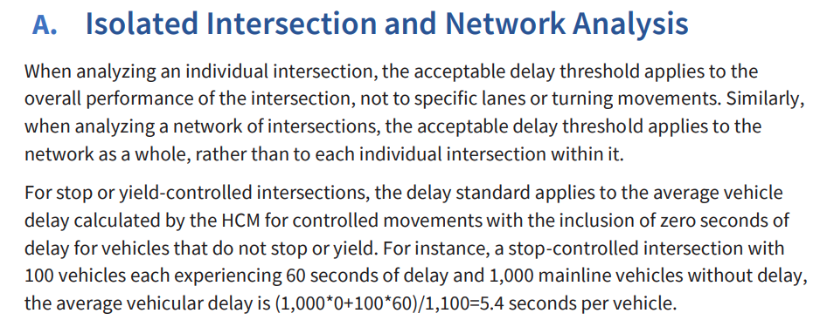
2025 LATR Guidelines, page 62
Corridor-Based Analysis
2023 LATR Guidelines, page 33

Slide 23
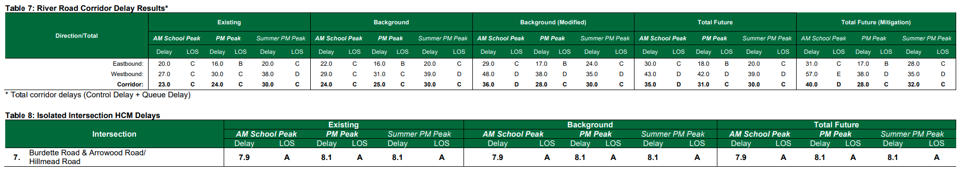
Intersection Delays
Exhibit 33, Tables 7/8, page 24

Slide 24
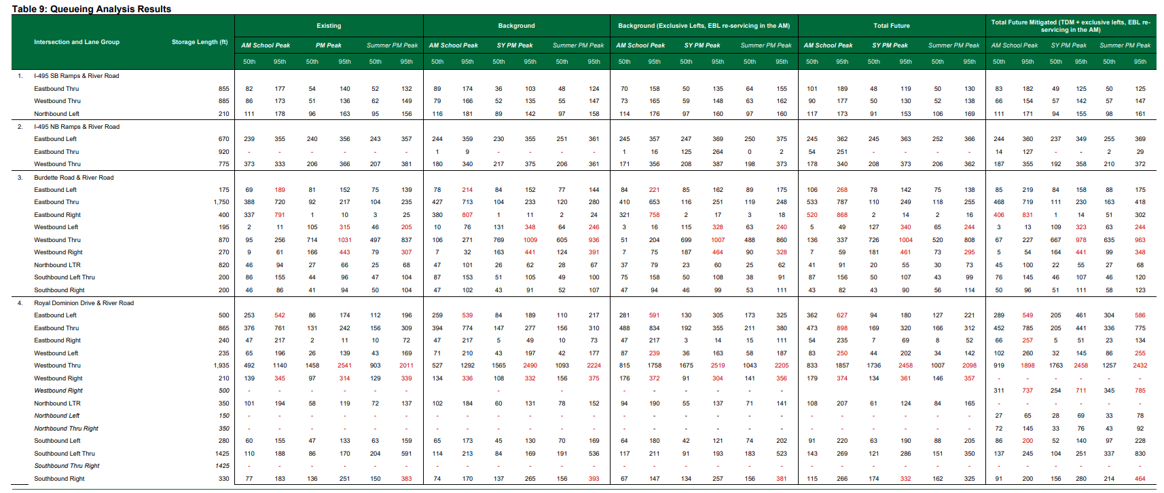
Intersection Queues
Exhibit 33, Table 9, page 24
School Driveway

Slide 25
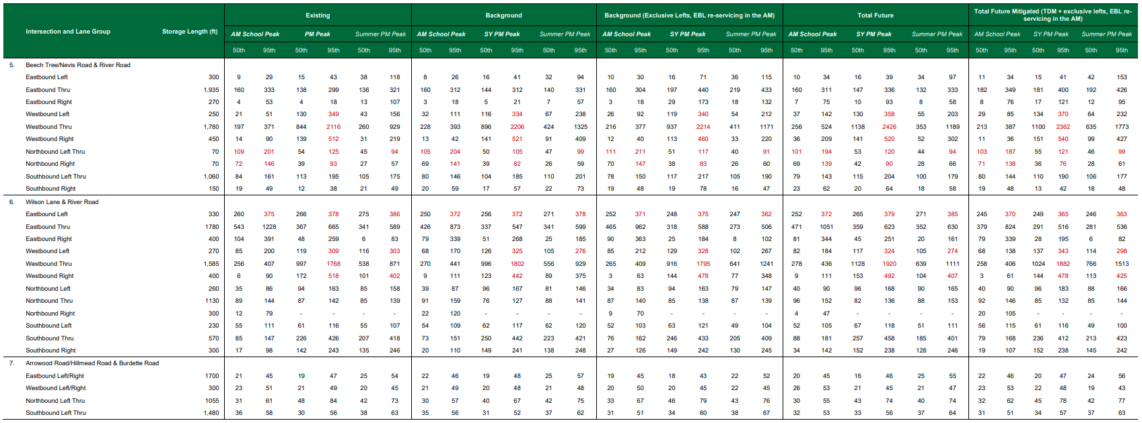
Intersection Queues
Exhibit 33, Table 9, page 25

Slide 26
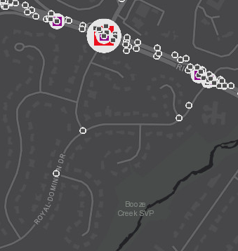
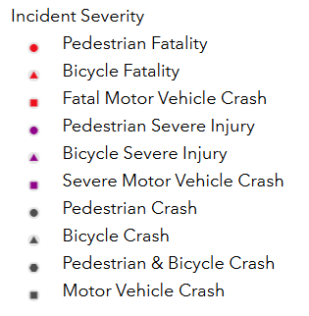
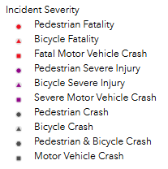
Crashes in Al Marah
Montgomery County Interactive Crash Map, Al Marah Neighborhood
All crashes are motor vehicle only (no pedestrians involved)

Slide 27
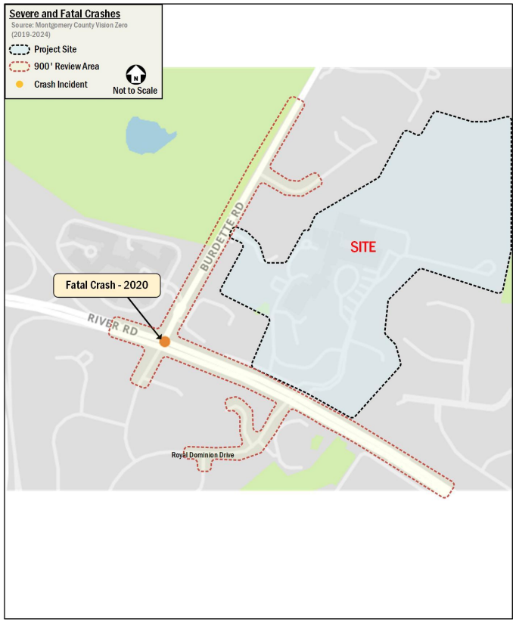
Severe and Fatal Crashes: Exhibit 33, Figure 4, page 16
Fatal vehicle crash

Slide 28
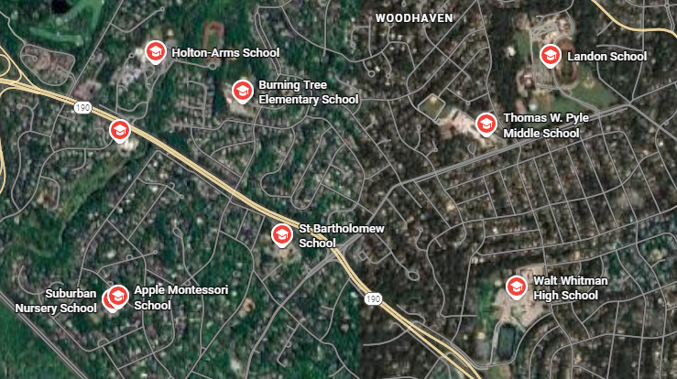
Schools Along the River Road Corridor

Slide 29
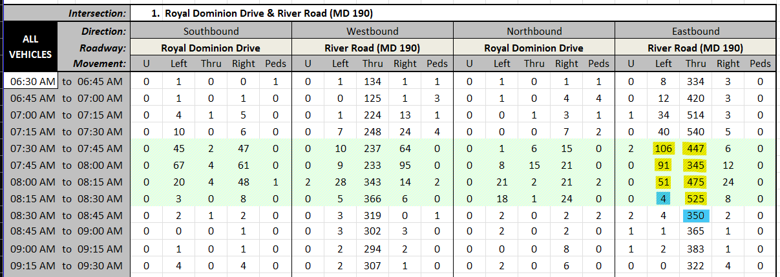
2025 AM Traffic Counts at Royal Dominion Drive

Slide 30
Proposed Mitigations at Royal Dominion Drive

Slide 31
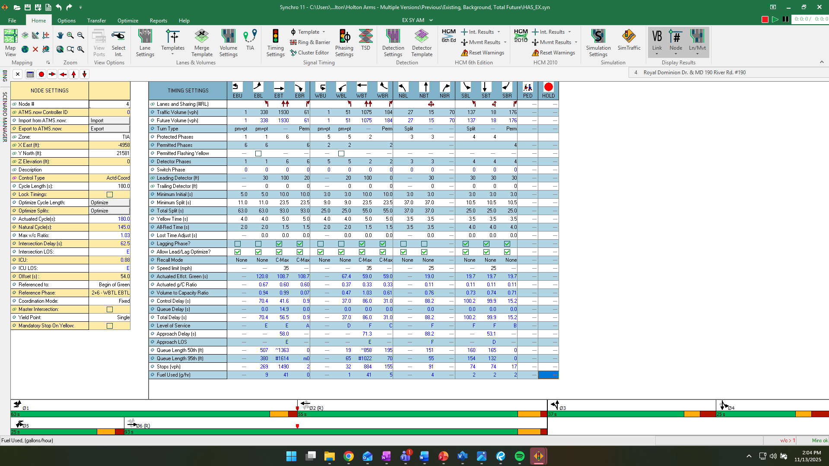
Existing AM Timings at River Road & Royal Dominion Drive

Slide 32
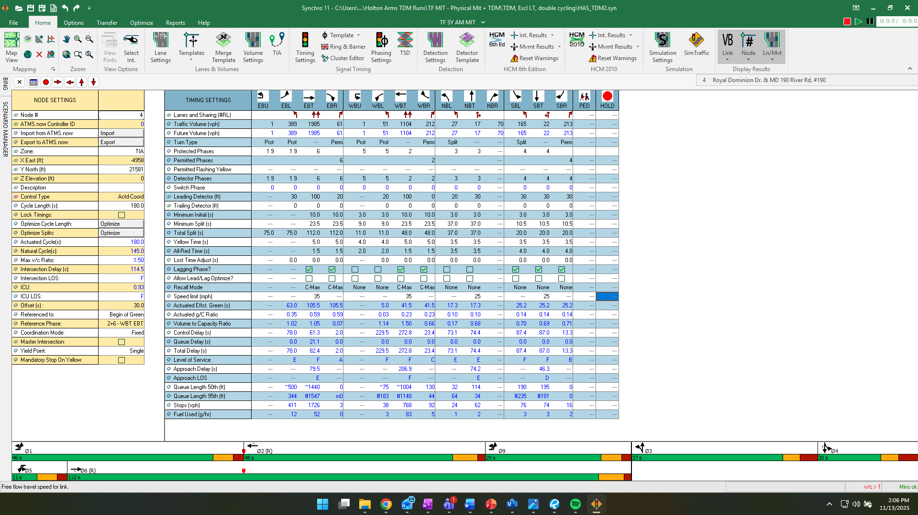
Proposed AM Timings at River Road & Royal Dominion Drive – Double Cycling

Slide 33
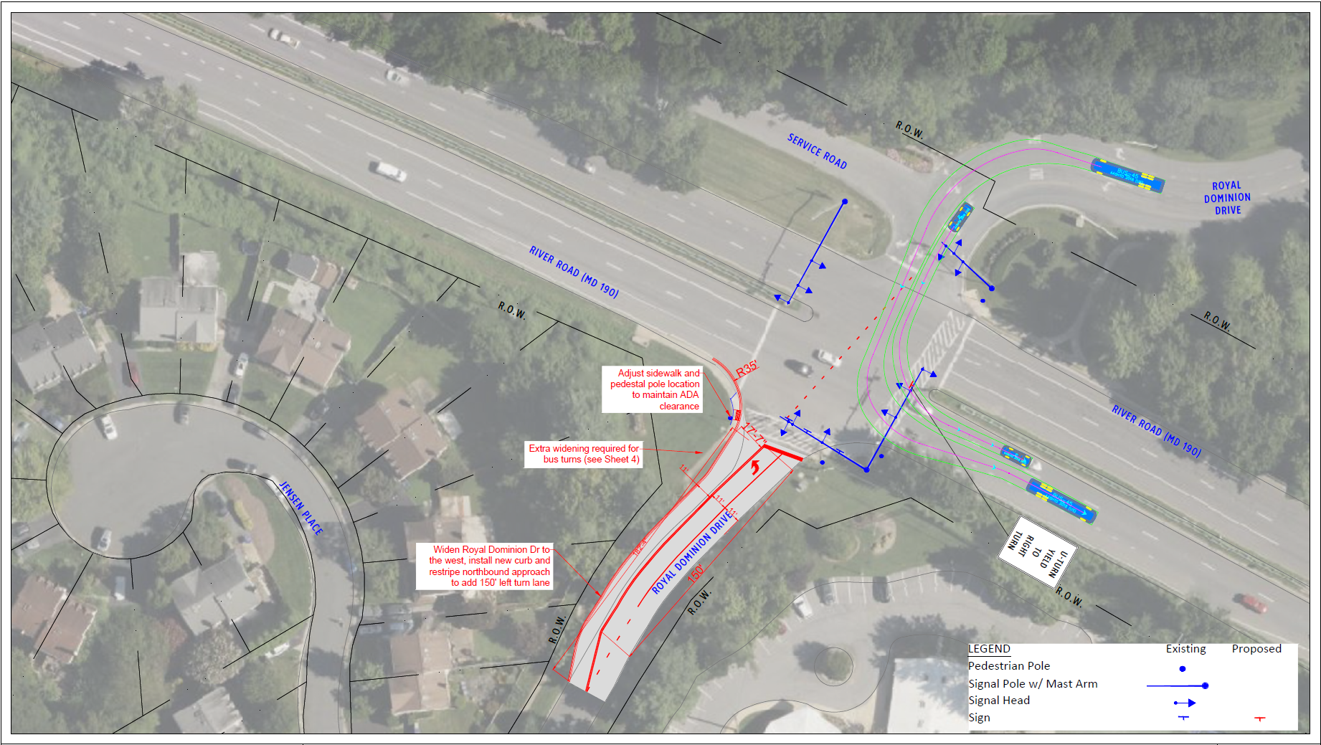
Proposed Mitigations at Royal Dominion Drive: Exhibit 40, Section O, page 335

Slide 34
Left Turns Out of the Al Marah Neighborhood

Slide 35
Cut-Through Analysis: Exhibit 38.c, Figure 1, page 5

Slide 36
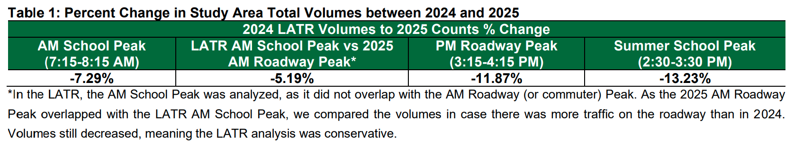
2024-2025 Volume Comparison
Exhibit 38.c, Table 1, page 2

Slide 37
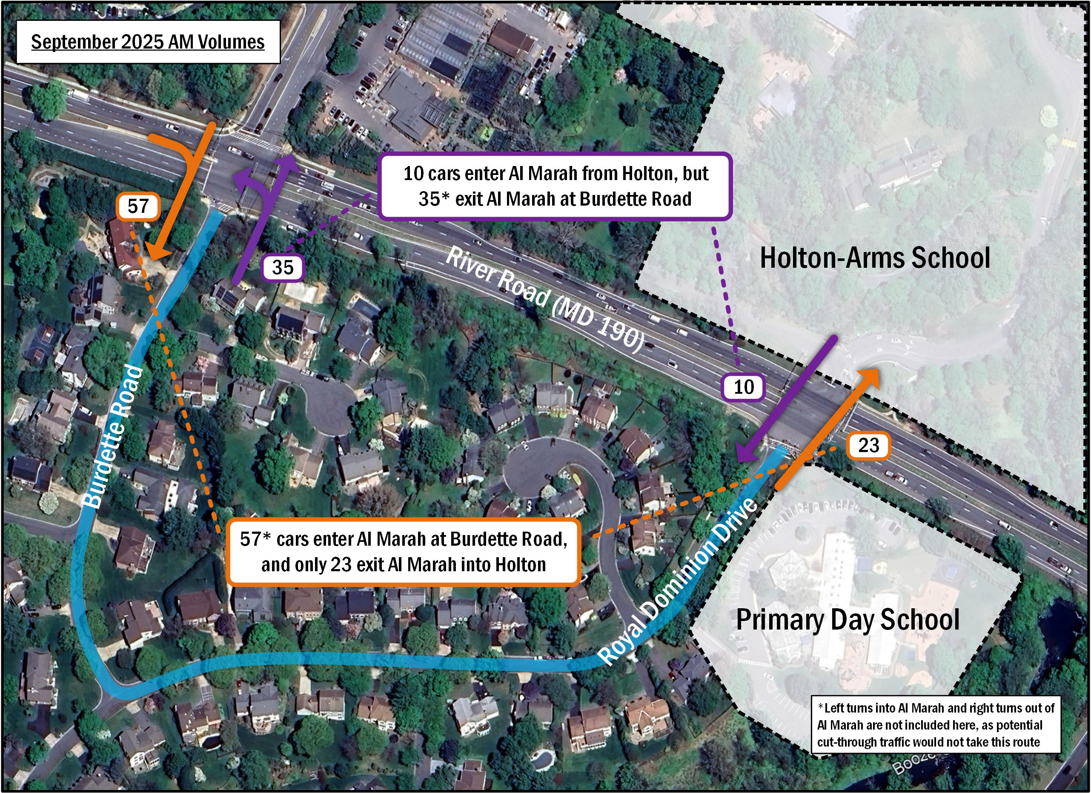
Cut-Through Analysis: Exhibit 38.c, Figure 2, page 6

Slide 38
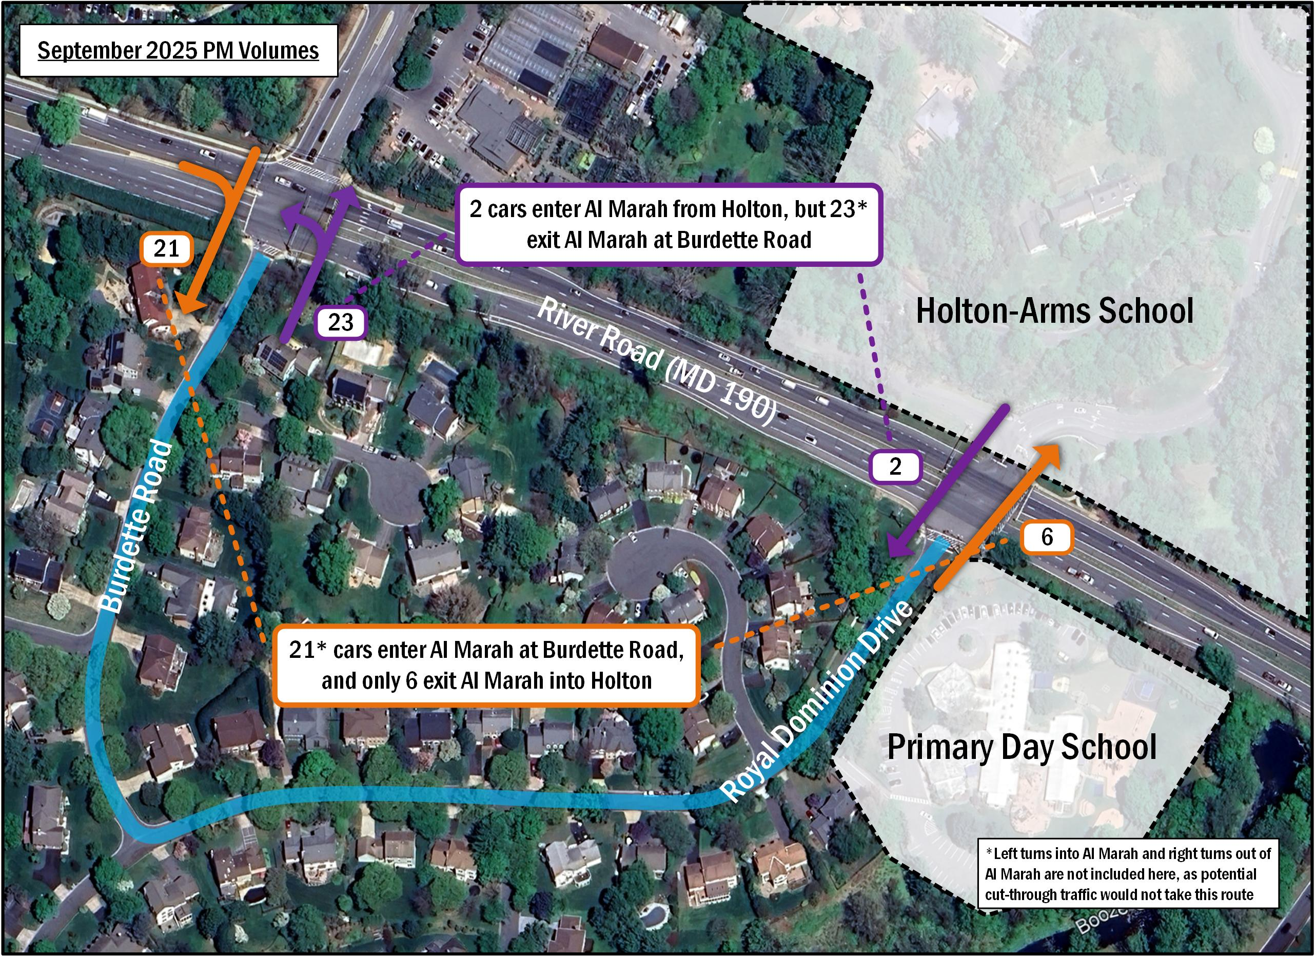
Cut-Through Analysis: Exhibit 38.c, Figure 3, page 7

Slide 39
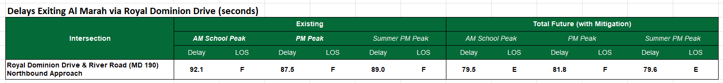
Delays for Vehicles Exiting Al Marah via Royal Dominion Drive

Slide 40
French International School Cut-Through

