Slide 2
Our Mission
The Office of Procurement obtains goods, services and construction for the County Government using a wide variety of purchasing methods and procedures. The Office of Procurement strives to maximize value and competition for Montgomery County residents, while maintaining integrity, transparency and legal requirements. The procurement process includes checks and balances and is comprised of multiple participants.
www.montgomerycountymd.gov/procurement
Core Values
Efficiency
Collaboration
Empathy
Transparency
$1.5
2,600
$5
9,500
Billion
Billion
Annual
Procurement $
Active
Contracts
Annual
Public Funds
Procurement
Actions
2

Slide 3
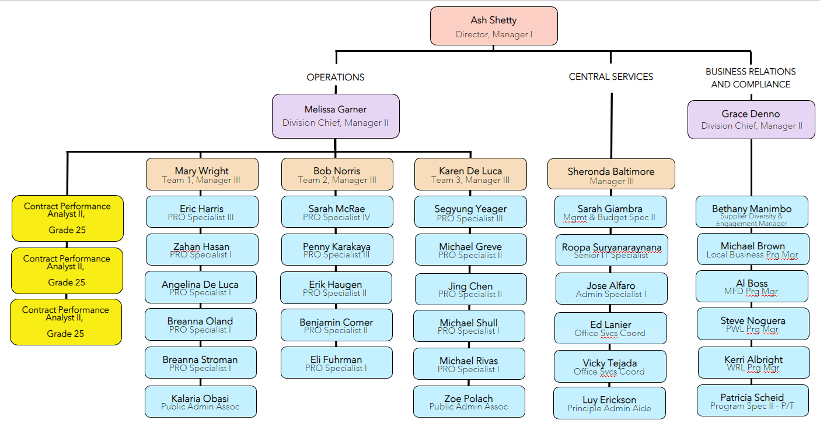
Procurement Organization Changes
3

Slide 4
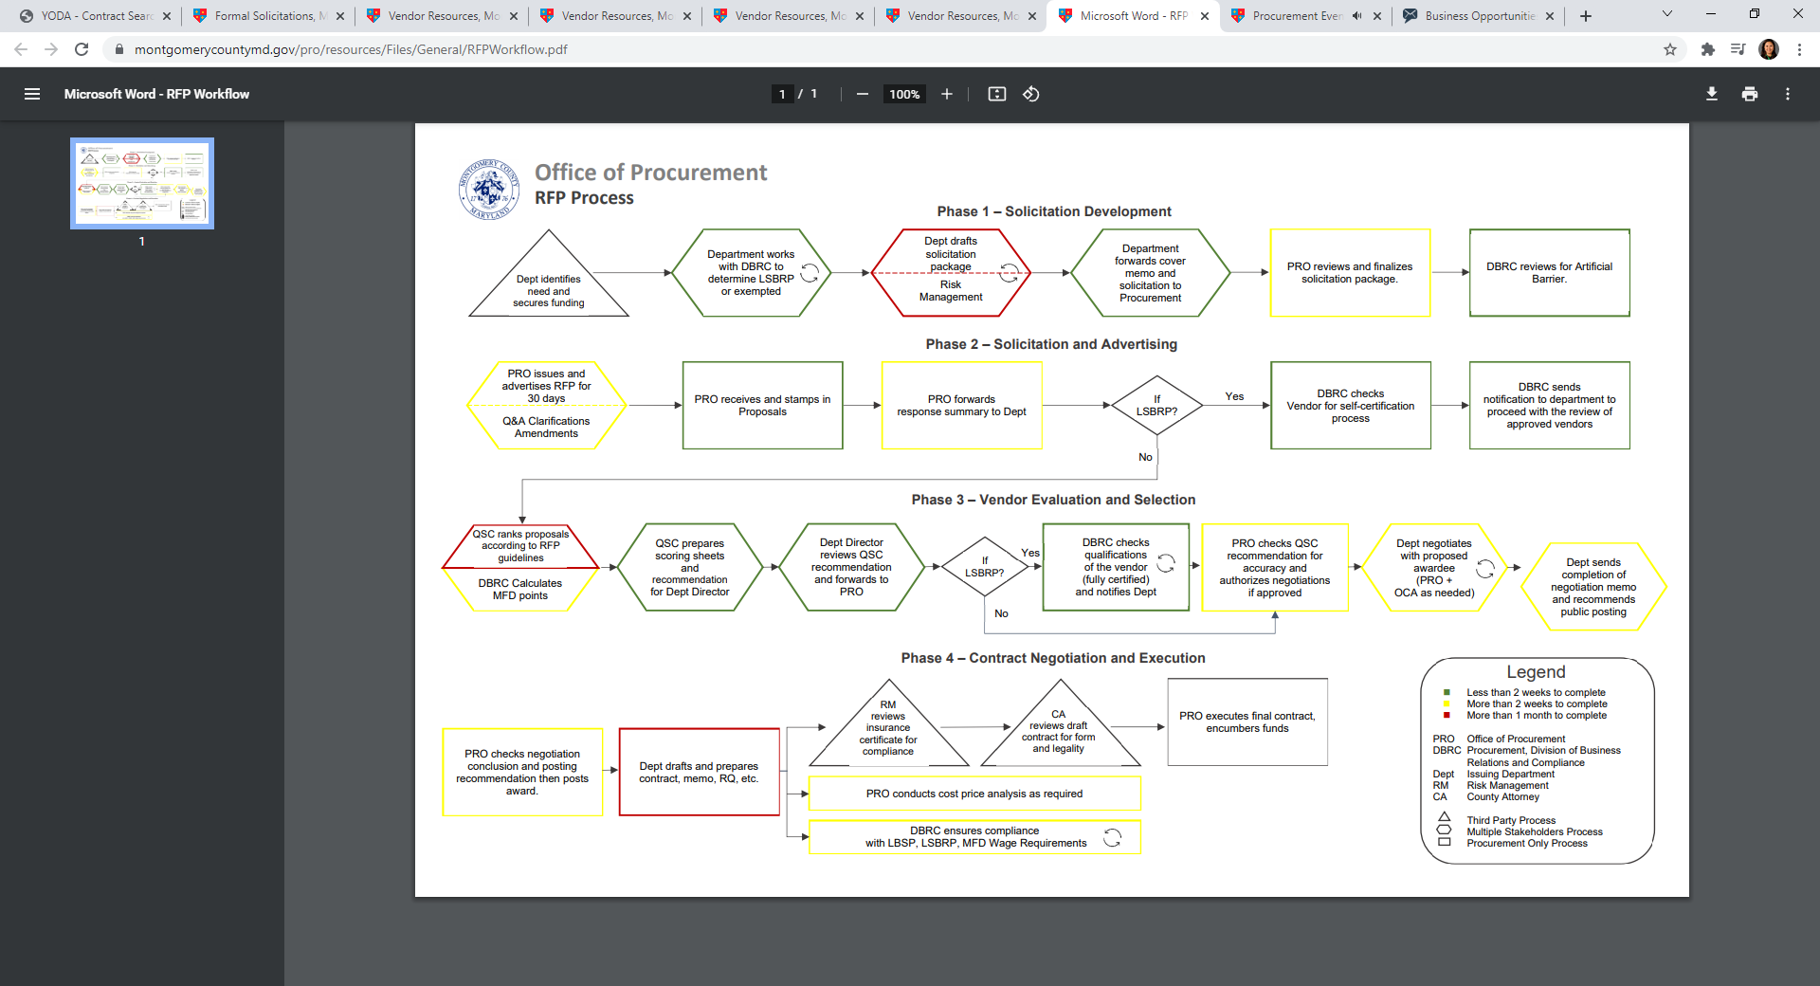
4

Slide 5
Formal and Informal Solicitations
Formal Solicitations (>$100K)
Invitation for Bid (IFB)
Request for Proposal (RFP)
Request for Express of Interest (REOI)
Informal Solicitations (< $100K, > $10K )
All reserved under the LSBRP
>$50K all subject to MFD requirements
>$50K services contracts subject to Wage requirements
Direct Purchase (< $10K)
(departments buy directly)
Open Solicitations
(fixed pricing, “open until filled”)
Purchasing Categories
Goods
Services
Construction
Other
Best Value
VS
Low Price

Slide 6
Contract Compliance Programs
Local Small Business Reserve Program (LSBRP)
Local Business Preference Program (LBPP)
Local Business Subcontracting Program (LBSP)
Minority Female Disabled persons Program (MFD)
Wage Requirements (Living Wage) Law (WRL)
Prevailing Wage Law (PWL)
6

Slide 7
Minority, Female, Disabled Persons Owned Business
(MFD) Program
MFD Subcontracting Goals
 | CY2023 | CY2024
Construction | 21% | 16%
Professional Services | 19% | 19%
Non-Professional Services | 22% | 23%
Goods | 10% | 8%
4-year spending history
Fiscal Year | Total $Subject to MFD | Total $ Encumbered to MFD | % of Total $ Encumbered to MFD
FY 23 | $1,090,391,062 | $246,374,095 | 22.60%
FY 22 | $816,175,595 | $212,449,525 | 26.03%
FY 21 | $746,510,083 | $200,457,253 | 26.86%
FY 20 | $797,850,214 | $182,655,316 | 22.89%

Slide 8
Headlines
Local Small
Businesses
MFD
Businesses
Proposed
Staffer
New Contractors
01
02
03
04
Designated all informal solicitations to LSBRP
Spent $305 million to LSBRP contractors, at 31.3%. Both are record high numbers
Expanded certifications to include the VA’s “Service-Disabled Veteran” certificate
Continue to hit high trend on FY23 MFD awards of 22.6% at $246 million
Proposed Sustainability/Green Staffer for FY24
33% Contracts Awarded to 1st Time Vendors in FY23
8

Slide 9
Local Small Business Reserve Program
Sets a 25% goal for County’s spending with Montgomery County based local small businesses (LSB).
In $ Values | FY12 | FY21 | FY22 | FY23
Total Encumbrance to LSBRP | $120,318,366 27.8% | $129,860,381 27.2% | $141,569,096 26.2% | $305,080,539 31.3%
LSBRP Annual Report
https://montgomerycountymd.gov/PRO/report/index.html

Slide 10
Wage Programs
Prevailing Wage Law (PWL)
Wage Requirement Law (WRL)
The prevailing wage rate: (MD state) https://dllr.state.md.us/PrevWage/PWRequestRates.aspx
Liquidated Damages:
(will be deducted from the Retainage)
$10 per person per day for late submission of payroll
$20 per person per day for misclassification
$16.00/hour for FY23.
$17.05/hour for FY24.
$17.60/hour for FY25.
Applies to all services contracts
Applies to all construction and maintenance contracts

Slide 11
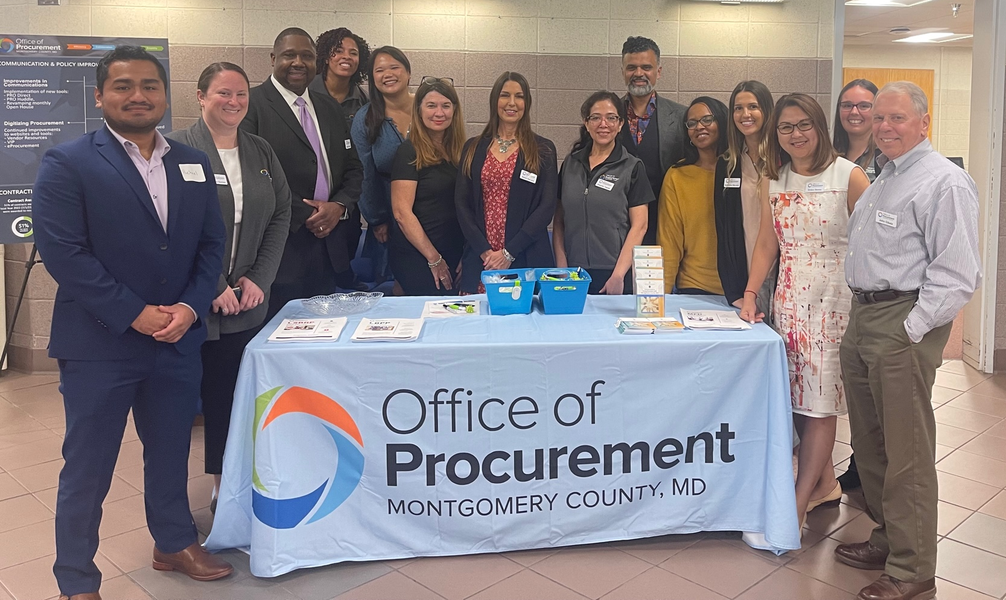
Outreach
Monthly Open House (Online since May 2020)
Minority Business Meet and Greet Event in April 2024
Procurement Fair: November 2023, September 2024
11

Slide 12
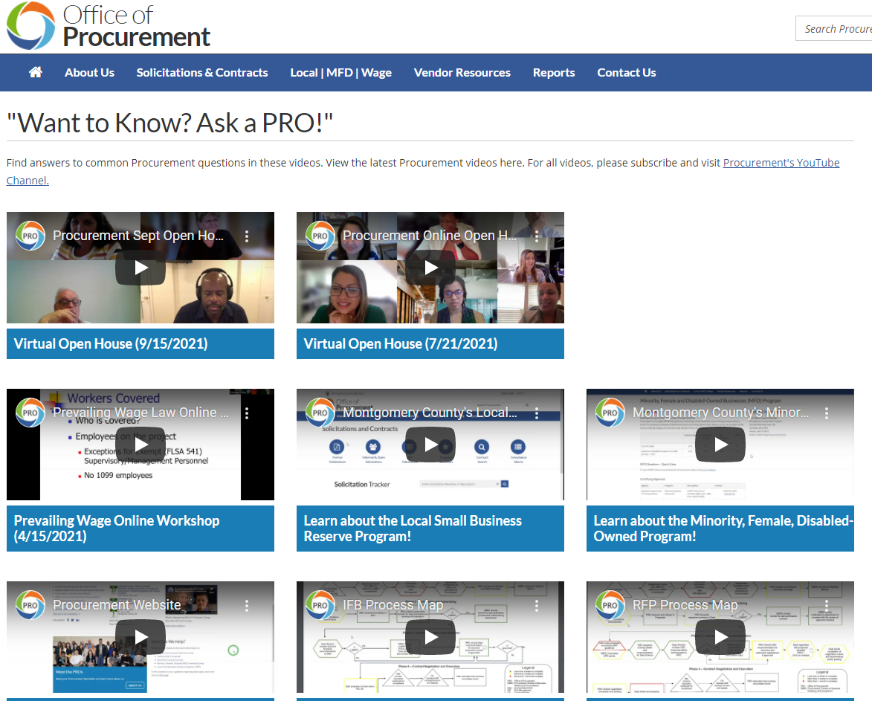
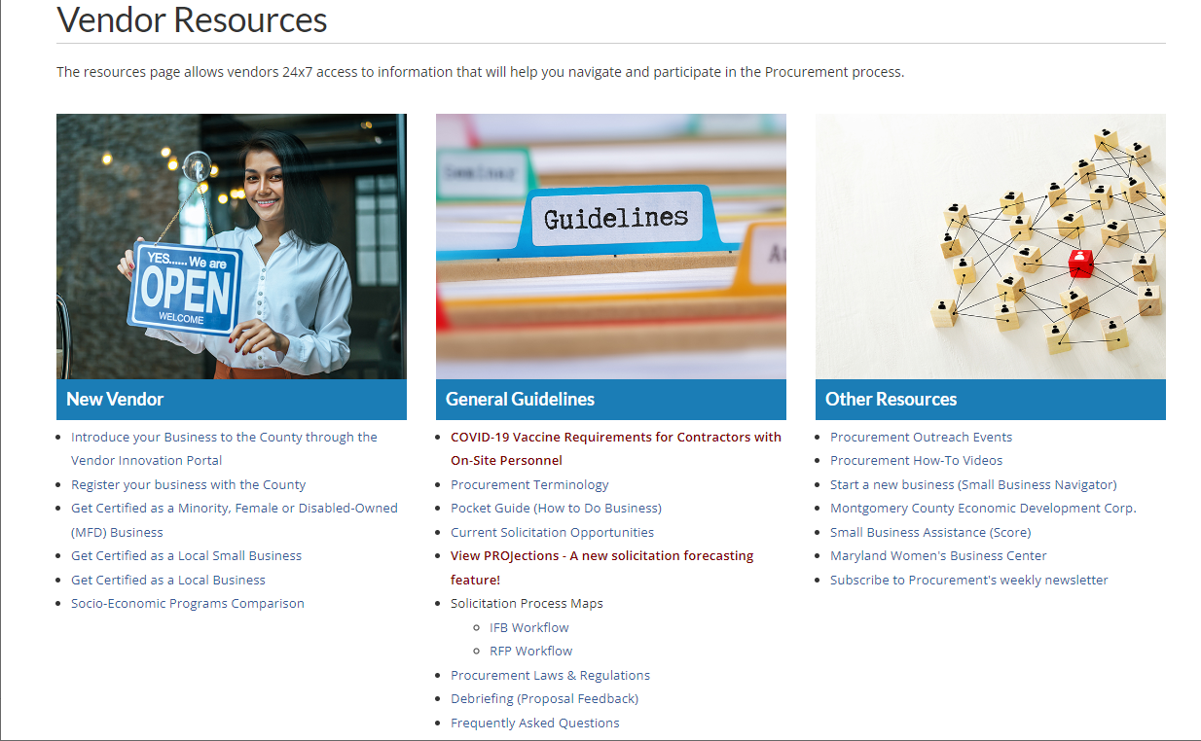
Website Demo
www.montgomerycountymd.gov/pro
Solicitation Tracker
Kanban board
PROjection

Slide 13
Increased Efficiencies
External Customers
Internal Customers
Solicitation Forecasting
PROJections
PRO Huddles
Provide information to vendors on
upcoming contracting
opportunities
Monthly meetings with Contract Administrators to improve communication and
training for Contract Administrators
Re-Designed Website
and Resource Tools
Updated website to assist vendors through the public purchasing process:
eProcurement
Vendor Resources Tab
Solicitation Tracker
How-To Videos
Vendor Innovation Portal (VIP)
View Scope button
Contract Monitoring Tools
Implementation of new communication
tools and contract monitoring tools
to assist Contract Administrators in
managing contracts
13

Slide 14
Staff Engagement
Innovation Accelerators
Other County
Associations
Ash Shetty
Bethany Manimbo
Sheronda Baltimore
Melissa Garner
Mary Wright
Edward Lanier
Grace Denno
Jose Alfaro
Michael Shull
Local & Regional Government Alliance on Race & Equity
Ash Shetty
Women in Government
Sheronda Baltimore
Karen DeLuca
QLF Planning Committee
Melissa Garner
Sheronda Baltimore
Racial Equity/MCG Delivers
Bethany Manimbo
Wellness Champion/Employee Giving Campaign
Karen DeLuca
14

Slide 15
National Recognition
National Association of Counties Award (NACo)
Emergency Procurement Management System
Visualizing the Solicitation Process with Kanban Boards
DPO Violation E-Notification and Response System
Construction Manager at Risk Project Delivery System
Solicitation Tracker – Transparency in Public Procurement
National Procurement Institute
Achievement of Excellence in Procurement Award
15

Slide 16
Procurement Organization & Contract Administrators
Team
1
Team
2
Team
3
6 PRO Specialists
HHS, TEBS, OGM,
LIB, OAG, DPS
5 PRO Specialists
DGS, DEP, OEMHS,DOCR, POL, SHF, OAS, FRS
6 PRO Specialists
DOT, REC, FIN, OHR, OMB, PRO, CEX, CCL, ABS, CEC, CCT, BOE, OCA, SAO, HCA, ORESJ, OLO, OCP, IGR, OIG, OLR, PIO, CUPF
35 Contract Administrators
45 Contract Administrators
84 Contract Administrators
16

Slide 17
IT Systems
E-Bidding System
Contract Management System
Contract Compliance System (MFD, LSBRP Monitoring)
Wage Compliance Monitoring System
REOI In Process > RFP
17

