Slide 1
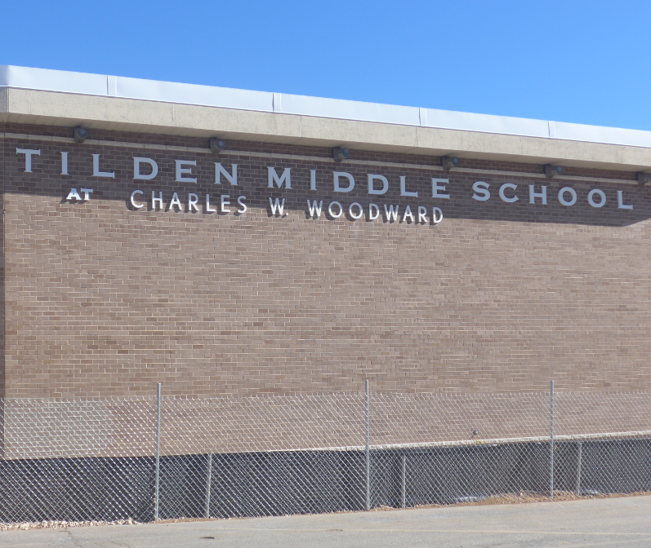
SBA Temporary Monopole @Tilden Middle School

Slide 2
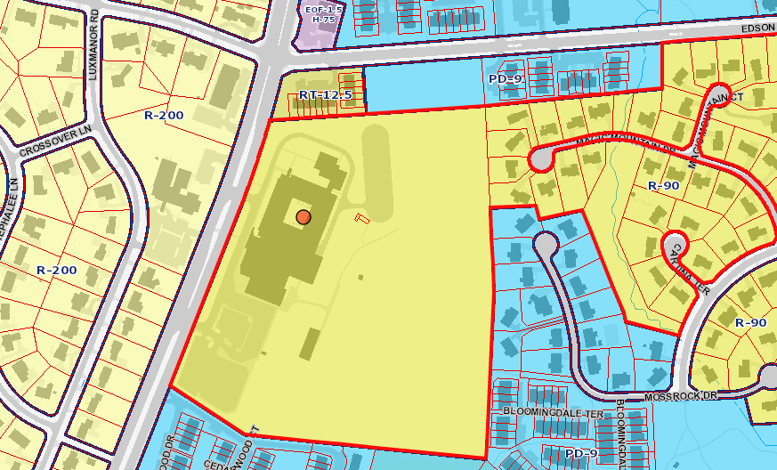
SBA Temporary Monopole @Tilden Middle School
Notes:
The site is located on the east side of Old Georgetown Rd. The school is undergoing renovation requiring the dismantling of a 75’ monopole on the property. That structure is owned by SBA and occupied by T-Mobile.

Slide 3
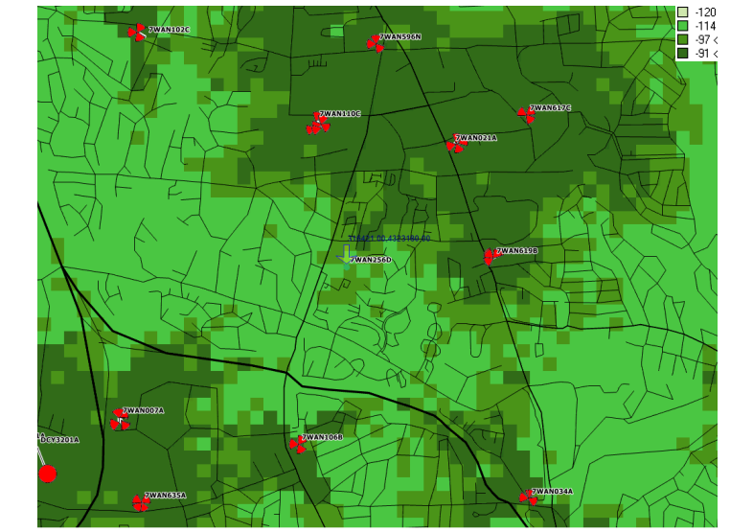
SBA Temporary Monopole @ Tilden Middle School
Notes:
T-Mobile has demonstrated coverage gaps without this site. RF Propagation maps have shown that existing sites in the area would not provide the same coverage. This map shows coverage without the Tilden Middle School Site (circled).

Slide 4
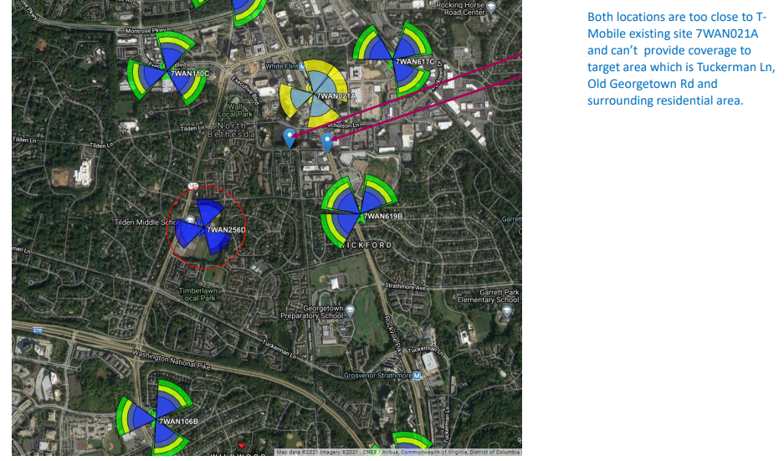
SBA Temporary Monopole @ Tilden Middle School
Notes:
The above map and caption provided by the applicant showed that alternate locations in the Montgomery County database would not provide the same coverage for T-Mobile.

Slide 5
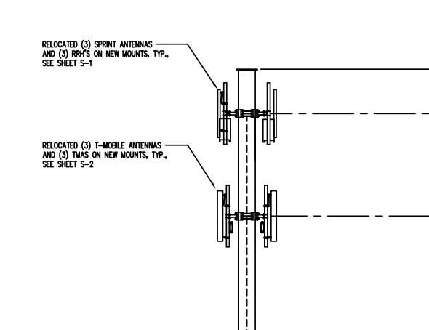
SBA Temporary Monopole @ Tilden Middle School
Notes:
The current monopole hosts Sprint and T-Mobile antennas. Three RR90-17-02VDPL antennas originally attached by Sprint (now part of T-Mobile) will be relocated at 70’ on the 75’ monopole. Three TMBXX-6516-R2M antennas attached by T-Mobile will be relocated at 60’.

Slide 6
SBA Temporary Monopole @Tilden Middle School
Notes:
A temporary equipment compound will also be established with chain link fencing. The existing equipment cabinets will be relocated.

Slide 7
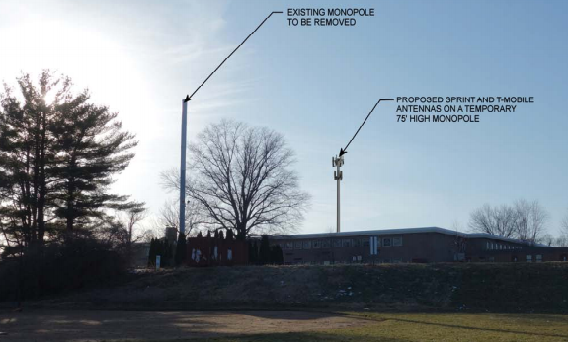
SBA Temporary Monopole @ Tilden Middle School
Notes:
Visual impact is expected to be minimal as the wireless site will be at an active construction site, and the residential area on the west side of Old Georgetown Road is shielded by trees and foliage.

