Slide 1
Telecommunications Facilities Coordinating Group
(TFCG) Slide Deck
June 2023

Slide 2
Crown Castle/T-Mobile @
PEPCO 794417-390280
(2023042145)

Slide 3
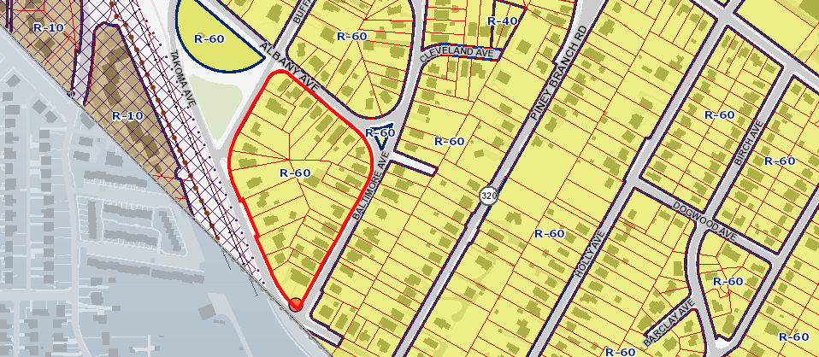
PEPCO 794417-390280

Slide 4
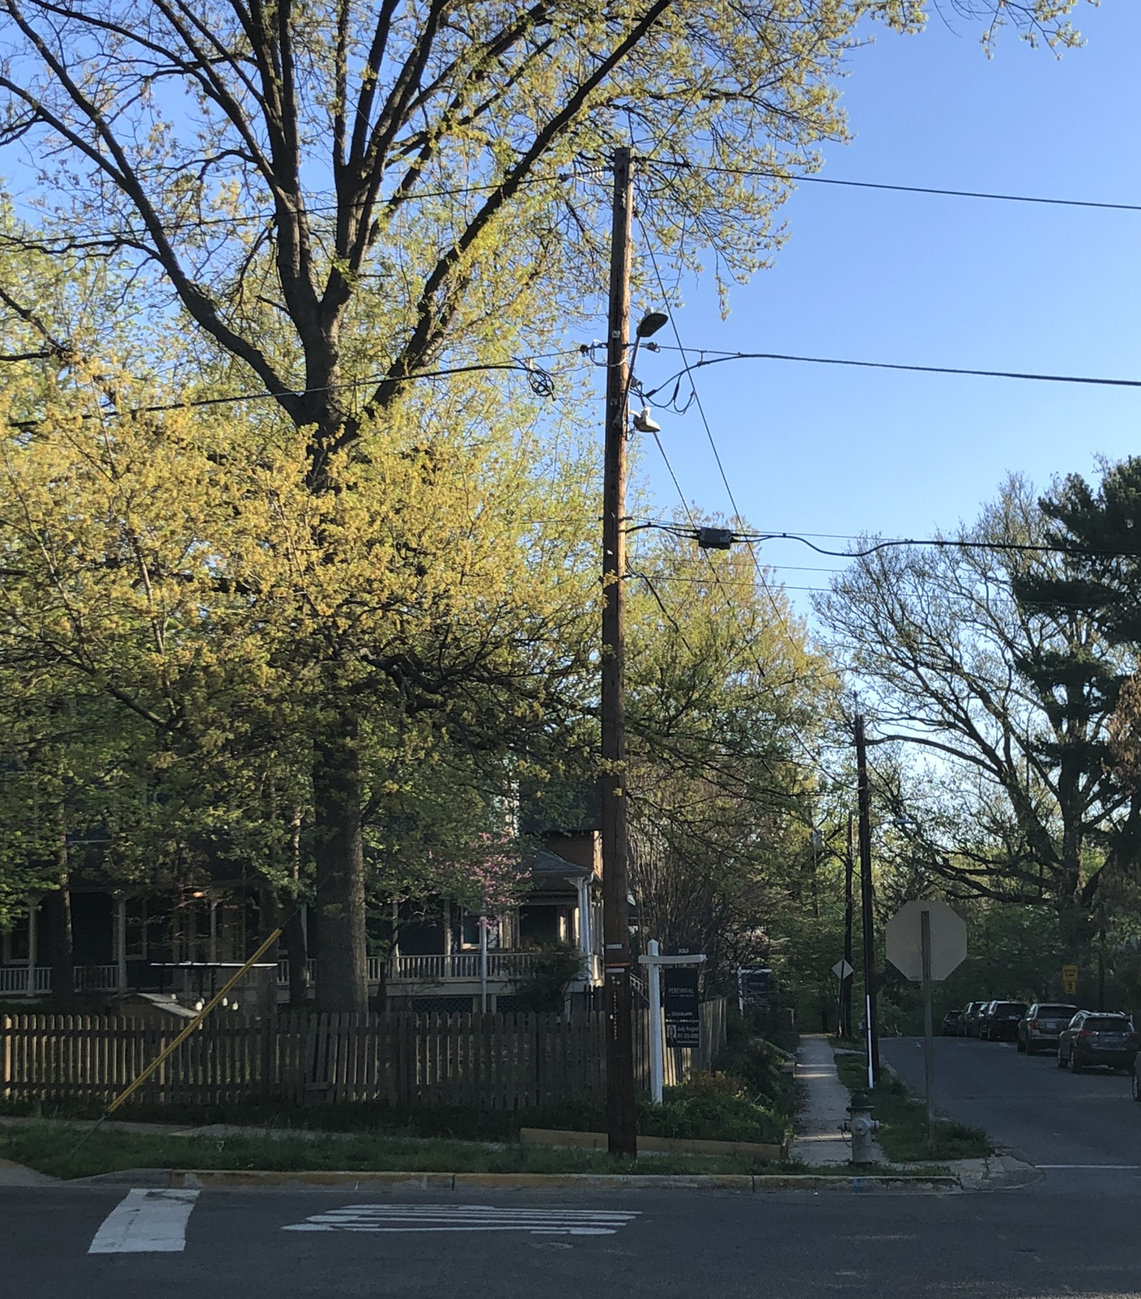
PEPCO 794417-390280

Slide 5
Crown Castle/T-Mobile @
PEPCO 795421-180920
(2023052160)

Slide 6
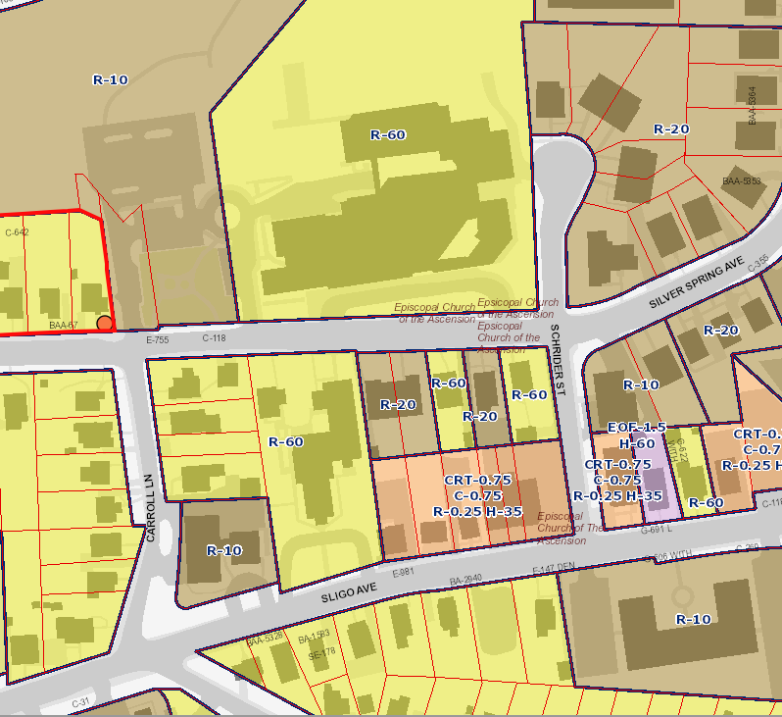
PEPCO 795421-180920

Slide 7
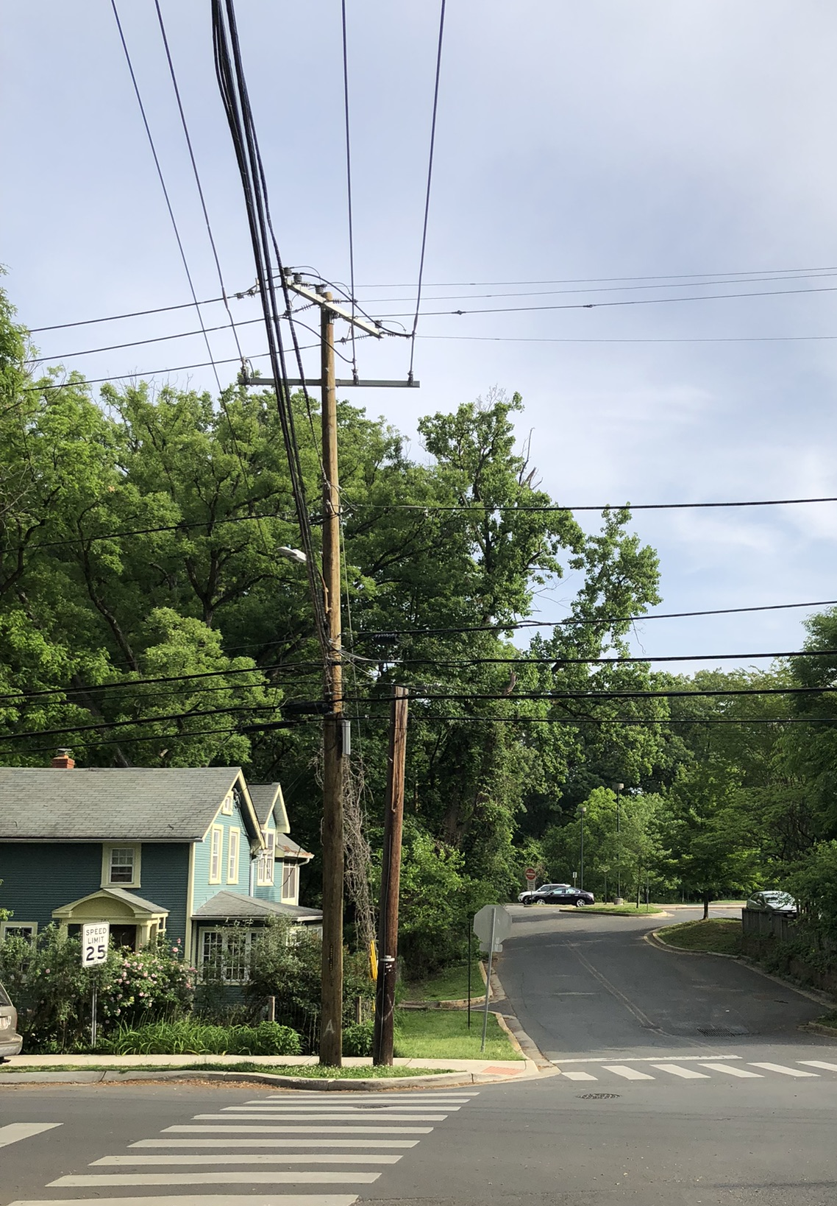
PEPCO 795421-180920

