Slide 1
Telecommunications Facilities Coordinating Group (TFCG) Slide Deck
August 2023

Slide 2
Crown Castle/T-Mobile @
PEPCO 787424-540730
(2023052169)

Slide 3
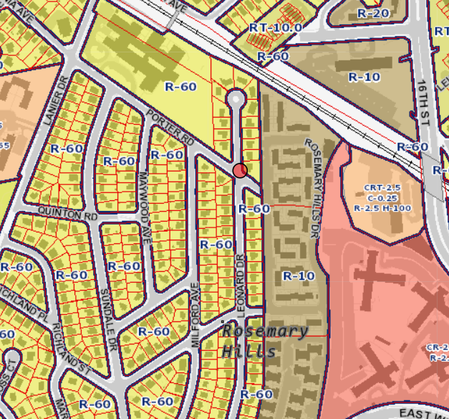
PEPCO 787424-540730

Slide 4
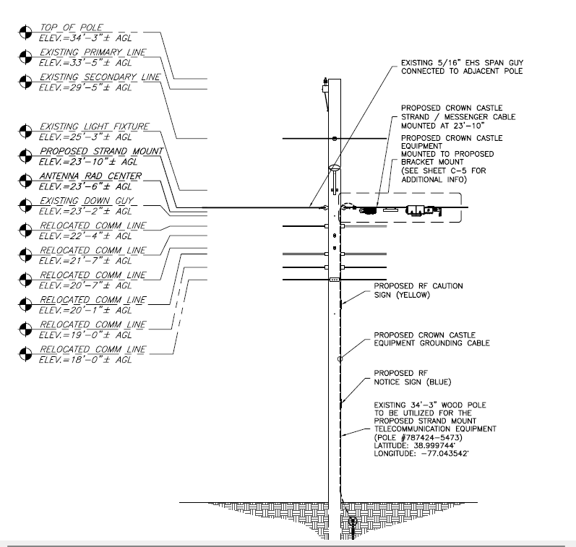
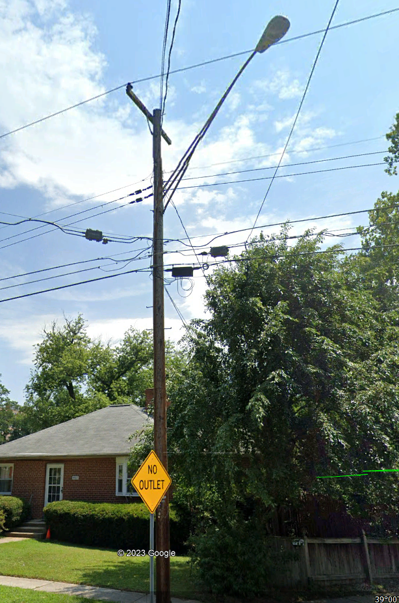
PEPCO 787424-540730

Slide 5
Crown Castle/T-Mobile @
PEPCO 799414-540730
(2023052156)

Slide 6
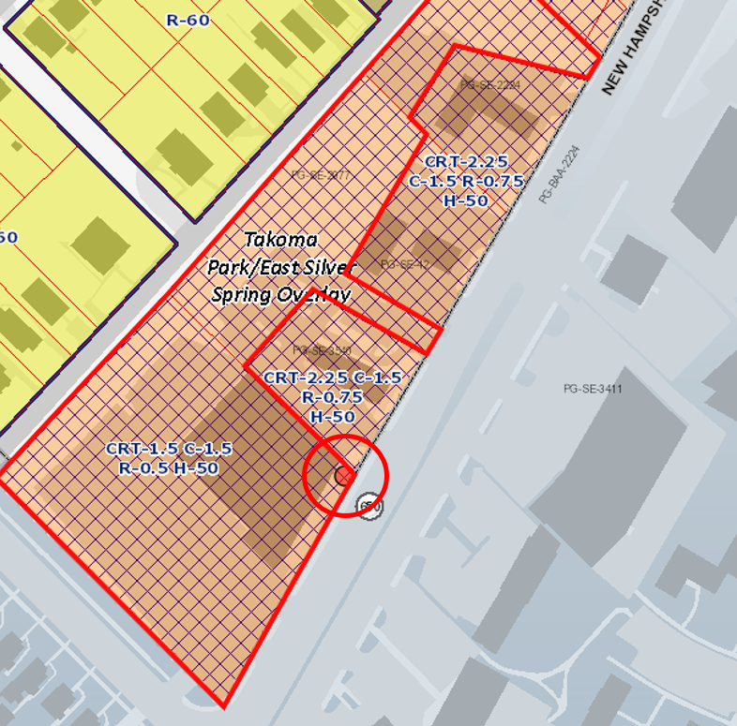
PEPCO 79912-8177

Slide 7
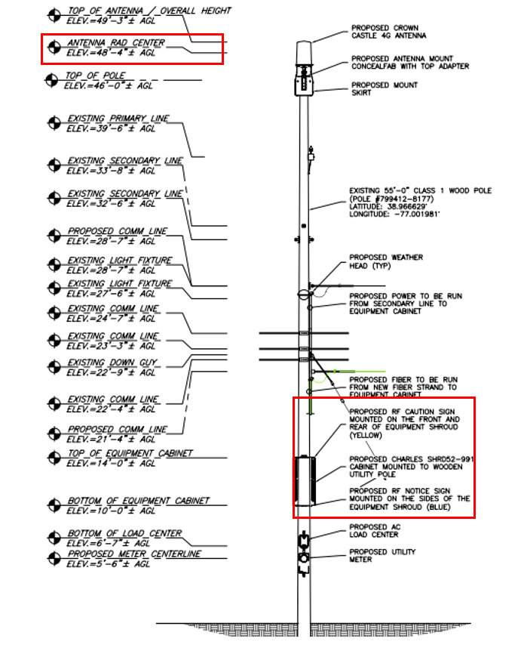
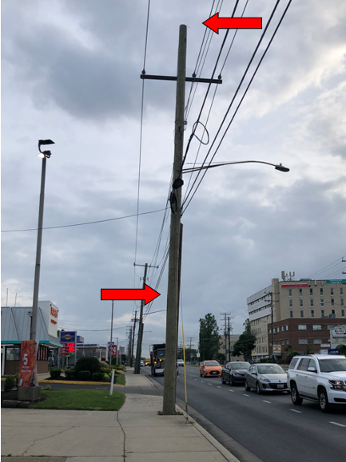
PEPCO 799412-8177

Slide 8
Crown Castle/T-Mobile @
PEPCO 21-S
(2023062172)

Slide 9
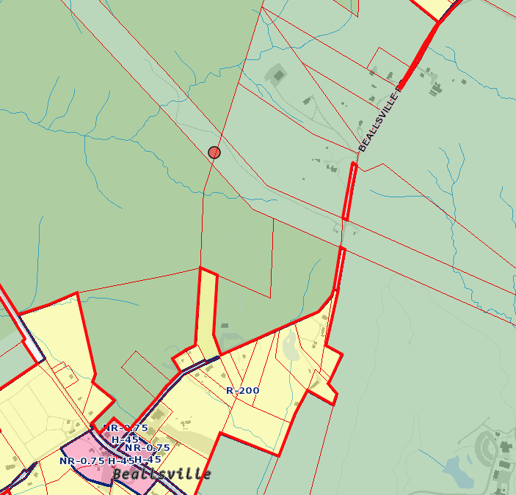
PEPCO 21-S

Slide 10
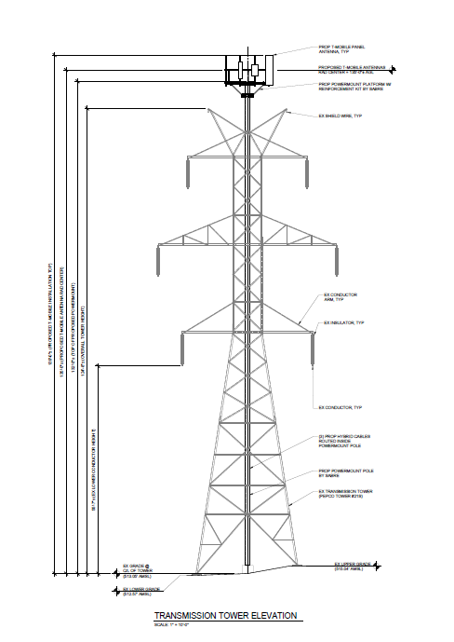
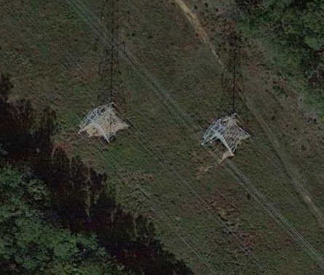
PEPCO 21-S

