Slide 1
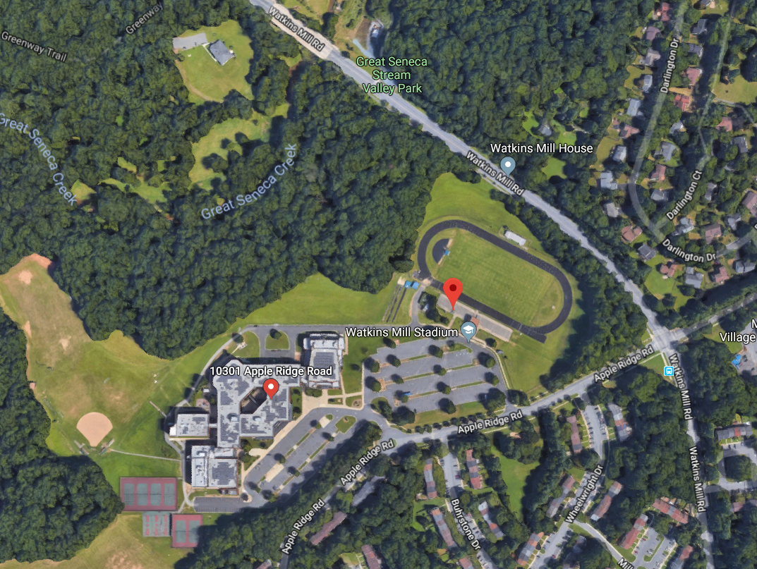
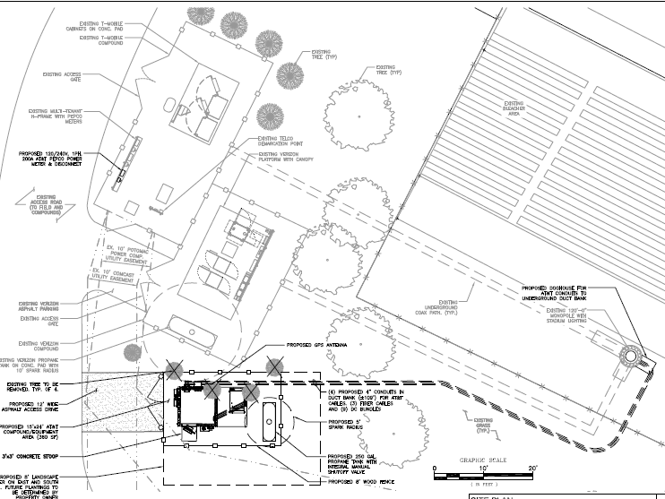
Watkins Mill High School

Slide 2
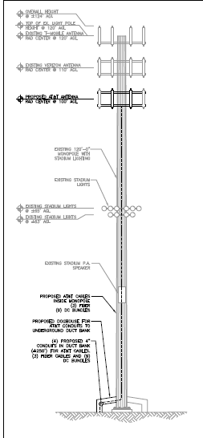
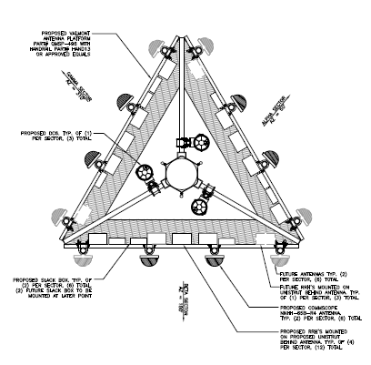
Watkins Mill High School

Slide 3
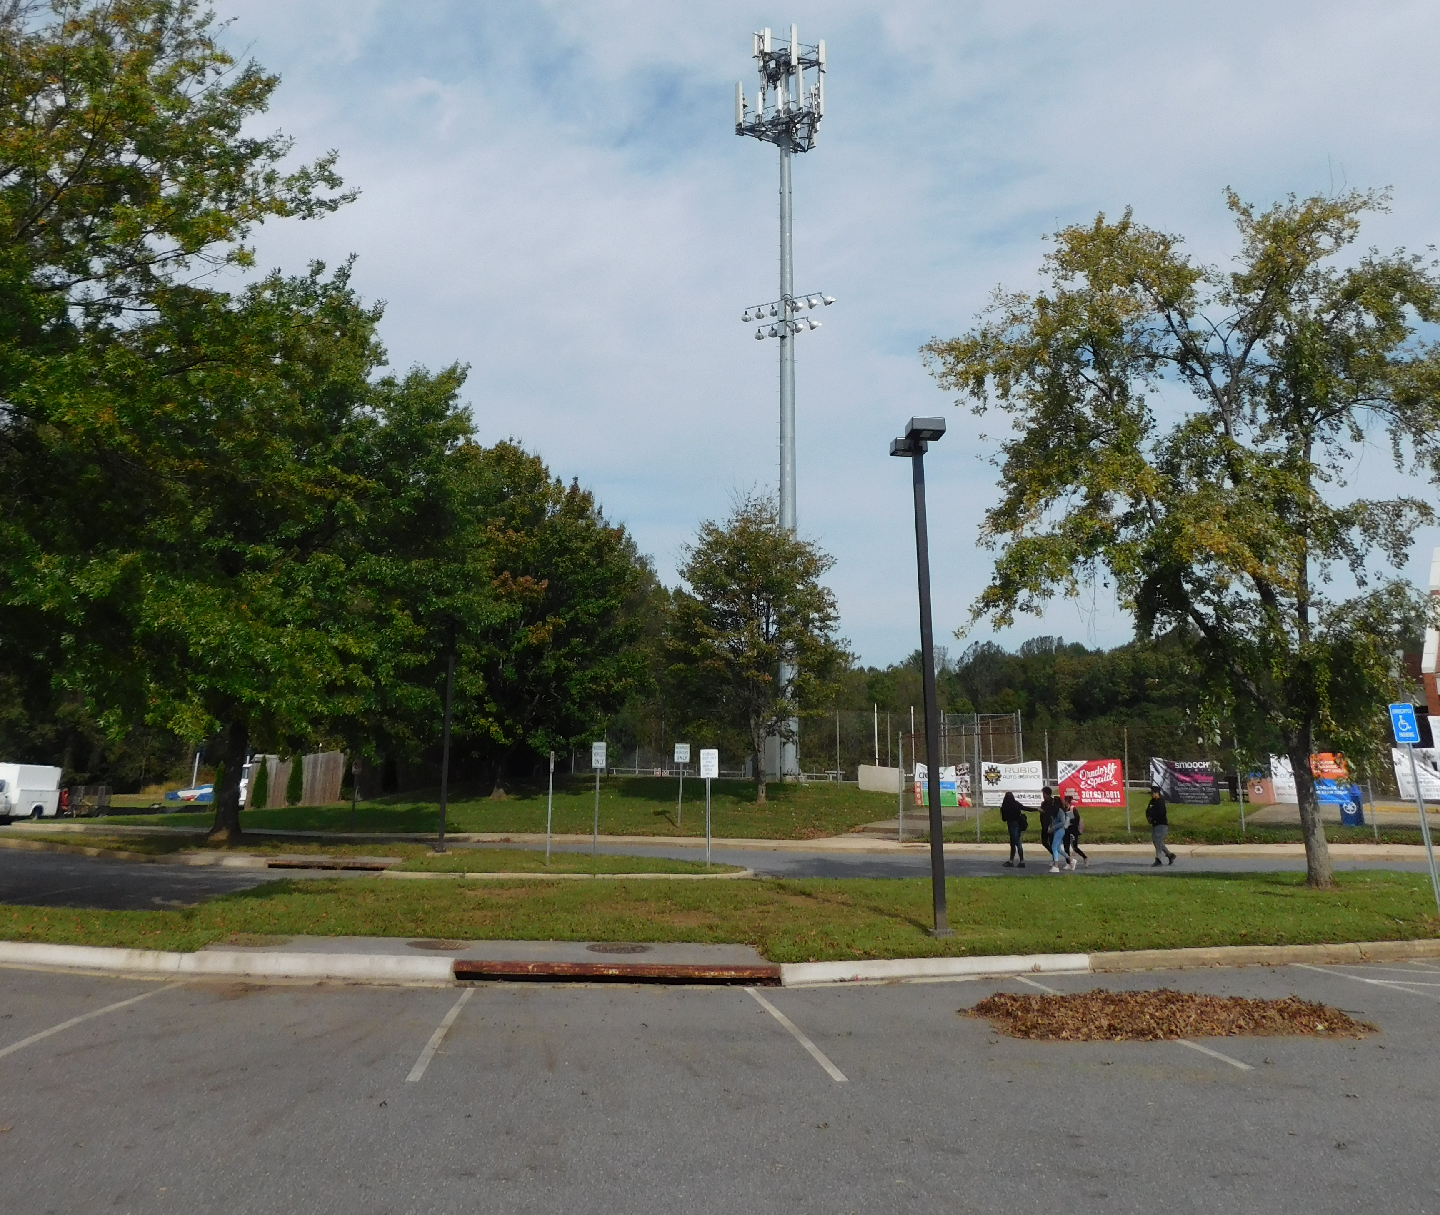
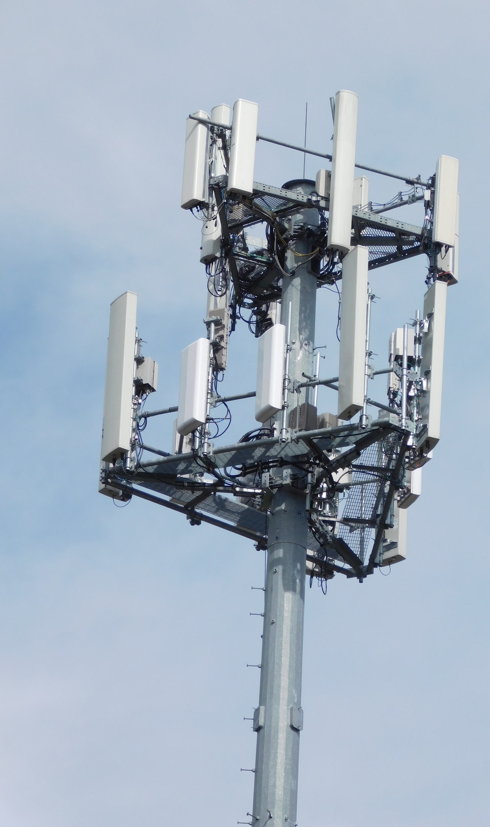
Watkins Mill High School

Slide 4
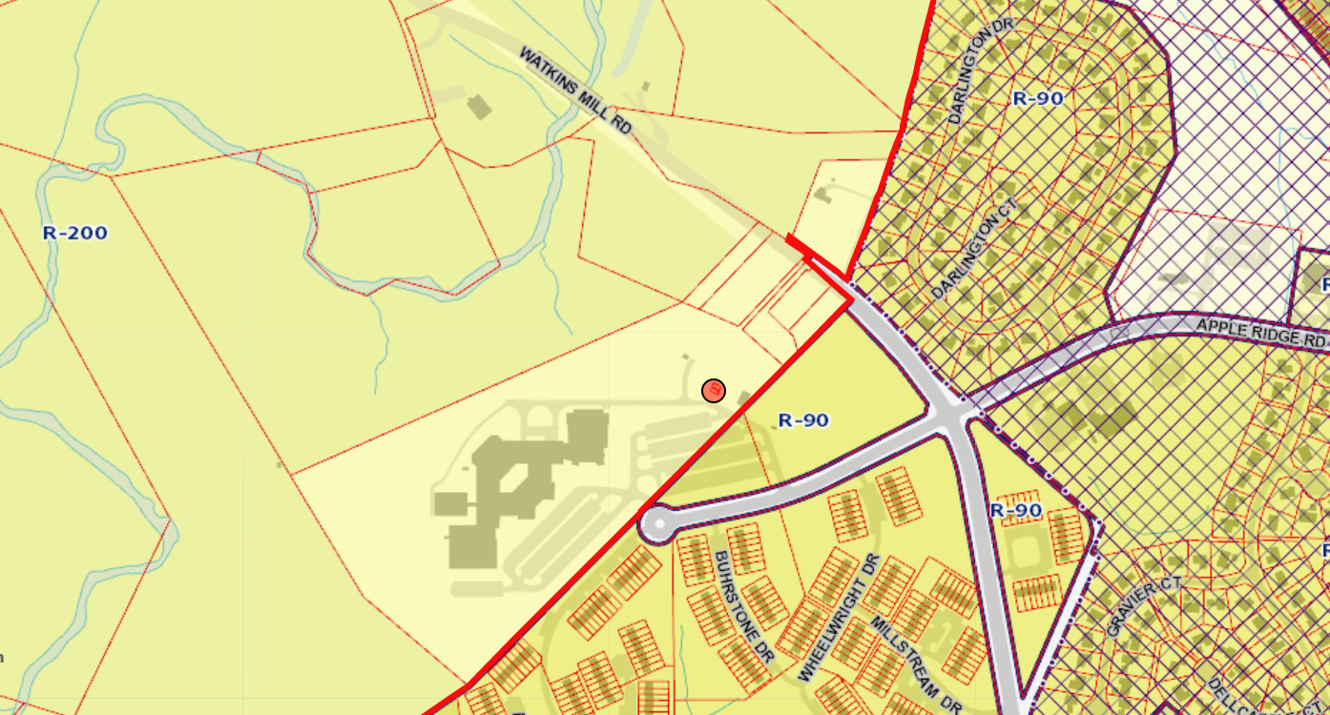
Watkins Mill High School
https://goo.gl/maps/eZYmsqJXe6J2

Slide 5
Suburban Propane

Slide 6
Suburban Propane

Slide 7
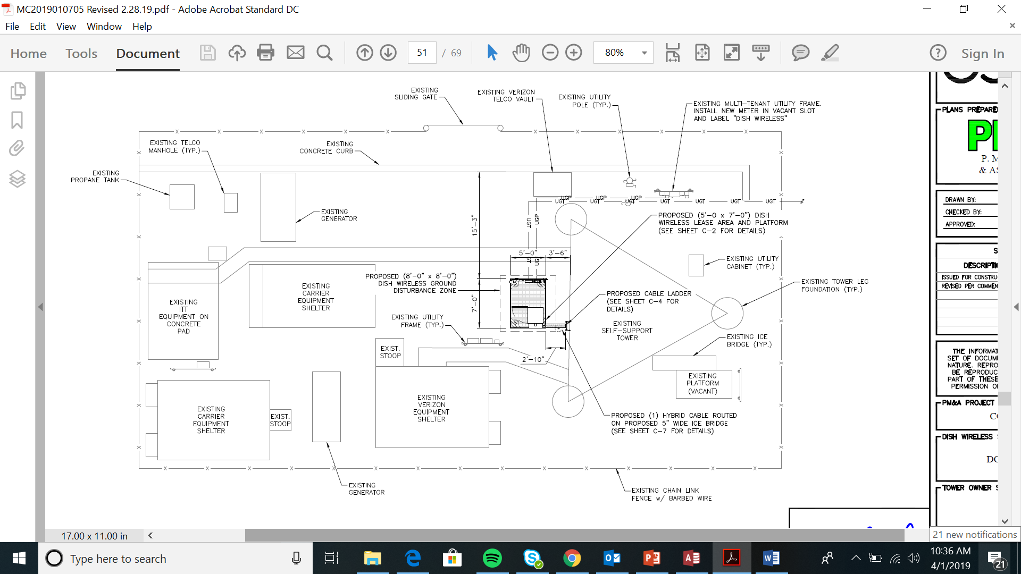
Suburban Propane

Slide 8
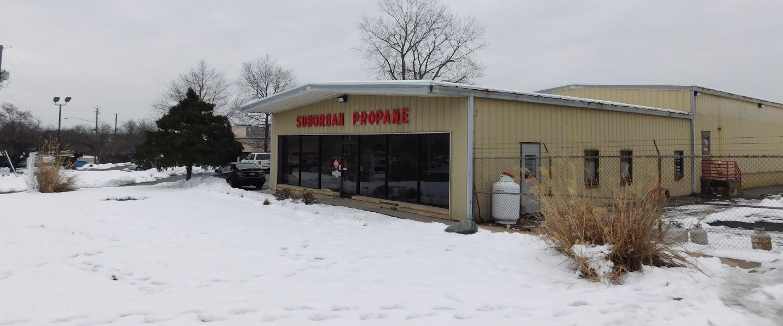
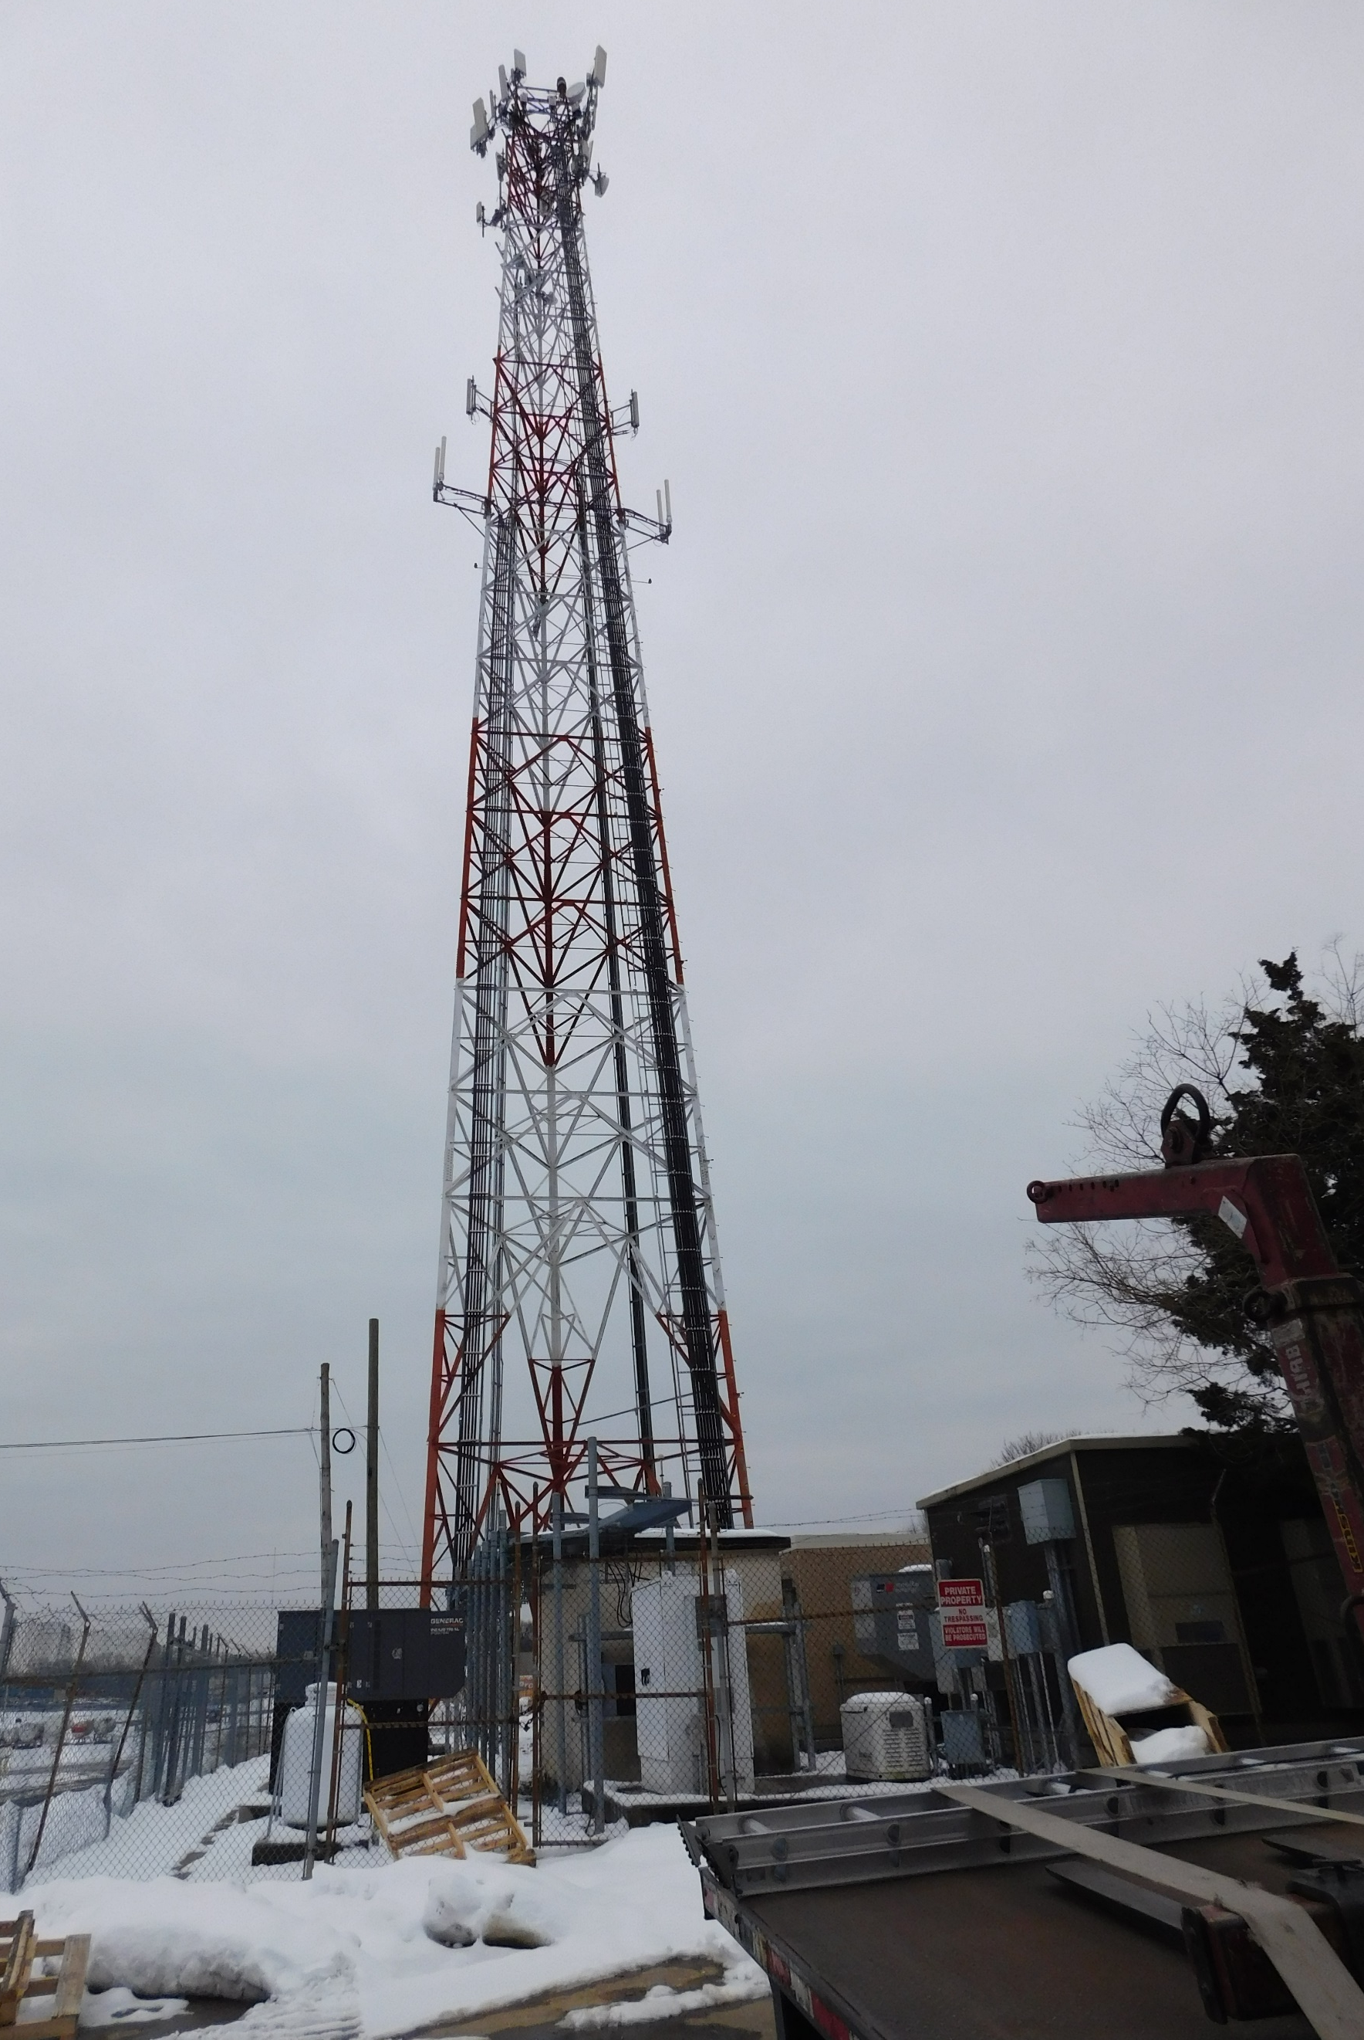
Suburban Propane

Slide 9
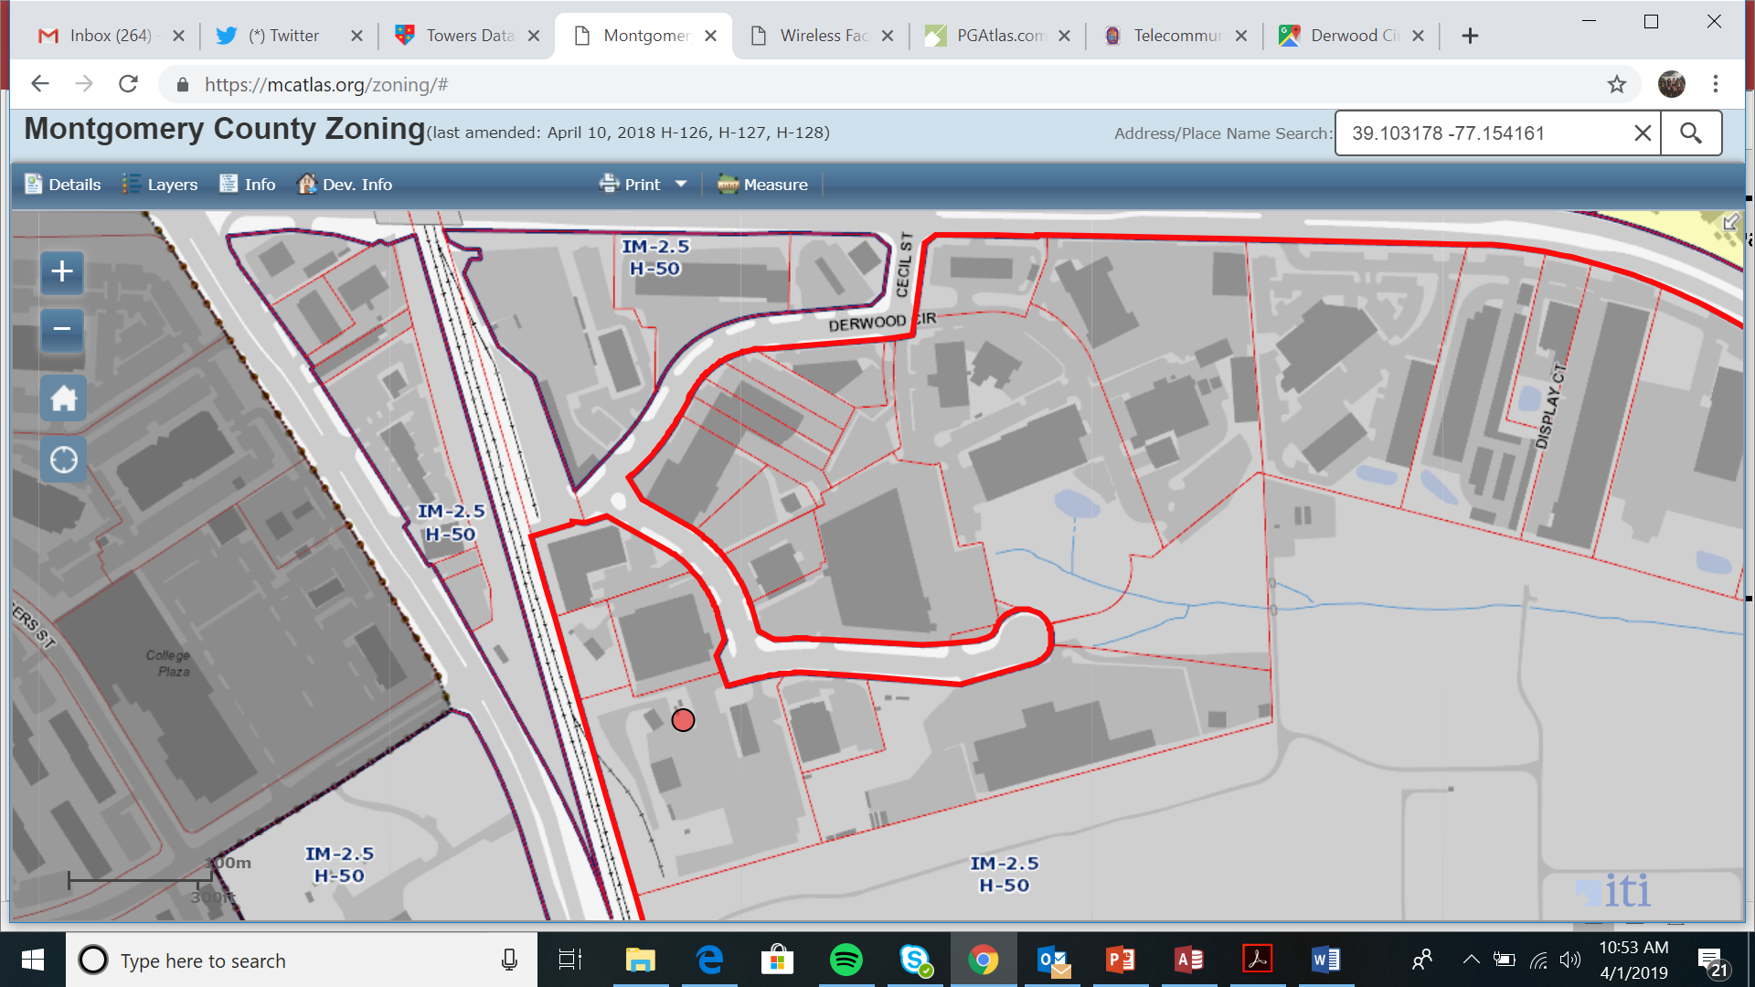
Suburban Propane

Slide 10
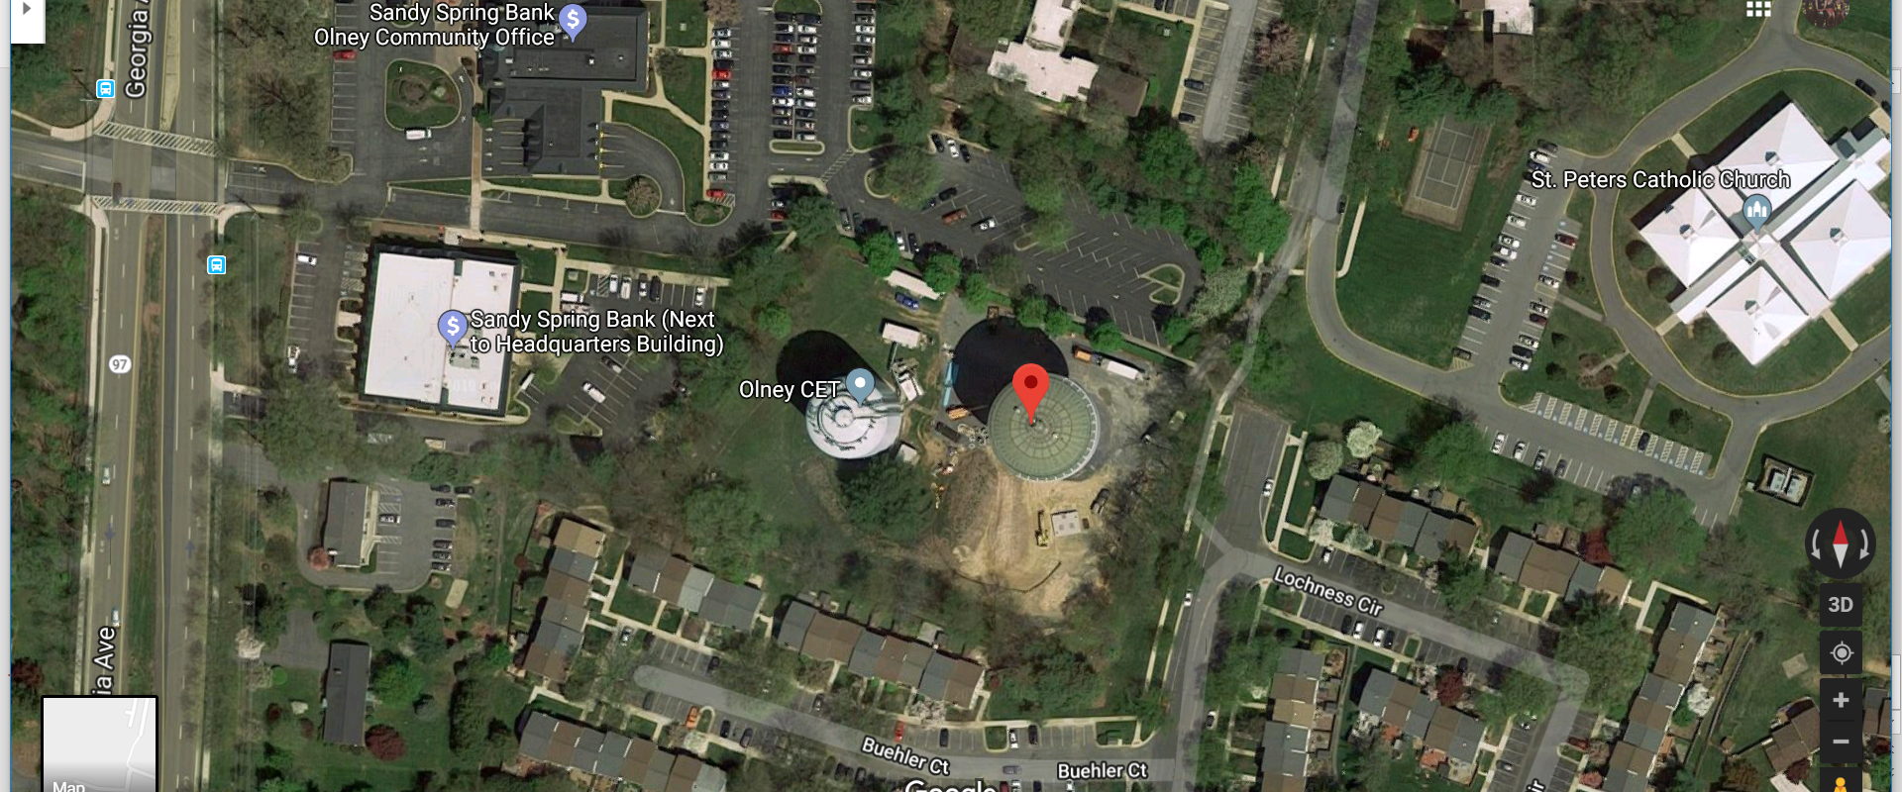
Olney Water Tank

Slide 11
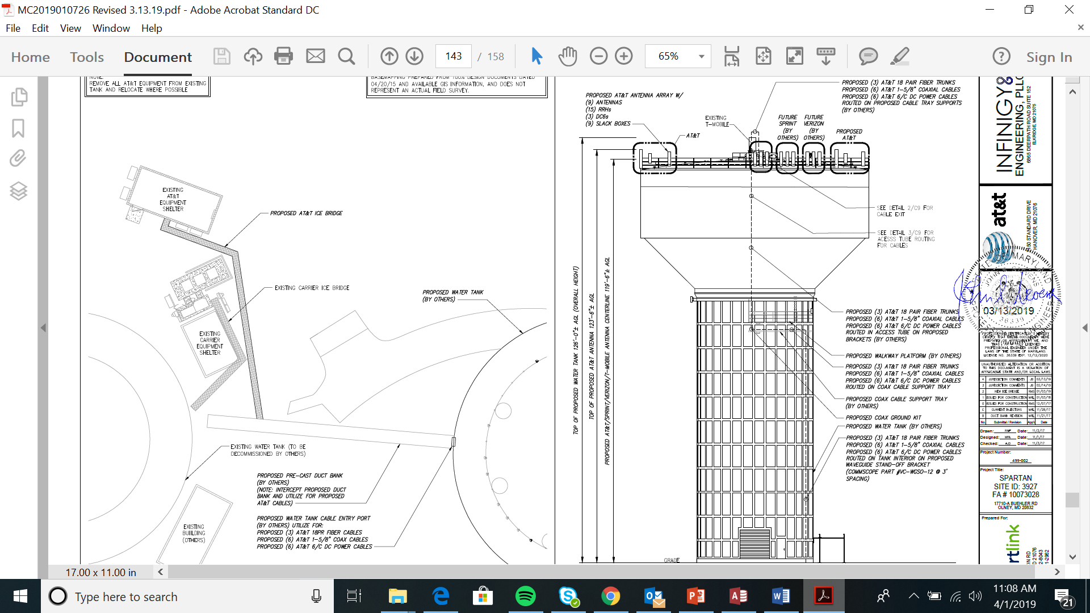
Olney Water Tank

Slide 12
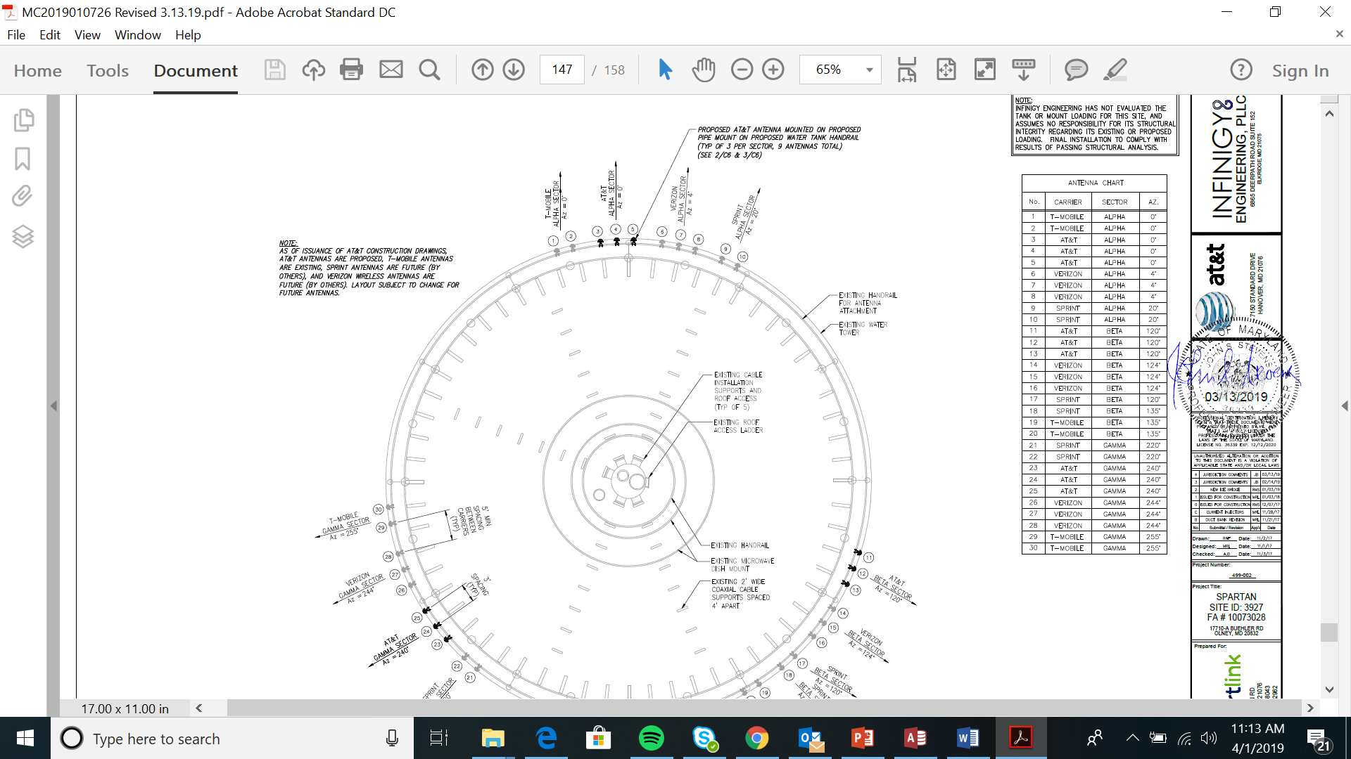
Olney Water Tank

Slide 13
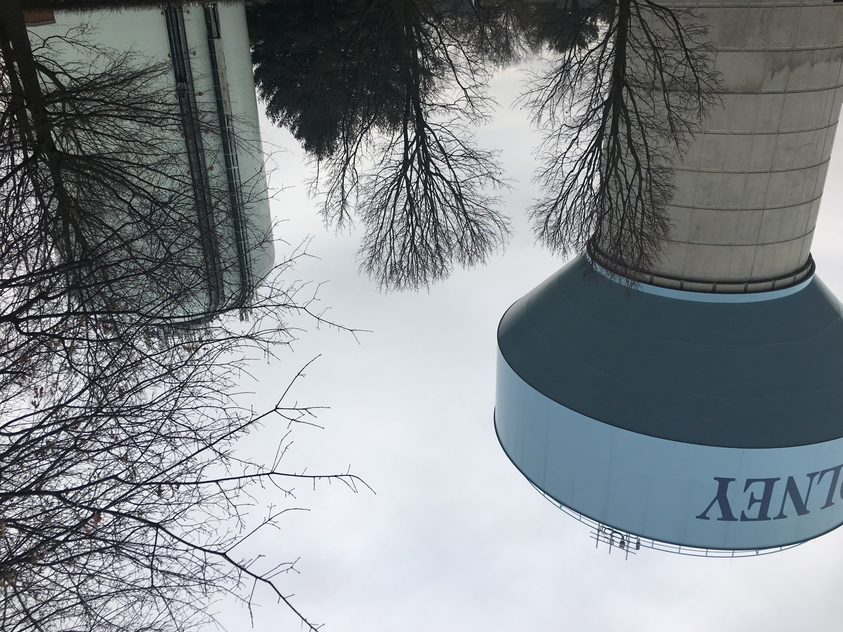
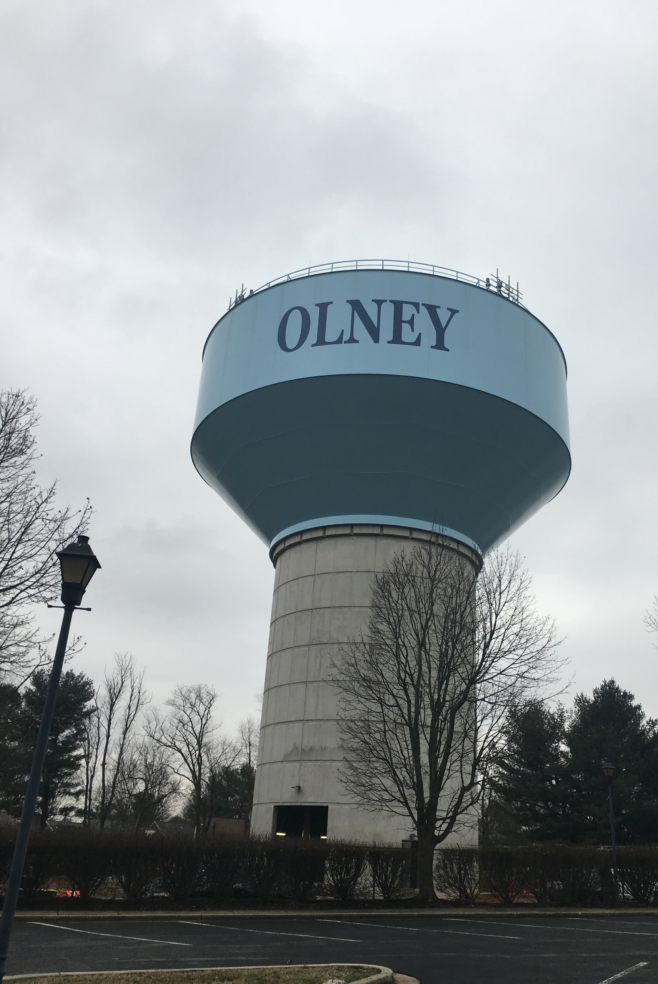
Olney Water Tank

Slide 14
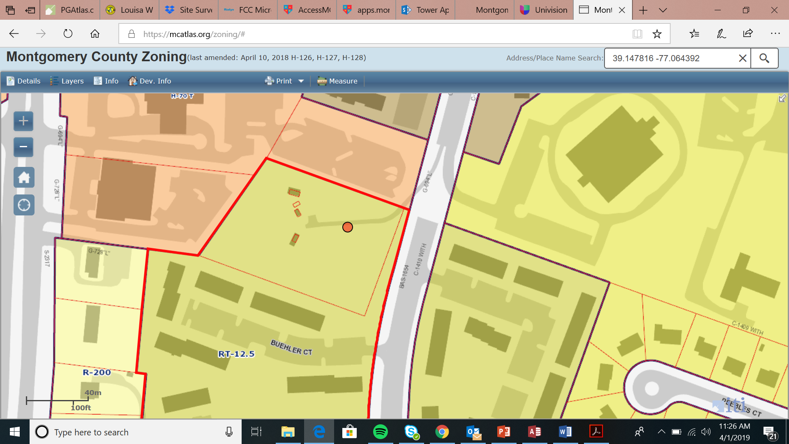
Olney Water Tank

Slide 15
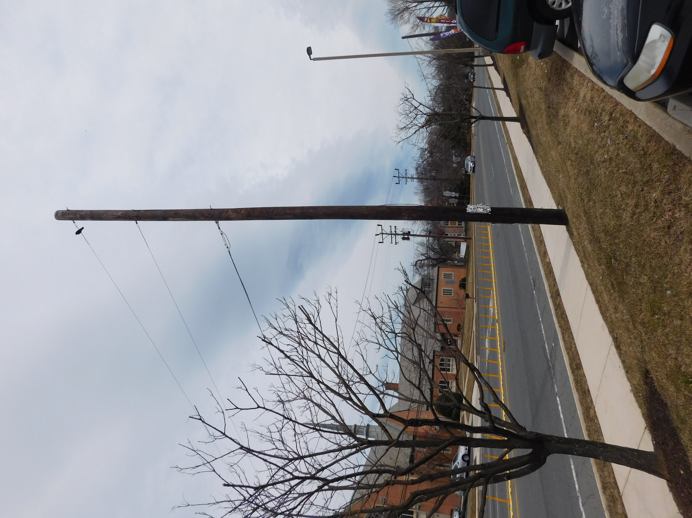
Pepco 806432-4594 / 10145 New Hampshire Ave,

Slide 16
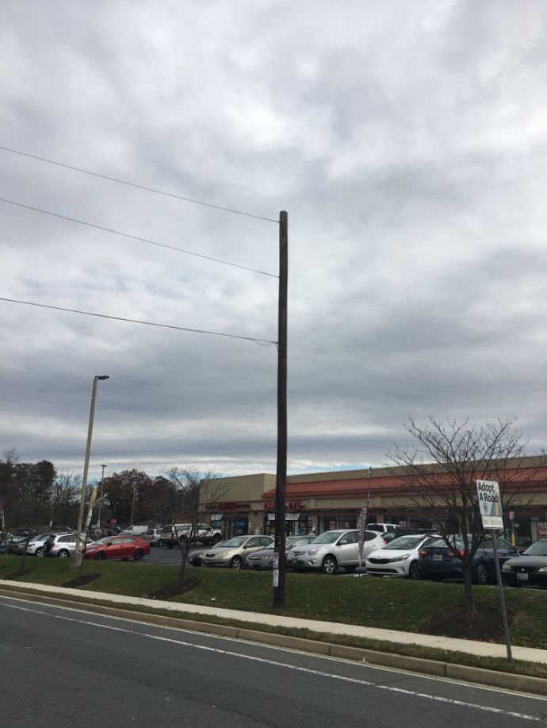
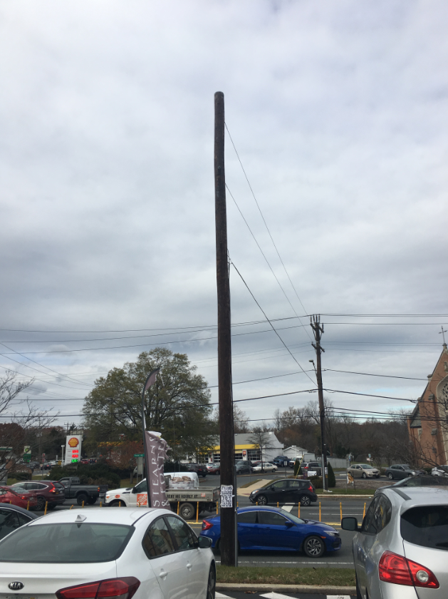
Pepco 806432-4594 / 10145 New Hampshire Ave,

Slide 17
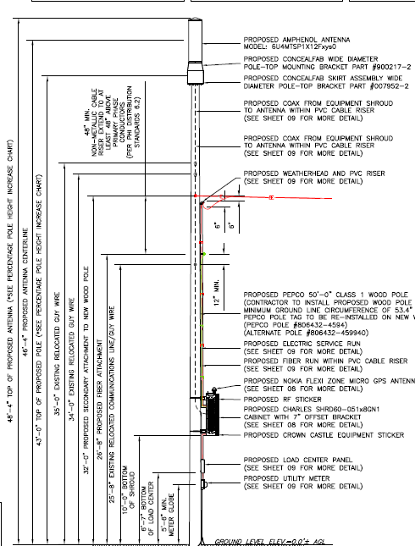
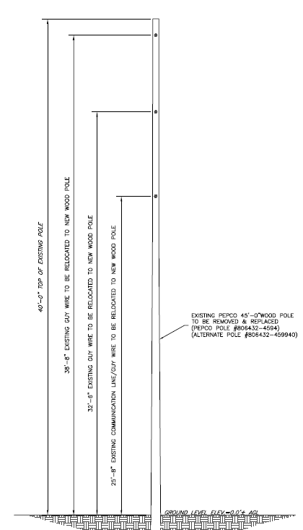
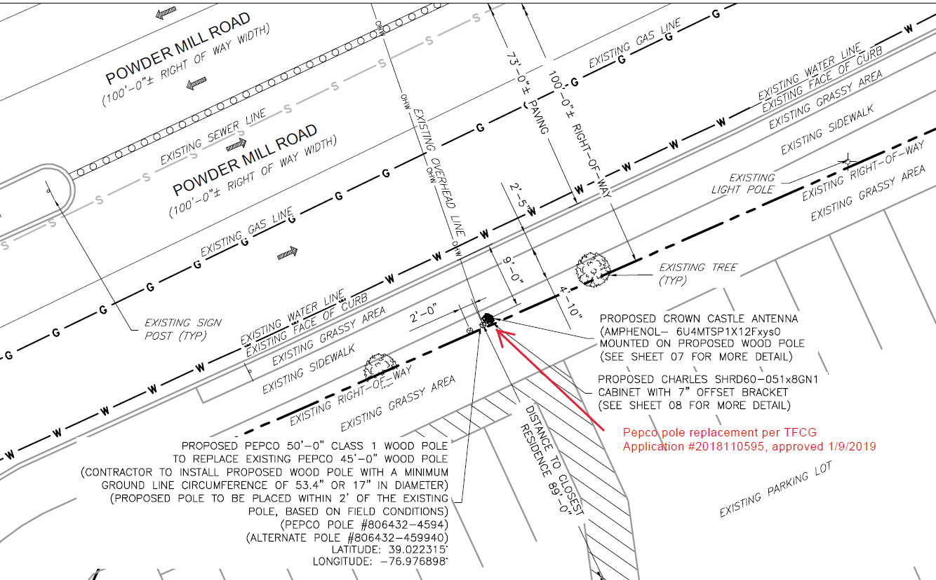
Pepco 806432-4594 / 10145 New Hampshire Ave,

Slide 18
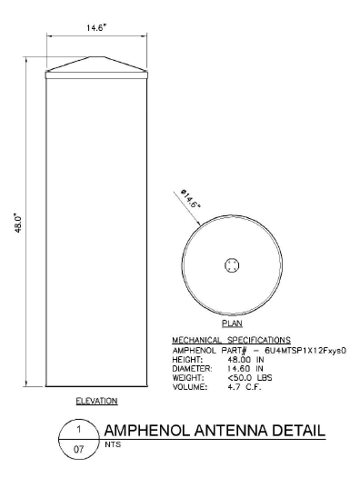
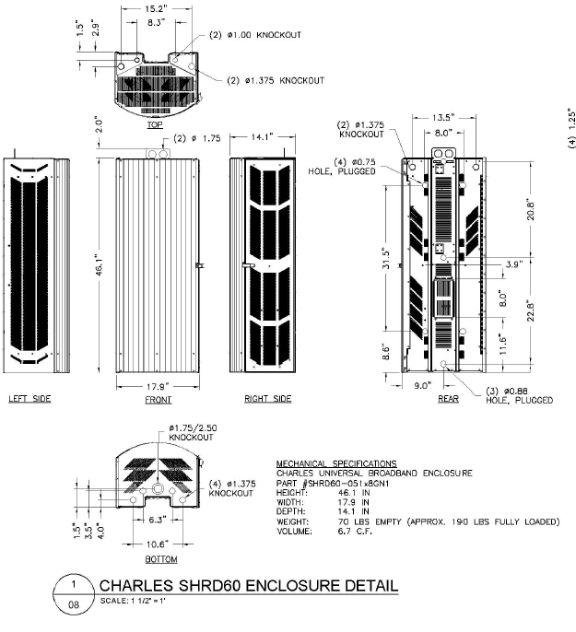
Pepco 806432-4594 / 10145 New Hampshire Ave,

Slide 19
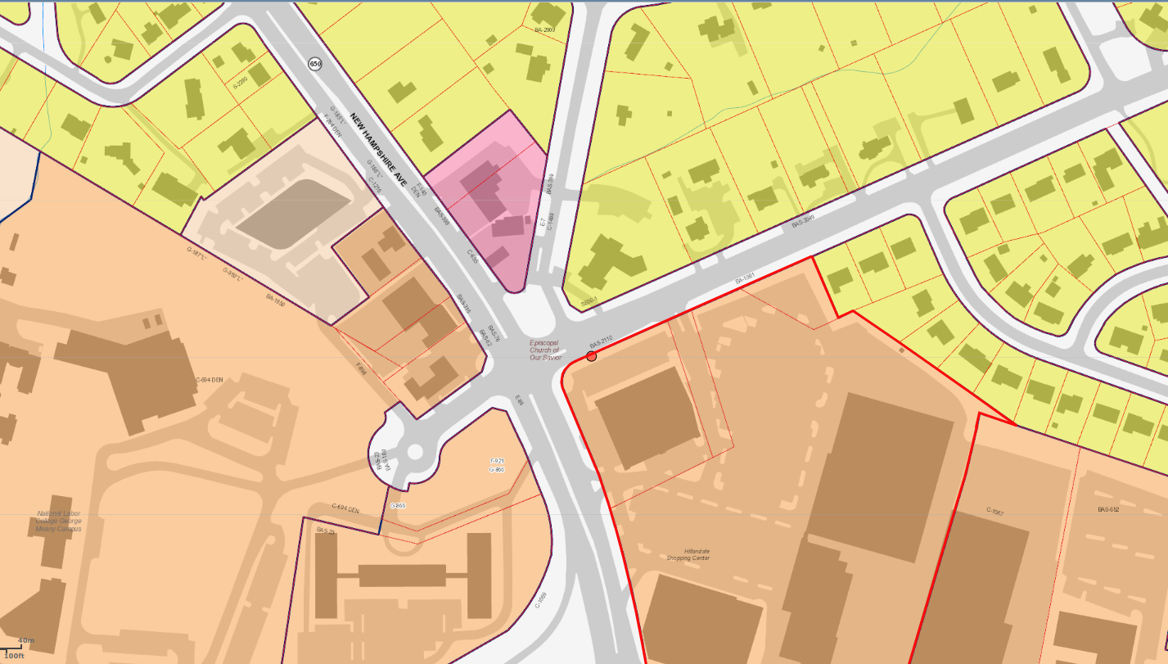
Pepco 806432-4594 / 10145 New Hampshire Ave,
https://goo.gl/maps/yQZ4Fitu5Pq

Slide 20
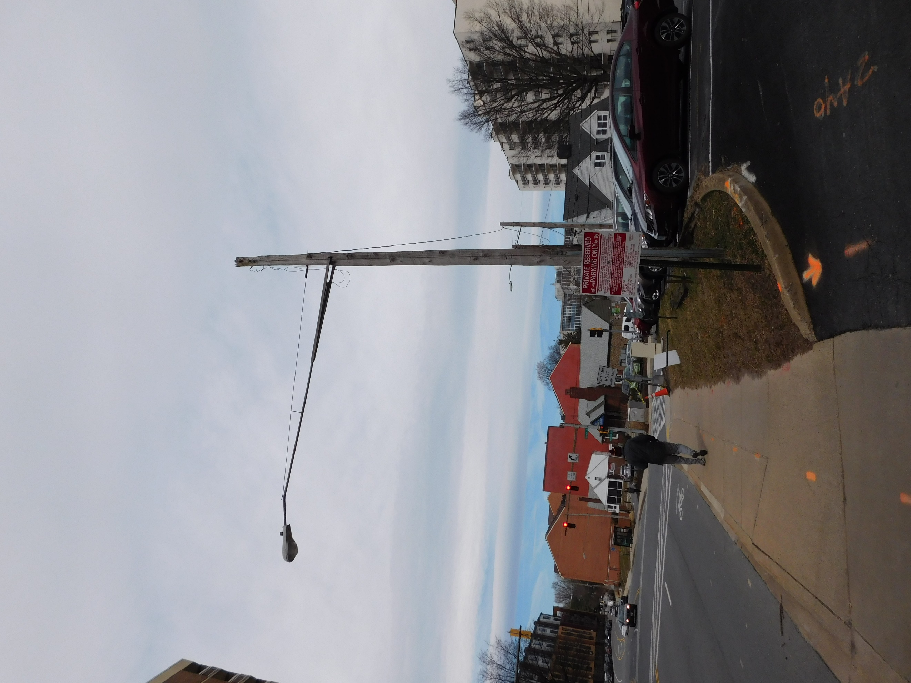
Pepco 790423-7160 / 1328 Fenwick Lane,

Slide 21
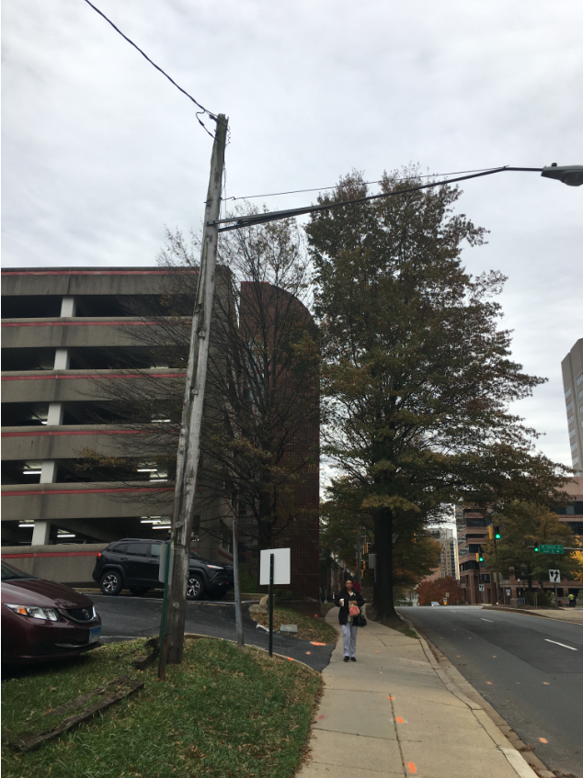
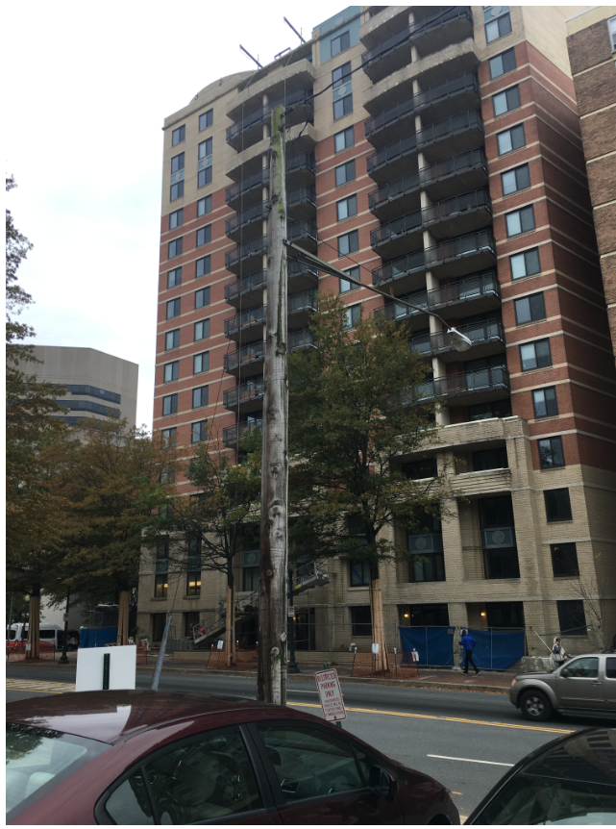
Pepco 790423-7160 / 1328 Fenwick Lane,

Slide 22
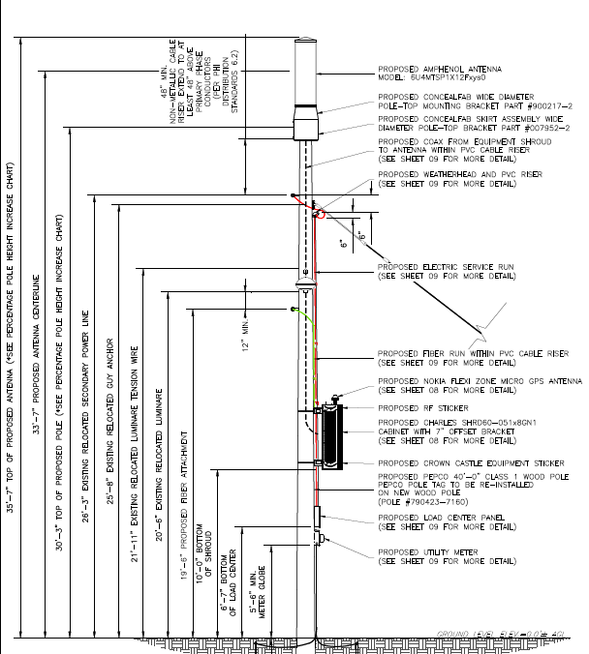
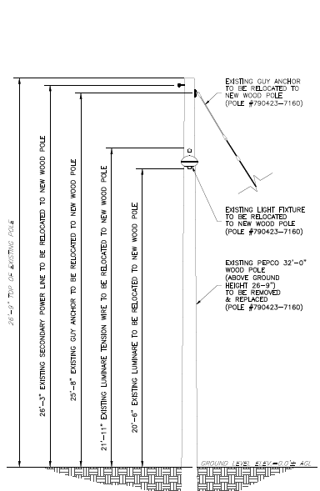
Pepco 790423-7160 / 1328 Fenwick Lane,

Slide 23
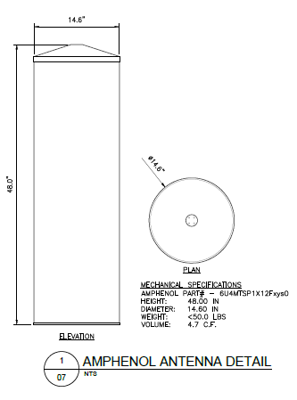
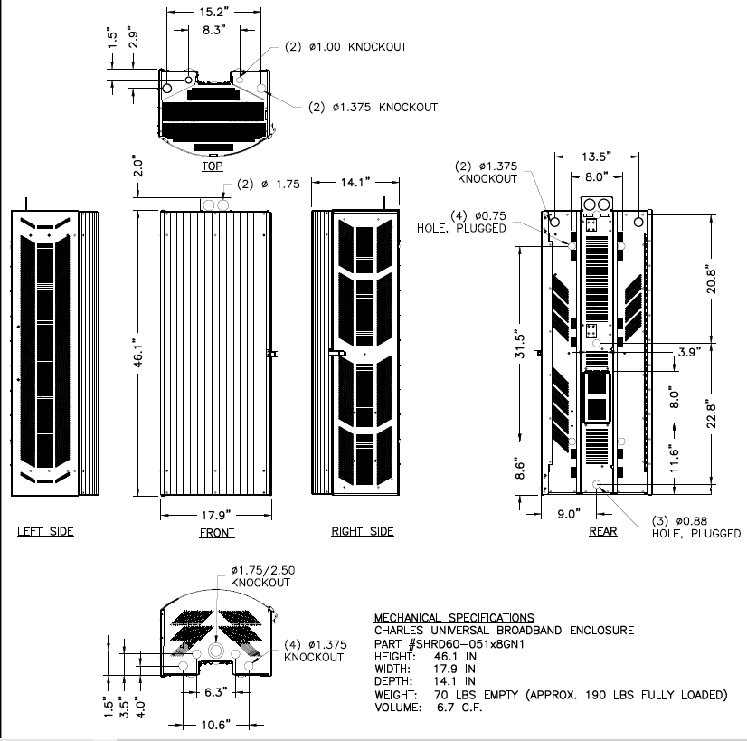
Pepco 790423-7160 / 1328 Fenwick Lane,

Slide 24
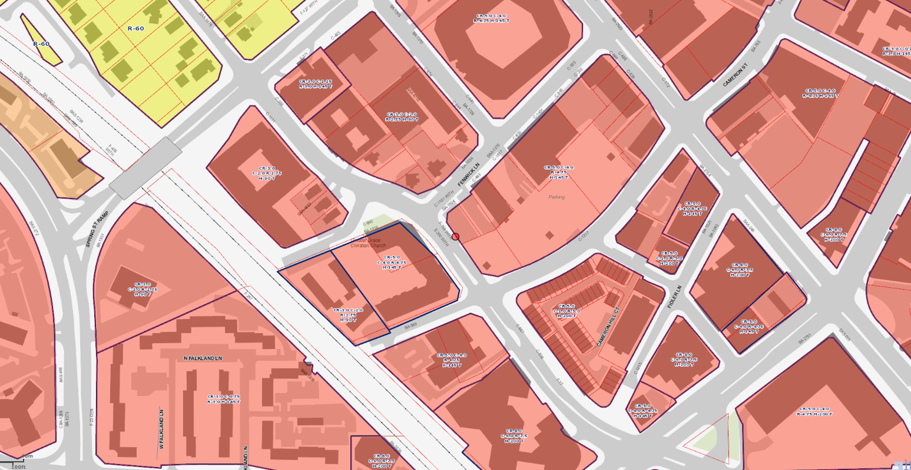
Pepco 790423-7160 / 1328 Fenwick Lane,
https://goo.gl/maps/EKGoHCbjfew

