Slide 1
Mid-County Citizens Advisory Board December 2020 Fire Rescue Update

Slide 2
Leisure World – Elkridge Court Fire
COVID19 and Impact to FRS
Holiday Fire Safety
Questions and Answers – from you

Slide 3
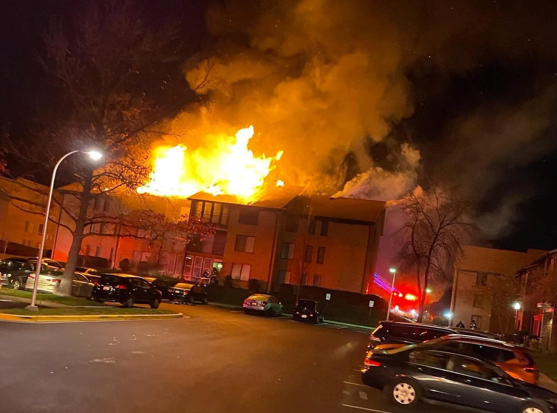
Elkridge Court

Slide 4
COVID
Coordination started in January
Service Changes in March
1st Surge April 13 to June 10
Started to see 2nd surge ~ 45 days ago
Continues and will be here

Slide 5
COVID #’s
Symptomatic Patients – 8,000 so far
Observed a higher % of really ill patients
Response times did not increase
Cycle times increased slighty

Slide 6
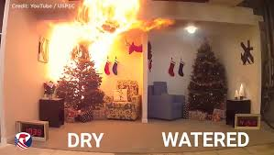
Holiday Fire Safety
Cooking
Space Heaters
Holiday Decorations
Ashes
Carbon
Monoxide

Slide 7
Questions

