Slide 1

Mid-County Citizens Advisory Board Presentation
June 16, 2020

Slide 2

Food Council: Key Strategies
Increase capacity of local programs, businesses, and organizations
Grow and strengthen networks and partnerships
Lead advocacy and drive policy and process change
Build knowledge and awareness of resources and issues
Research and communicate opportunities and challenges
Foster food system leadership locally, regionally & nationally
Notes:
The Food Council is a Montgomery County based 501c3 nonprofit that works to bring together stakeholders to create a robust, local, sustainable food system. We work on strategies that are wide ranging, from helping to support our farmers, producers and manufacturers in the agricultural reserve access local economic opportunities, working with food assistance providers to ensure that the more than 60,000 food insecure County residents are able to access food, and advancing strategies to reduce food waste and increase environmental sustainability. In addition to our four permanent staff members and two AmeriCorps VISTAs, we have 25 volunteer Councilmembers and 7 Board members who meet regularly to guide our priorities, and our four working groups: Food Recovery and Access, Food Education, Food Economy and Environmental Impact host monthly public meetings to advance topic-specific strategies. However, in order to keep a systems approach to our work, it’s essential that we regularly step outside those silos to ensure our work is as collaborative, streamlined, and systems-focused as possible. It also is important that we can more effectively communicate- to elected officials, funders, prospective partners- what the Food Council actually DOES to achieve our goals for the local food system. So, what do we bring to local and regional food system work that is specific to our structures and resources?

Slide 3
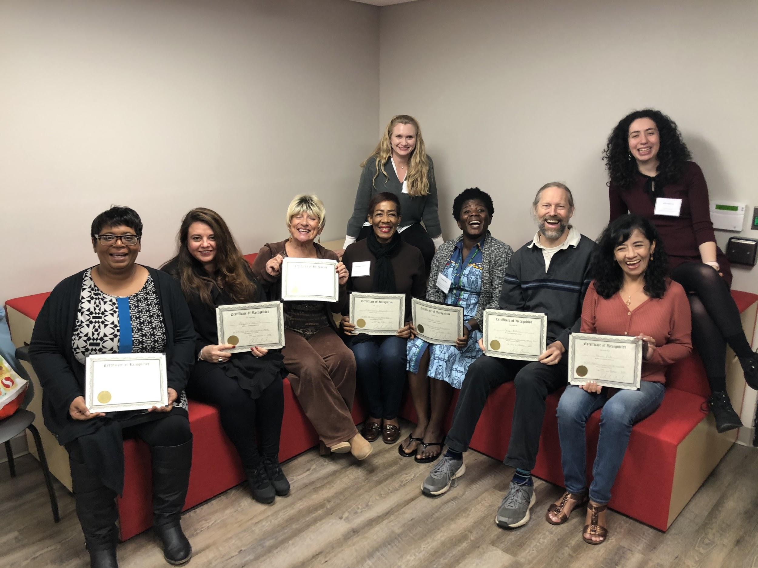
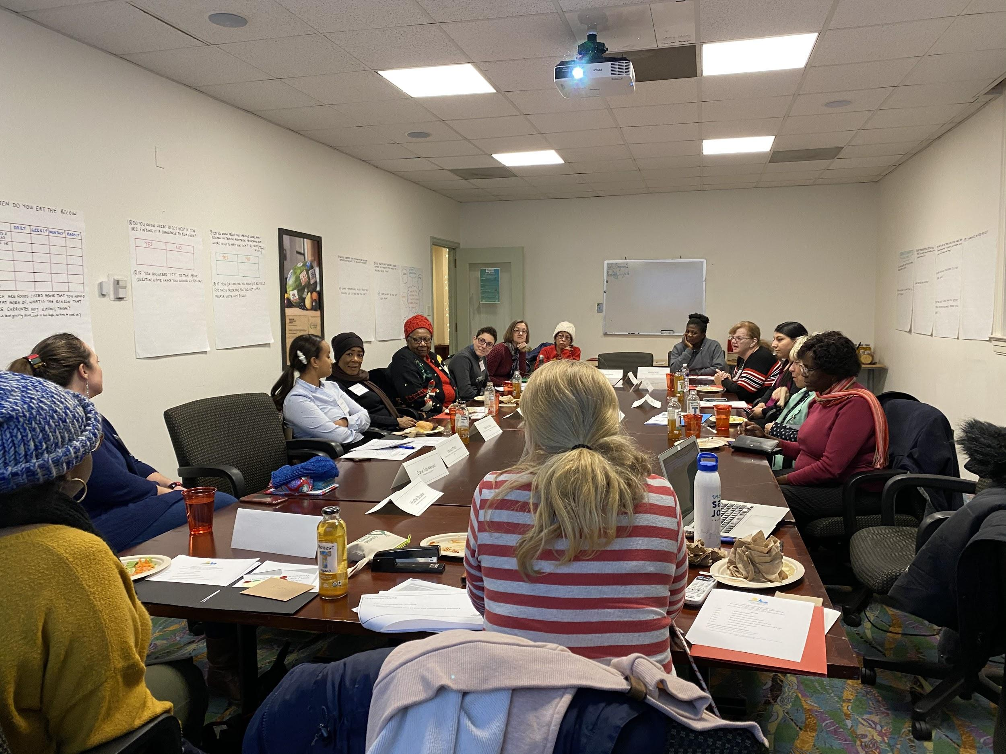
Food Security Community Advisory Board
Notes:
As I mentioned earlier, the Food Council works to ensure equitable access to food for all County residents, and this is especially important in MoCo where we are a majority minority population with a multicultural richness of language, ethnicity and identity. In addition to participating in monthly racial equity trainings funded by the Healthcare Initiative Foundation, we also have a culturally appropriate food subgroup that explores increasing the access to food items that our residents prefer to eat and know how to prepare.
It is also crucial to have insight and feedback from those County residents who are currently, or have in the past, experienced food insecurity while we work on developing programs and services. Their voice is essential to understand the effectiveness of programs and the gaps that still need to be addressed. For that reason, the Food Council created the Food Security Community Advisory Board (FSCAB) in December 2018. Thirteen FSCAB Members participate in four meetings per year alongside food assistance organization staff members to share their insight and perspectives as well as develop policies and action items to fight hunger in their communities. These Board Members draw on their lived experience to advise on food retail access challenges and guide advocacy and policy strategies to overcome food access barriers in Montgomery County.
The Board Members also receive training to enhance their work as resource ambassadors in their communities, thereby enabling them to more effectively share hunger-relief information, resources, and tools within their communities, and mobilize their communities to fight hunger from within. FSCAB meeting agendas regularly include informational trainings, on topics such as community engagement and advocacy, presented by community leaders from local nonprofit organizations and the County government. In between FSCAB meetings, Food Council staff provide support to members planning personal advocacy projects in their communities.
Examples of personal advocacy projects include: 1) sharing food assistance resources with members of their communities in between meetings; 2) recording their own, and encouraging others to complete their own, transportation logs to document food access challenges; 3) writing letters to legislators or sharing testimony at conferences and local meetings; 4) preparing for meetings with decision makers in their communities to effect change, for example, meeting with a grocery store manager to ask for lower prices for certain food staples. FSCAB Members are also given opportunities to speak and participate in Food Council events, meetings, and site visits.

Slide 4

The Food Security Strategic Plan
Bill 19-16 passed in July 2016 requiring delivery of Food Security Plan by December 2016
Plan development - Fall 2016
Plan released by the County Executive in January 2017
https://mocofoodcouncil.org/food-security/#unique-identifier1
Notes:
The Food Council, with input from its many community partners, co-created the Food Security Plan which was released by the County Executive in January 2017.The Plan was developed from public discussion forums, listening sessions, in-person interviews and roundtable discussion groups in partnership with more than 300 collaborators, including businesses, nonprofits, local and government agencies and food assistance providers.
The shared vision for the Food Security Plan was to make our community a place where all people at all times have access to safe, sufficient, nutritious food in order to lead fulfilling lives and contribute to making Montgomery County, MD a place where all live in dignity.
The Food Council works with our many food assistance provider partners such as food banks, food pantries and other multi-service organizations to
Facilitate increased connectivity among community partners, food assistance providers, and recipients so that resources are efficiently and systematically coordinated and shared and
Guide and inform County government agency Plan implementation

Slide 5




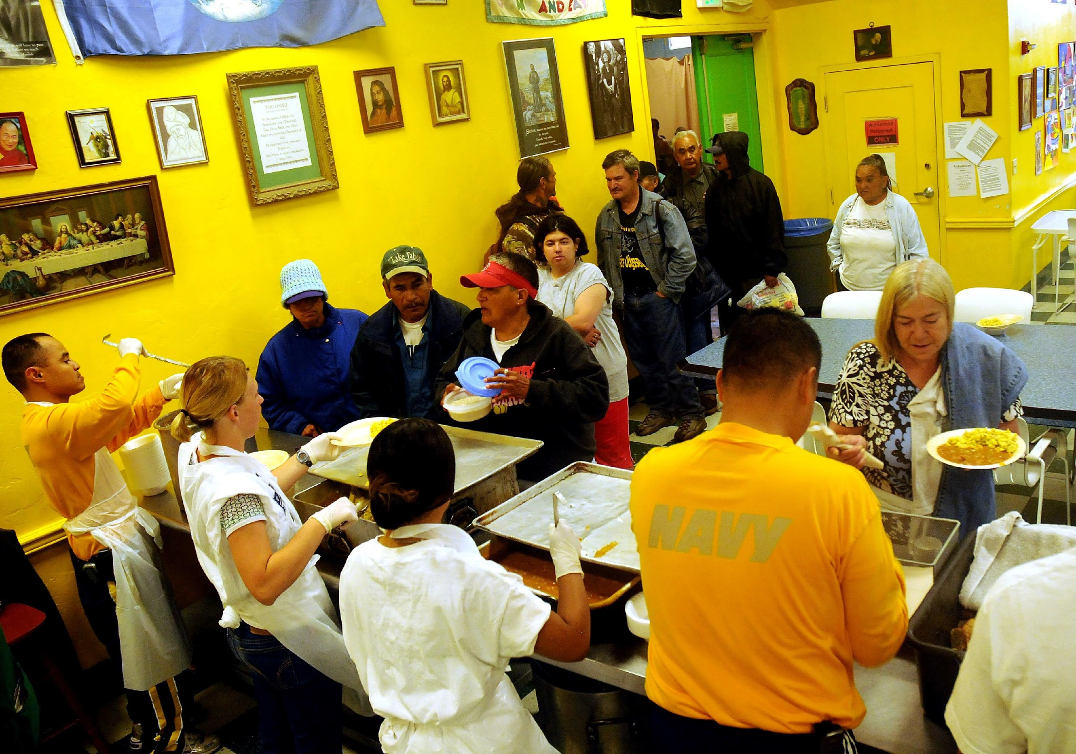
Findings
Children
Children were found to have insufficient food during summer and on weekends, and had a higher food insecurity risk if they were living in single parent households and were children of color. Childhood food insecurity can, among other things, result in long-term poor health consequences, behavioral and social difficulties and poor school performance.
Seniors
6.6% seniors in Montgomery county are estimated to live below the poverty level, and around 20-30,000 live below the self sufficiency standard. Many are also aging in place and in isolation, with limited access to transportation and technology, limited English proficiency, physical and mental disabilities and medical dietary restrictions.
People with Disabilities
Families with a disabled member were estimated to be 2 to 3 times more likely to be food insecure. Working aged adults with disabilities are twice as likely to live below the poverty level as adults without disabilities. Barriers to food security include lack of case management, limited communication ability, restricted mobility, and access to transportation to purchase and/or prepare food.
Foreign Born
50-60,000 foreign born residents were living at or below 150% of the poverty level in 2016. Food insecurity in this population results from factors such as language and cultural barriers, a lack of culturally appropriate food, and fear of asking for help, especially in mixed documentation status families.
Other Risk Factors
living below the self-sufficiency standard
having limited access to transportation
being eligible but not enrolled in benefits
being homeless
having faith based dietary restrictions
working two or more jobs.
Notes:
The most recent data from Feeding America show that the food insecurity rate in Montgomery County is 63,380 people of which 30,070 are children. Of course, this figure has likely increased on a large scale in the last few weeks, due to the COVID-19 crisis.
Research showed that there were varied, complex and interconnected root causes for this level of food insecurity, and that certain populations in the County were increasingly vulnerable to it, namely children, seniors, people with disabilities, and foreign-born residents. I want to draw your attention to the section on the far right hand side of the slide, in particular to the sentence stating that “living below the self-sufficiency standard” is a risk factor for food insecurity. As a benchmark, for a family of of 4 to live in Montgomery County with the most basic amenities, they would have to make an annual income of $91,252, which is significantly above the national poverty level of $24,300, and also the income eligibility level for SNAP (around $31,000), or WIC (around $45,000).
A huge number of people in Montgomery County fall into the gap of earning too much to be eligible for federal assistance programs, but yet not earning anywhere near enough to make ends meet. This makes our work in implementing the recommendations of the Food Security Plan all the more urgent and important, as we work to connect those residents with programs and services that will serve to alleviate their struggle.
As we also know, the negative health impacts of food insecurity are very serious - studies have shown that it leads to obesity and chronic disease as well as poor educational and disciplinary outcomes in children and youth

Slide 6
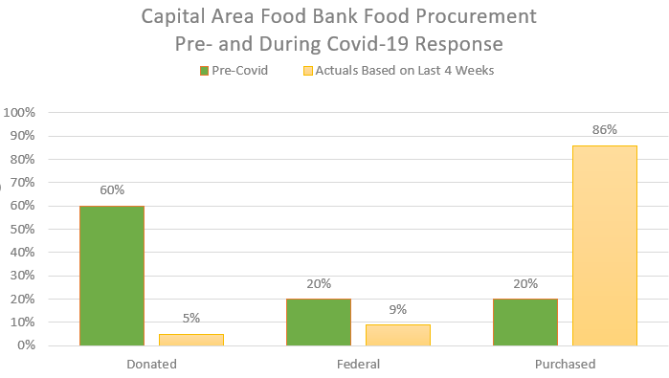
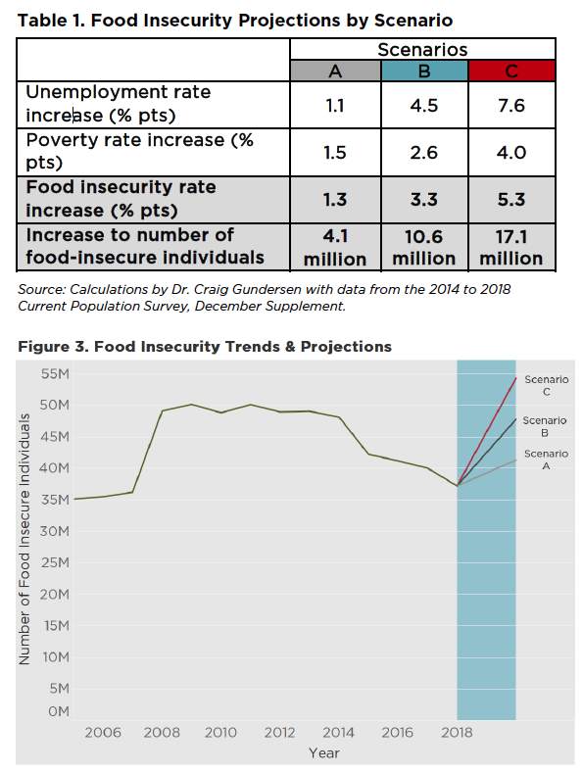
Potential Increased Long-Term Food Insecurity
2020 Projected Food Insecurity Rate
2018 → 2020
Change
13%
+62%
Notes:
The COVID-19 pandemic and the economic crisis triggered by critical response efforts have created a food access crisis in Montgomery County that our existing, decentralized food security resources are insufficient to address. The income disparities, high cost of living, and societal structures that resulted in an estimated 7% of the County’s population experiencing food insecurity prior to March 2020 have deepened inequities in our local food system as unemployment, small business closures, and health disparities rise during the pandemic.
Feeding America has used its Map the Meal Gap study to predict the change in food insecurity based on projected changes to unemployment and poverty. Feeding America produced three sets of projects they refer to as: scenario A, scenario B, and scenario C. “Scenarios A and B represent the same changes to unemployment and poverty that occurred during the Great Recession after one year and two years, respectively. … Scenario C represents a more severe possibility: if unemployment increases by 7.6 percentage points and poverty increases by 4.0 percentage points, 17.1 million more people will experience food insecurity.” According to Feeding America, “a recent Wall Street Journal poll of 60 economists predicted rates which, when considered across the year, are close to the unemployment rates assumed in Scenario C.” This Food Security Response Strategy takes a “hope for the best, but plan for the worst” approach, using Scenario C as a guide.
The most recent revised Feeding America projection for food insecurity in Montgomery County in 2020 is 13% which is a 62% increase from our pre-COVID level.
And we can see that happening in Maryland already. This chart shows the Pre-and Post-covid Food Bank Procurements in the early parts of the crisis. This is the enormous surge that prompted the creation of the response strategy.

Slide 7
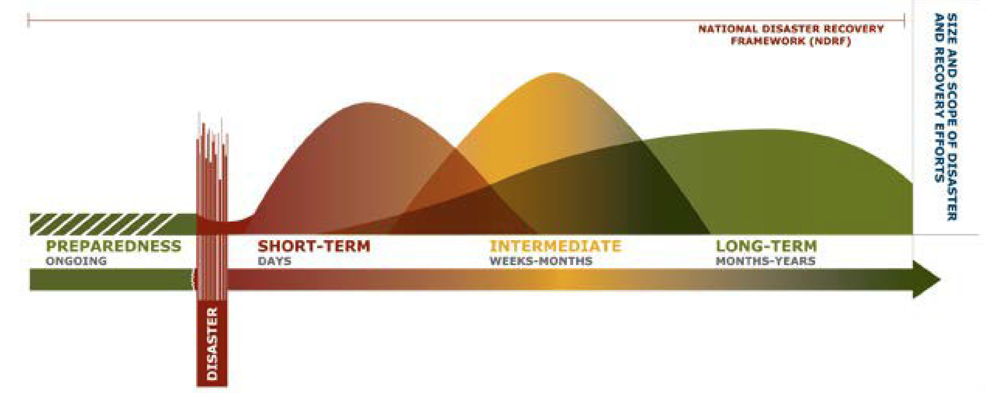
Recovery
Notes:
Ultimately, the County’s response to the COVID-19 crisis is an opportunity to transform our local food system through a process led by resident voices and representation. Through our response we can create economic opportunities, highlight the diverse food traditions of our residents and local businesses, and promote environmental sustainability in order to foster a permanently resilient and equitable food system in Montgomery County.
We thank you for your leadership during this time, and of course happy to answer any questions you may have.

Slide 8
Food Security Task Force
Partnership with the Montgomery County Office of Emergency Management and Homeland Security (OEMHS), Montgomery County Department of Health and Human Services (MDHHS), the Montgomery County Food Council (MCFC), and non-profit providers in Montgomery County
Established in early April 2020 as a response to the increased demand on food assistance providers during the COVID-19 pandemic
Mission:
  Increase the volume of food in the food assistance system;
  Improve access to food by building the capacity of the food assistance network to store and strategically, safely, and efficiently distribute food to residents through home delivery and community pickup sites; and
  To communicate information to residents on available resources and ensure residents are connected with available resources.

Slide 9
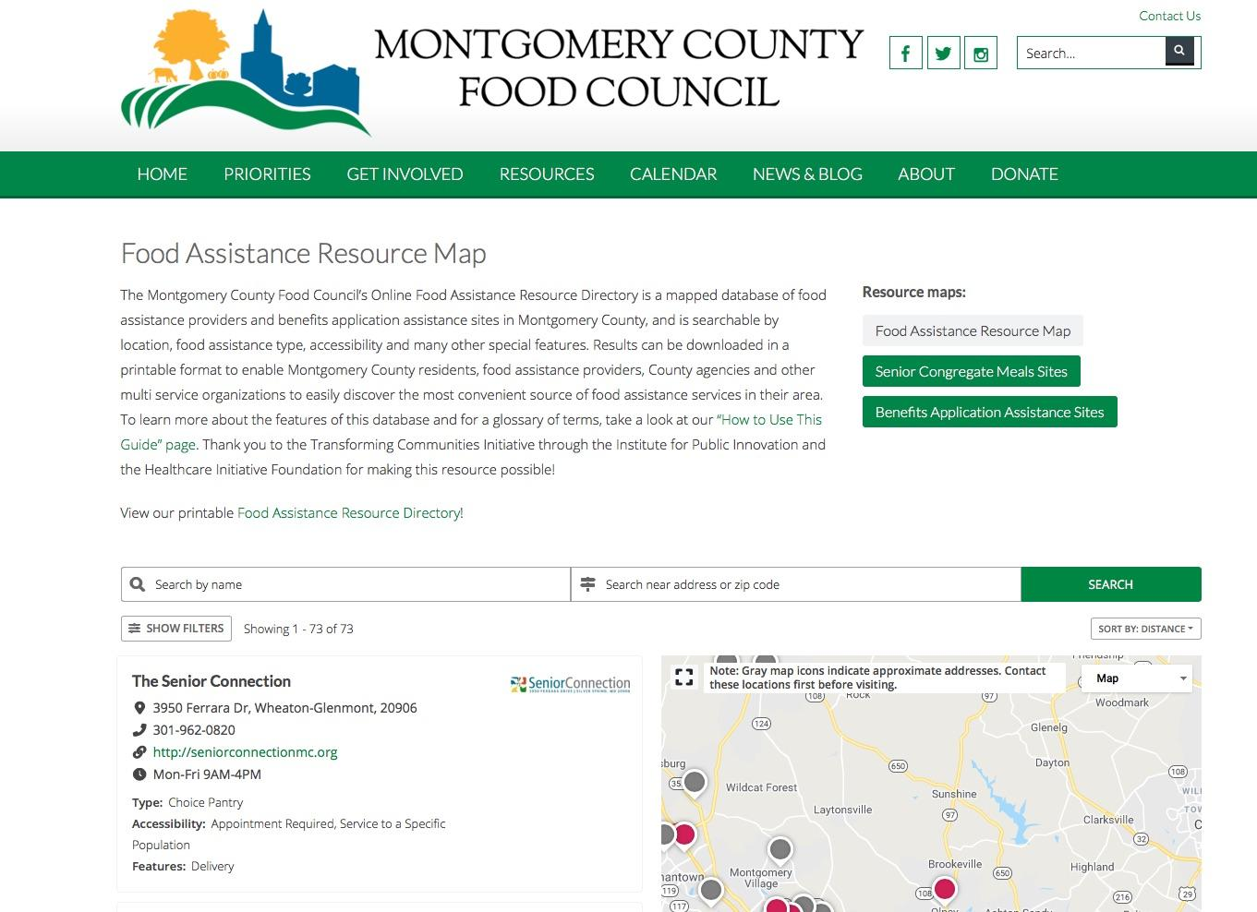
COVID-19 Food Assistance Resource Map
https://mocofoodcouncil.org/foodassistance/

Slide 10
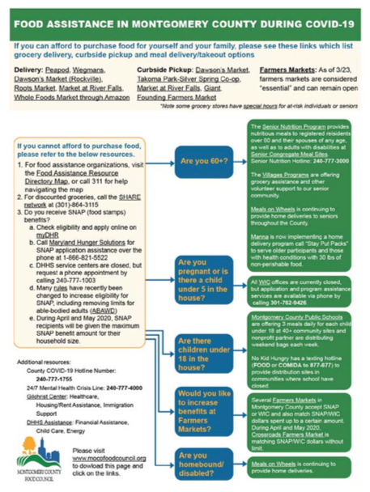
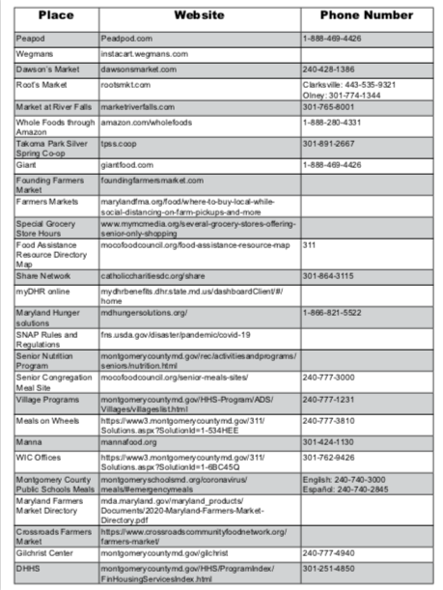
COVID-19 Food Assistance Referral Tool

Slide 11
more food to more people
Notes:
HEATHER - This Food Security Response Strategy outlines the initial strategies to both expand our current food assistance network, and build new capacity to connect residents to food assistance in the short-term response, while making investments in systems, programs, and partnerships that will last longer than this crisis.
The framework for our strategy is to connect more food - through a diverse sourcing strategy that bolsters local businesses and maximizes federal, state, philanthropic, and community funds - to more people by leveraging technology to efficiently connect residents to food in accessible, community-coordinated ways.

Slide 12
more food
Prepared Meals
from local caterers and restaurants
Shelf-stable Foods & Pantry Items
from local suppliers, distributed by Manna and CAFB
Increased Fresh Food
from local farms and wholesalers
Victory Gardening & Community Farming
Provide resident access to yard and patio gardening supplies, space, and educational materials
Notes:
HEATHER -
PREPARED MEALS
The pandemic has created a significant increased need for prepared meals for residents who are ill, or are taking care of someone who is ill, and/or have limited ability to cook, such as seniors, or residents experiencing homelessness, and those with disabilities.
Meals can be purchased from local caterers and restaurants for approximately $7 per meal. The County can establish procurement agreements with preselected vendors, potentially with fixed options and rates and a monthly invoicing schedule. The Task Force has been conducting extensive outreach to local restaurants specializing in a wide variety of food traditions, and meal production and distribution could be put in place very quickly when funds are available. Meal production can continue as long as there is a sustained need, at an appropriate level that will likely decrease as social distancing measures are eased and the number of quarantined and isolated households decreases.
SHELF STABLE
The current challenge is that this food distribution network is struggling under a massive increase in demand as food insecurity grows, and a substantial decrease in the supply of items typically donated by individuals and large organizations such as big-box grocers, and through food recovery.
Currently, local food banks are estimating that to meet the increased level of food insecurity, they will need to surge their output of food by more than 20%- likely closer to 40%. To meet that demand for six months and secure Montgomery County’s place in the procurement pipeline, a significant investment will need to be made in increasing procurement of shelf-stable food, alongside funds designated to enhance provider capacity to store and distribute shelf-stable products. Supply chain disruptions experienced throughout the food assistance network in May 2020 required the County to enter an emergency procurement agreement with a wholesaler to fill in the gap between what is available through CAFB/MFC supply chains and community demand. With the increase in demand for food assistance and the continued decrease in food donations, as well as the need to adapt the strategy in early June, it is likely that the Task Force will need more than $2 million to achieve this goal. This strategy is already being implemented – which initial purchases already working to supplement the CAFB and Manna’s network. After six months, Montgomery County should assess the use of the food, the continued demand, and the potential need for additional purchases given food supply chain disruptions and donation levels.
FARMS: Produce, meat, and dairy are often the most sought-after items in the food assistance network. They are critical components of healthy diets, but often the most difficult type of food assistance to source, store, and deliver. In addition to increased sourcing of fresh foods from local wholesalers and ethnic grocers, Montgomery County should support a significant expansion of existing “farm to food bank programs” aimed at buying fresh produce from local farms and local wholesale food distributors in this crisis. Close-to-market rates for high-quality farm products is typically cost prohibitive for food assistance providers to accommodate in large volumes in their purchasing budgets, but investments in sourcing products from local farms and food producers at a higher price will support the economic sustainability of the farm’s operations, increasing the strength of our local food production capacity while also connecting more residents to nutritious local food.
COMMUNITY ACCESS: Bulk purchase and distribution of gardening supplies in County communities, alongside educational resources on patio and community gardening resources, will increase cost efficiency and reduce supply chain challenges currently limiting individual purchases of these products, and increase long-term food access and resilience in our County’s communities.

Slide 13
to more people
Increased Benefits Access
expanding SNAP Outreach
expanding Farmers Market Double Dollars
Leveraging Technology to Efficiently Scale
  Web intake → Screening for services → Food Delivery
Getting the Word Out
Posters & Bus Advertisements
Digital Messaging,Traditional Paid & Earned Media
Community-level Engagement & Coordination
Community Food Resource Navigators
Community Food Hubs
Notes:
HEATHER
SNAP: Expanding County residents’ use of Federal benefits at retail locations such as grocery stores and farmers markets increases the investment of Federal funds in our local economy while increasing access to nutritious food. Social distancing and best practices in both retail settings allow their continued operation as safe and reliable food access sites. According to Maryland Hunger Solutions, Montgomery County has the highest percentage of residents who are eligible, but not enrolled, for the Supplemental Nutrition Program (SNAP) in the State of Maryland. Federal COVID-19 relief packages feature numerous additional benefits for SNAP participants, but many County residents are hesitant to enroll due to concerns and misconceptions about SNAP eligibility. Four multilingual SNAP outreach workers with internet and phone access could be hired and trained to work remotely conducting phone screening and application support, and potentially onsite at food distribution locations. if social distancing is possible. These Outreach Workers could be hired on a contract basis for 3-6 months and could be trained to do other outreach including census and healthcare enrollment as well.
TECHNOLOGY: Residents who are unable to access food or prepared meals as a result of the pandemic are located throughout the County, have varied transportation options, and have diverse food needs. Information on available food resources is often disconnected from other services, as well as difficult to find and language-inaccessible, for many residents. To address the challenges in connecting residents to food that is accessible and culturally and diet-appropriate, purchasing a web-based platform would coordinate and facilitate resident requests for assistance in accessing both groceries and prepared meals.
OUTREACH: A significant barrier to connecting residents to services is informing residents of the resources available to them through culturally competent, accessible methods, necessitating a communications program that provides strategic and diverse communication mechanisms, with a strategic focus on outreach in areas of the County most likely to have high levels of food insecurity based on existing zip code and demographic data and models.
COORDINATION: In a County as demographically and geographically diverse as ours, County-level strategies will never effectively identify and address the unique challenges and resources present in each of our neighborhoods. A strategy must be developed through extensive community engagement and representation and implemented with programmatic initiatives to formally embed community voice and leadership in the Countywide effort. It is also important to reflect on the rapidly changing landscape of providers- in the past 3 months, the number of organizations engaging in food assistance efforts has increased by 50%, with many groups conducting distribution for the first time. While this diversification of providers is essential for connecting all residents with services, it also presents significant logistical challenges that require significant hands-on coordination support at the County, hub, and neighborhood level.

Slide 14
How to Help
  Donate to local food assistance providers
  Connect with the Volunteer Center
  Support local businesses
  Engage in advocacy
Notes:
Find a provider near you and contact them directly for information on how to help- most welcome donations of food, PPE, and sanitizing equipment. Funding support is also critical
Review the Food Assistance Provider Needs spreadsheet to find out what providers near you may need in terms of food, funds, and supplies. Most providers are also accepting financial donations electronically.
Contact the Volunteer Center or visit the Volunteer Center website for opportunities to provide hands-on assistance
Follow crowdfunding opportunities (regularly posted in Support MoCo restaurants Facebook Group) to purchase meals from local restaurants to support healthcare workers, emergency responders, food insecure residents, families with children, and more.
Engage in advocacy
Online SNAP, extension of resources beyond April and May need community voices
Join our weekly calls Mondays at 1pm

Slide 15
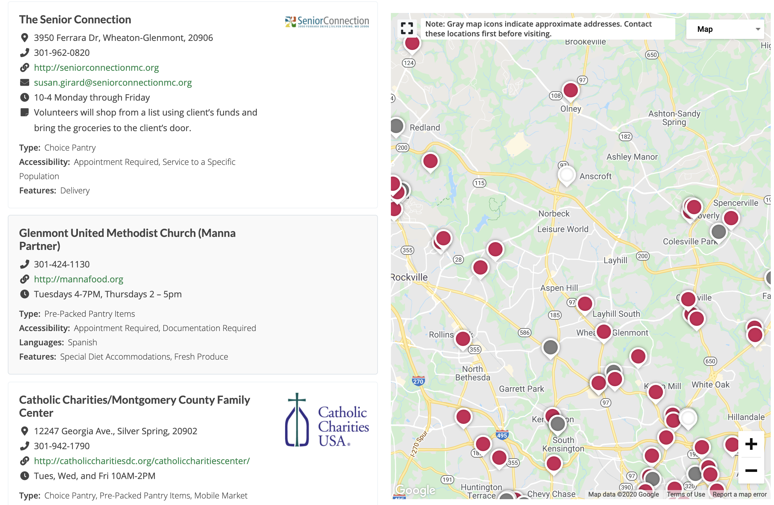
Notes:
Popups
Gaps

Slide 16
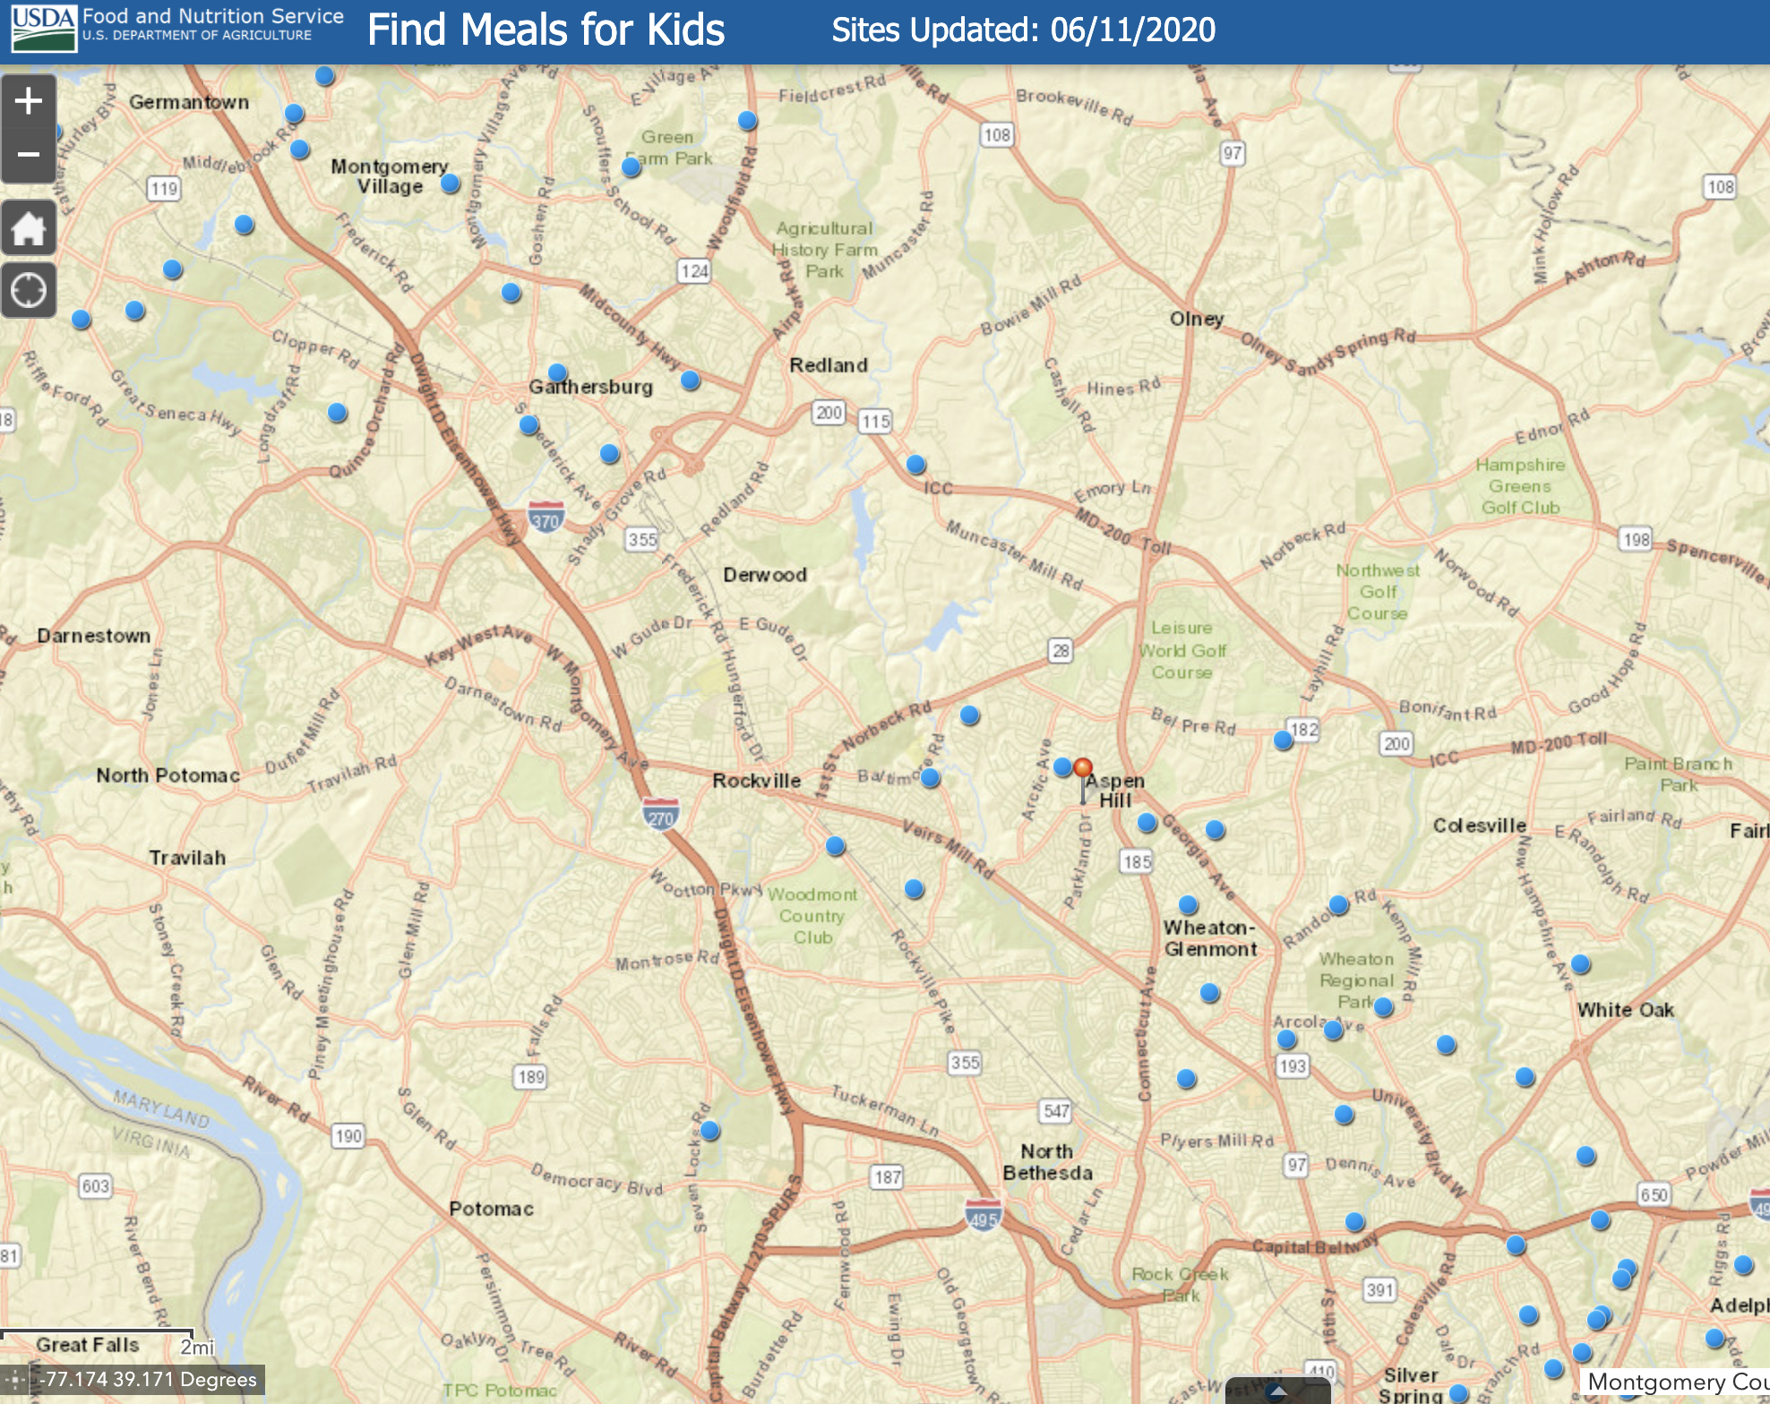

Slide 17
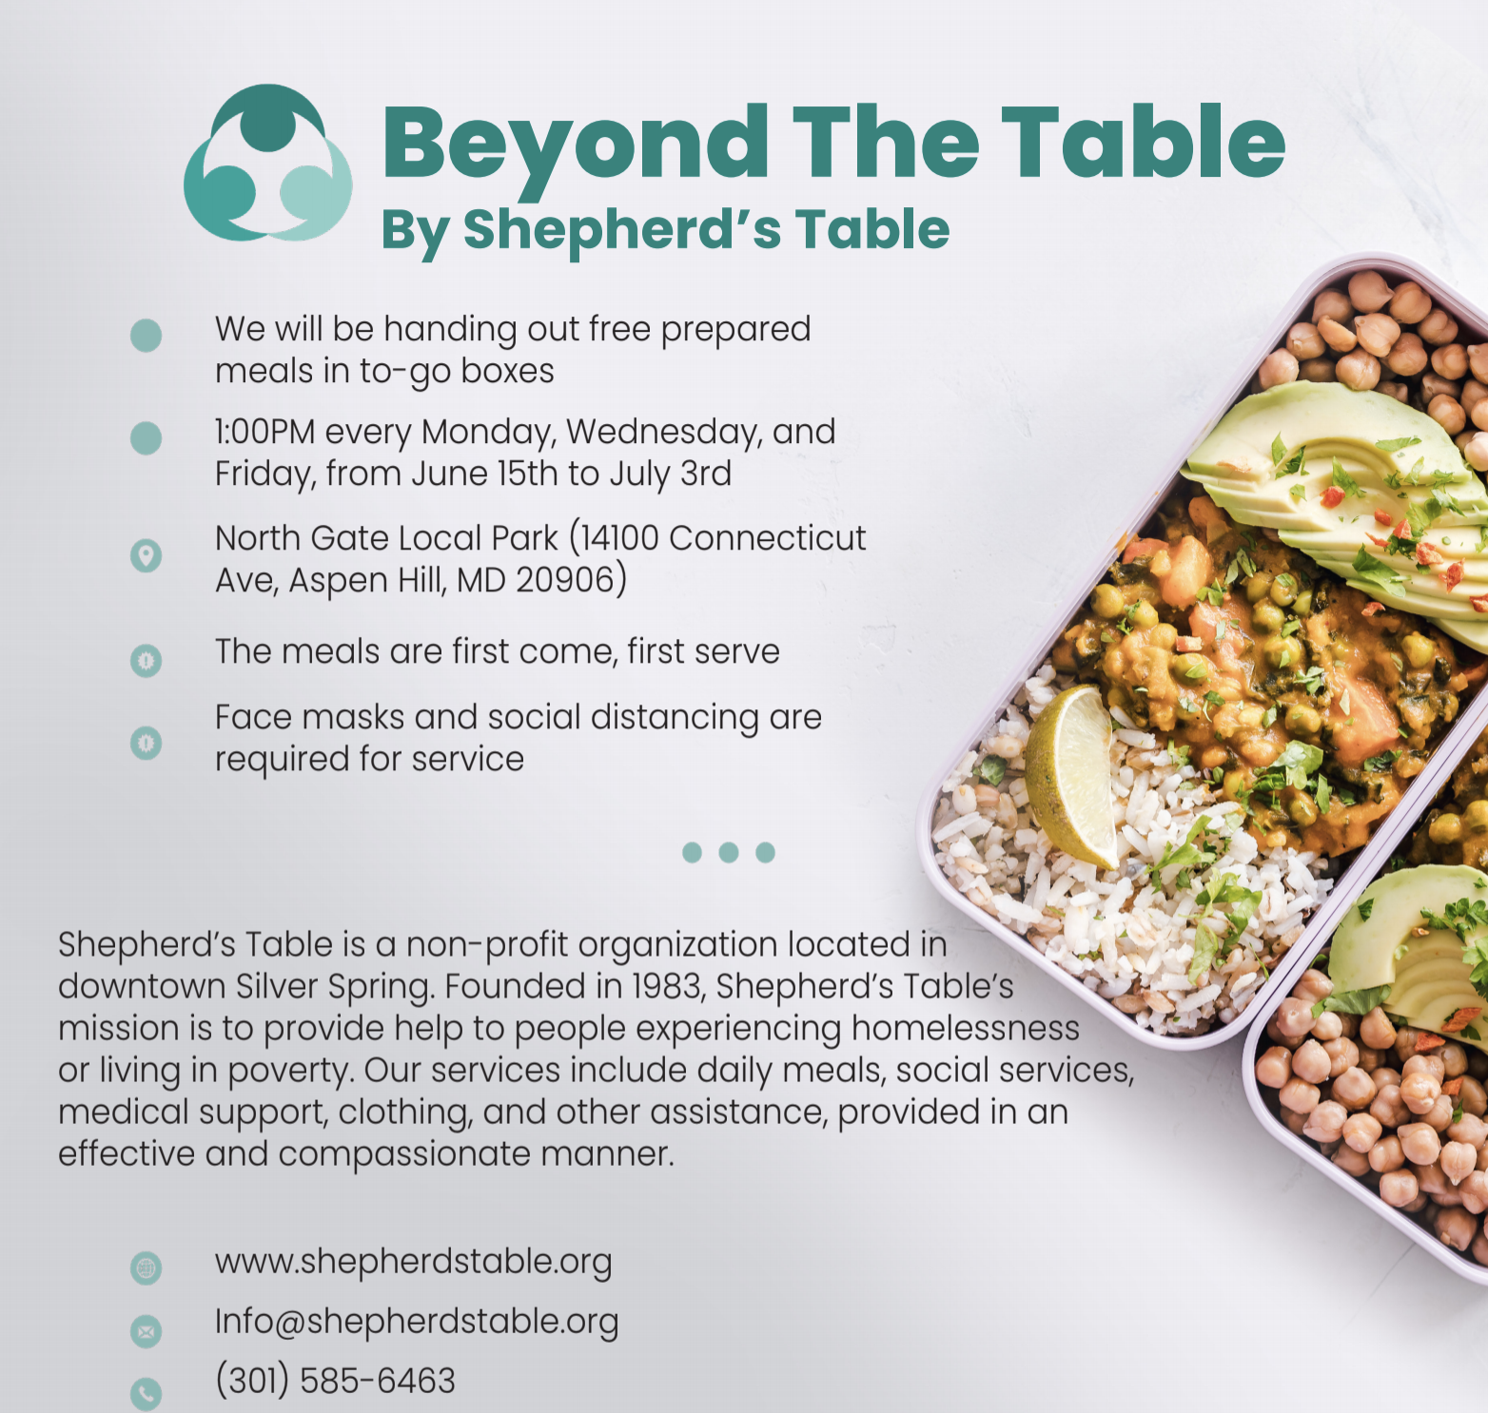

Slide 18
Heather Bruskin
Executive Director
hbruskin@mocofoodcouncil.org

