Slide 1
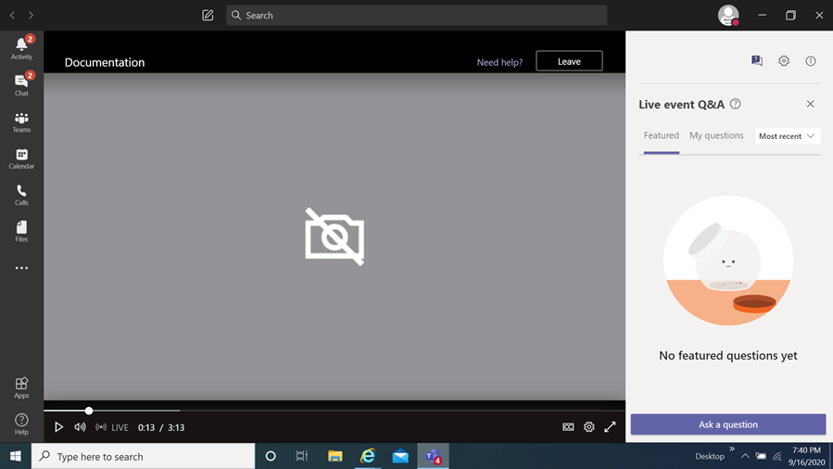
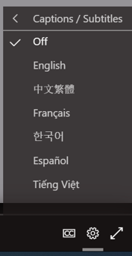
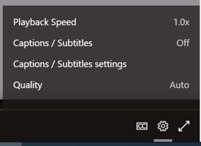
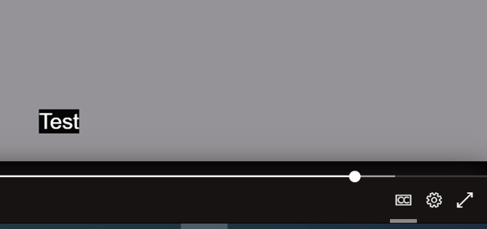
FY24 Cost Sharing Capital Grants
Information Session
How you can view the multi-lingual closed captions
Select this item
When you select it a menu appears,
choose captions / subtitles
It will then display the language chosen
You then select
the language of choice
Disclaimer
The translations provided in this application use what is referred to as mechanical translation technology. Although this method of translation is very effective and provides a high rate of accuracy it is NOT 100% word for word accurate. Things that may affect it are the quality of the microphone used and potentially a person speaking that may have an accent.

Slide 2
FY24 Cost Sharing Capital Grant
Awards Kick-Off
Information Session
December 5, 2024
Prepared by Montgomery County Office of Grants Management
Notes:
Rafael

Slide 3
Congratulations!
The slide deck will be available for future viewing on the Office of Grants Management online application portal on the FY24 Cost Sharing Capital Grants Program page for your reference
Templates and other resources related to the implementation of this grant program will also be posted on the program page
This is the same site that you visited to apply for this grant program and will be your “one-stop shop” throughout implementation until we transition to a new grants portal
FY24 Cost Sharing Capital Grants Program Page https://mcmdgrants.smapply.org/prog/FY24CSCG/
Notes:
OGM

Slide 4
Information Session Agenda
Why you won
Final steps for grant agreement approval process
Grant Agreement overview
Reporting & Payment requirements and timelines
Amendments process
Multi-year award process
Walking through key documents and tools
Q&A
Notes:
Next slide presented by DEP

Slide 5
Awarding Process
Notes:
DEP

Slide 6
Awarding Process con’t
Notes:
DEP

Slide 7
Scoring Process
3 MCG staff members with capital project experience reviewed and scored 6 State Matched Art Capital Project applications
3 MCG staff members with capital project experience reviewed and scored 11 State Matched Non-Arts Capital Project applications
Reviewers included representatives from the Office of Intergovernmental Relations, Office of the County Executive Business Center, and the Office of Management and Budget
Each application was independently reviewed and scored three times resulting in a total of 51 reviews
Reviewers provided the following:
  A score of up to 100 points shaped around pre-set criteria
  An overall recommendation to fund or not to fund the proposal
Notes:
OGM

Slide 8
Ranking and Resource Allocation Process:
Arts Facility Capital Awards
OGM sorted and filtered data in the following order:
  Average Scores – Sorted highest to lowest
  Overall Funding Recommendation – Filtered to applications who had positive consensus
ALL applications received a consensus recommendation to fund and relatively high score (lowest scoring application - 87%)
The CAO allocated funding to ALL applicants at 84% of their requested funding level given the high quality of projects
Notes:
OGM

Slide 9
Ranking and Resource Allocation Process:
Non-Arts Facility Capital Awards
OGM sorted and filtered data in the following order:
  Overall Funding Recommendation – Filtered to applications who had positive consensus
  Average Scores – Sorted highest to lowest
Funding amounts allocated based on reviewer recommended amounts (where there was disagreement on the timeline, OGM defaulted to the applicant’s requested disbursal timeline)
This resulted in FY24 surplus of $164,840. OGM accelerated funding from FY25 into FY24 by $82,420 for the two highest ranking projects with recommended multi-year awards
Notes:
OGM

Slide 10
Award Approval Process
Recipients submitted proposal updates through SM Apply.
OGM combined the proposal with other parts of the grant agreement into a single PDF Grant Agreement Package.
OGM and DGS reviewed to ensure updates are in line with the awarded project scope.
OGM emailed the Recipient the Grant Agreement Package for review and signature.
The Recipient signed the Grant Agreement Package and uploaded it into SM Apply.
OGM will transfer the Grant Agreement Package to the Office of County Attorney (OCA) for review and signature.
OGM will then transfer the OCA signed Grant Agreement Package to the Chief Administrative Officer, or his designee, for review and signature.
The fully signed Grant Agreement Package will be emailed back to the Recipient.
DGS will process a Direct Purchase Order (DPO) for the Grant Agreement through the Department of Finance.
DGS will email a copy of the approved DPO to the Recipient.
If any stakeholder finds an issue that requires changes, then it is back to Step #1
Notes:
Olga

Slide 11
Overview of Grant Agreement
Coversheet
Condenses all key information into a single page for easy reference by both Grantee and Grantor
List of Attachments (page 2)
Lists the key documents that are part of the Grant Agreement providing details on implementation scope.
Order of Authority (Page 2)
List the order of authority of documents (which trumps the others) if there is a conflict between different documents in the Grant Agreement package
Data Elements
Specifically define roles, terms, standards, processes, and timelines for various aspects of implementation
Signatures
Captures the signatures of all key parties. Grant Agreement is Finalized when all three parties have signed the document
General Conditions
Additional, more general, and inflexible requirements for all County Grant Agreements
Notes:
OGM

Slide 12
Data Elements (1 of 4)
Grant Agreement Award Amount – Defines the amount awarded
Grant Agreement Scope – Summarizes and defines the broad scope of the Grant Agreement
Chief Administrative Officer (CAO) – Affirms role and authority of CAO, or their designee, over grant agreements
Grant Monitor and Administrator – Defines roles of Grantor representatives listed in the Cover Sheet
Payment Method and Schedule – Defines process, requirements, and expected timelines for grant payments
Grant Agreement Compliance – Notes that both parties agree to follow the terms of the Grant Agreement

Slide 13
Data Elements (2 of 4)
Authorized Budget – Specifies the budget that will bind approved spending under the Grant Agreement
Allowable Costs – Defines criteria of how costs will be considered allowable
Amendment of Grant Agreement Budget – Defines budget intent, standards for needing an amendment, process for seeking amendments, notes a 10% flexibility without amendment, and notes that the County will not provide or reimburse spending outside of the approved budget
Term – Defines the length of time that the grant agreement must be completed by and the process for seeking extension via an amendment
Amendment – Requires all amendments to be mutually approved
Non-Liability – Removes liability from the County for grant implementation

Slide 14
Data Elements (3 of 4)
Notices – Defines addresses and effect of written notices for both parties
Refunds – Defines terms of when distributed grant funds need to be returned to the County
Termination – Defines timeline, process, and requirements related to the termination of a grant agreement by the County
Audit and Records – Sets requirements for maintaining proper financial documentation, term that these must be maintained, and provides the County the right to audit grant agreement related records at will
Right of Visitation and Inspection – Provides the County the right to inspect in-person grant agreement funded activities and related records
Reporting and Evaluation – Defines Programmatic and Financial reporting requirements, process, and link to payments

Slide 15
Data Elements (4 of 4)
Information Disclosure – Acknowledges that grant agreement related documentation is subject to the Maryland Public Information Act (MPIA)
Additional Grant Agreement Conditions – Establishes unique requirements for a particular grant program or individual grant agreement
Name and Signature Requirements– Sets requirements that legal name for organization must be used in the Grant Agreement and that the signatory is legally authorized to bind the organization

Slide 16
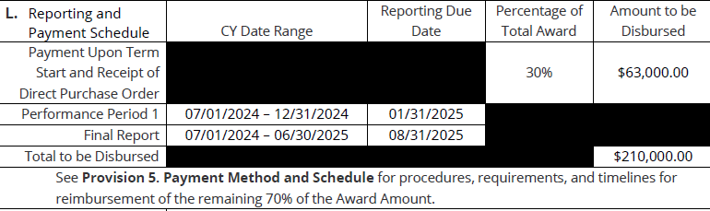
Sample Reporting & Payment Schedule
Note: Your specific Grant Agreement’s Reporting & Payment schedule is on the Grant Agreement Cover Sheet (the document’s first page).

Slide 17

How do I get paid?
  30% upfront payment
  Requirements
    Attend or view this training
    Grant Agreement
    Direct Purchase Order
    Request for Payment/Invoice (OGM or your template)
  Reimbursement of expenses thereafter up to the ceiling of the approved budget
  Requirements
    Programmatic Reports: 1 during implementation and 1 final
    Regular financial progress report (OGM template)
    Request for Payment/Invoice (OGM or your template)
  Payment contingent on grant monitor approval
  30 days processing time after approval
Notes:
OGM

Slide 18
Reporting Overview
See Section L. for Reporting and Payment Schedule on page 1 of the grant agreement
All reports should be electronically transmitted (emailed) to the Grant Monitor on or before the report due date listed in Section L.
Payment of funds are contingent on the Grant Monitor’s confirmation that the submitted reports thus far meet all requirements and that programmatic activity is consistent with the terms of the Grant Agreement.
Reporting requirements:
  A Programmatic Report summarizing the work accomplished during the performance period and in the format provided by the Grant Monitor
  A Financial Report summarizing spending through the performance period in the format of the Financial Progress Report Template provided by the Office of Grants Management
Final Reporting
  The Final Programmatic and Financial Reports should reflect all activity undertaken and expenses incurred during the life of the Grant Agreement
  Final Reporting must be in line with all other Programmatic Reporting and Financial Reporting requirements outlined above
Notes:
OGM

Slide 19
Payments Overview
See Section L for Reporting and Payment Schedule
30% of award amount is provided as Payment Upon Term Start
Costs incurred within the Grant Term (not the execution date of the grant agreement) and within the Authorized Budget are eligible for payment under the Grant Agreement
Each additional Request for Payment will be a reimbursement and must equal the total amount of expenditures which the Grantee has incurred beyond the initial payment and any previous reimbursements provided by the Grantor.
Requests for Payment do not need to include back-up documentation as part of the request. Back-up documentation must be produced upon demand by the Grantor and meet the requirements outlined in Provision 16. Audit and Records.
Requests for Payment must be submitted in sufficient time to allow at least thirty (30) working days for processing after the Grant Monitor has confirmed the Grantee has met programmatic and financial reporting requirements for that performance period and has accepted Grantee’s Request for Payment.
Notes:
OGM

Slide 20
Request for Grant Payment
and Invoice Standards
All Grant Agreement payments will require an invoice or a Request for Grant Payment to receive a disbursement of funds.
An invoice that meets the following minimum County standards by including the following:
  Invoice number
  Invoice Date
  Legal name of the organization
  Remit direction/vendor payment mailing address
  Itemization of goods/services being billed (aligned with the grant budget submitted)
  Total amount due (must be exactly what is listed for the relevant grant payment)
  Direct Purchase Order number
If your organization does not issue invoices or you choose not to use an invoice , you may use OGM’s Request for Grant Payment template that has been pre-approved to meet these minimum requirements.
Notes:
OGM

Slide 21
Initial 30% Upfront Payment
Requirements to receive this upfront payment are:
  A representative of your organization must attend this kick-off meeting. If an organization cannot send a representative to the live event, they may view the kick-off meeting recording and email OGM a confirmation of they have viewed and understood the training.
  You must have in-hand both a finalized Grant Agreement (signed by all parties) AND a Direct Purchase Order for the award.
  Submit a Request for Grant Payment or an Invoice that meets County invoice standards for the exact amount listed for the payment in the grant agreement.
The Grant Agreement provides the County the right to audit how these funds are spent and requires a refund if they are not fully spent by the end of the grant agreement or have been mis-spent.
Notes:
OGM

Slide 22
Reimbursement Payments
Each additional Request for Payment will be a reimbursement and must equal the total amount of expenditures which the Grantee has incurred beyond the initial payment and any previous reimbursements provided by the Grantor. These reimbursement Requests for Payment must include a:
  Summary of expenditures to date;
  Breakdown of expenses by category in the Authorized Budget;
  Brief narrative on any significant variances or concerns with expenditures as of the date of the request; and
  A Request for Grant Payment or an invoice that meets County invoice standards that requests County payment for the full amount of that Performance Period
Payments are conditional upon the Grant Monitor’s confirmation that the Grantee has met all programmatic and financial reporting requirements up to the date of the Request for Payment.
Requests for Payment may not be submitted more than once a month
Total requests for payment may not exceed the total award amount
If reporting or request for payment information is not sufficient, payments will be withheld until sufficient reporting/information is provided or possibly the termination of the Grant Agreement.
Remember, the Grant Agreement allows County representatives to audit and/or inspect both programmatic and financial reporting at will so all financial and programmatic documentation must be maintained.
Notes:
OGM

Slide 23
Before Seeking Payment…
Make sure your payment request package is complete AND checked for accuracy of details.
Ensure your registration with the Montgomery County Central Vendor Registration System (CVRS) (https://mcipcc.net) is up to date.
Ensure that your organization is in Good Standing with the Maryland State Department of Assessment and Taxation (SDAT). (https://egov.maryland.gov/businessexpress/entitysearch).
Understand that payments may take up to 30 days to be received AFTER the Grant Monitor has confirmed your reporting meets required standards.
OGM recommends that organizations sign up for ACH payments via the Central Vendor Registration System (CVRS) to expedite receipt of funds.

Slide 24
Amendments Process
Your Grant Agreement allows for amendments at the MUTUAL agreement of Grantor and Grantee. These can include:
  Extending the Term of the Grant Agreement (more time to spend existing funds)
  Changing the Authorized Budget (spend funds on different things)
  Changing the other portions of the project’s scope (update Project Work Plan or Project Performance Plan)
  A combination of several or all of the above
If seeking an amendment, the Grantee must propose one 30 days before the changes would take place to the Grant Monitor.
If the Grantor agrees to consider an amendment, the Grantee must provide updated versions of the Grant Agreement attachments that will change.
If the Grantor agrees, OGM will develop a Grant Agreement Amendment that includes all agreed upon changes to be signed by the Grantee and the CAO, or his designee.
Once the Grant Agreement Amendment is signed, the Grantee may begin shifting operations to match the changes.
Unless funds are being added to a Grant Agreement, an updated Direct Purchase Order is not necessary.
Notes:
OGM

Slide 25
Multi-Year Awards
A single grant agreement can only contain funding from a single fiscal year.
Some recipients received funds for both FY24 and FY25; some also received an FY26 intent to fund
FY24 and FY25 funds have already been appropriated so projects with funds in both of these years should have received two grant agreements
Each new fiscal year requires a new grant agreement but NOT a new competition if you received a multi-year award. Your Notification Letter is proof of your multi-year award; with the contingencies below.
FY26 funding is CONTINGENT on Council appropriations AND satisfactory project performance
    If the County Council does not appropriate sufficient funding in a given fiscal year a project may have its funding reduced or eliminated for that fiscal year.
    If a project is not performing well, implementing its proposal as approved, or an organization fails to stay in compliance then funding may not be renewed.
    An existing grant agreement could be cancelled mid-fiscal year. Grant Monitors and other County stakeholders will make this assessment.

Slide 26
Multi-Year Award Renewal Process
IF funding is available AND project performance is satisfactory, the County and the Recipient will renew funding through a NEW grant agreement each fiscal year.
Your Grant Monitor will reach out to the Recipient in roughly Spring of 2025 notifying them of the County’s intent to renew (or not) funding and for how much.
The CE Recommended Budget, distributed on March 15, will give departments, OGM, and you a sense of the likely funding landscape but Council makes the ultimate decision on funding availability.
The Recipient will provide an updated proposal for the coming fiscal year that includes:
  • Project Budget • Project Budget Narrative
  • Project Performance Plan • Project Work Plan/Timeline
OGM and the Grant Monitor will review the new fiscal year proposal to ensure it is aligned with the scope of the original award.
If approved, the proposal will be integrated into a new grant agreement for that fiscal year and provide a further 12 months of funding; this will not have to align with the fiscal year calendar.
If not, the Recipient will need to revise the updated proposal until approved by the County.
Notes:
OGM

Slide 27
Walkthrough of Key
Documents and Tools
FY24 Cost Sharing Capital Grants SM Apply Application Page
Financial Reporting Template
Request for Grant Payment Template

Slide 28
Further Questions
Rafael Murphy
Director, Office of Grants Management
240-777-2775
Olga Kravets
Program Manager, Office of Grants Management
240-773-3344
grants@montgomerycountymd.gov
FY24 Cost Sharing Capital Grants Application Page
https://mcmdgrants.smapply.org/prog/FY24CSCG/
OGM Website
https://montgomerycountymd.gov/ogm/
OGM online grants application platform
https://mcmdgrants.smapply.org
Notes:
OGM

