Slide 1

Welcome!
2425 Reedie Drive, 10th Floor
Thursday, July 17, 2025
6:00 p.m.

Slide 2

AGENDA
2425 Reedie Drive, 10th Floor, Wheaton
Thursday, July 17, 2025
6:00 p.m. Welcome and General Announcements
6:05 p.m. Review and Approve Agenda
6:08 p.m. Review and Approve June Minutes
6:10 p.m. Marty Fox, Aspen Institute Project Play, Children’s Sports Bill of Rights
6:40 p.m. Working Group Discussions
Advocacy: Ben, Jay, Tom, Tony, Steve (ex-officio)
Community Engagement: Samantha, Princess, Amy, Rick
Operations: Tina, Mary Kate, Christopher
      Annual Report Development
      Committee Member Nominations and Officer Elections
Recognition: David, Trish, Princess, Steve (ex-officio)
Communications: Mary Kate, Christopher
7:15 p.m. Sports Programming Directory Options
7:30 p.m. MCPS Intramural Sports
7:45 p.m. New Business
8:00 p.m. Adjourn

Slide 3
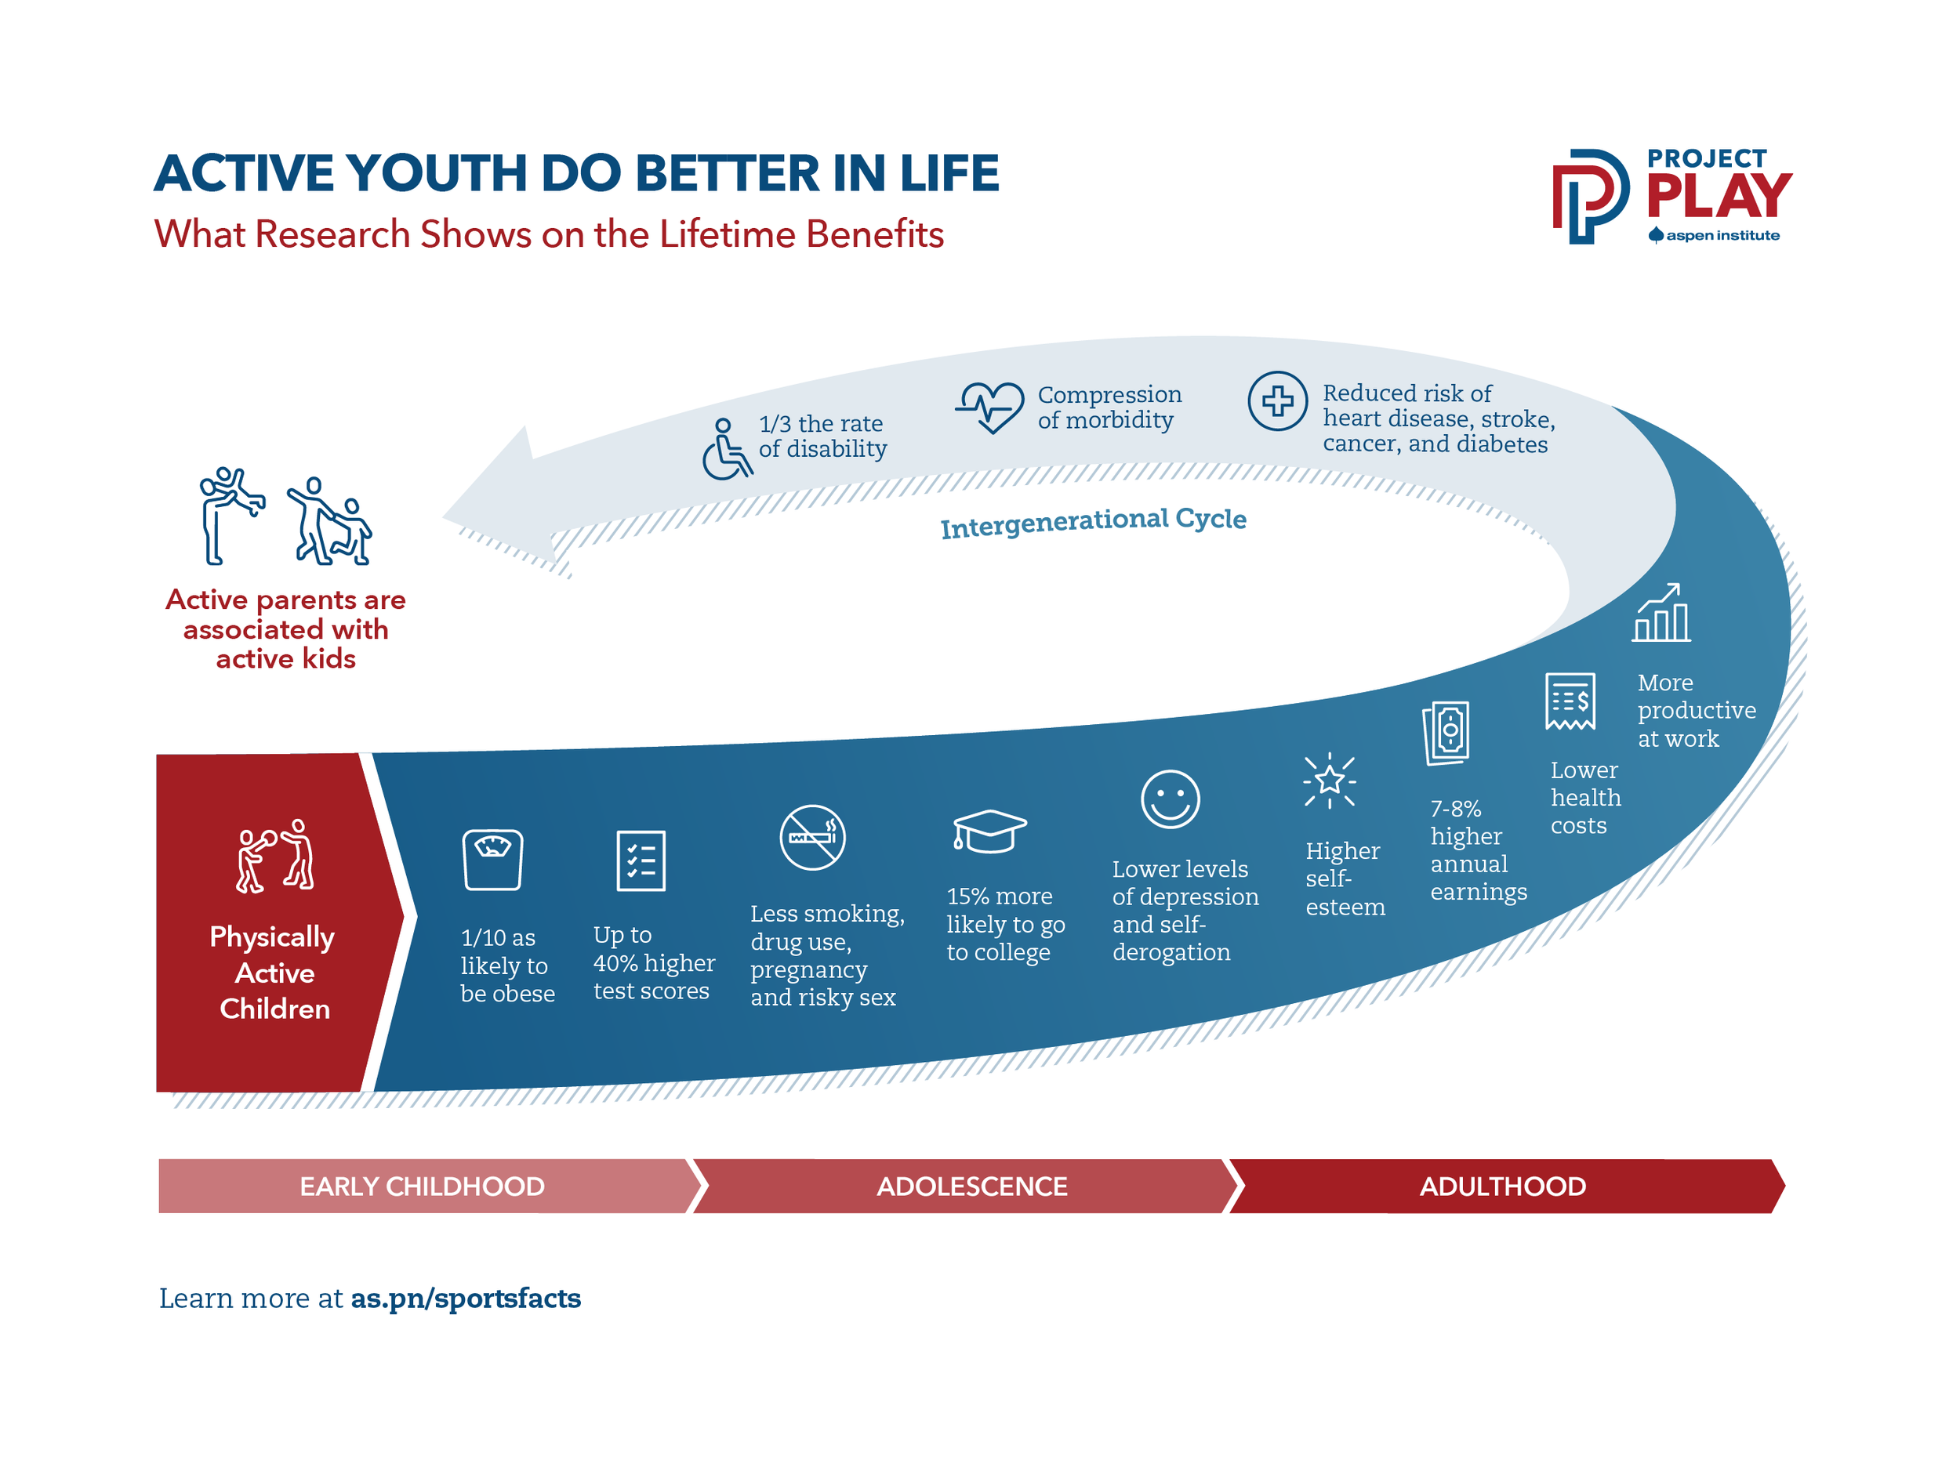

Slide 4
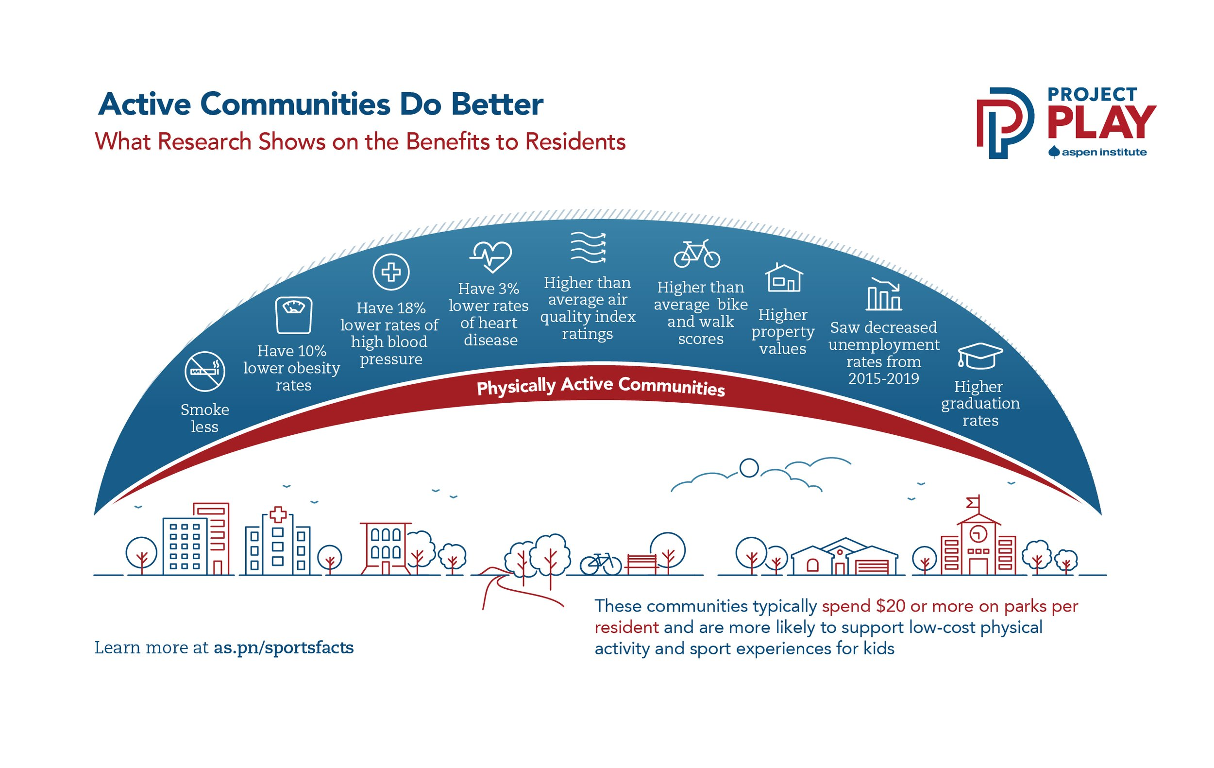

Slide 5


Slide 6
ALL CHILDREN HAVE THE RIGHT:
To play sports
to safe and healthy environments
to qualified program leaders
to developmentally appropriate play
to share in the planning and delivery of activities
to an equal opportunity for personal growth
to be treated with dignity
to enjoy themselves

Slide 7
All children have the right:
1. To play sports
Children have the right to have organizations make every effort to accommodate their interest to participate, and to play with peers from diverse backgrounds.
Providers should develop policies, practices, and partnerships to include youth from underrepresented populations, and create programs that both meet and stimulate youth interest in sports.
Non-profits and other groups that benefit from the use of public facilities have a special duty to protect the right of all children to participate.

Slide 8
All children have the right:
2. To SAFE AND HEALTHY ENVIRONMENTS
Children have the right to play in settings free from all forms of abuse (physical, emotional, sexual), hazing, violence, and neglect.
They must be provided safe and inclusive playing facilities and equipment.
While the physical nature of sports means all risks cannot be eliminated, programs should take precautions to protect youth from harm and dangerous situations.
At all times, the best interests of the child should prevail.

Slide 9
All children have the right:
3. To Qualified Program LEADERS
Children have the right to play under the care of coaches and other adults who pass background checks.
Coaches also should receive training in, at a minimum: general concepts in coaching youth; sport-specific coaching; the emotional needs of children; injury prevention; CPR and First Aid; and abuse prevention.
Children and parents/caregivers deserve to know program policies and procedures in these areas.

Slide 10
All children have the right:
4. To DEVELOPMENTALLY APPROPRIATE PLAY
Children have the right to play at a level commensurate with their physical, mental, and emotional maturity, and their emerging athletic ability. Roster sizes, rules, and equipment should be adapted to those levels.
They should not be subject to inappropriate pressure or exploitation.
Reasonable efforts should be made to recruit and accommodate youth with disabilities.
All children should be treated as young people first, athletes second.

Slide 11
All children have the right:
5. To SHARE IN THE PLANNING AND DELIVERY OF ACTIVITIES
Children have the right to share their viewpoints with coaches and program administrators, and for their insights to be incorporated into activities.
They have the right to identify sport options of their own interest and, especially with younger participants, consideration should be given to how much they want to train.
Youth should be provided ample space for free play and to enjoy other sport, cultural and family activities.

Slide 12
All children have the right:
6. TO AN EQUAL OPPORTUNITY FOR PERSONAL GROWTH
Children have the right to have programs invest equally in them, free of discrimination based on any personal or family characteristic.
Policies on minimum playing time in games should be established in recognition of the evolving capacities of youth, with a bias, especially at the younger ages, toward roughly equal playing time over the course of a season.
Programs should create balanced teams where possible and be judicious in creating competition formats that favor early bloomers to the exclusion of others.

Slide 13
All children have the right:
7. TO BE TREATED WITH DIGNITY
Children have the right to participate in environments that promote the values of sportsmanship, of respect for opponents, officials, and the game.
They have the right to make mistakes and fail without fear.
Policies should be established and enforced to prevent bullying behavior by coaches, parents, spectators, and teammates. Education on these matters should be provided to them, in a variety of formats and languages.

Slide 14
All children have the right:
8. TO ENJOY THEMSELVES
Children have the right to participate in activities they consider fun, and which foster the development of friendships, the prime motivations for many to participate.
Coaches and administrators should create the conditions to help them find comfort and happiness, and which in turn can facilitate a love of sport, self-learning, mastery, and sustained engagement.

Slide 15

The Children’s Bill of Rights in Sports has been endorsed by 500+ organizations, athletes and World Cup host committees across the United States, including the U.S. Olympic & Paralympic Committee and most National Governing Bodies (NGBs)

Slide 16




Slide 17





Slide 18


















Policymakers &
Civic Leaders

Slide 19
How to Activate?
Share Bill of Rights resources with leaders of parks and rec department, schools, and community youth sport programs
Review policies for facilities use through a bill of rights lens – leverage shared use agreements to improve safety, access, quality in programs that use fields, gyms and other recreational infrastructure
Share Project Play Parent Checklists to educate families
Educate youth athletes about their rights and build youth into decision-making processes
Unlock funding to help programs align with rights

Slide 20
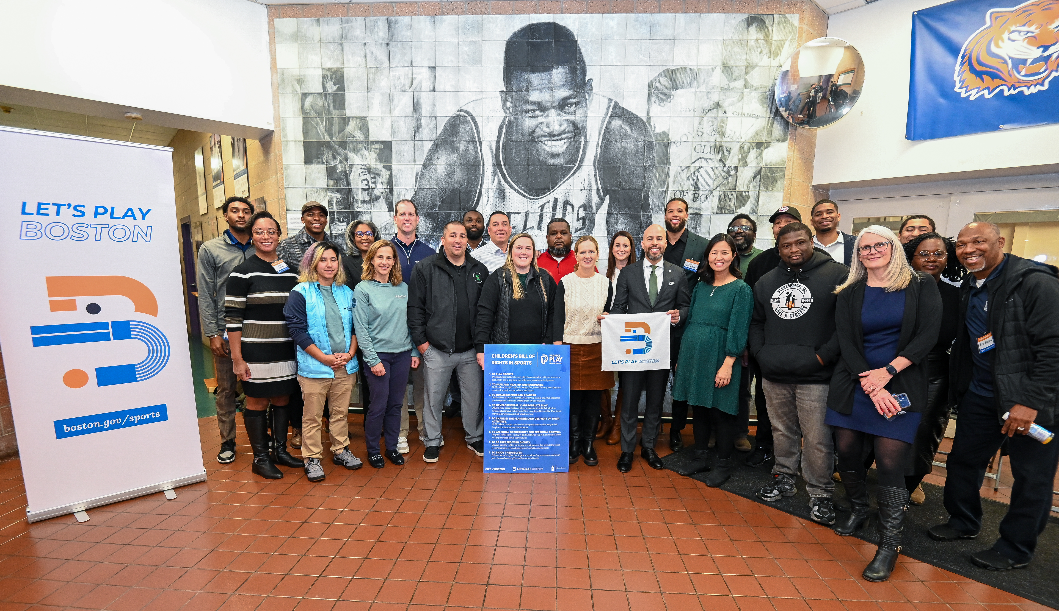

Slide 21
How Aspen Institute Can Help
Host webinar for leaders of parks and sport providers on the Bill of Rights and facilitate discussion on opportunities to fill gaps
Data-driven heat maps identifying sport deserts, sport interests
Youth insights via Aspen-hosted survey
Technical assistance on custom requests

Slide 22

Marty Fox
Program Manager, Sports & Society Program
Aspen Institute
martin.fox@aspeninstitute.org
202.464.4304

Slide 23
Working Group Discussions
Advocacy: Ben, Jay, Tom, Tony, Steve (ex-officio)
Community Engagement: Samantha, Princess, Amy, Rick
Operations: Tina, Mary Kate, Christopher
Recognition: David, Trish, Princess, Steve (ex-officio)
Communications: Mary Kate, Christopher

Slide 24
Community Engagement Survey
Created a google form survey to better reach youth, parents, and coaches across the county
  Tailored questions for each stakeholder
  Distributing survey:
    Included in newsletters as a link or QR code: target community members
    Share directly with providers
    Distributed in schools
Discussion Items:
Means of distribution
Possible incentives

Slide 25
Stakeholder Outreach
Contacted individuals from our Stakeholder Database
  First three contacts:
    Renee Prioleau: Executive Director, Kids Kitchen (EBB program)
    Larry Hayman: Program Director, i9 Sports
    JC Deverines: Let's Play! Coordinator, Maryland State Youth Soccer Association- Lets Play!
Discussion Items:
Database expansion:
  By next meeting make sure you have access and add a stakeholder
  Reaching out to existing connections

Slide 26
Interview Process
Email stakeholders using the SAC email and the Interview invitation template
Mark in the interview status column of the database to confirm/deny interview
Send out google calendar invite as well as interview questions
1-2 members will conduct the 20 minute interview consisting of about 5 questions that will be emailed to the stakeholders in advance.
  Drafting different interview questions that are specific to the stakeholder type
Ask if they have anyone else they recommend we speak to
Send a thank you email reiterating about other contacts and important ideas from the conversation
Still Drafting:
Interview notes template
Key themes to use to code responses

Slide 27
“Play Your Part, MoCo”
Sports Advisory Committee Social Marketing Campaign

Slide 28
Campaign Goals
Increase awareness of the community and health benefits of sport.
Promote opportunities to play sports in Montgomery County.
Recruit volunteers, coaches, and officials to support local sports.
Highlight sport's value in youth development and senior wellness.

Slide 29
Key Messages (Tailored to Audiences)
Audience | Message
Youth & Parents | "Play your part in fun, fitness, and friendship. MoCo sports build future leaders."
Seniors | "Stay strong, stay social, stay active. MoCo sports keep you moving."
Community Members | "Volunteer. Coach. Officiate. Your time can change lives."
General Public | "Sport brings MoCo together. Find your way to play your part."

Slide 30
Core Campaign Pillars
Play
Support
Officiate
Thrive

Slide 31
Campaign Timeline
Phase | Focus | Tactics
Launch Month | Awareness & Excitement | Community sport day kickoff, promo video drop, press release, media blitz
Months 2-4 | Engagement & Education | Community spotlights, volunteer training, school visits, digital content push
Months 5-6 | Call to Action | Big volunteer recruitment week, officiating fair, senior sport expo

Slide 32
Communication Channels
Social Media (through Rec):
  Mini-interviews, behind-the-scenes, real people in MoCo.
Local Press & Radio (council member newsletters):
  Highlight success stories, upcoming events.
Items that require a budget:
  Schools & Rec Centers: Flyers, announcements, digital screens.
  Transit & Public Ads: Buses, metro stops with slogans:

Slide 33
Success Metrics
Goal | Performance Indicator
Increase participation | # of new players registered (youth + seniors)
Boost volunteering | # of new coach/volunteer signups
Promote officiating | # of new certified officials
Raise awareness | Web traffic, social media engagement, community survey results

