Slide 1

Welcome!
Nancy H. Dacek N. Potomac CRC
Thursday, September 18, 2025
6:00 p.m.

Slide 2

AGENDA
Nancy H. Dacek N. Potomac CRC
Thursday, September 18, 2025
6:00 p.m. Welcome and General Announcements
6:10 p.m. Review and Approve Agenda
6:12 p.m. Review and Approve July Minutes
6:20 p.m. Summer Program Trends – MoCo Rec and Community Input
6:30 p.m. Update on Project Play, Children’s Sports Bill of Rights
6:50 p.m. Montgomery Parks Athletic Fields Policy – Carl Weber
7:15 p.m. Working Group Discussions
  Community Engagement: Samantha, Princess, Amy, Rick
  Operations: Tina, Mary Kate, Christopher
  Annual Report Development
  Committee Member Nominations and Officer Elections
  Recognition: David, Trish, Princess, Steve (ex-officio)
  Communications: Mary Kate, Christopher
  Advocacy: Ben, Jay, Tom, Tony, Steve (ex-officio)
7:45 p.m. New Business
8:00 p.m. Adjourn

Slide 3

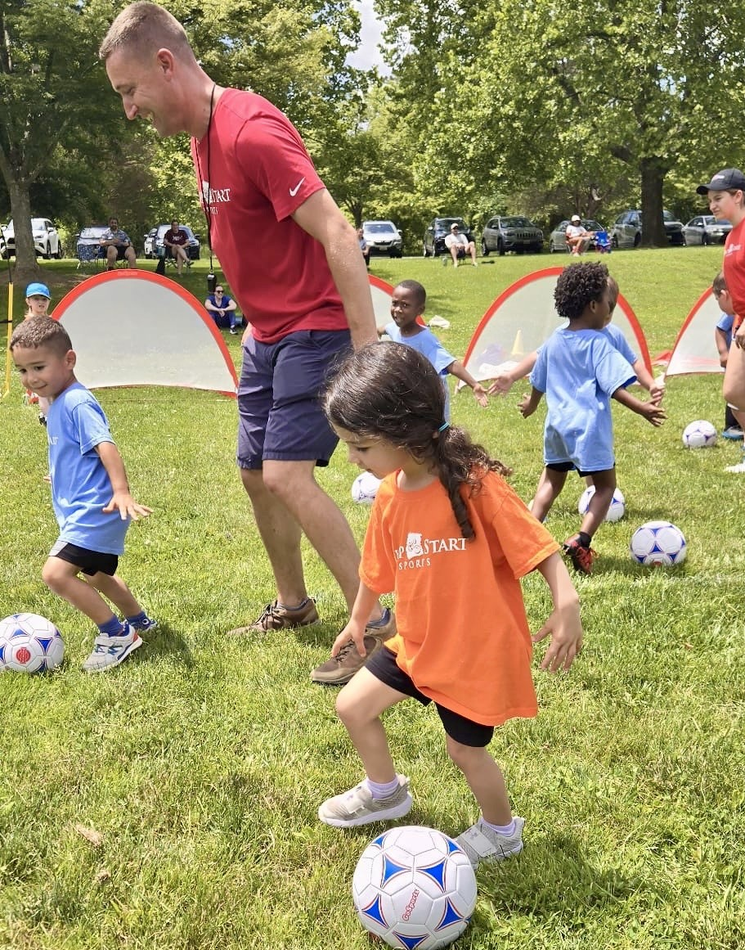
REC 111 Sports Camps (Contractors) | 2024 | 2025 | Increase
Basketball | 220 | 264
Karate - Jujitsu | 84 | 65
Multi-Sports | 1214 | 1362
Soccer | 309 | 266
Volleyball | 477 | 722
Summer Sports Contractor Camps | 2,304 | 2,415 | 375
Total CWP Summer Contractor Camps (Sports & Classes) | 4,767 | 5,283 | 516
REC 110 Camps (Taxpayer supported, staff run) | 2024 | 2025 | Increase
Multi-Sports | 373 | 371
Nature Outdoors Exploration & Skills | 106 | 101
Skateboarding | 70 | 179
Leagues: Cricket & HS Basketball
Summer Sports Staff Run Camps | 549 | 651 | 102
Total Number of Summer Sports Camps | 2,853 | 3,066
Total Number of Summer Camps (Sports & Classes) | 7,620 | 8,349 | 729
2024-25 Summer Sports Programming

Slide 4
Fall 2025 Youth Sports
Leagues
Flag Football
3v3 Basketball
Volleyball
Ultimate Frisbee
Camps & Clinics
Pickleball
Lacrosse
Multi-sports
Soccer
Cheer & Poms
Cricket
Skateboarding
Karate
Adaptive Sports (Therapeutic Recreation)
Basketball Skills & Drills
Volleyball Skills & Scrimmage
Indoor Bocce
Pickleball
Indoor Rock Climbing
Multi-sports
Karate

Slide 5
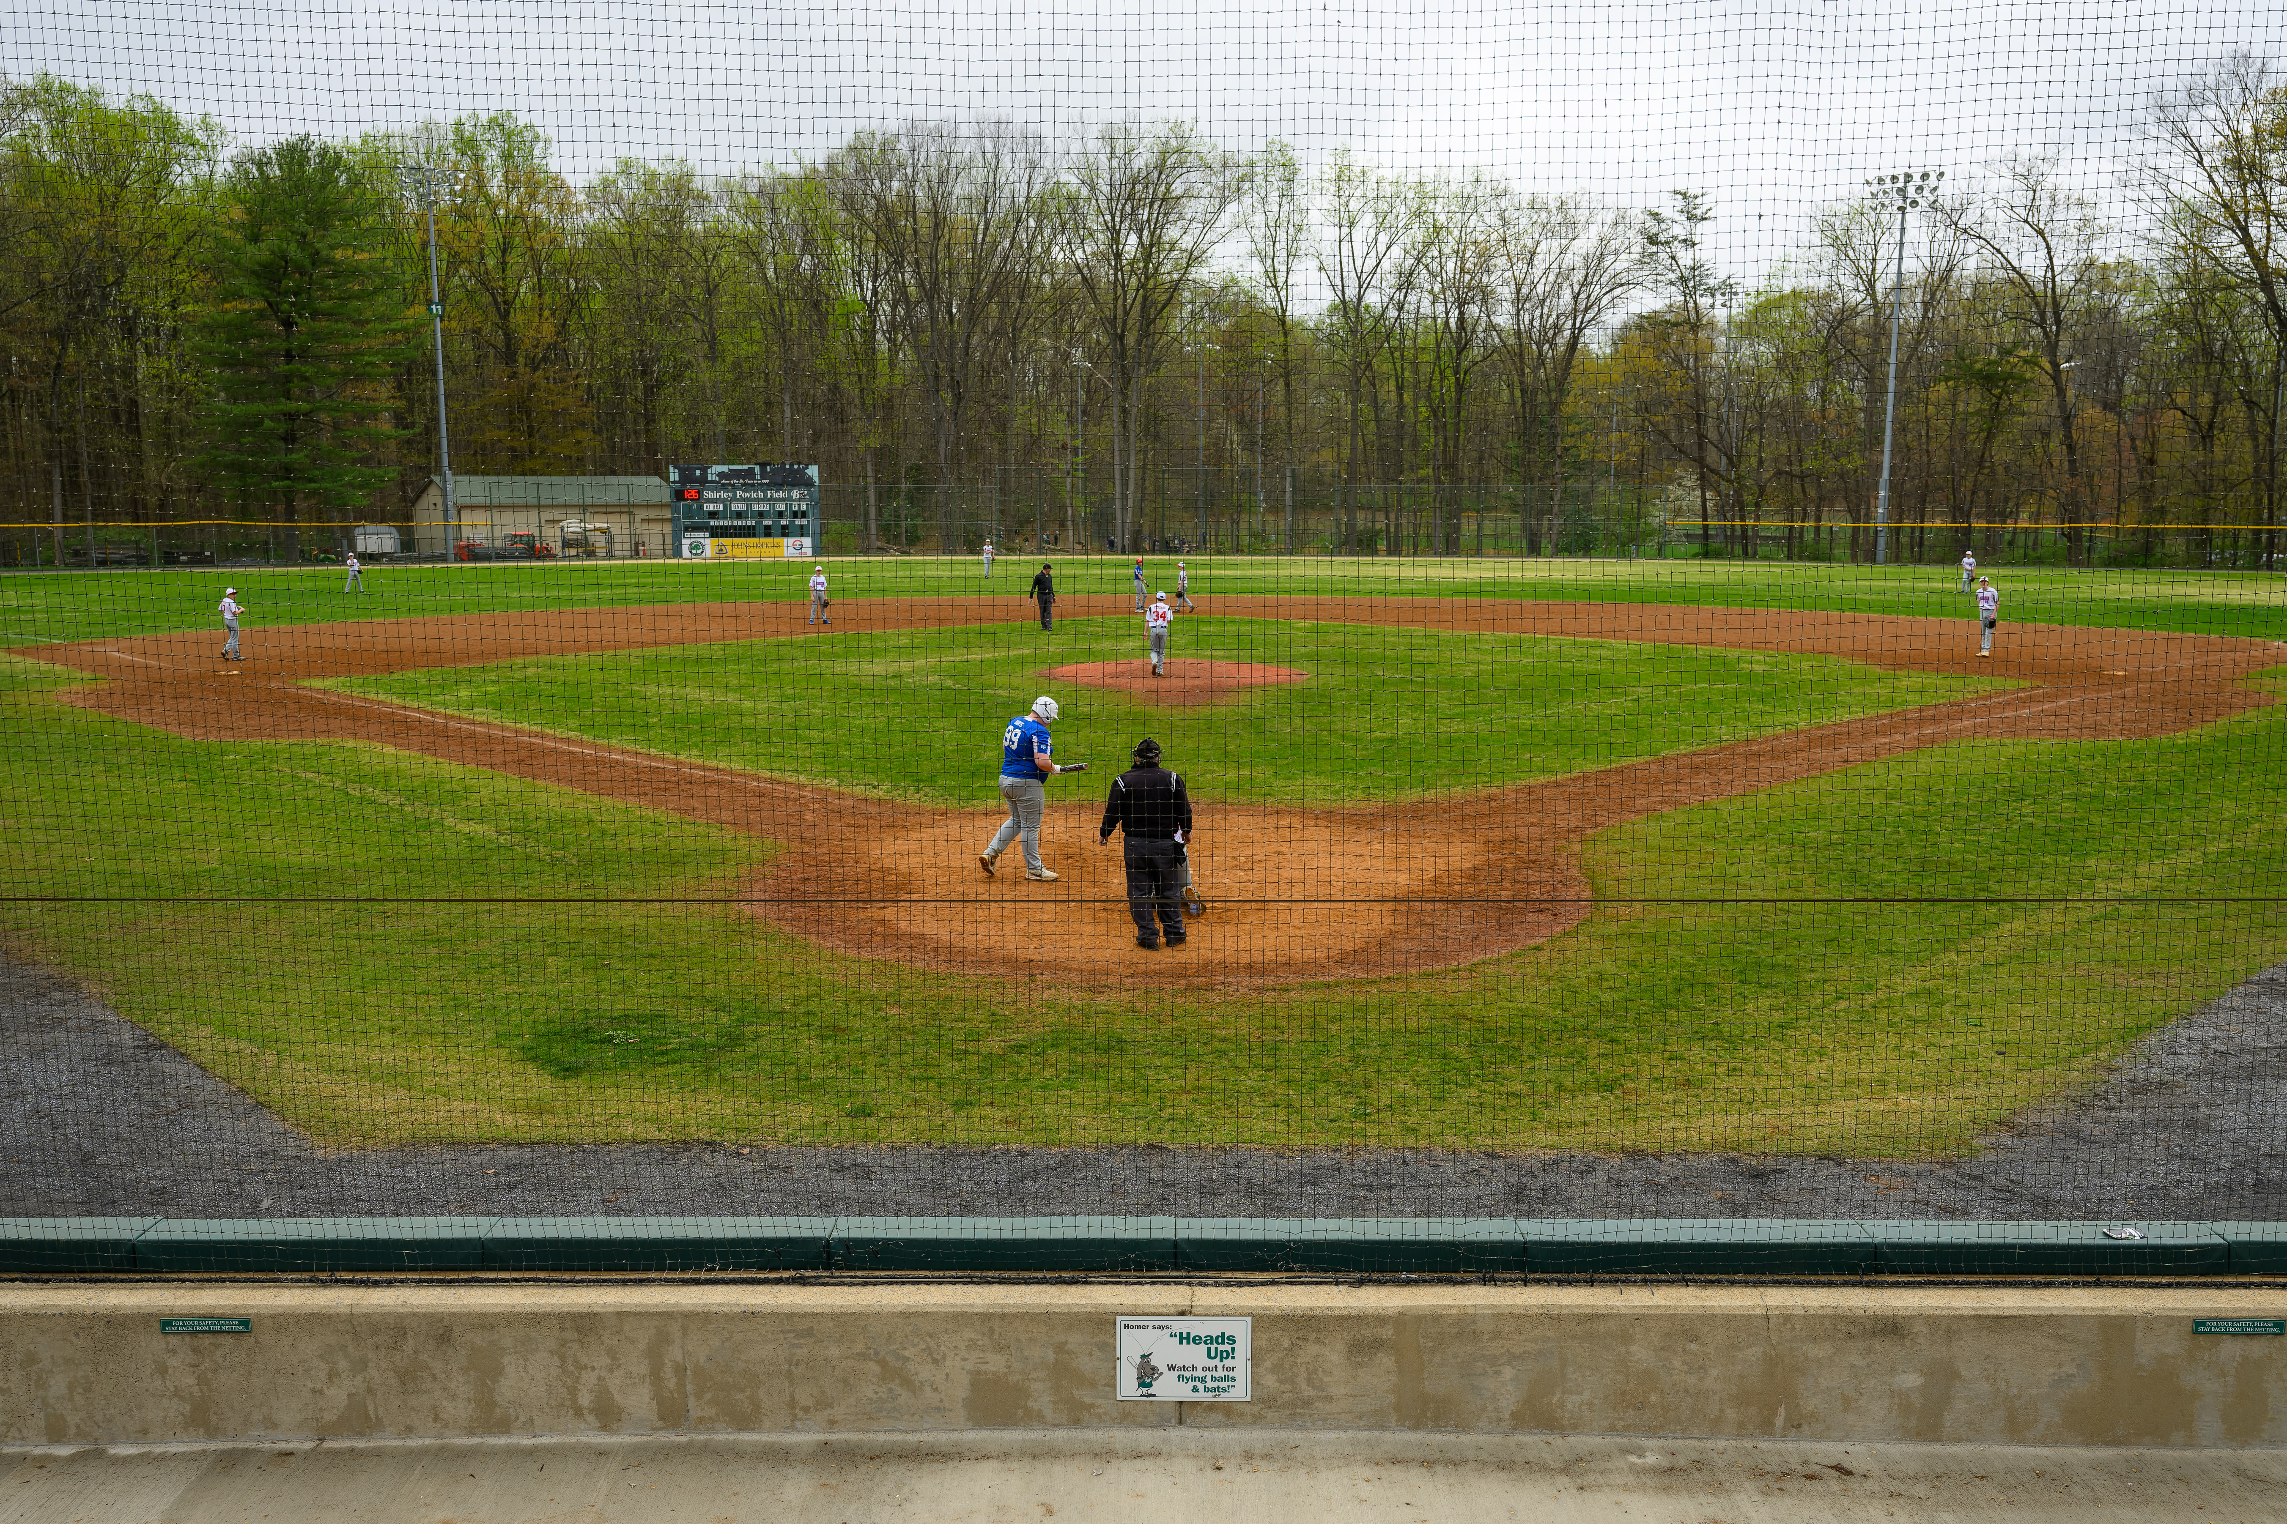

Athletic Field Use Permit Policy ​
Draft Update: September 2025

Slide 6
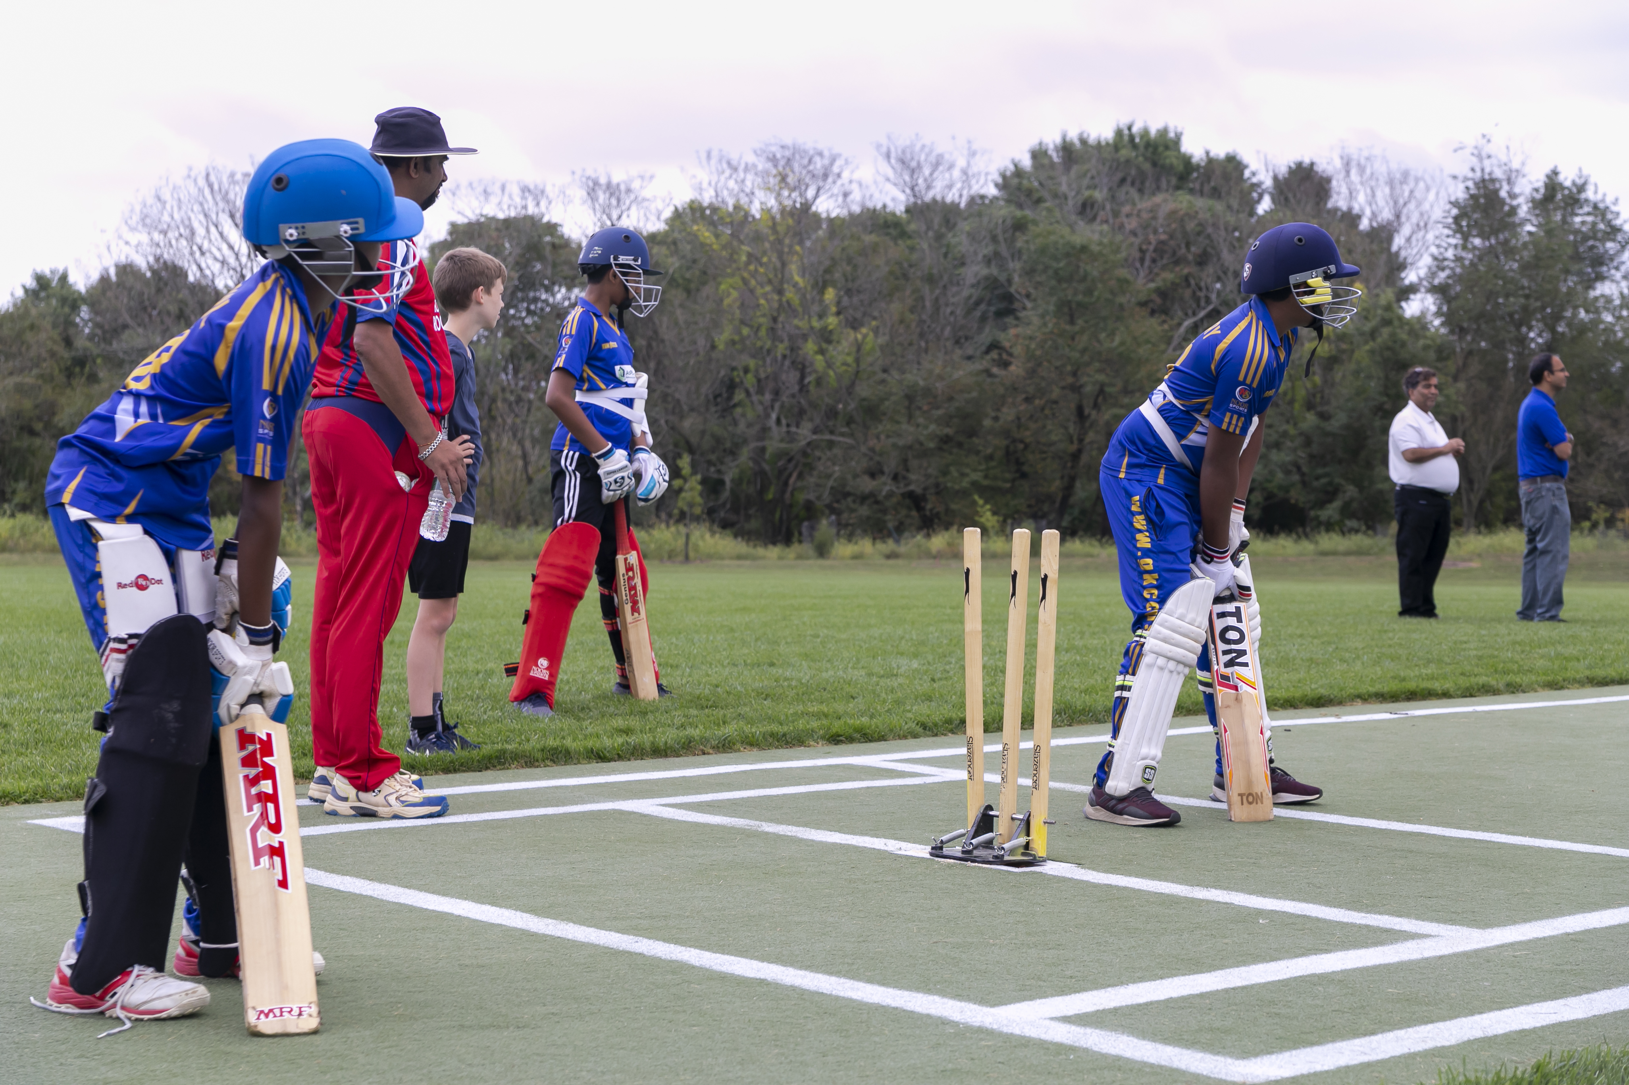
Reasons for a Policy Update
User policy was last updated in 2013
Last update only included minor changes​
Address the changing needs of the county and field users

Slide 7
Current Completed Processes​
Spring/Summer
Internal review and
focus group development
Spring/Summer
Internal review and creation of draft
2024
2025
Fall
Focus groups
Winter
Initial user group survey

Slide 8
External Stakeholder - Engagement Topics
Updated
Reviewed but unchanged​
Priority use​
Ghost permitting​
Permitting process​
Clarity​
Holiday closures​
Practice on game only fields​
Extending the season​

Slide 9
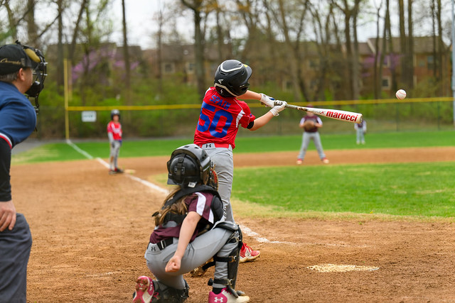
Formatting Changes
Adding a table of contents​
Tailoring language to the audience​
Aligning the terminology and descriptions with current processes taking place​
Attaching the Conditions of Use as an appendix

Slide 10

Athletic Field Classification System ​- Section 2
Provided detailed information about our classification system​
Provides permit requirements, permit availability, available dates, and usage restrictions
​Changed the names of field classification for users​
  Regional/Recreational Parks fields Game-Only fields​
  Local Park fields Practice/Game fields​
  Synthetic Turf fields Year-Round Synthetic Turf fields​

Slide 11
Criteria to Permitting Order of Consideration ​- Section 3
Permitting Order of Consideration is as follows​:
Contractual Agreements ​
Priority Use and Special Events ​
Montgomery County Government Agencies​
Go-Live Event (open online registration)

Slide 12
Priority Use - Section 3: B
Reduced from 7 days a week to 3 weekdays and 1 weekend day per field per organization similar to CUPF​ (Community Use of Public Facilities).
Must submit previous years’ roster data
  Organization name
  League name
  Team name
  Age group
  Gender
Teams must be comprised of 2/3 county residents
  Level (Rec or Travel)
  Number of hours of field usage
  Location
  Names
  Zip codes

Slide 13
Go-Live Event ​- Section 3: D
Defines the Go-Live event in detail​
Directs users to ActiveMontgomery.com for online permitting​
Outlines which fields can be permitted on Go-Live​
Details the dates of the Go-Live events for each season ​
  Go-Live events are held three times a year; these dates are subject to change:​
    Spring/Summer: February 15 ​
    Fall: July 15 ​
    Winter: November 1 ​

Slide 14
Sections 7 & 8
Off-Season Use Regulations moved​ to Field Closure Guideline - Section 7
Weather
Renovation
Winter and summer closures
Field Use for Non-Designated Sports ​changed to Permitting Order of Overlay Fields - Section 8
Providing better details for easier understanding

Slide 15
General Guidelines for Field Use/Conditions of Use ​- Section 9
Removed most of this section as most of it was duplicative of the Conditions of Use
Attached Conditions of Use to the document​ as an appendix
Section states you must follow the M-NCPPC Rules and Regulations, the Athletic Field Use Permit Policy, and the Athletic Field Condition of Use​

Slide 16
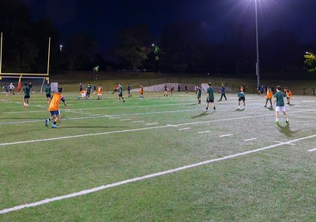
Pilot Programs​ - Section 12
Wanted to add a section to allow Montgomery Parks to run pilot programs without being in direct violation of our Athletic Field Use Policy. ​
  Damascus Recreational Park- practice on a Game Only Field​

Slide 17
Appendix A. Montgomery Parks Athletic Field Conditions of Use
Addition of language prohibiting ghost permitting ​
Addition of language prohibiting subletting permits​
Formatting upgrades​
Improved the Report an Issue or Concern section
Changed the Permit ​Change/Return Fee
  From a $50 fee per change request to a 25% charge of the permit

Slide 18
Timeline
Draft Complete​
Summer 2025
SAC/User Group Review -Survey​
Review Survey-Evaluate Potential Edits​
Planning Board Briefing & Approval​
New Policy In Place pending approval​
Mid-September the through October
Final Draft
Planning Broad Memo
Tentatively November/December​
Tentatively November/December​
Tentative Implementation Fall 2026 Season Permit

Slide 19
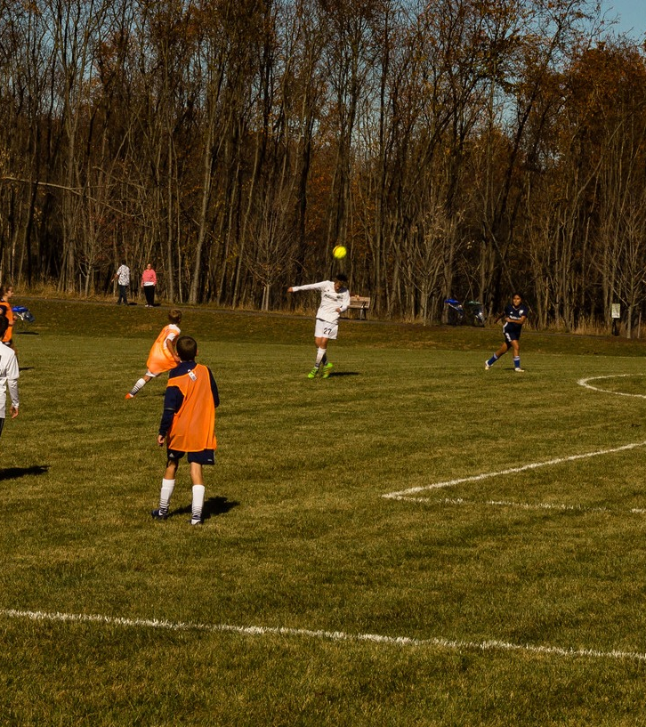

Comment Period
Survey Link will go live September 19 through October 19, 2025​
  Emailed out to all user groups. ​

Slide 20
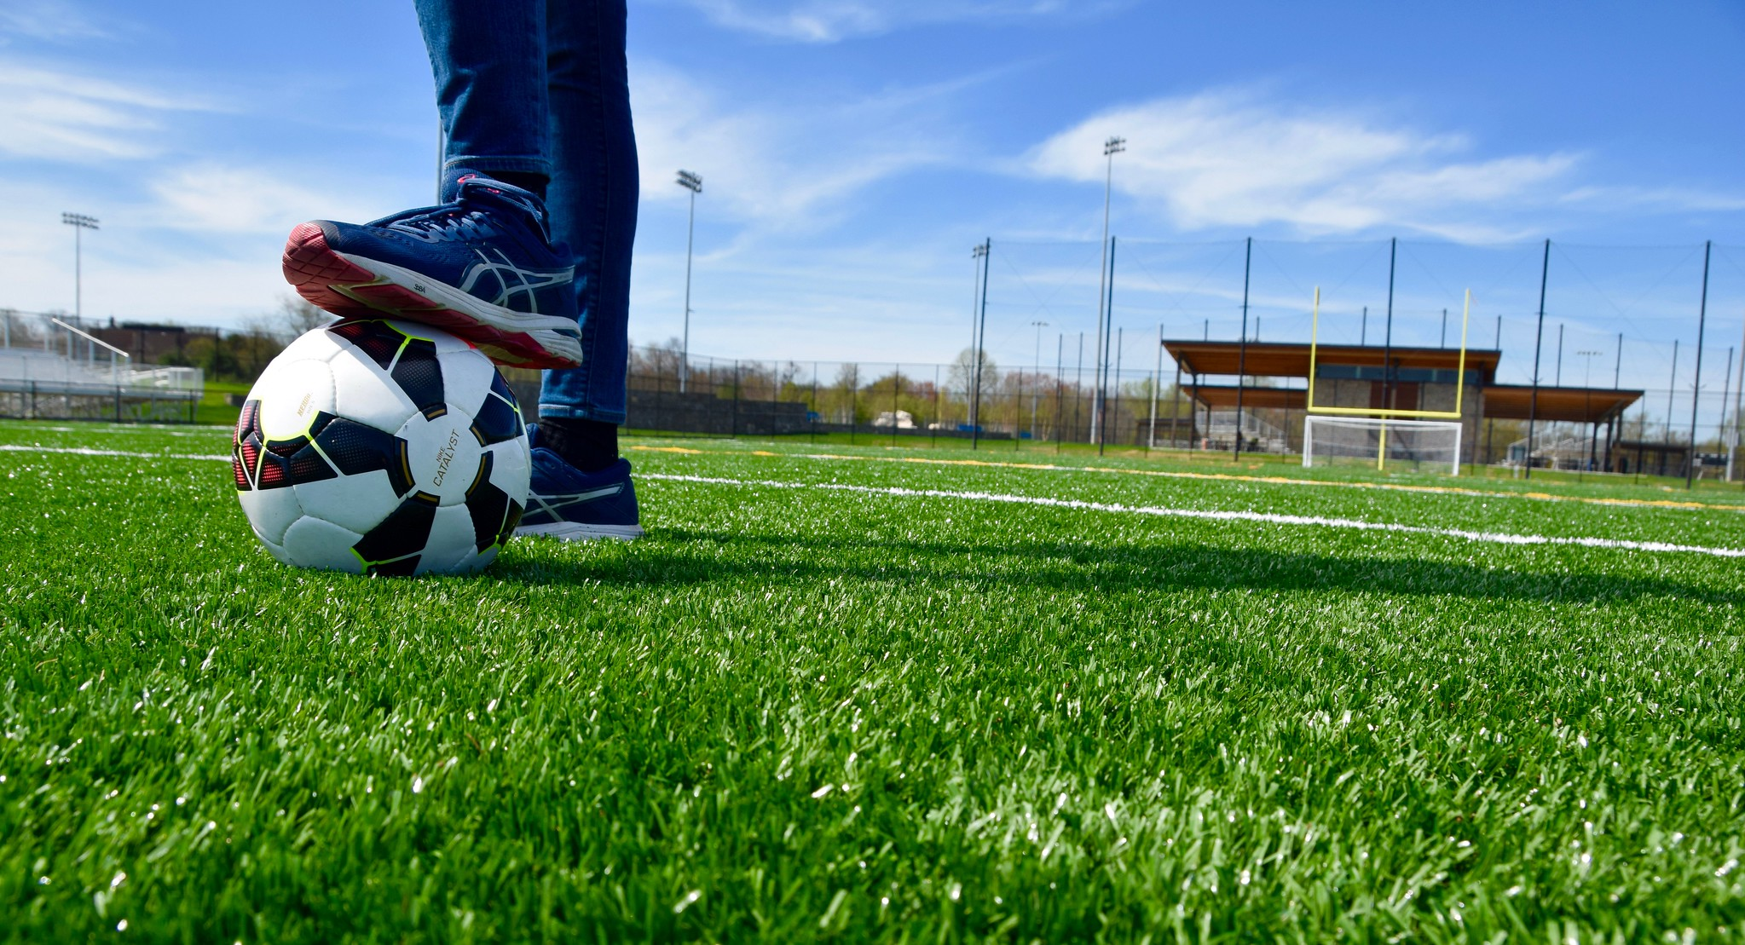
Thank you

Slide 21
Working Group Discussions
  Community Engagement: Samantha, Princess, Amy, Rick
  Operations: Tina, Mary Kate, Christopher
  Annual Report Development
  Committee Member Nominations and Officer Elections
  Recognition: David, Trish, Princess, Steve (ex-officio)
  Communications: Mary Kate, Christopher
  Advocacy: Ben, Jay, Tom, Tony, Steve (ex-officio)

Slide 22

Community Engagement

Slide 23
Stakeholder Outreach: Stakeholder Database
Now 60 primary contacts
Shoutout to Christopher for finding and adding all MCPS HS AD’s and MCPS MS AC’s

Slide 24
Stakeholder Outreach: Interview Process
Email stakeholders using the Interview invitation template.
Mark in the interview status column of the database to confirm/deny interview.
Send out google calendar invite as well as interview questions.
1-2 members will conduct the 20 minute interview consisting of about 5 questions that will be emailed to the stakeholders in advance.
Ask if they have anyone else they recommend we speak to.
Send a thank you email reiterating about other contacts and important ideas from the conversation.
Still Drafting:
  Interview notes template
  Key themes to use to code responses

Slide 25
Stakeholder Outreach: Next Steps
Stakeholder Database
  Ensure you have access to the Stakeholder Sheet
  Continue adding stakeholders!
Stakeholder Interview Process
  Review related documents and email the sub committee with more detailed feedback (Amy, Princess, Rick, Samantha)
    Invitation
    interview questions
    interview process

Slide 26
Other Community Engagement (if time allows)
Update on MCPD 4th District Event in Wheaton
Suggestions for community events
  Targeted questions
  Incentivized participation
  Clearly identifiable and trustworthy representatives
  Takeaway one-pager with resources that already exist (Rec Assist, MCPD Athletic staff at your school, etc.)
    Thoughts on contributing to a document in the short-term?

Slide 27
“Play Your Part, MoCo”
Sports Advisory Committee Social Marketing Campaign

Slide 28
Campaign Pillars + Goals
Play > Increase awareness of the community and health benefits of sport
Support > Promote opportunities to play sports in Montgomery County.
Officiate > Recruit volunteers, coaches, and officials to support local sports
Thrive > Highlight sport's value in youth development and senior wellness.

Slide 29
Brand Priorities v. 1.0
Is gender neutral
and
doesn’t exclude people who don’t normally play sports
but also >

Slide 30
Brand Priorities v. 1.0
communicates sports/play/movement without words
and
immediately differentiates from performing arts meaning
of “play your part” (theater, music)
while also >

Slide 31
Brand Priorities v. 1.0
balances double meaning of tagline:
invitation to play + expectation of civic duty
and finally >

Slide 32
Brand Priorities v. 1.0
Visually must:
Stand on its own without photography
Work well at all sizes
Work in both full color and a single color
Works well with other logos

Slide 33




Slide 34



Slide 35


Slide 36


Slide 37


Slide 38

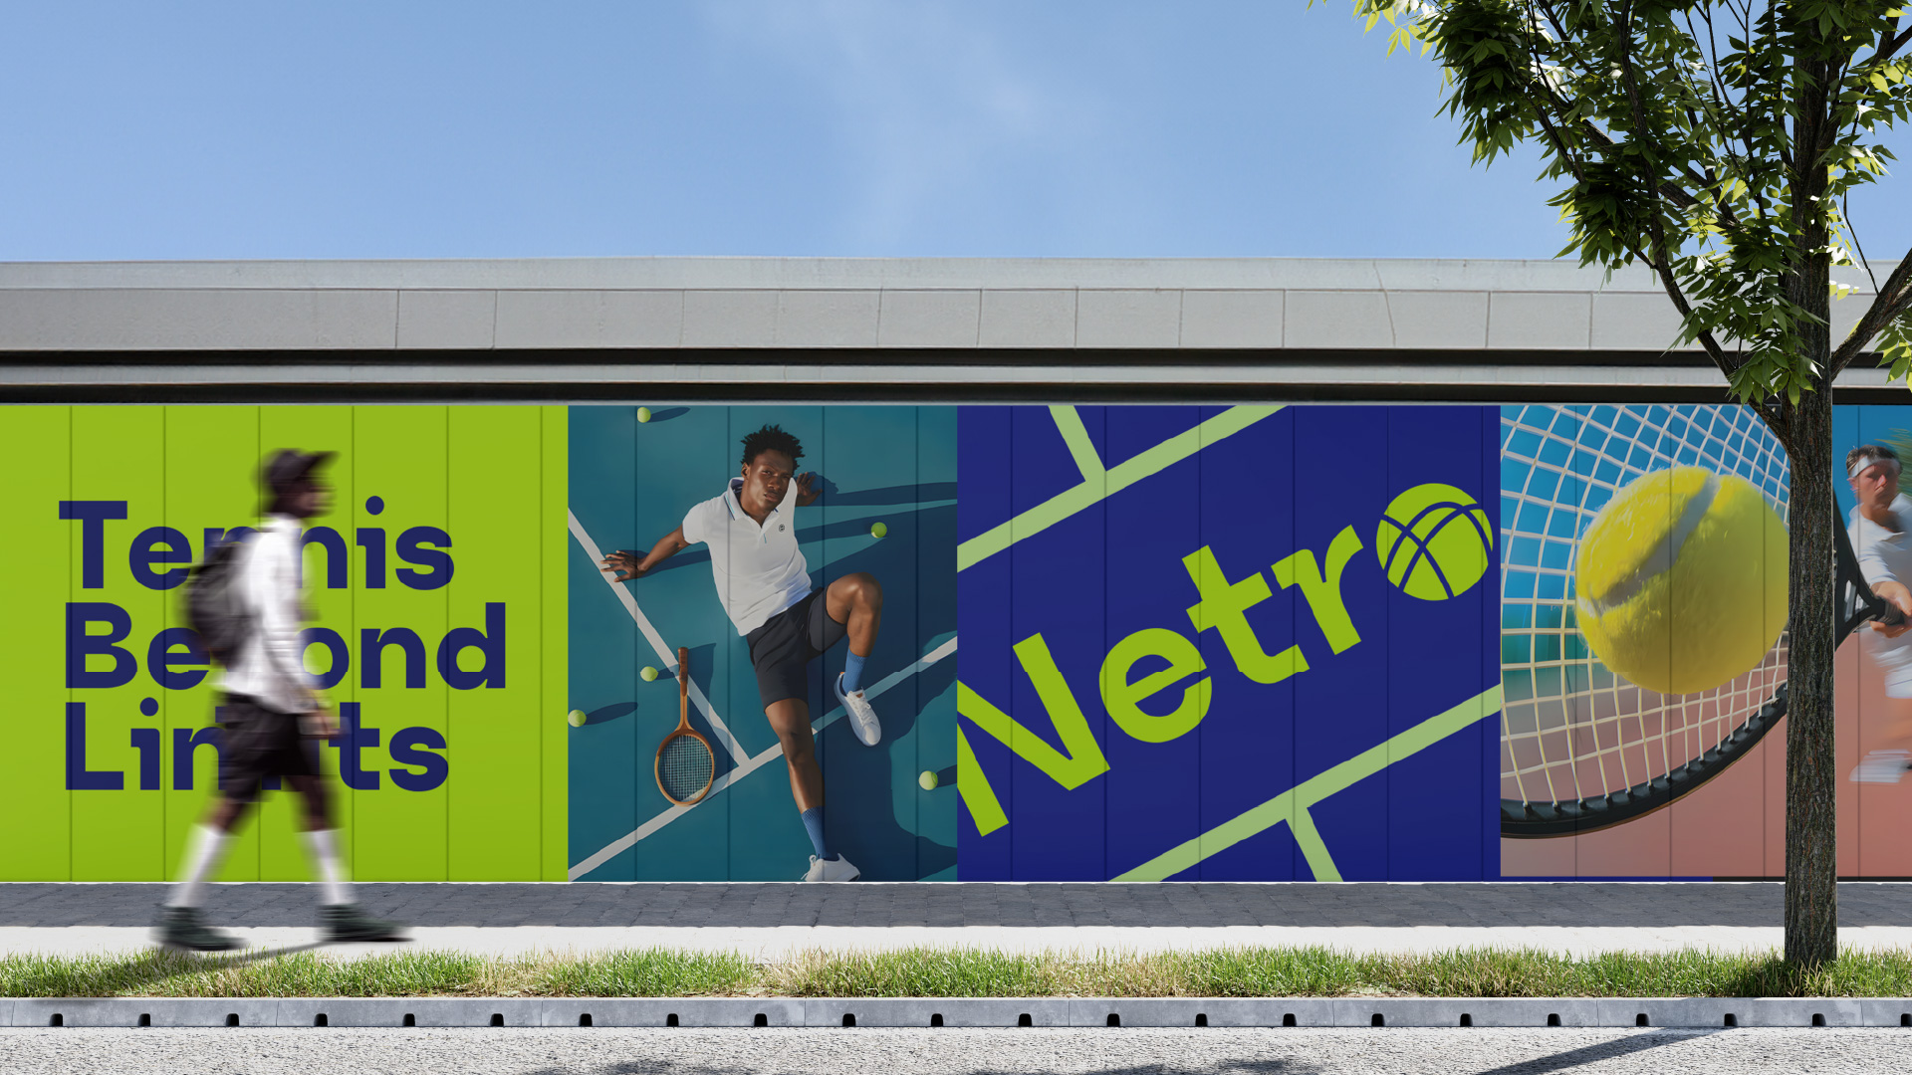

Slide 39


Slide 40


Slide 41
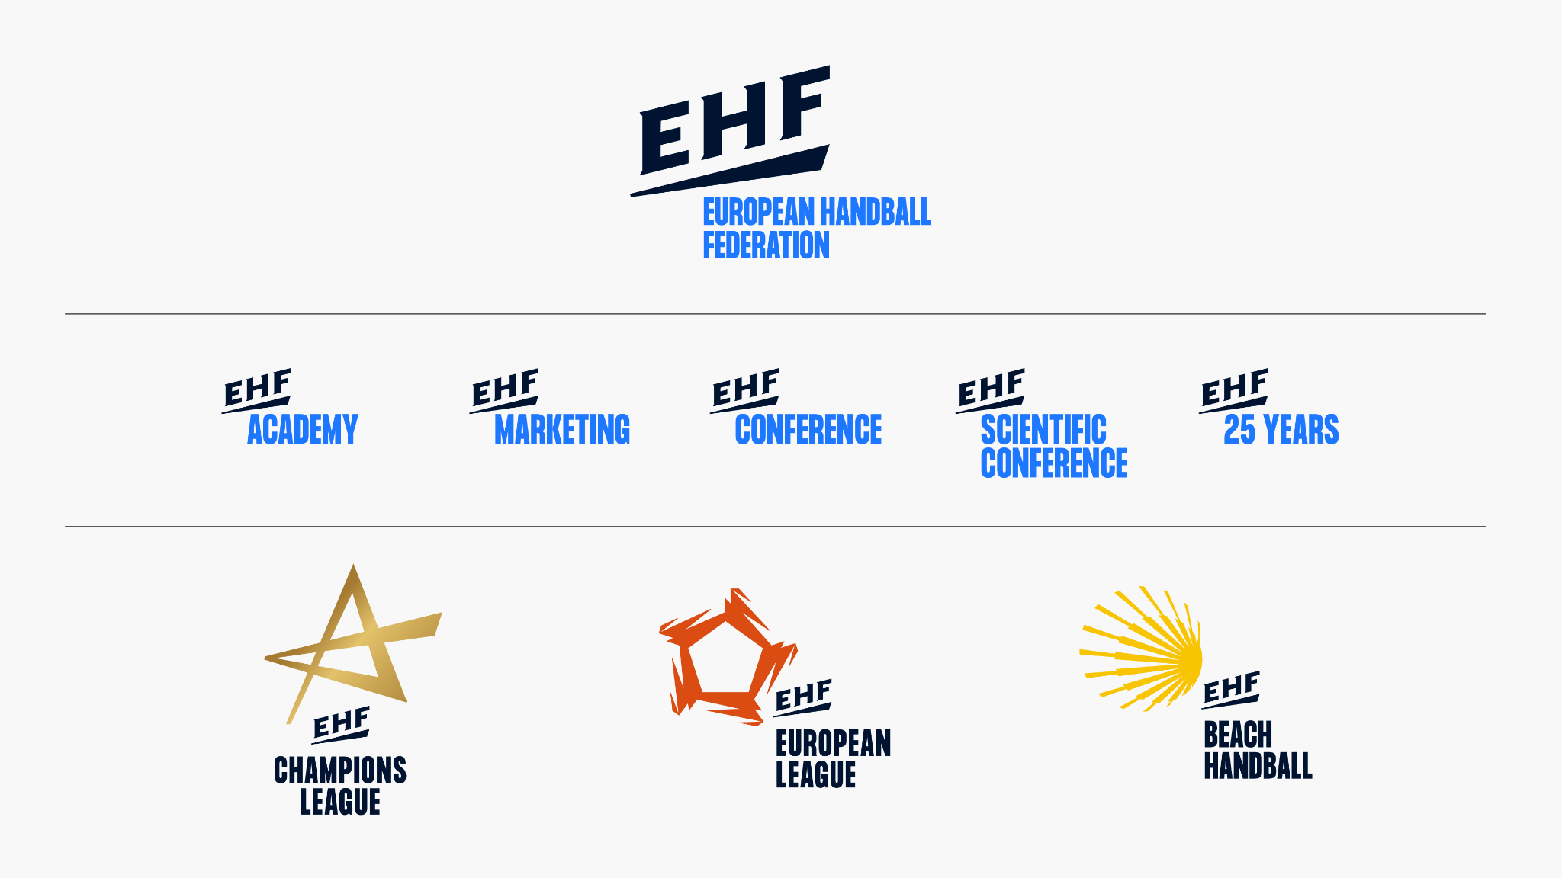

Slide 42



Slide 43
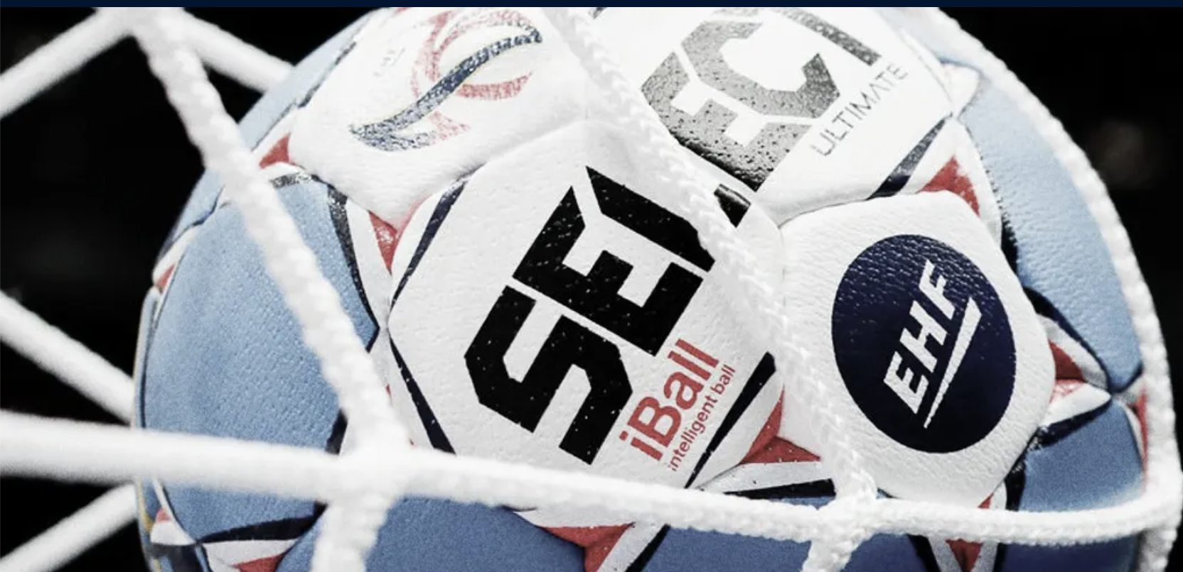

Slide 44


Slide 45


Slide 46
Key Messages (Tailored to Audiences)
Audience | Message
Youth & Parents | "Play your part in fun, fitness, and friendship. MoCo sports build future leaders."
Seniors | "Stay strong, stay social, stay active. MoCo sports keep you moving."
Community Members | "Volunteer. Coach. Officiate. Your time can change lives."
General Public | "Sport brings MoCo together. Find your way to play your part."

Slide 47
Campaign Timeline
Phase | Focus | Tactics
Launch Month | Awareness & Excitement | Community sport day kickoff, promo video drop, press release, media blitz
Months 2-4 | Engagement & Education | Community spotlights, volunteer training, school visits, digital content push
Months 5-6 | Call to Action | Big volunteer recruitment week, officiating fair, senior sport expo

Slide 48
Communication Channels
Social Media (through Rec):
  Mini-interviews, behind-the-scenes, real people in MoCo.
Local Press & Radio (council member newsletters):
  Highlight success stories, upcoming events.
Items that require a budget:
  Schools & Rec Centers: Flyers, announcements, digital screens.
  Transit & Public Ads: Buses, metro stops with slogans:

Slide 49
Success Metrics
Goal | Performance Indicator
Increase participation | # of new players registered (youth + seniors)
Boost volunteering | # of new coach/volunteer signups
Promote officiating | # of new certified officials
Raise awareness | Web traffic, social media engagement, community survey results

Slide 50
Campaign Goals
Increase awareness of the community and health benefits of sport.
Promote opportunities to play sports in Montgomery County.
Recruit volunteers, coaches, and officials to support local sports.
Highlight sport's value in youth development and senior wellness.

